Slide 1
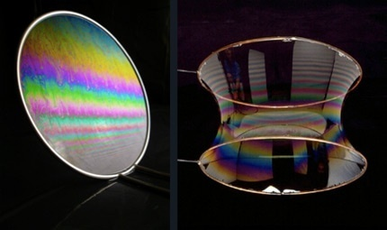
№4. Soap film
Sandro Barnaveli
GEORGIAN Team
Create a soap film in a circular wire loop. The soap film deforms when a charged body is placed next to it. Investigate how the shape of the soap film depends on the position and nature of the charge.

Slide 2
Presentation Plan
Description of soap film
Structure of soap film
Adding glycerin
2. Experiment
Description of experiment
Different shapes of charged bodies
Grounding
Phenomena, observed during experiments
3. Estimations and discussions
Interaction of film and charged ball
Film in uniform electric field
Interaction of film and charged nail; electric wind
Interaction of film and small-headed charged body
Discussion on different polarity discharges

Slide 3
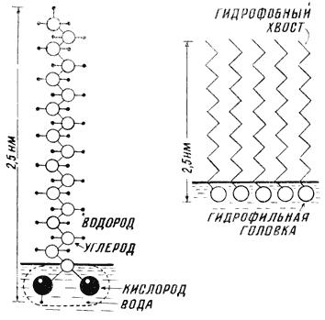
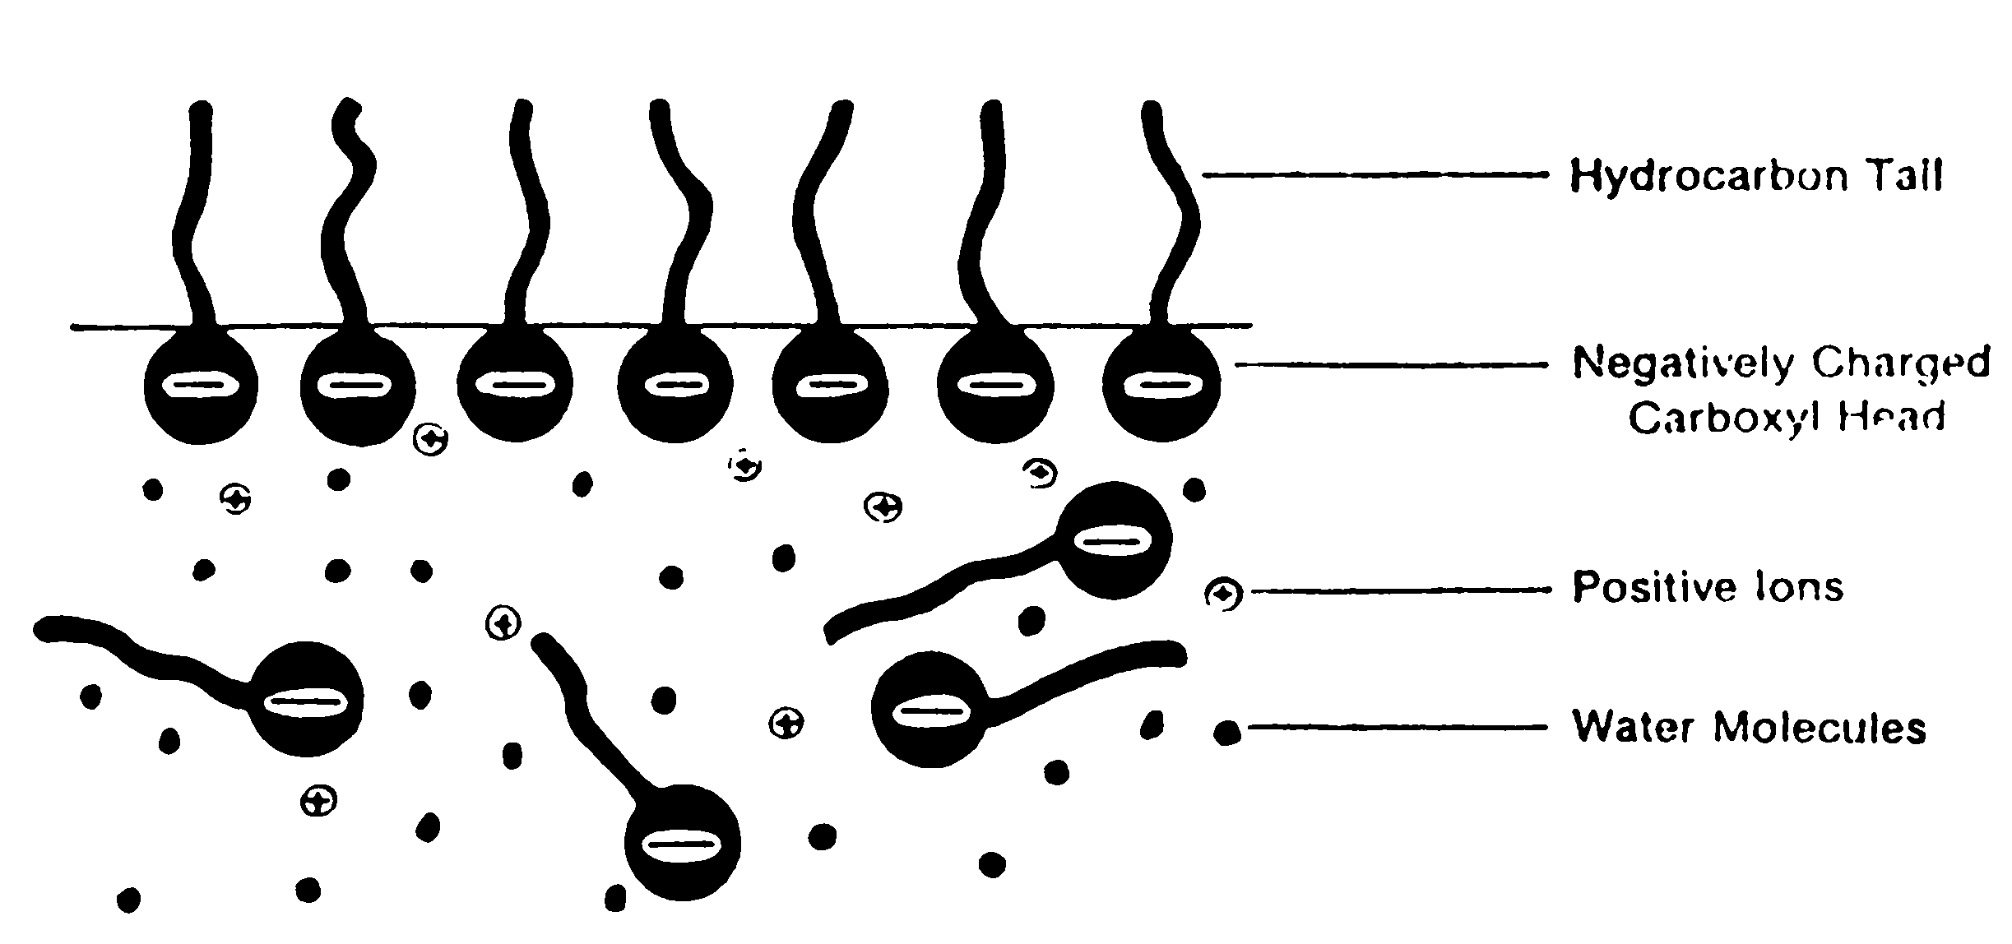
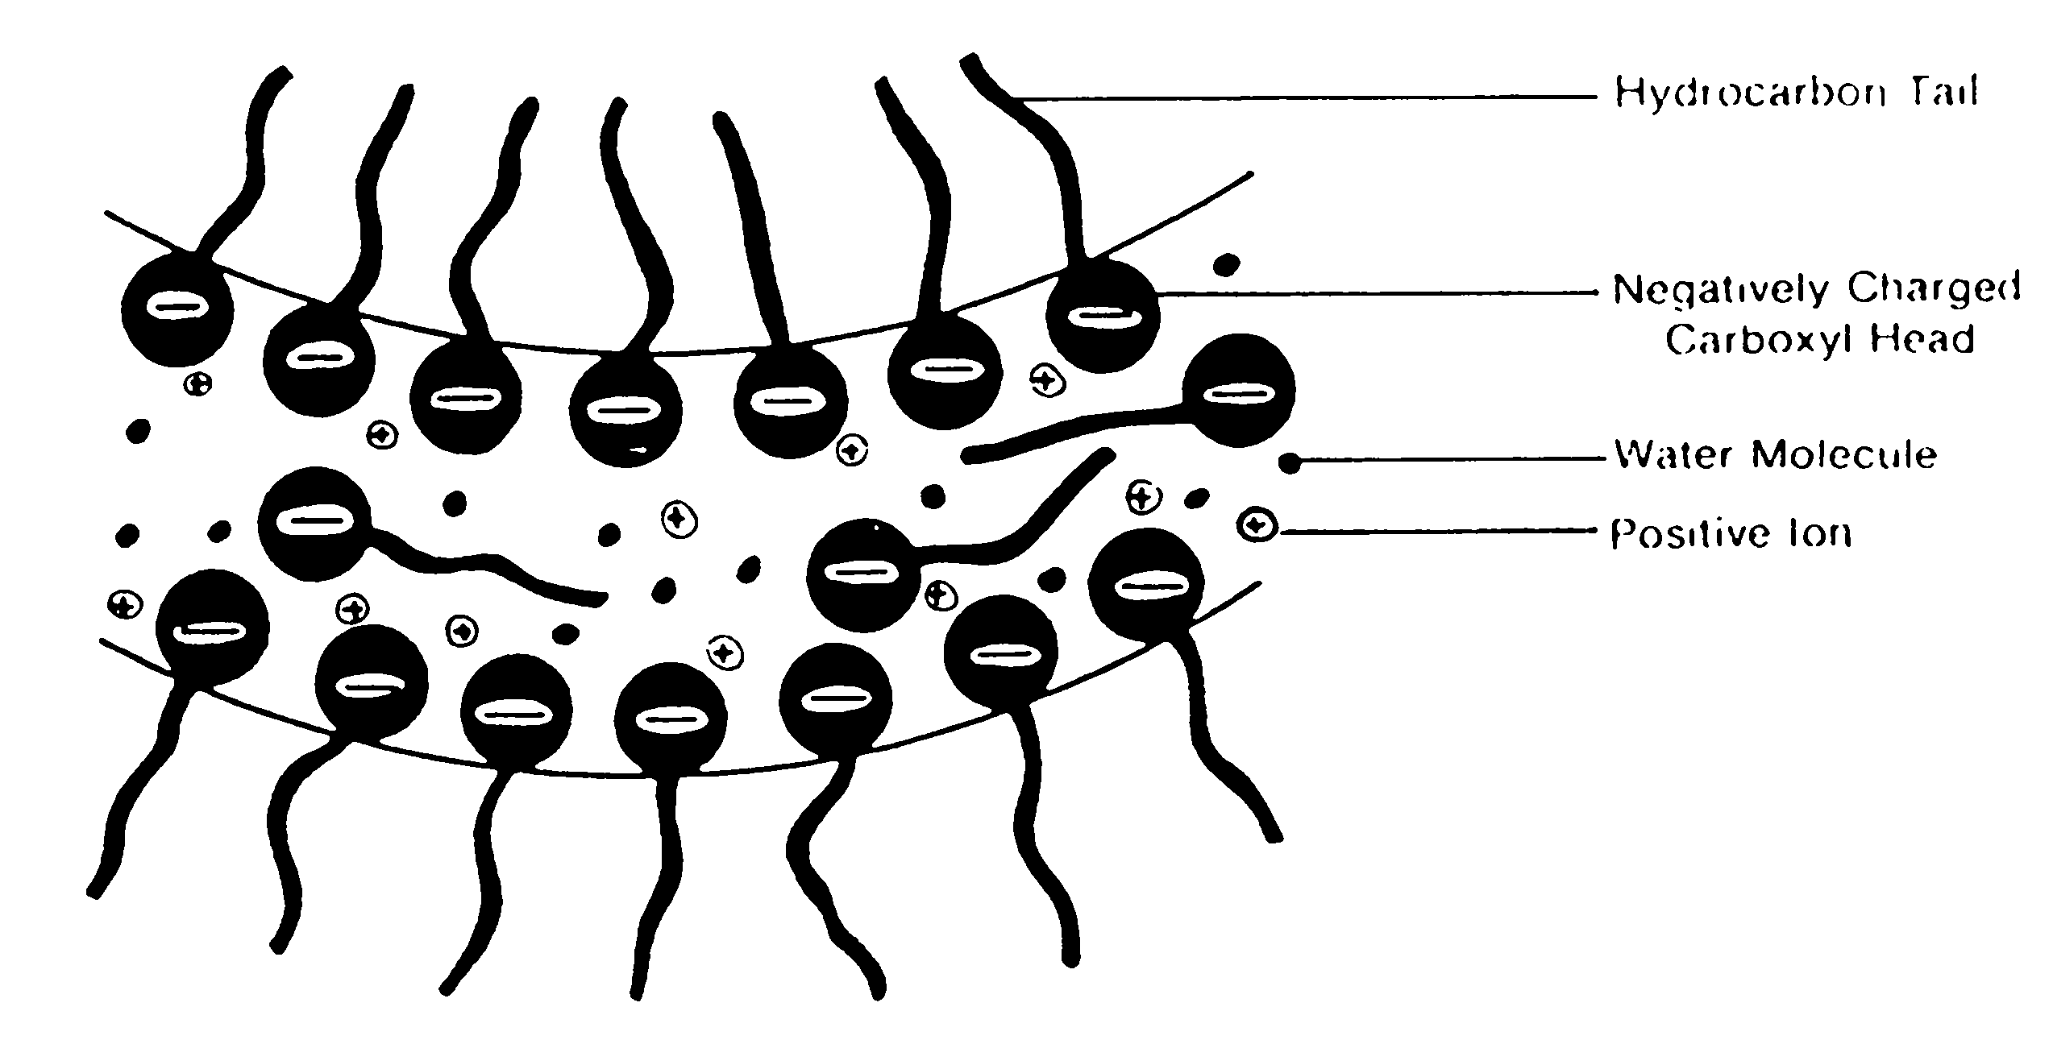
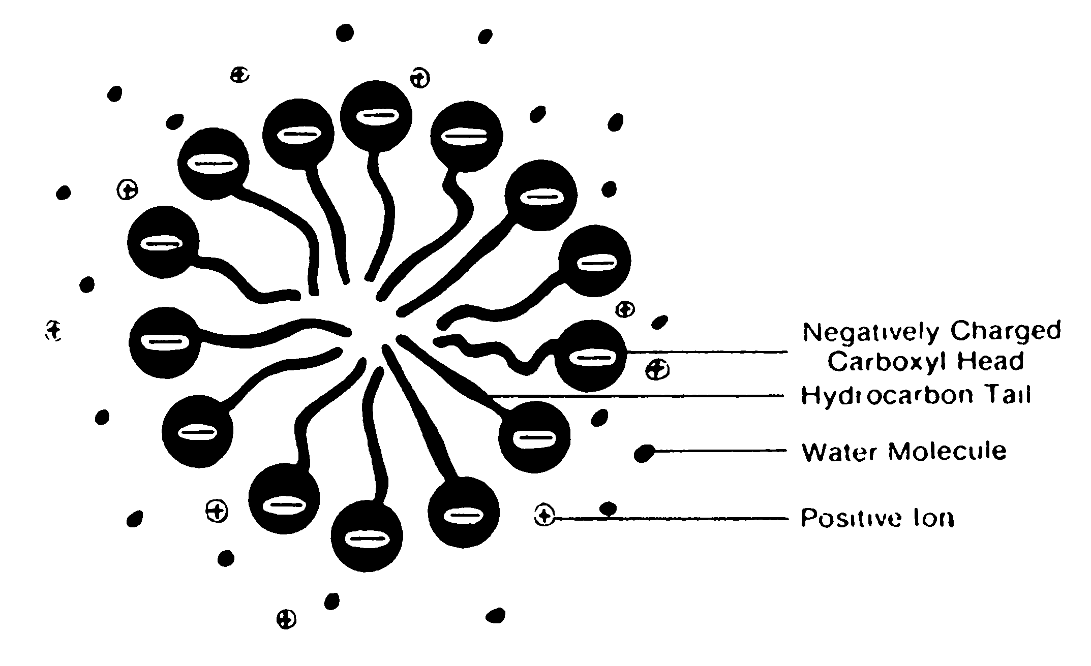
Structure of soap film
Hydrophobic Tail
Soap film is formed by Surface Active Agents (Surfactants)
Two layers of soap molecules, between which is water.
The depth of this layer is ~ 50Å÷2x10⁵Å , where Å = 10⁻¹⁰.
Soap molecule is divided into positive Na⁺ and
negative C₁₇H₃₅COO⁻ ions.
Negative ions collect on the surface of film and they make surface structure.
Between two layers of film there is Water and Na⁺ ions.
Hydrogen
Hidrophilic Head
Carboneum
Oxygen
Water
Soap molecules:
1. Make a surface structure of soap film.
2. Decrease evaporation of water.
3. Decrease surface tension.

Slide 4
Adding the glycerin
Without glycerin
With glycerin
Glycerin decreases the evaporation of water from surface.
Glycerin adds more freedom to motion of molecules, because now they are turning around glycerin and not around other soap molecules.
So, due to glycerin soap film gets "extra duration of life" and also becomes more elastic.

Slide 5
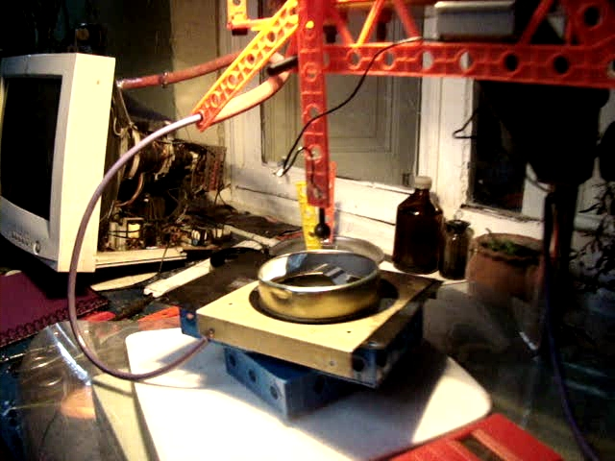
Experiment
Description of the experimental device
Voltage source: an old CRT monitor, which provides the 27 000 volts.
Electrodes of different forms
Different distances between electrodes and soap film.
Metal loop; grounded and not grounded
Dielectric loop.
Changing poles
With glycerin and without it.
Description of device (video)

Slide 6
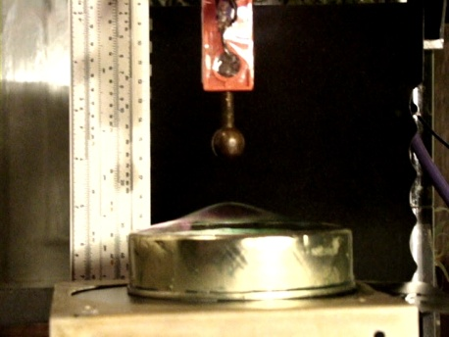
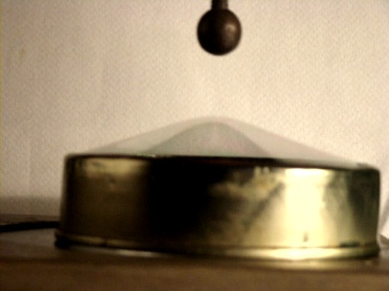
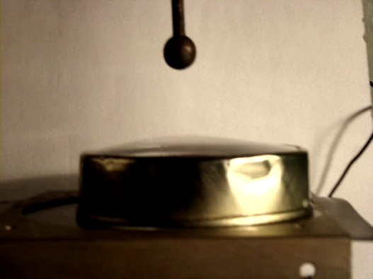
Charged Sphere
With glycerin the film was more stable.
without glycerin 1(video) with glycerin 1 (video)
Larger the distance d between sphere and film - less the influence (deformation).
In case of d~5 cm, the height h of film deformation in the center was up to 1 cm and the film remained stable.
stable (video)
For small d ~ h , the stable state did not occur. Film contained to stretch, discharge developed and film exploded.

Slide 7
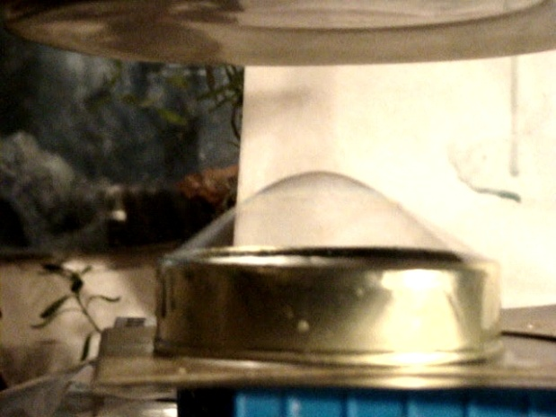
The flat charged body
By the flat charged body the film deformation was larger.
The flat charged body (video)
Approximately Uniform field.
To obtain the uniform field we used 2 parallel large lids.
The bottom lid was grounded while the top was under the high voltage.
The film was formed on a plastic ring.
Significant deformation did not occur. It just was torn in some time.

Slide 8
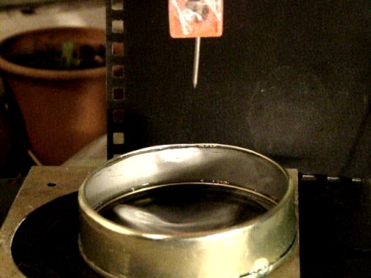
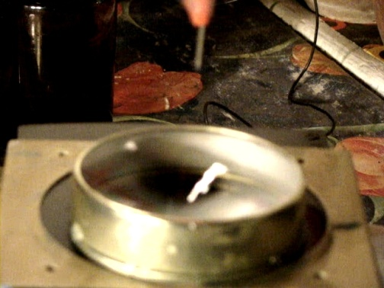
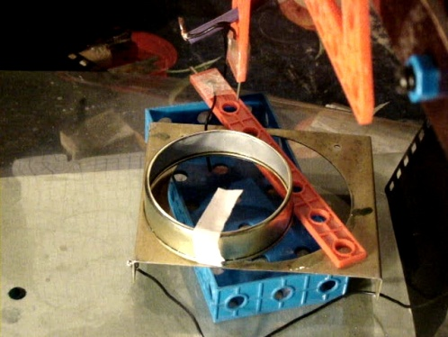
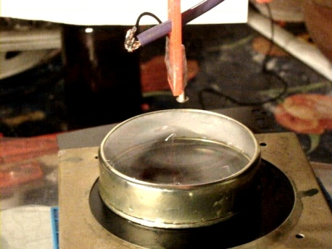
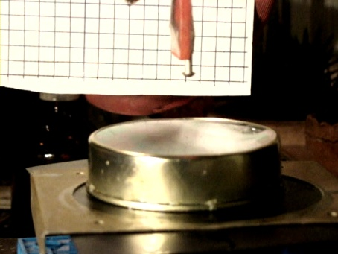
The charged body of a needle form
In case of charged nail. The soap film did not stretch out, but the dip was formed, as if there blew the wind from above.
nail 1 (video) nail 2 (video) nail and paper (video)
Test of wind by paper
The charged body with a small head.
In this case both - the "dip" and the "hill" are formed.
head 1 head 2
Without grounding
Without grounding stretch of the film was significantly less without grounding

Slide 9
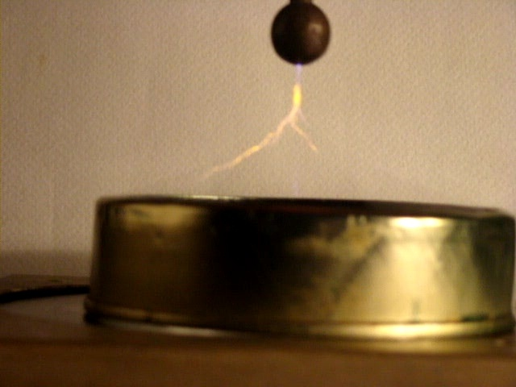
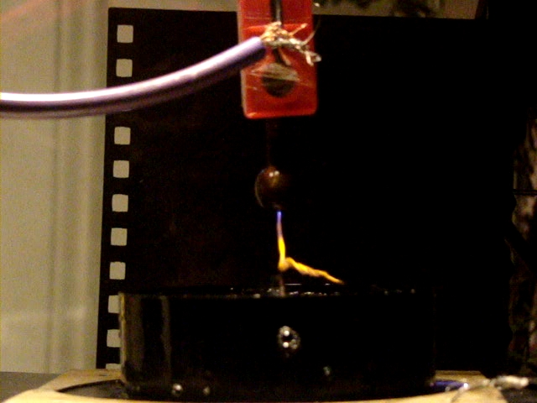
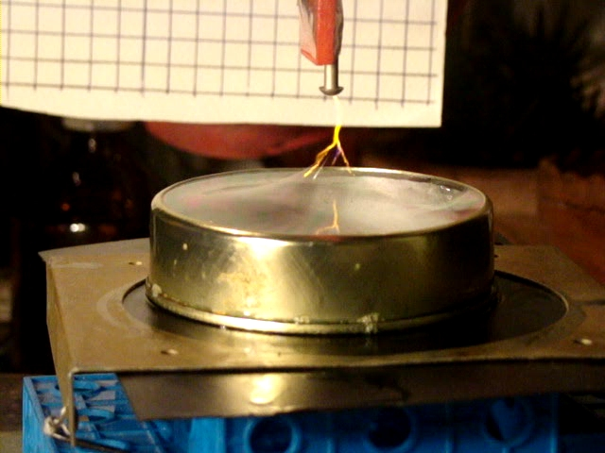
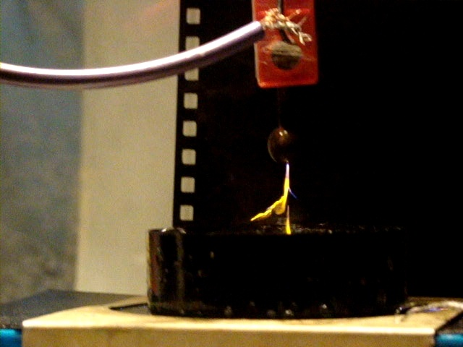
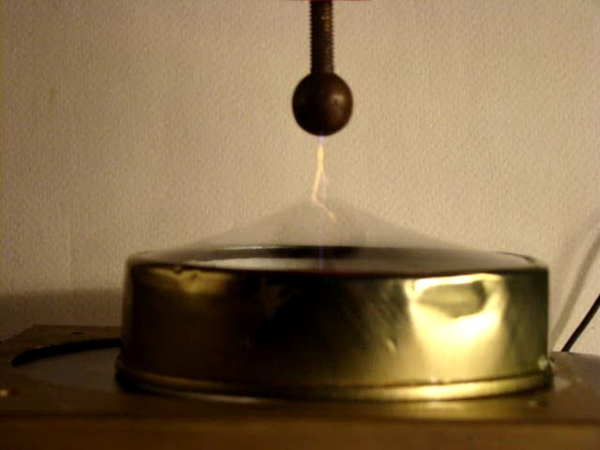
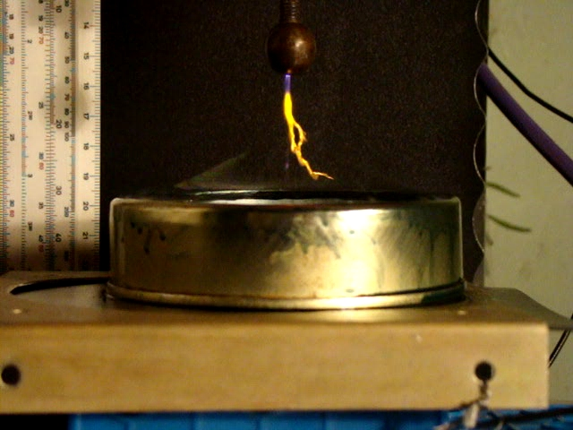
Change of poles / shape and color of discharge
Change of the poles the affects the shape and the color of discharge.
Spark is dependent on the signs of electrode and of the film.
When electrode was charged positively, discharge was spread and yellow

Slide 10
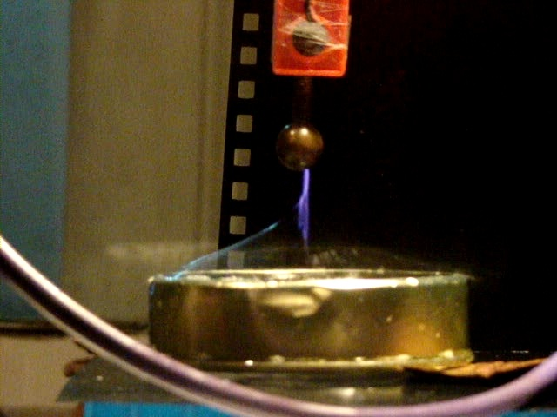
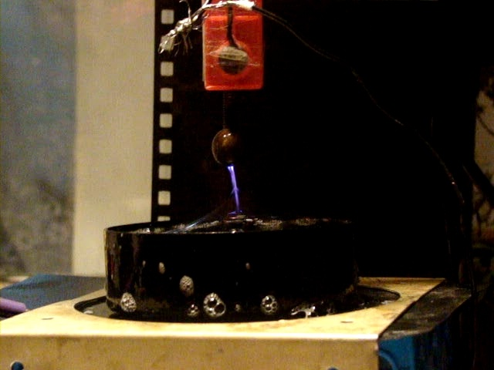
When electrode was charged negatively, discharge was bluish and straight

Slide 11
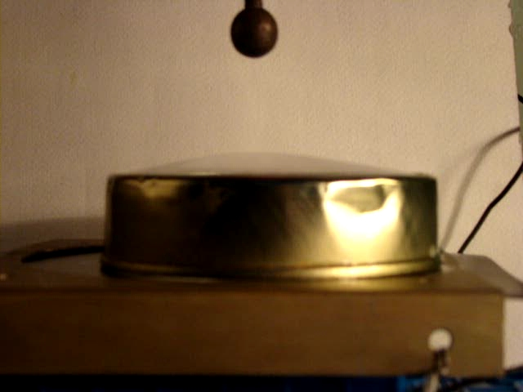
Explanations and evaluations
a) Interaction of film with the charged sphere
The electric force is balanced by the surface tension force ;
The surface tension force is calculated by means of Laplace equation;
The force between the charge and the film is calculated using "electrostatic image method";
Equating the electric and the surface tension forces.
Using the approximation, when the deformation is much less than the loop radius and distance to charged sphere;

Slide 12
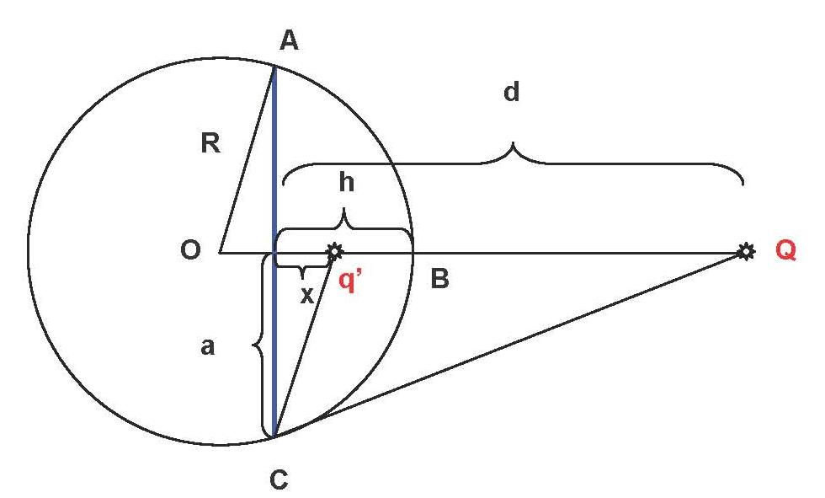
The method of electrostatic image . Electric force
External field redistributes the charges on the film.
The film surface is equal-potential.
Interaction between the charge and the grounded sphere film may be "effectively" presented as the interaction between two point charges.
The value and the place of "effective" charge must provide equal potential of film surface
The film is sphere segment ABC of the height h
AC – the loop with radius a.
Q – the external charge, at the distance d>>h
q’ – the "effective" charge at the distance x from the loop.
Condition of φ_{B} = φ_{C} = 0 (grounded film) leads to the following values:
(1) (2)
And the effective force
(3)

Slide 13
The surface tension force F_{l} .
Let us use Laplace formula and formula of the sphere segment area
S = π (a²+h²).
According the Laplace formula P_{l} = 4 σ₀ / R and taking into account, that
we obtain
If one writes down F_{l} = pS , it is possible to obtain, that the force of surface tension is
(4)
Balance of Electric and Surface tension forces
Using the condition of(3) da (4) forces equlibrium F_{k} = F_{l}
(5)

Slide 14
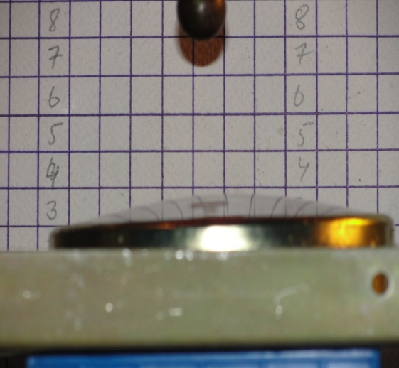
Approximation h << a; h<<d.
In this case the formulae (1), (2), (3), (5) transform to:
x ≈ 2h – d (6)
q’ ≈ -Q (7)
F = kQ²/(4d)² (8)
kQ² = 32πσ₀ hd² . (9)
from (9) we can obtain dependence of h on Q and d
(10)
Let's calculate h for our experiment.
(Graph is given on the next slide)
For 1 cm radius charged sphere, at the potential φ = 27 000 v,
Q = Cφ = 4πε₀r· φ ≈ 3 · 10⁻⁸ Coulomb
taking into account σ₀ ≈ 25 · 10⁻³ n/m, for the distance d = 5 cm from (10) we have:
h ≈ 1 cm
which is quite near to our experimental results.

Slide 15
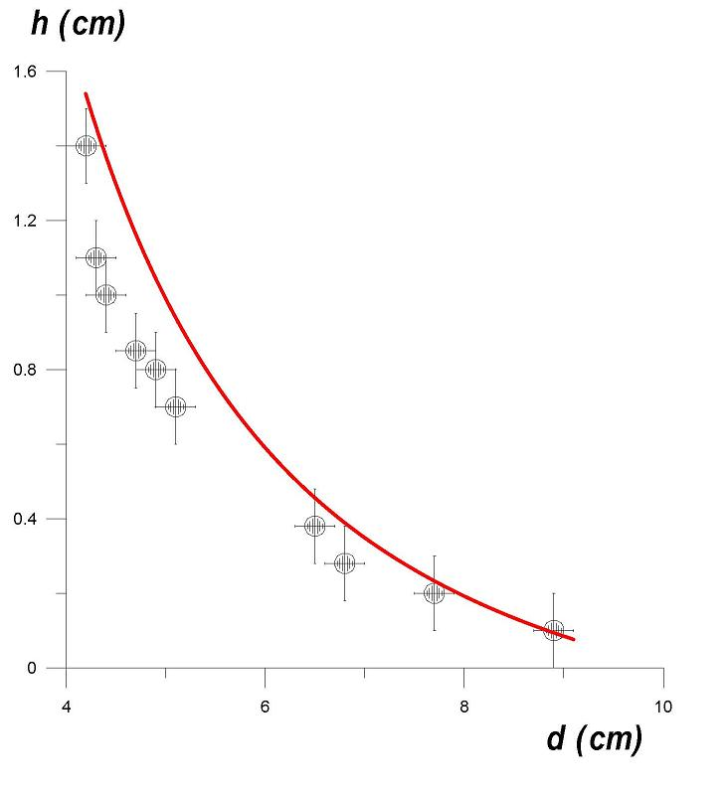
The dependence h (d)
for the stable states:
(experiment - points; theory - curve))
From the 4-th and 3-rd formulae :
F_{l} ~ h ; F_{k} ~ 1/(d-h)^{2.} .
If h << d, then the F_{l} increase with h faster, than F_{k}. So the stable equilibrium is reached.
If h ~ d, then F_{k} increases with h faster, than F_{l} so the film stretches and bursts.

Slide 16
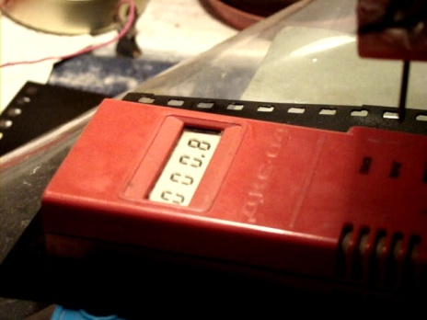
b) Behavior of film in uniform field
In uniform field the film did not stretch, due to symmetry.
In strong field film is torn by forces acting on the positive and negative charges.
c) Interaction of the film with charged nail
In this case the observed dip (instead of a "hill") was caused by so called "electric wind", which blow rather strong and this strength was greater than the strength of attraction.
electric wind
counter
nail 2
d) Interaction of film with small headed charge
In this case the observed behaviour reveals both processes -
the electric wind and the attraction towards electrode.
Head2

Slide 17
e) Asymmetry with respect to change of poles
At high temperatures the atoms emit the electromagnetic waves (photons). Frequency of emitted light depends on the transition energy between two levels in atom.
Where h – is Planck constant, and - frequency of emitted light.
Na emits yellow light, while N - emits bluish - lilac light.
So if electrode is charged negatively, then the atoms of Nitrogen (which are contained in air) are emitting the light.
In case of positively charged electrode -Sodium (Na) atoms are emitting.
Negative external charge accelerates the electrons toward the film. The accelerated electrons strike the atoms N of air and cause their bluish-lilac emission.
Positive external charge accelerates heavy ions of air towards the film. These ions hit the film and punch out of it the positive ions Na⁺.
Also in this case Na⁺ is attracted to negative ions of soap (which form film structure). So discharge becomes more "spread".
The upper part of the burst is blue, while the yellow region is under the level which can reach Na⁺.

Slide 18
Conclusion
Soap Film interactions with charged bodies were studied
Different shapes of charged bodies were tested
Resulting film deformations were examined
Film deformation strongly depends on:
Shape of charged body
Charge value
Distance from the film
Grounding of loop on which the film is formed
Film consistency
Discharge Asymmetry with respect to change of poles was observed

Slide 19
Thank you for attention!

