Slide 1
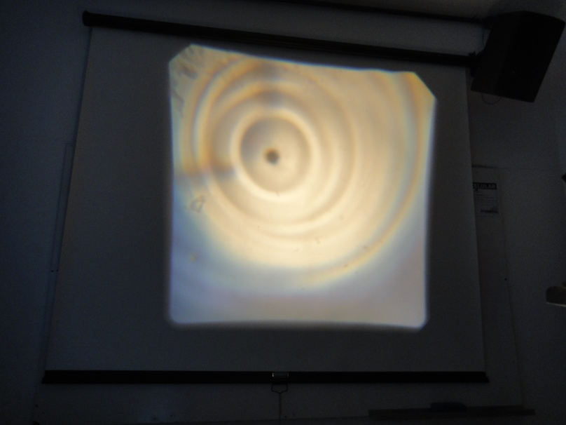
Problem 05 Bright waves
reporter:
Bárbara Cruvinel Santiago

Slide 2
Problem 05 Bright waves
Illuminate a water tank. When there are waves on the water surface, you can see bright and dark patterns on the bottom of the tank. Study the relation between the waves and the pattern.

Slide 3
Contents
Introduction
Caustics
Experiments
Experimental data
Conclusion
Analysis
Image point
Catastrophe theory
Theory validation
Comparison
General features

Slide 4
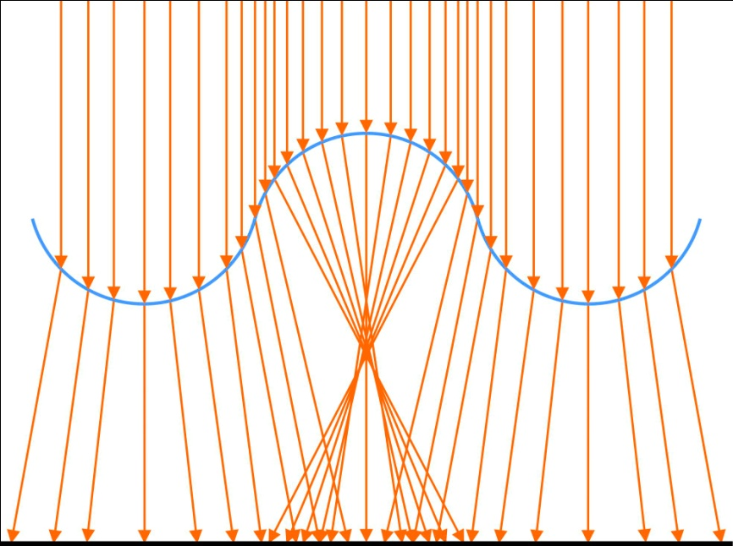
Caustics
Envelope of light rays reflected or refracted by a curved surface or object, or the projection of that envelope of rays on another surface.
Waves act like lenses
Caustics are formed
Penumbra
Bright
Penumbra

Slide 5
Depth
About 2 or 3 cm. *
From this distance on, the brightness decreases.
Critical depth: 1st ray crosses the 2nd
Image point distance: maximum brightness
* WALKER, J. “Shadows Cast on the Bottom of a Pool Are Not Like Other Shadows. Why?”. 1988

Slide 6
Depth
O
*
α
p
*
N
Θ₁
d
R
n₁
Θ₂
β
q
C
n₂
ϒ
I
Image point distance
* Assuming small angles

Slide 7
Depth
In the infinity
O
α
p
N
Θ₁
d
R
n₁
Θ₂
β
q
C
n₂
ϒ
I

Slide 8
Depth
R
R
C
λ
R
R
E
C
Specific case of water n = 4/3.

Slide 9
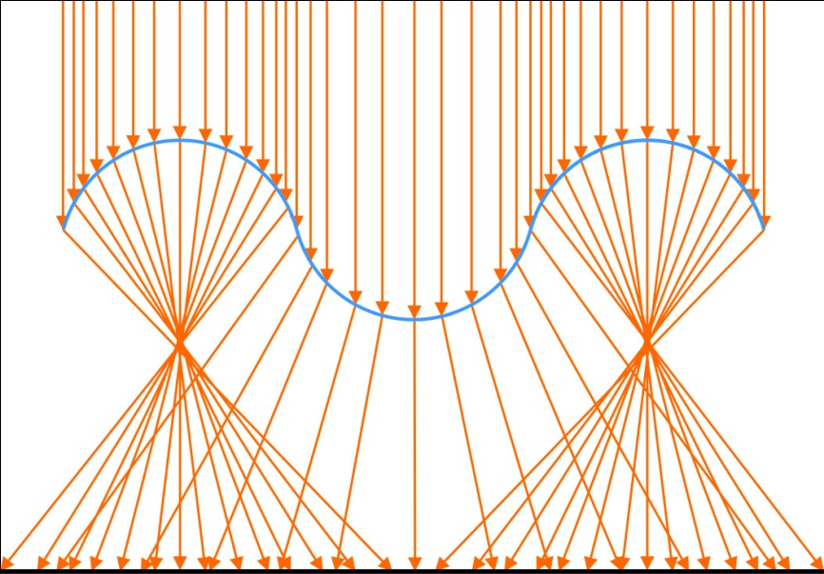
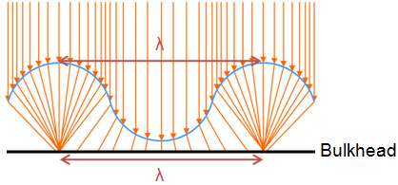
Width of the pattern
Bulkhead in q.
Other depths: catastrophe theory

Slide 10
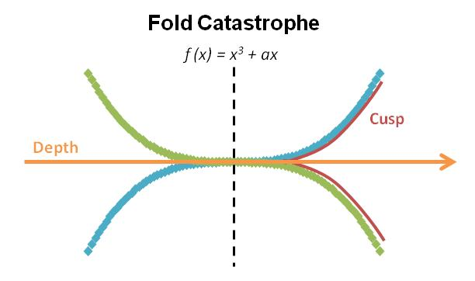
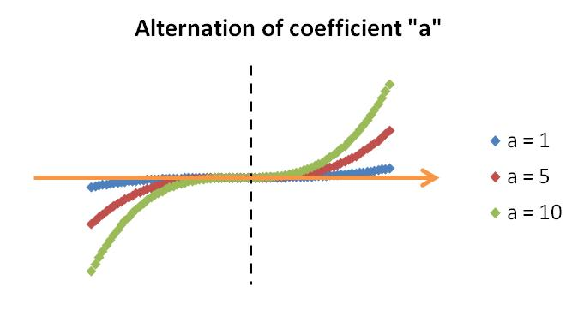
Width of the pattern
Fold catastrophes united by cusps.
Varies the catastrophe opening.

Slide 11
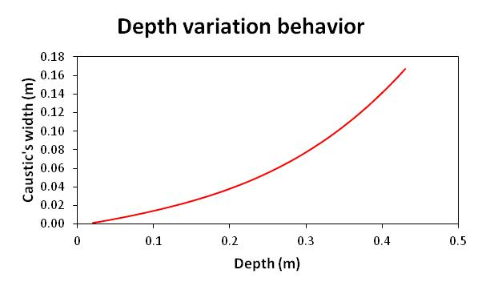
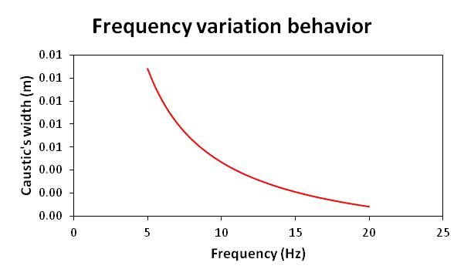
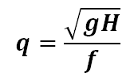
Width of the pattern
General expression for bright pattern’s width behavior:
a = 0.1
f = 30 Hz
g = 9.81 m/s²
a = 1
H = 1.5 cm
g = 9.81 m/s²

Slide 12
Other wave’s characteristics
Influences:
λ: size of the pattern
A: radius
T, v and f: periodic interchange between bright and dark patterns.
Type of wave: circular or linear patterns.
A’
A

Slide 13
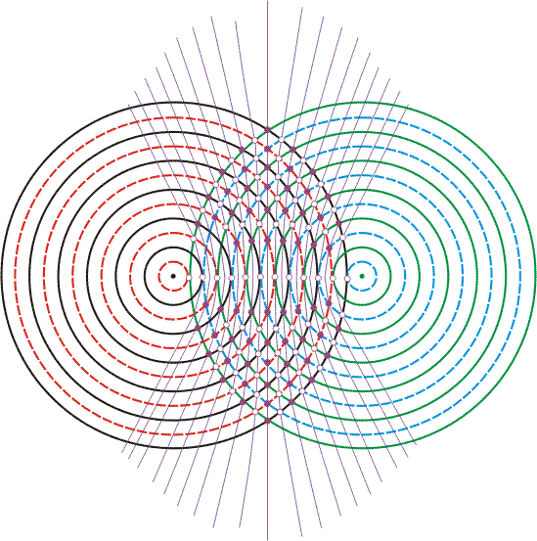
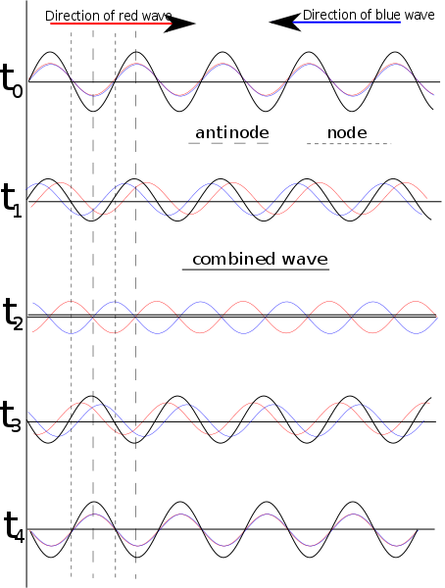
Interference
Two punctual sources:
Reflected water waves:
Same frequency and opposite directions.
Constructive: n = 0, 1; 2; 3...
Destructive: n = 0,5; 1,5; 2,5; 3,5...

Slide 14
Interference
Two punctual sources:
Reflected water waves:
Same frequency and opposite directions.
Standing waves are produced
Constructive: n = 0, 1; 2; 3...
Destructive: n = 0,5; 1,5; 2,5; 3,5...
Easier to analyze experimentally.

Slide 15
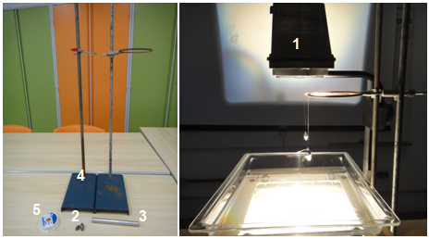
Material
Ripple tank
Lead weights
Cylinder
Metal support
Nylon
Acoustic boxes
Water
Aquarium
Computer
Wave generator

Slide 16
Experimental description
Experiment 1: analysis of the used source.
Experiment 2: bright pattern interference analysis.
Experiment 3: obtaining the coefficient a of the catastrophe theory.
Experiment 4: depth variation analysis.
Experiment 5: frequency variation analysis.

Slide 17
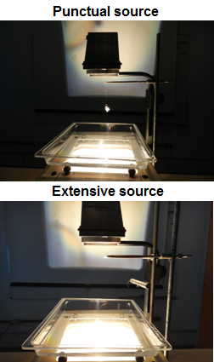
Experiment 1: analysis of the used wave source
Source
Interference
Coefficient a
Depth
Frequency
Wave fronts near wave’s source
High energy/amplitude
Different “q”
Different brightness
Wave source
Wave source
Patterns differ in geometry

Slide 18
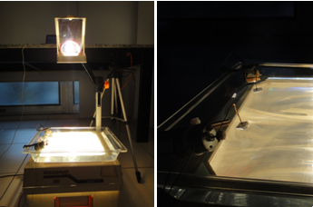
Experiment 2: interference analysis
Source
Interference
Coefficient a
Depth
Frequency

Slide 19
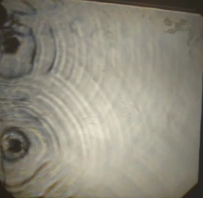
Experiment 2: interference analysis
Source
Interference
Coefficient a
Depth
Frequency
Some points of interference can clearly be seen.
Change in the pattern’s geometry

Slide 20
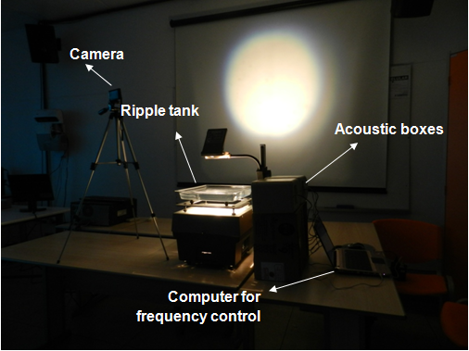
Experiment 3: coefficient “a”
Source
Interference
Coefficient a
Depth
Frequency

Slide 21
Experiment 3: coefficient “a”
Source
Interference
Coefficient a
Depth
Frequency
 | Caustic width (cm) | a
1st | 0.10 | 1.41E-03
2nd | 0.11 | 1.56E-03
3rd | 0.12 | 1.70E-03
4th | 0.10 | 1.41E-03
5th | 0.11 | 1.56E-03
6th | 0.10 | 1.41E-03
7th | 0.10 | 1.41E-03
Average | 0.11 | 1.50E-03
Standard deviation | 0.008 | 1.11E-04
a = catastrophe theory coefficient (caustic opening)

Slide 22
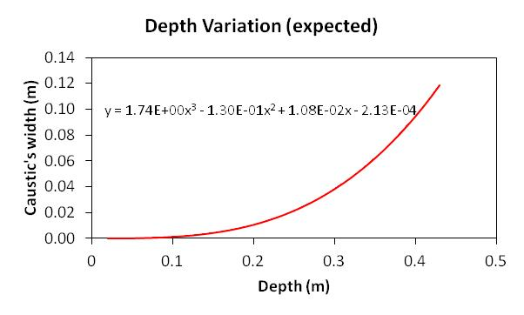
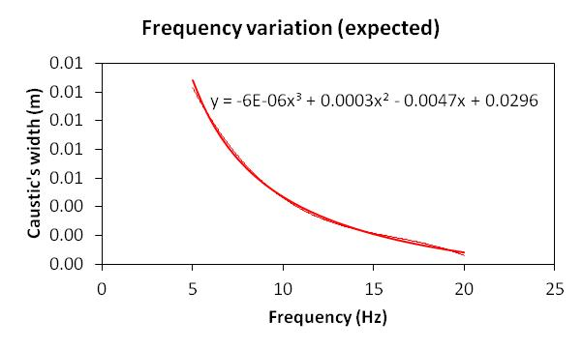
Experiment 3: coefficient “a”
Source
Interference
Coefficient a
Depth
Frequency
Expected behavior applying “a” gotten previously:
General equation applied
Used in comparison (next experiments)

Slide 23
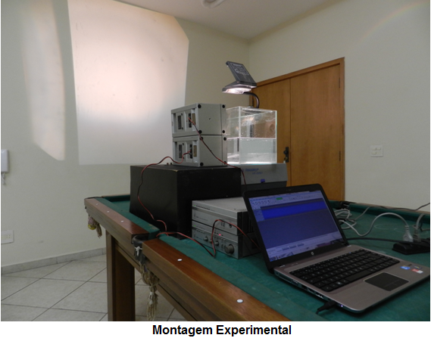
Experiment 4: depth variation
Source
Interference
Coefficient a
Depth
Frequency

Slide 24
Experiment 4: depth variation
Source
Interference
Coefficient a
Depth
Frequency

Slide 25
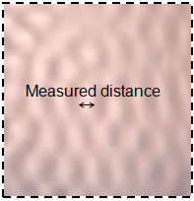
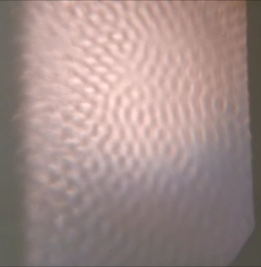
Experiment 4: depth variation
Source
Interference
Coefficient a
Depth
Frequency
Interference by reflection produce standing waves for easier analysis.

Slide 26
Experiment 4: depth variation
Source
Interference
Coefficient a
Depth
Frequency
Standard deviation = 0.006 m

Slide 27
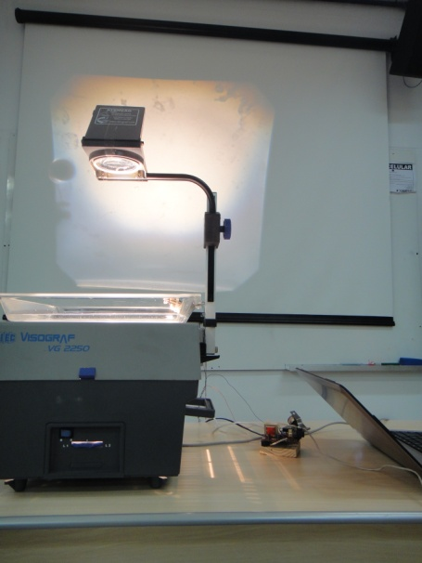
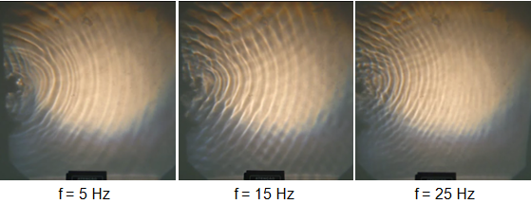
Experiment 5: frequency variation
Source
Interference
Coefficient a
Depth
Frequency
Decreasing width with increasing frequency

Slide 28
Experiment 5: frequency variation
Source
Interference
Coefficient a
Depth
Frequency
Standard deviation = 1.77∙10⁻⁵ m

Slide 29
Conclusion
The patterns are formed by caustics.
a ≈ 1.5∙10⁻³ (exp. 3) and characterizes the opening of the caustic. Predictions with this coefficient fitted experimental data.
Behavior of the patterns in function of the depth and frequency were showed and complies with the expected behavior (exp. 4/5).
depth/wavelength/amplitude/frequency
distance “q”/bright pattern’s length
interference
pattern‘s length and/or geometry
type of wave/wave source
pattern‘s geometry
period/frequency/velocity
bright/dark periodic interchange

Slide 30
References
1. SERWAY, Raymond A.; JR., John W. Jewett – Princípios de Física – Volume 4 – Óptica e Física Moderna – Thomson Learning – 2007
2. http://optica.machorro.net/Optica/SciAm/PoolShadows/1988-07-fs.html
3. http://dic.busca.uol.com.br/result.html?t=10&ref=homeuol&ad=on&q=c%E1ustica&group=0
4. http://www.physicstutorials.org/home/waves/water-waves
5. http://www.atoptics.co.uk/fz535.htm
6. http://mathworld.wolfram.com/FoldCatastrophe.html
7. http://www.iag.usp.br/~marcelo/agg232/
8. http://www.fisicaevestibular.com.br/ondas4.htm
9. http://www.infoescola.com/fisica/onda-estacionaria/

Slide 32
Depth
O
α
p
N
Θ₁
d
R
n₁
Θ₂
β
C
q
n₂
ϒ
I

Slide 33
Depth
O
α
p
N
Θ₁
d
R
n₁
Θ₂
β
C
q
n₂
ϒ
I

Slide 34
Depth
No infinito
O
α
p
N
Θ₁
d
R
n₁
Θ₂
β
C
q
n₂
ϒ
I

Slide 35
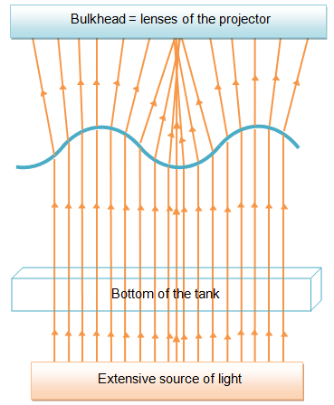
Differences when the tank is lit by its bottom
One more refraction.
Role of water lenses is inverted.
Convergence above the waves.
The bulkhead is the lenses of the projector.
The behavior in function of the depth continues the same (also shown by exp. 4).

Slide 36
Deduction of length in function of depth

Slide 37
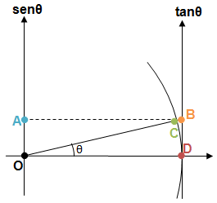
Trigonometric approximations

Slide 38
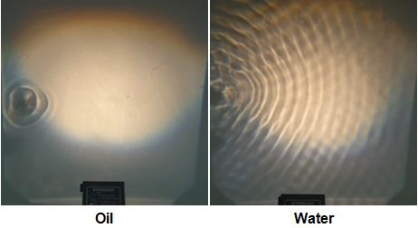
Different fluids
Refraction index: convergence is altered and, thus, q is altered.
Absorbance: bright pattern intensity changes.
Viscosity: wave features, as wave length, velocity, frequency etc are altered.

Slide 39
Capillary waves
Are generated by surface tension effects mainly.
With a high amplitude, we consider gravitaonal wave, for the high energy used.
Software for our expriments: Audacity
The maximum amplitude (1 in arbitrary units) of the software was used.

