Slide 1
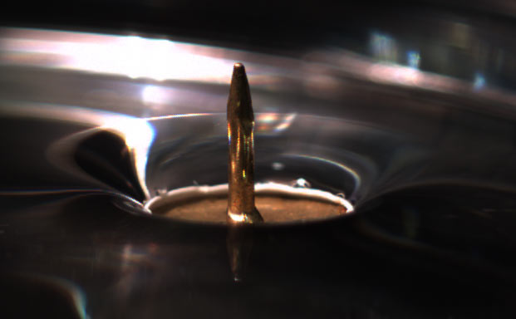
Problem 07 Drawing pins
reporter:
Ibraim Rebouças

Slide 2
Problem 07 Drawing pins
A drawing pin (thumbtack) floating on the surface of water near another floating object is
subject to an attractive force. Investigate and explain the phenomenon. Is it possible to achieve a repulsive force by a similar mechanism?

Slide 3
Contents
Theoretical introduction
Experiments
Conclusion
Surface tension
Viscosity
Capillarity
Interaction energy
Horizontal Forces
Tests
Comparison between theory and experiments
Attraction and repulsion
Dimensionless parameters
Time of approach

Slide 4
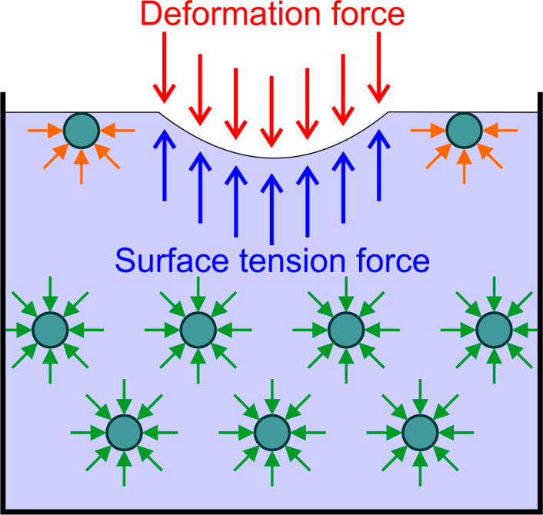
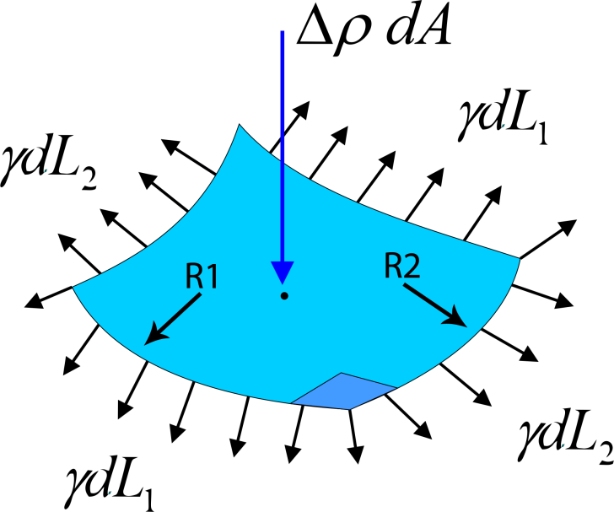
Surface tension
Definition:
Is a property of fluids caused by intermolecular forces, and tends to minimize the surface area to minimize his energy.
Surface tension table
Liquid | Temperature °C | Surface tension, γ
Acetic acid | 20 | 27.6
Acetic acid (40.1%) + Water | 30 | 40.68
Acetone | 20 | 23.7
Ethanol | 20 | 22.27
Glycerol | 20 | 63
Isopropanol | 20 | 21.7
Mercury | 15 | 487
Methanol | 20 | 22.6
n-Octane | 20 | 21.8
Water | 25 | 71.97
$$∆p=Υ[({R_{1})}^{−1}+{R_{2})}^{−1}]$$

Slide 5
Drag force
We have a drag force caused by the viscosity of the fluid.
Viscous Force$(F_{v})$
Radius of the shape
Adjustment parameter
$$F_{v}=6πRμα\frac{dL}{dt}$$
Absolut viscosity (Pa.s)
Velocity

Slide 6
Capillarity
The interaction between contacting surfaces of a liquid and a solid that distorts the liquid surface from a planar shape.
Considering water as the fluid, we can classify the particles in:
Hydrophilic particle
Hydrophobic particle
Hydrophilic: attract the water molecules
Hydrophobic: repels the water molecules
Hydrophilic particle
Hydrophobic particle

Slide 7
Meniscus – kinds of forces
Attractive Force
Attractive Force
Repulsive Force

Slide 8
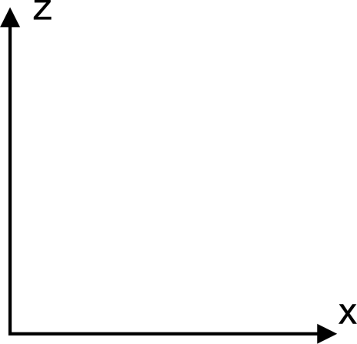
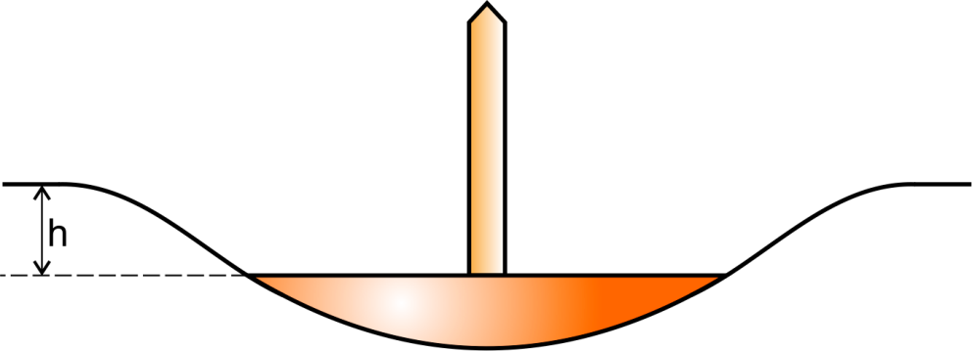
Vertical forces
$$F_{c}=2π(R\sin{θ_{c})γ\sin{[θ_{c}−\left(π−α\right)]}}$$
Capillary
forces
Pressure
Force
$$F_{p}=\int_{0}^{θ_{c}}{p\cos{θ(2πR\sin{θ)R dθ}}}$$
Atmospheric
pressure
Atmospheric
pressure
$$\boxed{F_{p}=ρ_{l}gV_{w}−Δρh_{2}A }$$
$$θ_{c}$$
$$V_{w}=πR^{3}\left(\frac{2}{3}−\cos{θ_{c}}+\frac{1}{3}\cos^{3}{θ_{c}}\right)$$
$$A=2πR^{2}\left(1−\cos{θ_{c}}\right)$$
Weight
At the equilibrium
$$F_{c}+F_{p}=Mg$$

Slide 9
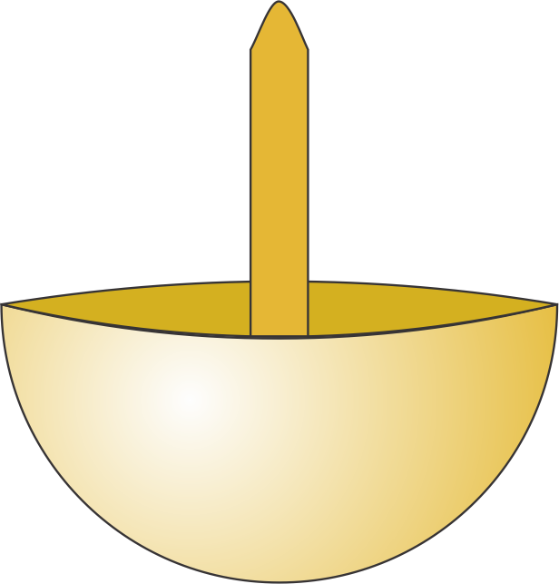
Horizontal forces
Liquid$(l)$
Gas$(g)$
$$\arctan{{h′}_{c}}$$
$$h$$
$$θ_{c}$$
$$θ$$
Contact point
The interaction energy is given by the Nicolson’s superposition approximation:
Bound number
$$h\sin{θ}$$
$$E_{i}=−2πγ{B_{o}}^{2}ζ_{1}ζ_{2}[K_{0}\left(\frac{L}{L_{c}}\right)]$$
$$F_{r}\left(L\right)=−2πγR\sqrt{B}{\left(β\right)}^{2}[K_{1}(\frac{L}{L_{c}})]$$
$$L_{c}=\sqrt{\frac{γ}{Δρg}}$$
Capillary length
$$F_{r}(L)=\frac{dE}{dL}$$
Bessel function

Slide 10
Dimensionless parameters
$$B_{o}≅\frac{R^{2}}{{L_{c}^{}}^{2}}$$
Bound number
Radius of the semi sphere
$$D=\frac{ρ_{s}}{ρ_{l}}$$
$$ζ_{k}=\frac{2D−1}{3}−\frac{1}{2}cosθ_{c}+\frac{1}{6}\cos^{3}{θ_{c}}≅\frac{h\sin{θ_{c}}}{B_{o}}$$
$$k∈\left\{1,2\right\}$$
Contact angle

Slide 11
Attraction and repulsion
Attraction cases
$$F_{r}<0$$
$$\sin{θ_{1}<0}$$
$$\sin{θ_{2}<0}$$
Or
$$\sin{θ_{1}>0}$$
$$\sin{θ_{2}>0}$$

Slide 12
Attraction and repulsion
Repulsion cases
$$F_{r}>0$$
$$\sin{θ_{1}<0}$$
$$\sin{θ_{2}>0}$$
Or
$$\sin{θ_{1}>0}$$
$$\sin{θ_{2}<0}$$

Slide 13
Space function for small L
For small values of L, the Bessel function can reduced to:
$$K_{1}\left(L≪1\right)≈\frac{1}{L}$$
$$F_{r}\left(L\right)=\frac{−2πγ{B_{o}}^{\frac{5}{2}}ζ_{1}ζ_{2}L_{c}}{L}$$
Using Torricelli's equation:
$$\int_{0}^{v}{v}dv=\int_{0}^{L}{a dL}$$
We get:
$$L\left(t\right)=\sqrt{L{\left(0\right)}^{2}−\frac{2γL_{c}{B_{o}}^{\frac{5}{2}}ζ_{1}ζ_{2}}{3μαm}}t$$

Slide 14
Experiment 1: Two pins in water - attraction
1
2
3
4
5
1

Slide 15
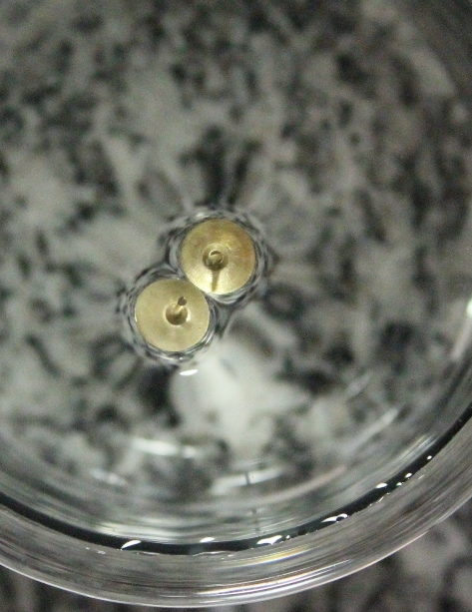
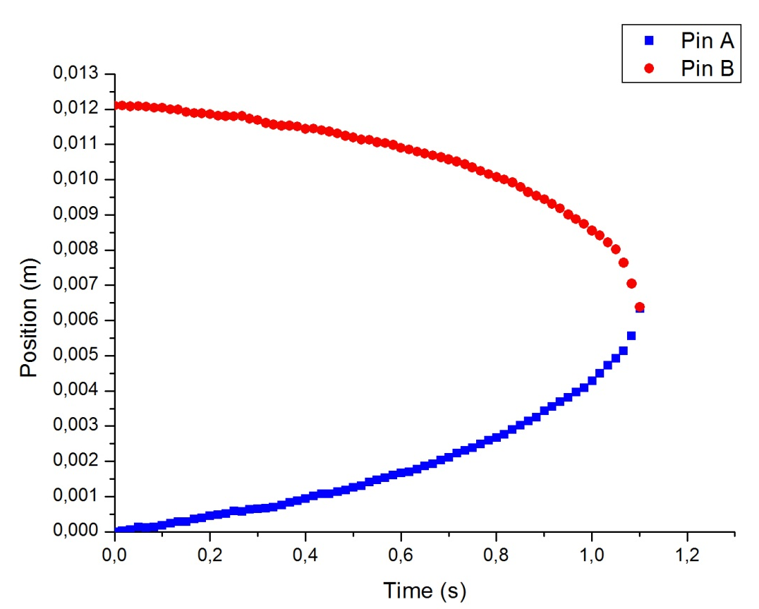
Experiment 1: Two pins in water - attraction
1
2
3
4
5
Position in function of time
1

Slide 16
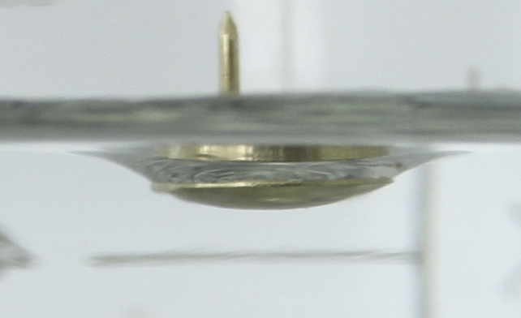
Experiment 1: Two pins in water
$$m=0.0003kg$$
$$γ_{water}=0.0728N/m$$
$$θ=38°$$
Temperature: $20℃$
Radius: 24.62 mm
h: 0.00103 m
1
2
3
4
5
$$θ$$
Source of errors
Rule and conversion: $± 0.5mm$
c $=8.5mm$
$$B_{o}=\frac{R^{2}}{L_{c}²}$$
$$β=h\sin{θ}$$
$$β=\text{0.00616}$$
$$B_{o}≅74$$

Slide 17
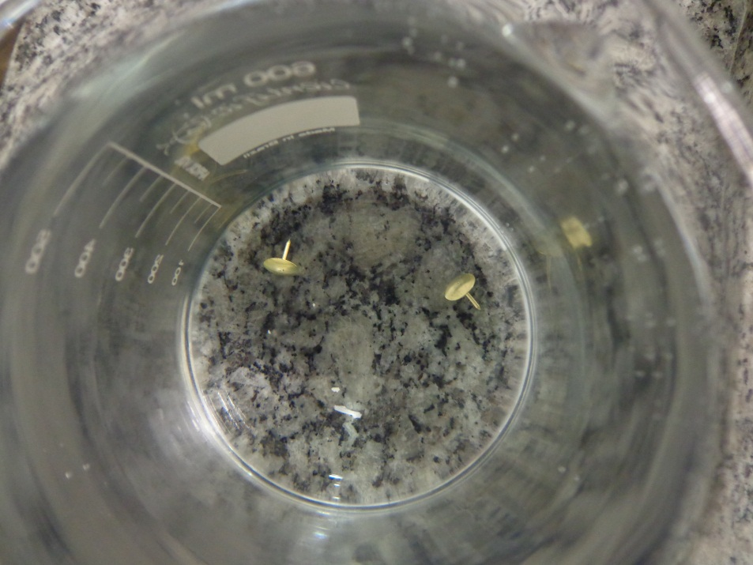
Experiment 2: Water with surfactant
1
2
3
4
5
The phenomena does not occur, because the surfactant break the surface tension, and the force became 0, according to the theory.
$$γ\underset{→}{}0$$
$$F\underset{→}{}0$$
$$F_{r}\left(L\right)=\frac{−2πγ{B_{o}}^{\frac{5}{2}}ζ^{2}L_{c}}{L}$$

Slide 18
Experiment 3: distance vs. time of approach
1
2
3
4
5
Distance (cm) | Time of approach(s)
1.09 | 0.82
1.95 | 9.81
1.36 | 2.17
1.54 | 2.95
1.37 | 1.33
0.76 | 0.92
Source of errors:
Measure of the distance and conversion
Imprecisions:
Time: $±0.05s$
Conversion and measurement: $±0.5mm$
There’s no pattern.

Slide 19
Experiment 4:Repulsion
1
2
3
4
5
The phenomenon

Slide 20
Experiment 4:Repulsion
1
2
3
4
5
Position X Time (Repulsion)
The pin stop
Precision: ±0.5 mm
Initial impulse

Slide 21
Experiment 5: Two pins in glycerin
1
2
3
4
5
Precision: ±0.5 mm

Slide 22
Conclusion
The movement
Repulsion
Viscosity
Time of approach

Slide 23
References
G. K. Batchelor, An Introduction to Fluid Dynamics Cambridge U.P.,Cambridge, 1967.
Fluid Mechanics 4th ed - F. White
D.D. Joseph, J. Wang, R. Bai, and B.H. Yang, 2003. Particle motion in a liquid film rimming the inside of a partially filled rotating cylinder. J. Fluid. Mech., 496, 139-163.
P. A. Kralchevsky, K. D. Danov, Interactions between Particles at a Fluid Interface, In: Nanoscience: Colloidal and Interfacial Aspects, V. M. Starov, Ed.; CRC Press, New York, 2010; Chapter 15, pp. 397-435.
P. Singh and D.D. Joseph, 2005. Fluid dynamics of floating particles. J. Fluid Mech., 530, 31-80.
Capillary interactions between particles bound to interfaces, liquid films and biomembranes - Peter A. Kralchevsky a,b, Kuniaki Nagayamaa,U

Slide 25
Appendix A
Brownian motion
Particle
Fractal

Slide 26
Bessel function
There’s no analytical solution for the equation in no asymptotic cases.
$$x²\frac{d²y}{dx²}+x\frac{dy}{dx}−(x−α)$$
Order

Slide 27
Software used to data collect and analysis
Tracker Physics Video analysis V 4.62
Origin Pro 7.0
Corel Draw X5

