Slide 1
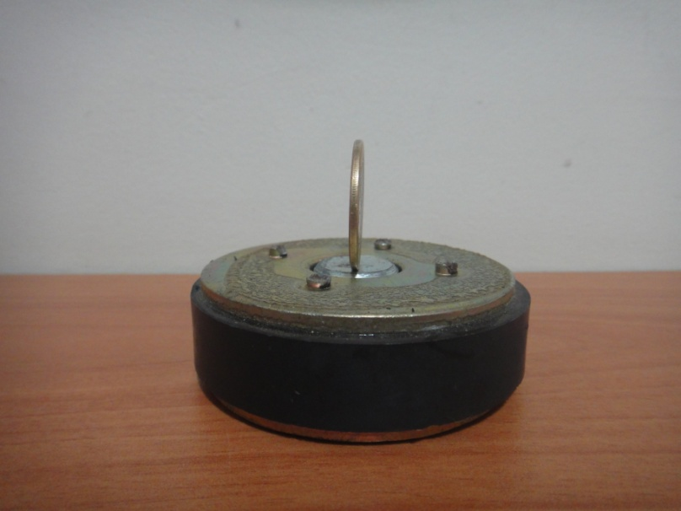
Problem 09 Magnet and coin
reporter:
Bárbara Cruvinel Santiago

Slide 2
Problem 09 Magnet and coin
Place a coin vertically on a magnet. Incline the coin relative to the magnet and then release it. The coin may fall down onto the magnet or revert to its vertical position. Study and explain the coin's motion.

Slide 3
Contents
Introduction
Threshold angle
Experiments
Experimental data
Conclusion
Analysis
Oscillations
Theory validation
Comparison
Rotational motion

Slide 4
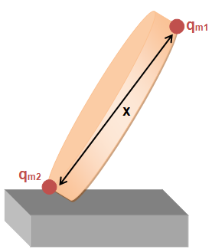
Magnetization of the coin
Magnetization is the main cause of the phenomenon.
Difficult to predict mathematically for ferromagnetic material.
Equivalent to “magnetic charges” for simplification.
Considered constant as just one position is taken.
Acts as kind of an average for the magnetic momentum

Slide 5
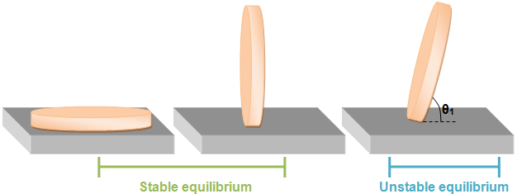
Threshold angle
Threshold angle is defined

Slide 6
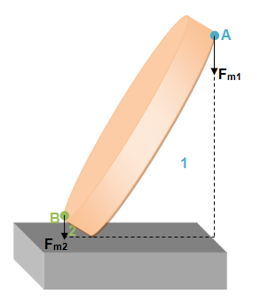
Threshold angle

Slide 7
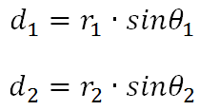
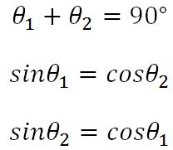
Threshold angle
The regions taken must be small enough to be considered single points, as “point magnetic charges”.

Slide 8
Threshold angle
In the equilibrium:
Threshold angle:

Slide 9
Threshold angle
tan³θ₁ < r₂/r₁
The coin falls over the magnet.
tan³θ₁ = r₂/r₁
The coin is in instable equilibrium.
tan³θ₁ > r₂/r₁
The coin comes back to the original position.
Magnetic properties:
Condition for effect occurrence.
Have no influence in the threshold angle determination.
Weight: can be neglected as it is going to be showed.

Slide 10
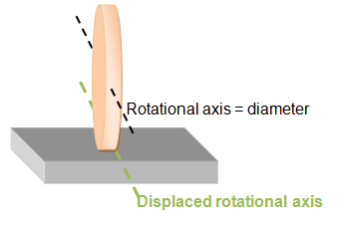
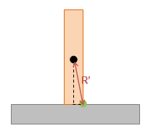
Rotational motion
Moment of inertia:

Slide 11
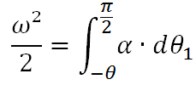
Rotational motion
Angular acceleration:
Dependent on the inclination angle and on the magnetic properties.

Slide 12
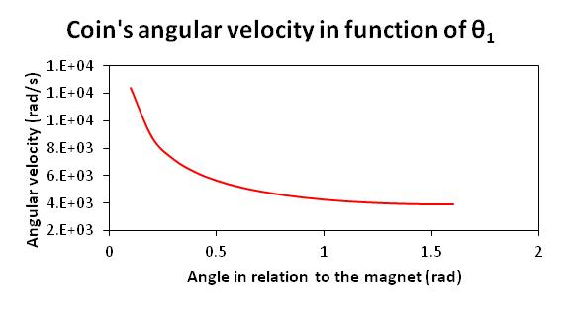
Rotational motion
Angular velocity approximately constant near the normal line to the magnet.

Slide 13
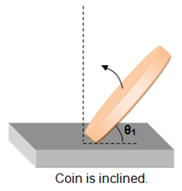
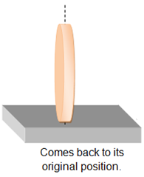
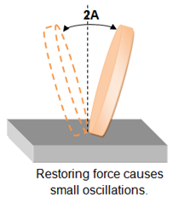
Oscillations
Angular velocity approached to constant
Amplitude that decreases with time
Under-damped Harmonic Oscillation
A < 15°

Slide 14
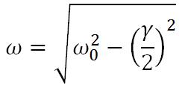
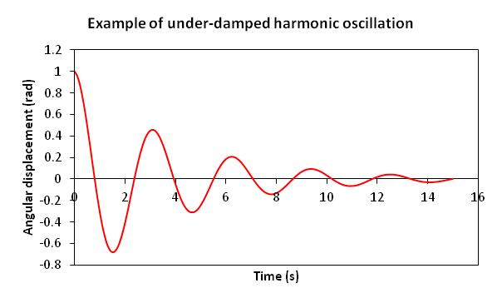
Oscillations
Dissipative force of type –bv.
However, magnetic force does not vary linearly and so does the damping. Hence, the period varies. So, that’s just a first approximation!

Slide 15
Eddy currents: source of dissipative force
Variation of magnetic flux
Induction of electrical currents
Dissipative force generated
Case of our experiments
1st case:
2nd case:
A≈5°
A
A
α
θ₁
θ₁
α
1st case: on the poles
2nd case: on the sides
In our case, the eddy currents have their maximum influence in relation to the position on the magnet.

Slide 16
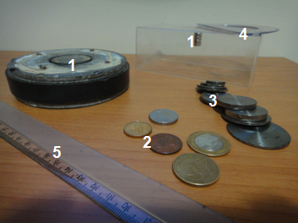
Material
1. Magnets
2. Real coins
3. Steel coins
4. Protractor (±0,5°)
5. Acrylic ruler
• Iron filings
• White paper
• Dynamometer (±0.05N)
• Support for the dynamometer
• Camera

Slide 17
Experimental description
Experiment 1: show that the weight is negligible in comparison to the magnetic force.
Experiment 2: threshold angle analysis.
Experiment 3: magnet analysis.
Experiment 4: oscillation analysis.

Slide 18
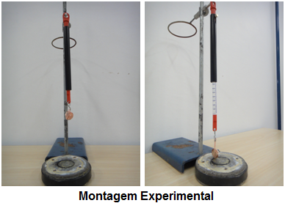
Experiment 1: weight analysis
Weight
Threshold angle
Magnet
Oscillations
 | Force (N)
1st | 7.9
2nd | 7.7
3rd | 7.6
4th | 7.8
5th | 7.6
Average | 7.72
Standard Deviation | 0.13

Slide 19
Experiment 1: weight analysis
Weight
Threshold angle
Magnet
Oscillations
Total force (N) |  | 7.72
Weight (N) |  | 0.04
Magnetic force (N) |  | 7.68
The weight represents | 0.52% | of the magnetic force
The weight can actually be neglected.

Slide 20
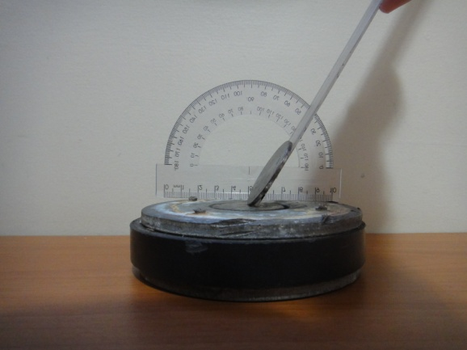
Experiment 2: threshold angle analysis
Weight
Threshold angle
Magnet
Oscillations
8 coins are used.
They are inclined 1 by 1 degree.
This is repeated 10 times for each coin.
The points are averages.

Slide 21
Experiment 2: threshold angle analysis
Weight
Threshold angle
Magnet
Oscillations
Average deviation: 4%
Precision of the protractor: ±0,5°

Slide 22
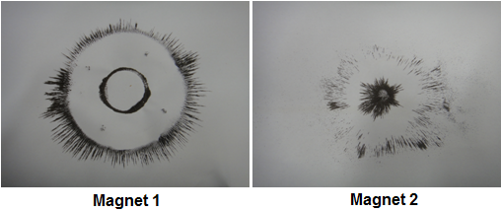
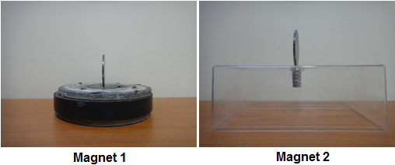
Experiment 3: different magnets
Weight
Threshold angle
Magnet
Oscillations

Slide 23
Experiment 3: different magnets
Weight
Threshold angle
Magnet
Oscillations
Threshold angle in degrees
 | Magnet 1 | Magnet 2
1st | 26 | 30
2nd | 25 | 26
3rd | 24 | 27
4th | 27 | 26
5th | 26 | 28
6th | 25 | 27
7th | 25 | 25
8th | 25 | 24
9th | 26 | 26
10th | 27 | 24
Average | 25.6 | 26.3
Standard deviation | 1.0 | 1.8
The angles are the same considering the standard deviation.

Slide 24
Experiment 4: oscillation analysis
Weight
Threshold angle
Magnet
Oscillations

Slide 25
Experiment 4: oscillation analysis
Weight
Threshold angle
Magnet
Oscillations
Resembles an under-damped harmonic oscillation, but the period varies.
Coin with larger area
Greater damping
Evidence of eddy currents

Slide 26
Conclusion
Magnetic properties are important for the motion itself and are the initial condition for the effect occurrence.
Threshold angle is dependent only on the coins dimensions (exp. 2/3).
The fall or reverting motion is due to the torque of the magnetic force.
Oscillations resembles an under-damped harmonic oscillations but the period varies (exp. 4).
Evidences of dissipation by eddy currents (exp. 4).

Slide 27
References
1. http://www.bcb.gov.br/?MOEDAFAM2
2. http://www.infomet.com.br/acos-e-ligas-conteudo-ler.php?cod_tema=9&cod_secao=10&cod_assunto=81&cod_conteudo=123
3. http://www.usmint.gov/mint_programs/circulatingCoins/index.cfm?action=CircPenny
4. http://geophysics.ou.edu/solid_earth/notes/mag_basic/mag_basic.html
5. PRÄSS, Prof. Alberto Ricardo. Oscilações: Movimento Harmônico Simples – MHS. Física.net

Slide 29
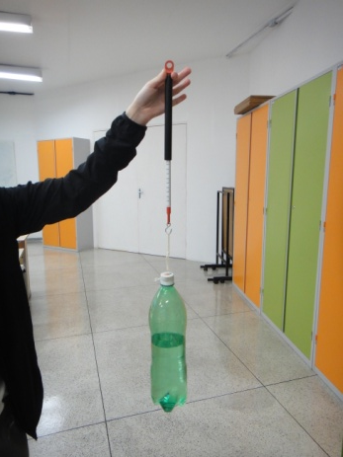
Dynamometer calibration
The dynamometer was calibrated with PET bottle full of water, with exact 1 kg, measured with a scale of precision of 0.1 g. The maximum mark of the dynamometer is 10N.

Slide 30
Real coin’s table
Technical characteristics of the coin
Value (R$) | Diameter (mm) | Thickness (mm) | Mass (g) | Material
0.01 | 17 | 1.65 | 2.43 | Steel covered with copper
0.05 | 22 | 1.65 | 4.10 | Steel covered with copper
0.10 | 20 | 2.23 | 4.80 | Steel covered with bronze
0.25 | 25 | 2.25 | 7.55 | Steel covered with bronze
0.50 | 23 | 2.85 | 6.80 | Stainless steel
1.00 | 27 | 1.95 | 7.00 | Stainless steel (core) a steel covered with bronze (ring)

Slide 31
Table for experiment 2
Threshold angle (in degrees)
Coins | 0.16 | 0.08 | 0.04 | 0.07 | 0.1 | 0.13 | 0.17 | 0.06
1 | 33 | 28 | 21 | 25 | 26 | 25 | 28 | 23
2 | 31 | 25 | 22 | 24 | 25 | 25 | 32 | 25
3 | 30 | 25 | 23 | 22 | 24 | 24 | 34 | 21
4 | 29 | 24 | 20 | 23 | 27 | 30 | 31 | 23
5 | 28 | 23 | 19 | 24 | 26 | 29 | 29 | 22
6 | 28 | 24 | 18 | 24 | 25 | 28 | 33 | 21
7 | 29 | 23 | 19 | 23 | 25 | 33 | 30 | 23
8 | 28 | 24 | 19 | 23 | 25 | 31 | 29 | 22
9 | 28 | 24 | 20 | 23 | 26 | 27 | 29 | 21
10 | 29 | 23 | 19 | 24 | 27 | 26 | 30 | 23
Average | 29.3 | 24.3 | 20 | 23.5 | 25.6 | 27.8 | 30.5 | 22.4
Theory | 28.5 | 23.3 | 18.9 | 22.4 | 24.9 | 26.9 | 29.0 | 21.4
Standard deviation | 1.64 | 1.49 | 1.56 | 0.85 | 0.97 | 2.94 | 1.96 | 1.26
Percentage error | 3% | 4% | 6% | 5% | 3% | 3% | 5% | 5%
Average Percentage Error |  |  |  |  |  |  |  | 4%

Slide 32
Experiment 2 for real coins - table
Threshold angle (in degrees)
Coins | R$ 1.00 | R$ 0.50 | R$ 0.25 | R$ 0.10 | R$ 0.05
1 | 25 | 26 | 25 | 25 | 25
2 | 26 | 27 | 26 | 26 | 24
3 | 23 | 25 | 25 | 29 | 23
4 | 22 | 27 | 24 | 25 | 23
5 | 24 | 28 | 26 | 26 | 25
6 | 22 | 29 | 24 | 27 | 24
7 | 24 | 27 | 25 | 27 | 23
8 | 23 | 28 | 27 | 25 | 25
9 | 22 | 27 | 24 | 27 | 23
10 | 21 | 26 | 25 | 28 | 23
Average | 23.2 | 27 | 25.1 | 26.5 | 23.8
Theory | 22.6 | 26.5 | 24.1 | 25.7 | 22.9
Standard deviation | 1.55 | 1.15 | 0.99 | 1.35 | 0.92
Percentage error | 3% | 2% | 4% | 3% | 4%
Average Perc. Error |  |  |  |  | 3%

Slide 33
Experiment 2 for real coins - graphic
Percentage error = 3%

Slide 34
Threshold angle: Ampère model consideration
Ampère Model:

Slide 35
Threshold angle: Ampère model consideration
Ampère Model:

Slide 36
Experiment 2: threshold angle analysis
Weight
Threshold angle
Magnet
Oscillations
Precision of the protractor: ±0,5°

Slide 37
Coin’s material
Used coins: steel (iron + carbon).
Ferromagnetic: existence condition for the phenomenon.
Iron, cobalt, nickel and gadolinium;
Magnetic domains are oriented in the direction of the external field.
Certain coins cannot be tested, like dollar coins (zinc+ copper).

Slide 38
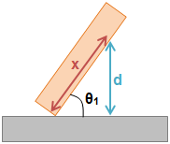
Magnetic properties

Slide 39
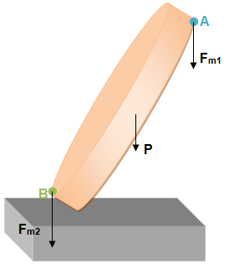
Contribution of the weight for the torque
Without disregarding the weight, the relation without c wouldn’t be gotten.
Correction factor for systematic error.

