Slide 1
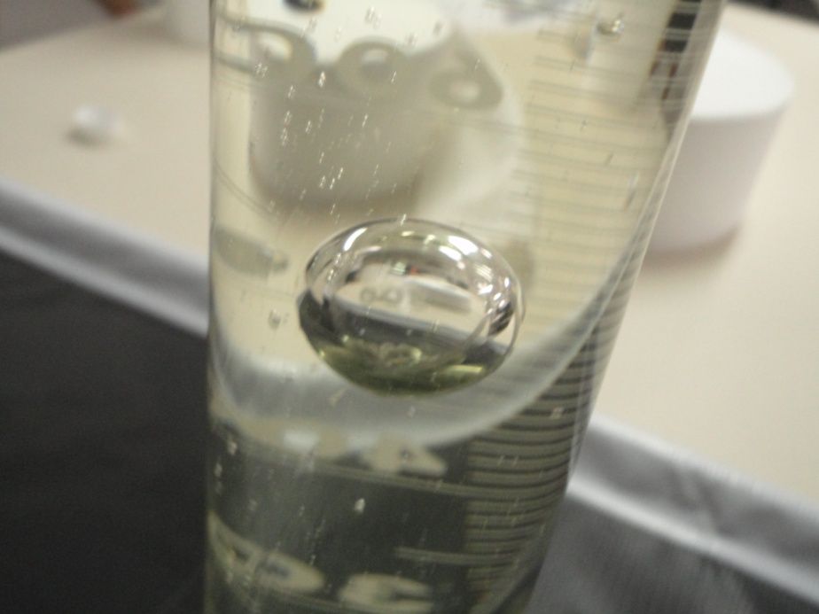
Problem 16 Rising bubble
reporter:
Ibraim Rebouças

Slide 2
Problem 16 Rising bubble
A vertical tube is filled with a viscous fluid. On the bottom of the tube, there is a large air bubble. Study the bubble rising from the bottom to the surface.

Slide 3
Contents
Theoretical introduction
Experiments
Conclusion
Kinds of bubble
Viscosity
Drag forces
Lateral Flow
Tests
Comparison between theory and experiments
Rise velocity
Smaller spherical cap
Influence of the temperature

Slide 4
Kinds of bubbles
Spherical bubble
Very viscous fluids.
Governed by stokes low
Spherical cap bubble
Stable to moderated viscous fluids.
Taylor’s bubble
Height bigger than the diameter of the pipe.
Constant velocity for all volumes.

Slide 5
The phenomenon

Slide 6
Viscosity
It’s the measurement of the resistance to a shear stress.
The viscosity is measured by a coefficient.
$$τ∝\frac{∂u}{∂y}\overset{⇒}{}τ=μ\frac{∂u}{∂y}$$
$μ$ is called absolute viscosity coefficient.
Kinematic viscosity $ν=\frac{μ}{ρ}$
$ρ$ is de density of the fluid
$$\frac{∂u}{∂y}$$

Slide 7
Forces acting on the bubble
Buoyancy
Drag
forces
Weight

Slide 8
Forces acting on the bubble
$$\overset{Newton^{′}s equation}{\overbrace{F_{d}=\frac{1}{2}A{ U}^{2}C_{d}}}$$
$$\overset{Stoke^{′}s drag}{\overbrace{F_{d}=−bv }}$$
Both are wrong, because they do not consider the boundary effects.

Slide 9
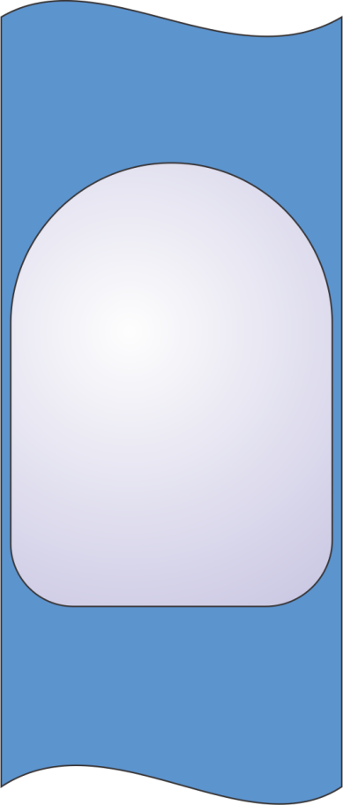
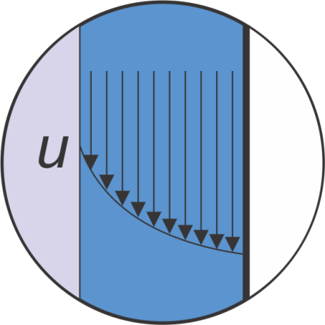
Border of the bubble
Pressure
We must have conservation of mass for the liquid ahead and behind the bubble.
$$y$$
$$x$$
$$μ\frac{d^{2}u}{dx^{2}}=\frac{∂p}{∂y}=constant<0$$
Buoyancy
$$u=−\frac{dp}{dy}\frac{h^{2}}{2μ}\left(1−{\left[\frac{x}{h}\right]}^{2}\right)$$
$$−h$$
$$+h$$

Slide 10
Large spherical cap or Taylor bubble velocity
For Taylor bubble or large spherical cap bubbles, the velocity can be described by the following equation:
Terminal velocity
(m/s)
$$\frac{U}{\sqrt{gD}}=−\frac{8}{3}\frac{ν}{\sqrt{gD^{3}}}+\frac{\sqrt{2}}{3}{\left(1+\frac{32ν^{2}}{gD^{3}}\right)}^{1/2}$$
Taylor bubble
Large spherical cap
For low viscosity fluids(e.g. Water), the equation can be written as:
The velocity is constant and does not depend on the volume of the bubble.
Diameter of the bubble
$$\boxed{U=\frac{\sqrt{2}}{3}\sqrt{gD}}$$

Slide 11
Spherical cap bubbles
Diameter smaller than the tube
Lateral oscillation
Drag coefficient
$$C_{d}=6+\frac{32}{R_{e}}$$
Wave length
$$λ_{c}=2πL_{c}$$
$$L_{c}=\sqrt{\frac{γ}{Δρg}}$$
Drag force
Capillary length
$$R_{e}=\frac{UD}{ν}$$
$$F_{d}=C_{d}\frac{π}{2}ρU^{2}R^{2}$$
$$L_{c}=\sqrt{\frac{γ}{Δρg}}$$
Surface tension coefficient
Difference of density (air-liquid)

Slide 12
Rise velocity of spherical cap
At the equilibrium:
$$F_{d}=B$$
$$F_{d}=C_{d}\frac{π}{2}ρU^{2}R^{2}$$
$$C_{d}\frac{π}{2}ρU^{2}R^{2}=ρgV$$
$$B=ρgV$$
Finally:
$$U\left(\frac{32ν}{D}+6U\right)=2gV$$

Slide 13
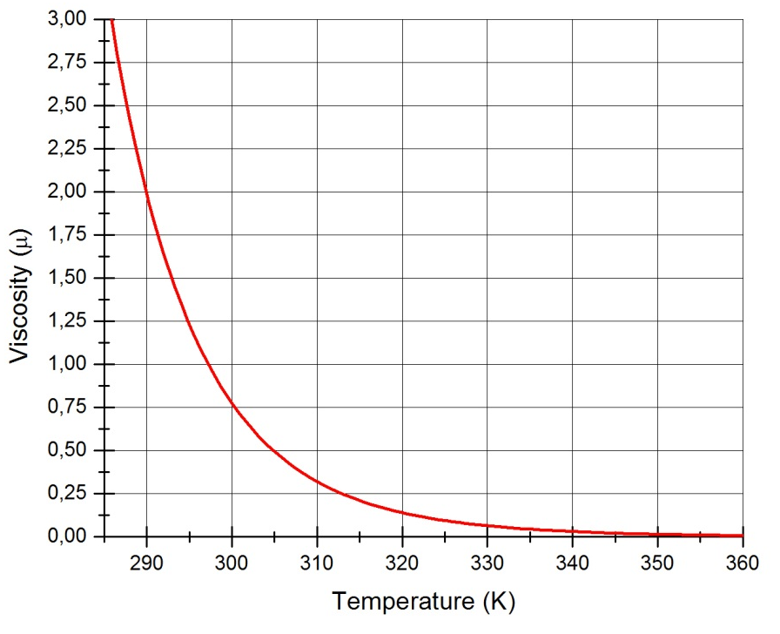
Influence of temperature
The temperature acts changing the viscosity of the fluid and the density of the air inside the bubble.
Reference temperature in Kelvin
Viscosity parameter
$$μ≈exp\left[ C\left(\frac{T_{0}(K)}{T(K)}−1\right) \right]{ μ}_{0}$$
Reference viscosity
Temperature in kelvin
Accuracy of $±6\%$ for temperature range: $0<T<100℃$

Slide 14
Experimental description
Experiment 1
Vary the volume of the bubble
Experiment 2
Vary the temperature
Experiment 3
Vary the diameter of the tube
Experiment 4
Influence of surfactant

Slide 15
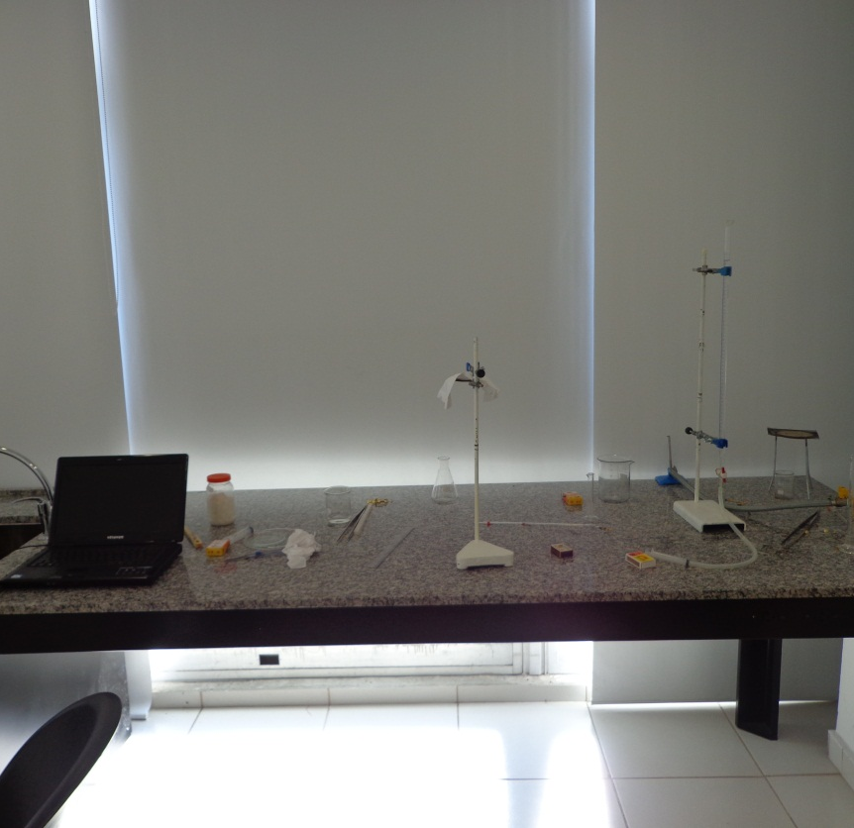
Materials
Burette 50 ml
Pipette 10 ml
Glass tube 250 ml
Syringe 10 ml
Rubber tube
Camera
Computer software's

Slide 16
Experiment 1: Variation of the volume
Volume
Temperature
Diameter
Tube diameter: 15 mm
Syringe: 20 ml
Fluid: Glycerin
Temperature: $20℃$
Source of errors:
Measuring ruler and conversion scale: $±0.5mm$
Volume of the syringe: $±0.5 ml$

Slide 17
Experiment 1: Variation of the volume
Volume
Temperature
Diameter
$Vm=0.014$25 m/s
$Vm=0.014$49 m/s

Slide 18
Experiment 1: Variation of the volume
Volume
Temperature
Diameter
$Vm=0.014$45 m/s
$Vm=0.014$77 m/s

Slide 19
Experiment 1: Variation of the volume
Volume
Temperature
Diameter
$Vm=0.014$80 m/s
$Vm=0.014$98 m/s

Slide 20
Experiment 1: Variation of the volume
Volume
Temperature
Diameter
$Vm=0.01640$ m/s
$Vm=0.0171$0 m/s

Slide 21
Experiment 1: Variation of the volume
Volume
Temperature
Diameter

Slide 22
Experiment 1: Variation of the volume
Volume
Temperature
Diameter
Volume (ml) | Experimental velocity ($m/s$) | Theoretical velocity ($m/s$)
9 | $0.014$2 | 0.0146
8 | $0.014$4 | 0.0146
7 | $0.014$4 | 0.0146
6 | $0.0147$ | 0.0146
5 | $0.014$8 | 0.0146
4 | $0.0149$ | 0.0146
3 | $$0.0164$$ | 0.0146
2 | $0.0171$ | 0.0146
Average | 0,0151 | 0.0146
Average error for all points: 4.62% Average error for [4;9]: 1.37%
Out of the regime
Experiment agrees with the theory

Slide 23
Experiment 2: Variation of the temperature
Volume
Temperature
Diameter

Slide 24
Experiment 2: Variation of the temperature
Volume
Temperature
Diameter
Temperature T (°C) | Calculated Viscosity (m²/s) $∗{10}^{−4}$ | Predicted Velocity (m/s) | Experimental velocity
55.0 | 0.409 | 0.0981 | 0.0850
45.0 | 0.876 | 0.0779 | 0.0694
35.0 | 1.973 | 0.0229 | 0.0234
25.0 | 4.685 | 0.00910 | 0.0103

Slide 25
Experiment 2: Variation of temperature
Volume
Temperature
Diameter
Average error: 10%

Slide 26
Experiment 3: Variation of the diameter
Volume
Temperature
Diameter
Fluid: Soy bean oil
Kinematic viscosity at $20℃$ $\left(ν\right)$: $7.5∗{10}^{−5}$
Experimental velocities
0,193 m/s
0,0703 m/s
Precision: ±0.5 mm
0,0240 m/s

Slide 27
Experiment 3: Variation of the diameter
Volume
Temperature
Diameter
Diameter (mm) | Calculated Velocity (m/s) | Experimental Velocity (m/s)
25.0 | 0.2270 | 0.2130
6.5 | 0.0932 | 0.0790
5.0 | 0.0387 | 0.0340
Average error: 11%

Slide 28
Conclusion
Diameter of the tube
Viscosity
Temperature
Diameter

Slide 29
References

Slide 31
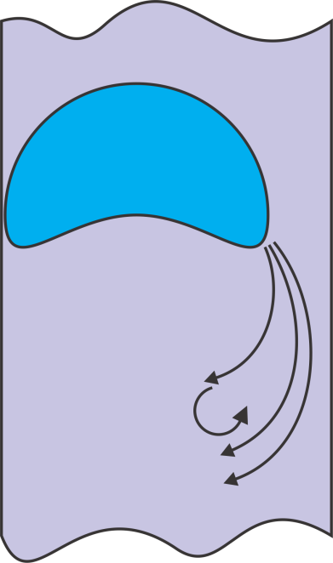
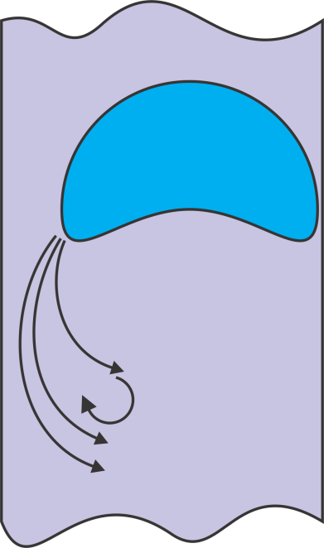
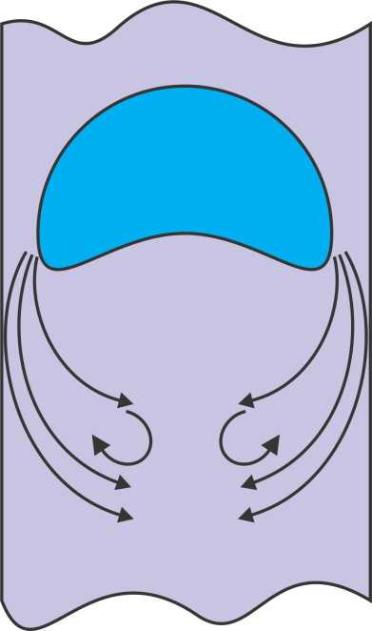
Lateral Flow
For bubble measures comparable to the tube.

Slide 32
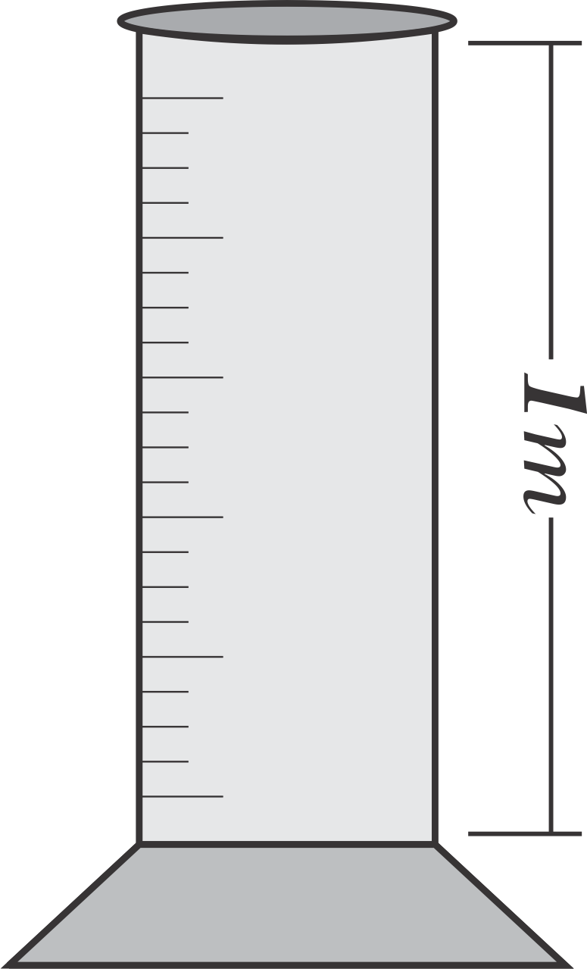
Pressure and volume variation
For the following parameters:
Fluid: Water
Length of beaker: 1m
P

Slide 33
The weight of the bubble
Considering a bubble with a volume of 2x10⁻⁵m³ (20mL):
Buoyancy
Weight
Relation between them
Conclusion

Slide 34
http://www.pmmh.espci.fr/~jbico/TP/taylor50bulle.pdf

Slide 35
Fluid ($l$) | C | Fluid ($l$) | C
Ammonia | 1.05 | Freon 12 | 1.76
Ethanol | 5.72 | Benzene | 4.34
Gasoline | 3.68 | Mercury | 1.07
Glycerin | 28.0 | Methanol | 4.63

