Slide 1
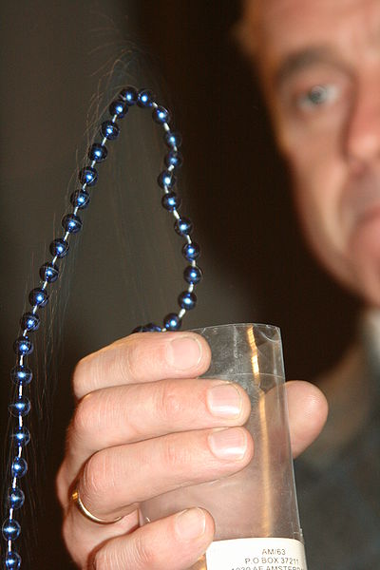
Problem 03 String of beads
reporter:
Bárbara Cruvinel Santiago

Slide 2
Problem 03 String of beads
A long string of beads is released from a beaker by pulling a sufficiently long part of the chain over the edge of the beaker. Due to gravity the speed of the string increases. At a certain moment the string no longer touches the edge of the beaker (see picture). Investigate and explain the phenomenon.

Slide 3
Contents
Introduction
Acceleration
Experiments
Experimental data
Conclusion
Analysis
Initial energy
Detachment
Theory validation
Comparison

Slide 4
Introduction
“sufficiently long part of the chain”: there is a minimum energy to overcome inertia.
“the speed of the string increases”: two cases
Initial height > String’s length: 2 phases for acceleration behavior
Initial height < String’s length: 3 phases for acceleration behavior
“the string no longer touches the edge of the beaker”: there is a mechanism which makes the chain detach from the beaker.

Slide 5
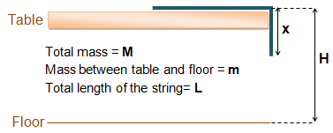
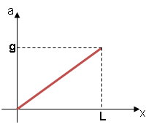
Acceleration and motion features
When H>L

Slide 6
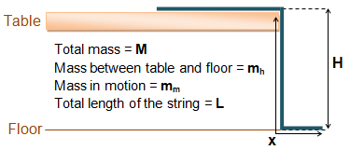
Acceleration and motion features
When H<L
1st part: till x = H
2nd part:
3rd part:
Total length that already left the beaker, including what already touched the floor.

Slide 7
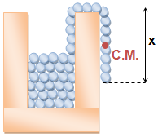
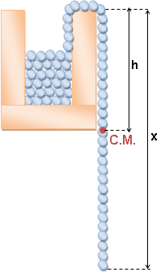
Initial energy to overcome inertia
Referential for energy calculation.
Initial energy:

Slide 8
Detachment
Cause: tension causes an impulse that pull the chain upwards.
Velocity increases
Tension increases
Detachment height increases with time
*
*WANG, C. W.; YASUI, K.. Falling chains. University of California. 20 Feb 2006

Slide 9
Detachment
Detachment
Transference into gravitational potential energy
Dissipation of energy
Beads touch the floor
The height of the beaker influences the height of detachment above the beaker’s border.

Slide 10
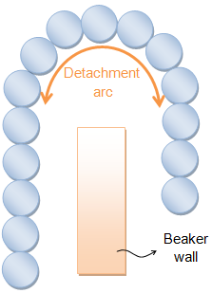
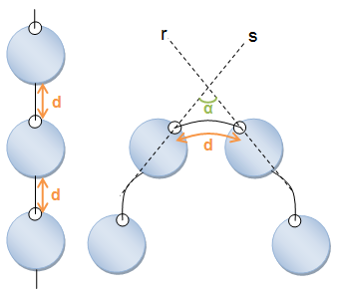
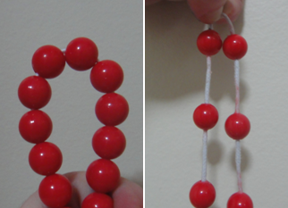
Detachment
Cut diametrically the beads
Larger angle
Larger detachment arc
There’s a maximum arc of tension

Slide 11
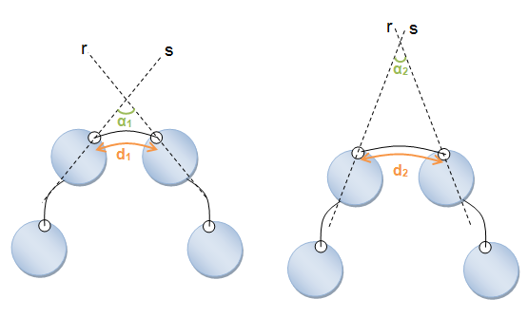
Detachment
d₁ < d₂
α₁ > α₂
Higher tension
Takes different shapes due to the arrangement inside the beaker.
Larger bead’s size
Larger angle
Higher tension

Slide 12
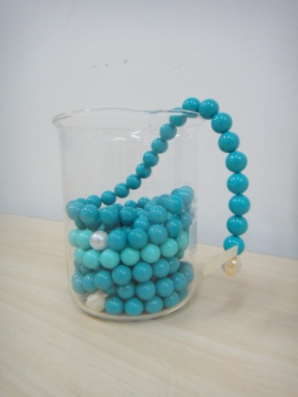
Material
Beakers
Chains (beads and nylon)
Table
Camera
Measuring tape (precision of ±0.05 cm)
Precision scale (precision of ±0.1 g)

Slide 13
Experimental description
Experiment 1: acceleration analysis.
Experiment 2: initial energy analysis.
Experiment 3: detachment analysis.
Experiment 4: detachment evolution with time.
Experiment 5: height of launch variation.
Experiment 6: beaker dimensions variation.
Experiment 7: variation of the distance between beads.

Slide 14
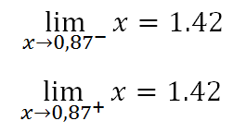
Experiment 1: acceleration analysis
Initial energy
Detachment shape
Detachment in time
Height of launch
Beaker dimensions
Acceleration
Distance between beads
Function is differentiable

Slide 15
Experiment 1: acceleration analysis
Acceleration
Initial energy
Detachment shape
Detachment in time
Height of launch
Beaker dimensions
Distance between beads
Source of errors: measuring tape (±0.5 mm) and conversion scale.

Slide 16
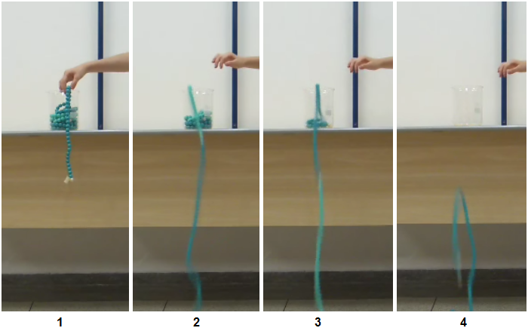
Experiment 1: acceleration analysis
Acceleration
Initial energy
Detachment shape
Detachment in time
Height of launch
Beaker dimensions
Distance between beads

Slide 17
Experiment 2: initial energy analysis
Acceleration
Initial energy
Detachment shape
Detachment in time
Height of launch
Beaker dimensions
Distance between beads
Minimum energy (J)
0.044
0.038
0.033
0.038
0.038
0.044
0.038
Standard deviation: 0.004 J
Average:
0.039 J
Theoretical:
0.038 J
Experiment agrees with theory
Chain mass: 270 g
Chain length: 2.7 m
Beaker height: 14 cm
Source of error: measuring tape (±0.5 mm) e of the scale (±0.1 g).

Slide 18
Experiment 3: detachment analysis
Acceleration
Initial energy
Detachment shape
Detachment in time
Height of launch
Beaker dimensions
Distance between beads

Slide 19
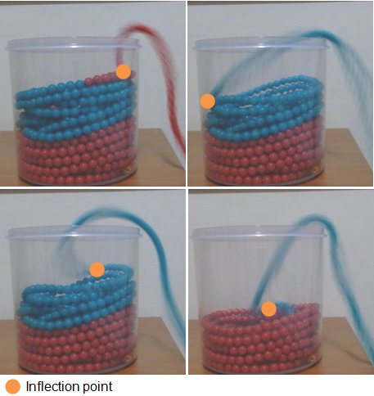
Experiment 3: detachment analysis
Acceleration
Initial energy
Detachment shape
Detachment in time
Height of launch
Beaker dimensions
Distance between beads

Slide 20
Experiment 3: detachment analysis
Acceleration
Initial energy
Detachment shape
Detachment in time
Height of launch
Beaker dimensions
Distance between beads
Possible to see the relation between patterns

Slide 21
Experiment 4: evolution of the detachment with time
Acceleration
Initial energy
Detachment shape
Detachment in time
Height of launch
Beaker dimensions
Distance between beads

Slide 22
Experiment 4: evolution of the detachment with time
Acceleration
Initial energy
Detachment shape
Detachment in time
Height of launch
Beaker dimensions
Distance between beads
Tends to increase
Oscillates with time due to energy dissipation by collision.

Slide 23
Experiment 5: height of launch variation
Acceleration
Initial energy
Detachment shape
Detachment in time
Height of launch
Beaker dimensions
Distance between beads
Optimum point
Dissipation starts to overcome the transference into potential energy.

Slide 24
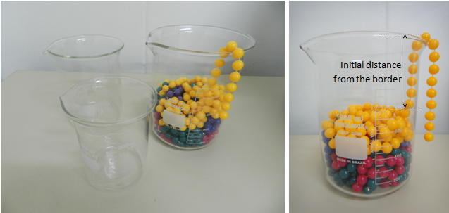
Experiment 6: beaker dimensions variation
Acceleration
Initial energy
Detachment shape
Detachment in time
Height of launch
Beaker dimensions
Distance between beads
It is varied.

Slide 25
Experiment 6: beaker dimensions variation
Acceleration
Initial energy
Detachment shape
Detachment in time
Height of launch
Beaker dimensions
Distance between beads

Slide 26
Experiment 6: beaker dimensions variation
Acceleration
Initial energy
Detachment shape
Detachment in time
Height of launch
Beaker dimensions
Distance between beads
Larger initial distance from the border
Larger distance for the detachment to overcome
Lower detachment height

Slide 27
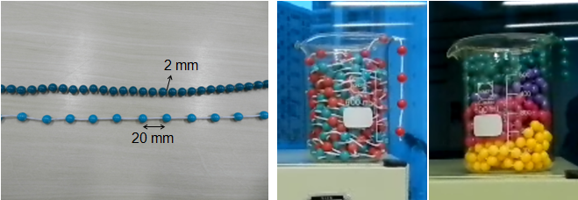
Experiment 7: distance between beads
Acceleration
Initial energy
Detachment shape
Detachment in time
Height of launch
Beaker dimensions
Distance between beads

Slide 28
Experiment 7: distance between beads
Acceleration
Initial energy
Detachment shape
Detachment in time
Height of launch
Beaker dimensions
Distance between beads

Slide 29
Experiment 7: distance between beads
Acceleration
Initial energy
Detachment shape
Detachment in time
Height of launch
Beaker dimensions
Distance between beads
Larger distance between beads
Lower tension
Lower detachment height

Slide 30
Conclusion
Initial energy: related to the position of the center of mass (exp. 3).
Acceleration increases until g is reached in three phases (exp. 2).
Detachment:
Impulse of the tension pulls the string upwards;
Different shapes due to chain’s arrangement (exp. 4);
Energy conversion (exp. 5);
Initial height (exp. 5);
Beaker’s dimensions (exp. 6);
Distance between beads (exp. 7).

Slide 31
References
1. GREWAL, Anoop; JOHNSON, Phillip; RUINA, Andy. A chain that accelerates rather than slows due to collisions: how compression can cause tension. Cornell University. 13 mar. 2011.
2. http://mathworld.wolfram.com/Catenary.html
3. WANG, Chun Wa; YASUI, Kosuke. Falling chains. University of California. 20 Feb 2006

Slide 33
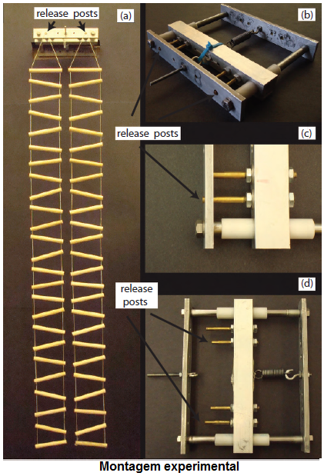
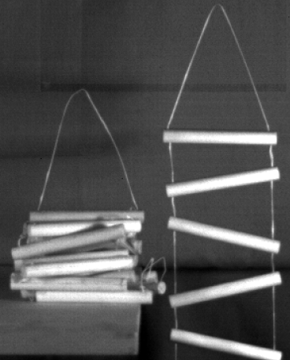
Summary of the experiment in reference 1

Slide 34
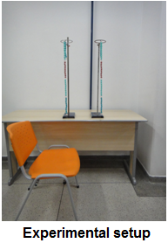
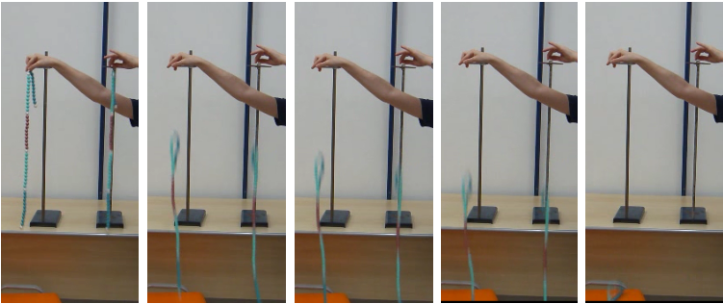
Experiment: collision analysis
Collision
Beads continue synchronized
Acceleration equal to g

Slide 35
Experiment: detachment shape (upper part)
Average percentage error = 9.4%

Slide 36
Experiment: detachment shape (upper part)
Average percentage error = 12.7%

Slide 37
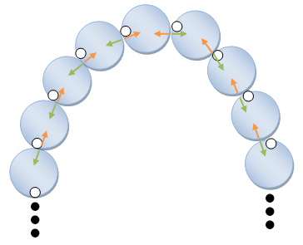
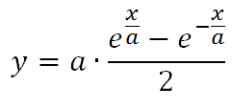
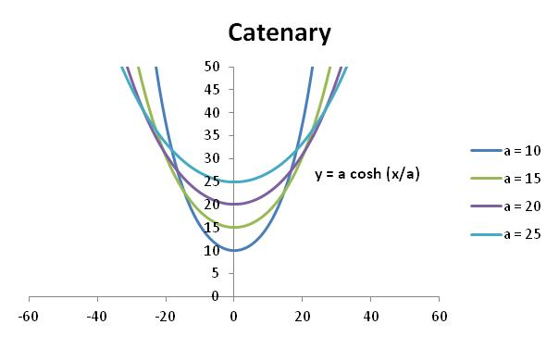
Explanation: detachment shape (upper part)
Uniform force distribution
Catenary

Slide 38
Detachment without collision
The chain is released from 12 m of height.
There’s no collision with the floor, but the detachment occurs.
Slow motion video:

Slide 39
Experiment 2: initial energy calculation
Theoretical value
Experimental value
The chain is pulled from rest bead by bead.
h = half the minimum length pulled for motion beginning.
Value gotten applying last formula.
Acquired data: next slide
Chain mass (M): 270 g
Chain length (L): 2.7 m
Beaker height (h): 14 cm

Slide 40
Experiment 2: initial energy calculation
 | Half the minimum length
 | 0.15
 | 0.14
 | 0.13
 | 0.14
 | 0.14
 | 0.14
 | 0.15
Average | 0.14
Theoretical | 0.14
Standard Deviation | 0.007
Half the minimum length measured

