Slide 1
7. Drawing Pins
Howell Fu
New Zealand
2012

Slide 2
The Problem
A drawing pin (thumbtack) floating on the surface of water near another floating object is subject to an attractive force. Investigate and explain the phenomenon. Is it possible to achieve a repulsive force by a similar mechanism?

Slide 3
Presentation Structure
Definitions/interpretations
Observations and conditions
Theory
Further experimentation
Conclusion

Slide 4
Definitions
Drawing pin density > water
Flotation due to surface tension and buoyancy
Surface tension is a property of the surface of a liquid that allows it to resist an external force. In water, it is caused by Hydrogen Bonding of water molecules

Slide 5
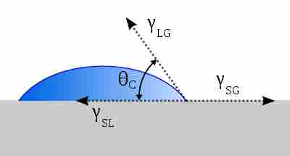
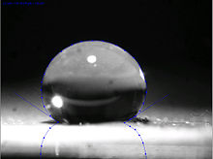
Definitions
Contact angle
Wetting & non-wetting
Hydrophilic & hydrophobic

Slide 6
Attraction

Slide 7
Attraction

Slide 8
Attraction

Slide 9
Attraction

Slide 10
Attraction

Slide 11
Repulsion

Slide 12
Repulsion

Slide 13
Repulsion

Slide 14
Phenomenon Summary
Like curves attract; unlike curves repel
Confirmed with 2 ping pong balls: they attracted

Slide 15
Detergent
Notes:
1:40 by vol

Slide 16
Water Control

Slide 17
Equilibrium

Slide 18
Equilibrium

Slide 19
Theory - Wells
Interaction of deformations

Slide 20
Theory - Wells

Slide 21
Theory - Wells
Measurements: calibrated measuring tape in Tracker
No attraction or repulsion beyond a certain distance: ~13.1 mm
Well radius of ~12.5 mm

Slide 22
Theory - Wells
cceleration/ m s^-2
Collision
Ime / s

Slide 23
Theory

Slide 24
Theory – Surface Tension
Top view
$$σ=\frac{F}{l}$$ $σ$=surface tension l=length=2πr F=force

Slide 25
Theory – Surface Tension

Slide 26
Theory – Surface Tension
Top view

Slide 27
Theory – Net Forces

Slide 28
Theory – Net Forces
$$F_{Tens 1}=F_{Tens 2}$$
$$F_{x1}>F_{x2}$$
Net force

Slide 29
Theory – Net Forces

Slide 30
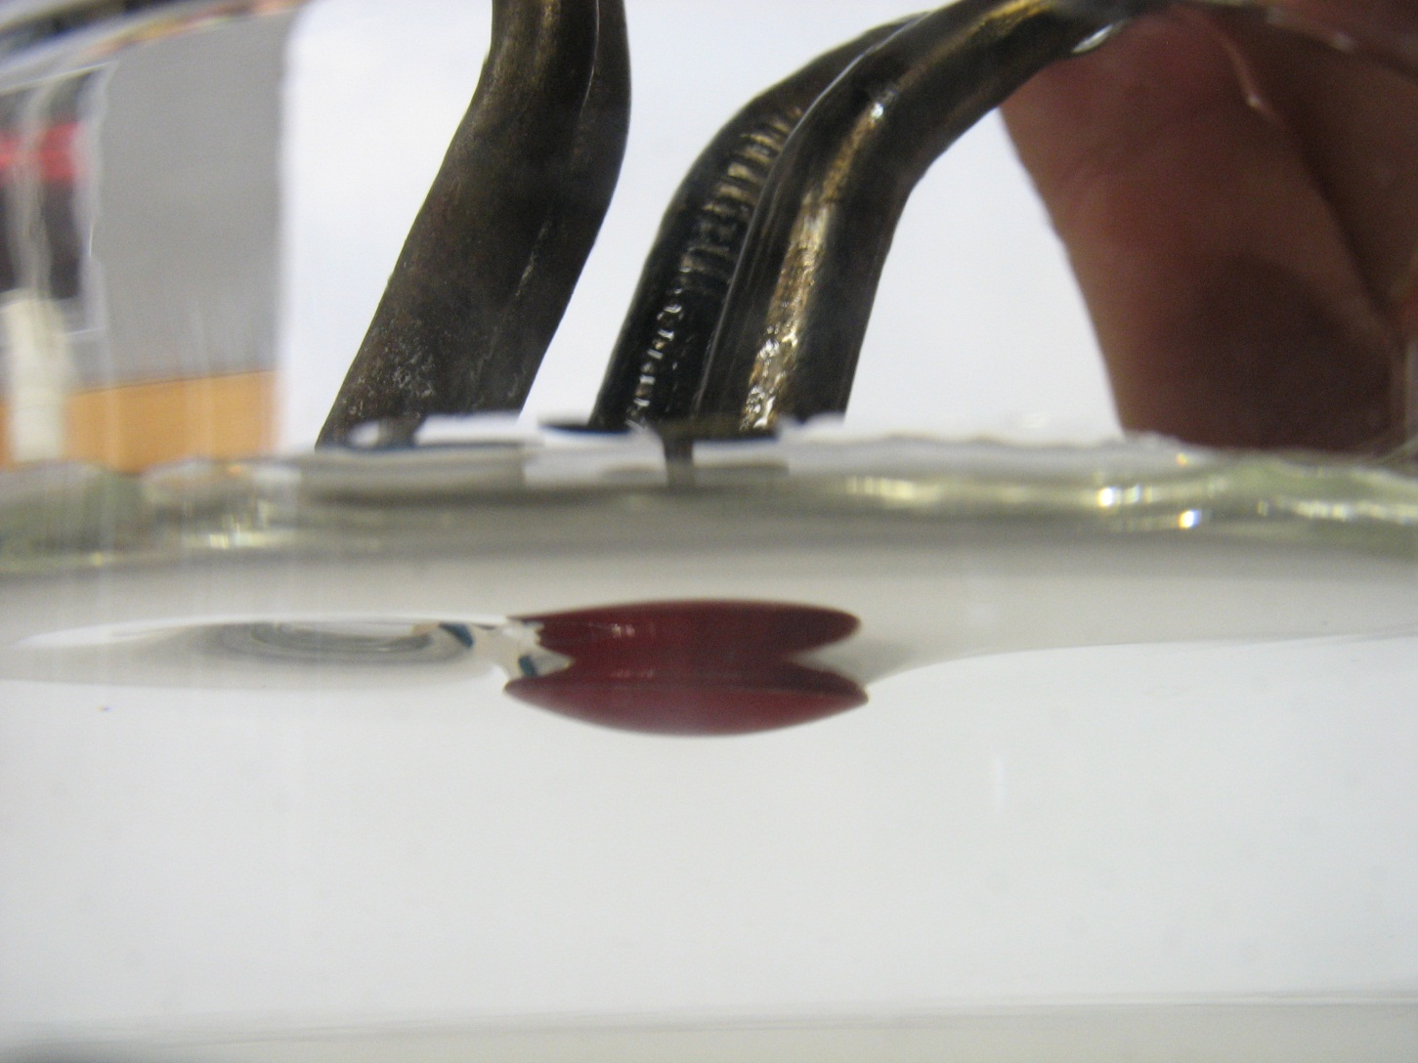
Theory – Net Forces

Slide 31
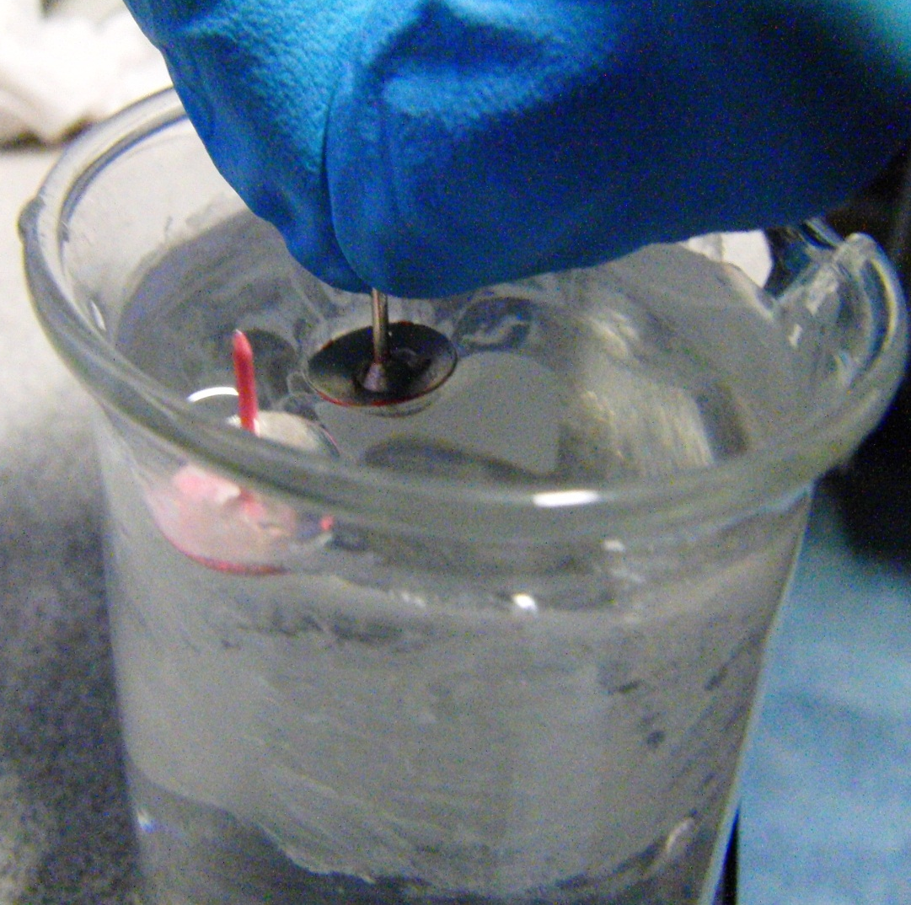
Changing the Phenomenon

Slide 32
Changing the Phenomenon

Slide 33
Changing the Phenomenon
Ppt Stuff\PPT Trimmed Vids\Slit Edge.wmv

Slide 34
Changing the Phenomenon
Notes:
Ping pong ball attract then repel

Slide 35
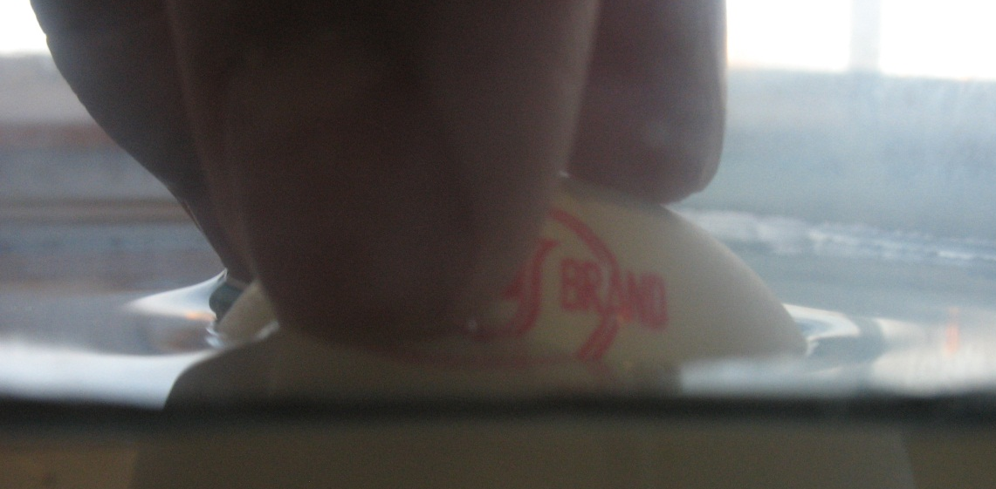
Changing the Phenomenon

Slide 36
Changing the Phenomenon
A finger, a candle, folded tinfoil – they all work
Hysteresis

Slide 37
The Problem
A drawing pin (thumbtack) floating on the surface of water near another floating object is subject to an attractive force. Investigate and explain the phenomenon. Is it possible to achieve a repulsive force by a similar mechanism?

Slide 38
Conclusion
All objects deform the surface of the water
Like curves attract; opposite curves repel
Lifting and depressing the 2nd object can change the effect from attraction to repulsion
Material and buoyancy matter only so far as they dictate the nature of the curve – any object will produce one or the other effect
When the 2nd object has a very small deformation, there exists an optimum distance at which the floating pin is most stable
The accelerating forces are caused by surface tension

Slide 39
Thank you for listening

Slide 40
References
An Introduction to Fluid Dynamics. By G.K. Batchelor. Cambridge University Press, 1967
Introduction to Interfaces and Colloids. By J.C. Berg. World Scientific Publishing Co., 2010
College Physics. By R.A. Serway, J.S. Faughan, C. Vaille. Cengage Learning, 2012.
http://www.oup.com/uk/orc/bin/9780199571185/9780199571185_ch02.pdf
http://www.cns.gatech.edu/~predrag/courses/PHYS-4421-10/Lautrup/surface.pdf
Professor T.R. Akylas http://web.mit.edu/1.63/www/Lec-notes/Surfacetension/Lecture3.pdf

Slide 41
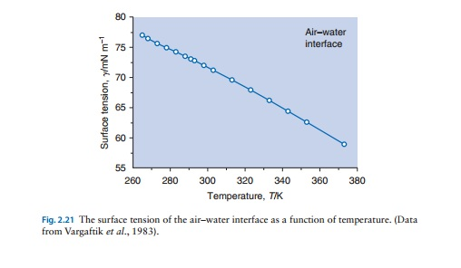
Temperature
Temperature dependence: goes down from 72mN/m to 68mN/m from 25C to 50C

Slide 42
Balance of Forces
Buoyancy force = Vρg
=${(0.01048÷2)}^{2}π×0.0027×1000×9.81=0.00187N=2.28×{10}^{−3}N$
Weight force = mg
=0.45$×{10}^{−3}×9.81=4.41×{10}^{−3}N$
S.T. Component = 4.$41−2.28=2.13 mN$

Slide 43
Balance of Forces
Buoyancy force = Vρg
=${(0.0105÷2)}^{2}π×0.0022×1000×9.81=0.00187N=1.87×{10}^{−3}N$
=6.542x${10}^{−7}×1000×9.81=6.42×{10}^{−3}N$
Weight force = mg
=0.46$×{10}^{−3}×9.81=4.51×{10}^{−3}N$
S.T. Component = 4.$51−1.87=2.64mN$

Slide 44
Force Calculations
$F=σl$
Fx=0.434 mN
F=72.8$×{10}^{−3}×π×0.0105=2.40×{10}^{−3}$N
F=ma
F=0.46$×{10}^{−3}×0.40=0.18×{10}^{−3}$N
0.18$÷0.434=0.42=42\%$

Slide 45
Verification
Calculated surface tension force, $F=σl$
Calculated max. accelerating force F=ma
ma < 10%($σl$)

Slide 46
Verification
$$F_{Tens 1}=F_{Tens 2}$$
$$F_{x1}>F_{x2}$$
Net force

Slide 48
Verification
Took measurements of the gradient of the curve by laser reflection
Made 3D model of the well
well_interaction3D Latest.cdf

Slide 49
Different Shapes

Slide 50
Acceleration Figures
Trial | Acceleration of Pin A /$m{ s}^{−2}$ | Acceleration of Pin B /$m s^{−2}$
1 | 0.13 | 0.31
2 | 0.22 | 0.20
3 | 0.36 | 0.40
4 | 0.29 | 0.32
Maximum velocity 0.03 m s⁻¹

Slide 51
Equilibrium

Slide 52
Equilibrium

Slide 53
Equilibrium

Slide 54
Theory 1

Slide 55
Theory 1

Slide 56
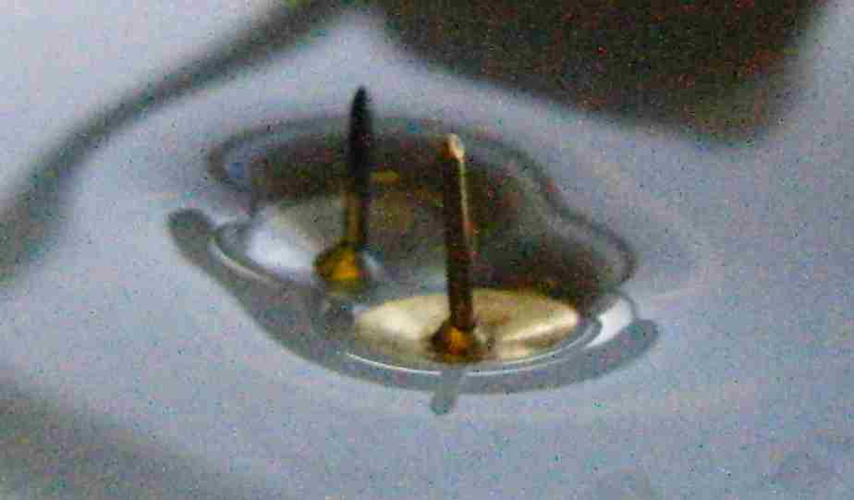
Theory 1

Slide 57
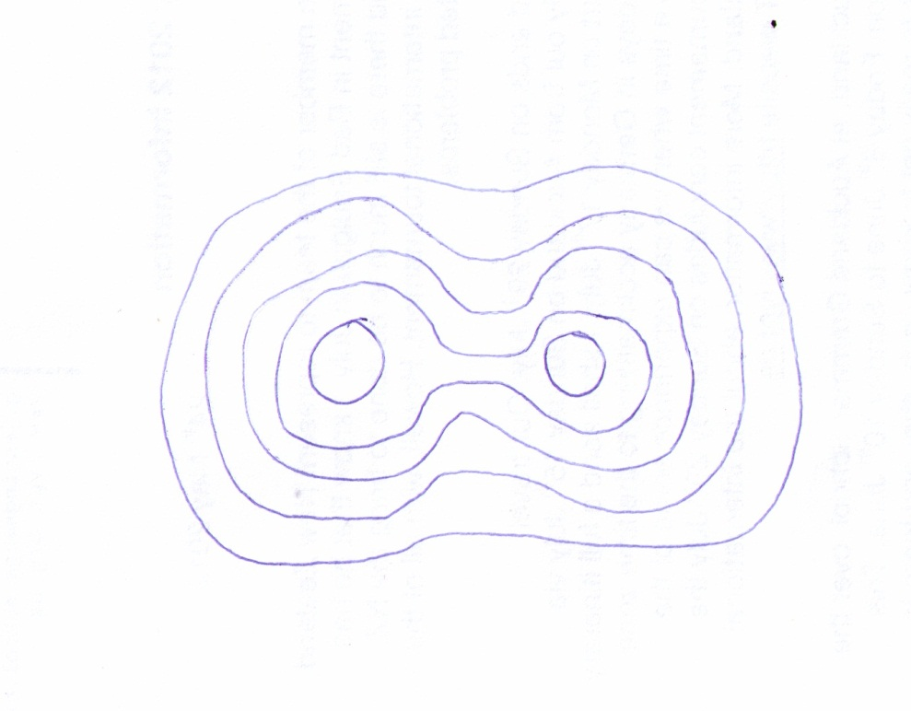
Theory 1

Slide 58
Theory 2

Slide 59
Theory 2

Slide 60
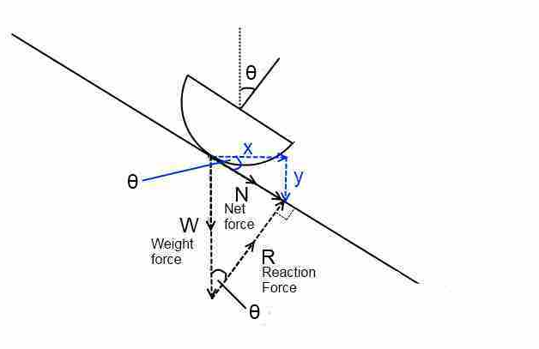
Theory 2
Find $F_{x}$
$$\frac{F_{N}}{W}=\sin{θ}$$
$$\frac{F_{x}}{F_{N}}=\cos{θ}$$
$$F_{x}=F_{N}\cos{θ} \\ F_{x}=W\sin{θ}\cos{θ} \\ ∵2\sin{A}\cos{A}≡\sin{2A} \\ ∴F_{x}=\frac{1}{2}W\sin{2θ}$$

Slide 61
Theory 2
$$F_{x}=\frac{1}{2}W\sin{2θ}$$
$$ma=\frac{1}{2}W\sin{2θ}$$
m=0.32g
Tracker: max. acceleration =0.54 ${m s}^{−1}$
$$θ=3.16°$$

Slide 62
Theory 2
60 fps continuous shooting
Enabled me to take HD photos – essential for magnification and angle measurement

Slide 63
Theory 2
3.06
1.75
4.88
2.13
2.40
0.74
1.51
1.88

Slide 64
Theory 2
Repulsion
Similar method of continuous shooting

Slide 65
Theory 2

Slide 66
Theory 2
Inconclusive: error quite significant: $±0.5°$
Did not have calculated values to match to each individual measured angle

Slide 67
Theory 3 - Energy
Surface tension is also defined as $γ=\frac{E}{A}$ $units of\frac{J}{m^{2}}$
Energy per surface area
To minimise area, liquids tend to form spherical droplets (when free of other influences)
Applies to small scales – $γ$ is more significant than hydrostatic pressure differences

Slide 68
Theory 3 - Energy
When wells interact, surface area is best minimised by merging and forming a lower level, instead of maintaining 2 separate wells
The minimum area is when the 2 pins are touching, so this is what tends to happen – hence attraction

Slide 69
Theory 3 - Energy
Flaws – difficulty explaining the repulsion and equilibrium effects

Slide 70
Hydrophobic Substances
Waxed pins – had no effect

Slide 71
Different Shapes
Ppt Stuff\PPT Trimmed Vids\Squares.wmv

Slide 72
Different Shapes
Like curves attract, opposite curves repel
Confirmed with ping pong balls, which both have upward-curving menisci. They attracted.

