Slide 1
Bubbles
8
Kamila Součková

Slide 2
Task
Is it possible to float on water when there are a large number of bubbles present? Study how the buoyancy of an object depends on the presence of bubbles.

Slide 3
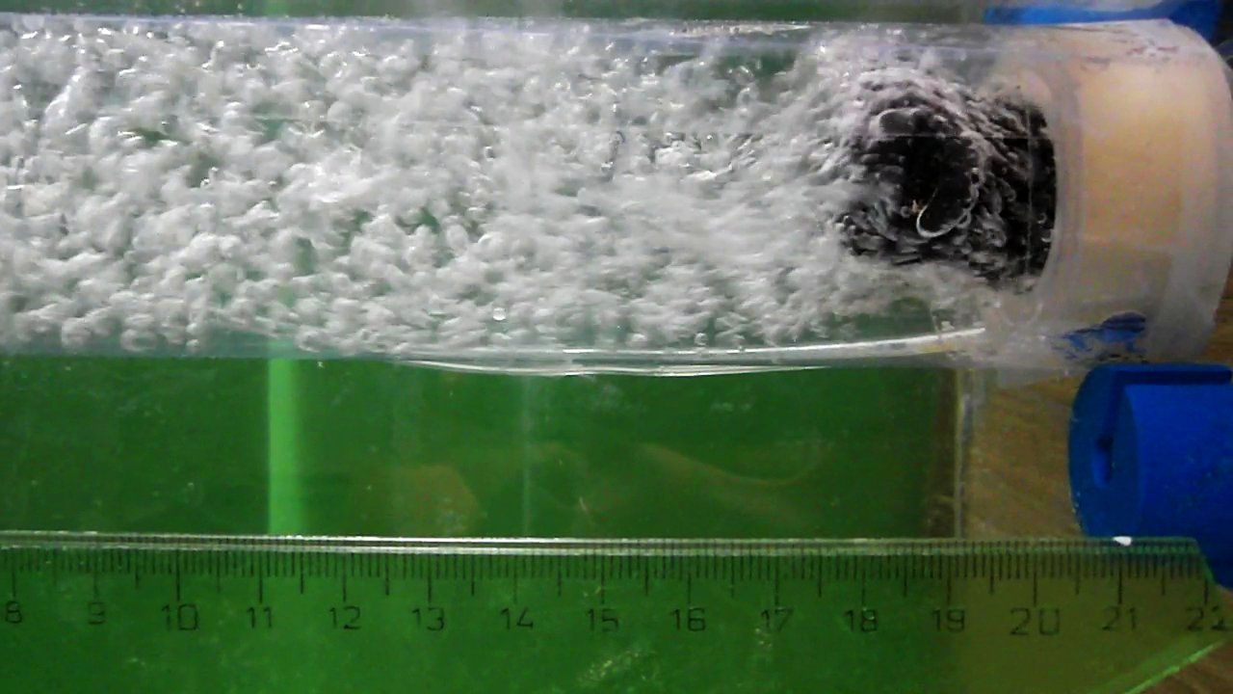
Parameters of the System
Bubbles
Size
Amount
Object
Shape
Size
Tank
Radius
Size of bubble source

Slide 4
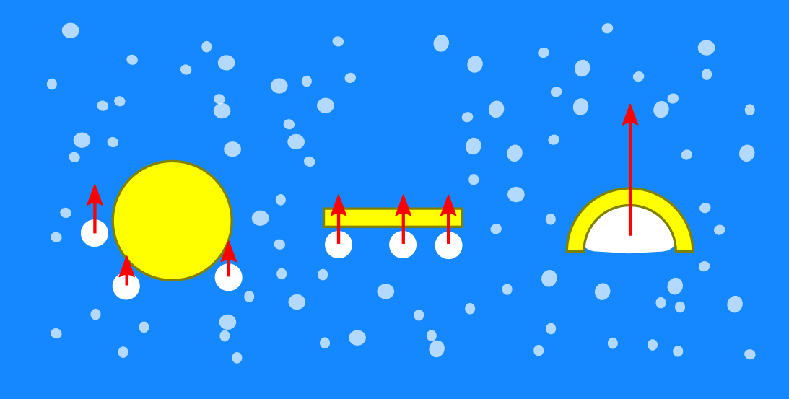
Object Shape
affects how bubbles interact with the object

Slide 5
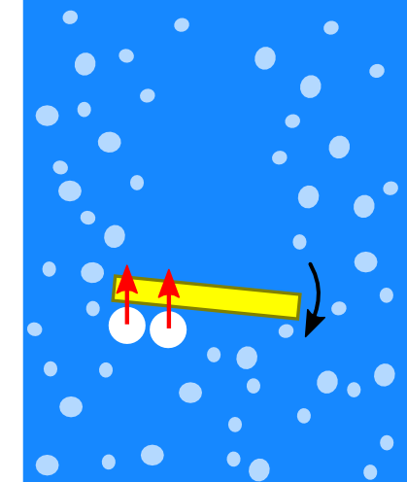
Object Shape
affects how bubbles interact with the object

Slide 6
Object Shape
our experiments:
spheres
symmetrical
no cavities
cylinders
symmetric along 1 axis
no cavities
easy to change properties (adding weights inside)
bigger surface/volume ratio

Slide 7
How Bubbles Influence Floating
decreased water density
attached bubbles
flow of water in the container

Slide 8
Decreased Water density
buoyant force made smaller: $F_{b}=ρgV$

Slide 9
Measuring Density 1: Flow Rate
(volumetric) ratio of water and air in the tank:
density of water with bubbles:
$$q=\frac{V_{air}}{V_{air}+V_{water}}$$
$$=\frac{Q}{πr^{2} v}$$
measure
$$ρ=ρ_{water}(1−q)$$
$Q$: volumetric flow rate of air
$v$: velocity of bubbles
$r$: tank radius
$ρ_{water}$: density of (pure) water
$ρ$: density of water with bubbles

Slide 10
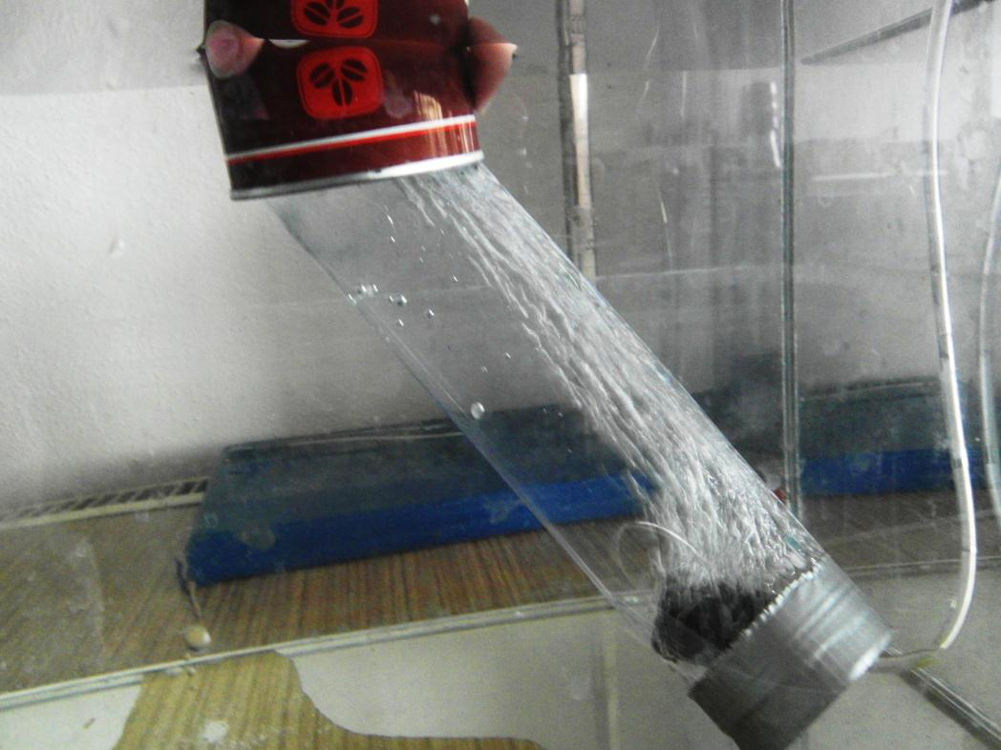
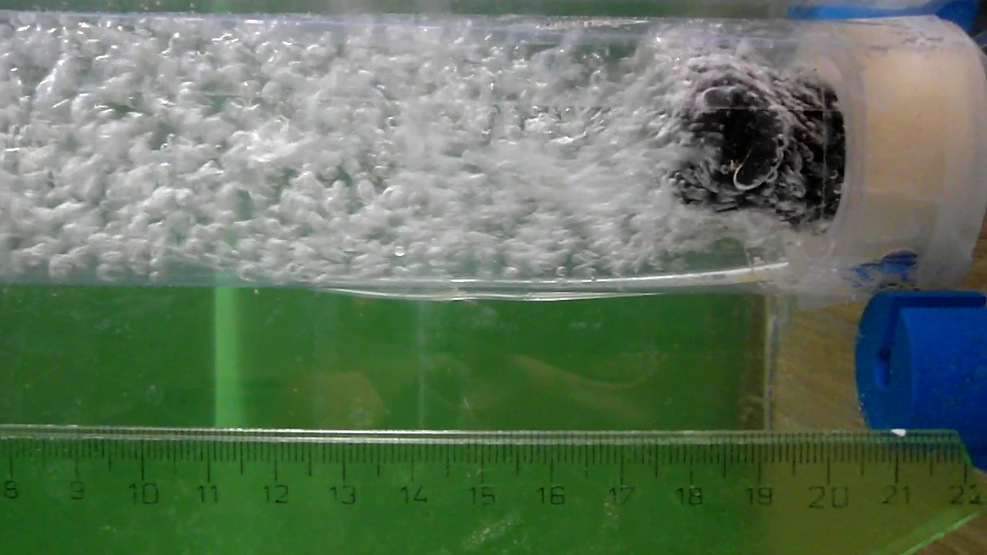
Measuring Density 1: Flow Rate
measured volume of raised gas in time
speed of bubbles: from high-speed video

Slide 11
Measuring Density 1: Flow Rate

Slide 12
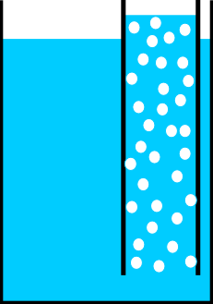
Measuring Density 2: Hydrostatic Pressure
2 tanks connected at the bottom (same pressure), one with bubbles, the other without
$$p_{1}=p_{2}$$
$$ρgh_{1}=ρ_{w}gh_{2}$$
$$ρ=ρ_{w}\frac{h_{2}}{h_{1}}$$
$$h_{1}$$
$$h_{2}$$
$p_{1}/ p_{2}$: hydrostatic pressure
$h_{1}/ h_{2}$: height of water surface
$ρ$: density of water with bubbles
$ρ_{w}$: density of (pure) water

Slide 13
Measuring Density 2: Hydrostatic Pressure

Slide 14
Measuring Density: Comparison

Slide 15
Influence of Density Decrease
$$F_{b}=ρg V$$
$$V=1.0 l$$
$$g=9.81 m⋅s^{−2}$$

Slide 16
Influence of Density Decrease

Slide 17
Critical Object Density

Slide 18
Attached Bubbles
$$F_{b}=ρg\left(V+V_{bubbles}\right)$$

Slide 19
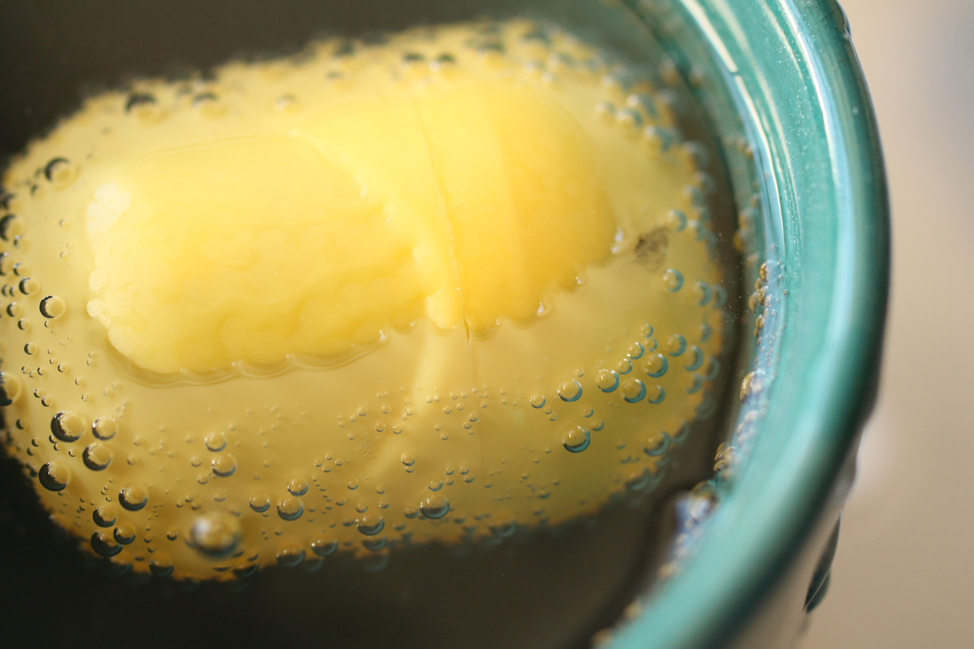
Influence of Attached Bubbles
object surface partly covered by bubbles
lower average density of object

Slide 20
Influence of Attached Bubbles
$$F=F_{b}−F_{g}$$
upper bound: max possible packing of spheres sized like a typical bubble
measurement: cylindrical object
$$F_{b}=ρg\left(V_{o}+V_{air}\right), F_{g}=g(m_{o}+ρ_{air}V_{air})$$
$$V_{air}= {c_{p}⋅A}_{o}d$$
$$V_{o}=πr^{2}h, A_{o}=2πr\left(r+h\right)$$
typical bubble diameter d = 0,5 mm

Slide 21
Influence of Attached Bubbles
effectively: $\sim \frac{3}{5}$ of max
Notes:
TODO obrazky

Slide 22
Flow in the Container

Slide 23
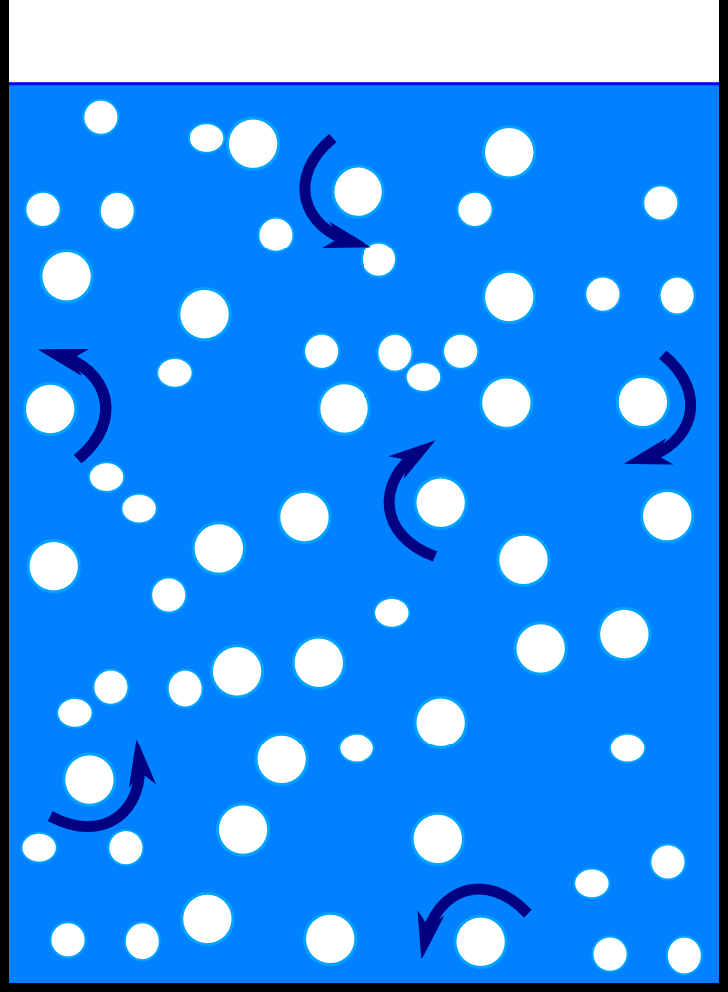
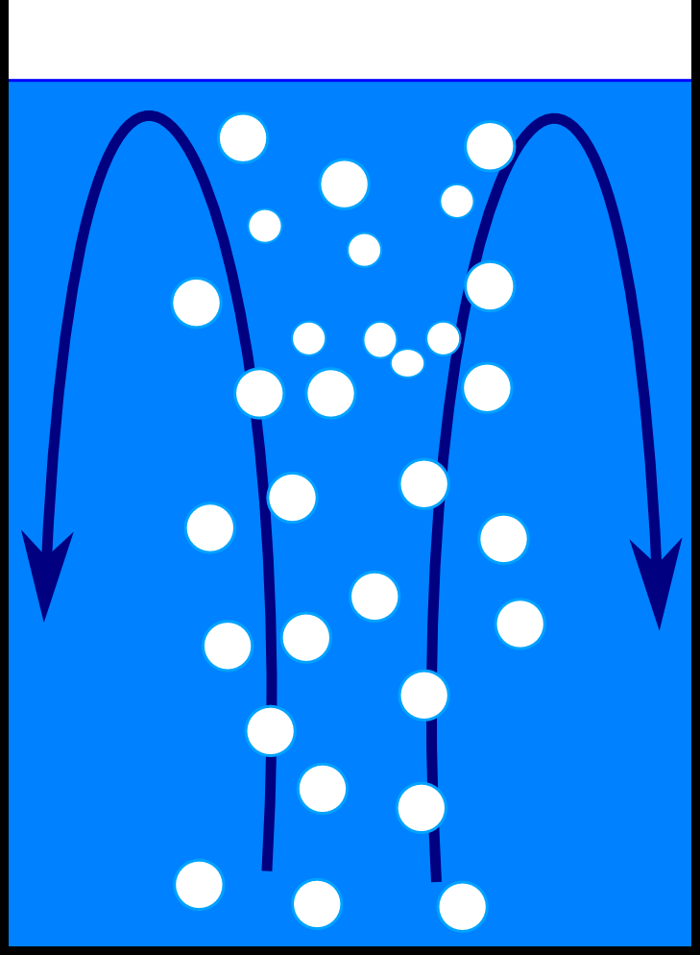
Flow “Modes”
Disordered (random) water flow
Bubbles distributed uniformly in the whole tank
no preferred direction of flow
Ordered water flow
Tank radius bigger than source of bubbles
convection pattern

Slide 24
Disordered Water Flow
no preferred flow direction → only local influences
no overall change in floating

Slide 26
Ordered Water Flow
convection pattern:
↑ above bubble source ⇒
helps floating
↓ near the walls ⇒ pulls
downward

Slide 28
Up or Down?

Slide 29
Quantify Buoyancy Change
+
define: force difference $ΔF=F_{w}−F$
$F_{w}:$ total force in steady water
$F:$ total force in water with bubbles
–
$ΔF>0$: dominant effect: uplifting due to
convection flow + attached bubbles
$ΔF<0$: dominant effect: density decrease
and/or downward flow (if near walls)

Slide 30
Force Difference Measurements

Slide 31
Object: diameter = 1cm, mass = 14 g Bubble source diameter: 4cm

Slide 32
Object : diameter = 2cm, mass = 25 g Bubble source diameter: 4cm

Slide 33
Object: diameter = 3 cm, mass = 83 g Bubble source diameter: 4cm

Slide 34
Conclusion
decreased water density
attached bubbles
flow of water in the container
Notes:
identified how bubbles can influence the buoyancy of an object
quantified the first two
experimentally proved all three
compared buoyancy change for different objects

Slide 35
Conclusion
buoyancy change:
density decrease
upward flow,
attached bubbles

Slide 36
8. Bubbles
Kamila Součková

Slide 37
Appendix

