Slide 1
Flat Flow
11
by Kamila Součková

Slide 2
Task
Fill a thin gap between two large transparent horizontal parallel plates with a liquid and make a little hole in the center of one of the plates.
Investigate the flow in such a cell, if a different liquid is injected through the hole.

Slide 3
Notes:
TODO dat sem video; alebo aspon ostrejsiu fotku
tu bude live experiment

Slide 4
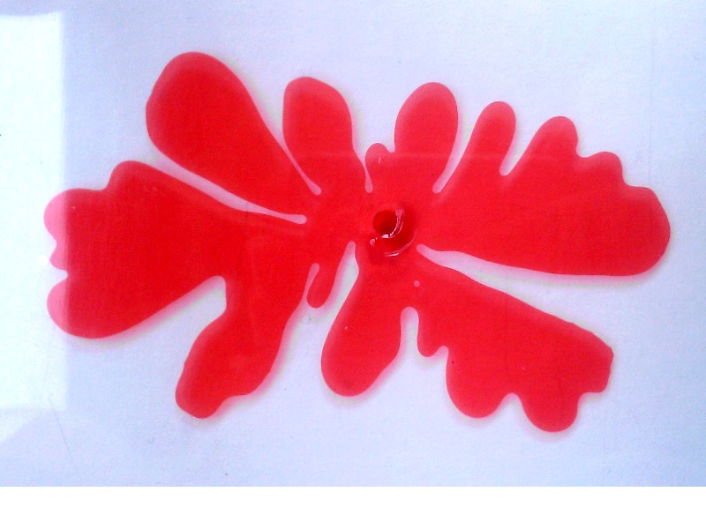

Slide 5
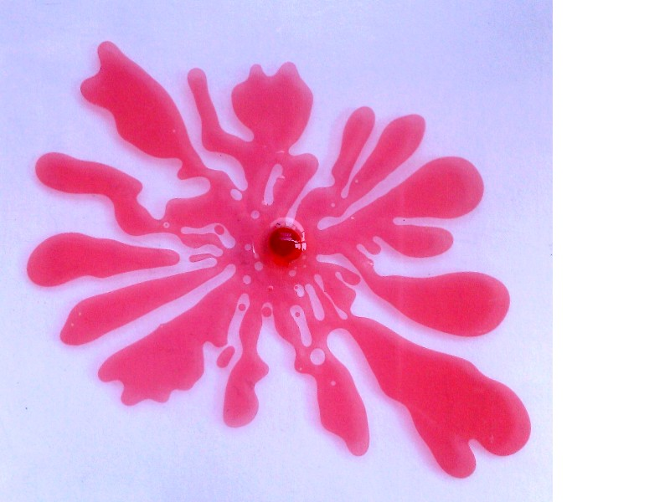

Slide 7
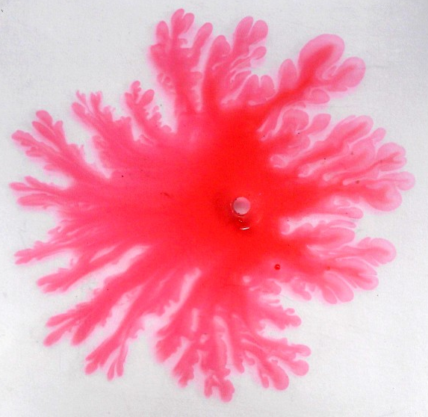

Slide 8
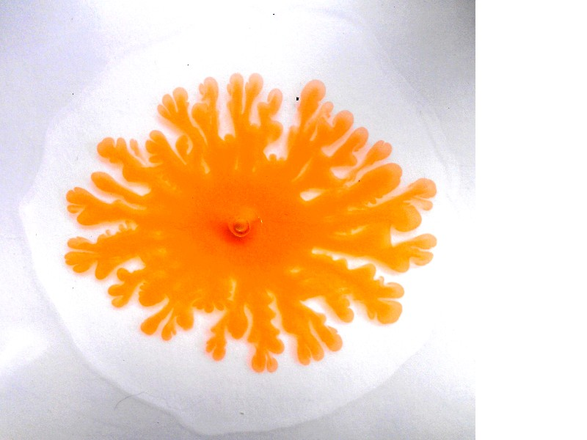

Slide 9
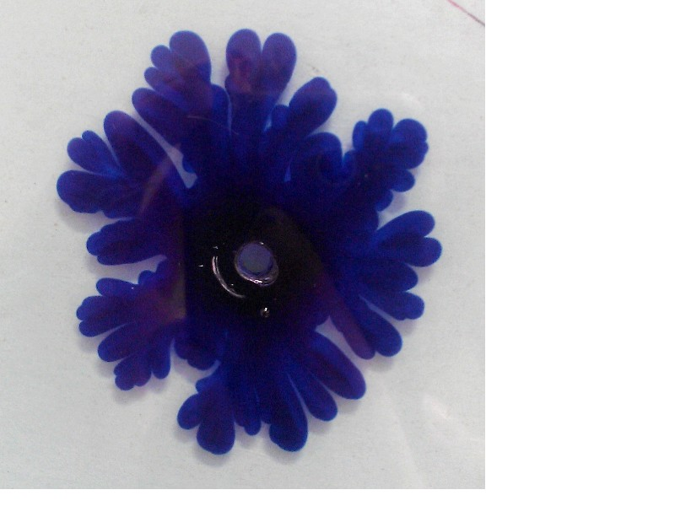

Slide 10
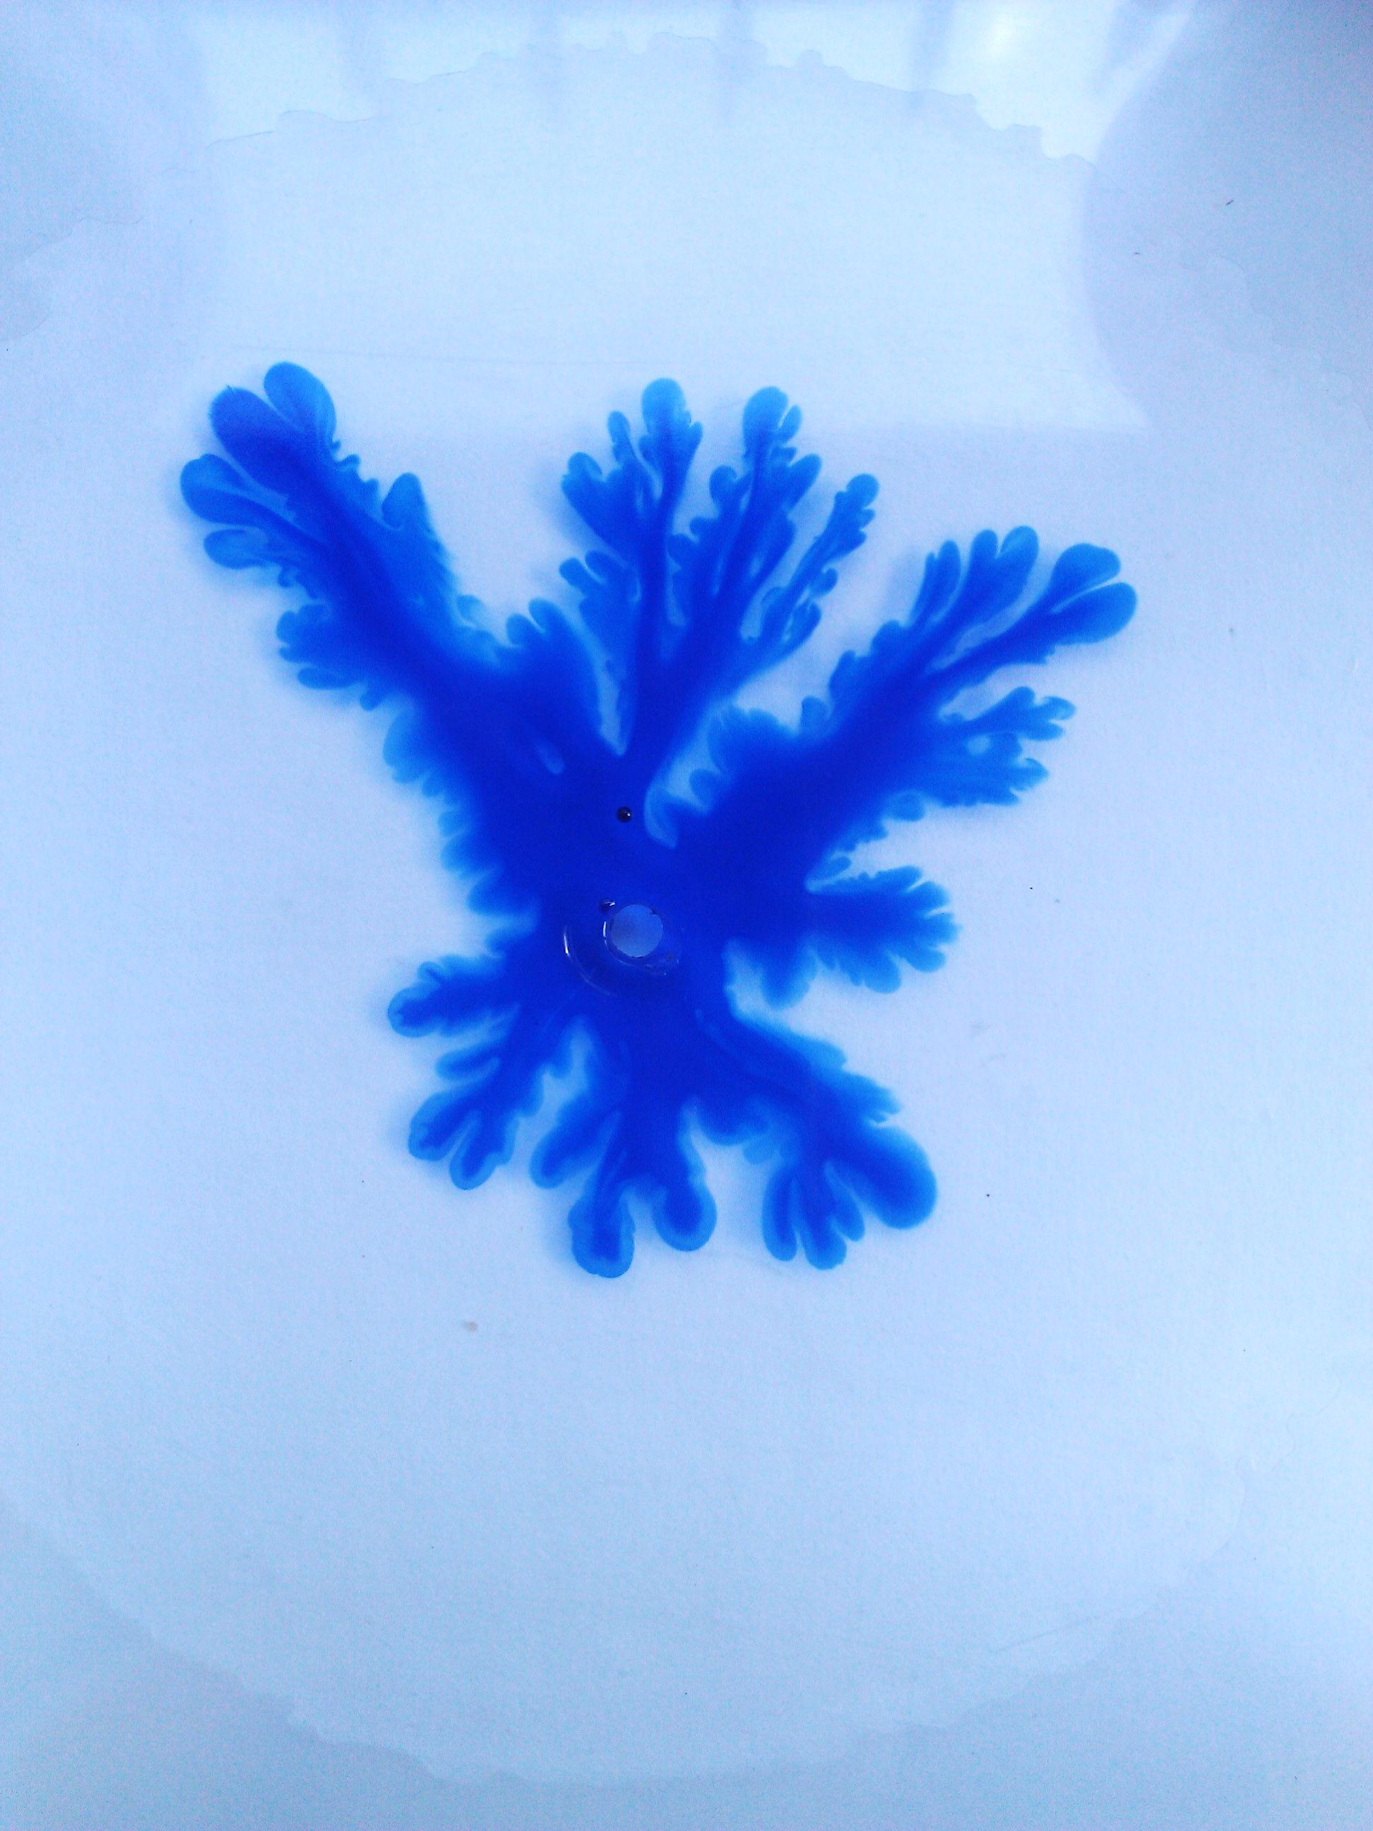

Slide 13
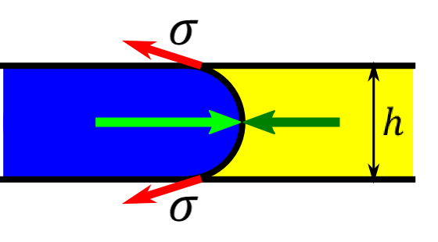
Interfacial Pressure
$$p_{1}$$
$$p_{2}$$
$$Δp_{i}=p_{1}−p_{2}=\frac{σ}{R}$$
interfacial pressure due to curved surface must be overcome
$$R≈\frac{h}{2}$$
$$σ≈{10}^{−1}, R≈{10}^{−4}⇒ Δp_{i}≈{10}^{3}$$
pressures we work with are $\sim {10}^{4} \text{to}{ 10}^{5}$ ⇒ negligible
Notes:
the velocity is going to be zero unless we overcome the interfacial pressure

Slide 14
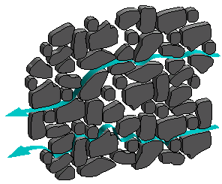
Understood Phenomena
flow through a porous medium
Darcy’s Law: $v=−\frac{k}{η} ∇p$
flow in a small gap
Hele-Shaw equation: $v=−\frac{h^{2}}{12η}∇p$
Figure from Hornberger et al. (1998)
k : permeability of medium
h : gap between plates
$η$ : viscosity of liquid
∇p : pressure gradient
Notes:
dependencies: the greater the viscosity, the lower the speed; the greater the pressure gradient, the greater the speed
intuitively correct

Slide 15
Position, Velocity
measure how fast the interface moves
at various places – take the average
weight on syringe removed
Notes:
TODO osi
TODO fit (3 serie :D)

Slide 16
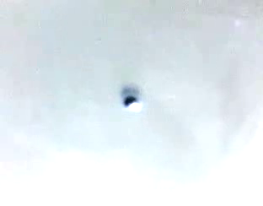
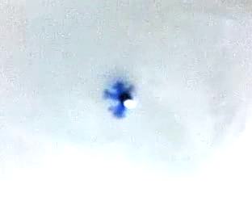
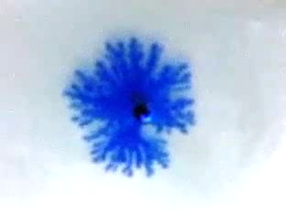
Formation of Instabilities

Slide 17
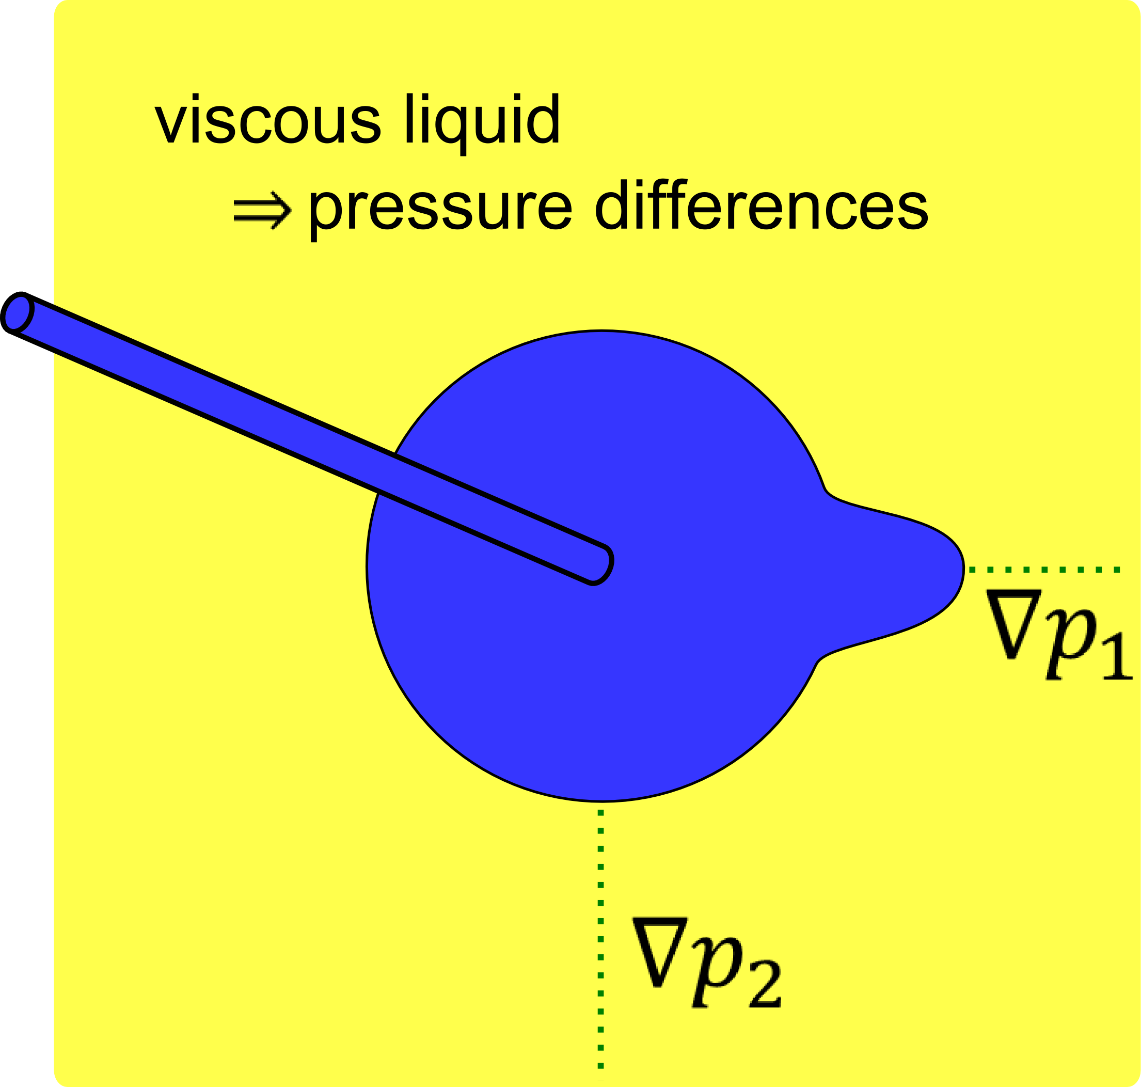
Formation of Instabilities
small instability
pressure differences
instability grows
“fingers”
Notes:
NIE tlaky

Slide 18
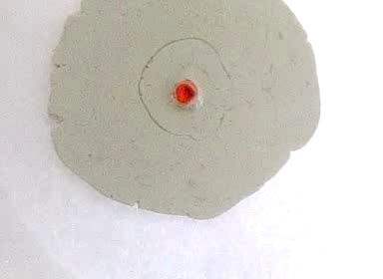
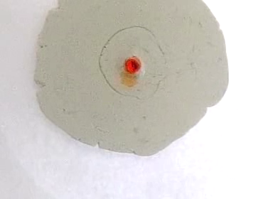
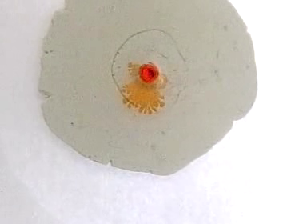
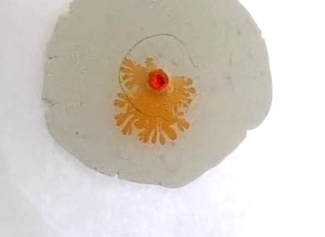
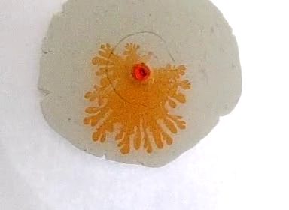
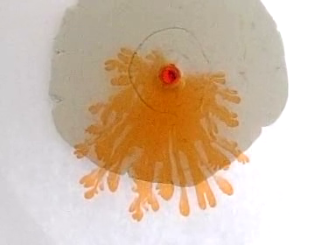
Slow-Motion Video of Patterns
300 fps

Slide 19
What Affects Instabilities?
destabilizing
high viscosity of liquid in the gap → pressure differences
stabilizing
surface tension
big pressure gradient
promotes disturbances
tries to dampen out disturbances

Slide 20
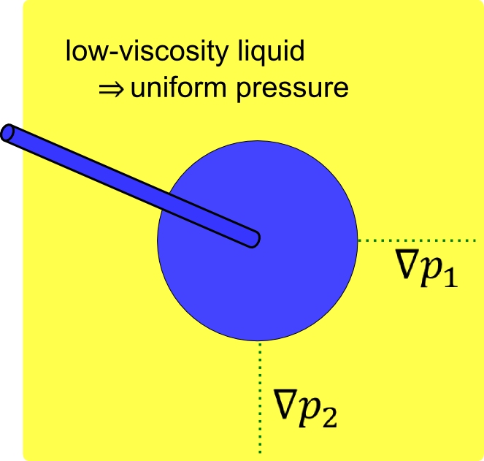
Low Viscosity → No Fingers
low viscosity
symmetrical situation
easier to spread out evenly
no “fingers”
Notes:
NIE tlaky

Slide 21
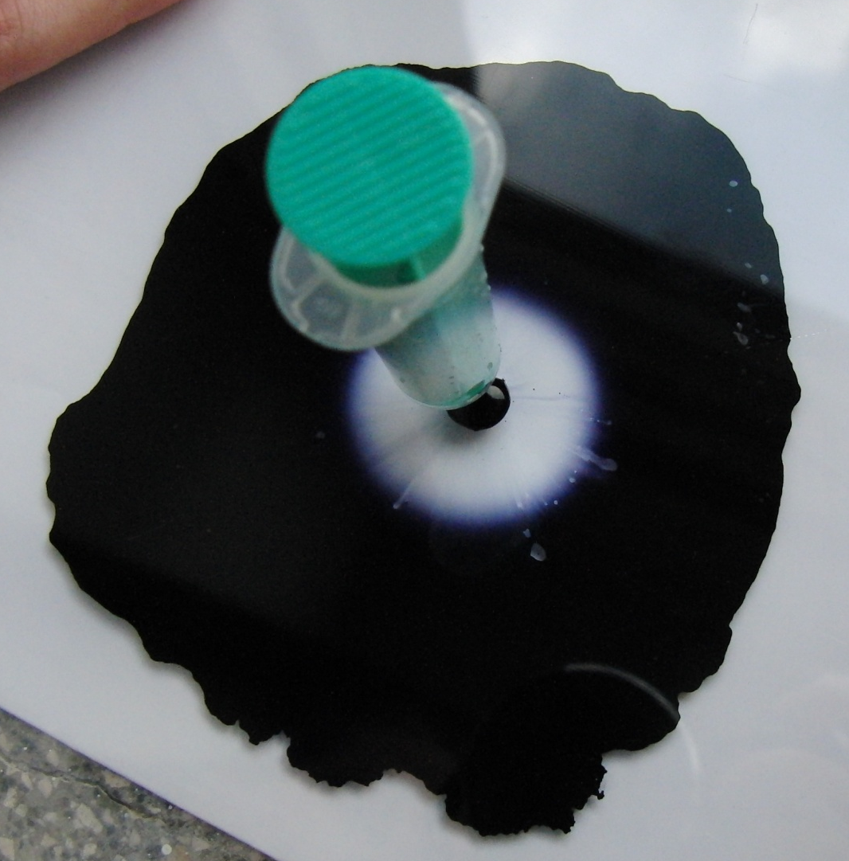
Low Viscosity → No Fingers
Ink
(less viscous)
Glycerol
(more viscous)

Slide 22
Pattern Complexity Measurements

Slide 23
Equipment
Liquid :
more viscous: glycerol, motor oil
less viscous: water (colored), ink, ethanol
Plates – plexiglass (Hele–Shaw cell):
25 x 25 cm
gap: distance set by weights
hole: size customized to the syringe

Slide 24
Equipment

Slide 25
Equipment

Slide 26
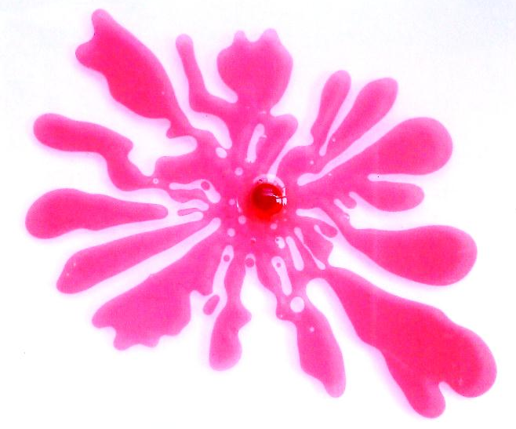
What to Measure
quantify the instabilities
count perturbances
tells how “interesting” the pattern is
to make more objective:
Notes:
TODO tak ako to zadefinovat?

Slide 27
Viscosity

Slide 28
Viscosity of Medium
water → motor oil 5W
water → motor oil 10W
Viscosity
<
$η$ = 0.14 Pa.s
$η$ = 0.17 Pa.s

Slide 29
Viscosity of Medium
water → motor oil 15W
water → glycerol
Viscosity
<
$η$ = 0.41 Pa.s
$η$ = 1.48 Pa.s

Slide 30
# of Fingers vs Viscosity of Medium

Slide 31
Viscosity of Injected Liquid
old ink (more viscous) → glycerol
new ink (less viscous) → glycerol
Viscosity
>
Notes:
we observed :D

Slide 32
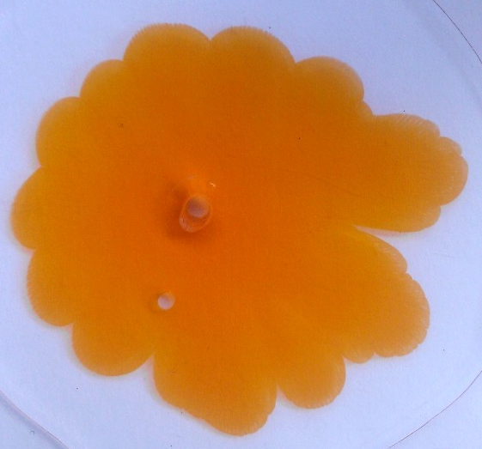
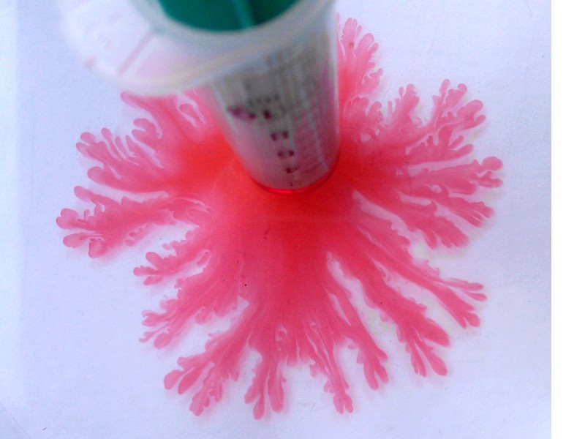
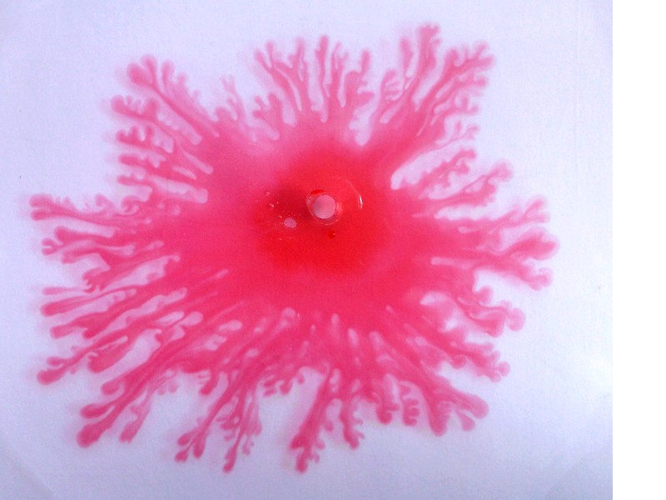
Distance of the plates

Slide 33
Gap Size
(Water → glycerol)
1mm
≈0.8 mm

Slide 34
≈0.4mm
≈0.2mm
≈0.1mm

Slide 35
# of Fingers vs Gap Size
Notes:
TODO dat ho na nulu

Slide 36
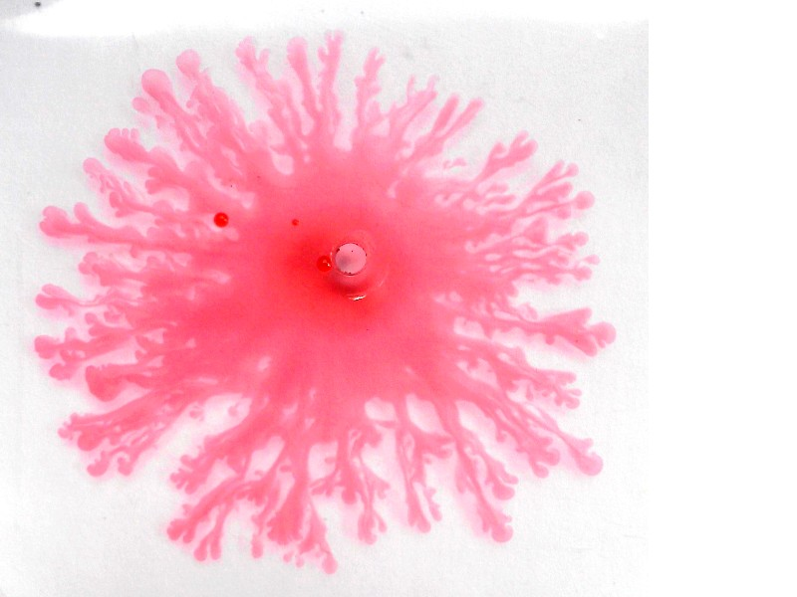
pressure in syringe

Slide 37
Pressure in Syringe
changed by putting weights on syringe
p = 15 kPa (300g)
p = 22 kPa (450g)
p = 49 kPa (1 kg)

Slide 38
# of Fingers vs Pressure

Slide 39
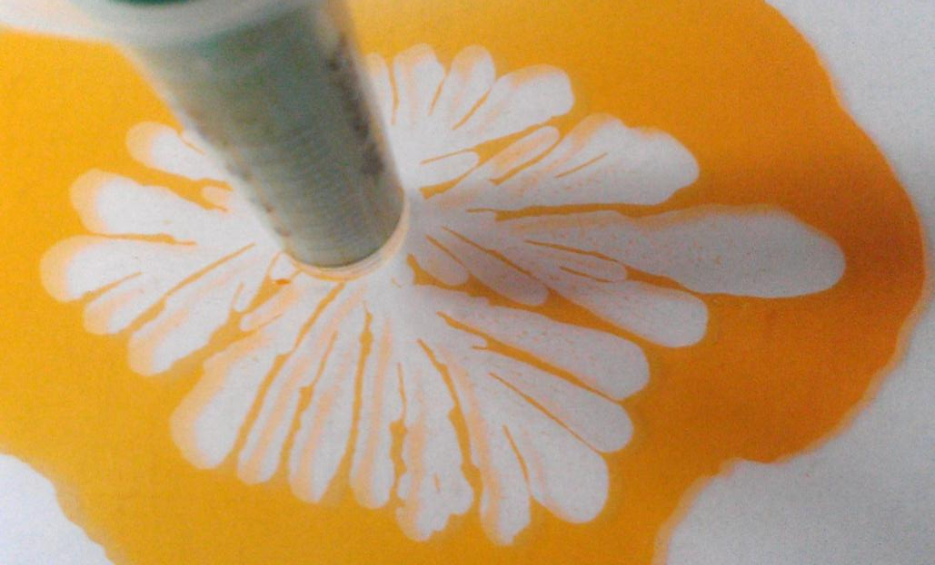
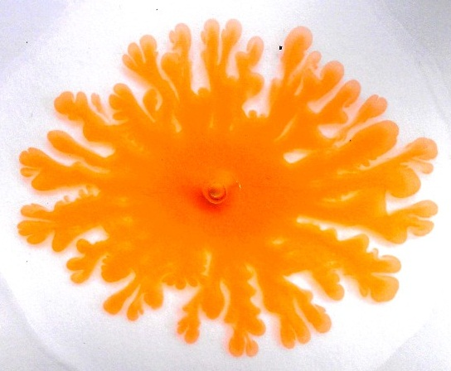
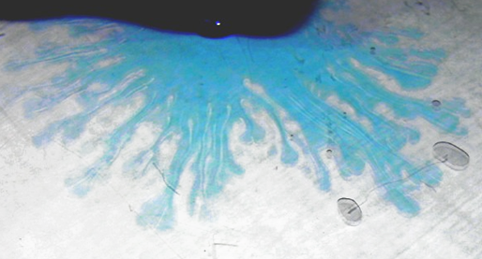
Interfacial Tension

Slide 40
Interfacial Tension
Ethanol:
→ glycerol
Water:
→ glycerol
$η$ = 0.009 Pa.s
$γ$ = 0.0225 N/m
$η$= 0.001 Pa.s
$γ$= 0.072 N/m

Slide 41
Air → water ( = 0.072 N/m)
Higher surface tension → more rounded
Air → water with detergent
(δ = 0.025 N/m)
Lower surface tension → greater instability

Slide 42
Further investigation

Slide 43
An analogous experiment
Jose A. Miranda, Michael Widom: Radial Fingering in a Hele-Shaw Cell: a weakly nonlinear analysis, Physica D 120(1998) 315-328
$$n=\sqrt{\frac{2}{π}\frac{QR(η_{2}−η_{1})}{h^{3}γ}}$$
Q = flow [m³/s]
R = initial radius [m]
$η_{1}=$ viscosity of injected liquid [Pa.s]
$η_{2}=$ viscosity of medium [Pa.s]
h = gap width [m]
$γ$ = interfacial surface tension [N.m]

Slide 44
Viscosity $η_{2}$
$$n=\sqrt{\frac{2}{π}\frac{QR(η_{2}−η_{1})}{h^{3}γ}}$$

Slide 45
Gap Size h
$$n=\sqrt{\frac{2}{π}\frac{QR(η_{2}−η_{1})}{h^{3}γ}}$$
Notes:
TODO dat ho na nulu

Slide 46
Pressure p
$$n=\sqrt{\frac{2}{π}\frac{QR(η_{2}−η_{1})}{h^{3}γ}}$$
$$Q∝p−p_{0}$$

Slide 47
Interfacial Tension $γ$
Ethanol → glycerol
Water → glycerol
$γ$ = 0,0225 N/m
$γ$= 0,072 N/m
$$n∝1/\sqrt{γ}$$

Slide 48
Conclusion
observed the phenomenon
showed when it does not work
explained the mechanism of emerging patterns
Notes:
fix obrazky nie tlaky

Slide 49
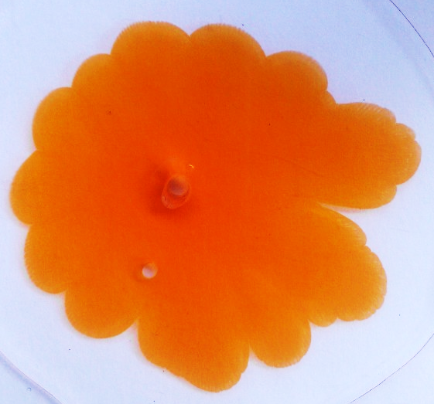
Conclusion
Proved assumed influences on the phenomenon:
viscosity
gap between the plates
pressure
surface tension
<
<
<
>

Slide 50
Thank you for your attention!
Proved assumed influences on the phenomenon:
viscosity
gap between the plates
pressure
surface tension
<
<
<
>

Slide 51
11. Flat Flow
Kamila Součková

Slide 52
Appendix

Slide 53
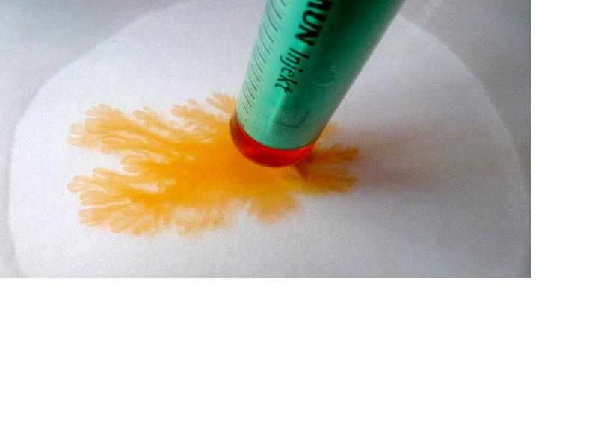
Changing temperature of glycerol
80°C → the same patterns

Slide 54
Data for experiments

Slide 55
Motor oil → glycerol (∆ ν = 1119,5 . 10⁻⁶ m²/s)

