Slide 1
Frustrating golf ball
15.
Matej Badin

Slide 2
Problem
It often happens that a golf ball escapes from the hole an instant after it has been putted into it. Explain this phenomenon and investigate the conditions under which it can be observed.

Slide 3
Content
Definitions
Analysis of the motion
Rolling, flight, collisions
Simulation
Experiment
Conclusion

Slide 4
Our definitions
Golf ball
USGA norm – diameter not less than 4.267 cm
Our ball – d=4.27 cm
Hole – cylinder
Diameter = 10.8 cm
Depth = 10.2cm

Slide 5
Putting green
Very short grass

Slide 6
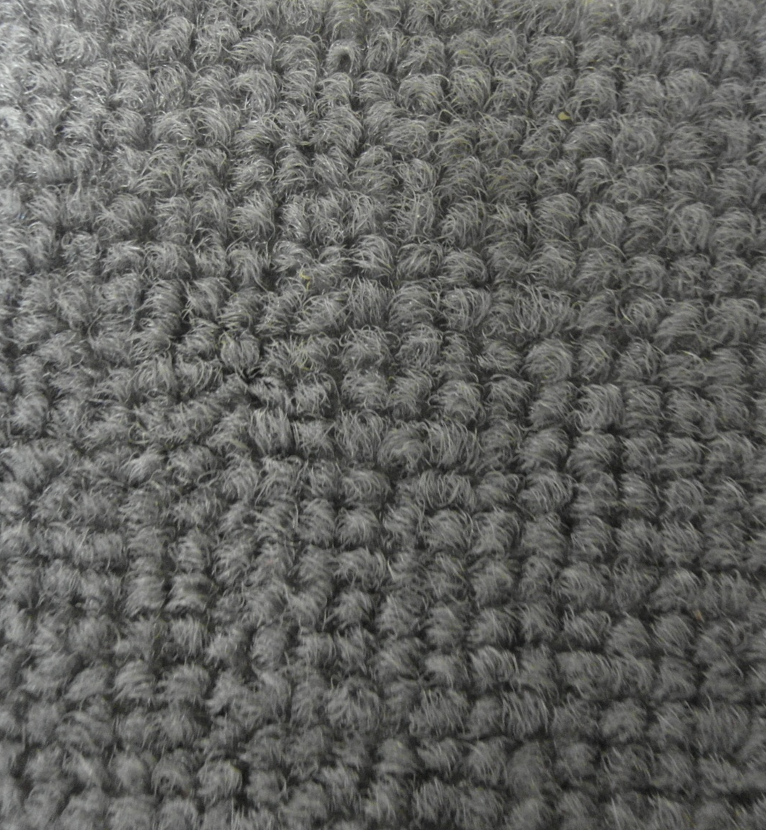
Structure of carpet
1 cm

Slide 7
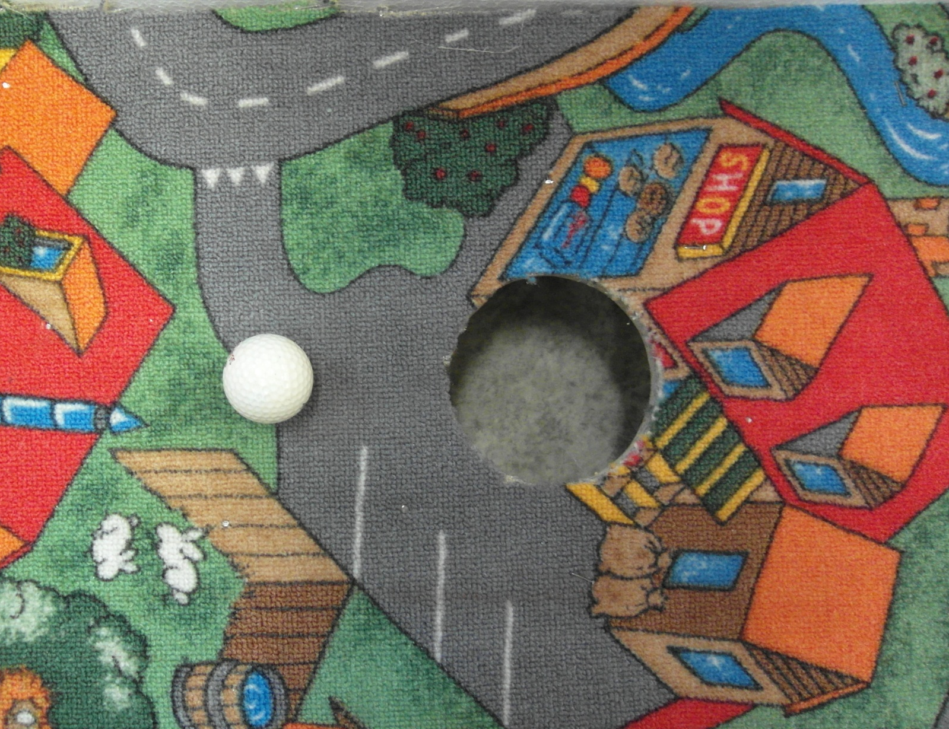
Our “green”
Golf hole
Nails
Carpet

Slide 8
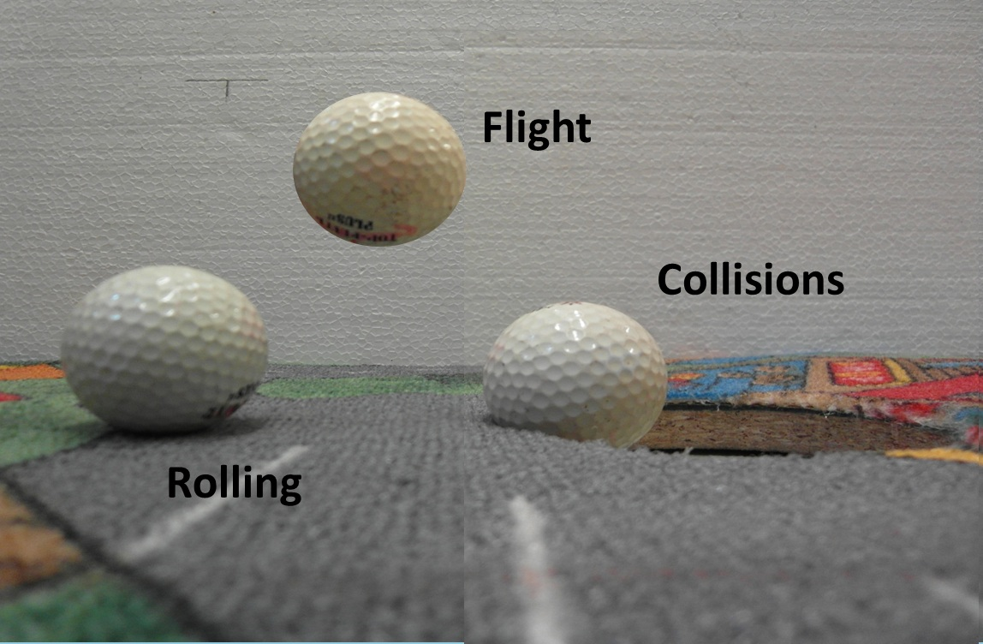
Analysis of the motion

Slide 9
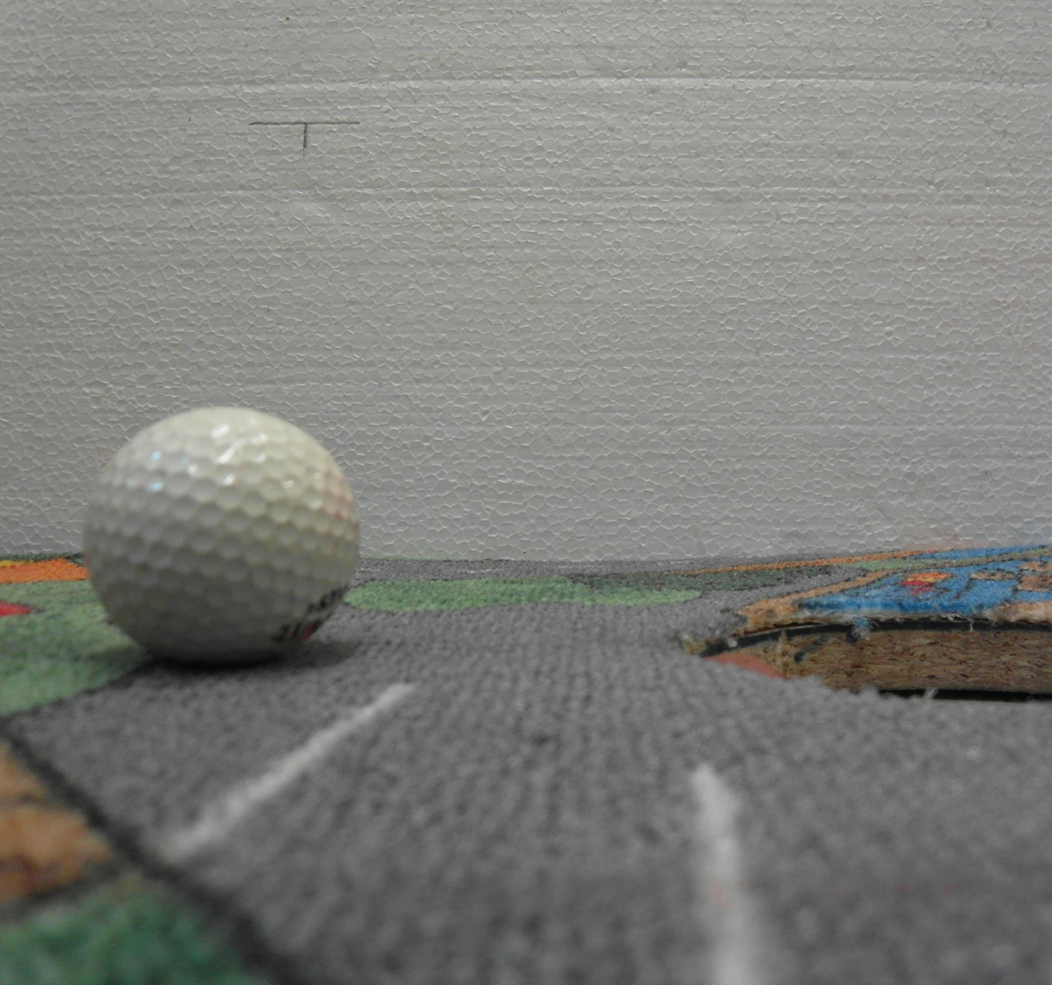
Rolling
- Gravity force
- Normal force
- Friction force
- Air drag force
Rolling resistance
torque
Rolling resistance
force

Slide 10
Another resistance in rolling
Resistance torque to rotation around perpendicular axis to horizontal caused by deformation of the surface or the ball
Ball “cap” effect
surface

Slide 11
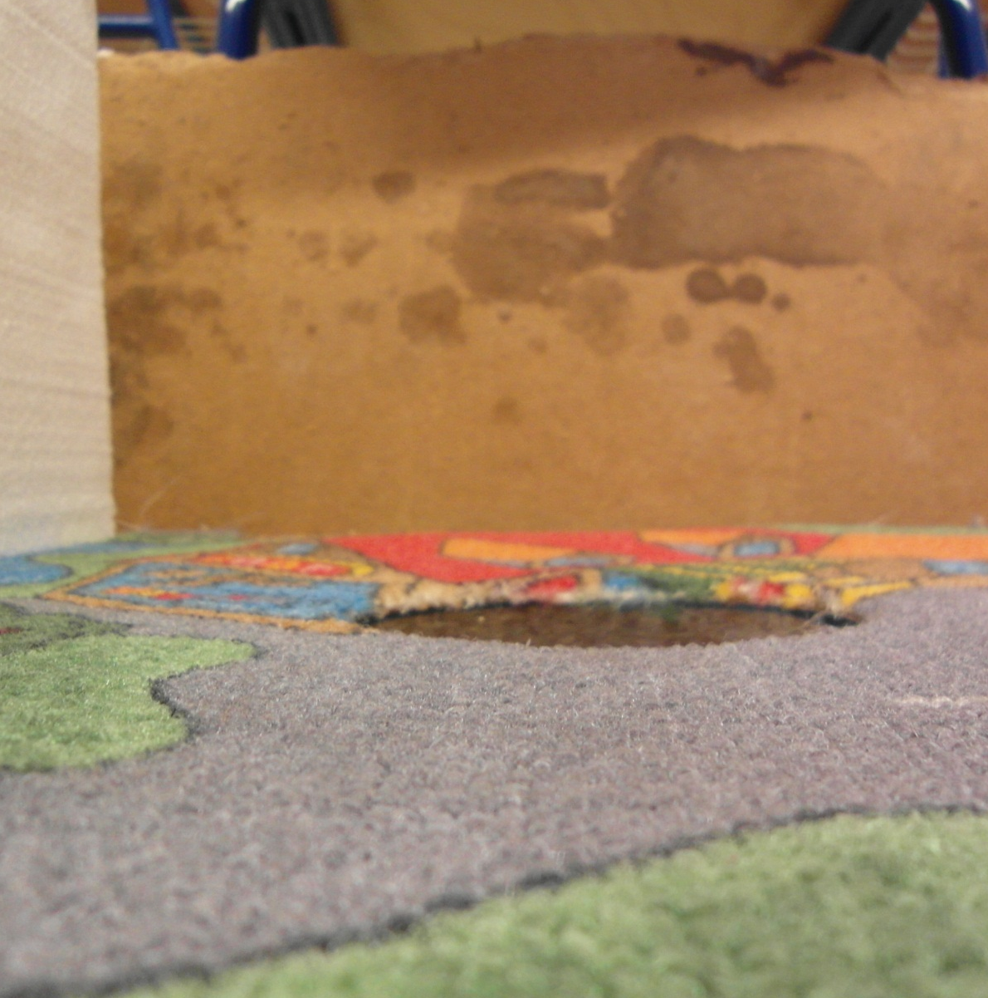
Flight
- Gravity force
- Drag force
- Drag torque

Slide 12
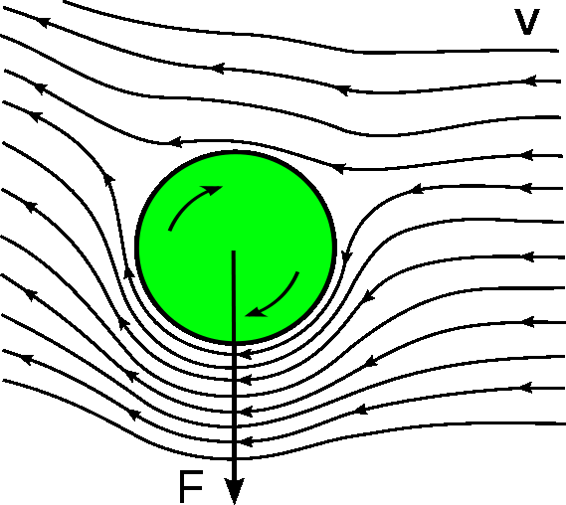
Magnus-Robins effect
Force caused by pressure difference on forward and backward moving side of spinning object.

Slide 13
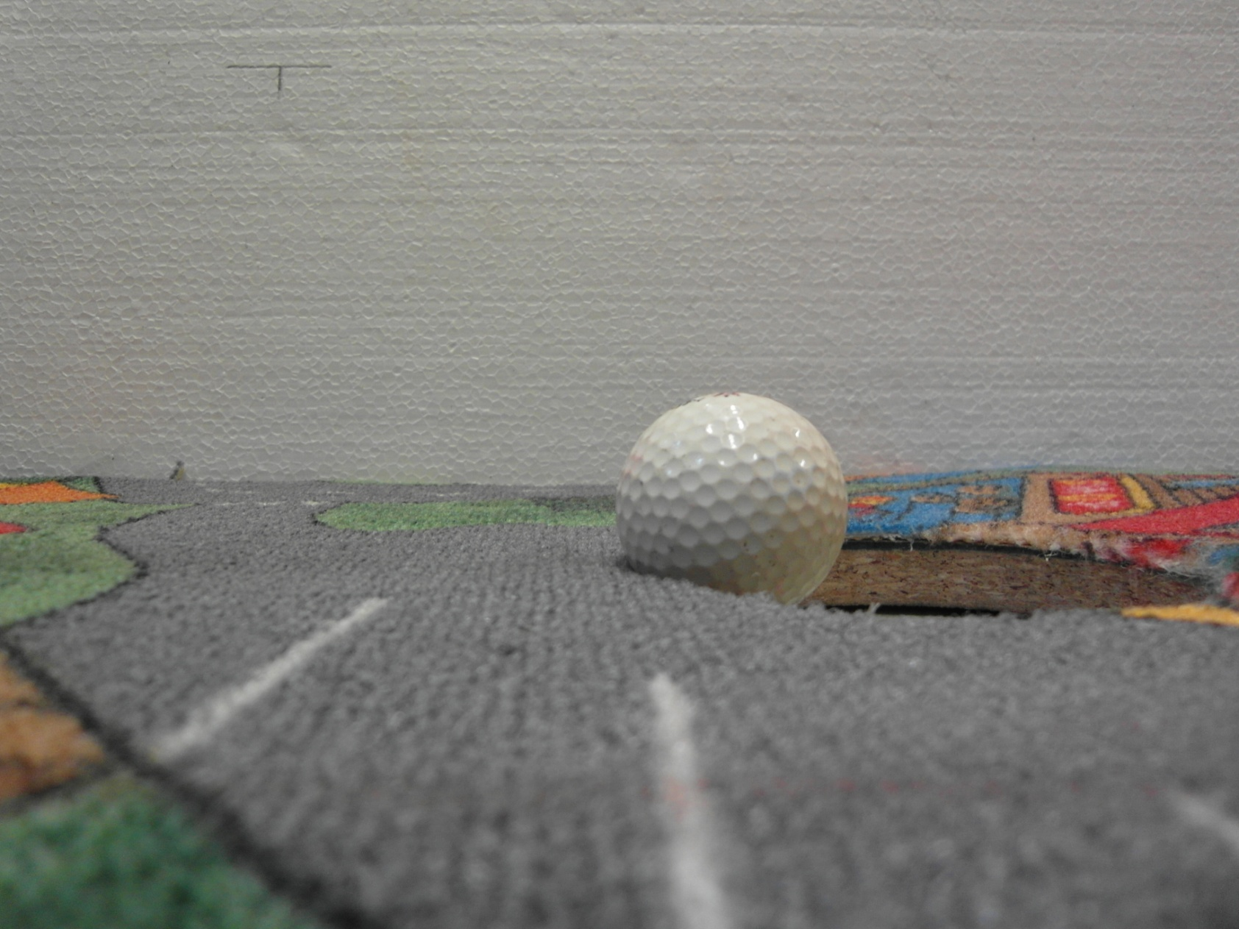
Collisions
Tangential
Velocity after impact
Horizontal
Velocity before impact
z
y
x

Slide 14
Collision
Translation motion and rotation
Normal force and friction
While slipping
If not

Slide 15
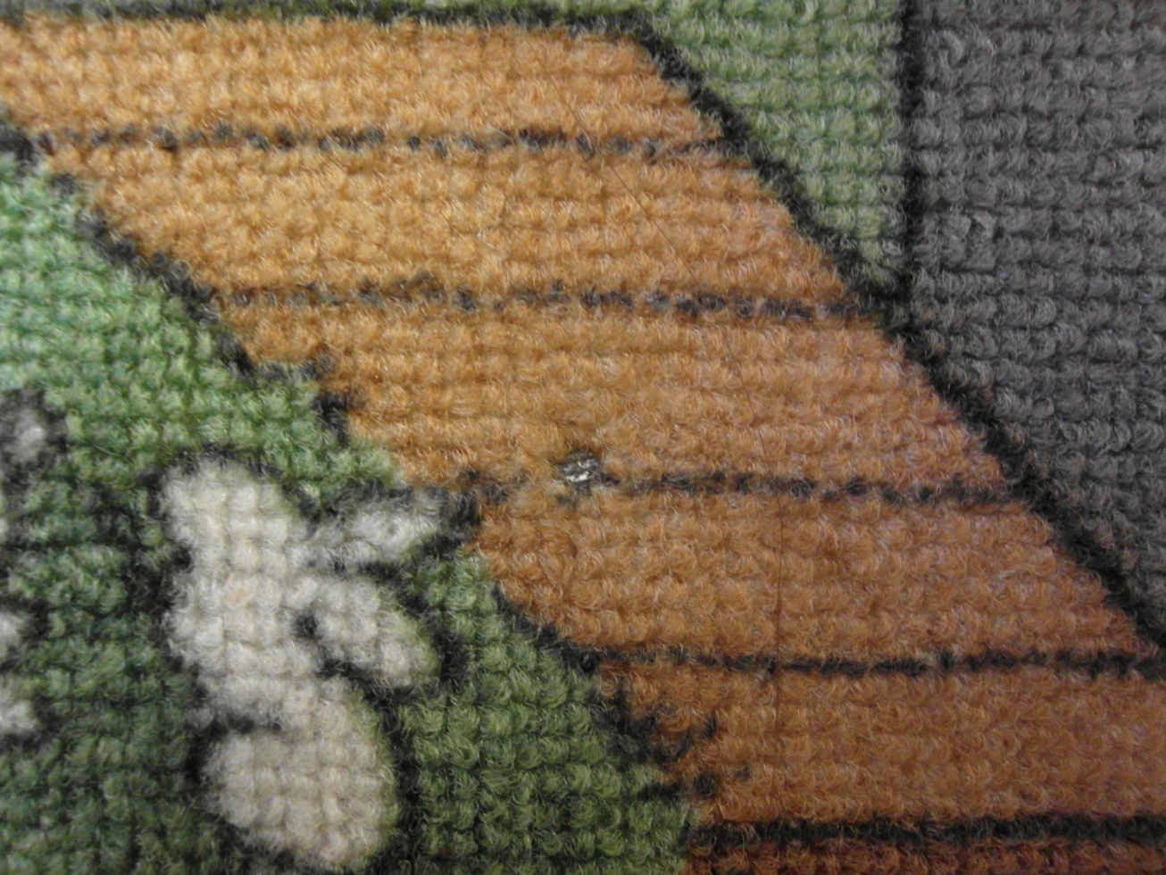
Slipping during collision
Direction of friction force is opposite to the direction of a contact point
Top view
During small time :

Slide 16
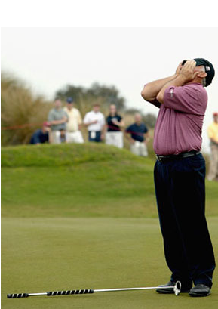
We don’t know how the normal force changes in time.

Slide 17
Used trick - simulation
Use of Newton’s laws
Simulation over small increments of the momentum
Calculation of , from :

Slide 18
Simulation
(Ball cap effect)

Slide 19
Summary of coefficients
Rolling
Fly
Collisions
Rolling resistance arm
Shape coefficient
Contact area radius
Frictions coefficients
Moment of inertia
Mass
Radius
Shape coefficients
Friction coefficient
Coefficient of restitution on the edge (in dependence on angle)

Slide 20
Summary of effects
Rolling
Fly
Collisions
Rolling resistance
Air resistance
Air resistance torque
Ball cap effect (deformation of ball or deformation of surface)
Magnus effect
Air resistance
Air resistance torque
Sliding
Ball cap effect
Negligible

Slide 21
Simulation
Used described theory
In collisions we rotated the frame of the reference

Slide 22
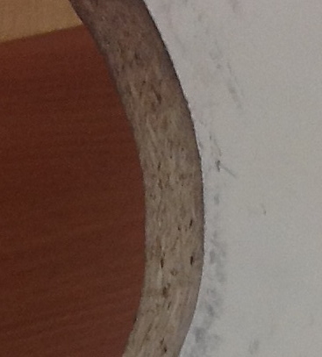
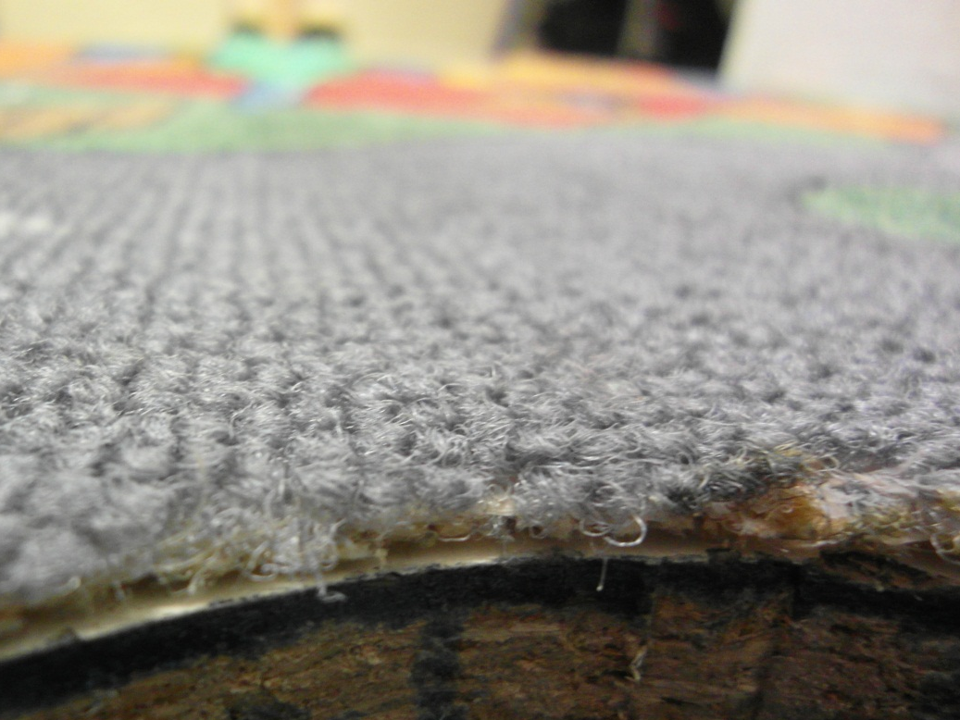
Experiments
Two surfaces
Wood
Carpet & Wood
Smooth and smooth edges
Similar to grass and rough edges

Slide 23
Wood simulation results
Shift
-54mm
0 mm
54 mm
0,1
IN
OUT
2,2
5
Initial velocity [m/s]

Slide 24
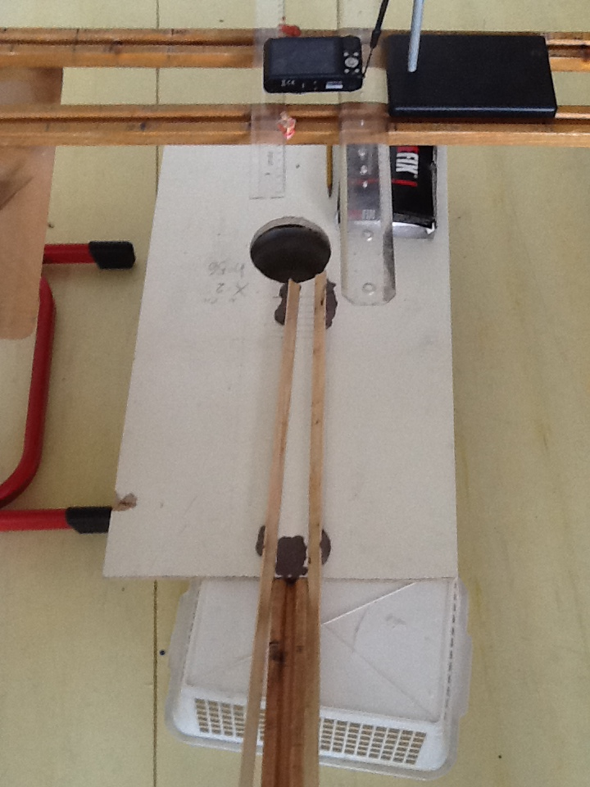
First experimental setup
High-speed camera
Rails – stabilisation of the ball
Inclined plane – regulation of the speed

Slide 25
Second experimental setup
Inclined plane – regulation of the speed
Place of high-speed camera

Slide 26
Theory vs. experiment
Shift
-54 mm
0 mm
54 mm
0,1
IN
IN
OUT
OUT
2,2
5
- Experiment IN
- Experiment OUT
Initial velocity [m/s]

Slide 27
Island
Shift
-5mm
0mm
5mm
IN
OUT
2,2m/s

Slide 28
Comparision - Escape
No shift
Velocity – 2,2 m/s

Slide 29
Comparision - Jump
No shift
Velocity – 2,0 m/s

Slide 30
Comparision – Too much
No shift
Velocity – 4,0 m/s

Slide 31
Comparision – Turn around
Shift – 35 mm
Velocity – 1,0 m/s

Slide 32
Carpet simulation
Shift to the side
Initial positions

Slide 33
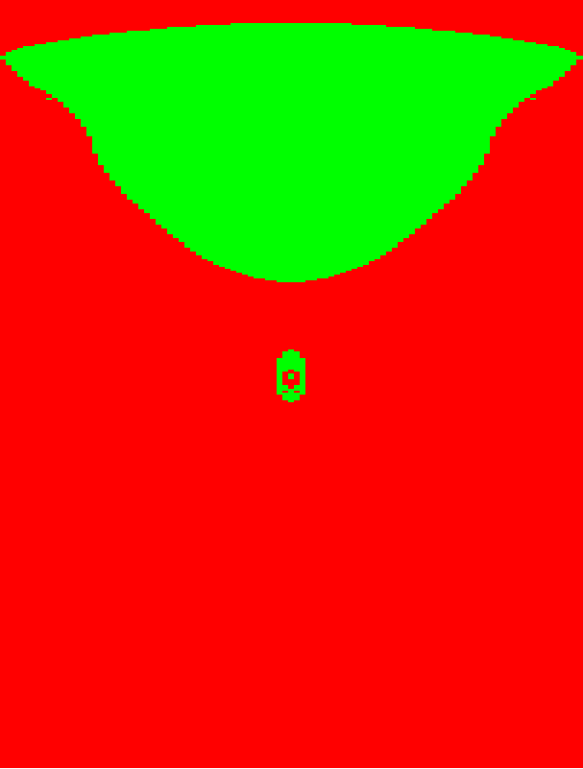
Carpet simulation result
Shift [mm]
-54 mm
0 mm
54 mm
0,01 m/s
Rolling resistance
IN
OUT
Initial velocity [m/s]
4 m/s

Slide 34
Island or face?
Shift
-3 mm
0 mm
3 mm
OUT
IN
Initial velocity
1,95 m/s
2,09 m/s

Slide 35
Carpet - Escape
No shift
Velocity – 1,94 m/s

Slide 36
Influence of diameter of the hole
Shift [cm]
Wooden surface

Slide 37
Conclusion
The most important parameters and effects are:
Rotation
Slipping during collision
Coefficient of restitution on the edge
Coefficient of restitution in the hole

Slide 38
Conclusion
We developed the model of the motion and collisions
We theoretically predicted the path of the ball
Prediction correlates with experiment
We explained the most important parameters under which can be phenomenon observable

Slide 39
Thank you for your attention

Slide 40
Ball cap effect
We assume that normal force is evenly distributed to a contact area.
Torque acts on ball in z-axis:
surface

Slide 41
Deformation of the ball
We assume that normal force is evenly distributed to a contact area.
Torque acts on ball in z-axis:
Wood surface

Slide 42
Measurement of coefficients

Slide 43
Drag

Slide 44
Magnus effect
Detaily explained and investigated in (also with other forces) :
Borg, Karl et al. “ Forces on a spinning sphere moving in a rarefied gas." Physics of Fluids Volume 15, Number 3 (March 2003): 736-41
Effect is unobservable at this small range of velocities (0 – 5 m/s)
Just try to spin the ball and let it fall. There is no shift to the side.
Also calculated in : Barber ”Golf Ball Flight Dynamics” Final project,
Cornell University
Result = The effect is relevant only in the motion with long trajectories.

Slide 45
Summary of coefficients
Carpet
Rolling resistance arm - 0.0015 m
Shape coefficient (Air drag) – 0.1
Coefficient of restitution Ball with
Carpet 0.4
Hole bottom 0.8
Hole walls, edges 0.55
Friction coefficients - ball with
Carpet 0.23
Hole bottom 0.12
Hole walls 0.1
Hole edges 0.4
Ball cap effect – contact
radius ball on :
Carpet - 0.0004 m
Bottom –0.0001 m

