Slide 1
Lanterns
12.
Marco Bodnár

Slide 2
Task
Paper lanterns float using a candle. Design and make a lantern powered by a single tea-light that takes the shortest time (from lighting the candle) to float up a vertical height of 2.5m. Investigate the influence of the relevant parameters.

Slide 3
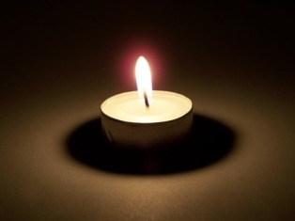
Single tea-light
Mass
5-15g
Power
40W

Slide 4
First simplistic model
Buoyant force
Losses
Power
Gravitational force

Slide 5
Is power 40W enough?
Condition to lift off
F_{b} – buoyant force
F_{g} – gravitational
force
V – volume of lantern
∆ρ – difference in density of air inside the lantern and outside
M – mass of the candle
σ – surface density
S - surface
Notes:
We proposed a theoretical model based on THREE equations. The first of them says, that..”
Martin: Nie su zadefinovane premenne...

Slide 6
Heat balance in lantern
K_{A} heat transfer constant from 5-25 W/m²K
S surface of lantern
∆T difference of temperatures
P power of tea light
http://engineeringtoolbox.com/convective-heat-transfer-d 430.html
Notes:
Poriadne napisat vzorec, metre su stvorcove, takze do horneho indexu.

Slide 7
Ideal gas
Notes:
Platí len v diferenciálnom tvare, treba vysvetliť a korektne napísať. For sufficiently small differences in density and temperature we may use

Slide 8
Limits of power
1)
3)
2)
Notes:
pri fixovanom objeme sa prava strana minimalizuje pre gulu. Pre fixny tvar potom mame vpravo jediny volny parameter – objem. Ostatne pismena su len zname konstanty
Martin: Niekde by to chcelo obrazok a popis velicin, takto je to o nicom.

Slide 9
Minimal power to lift off
Notes:
Zasa metre na tretiu napisat slusne.

Slide 10
Limitation of the task says: there is no chance to design such a lantern
Notes:
Angličtina.

Slide 11
Conclusion
Theoretical calculation of conditions to lift off proved, that tea light doesn’t work…
Is this the end?

Slide 12
Task ver. 2
Paper lanterns float using a candle. Design and make a lantern powered by a fuel with constant power that takes the shortest time (from lighting the candle) to float up a vertical height of 2.5m. Investigate the influence of the relevant parameters.

Slide 13
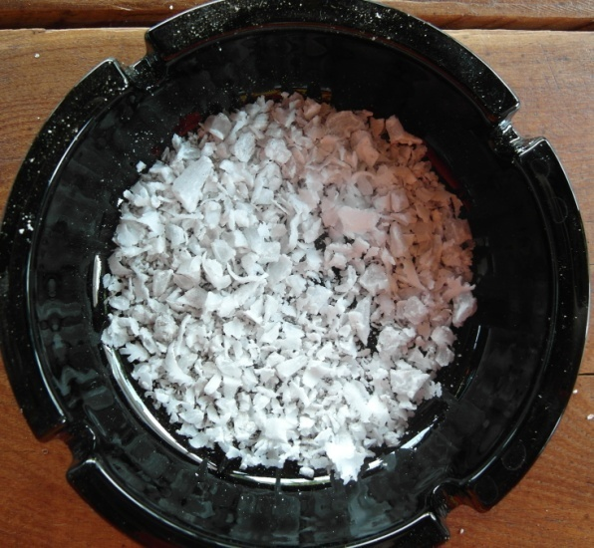
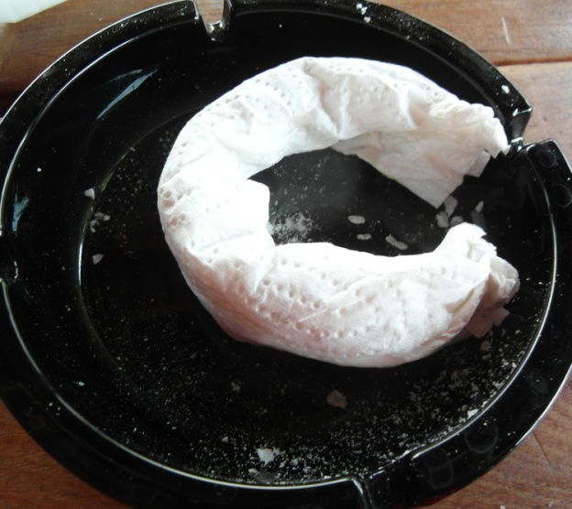
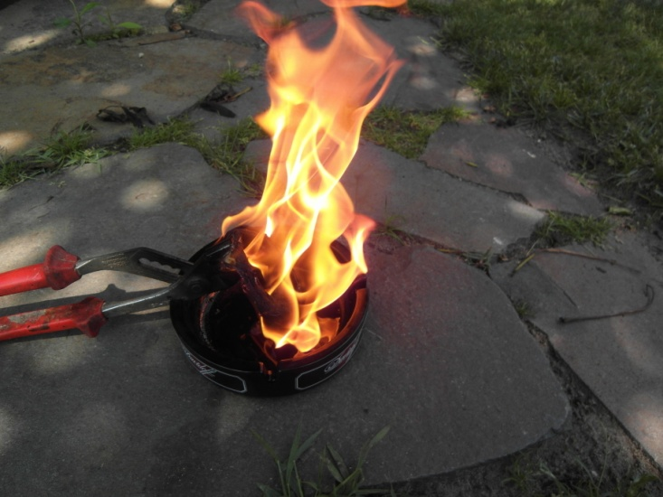
Higher power? No problem…
1500 W

Slide 14
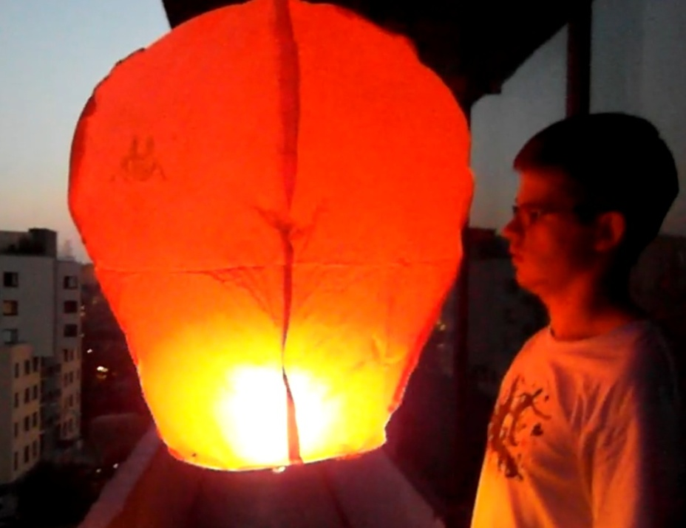
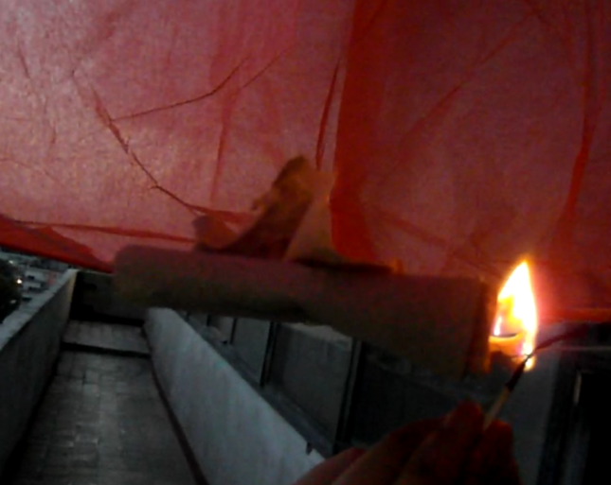
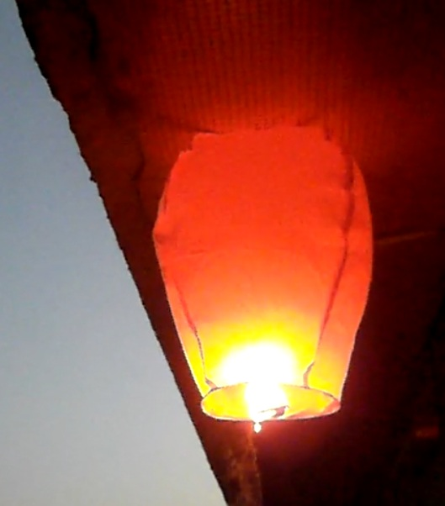
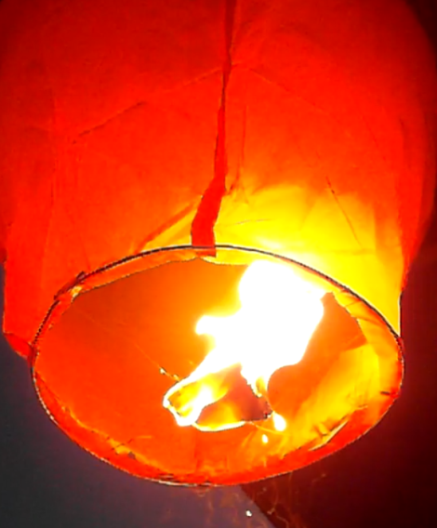
And it really works...
Ready...
Steady...
GO!

Slide 15
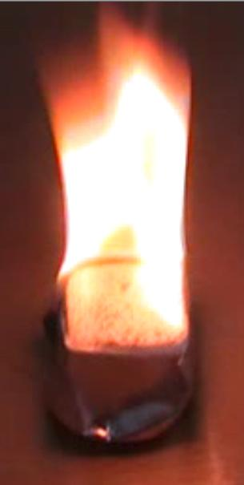
Using solid fuel
Constant power 800W
Lantern can lift off

Slide 16
How it really works?
Volume dependence
Time dependence
Notes:
“Aby sme mohli optimalizovat lampion pre co najrychlejsi vzlet, musime zistit nieco o tom, ako prebieha ohrev vzduchu v balone, a ako tento jav zavisi od tvar a objemu balona”.

Slide 17
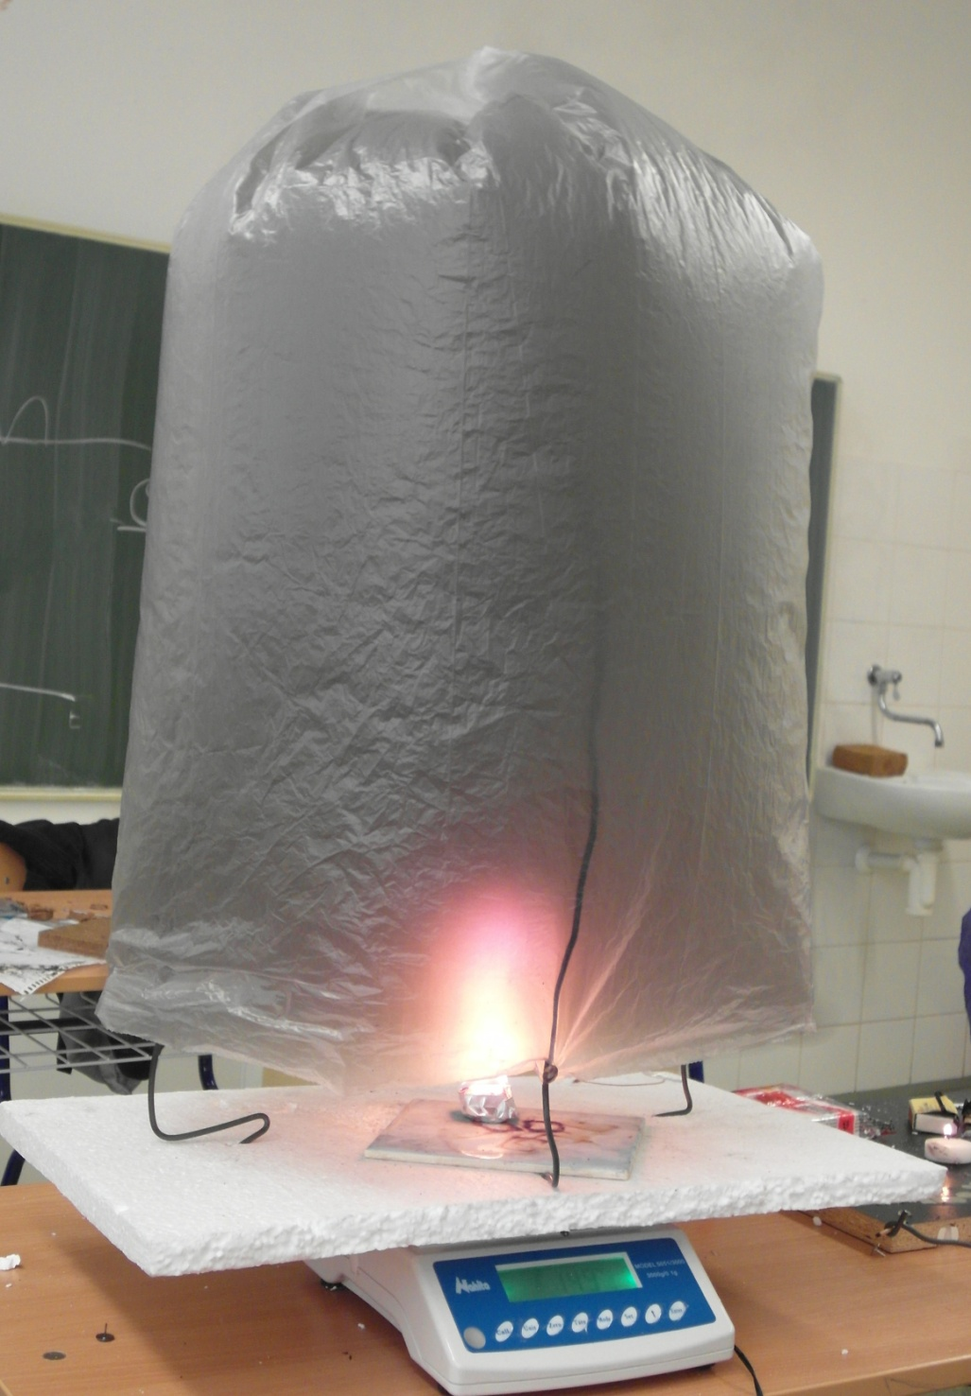
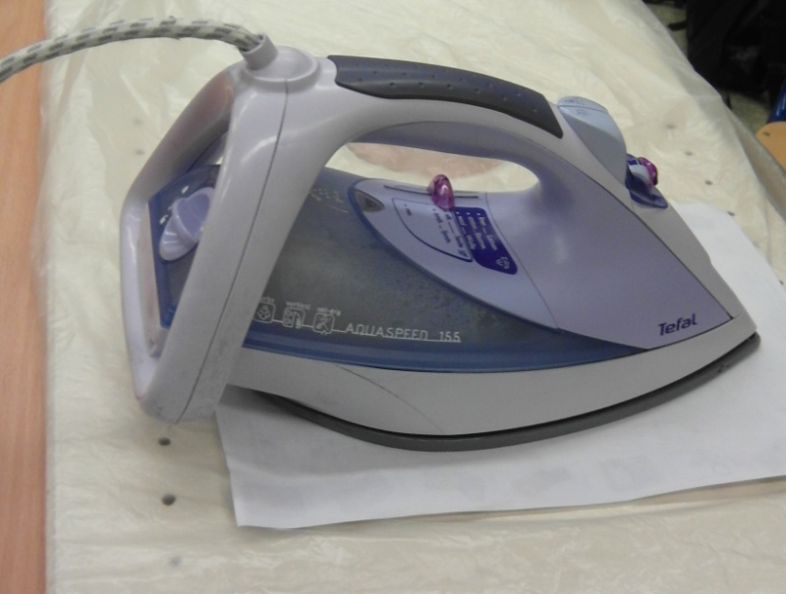
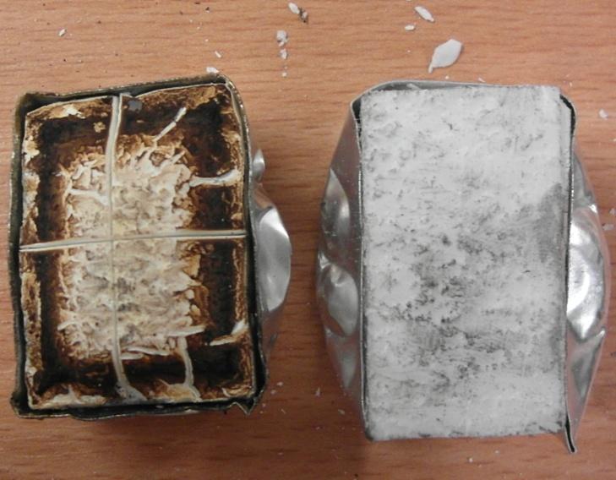
Apparatus
Lantern
3 different models – different bottom areas (A)
Iron for glueing
Solid
fuel
Solid fuel
scales
Notes:
We tried 3 models that differed in bottom area. The height (volume) was further changed for each of the models. Using iron

Slide 18
Model #1: A = 0.06 m²
Notes:
Co je A? Povrch? Nebolo to doteraz S?

Slide 19
Model #1: A = 0.06 m²
Notes:
Vzorec je prilis maly.

Slide 20
Model #2: A = 0.12 m²

Slide 21
Model #2: A = 0.12 m²

Slide 22
Model #3: A = 0.45 m²

Slide 23
Model #3: A = 0.45 m²

Slide 24
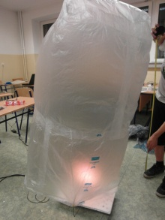
All models together → universal behavior
Does the shape matter???
Model #1: A = 0.06 m²
Model #2: A = 0.12 m²
Model #3: A = 0.45 m²
Notes:
Universal bahaviour – fits in the same curve

Slide 25
Heat balance
Heat dissipated through the bottom area
Heat dissipated through the surface
Notes:
Ka – 36.88/4,8 =7,68.. Dve vrstvy zvnutra aj vonku Ka2- 7.84 prudenie zo spodu

Slide 26
Theoretical fit
Model #1: A = 0.06 m²
Model #2: A = 0.12 m²
Model #3: A = 0.45 m²
Notes:
fitting experimentally observed universal behavior for lambda we obtain perfect correspondence
V tych vyssich objemoch je to pod krivkou lebo uz to je viac valcove, nie uplna gula.. Cize aj ked nezavisy, trochu hej

Slide 27
How it really works?
Volume dependence
Time dependence
?
Notes:
Preco krizik pri time dependance?

Slide 28
Time dependence (experimental)
Volume 70 l

Slide 29
Dynamic model
U – inner energy of lantern
Notes:
Numericke riesenie.. Aj zmena heat capacity zaratana

Slide 30
Time dependence (exp. vs. theory)
NO FIT! – constants used from previous experiment
Notes:
Tu sme pouzili koeficienty, ktore predtym cize nula fitovania.. A je to konsistentne.. Mozme use..
Numericke riesenie.. Aj zmena heat capacity zaratana

Slide 31
How it really works?
Volume dependence
Time dependence
Now we know everything we need…

Slide 32
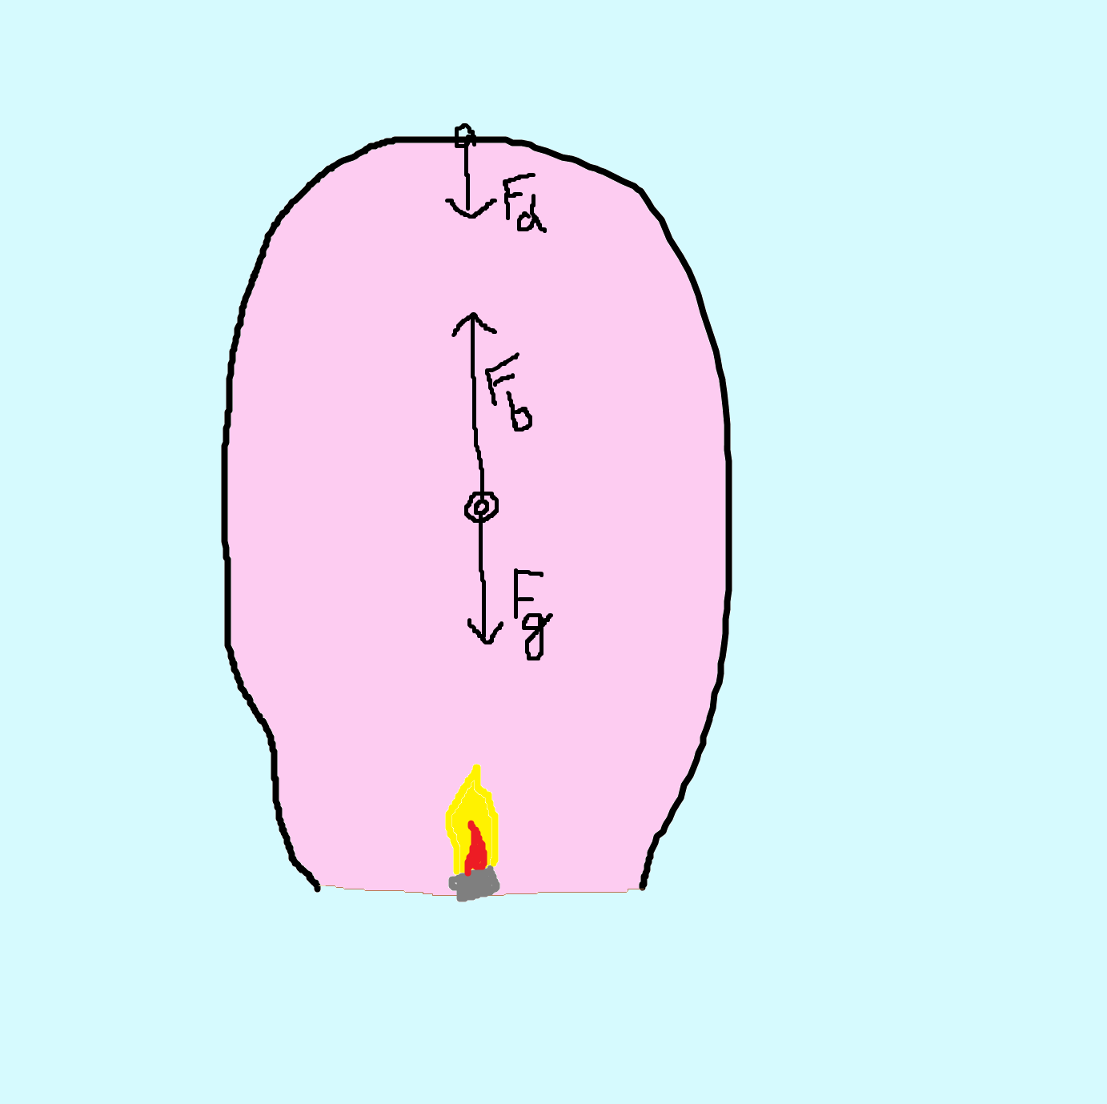
Forces on lantern
Euler method of finite increments
MS Excel
Theoretical description of motion
Excel simulation

Slide 33
Time to reach 2,5m
Lantern with this volume was produced

Slide 34
Lantern; approximately 75 liters

Slide 35
Conclusion
Theoretical description of the problem
With constant power found most suitable volume (around 75 liters)
But this is not everything…

Slide 36
Task vs. 3
Paper lanterns float using a candle. Design and make a lantern powered by a modified single tea-light , which doesn’t have to lift on with lantern, that takes the shortest time (from lighting the candle) to float up a vertical height of 2.5m. Investigate the influence of the relevant parameters.
Notes:
Modifikovane wicks.. Dolievanie vosku output 600W

Slide 37
What changes?
New relevant parameter
Time of holding
Small difference in simulation
No extra mass added to lantern
Power dissipates during the flight

Slide 38
Experiment
Highest volume 170 liters
Smallest volume
50 liters
Surface density
8 g/m2

Slide 39
Time to reach 2,5m

Slide 40
Output from simulation
The fastest one created
Best volume
120 liters
Time of holding
63 sec.
Total time
70 sec.
Notes:
Co znamena zlty bod?

Slide 41
But we found something better

Slide 42
Second experiment
The lowest surface density
Highest volume
15 l
Lowest volume
10 l
Surface density
5 g/m2

Slide 43
Only 1 point, but the best
Not able to lengthen the bag,
because it tears
Burned bag
Notes:
Prilis malinke pismenka na grafe.

Slide 44
Second experiment
The lowest surface density
Best volume
15 l
Time of holding
7 sec.
Time to reach 2,5m
10 sec.

Slide 45
Correlation

Slide 46
Conclusion
Investigated the original task
- No lantern in these conditions can be build
Modified task to investigate this phenomenon
- Solid fuel instead of tea light
- Modified tea light not a part of lantern
Found relevant parameters (volume, power, surface, time of holding…)
Built the quickest lantern for each variant of task

Slide 47
Thank you for your attention

Slide 48
Superlantern 10 sec.

Slide 49
Appendices

Slide 50
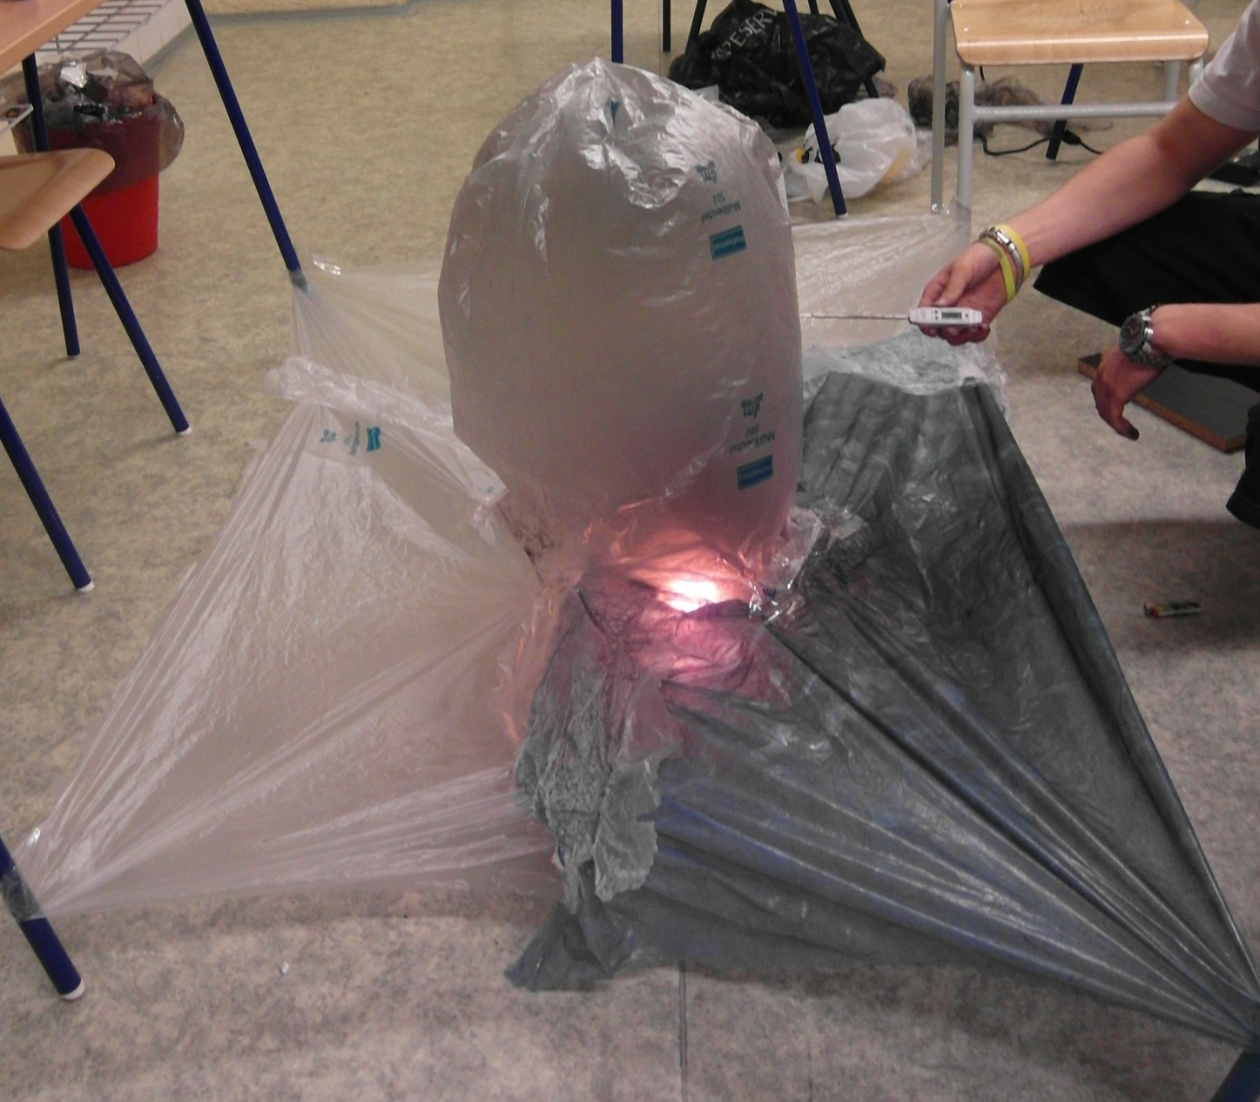
Measurement of temperature
thermometer
Hot air going outside has no influence on measurement

Slide 51
Temperatures

Slide 52
Redistributed temperature
Linear gradient
Shape approximately spherical
Outside lantern is
Notes:
We measured the temperature
Martin: Co znamena tych 40 stupnov nad plamenom?

Slide 53
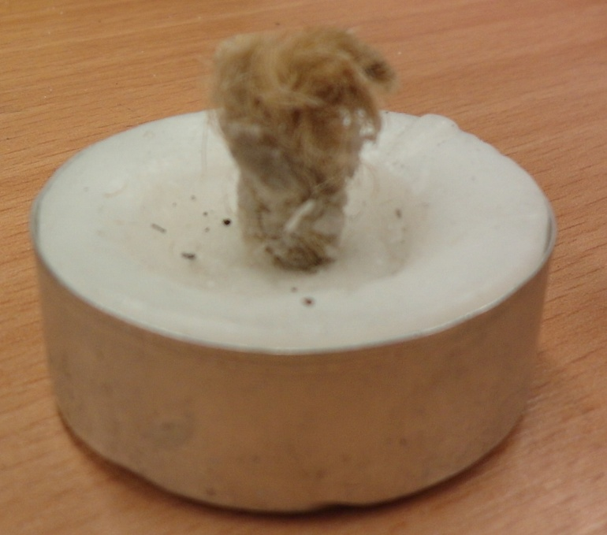
No manipulation – steady power output
Power 600W
burning of wax of tea light 4h
of modified tea light 16min
To o tom case horenie ja fajn vediet a pamatat si – ale … nezda sa mi to byt podstatne. Pride mi, ze jedinou podstsatnou informaciou je vykon 600W a ten za samostatnhy slide nestoji.

Slide 54
First experiment
Highest volume 170 liters
Best volume
110 liters
Time of holding
63 sec.
Total time
70 sec.
Hmm.. Tento slide tiez nie je podstatny. Nestaci to len ukazat a zvyraznit na predoslom grafe?
(navyse, nezda sa mi, ze v predoslom grafe je na 170 L cas 70 sekund :P)

Slide 55
Forces on lantern
Tieto rovnice su nepodstatne. Staci povedat, ze sme pouzili Eulerovu metodu konecnych inkrementov + Exce a ziskali sme…
Rovnice preloz do appendixu, ak sa na ne niekto spyta. Len si pamataj tie tri sily, ktore posobia na balon ☺
Excel simulation

