Slide 1
Rising Bubble
16
Kamila Součková

Slide 2
Task
A vertical tube is filled with a viscous fluid. On the bottom of the tube, there is a large air bubble. Study the bubble rising from the bottom to the surface.

Slide 3
Understanding the Task
A vertical tube is filled with a viscous fluid. On the bottom of the tube, there is a large air bubble. Study the bubble rising from the bottom to the surface.
large = length > width

Slide 4
Understanding the Task
A vertical tube is filled with a viscous fluid. On the bottom of the tube, there is a large air bubble. Study the bubble rising from the bottom to the surface.
large = length > width
= stable flow

Slide 5
Understanding the Task
A vertical tube is filled with a viscous fluid. On the bottom of the tube, there is a large air bubble. Study the bubble rising from the bottom to the surface.
large = radius comparable to radius of tube
(length > width)
= stable flow

Slide 6
Understanding the Task
“Study the bubble”
What to Study:
Depending on:
motion
shape of bubble
volume of bubble V
diameter of tube D
properties of liquid

Slide 7
Analysis of the SYstem

Slide 8
Properties of Liquid
 | density | viscosity | surface tension
 | ρ | = resistance to flow dynamic µ kinematic | result of cohesive intermolecular forces minimizes surface area σ
water | 1000 kg/m³ | 1.0 kg/(s·m) (at 20°C) | 71.97 mN/m
oil | 890 kg/m³ | 43.7 kg/(s·m) | 32 mN/m
ethanol | 789 kg/m³ | 0.9 kg/(s·m) | 22.27 mN/m
soap | 1020 kg/m³ | 5 kg/(s·m) | 3 mN/m

Slide 9
Forces in the System
gravity acting on liquid
liquid will flow down,
pushing bubble up
gravity acting on bubble
water needs to flow around

Slide 10
Forces in the System
gravity acting on liquid
liquid will flow down,
pushing bubble up
gravity acting on bubble
water needs to flow around
resistance due to viscosity
pressure inside bubble
stresses due to surface tension
and pressure in the liquid

Slide 11
Motion of the bubble

Slide 12
Speed of rising
stabilized soon due to viscous forces
water,
D = 1.4cm

Slide 13
Speed of rising
does not depend on bubble volume:
water,
D = 0.9cm
oil,
D = 1.4cm

Slide 14
Speed of Rising: Different Liquids, Tubes
 | density ρ | dynamic viscosity µ | surface tension σ
water | 1000 kg/m³ | 1.0 kg/(s·m) | 71.97 mN/m
oil | 890 kg/m³ | 43.7 kg/(s·m) | 32 mN/m
ethanol | 789 kg/m³ | 0.9 kg/(s·m) | 22.27 mN/m
soap | 1020 kg/m³ | 5 kg/(s·m) | 3 mN/m
Notes:
vidime ze pre rozne kvapaliny s roznymi vlastnostami su rozne rychlosti, je to cele zlozite… podme to popisat!

Slide 15
Description of Bubble Rising
w
v
u(z)
z

Slide 16
Starting with…
w
v
u(z)
unknowns:
velocity profile of the thin layer flowing around the bubble u(z)
velocity of bubble v
width of layer flowing around bubble w

Slide 17
Starting with…
w
v
u(z)
unknowns:
velocity profile of the thin layer flowing around the bubble u(z)
velocity of bubble v
width of layer flowing around bubble w
$$u\left(z\right)=−\frac{ρg}{2μ}{(w}^{2}−2wz)$$
gravity + shear force →
w
Notes:
ok, mam u(z)… (medzera) teraz podme rozmyslat nad tym, ako dostat hentie 2 ciselka
nemam popisane veliciny

Slide 18
Starting with…
w
v
u(z)
unknowns:
velocity profile of the thin layer flowing around the bubble u(z)
gravity + shear force →
velocity of bubble v
width of layer flowing around bubble w
$$u\left(z\right)=−\frac{ρg}{2μ}{(w}^{2}−2wz)$$
continuity (liquid ↓ = air ↑ ) →
$$\frac{2πRρgw^{3}}{3μ}=πR^{2}v$$

Slide 19
Starting with…
h
v
u(z)
unknowns:
velocity profile of the thin layer flowing around the bubble u(z)
gravity + shear force →
velocity of bubble v
width of layer flowing around bubble w
$$u\left(z\right)=−\frac{ρg}{2μ}{(w}^{2}−2hz)$$
continuity (liquid ↓ = air ↑ ) →
$$\frac{2πRρgw^{3}}{3μ}=πR^{2}v$$
Notes:
3rd equation

Slide 20
Combine the equations
velocity profile
continuity
$$u\left(z\right)=−\frac{ρg}{2μ}{(w}^{2}−2hz)$$
$$\frac{2πRρgw^{3}}{3μ}=πR^{2}v$$
tried to find 3rd equation → no analytical solution; very difficult to solve numerically

Slide 21
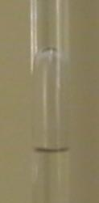
Bubble Rising: Experimentally Prove Expected v/h³
need to find h → measure change in bubble length
“head”
cylindrical “body”
L
expectation:

Slide 22
Bubble Rising: Experimentally Prove Expected v/h³
L = 1.15L₀ + 1.06
expectation:

Slide 23
Bubble Rising: Experimentally Prove Expected v/h³
Prolonging of the cylindrical part:

Slide 24
Bubble Rising: Experimentally Prove Expected v/h³
Pluding experimental velocity:

Slide 25
Bubble Rising: Experimentally Prove Expected v/h³
✓
Theory correlates with experiment

Slide 26
Speed of Rising: More Experiments

Slide 27
Isolate Parameter: Viscosity
hot water: viscosity changes with temperature much more than density, surface tension
http://www.engineeringtoolbox.com/water-dynamic-kinematic-viscosity-d_596.html
27

Slide 28
Shape of Bubbles

Slide 29
Characterizing the System
Reynolds number: viscous vs inertial forces
Eötvös (Bond) number: surface tension vs gravitational forces
Notes:
velky eotvos znamena male sigmy → bude to negulate

Slide 30
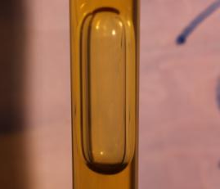
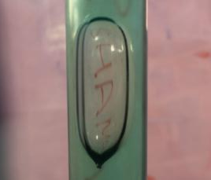
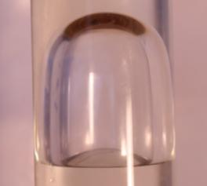
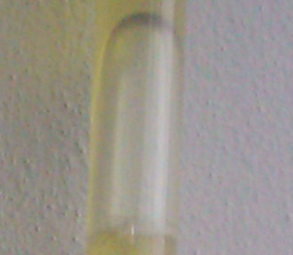
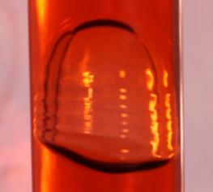
Shapes of Bubble
Re | Eo | 5 | 10 | 20
5
10
20
?
honey
shampoo
oil
petrol
water

Slide 31
Shapes of Bubble: Comparison with Literature (no tubes)
source: Jinsong Hua, Jing Lou, 2007, Numerical simulation of bubble rising in viscous liquid

Slide 32
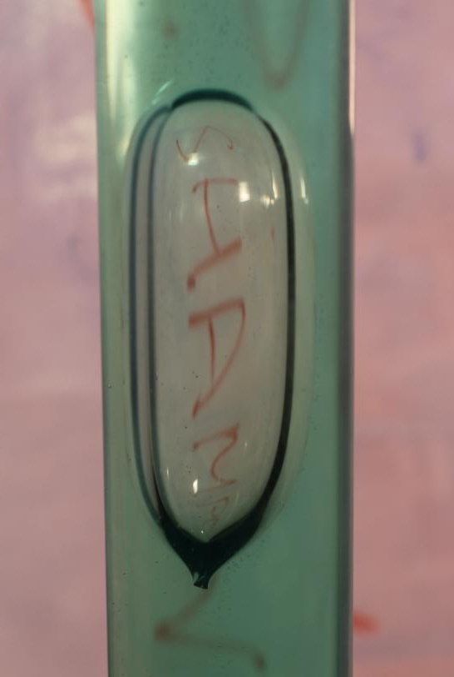
Mystery: Tail
shampoo has a clearly visible tail
sometimes a small tail can be observed in honey too (esp. when not exactly vertical)
not mentioned in literature
our explanation: very viscous → does not “fill” the bottom fast enough

Slide 33
Conclusion

Slide 34
Conclusion
force analysis
gravity acting on liquid
liquid will flow down,
pushing bubble up
gravity acting on bubble
resistance due to viscosity
pressure inside bubble
stresses due to surface tension

Slide 35
Conclusion
force analysis (gravity, viscosity, pressure, surface tension)
flow in the tube
w

Slide 36
Conclusion
force analysis (gravity, viscosity, pressure, surface tension)
flow in the tube (velocity profile)
speed of rising
✓
theory correlates with experiment

Slide 37
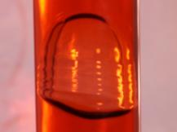
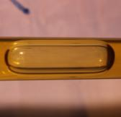
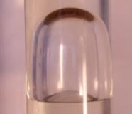
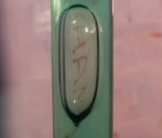
Conclusion
force analysis (gravity, viscosity, pressure, surface tension)
flow in the tube (velocity profile)
speed of rising (theory + correlating exp for various parameters)
shapes of bubbles

Slide 38
Conclusion
force analysis (gravity, viscosity, pressure, surface tension)
flow in the tube (velocity profile)
speed of rising (theory+correlating exp for various parameters)
shapes of bubbles (depending on Re, Eo)
✓
“study the bubble”

Slide 39
Thank you for your attention!
force analysis (gravity, viscosity, pressure, surface tension)
flow in the tube (velocity profile)
speed of rising (theory+correlating exp for various parameters)
shapes of bubbles (depending on Re, Eo)
✓
“study the bubble”

Slide 40
16. Rising Bubble
Kamila Součková

Slide 41
Appendix

Slide 42
Characteristics of the System: Flow
Reynolds number: defines relative importance of viscous and inertial forces
in our case always ⇒ flow is laminar

Slide 43
Reynolds number
v – velocity of bubble
u – velocity of liquid
R- radius of bubble
ρ- density of liquid
µ - viscosity of liquid
w- thickness of layer
$\frac{vRρ}{µ}$ =
Re_{found} _{in} _{articles} =
Re_{ussualy} _{expected} =
Estimations from continuity equation:
$$\frac{uwρ}{µ}$$
$$\frac{1}{2}$$
= Re_{found} _{in} _{articles}
R
v
w
u

Slide 44
Velocity Profile
velocity profile of the thin layer flowing around the bubble u(z)
gravity + shear force
w
⇒
(holds for laminar flow and sufficiently long bubbles)
source: Zbierka FX (collection of solved physics problems)

Slide 45
Velocity of Rising, Width of Layer
velocity of bubble v
width of layer flowing around bubble h
continuity
amount of liquid going down = amount of air going up
integrating + simplifying *
velocity profile
(approximation:
cylinder)
=
* simplification: thin layer

Slide 46
Description of Bubble Rising
velocity profile
continuity
(const for a given liquid & tube)

Slide 47
Beyond the Ratio
?
?
→ experiment: v depending on R

Slide 48
Beyond the Ratio
?
2
1
?
→ experiment: v depending on R

