Slide 1
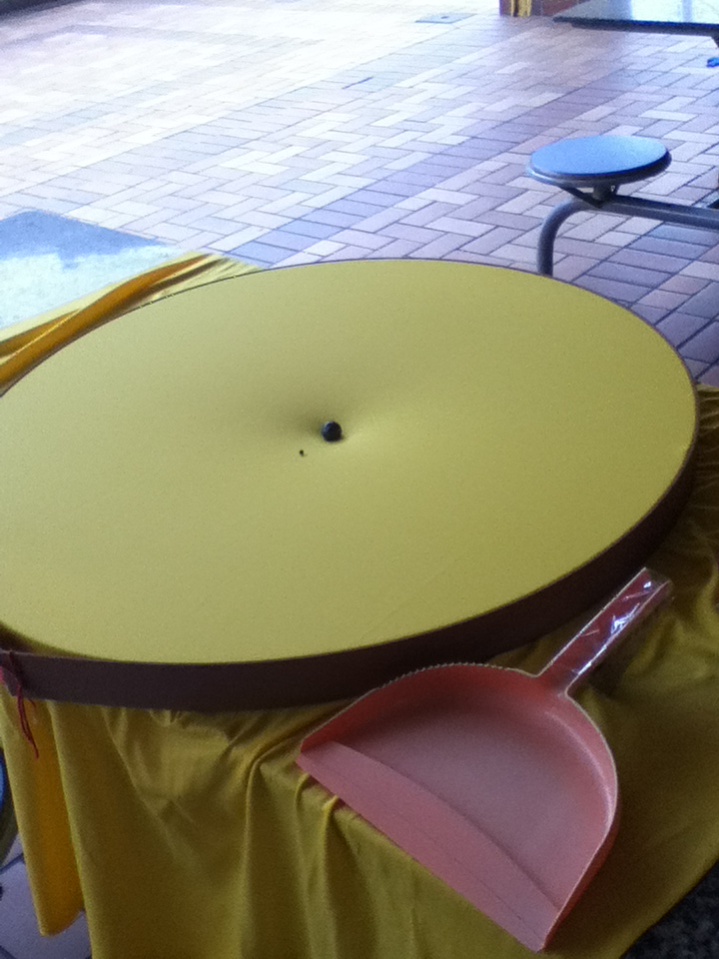
Problem 02 Elastic Space
reporter:
Denise Sacramento Christovam

Slide 2
Problem 2
Elastic Space
The dynamics and apparent interactions of massive balls rolling on a stretched horizontal membrane are often used to illustrate gravitation. Investigate the system further. Is it possible to define and measure the apparent “gravitational constant” in such a “world”?

Slide 3
Contents
Introduction
Relativity and proposed model
Experiments
Same balls, different membranes
Conclusion
Analysis
Field dimension
Comparison
Different balls, same membrane
Newtonian model: Gravitational constant and approach movement
Spring constant
Circular motion
System’s dimensions
Elastic membranes and deformation
Membrane solution and general model

Slide 4
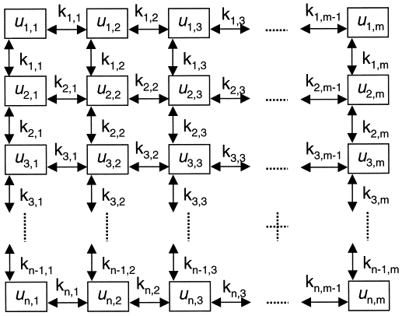
Elastic Membrane - Deformation
Vertical displacement of the membrane:
Continuous isotropic membrane
Discrete system
Using Hooke’s Law:

Slide 5
Elastic Membrane - Deformation
.
.
.
.
Massic density (constant)

Slide 6
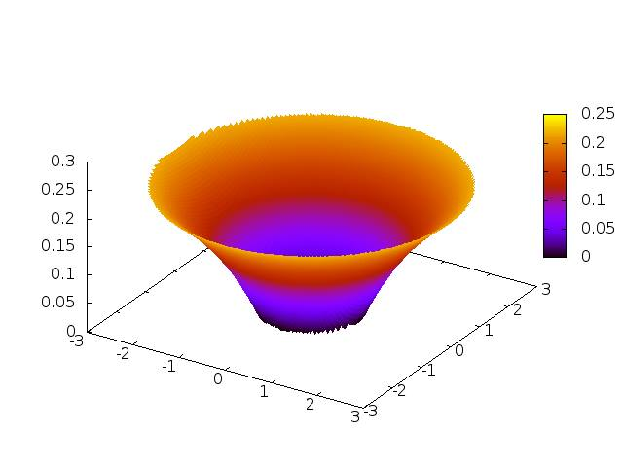
Elastic Membrane - Potential
Membrane obeys wave equation:
Stationary form:
Distance from the center to any other position (radial coordinates)
Vertical displacement
Adjustment constant

Slide 7
Elastic Membrane - Potential
Ball is constrained to ride on the membrane.
Mass of the particle
As the force does not vary with 1/r², our system is not gravitational.
We find, then, an analogue G.
Force due to membrane’s potential
Earth’s Gravity

Slide 8
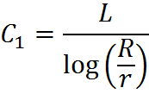
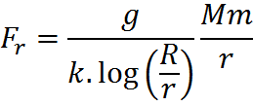
Elastic Membrane - C₁ (and analog G) definition
Analog G

Slide 9
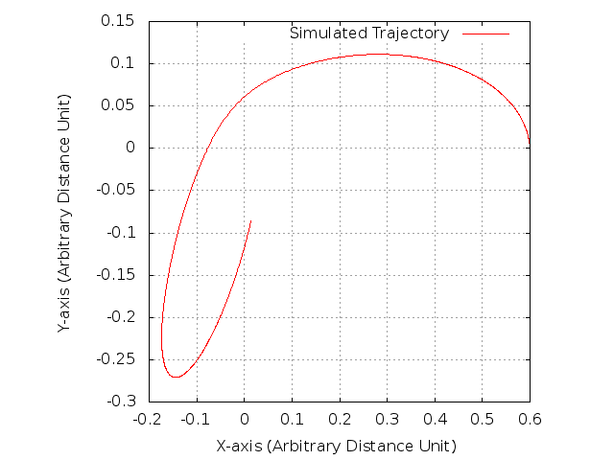
Elastic Membrane – Motion Equation
y
x
Gravity
Masses
Radii
Elastic constants
The validity of this trajectory will be shown qualitatively in experiment.
Damping constant (dissipative forces)

Slide 10
Elastic Membrane – Motion Equation
Rolling ball’s behavior:
Close to the great mass (“singularity”)
Far from singularity
The closer to singularity, the greater deviation from parabola

Slide 11
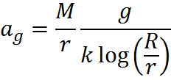
Approach Movement
Disregarding vertical motion (one-dimensional movement), the smaller ball’s acceleration towards the other is equivalent to the gravitational pull
Fg
M

Slide 12
Elastic Membranes
Different rolling masses
Great masses compared to the central one
Both deform the sheet
Constant dependent on depth of deformation
Deformations add themselves meniscus-like
Greater than real gravitational constant
Model applicability finds limitation

Slide 13
Gravitational Field’s Dimension
Space-time: continuous
Membrane: limited
Limit= Borders

Slide 14
Relativity and Membranes
Basic concepts: space-time and gravity wells
Fundamental differences:
Time
Friction
Kinetic energy
Gravitational potential
Our model: Earth’s gravity causes deformation (great ball’s weight) (Rubber-sheet model)
It’s not a classical gravitation model, but it’s possible to make an analogy.

Slide 15
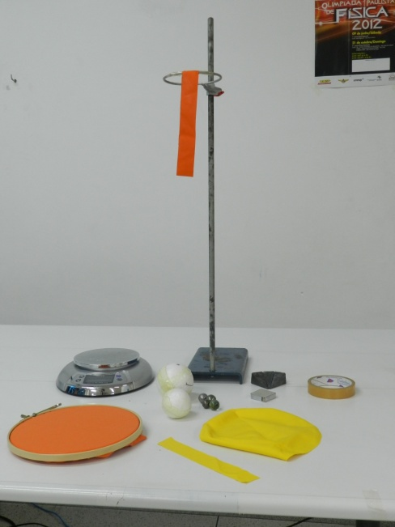
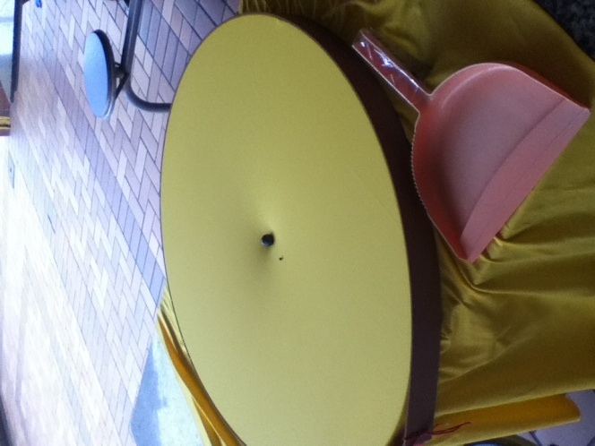
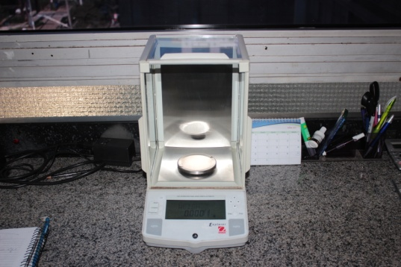
Material
Strips of rubber balloon and lycra
Half of rubber balloon and lycra (sheet)
Baste
Styrofoam balls with lead inside
Metal spheres, marbles and beads
Two metal brackets
Scale (±0.0001 g - measured)
Sinkers
Measuring tape (±0.05 cm)
Plastic shovel with wooden
block (velocity control)
Adhesive tape
Camera
1
6
4
5
8
9
2
3
2
1
2
10
7

Slide 16
Experimental Description
Experiment 4: System’s dimensions were varied.
Experiment 5: Circular motion.
Experiment 1: Validation of theoretical trajectory.
Experiment 2: Determination of rubbers’ spring constant.
Experiment 3: Same balls interacting, variation of rubber-sheet and dimensions.
Experiment 4: Same membrane and center ball (great mass), different approaching ball.

Slide 17
Experiment 1: Trajectory
Trajectory
Different ball
Dimensions
Spring Constant
Using the shovel, we set the same initial velocity for all the repetitions.

Slide 18
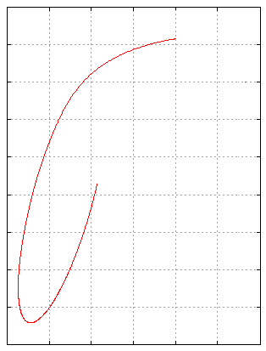
Experiment 1: Trajectory
Trajectory
Different ball
Dimensions
Spring Constant
The obtained trajectory fits our model, thus, validating the proposed equations.

Slide 19
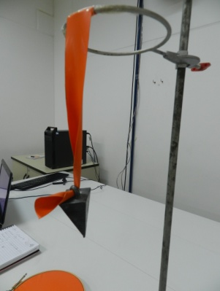
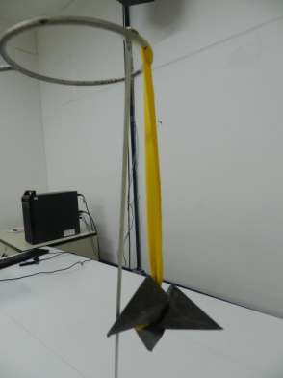
Experiment 2: Spring Constant
Trajectory
Different ball
Dimensions
Spring Constant
Experimental Setup:
5 sinkers, added one at a time.

Slide 20
Experiment 2: Spring Constant
Trajectory
Different ball
Dimensions
Spring Constant
Yellow: k=0.82 N/cm
Orange: k=0.95 N/cm
The yellow sheet will be the most deformed: higher gravitational constant.

Slide 21
Experiment 3: Different rubber-sheets
Trajectory
Different ball
Dimensions
Spring Constant
Experimental procedure:
Five repetitions for every ball/sheet combination

Slide 22
Experiment 3: Different rubber-sheets
Trajectory
Different ball
Dimensions
Spring Constant
G_{aO}: 6,3.10⁻¹² m³/kg.s²
G_{aY}: 1,18.10⁻¹¹ m³/kg.s²
M = 77,3 g

Slide 23
Experiment 3: Different rubber-sheets
Comparison between formulas
 | Orange | Yellow
M (g) | 77.3 | 77.3
G (Young Modulus) (mm³.kg⁻¹.s⁻²) | 1.16.10⁻¹¹ | 6.29.10⁻¹²
G (potential) (mm³.kg⁻¹.s⁻²) | 1.18.10⁻¹¹ | 6.30.10⁻¹²
Average | 1.17.10⁻¹¹ | 6.29.10⁻¹²
Deviation (%) | 0.84 | 0.11
Both formulas agree (given the errors), based on experimental results.
Gravity (Earth): 9,8 m/s²
∆L measured with tape

Slide 24
Experiment 3: Different rubber-sheets
Trajectory
Different ball
Dimensions
Spring Constant
Gravitational Constant
Theoretical | G_{y} | G_{o}
6,67E-11 | 6.29E-12 | 1.17E-11
Deviation | 90.56 | 82.45
6,67.10⁻¹¹ m³kg⁻¹s⁻²
m≈6.9.10⁻⁶%M
Analogue gravitational constant

Slide 25
Experiment 3:
Trajectory
Different ball
Dimensions
Spring Constant
The “gravitational constant” is dependent on the distance from the center, showing that, again, our system is not gravitational.

Slide 26
Experiment 4: Different rolling ball
Trajectory
Different ball
Dimensions
Spring Constant
Blue: marble
Red: bead

Slide 27
Conclusion
The proposed system is not a gravitational system;
It is possible to determine analogue analogue gravitational constant of the system (exp. 3);
This G_{a} is dependent on geometric and elastic characteristics of the system;
G_{a} not equal to G, as the system’s not gravitational;
The model’s approach is limited to very different masses (exp.4). Otherwise, the model is not applicable.

Slide 28
References
CARROLL ,Sean M. Lecture Notes on General Relativity. Institute for Theoretical Physics, University of California, 12/1997.
MITOpenCourseWare – Physics 1: Classical Mechanics. 10 – Hooke’s Law, Simple Harmonic Oscillator. Prof. Walter Lewin, recorded on 10/01/99.
HAWKING, Stephen, MLODINOW, Leonard. A Briefer History of Time, 1st edition.
HALLIDAY, David, RESNICK, Robert. Fundamentals of Physics, vol 2: Gravitation, Waves and Thermodynamics. 9th edition.
HAWKING, Stephen. The Universe in a Nutshell.
POKORNY, Pavel. Geodesics Revisited. Prague Institute of Chemical Technology, Prague, Czech Republic.

Slide 30
THANK YOU!

Slide 31
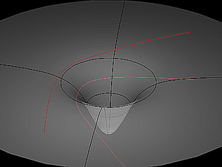
Geodesics
A geodesic is defined as
the shortest path between
two nearby points. In
general relativity, bodies
always follow geodesics in
four-dimensional space-
time. In absence of matter
or energy, they are straight;
in three dimensional space,
however, their presence in
space-time curves in a way the
trajectory of bodies or light becomes a curve.

Slide 32
Gravitational Constant (G)
As the gravitational constant is universal, the gravitation constant acting in our experiment must be 6,67.10⁻¹¹ m³kg⁻¹s⁻², in order to the model to be valid.
To validate this Newtonian model, relative conditions have to be similar to space-time, in terms of system dimensions.

Slide 33
Gravity Wells
A gravity well or gravitational well is a conceptual model of the gravitational field surrounding a body in space. The more massive the body the deeper and more extensive the gravity well associated with it. The Sun has a far-reaching and deep gravity well. Asteroids and small moons have much shallower gravity wells. Anything on the surface of a planet or moon is considered to be at the bottom of that celestial body's gravity well. Entering space from the surface of a planet or moon means climbing out of the gravity well. The deeper a planet or moon's gravity well is, the more energy it takes to achieve escape velocity.
In astrophysics, a gravity well is specifically the gravitational potential field around a massive body. Other types of potential wells include electrical and magnetic potential wells. Physical models of gravity wells are sometimes used to illustrate orbital mechanics. Gravity wells are frequently confused with general relativistic embedding diagrams, but the two concepts are unrelated.

Slide 34
Escape Velocity
In E_{m}> 0, the body is released from gravitational action and continues moving.
In E_{m}= 0, the body only has enough energy to break free of the gravitational field.
In E_{m}<0, the body hasn’t enough energy to escape the field, enters orbit and collides with the massive body causing deformation/gravitational field.

Slide 35
Experiment 1:
Yellow |  |  | Orange
m (g) | P (N) | x (cm) | m (g) | P (N) | x (cm)
109 | 1.09 | 1.2 | 109 | 1.09 | 1.3
171 | 1.71 | 1.8 | 171 | 1.71 | 2.1
218 | 2.18 | 2.2 | 218 | 2.18 | 2.7
265 | 2.65 | 2.8 | 265 | 2.65 | 3.2
328 | 3.28 | 3.5 | 328 | 3.28 | 4.0

Slide 36
Experiment 2: Fitting
Fitting to a polynomial of third degree:
s₀= 4.99654 +/- 0.8014 (16.04%)
v₀ = -0.496198 +/- 0.07466 (15.05%)
a = 0.035475 +/- 0.004634 (13.06%)
c = -0.000212467 +/- 2.395e-05 (11.27%)
Thus, parabolic fitting is valid.

Slide 37
Experiment 2: Variation of Acceleration

Slide 38
Experiment 1: Friction
Spring Constant
Different Sheets
Different ball
Experimental procedure:

Slide 39
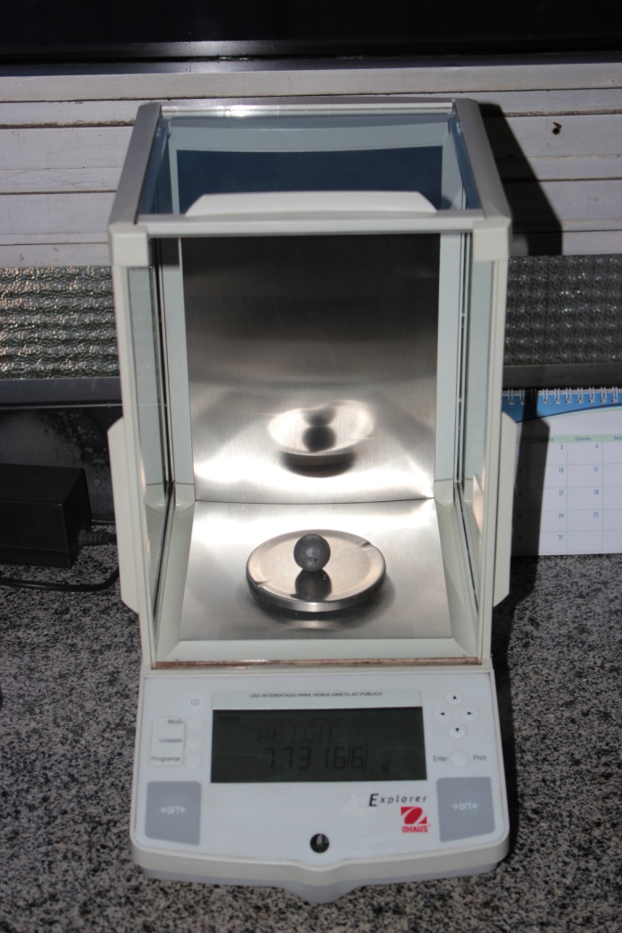
Measuring the balls’ masses

Slide 40
Experiment 1: Friction
Spring Constant
Different Sheets
Different ball
Friction
Erro 32,4%

Slide 41
Movement Equations

Slide 42
Elastic Membrane – Motion Equation
Newton’s second law (differential form):
Taylor series of x leads to a polynomial function x = a₀ + a₁t + a₂t² + a₃t³+...+ a_{n}t^{n}
n≥3 are negligible, as a₂ >>a₃
x(t)∼parabolic

Slide 43
Elastic Membranes and Deformation
Young Modulus is applicable in rubber-sheets:
This is just a first approximation, to show the relation between G_{a} and k!
A₀: cross sectional area
L₀: initial length
E: Young Modulus
k: spring constant

