Slide 1
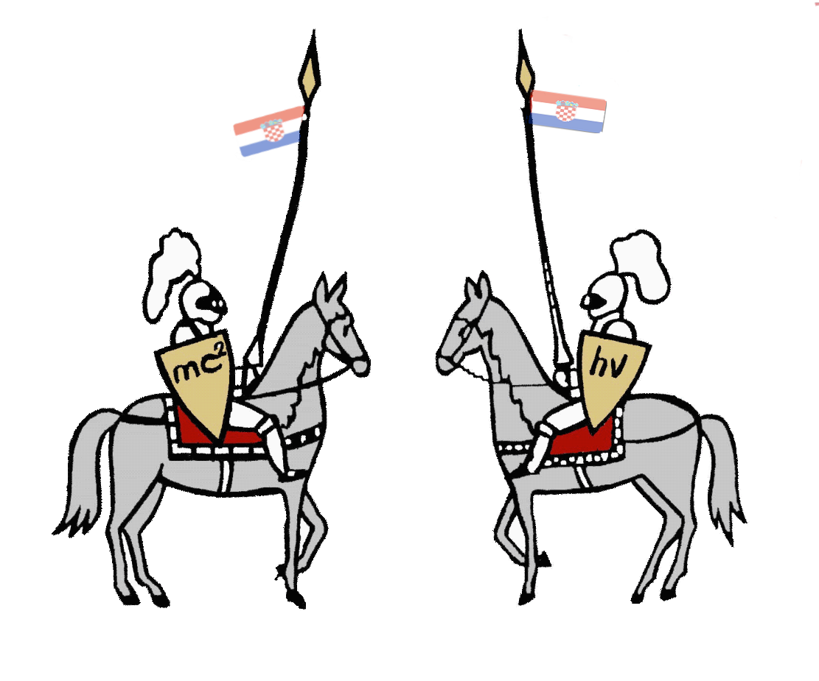
2. Elastic space
IYPT 2013 team of Croatia
Reporter: Domagoj Pluščec

Slide 2
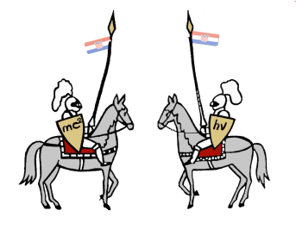
Problem
The dynamics and apparent interactions of massive balls rolling on a stretched horizontal membrane are often used to illustrate gravitation. Investigate the system further. Is it possible to define and measure the apparent “gravitational constant” in such a “world”?
2

Slide 3
3

Slide 4
Summary
Hypothesis
Theory
Fabric shape
Test ball
Kepler’s laws
Apparatus and methods
Results
Fabric shape
Gravitational constant
Orbit
Energy and angular momentum
Conclusion
4

Slide 5
Hypothesis
It was assumed that the shape of the curve behaves like a gravitational potential and that the form should be inversely proportional to ρ
ρ
$$z(ρ)∝\frac{1}{ρ}$$
z
5

Slide 6
Fabric shape and force on the ball
N
G
deformation depends on:
The coefficient of elasticity
The mass of the ball
The position of the ball on the fabric
Shape can’t be calculated analyticaly because of big deformations → it was determined experimentaly
6

Slide 7
Test ball – circular orbit
Test ball – small mass → negligibile deformation
$$tg\left(α\right)=z^{′}\left(ρ\right)=\frac{dz}{dρ}=\frac{N_{ρ}}{N_{z}}=\frac{F_{i}}{G}=\frac{v^{2}}{gρ}$$
z(ρ)
ρ
Looking from ball’s inertial system:
z
N
ρ
F_{i}
α
G
 | Elastic membrane | Universe
Force | $$F=−mg\frac{dz}{dρ}$$ | $$F=−m\frac{γM}{ρ^{2}}$$
Speed | $$v=\sqrt{gρ\frac{dz}{dρ}}$$ | $$v=\sqrt{ρg}$$
7

Slide 8
Test ball – energy
Energy of the system:
$$Etot=E_{k}+E_{p}+W_{fr}$$
Kinetic energy:
$$E_{k}=\frac{1}{2}\left(I_{cm}ω^{2}+mv^{2}\right)=\frac{7}{10}mv^{2}$$
Approximation – friction is constant
Potential energy:
$$\vec{F_{fr}}=−μmg\frac{\vec{v}}{v} \\ dW=F_{fr}ds=−μmg\frac{\vec{v}}{v}ds \\ dW=−μmg\frac{\vec{v}}{v}v\left(t^{′}\right)dt′ \\ W_{fr}\left(t\right)=μmg\int_{0}^{t}{v\left(t′\right)dt′}$$
Ball’s moment of inertia: $I_{cm}=\frac{2}{5}mr^{2}$
$$E_{p}=mgz\left(ρ\right)$$
Friction that does work on the ball is occuring when ball deformates the fabric when traveling on it (assumption μ is relatively small)
$$E=\frac{1}{2}\left(\frac{7}{5}mv^{2}\right)+mgz(ρ)+μmg\int_{0}^{t}{v\left(t′\right)dt}$$
8

Slide 9
Test ball – angular momentum
$$\vec{L}=m\vec{ρ}×\vec{v}=m\vec{ρ}×\vec{v_{ρ}}+m\vec{ρ}×\vec{v_{φ}}=m\vec{ρ}×\vec{v_{ρ}} \\ L=mρ^{2}ω \\ \frac{d\vec{L}}{dt}=m\vec{v}×\vec{v}+m\vec{ρ}×\vec{a}=m\vec{ρ}×\vec{a_{ρ}}+m\vec{ρ}×\vec{a_{φ}}=m\vec{ρ}×\vec{a_{φ}} \\ \vec{a_{φ}}=\frac{\vec{F_{fr}}}{m}=−μg\frac{\vec{v}}{v} \\ \frac{d\vec{L}}{dt}=−μmg\frac{ωρ^{2}}{v}\vec{k}=−μg\frac{L}{v}\vec{k}$$
$$φ$$
$$ρ$$
$$L\left(t\right)=L_{0}+∆L\left(t\right) \\ L\left(t\right)=m{ρ_{0}}^{2}ω_{0}−μmg\int_{0}^{t}{\frac{ρ^{2}ω}{v}dt}$$
z
L – angular momentum
ω – angular velocity

Slide 10
Kepler’s laws
The orbit of every planet is an ellipse with the Sun at one of the two foci.
A line joining a planet and the Sun sweeps out equal areas during equal intervals of time. ($\vec{L}=const$)
The square of the orbital period of a planet is proportional to the cube of average distance from the sun.
Universe | Elastic membrane
$$T^{2}=\frac{4π^{2}ρ^{3}}{γM}$$ | $$T^{2}=\frac{4π^{2}ρ}{g\frac{dz}{dρ}}$$
$$\frac{dL}{dt}=0$$ | $$\frac{dL}{dt}=−μg\frac{L}{v}$$
10

Slide 11
Apparatus
Bicycle wheel $\left(R=32.2 cm\right)$
Elastic fabric
Stands
Tubular spirit level
Meter
Camera
Balance
Computer software (ImageJ, IrfanView, self-made programs for numerical analysis)
Balls that we used
11
11

Slide 12
Method – fabric shape
Massive ball was placed in the middle of the wheel
Camera was perpendicular to the lowest point of elastic membrane
Coordinates of the fabric ends were determined by computer program ImageJ
12

Slide 13
Example of shape’s photography
Elastic space Croatian team Domagoj Pluscec
13

Slide 14
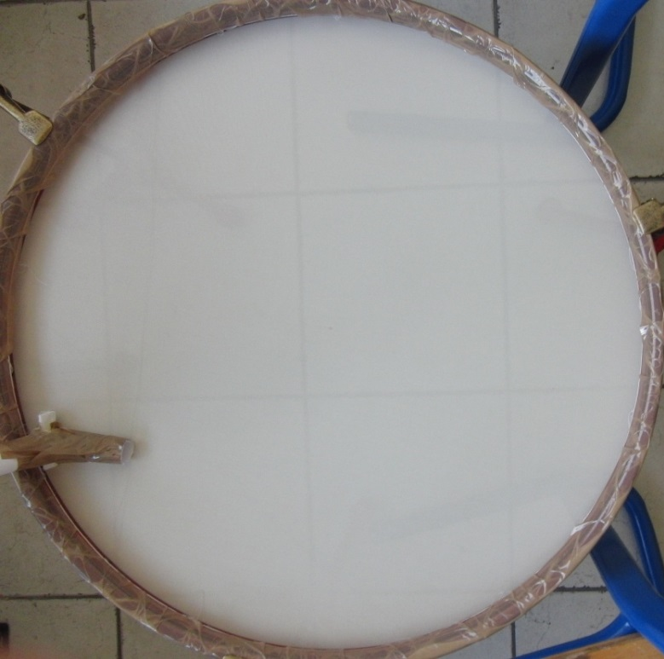
Method – motion of the balls
Massive ball – center of the wheel
Small ball ejected from the channel with initial speed
Camera was perpendicular to the plane of the wheel
Coordinates of the balls were obtained by video analysis (120-240)fps
14

Slide 15
Fabric shape
Ball: m₁=109g; r₁=1.5 cm
15

Slide 16
Fabric shape
16

Slide 17
Test – is our potential proportional to Kepler’s potential ?
Plot of our fabric shape dots on $z−\frac{1}{ρ}$ graph
Our hypothesis
Our shape
17

Slide 18
Function of our shape
Function that describes fabric shape in form:
$$z\left(ρ\right)=A+Bρ^{p}$$
Numerically calculated A, B, p so that they best fit to measured data
18

Slide 19
„Gravitational constant”
Elastic membrane
Universe
$$z\left(ρ\right)=A+Bρ^{p} \\ U\left(ρ\right)=U_{0}+mgBρ^{p}$$
$$F=−∇U(ρ)=−mg\frac{dz}{dρ}=−mg\frac{pB}{ρ^{1−p}}$$ → constant in our system:
$$Γ=pgB$$
$$z\left(ρ\right)=−32.16702+4.214ρ^{0.285}$$ $$Γ=11.782 m^{1.715}s^{−2}$$
$$U\left(ρ\right)=\frac{γM}{ρ} \\ F=−γ\frac{mM}{ρ^{2}}$$
$γ=6.6742∗{10}^{−11}m^{3}{kg}^{−1}s^{−2}$
A
B
p
19

Slide 20
Trajectory animation
20

Slide 21
Trajectory
21

Slide 22
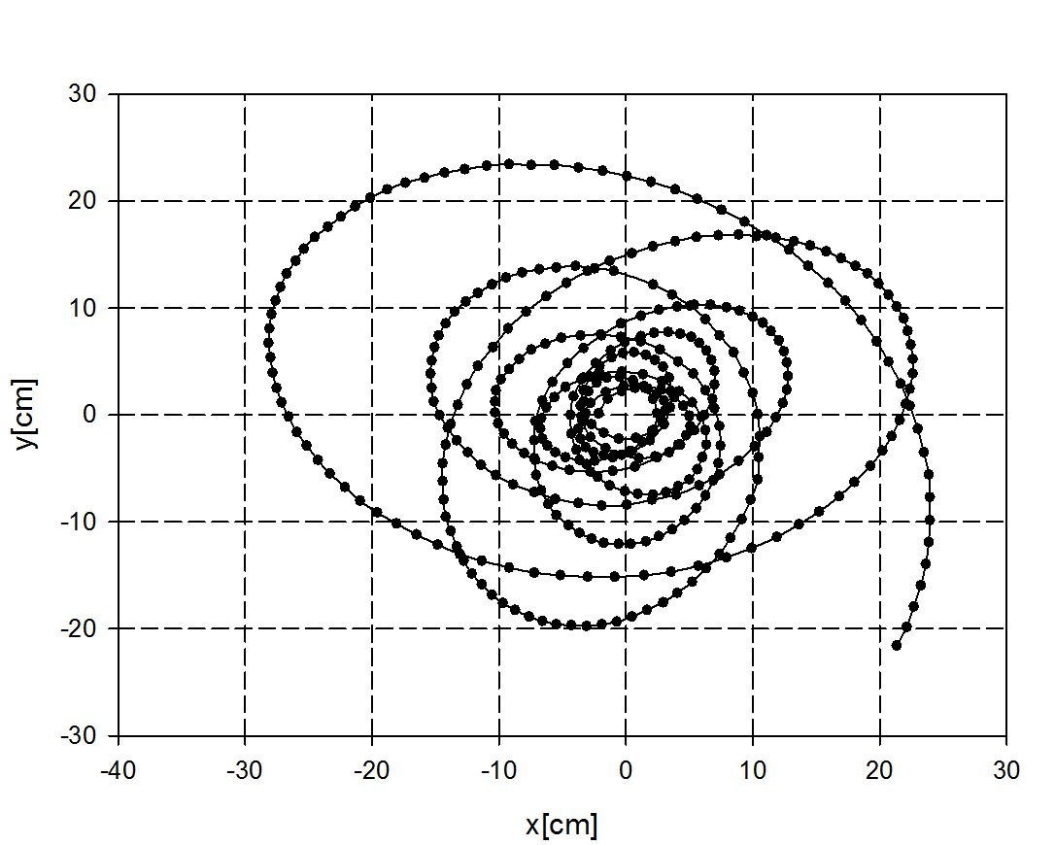
Ball distance from center vs time
ρ
22

Slide 23
Second Kepler’s law
$$ρ_{1},t_{1}$$
$$ρ_{2},t_{2}$$
dA
Calculated from coordinates of the ball $$dA=\frac{1}{2}ρ_{1}ρ_{2}\sin\left(∡\left(ρ_{1}ρ_{2}\right)\right) \\ t=t_{2}$$
dA – sweeped area in time interval dt (0.03 s)
23

Slide 24
Energy
Numerically adjusting $μ$ →show’s that if there weren’t friction the ball would have the same energy (maximal deviation 8%)
$$E_{0}$$
$$E=\frac{1}{2}\left(\frac{7}{5}mv^{2}\right)+U+W \\ E\left(t\right)=E_{0}−W(t) \\ W\left(t\right)=μmg\int_{0}^{t}{v\left(t′\right)dt}$$
E(t) numerically calculated from a video
24

Slide 25
Angular momentum
Numerically adjusting $μ$ →show’s that if there weren’t friction the ball would have same angular momentum (maximal deviation 12%)
$$L_{0}$$
$$L=mρ^{2}ω$$
$$L\left(t\right)=L_{0}−μmg\int_{0}^{t}{\frac{ρ^{2}ω}{v}}dt$$
L(t) numerically calculated from video
25

Slide 26
Conclusion
We have determined the potential of the system by experimentaly determing shape of our membrane
Potential in our system isn’t proportional to Kepler’s potential
We have calculated constant of our system which is not analogous to the gravitational constant because we couldn’t determine dependence of deformation to the mass
We have a non-central force (friction) in system
Second Kepler’s law isn’t valid in our case
26

Slide 27
Conclusion – comparison between universe and elastic membrane
 | Universe | Elastic membrane
Potential | $$U\left(ρ\right)=\frac{γM}{ρ}$$ | $$U\left(ρ\right)=U_{0}+mgBρ^{p}$$
Force | $$F=−m\frac{γM}{ρ^{2}}$$ | $$F=−mg\frac{dz}{dρ}$$
Circular orbit speed | $$v=\sqrt{gρ}$$ | $$v=\sqrt{gρ\frac{dz}{dρ}}$$
Period of an orbit | $$T^{2}=\frac{4π^{2}ρ^{3}}{γM}$$ | $$T^{2}=\frac{4π^{2}ρ}{g\frac{dz}{dρ}}$$
Angular momentum | $$L=m{ρ_{0}}^{2}ω_{0} \\ L=const$$ | $$L\left(t\right)=m{ρ_{0}}^{2}ω_{0}−μmg\int_{0}^{t}{\frac{ρ^{2}ω}{v}dt}$$
Energy | $$E_{tot}=E_{k}+E_{p}$$ | $$E=\frac{1}{2}\left(\frac{7}{5}mv^{2}\right)+mgz(ρ)+μmg\int_{0}^{t}{v\left(t′\right)dt}$$

Slide 28
Thank you
IYPT 2013 team of Croatia

Slide 29
Period of an orbit
$$F_{i}=−F_{cp} \\ mg\frac{dz}{dρ}=mω^{2}ρ \\ g\frac{dz}{dρ}=\frac{4π^{2}}{T^{2}}ρ \\ T^{2}=\frac{4π^{2}ρ}{g\frac{dz}{dρ}}$$

