Slide 1
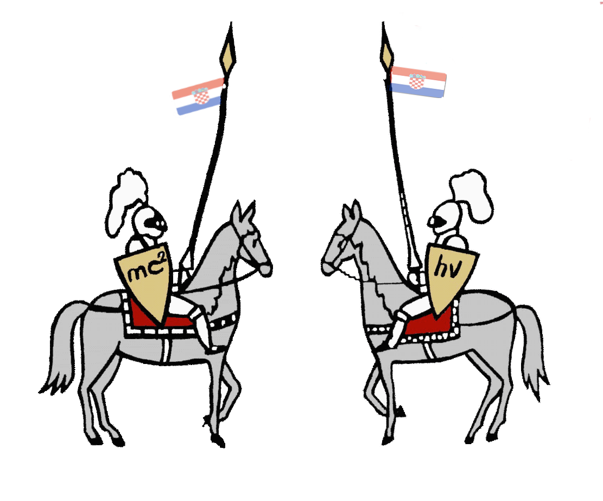
Invent yourself
IYPT 2013 team of Croatia
Reporter: Domagoj Pluščec

Slide 2
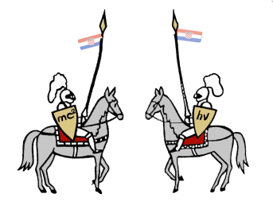
Problem
„It is more difficult to bend a paper sheet, if it is folded ‘accordion style’ or rolled into a tube. Using a single A4 sheet and a small amount of glue, if required, construct a bridge spanning a gap of 280 mm. Introduce parameters to describe the strength of your bridge, and optimise some or all of them.“
280 mm
2

Slide 3
Collapse of the bridge

Slide 4
Summary
Theory
Equilibrium
Stress
Buckling
Strength of the bridge
Experiment
Models
Apparatus
Method
Results
Conclusion
4

Slide 5
Equilibrium conditions
N
N
$\sum{\vec{F}=0}$
$\sum{\vec{τ}=0}$
For unloaded bridge
$2N−G=0$
Point A: $G∙\frac{l}{2}−Nl=0$
A
G
N
N
A
G+F
For loaded bridge
$2N−(G+F)=0$
Point A: $\left(G+F\right)∙\frac{l}{2}−Nl=0$
5

Slide 6
Basic characteristics
Paper
orthotropic (orthogonally anisotropic)
mechanical properties equal in certain directions of the fibers
80 gm⁻²; (210x297)mm
When the force is applied it leads to appearance of internal forces in material
6

Slide 7
Stress
Two types of stress: normal (σ) and shear stress (τ)
The Cauchy stress tensor - total stress at the point:
$\left[σ_{ij}\right]=\left[\begin{matrix}σ_{xx} & τ_{xy} & τ_{xz} \\ τ_{yx} & σ_{yy} & τ_{yz} \\ τ_{zx} & τ_{zy} & σ_{zz}\end{matrix}\right]$
Normal stress
$σ_{z}=\frac{F_{z}}{A}=\frac{M}{I_{y}}z$
z
x
y
F+mg
7

Slide 8
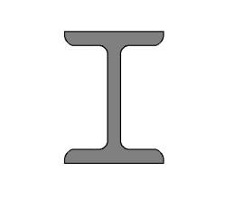
Top of the beam is
under compression
Bottom of the beam is under tension
Beam’s centerline is
neither under tension
nor compression
That is why I-cross section is used in construction of complex building structures
8

Slide 9
Area moment of inertia
Geometrical property of an area
reflects how its points are distributed with regard to an arbitrary axis
Definition
$I_{x}=\int_{A}{y^{2}dA=\int{\int_{A}{y^{2}dxdy}}}$
y
r2
$$I_{x}=\frac{π}{4}({r_{2}}^{4}−{r_{1}}^{4})$$
r1
x
9

Slide 10
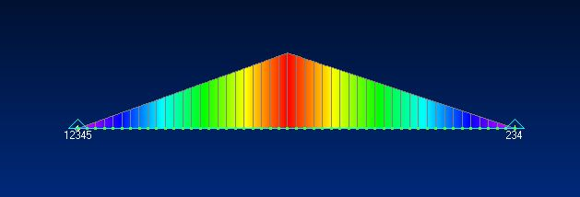
Simulation of stresses in the material
Software FEMAP – Finite Element Modeling And Postprocessing (numerically solves differential equation)
Necessary to define:
Material
Constraints
Shape of the bridge
Load
Plane moment of the beam
10

Slide 11
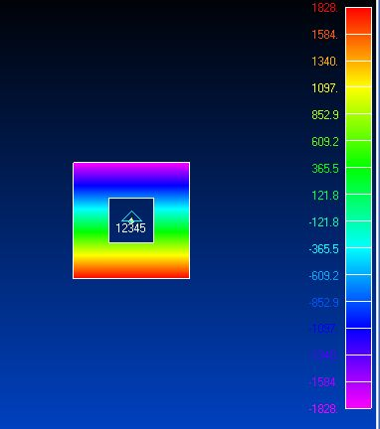
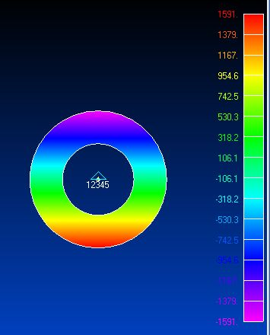
11

Slide 12
Buckling
When area moment of inertia is too large it comes to buckling of the section
It is necessary to find the optimal ratio between the area moment of inertia and stiffness of the bridge (stifness changes with number of windings)
I>>
I>>
I
12

Slide 13
Definition of the "strength" of the bridge
Strength - ability to carry a load without causing failure
Rigidity - resistance to structural deformation (change in shape and volume)
Stability - the ability of construction and its elements that under given load retain the original form of elastic equilibrium
13

Slide 14
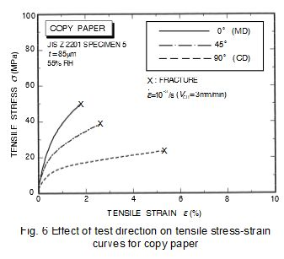
Definition of the "strength" of the bridge
*
The maximum force prior to the plastic deformation
If plastic deformation doesn’t occur – maximum force before the collapse of the bridge
* Włodzimierz Szewczyk, Krzysztof Marynowski, Wiktorian Tarnawski, An Analysis of Young’s Modulus Distribution in the Paper Plane
14

Slide 15
Definition of the model
Model - basic shape of the bridge
Defined by as little as possible parameters
„bi-triangle”
Model |  | The range of the area moment of inertia [cm⁴]
Basic models
Triangle |  | 0.14 – 5.19
Rectangle |  | 0.40 – 12.26
Circle |  | 0.35 – 11.21
Accordion |  | 0.11 – 4.41
U-shape |  | - model discarded
Complex models
 | Isosceles trapezoid „Bi-triangle” „Accordion with base”
15

Slide 16
Experiment
F
Δx
We measured:
Δx – vertical displacement while applying some force F (∆x is proportional to the radius and angle of curvature of the bridge)
16

Slide 17
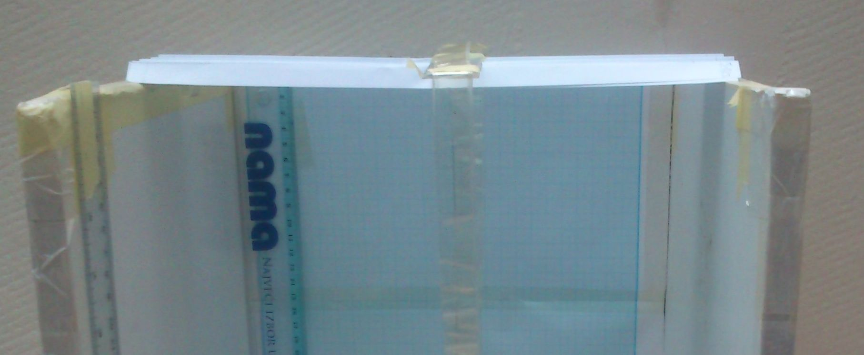
Aparatus
Stands
Caliper
Scale
Ruler
Software (FEMAP)
A4 paper and glue
Mirror
In preparing of the setup we wanted to :
Reduce possible vibration of the environment
Reduce the possibility of parallax by using a mirror
That the force on the bridge is perpendicular to the plane in which bridge lies
17

Slide 18
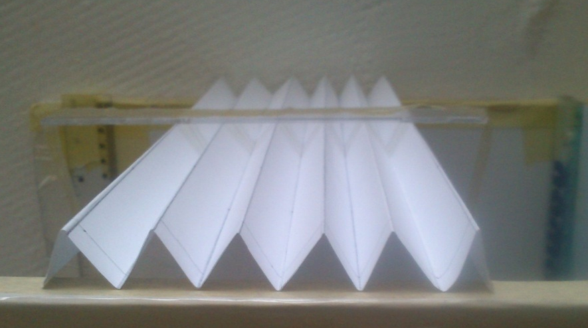
Method
Bridge was constructed
Bridge was simetrically positioned on the setup
Bridge was loaded in a way that the force was perpendicular to the plane of the bridge
Vertical displacement was measured
We checked if there was plastic deformation of the bridge
18

Slide 19
Circle – force vs vertical displacement
19

Slide 20
Circle – maximal force vs number of windings
20

Slide 21
Triangle – maximal force vs angle
Invent yourself Croatian team Domagoj Pluscec
α
21

Slide 22
Triangle – maximal force vs number of windings
22

Slide 23
Rectangle – maximal force vs page ratio
$$Page ratio \\ \frac{a}{b}$$
a
b
23

Slide 24
Rectangle – Maximal force vs number of windings
24

Slide 25
Accordion – maximal force vs number of winkles
1 wrinkle
25

Slide 26
Optimization
Complex models
Bigger number of parameters
Design based on conclusions from the measurements on basic models
Optimal model – maximal force before plastic deformation or before collapse of the bridge
26

Slide 27
Maximal force for every model
Model | Maximal force[N]
Circle | $$4.6$$
Triangle | $$2.8$$
Rectangle | $$2.6$$
Accordion | $$2.0$$
Isosceles trapezoid | $$2.5$$
„Bi-triangle” | $$1.4$$
„Accordion with base” | $$2.3$$
27

Slide 28
Conclusion
Strenght was defined trought parameters:
Area moment of inertia
Stifness (number of windings)
We have defined and analysed 8 models
Models were analysed experimentaly
We have theoreticaly explained what happens to the bridge when force acts on it
Optimal model is bride with circular cross section with 3 windings (inner radius 11.1 cm)
28

Slide 29
Literature
Vice Šimić, Strength of Materials I., Školska knjiga, Zagreb, 2002.
Vice Šimić, Strength of Materials II., Školska knjiga, Zagreb, 1995.
J. E. Gordon, Structures, Penguin Group, London, 1987.
Željana Nikolić, Basics of structures II, Civil Engineering and Architecture, University of Split
Włodzimierz Szewczyk, Krzysztof Marynowski, Wiktorian Tarnawski, An Analysis of Young’s Modulus Distribution in the Paper Plane
Prateek Verma , A Review of Poisson’s Ratio of Paper, Georgia Institute of Technology

Slide 30
Thank you
IYPT 2013 team of Croatia

