Slide 1
4. Soliton
IYPT 2013 team of Croatia
Reporter: Domagoj Pluščec

Slide 2
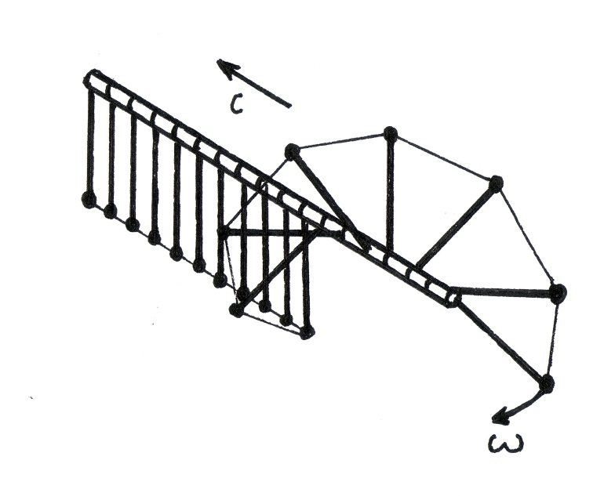
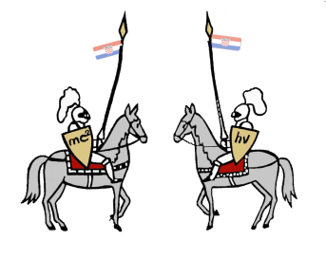
Problem
A chain of similar pendula is mounted equidistantly along a horizontal axis, with adjacent pendula being connected with light strings. Each pendulum can rotate about the axis but can not move sideways (see figure). Investigate the propagation of a deflection along such a chain. What is the speed for a solitary wave, when each pendulum undergoes an entire 360º revolution?
2

Slide 3
Pendulum system
3

Slide 4
Summary
Theory
What is a soliton?
Model of the system
Experimental
Apparatus
Methods
Results
Conclusion
Equilibrium position
4

Slide 5
Soliton
Wave packet that travels trought medium with unchanged shape
Form of solution of some nonlinear partial diferential equations (Sine-gordon equation, KdV equation)
They can interact with other solitons, and emerge from the collision unchanged except for a phase shift
5

Slide 6
Theory – basic concepts
∆z
z
d
$$Iα_{k}=\sum{τ}$$
$${\vec{ρ}}_{k}$$
l
$Iα_{k}=τ_{g}+τ_{k+1, k}+τ_{k, k−1}$
Analogly derived
$${\vec{r}}_{k+1,k}$$
$$τ_{g}=−mgdsin(φ_{k})$$
$${\vec{ρ}}_{k}=l∗(cos\left(φ_{k}\right)\vec{i}+\sin\left(φ_{k}\right)\vec{j})$$
$${\vec{r}}_{k+1,k}={\vec{ρ}}_{k+1,k}+∆z\vec{k}$$
$${\vec{τ}}_{k+1,k}=\vec{l}×{\vec{F}}_{k+1,k}$$
Hooke’s law:
$$F_{k+1,k}=k(r_{k+1,k}−∆z)$$
y
φ_{k}
φ_{k+1}
$$τ_{g}−gravitational torque$$
$$τ_{k+1,k}−torque from next pendulum$$
$$k −coefficient of elasticity of the string \\ d −distance between center of gravity and horizontal rod \\ I−moment of inertia of the pendulum$$
$${\vec{F}}_{k+1,k }$$
$${\vec{F}}_{k,k−1}$$
x
6

Slide 7
Theory – our model
Torque from elastic string:
$$τ_{k+1,k}=kl^{2}A_{k+1,k}\sin\left(φ_{k+1,k}\right)$$
Equation of the motion of the pendulum:
$$Iα_{k}=−mgdsinφ_{k}+kl^{2}\left(A_{k+1,k}\sin{φ_{k+1,k}}−A_{k,k−1}\sin{φ_{k,k−1}}\right)$$
We solved it numerically with computer (programing languages – python and quick basic) for every pendulum in some time interval
initial conditions from experimental setup (initial position and velocities for system of pendulums)
y
φ_{k}
Substitution:
$$A_{n+1,n}=\left(1−\frac{1}{\sqrt{1+B^{2}\sin^{2}\frac{φ_{n+1,n}}{2}}}\right) ;B=\frac{2l}{Δz}$$
φ_{k+1}
x
7

Slide 8
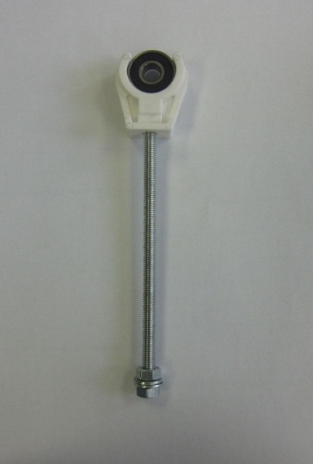
Apparatus
HS camera
Custom stand
Reduce vibrations of horizontal rod
Ruler
Software (ImageJ, self-made programs for numerical analysis)
Balance
Ball bearing
Plastic holder
Threaded rod
Nut
Pendulum
Stand
String
8

Slide 9
Characteristics of our system
Pendulum
Length = 14.5 cm
Mass = 45 g
Distance from centre of the gravity to the rotational center = 6.1 cm
Moment of inertia = $3.69∗{10}^{−4}$ kgm²
Internal radius of a ball bearing = 8 mm
External radius of a ball bearing = 22 mm
System
Distance between pendulums 5.3 cm
Number of pendulums = 27
Ball bearing
Plastic holder
Threaded rod
Nut

Slide 10
Method
Weight was connected to the first pendulum
We released the weight to give initial speed
Weight would disconnect from pendulum
Pendulums
Pulley
Pulley
The wave was filmed by high speed camera (120 -420 fps)
Weight
Pendulum
10

Slide 11
Traveling wave
120 fps
Speed of the wave – displacement of the amplitude of the wave divided by the time interval
11

Slide 12
Theoretical wave
We created system with the same initial conditions
Every white line represents one pendulum
12

Slide 13
Comparison
13

Slide 14
Width of the wave vs coefficient of elasticity
Width of the wave increases with coefficient of elasticity
Energy given to the system was same for every measurement
14

Slide 15
Speed of the wave vs energy given to the system
Speed of the wave increases with increasing energy given to the system
Energy was changed by changing mass of the weight
15

Slide 16
Collision – clockwise-counterclockwise
Solitons repel each other – they reflect with phase shift = π
In collision they behave like a fixed end

Slide 17
Collision – clockwise-clockwise
Solitons pass trought each other – they don’t add them selves by superposition principle

Slide 18
Conclusion
Pendulum system was constructed
We have modeled the system theoreticaly and shown the correlation between experiment and theory
Speed of the wave increases with initial energy given to the system
Speed of the wave increases with increasement of coefficient of elasticity of the string
Two types of collision were observed
Same direction of rotation → pass through each other
Opposite direction of rotation → reflection on fixed end
18

Slide 19
Literature
[1] Andrey Miroshnichenko, Solitons and Soliton collisions, http://www.mpipksdresden.mpg.ge/~andreym/solitons [2] Peter S. Lomdahl, What is soliton, http://www.fas.org/sgp/othergov/doe/lanl/pubs/00326980.pdf
[3] System of Pendulums: A Realization of Sine-Gordon Model, http://demonstrations.wolfram.com/SystemOfPendulumsARealizationOfTheSineGordonModel/
[4] Clay James Grewcoe, Analysis of soliton solutions of Sine - Gordon equation.

Slide 20
Thank you
IYPT 2013 team of Croatia

Slide 21
Derivation of theory
∆z
z
d
Hooke’s law:
$$F_{k+1,k}=k\left(r_{k+1,k}−∆z\right) \\ F_{k+1,k}=k∆z\left(\sqrt{1+b^{2}\sin^{2}\left(\frac{φ_{k+1,k}}{2}\right)}−1\right)$$
l
$$∆\vec{r}=\vec{r_{k+1}}−\vec{r_{k}} \\ \vec{r_{n}}=\vec{ρ_{n}}+z_{n}\vec{k} \\ \vec{ρ_{n}}=l\left(\cos\left(φ_{n}\right)\vec{i}+\sin\left(φ_{n}\right)\vec{j}\right) \\ \left|r_{k+1,k}\right|=\sqrt{\vec{ρ_{k+1,k}}+∆z} \\ \left|r_{k+1,k}\right|=∆z\sqrt{1+b^{2}\sin^{2}\left(\frac{φ_{k+1,k}}{2}\right)} \\ b=\frac{2l}{∆z}$$
y
φ_{k}
φ_{k+1}
$${\vec{F}}_{k+1,k }$$
$${\vec{F}}_{k,k−1}$$
x

Slide 22
Derivation of theory
∆z
z
d
Hooke’s law:
$$F_{k+1,k}=k∆z\left(\sqrt{1+b^{2}\sin^{2}\left(\frac{φ_{k+1,k}}{2}\right)}−1\right)$$
l
$${\vec{τ}}_{k+1,k}=\vec{l}×{\vec{F}}_{k+1,k} \\ {\vec{τ}}_{k+1,k}=F_{k+1,k}∗\frac{l^{2}}{r_{21}}\sin\left(φ_{21}\right)\vec{k} \\ τ_{k+1,k}=kl^{2}\left(1−\frac{1}{\sqrt{1+{\left(\frac{2l}{Δz}\right)}^{2}\sin^{2}\frac{φ_{n+1,n}}{2}}}\right)\sin{φ_{k+1,k}}$$
y
φ_{k}
φ_{k+1}
$${\vec{F}}_{k+1,k }$$
$${\vec{F}}_{k,k−1}$$
x

Slide 23
One pendulum rotation - damping

