Slide 1
Problem #17
Fire Hose
Mingyu Kang
Team Korea

Slide 2
Phenomenon
PARAMETERS?
Notes:
노즐 달아서 더 지랄맞은거 보여줌

Slide 3
Force Analysis: Fluid inside the nozzle
Pressure Force
$p_{L}$: Internal pressure at the end of the hose
$A$: Internal cross-section area
$$y$$
$$p_{L}A$$
$p_{L}$: Internal pressure at the end of the hose
$l$: Length of the nozzle
$M$: Mass of fluid per unit length
$F$: Force per unit length between tube and fluid
$q$: Shear stress on the tube
$S$: Internal perimeter
$A$: Internal cross-section area
$$x$$
Gravitational Force
$M$: Mass of fluid per unit length
$l$: Length of the nozzle
$$M\frac{∂^{2}y}{∂t^{2}}l$$
Friction Force
$q$: Shear stress on the tube
$S$: Internal perimeter
$l$: Length of the nozzle
$$qSl$$
Inertial Force
$M$: Mass of fluid per unit length
$l$: Length of the nozzle
$$Fl$$
Force between nozzle and fluid
$F$: Force per unit length
between nozzle and fluid
$l$: Length of the nozzle
$$Mgl$$

Slide 4
Force Analysis: Nozzle
$$y$$
$$T_{L}$$
Tension Force
$T_{L}$: Tension force at the end of the hose
$$x$$
$T_{L}$: Tension force at the end of the hose
$m′$: Mass of nozzle per unit length
$F$: Force per unit length between nozzle and fluid
$q$: Shear stress on the tube
$S$: Internal perimeter
$l$: Length of the nozzle
Gravitational Force
$m′$: Mass of nozzle per unit length
$l$: Length of the nozzle
$$Fl$$
Friction Force
$q$: Shear stress on the tube
$S$: Internal perimeter
$l$: Length of the nozzle
$$m′\frac{∂^{2}y}{∂t^{2}}l$$
Force between nozzle and fluid
$F$: Force per unit length
Between nozzle and fluid
$l$: Length of the nozzle
Inertial Force
$m′$: Mass of nozzle per unit length
$l$: Length of the nozzle
$$qSδx$$
$$m′gl$$

Slide 5
Force Equation
$$p_{L}A$$
$$y$$
$$x$$
$$M\frac{∂^{2}y}{∂t^{2}}l$$
$$qSl$$
$$Fl$$
$$Mgl$$
$$\frac{p_{L}A}{l}−qS+Mg+F\frac{∂y}{∂x}=0$$
$$F+M\frac{∂^{2}y}{∂t^{2}}−\frac{A}{l}\left(p_{L}\frac{∂y}{∂x}\right)+qS\frac{∂y}{∂x}=0$$
$x$:
$y$:

Slide 6
Force Equation
$$T_{L}$$
$$y$$
$$x$$
$$Fl$$
$$m′\frac{∂^{2}y}{∂t^{2}}l$$
$$qSl$$
$$m′gl$$
$$−\frac{T_{L}}{l}+qS+m^{′}g−F\frac{∂y}{∂x}=0$$
$$F−m′\frac{∂^{2}y}{∂t^{2}}−\frac{1}{l}\left(T_{L}\frac{∂y}{∂x}\right)+qS\frac{∂y}{∂x}=0$$
$x$:
$y$:

Slide 7
Combined equation
$$\frac{∂^{2}y}{∂t^{2}}+g\frac{∂y}{∂x}≈\frac{∂^{2}y}{∂t^{2}}+g\sin{θ}=0$$
$$y$$
$$\frac{∂y}{∂x}≈0$$
$$x$$
$$T_{L}−p_{L}A=(M+m^{′})gl$$

Slide 8
Difference between nozzle and hose

Slide 9
Force Analysis: Fluid
$$y$$
Pressure Force
$p$: Internal pressure
$A$: Internal cross-section area
$$pA$$
$p$: Internal pressure
$M$: Mass of fluid per unit length
$U$: Flow velocity
$F$: Force per unit length between tube and fluid
$q$: Shear stress on the tube
$S$: Internal perimeter
$A$: Internal cross-section area
$$x$$
Gravitational Force
$M$: Mass of fluid per unit length
$$M{(\frac{∂}{∂t}+U\frac{∂}{∂x})}^{2}yδx$$
Friction Force
$q$: Shear stress on the tube
$S$: Internal perimeter
$$qSδx$$
Non-Inertial Frame Acceleration
$M$: Mass of fluid per unit length
$U$: Flow Velocity
$$Fδx$$
Force between hose
and fluid
$F$: Force per unit length
between hose and fluid
$$Mgδx$$
$$(p+\frac{∂p}{∂x}δx)A$$

Slide 10
Non-Inertial Reference Frame
$$y$$
$$a_{iniertial}=M\frac{∂^{2}y}{∂t^{2}}δx$$
$$a_{centripetal}=M\frac{U^{2}}{R}δx$$
$$κ=\frac{1}{R}≈\frac{∂^{2}y}{∂x^{2}}$$
$$∴a_{centripetal}=MU^{2}\frac{∂^{2}y}{∂x^{2}}δx$$
$$a_{coriolli}=2ωv_{x}′$$
$$=2\frac{U}{R}\frac{∂x}{∂t}=2U\frac{∂^{2}y}{∂x∂t}$$
$$a=M{(\frac{∂}{∂t}+U\frac{∂}{∂x})}^{2}δx$$
$$x$$
$$R$$
$$y′$$
$ω$ (Angular velocity of
reference frame)
$$x′$$

Slide 11
Force Analysis: Hose
$$T$$
$$y$$
Tension Force
$T$: Tension force
$$Q$$
Gravitational Force
$m$: Mass of hose per unit length
$$x$$
$T$: Tension force
$U$: Flow velocity
$m$: Mass of hose per unit length
$F$: Force per unit length between tube and fluid
$q$: Shear stress on the tube
$S$: Internal perimeter
$Q$: Transverse shear force on the tube
$$Fδx$$
$$m\frac{∂^{2}y}{∂t^{2}}δx$$
Friction Force
$q$: Shear stress on the tube
$S$: Internal perimeter
Inertial Force
$m$: Mass of hose per unit length
$$Q+\frac{∂Q}{∂x}δx$$
Flexural Force
$Q$: Transverse shear force on the tube
$$qSδx$$
Force between hose
and fluid
$F$: Force per unit length
Between hose and fluid
$$mgδx$$
$$T+\frac{∂T}{∂x}δx$$

Slide 12
Bending Moment
$$\vec{F}$$
$$σ_{x}$$
$$\vec{M}$$
$$\vec{M}$$
Bending Moment
$$M=\int_{A}{σ_{x}ydA}=κEI$$
Rigidity
Notes:
Bending moment에 의한 위치에너지 식에 대한 설명 추가

Slide 13
Transverse shear force on the hose
$$y$$
$$Q$$
$$x$$
$$M=κEI=EI\frac{∂^{2}y}{∂x^{2}}$$
$$Q=−\frac{∂}{∂x}M=−EI\frac{∂^{3}y}{∂x^{3}}$$
$$∴ \frac{∂Q}{∂x}δx=−EI\frac{∂^{4}y}{∂x^{4}}δx$$
$$Q+\frac{∂Q}{∂x}δx$$
Notes:
Bending moment – resistance to torque

Slide 14
Force equation
$$pA$$
$$y$$
$$x$$
$$M{(\frac{∂}{∂t}+U\frac{∂}{∂x})}^{2}δx$$
$$qSδx$$
$$Fδx$$
$$(p+\frac{∂p}{∂x}δx)A$$
$$Mgδx$$
$$−A\frac{∂p}{∂x}−qS+Mg+F\frac{∂y}{∂x}=0$$
$$F+M{(\frac{∂}{∂t}+U\frac{∂}{∂x})}^{2}y+A\frac{∂}{∂x}\left(p\frac{∂y}{∂x}\right)+qS\frac{∂y}{∂x}=0$$
$x$:
$y$:

Slide 15
Force equation
$$T$$
$$Q$$
$$y$$
$$Fδx$$
$$x$$
$$m\frac{∂^{2}y}{∂t^{2}}δx$$
$$Q+\frac{∂Q}{∂x}δx$$
$$qSδx$$
$$mgδx$$
$$T+\frac{∂T}{∂x}δx$$
$$\frac{∂T}{∂x}+qS+mg−F\frac{∂y}{∂x}=0$$
$x$:
$$−EI\frac{∂^{4}y}{∂x^{4}}+F−m\frac{∂^{2}y}{∂t^{2}}+\frac{∂}{∂x}\left(T\frac{∂y}{∂x}\right)+qS\frac{∂y}{∂x}=0$$
$y$:

Slide 16
Combined Equation
For the end point & $T_{L}−p_{L}A=(M+m^{′})gl$
$$\frac{∂^{2}y}{∂t^{2}}=−\frac{EI}{M+m}\frac{∂^{4}y}{∂x^{4}}−\frac{M}{M+m}U^{2}\frac{∂^{2}y}{∂x^{2}}−2\frac{M}{M+m}U\frac{∂^{2}y}{∂x∂t}−g\frac{∂y}{∂x}$$
Flexural
Restoring
Force
Centrifugal Force
Coriolis
Force
Gravity
Restoring force?

Slide 17
Coriolis force is not a restoring force!
$$a_{coriolli}=−2\frac{M}{M+m}U\frac{∂^{2}y}{∂x∂t}$$
$=$ $−2\frac{M}{M+m}U\frac{∂}{∂t}\left(\frac{∂y}{∂x}\right)=−2\frac{M}{M+m}Uω_{hose}$
$$y$$
$$a_{coriolli}$$
$$ω_{hose}$$
$$ω_{hose}$$
$$y$$
Notes:
코리올리로 호스의 움직임 시뮬레이션?

Slide 18
Restoring forces are…
$$\frac{∂^{2}y}{∂t^{2}}=−\frac{EI}{M+m}\frac{∂^{4}y}{∂x^{4}}−\frac{M}{M+m}U^{2}\frac{∂^{2}y}{∂x^{2}}−2\frac{M}{M+m}U\frac{∂^{2}y}{∂x∂t}−g\frac{∂y}{∂x}$$
Flexural
Restoring
Force
Centrifugal Force
Coriolis
Force
Gravity
Coriolis
Force
Restoring force!
$$T$$
Notes:
각 힘들의 맥시멈 값 스케일 비교해 보기1

Slide 19
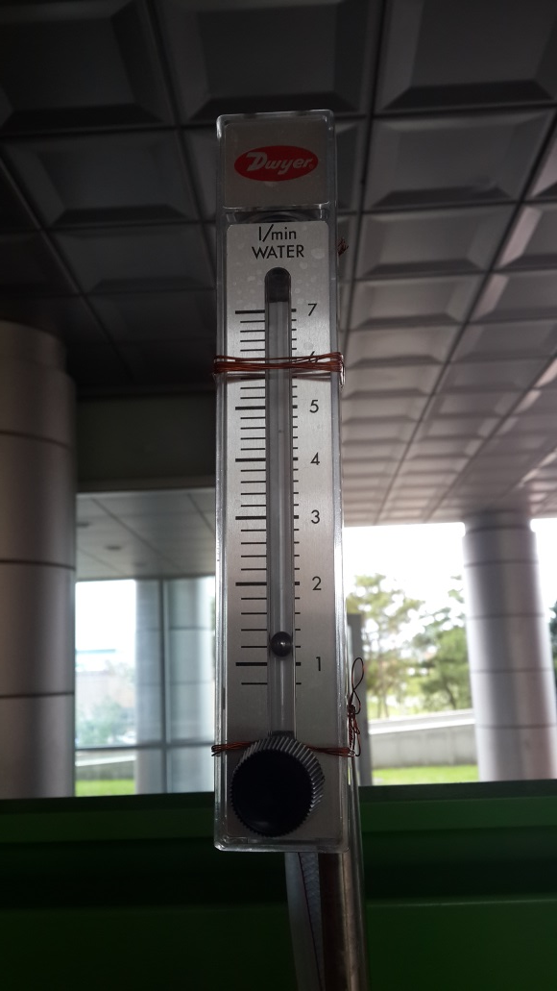
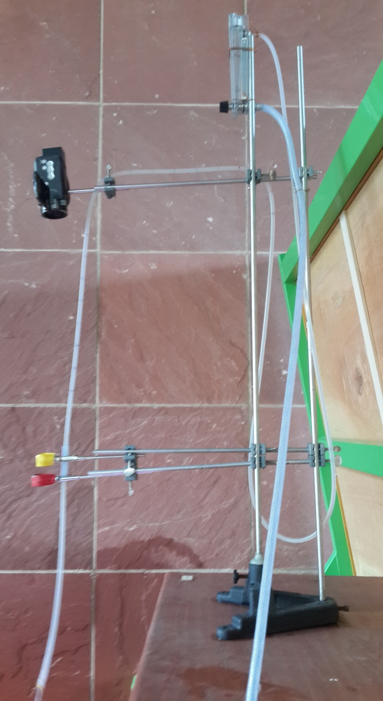
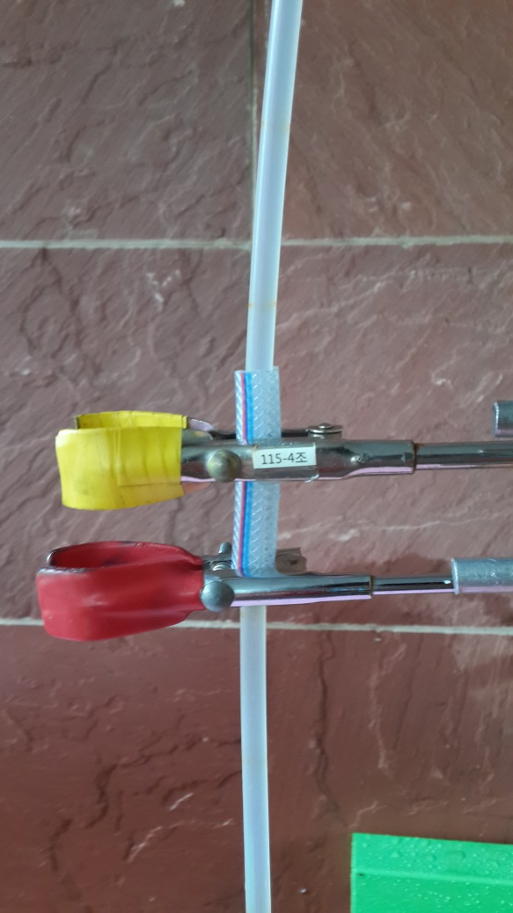
Experimental Setting - Vertical
Hose
Rigidity
Flow
Rate
Nozzle
mass
/radius
Free
Length

Slide 20
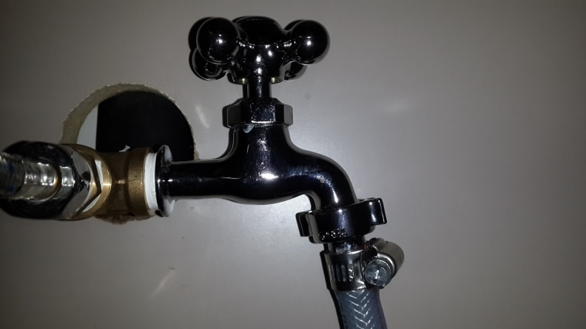
Experimental Setting - Horizontal
Valve
Soap
Clamp

Slide 21
Free length – Oscillation period Tendency
$$R$$
$$R$$
$$θ$$
$$θ≈\frac{dy}{dx}$$
$$θ$$
$$\frac{1}{R}≈\frac{d^{2}y}{dx^{2}}$$

Slide 22
Free length – Oscillation period Tendency
$$\frac{∂^{2}y}{∂t^{2}}=−\frac{EI}{M+m}\frac{∂^{4}y}{∂x^{4}}−\frac{M}{M+m}U^{2}\frac{∂^{2}y}{∂x^{2}}−2\frac{M}{M+m}U\frac{∂^{2}y}{∂x∂t}−g\frac{∂y}{∂x}$$
Flexural
Restoring
Force
Centrifugal Force
Coriolis
Force
Gravity
$$T$$

Slide 23
Free length – Oscillation period Graph (Vertical)
2nd
harmonics!

Slide 24
Modes of Oscillation
30cm
70cm

Slide 25
Free length – Oscillation period Graph (Horizontal)
Effective
Free Length!

Slide 26
Effective Free Length
FIXED
$L=60$cm

Slide 27
Flow rate – Oscillation period Tendency
$$\frac{∂^{2}y}{∂t^{2}}=−\frac{EI}{M+m}\frac{∂^{4}y}{∂x^{4}}−\frac{M}{M+m}U^{2}\frac{∂^{2}y}{∂x^{2}}−2\frac{M}{M+m}U\frac{∂^{2}y}{∂x∂t}−g\frac{∂y}{∂x}$$
Flexural
Restoring
Force
Centrifugal Force
Coriolis
Force
Gravity
$$T$$

Slide 28
Flow rate – Oscillation period Graph (Vertical)
Notes:
첫 점 이유 밝히셈

Slide 29
Flow rate – Oscillation period Graph (Horizontal)

Slide 30
Nozzle mass– Oscillation period Tendency
$$\frac{∂^{2}y}{∂t^{2}}=−\frac{EI}{M+m}\frac{∂^{4}y}{∂x^{4}}−\frac{M}{M+m}U^{2}\frac{∂^{2}y}{∂x^{2}}−2\frac{M}{M+m}U\frac{∂^{2}y}{∂x∂t}−g\frac{∂y}{∂x}$$
Flexural
Restoring
Force
Centrifugal Force
Coriolis
Force
Gravity
$$T$$

Slide 31
Nozzle mass – Oscillation period Graph (Vertical)

Slide 32
Nozzle mass – Oscillation period Graph (Horizontal)

Slide 33
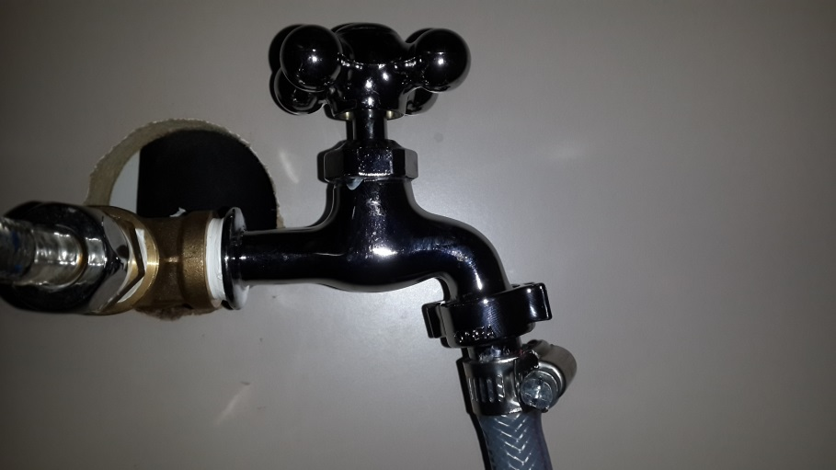
Nozzle radius – Oscillation period Tendency
$$p$$
$$p$$
$$r_{1}$$
$$U$$
$$p+\frac{1}{2}ρU^{2}=\frac{1}{2}ρu^{2}$$
$${r_{1}}^{2}U_{L}={r_{2}}^{2}U_{l}$$
$$U_{L}=\sqrt{\frac{2p}{ρ(\frac{{r_{1}}^{2}}{{r_{2}}^{2}}−1)}}$$
$$u$$
$$r_{2}$$

Slide 34
Nozzle radius – Oscillation period Tendency
$$\frac{∂^{2}y}{∂t^{2}}=−\frac{EI}{M+m}\frac{∂^{4}y}{∂x^{4}}−\frac{M}{M+m}U^{2}\frac{∂^{2}y}{∂x^{2}}−2\frac{M}{M+m}U\frac{∂^{2}y}{∂x∂t}−g\frac{∂y}{∂x}$$
Flexural
Restoring
Force
Centrifugal Force
Coriolis
Force
Gravity
$$T$$

Slide 35
Nozzle radius – Oscillation period Graph (Horizontal)

Slide 36
Hose Rigidity– Oscillation period Tendency
$$\frac{∂^{2}y}{∂t^{2}}=−\frac{EI}{M+m}\frac{∂^{4}y}{∂x^{4}}−\frac{M}{M+m}U^{2}\frac{∂^{2}y}{∂x^{2}}−2\frac{M}{M+m}U\frac{∂^{2}y}{∂x∂t}−g\frac{∂y}{∂x}$$
Flexural
Restoring
Force
Centrifugal Force
Coriolis
Force
Gravity
$$T$$

Slide 37
Hose Rigidity– Oscillation period Graph (Vertical)
$$m=0.019kg/m$$
$$r_{in}=4.5mm$$
$$m=0.020kg/m$$
$$r_{in}=4.0mm$$
$$m=0.040kg/m$$
$$r_{in}=5.5mm$$
PARAMETER
CONTROL

Slide 38
Why does instable motion occur?
L =90cm

Slide 39
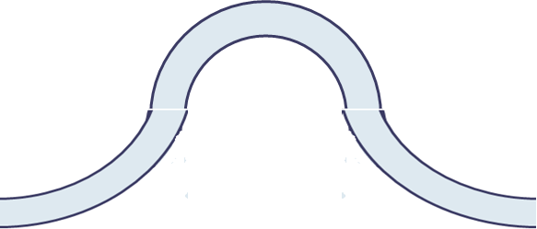
Instability 1 : Centrifugal Force
$$F_{c}$$
$$L, U$$
$$F_{c}=\frac{mU^{2}}{R}$$
$$R$$
$$R$$
Initial Displacement

Slide 40
Instability 2: Friction
$$μ_{s}$$
$$μ_{k}$$
$$F$$
Discontinuity
On Time

Slide 41
Conclusion
Parameters :
$$T$$
Free Length
of the Hose
Flow Rate
Nozzle Mass
Nozzle Radius
Rigidity of the Hose
Instability
Centrifugal Force
Friction

Slide 42
Thank You

Slide 43
Problem statement
Consider a hose with a water jet coming from its nozzle. Release the hose and observe its subsequent motion. Determine the parameters that affect this motion.

Slide 44
Flow rate – Oscillation period Graph
Critical
Flow Rate

Slide 45
Nozzle radius – Critical flow rate Graph

Slide 46
Solving the Differential Equation
$$y\left(0, t\right)=0$$
$$\frac{∂}{∂x}y\left(x, t\right)｜x=0=\frac{∂^{2}}{∂x^{2}}y(x, t)｜x=0=\frac{∂^{3}}{∂x^{3}}y\left(x, t\right)｜x=0=0.01$$

Slide 47
Bending Moment and Curvature
$$∆L$$
$$L$$
$$y$$
$$R$$
$$θ$$
$$θ$$
$θ=\frac{L}{R}=\frac{∆L}{y}$ . $y=R\frac{∆L}{L}=Rε$ . $σ=Eε=E\frac{y}{R}$
$$M=\frac{E}{R}\int{y^{2}dA}=κEI$$
Rigidity

Slide 48
Combined Equation – Length term included
$T_{L}−p_{L}A=(M+m^{′})gl$)
$$\frac{∂^{2}y}{∂t^{2}}=−\frac{EI}{M+m}\frac{∂^{4}y}{∂x^{4}}−\left(\frac{M}{M+m}U^{2}+\left(L+l−x\right)g\right)\frac{∂^{2}y}{∂x^{2}}−2\frac{M}{M+m}U\frac{∂^{2}y}{∂x∂t}−g\frac{∂y}{∂x}$$
Pressure & Tension term
Included!

Slide 49
Different oscillation modes in same length

Slide 50
Nodes and Antinodes
Nodes
Antinodes
1st harmonic oscillation
2nd harmonic oscillation

