Slide 1
Problem #7
Hearing Light
Mingyu Kang
Team Korea

Slide 2
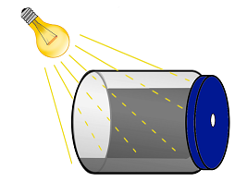
Problem Statement
Drilled hole
Connected to AC
Layer of soot
DISTINCT SOUND?

Slide 3
WHY does the
sound occur?

Slide 4
Soot absorbs light
Absorption coefficient $β$
$I(x)=I_{0}e^{−βx}$ ( $x$ : depth through sample)
Absolutely opaque: ALL light is absorbed
Notes:
파장에 관한 실험…!
유리 자외선 차단 근거자료!

Slide 5
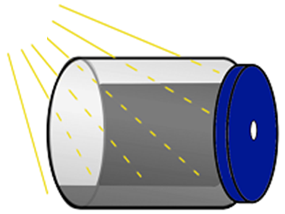
Explanation #1: Thermal Vibration
$∆$ Light intensity
$∆$Pressure
SOUND
Conduction
Allan Rosencwaig and Allen Gersho, Theory of the photoacoustic effect with solids, Journal of Applied Physics (Jan. 1976), vol. 47, No. 1
Notes:
CONDUCTION
Radiation은 왜 안 되는지 확실히 알기 – radiation으로 공기가 에너지를 흡수하면 공기가 불투명해야됨 ㅋㅋㅋㅋㅋ
빛과 공기 사이의 radiation 상호작용은 전혀 없음!
빛 흡수: excitation (of molecules) 방출: NONRADIATIVE DEEXCITATION

Slide 6
Explanation #2: Mechanical Vibration
Soot itself
expands and contracts!
SOUND
F. Alan McDonald, Photoacoustic effect and the physics of waves, American Journal of Physics (Jul. 1979), vol. 48

Slide 7
What is the frequency?
“Blink” twice at each AC wave!
Sound frequency = 2$×$(AC frequency) = 120Hz
Manfred Euler, Hands-On Resonance-Enhanced Photoacoustic Detection, Physics Teacher (Oct. 2011), vol. 39

Slide 8
AC Bulb Experiment Setting
Microphone
Jar + Soot
Empty Jar
Power-controllable
Lightbulb

Slide 9
Recorded Sound
Fast Fourier Transform
Sample rate: 192000 /s
Notes:
Lightbulb power: 500W

Slide 10
Frequency-Domain Graph
: Jar with soot
: Empty jar (noise)
Notes:
만약에 y축을 그냥 amplitude (!20hz peak 말고) 로 한 놈이 있으면
얘는 y축이 noise일 가능성이 굉장히 높다.
(일단 저음역대 noise가 120hz보다 무조건 높다)
Sensitivity is different according to frequency
FFT: UNIT!!!!!!! Fft가 저음역대 더 잘 잡는 것에 대해….

Slide 11
Frequency-Domain Graph
120hz
Harmonics!
240hz
360hz
Notes:
음의 peak도 보여줘야 하지 않을까?
Harmonics: mode of Helmholtz resonance
(240Hz dies away quickly – why jar does not resonate in 240hz)

Slide 12
Light intensity – 120hz peak intensity Graph

Slide 13
What is the
role of the JAR?

Slide 14
Helmholtz Resonance
Resonance frequency of
AIR inside the jar
$$f_{H}=\frac{v}{2π}\sqrt{\frac{A}{VL_{eff}}}$$
$v$: speed of sound
$f_{H}≅120$Hz :
RESONANCE!
$$A$$
$$L_{eff}$$
$$P$$
$$V$$
Notes:
Leff = L + 1.45r

Slide 15
Various jars

Slide 16
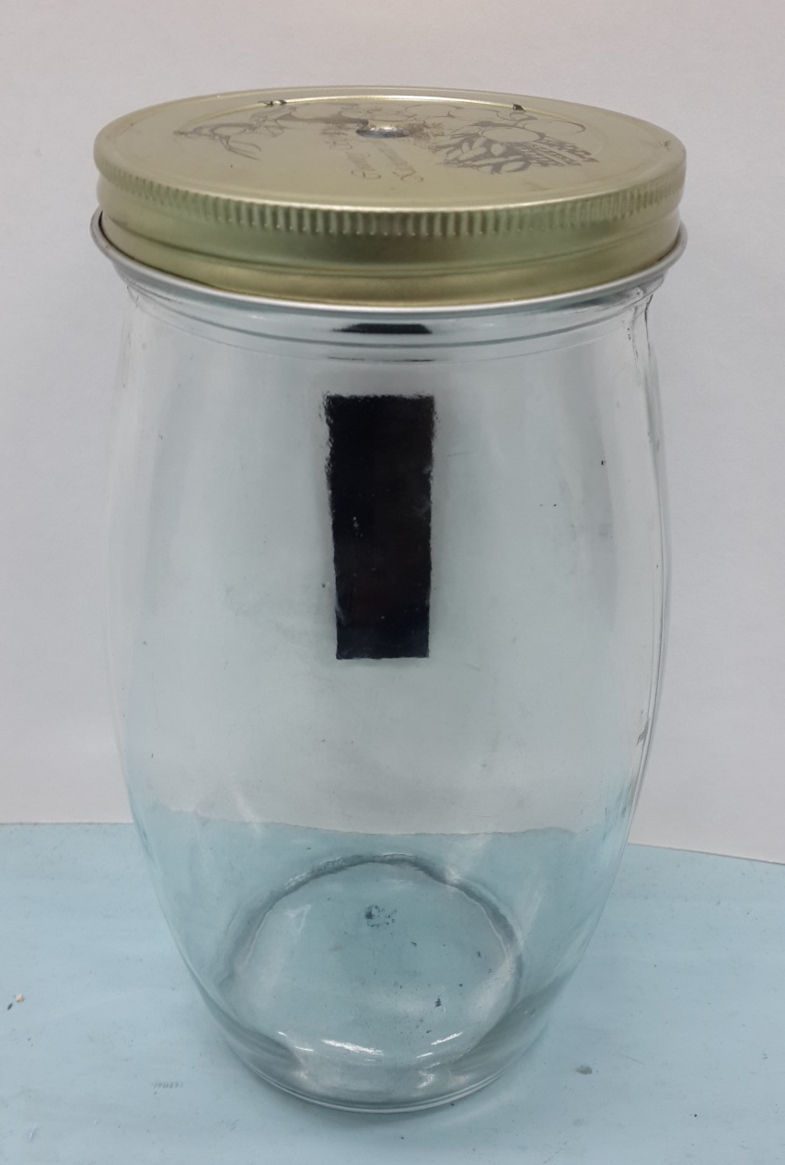
Parameter control for various jars
Slide-glass covered
with soot

Slide 17
Helmholtz Frequencies of jars
RESONANCE!

Slide 18
Sound produced in various jars

Slide 19
Another method to change Helmholtz Frequency: Neck Length
$$l$$

Slide 20
Sound produced by jars of different neck length

Slide 21
Frequency Control
Extract only the sound produced by light
New Experiment Setting!

Slide 22
Preliminary Experiment Setting

Slide 23
Stroboscope Experiment Setting
Stroboscope

Slide 24
Flash frequency – Fundamental sound frequency graph

Slide 25
Limits of Stroboscope Setting
Noise caused
by jar itself
Glass blocks
ultraviolet rays

Slide 26
Revised Experiment Setting

Slide 27
Fundamental Approach
Waveform
Material
Notes:
이걸 왜 햇냐 더 깔끔하게 설명
빛에 의한 소리만 보고 싶어서 빛을 되게 짧게 주고 싶어서 strobo를 썼따!

Slide 28
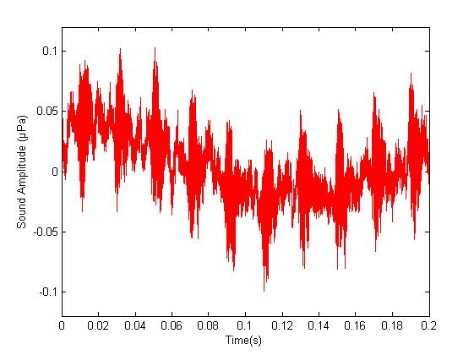
Recorded Sound
: Slide glass with soot
: Empty slide glass (noise)
Notes:
50Hz chopping frequency
Does silence always happen?
빨간색 좀 떨어뜨려놓고 plot

Slide 29
Zoom-in!
IMPACT!
damping
stroboscope noise
silence
5~7 small vibrations
silence
Notes:
Empty slideglass
Always the same waveform prove (in one sound, and even in different mateirals)
Strobo에서 나오는 고전압의 영향… electrical signal
Mic의 response time
20000Hz 이상 소리는 일종의 damping?!
Sound sensor랑 photodetector 동시에 켜서 그 time gap을 본다 (triggering)
Dephase 와 decay는 다름
Decay는 lorenz curve fit or gaussian curve fit 이렇게 갑자기 죽은건 dephase라 봄
소수 frequency (47Hz)
Small vibration이 약해지는 것도 주기가 있을 수 있따
나노초고속현상실험실
마지막에 stroboscope noise라는거 증명

Slide 30
Sound caused by only light
Half-period $≅$ 0.00005s

Slide 31
Duration of Stroboscope Flash
Speed Camera
Resolution 32×32 Sample rate 83333 /s
Duration of flash
$$≅4.5×\left(\frac{1}{83333s^{−1}}\right)=0.00005s$$
Notes:
왜 같은지 설명
스트로보스코프 저frequency 에서 스피드카메라로 촬영

Slide 32
Flash at what point?
stroboscope noise
Notes:
AMPLITUDE
Shockwave!!!!1!!!!!! 샤프심 부러뜨려보기

Slide 33
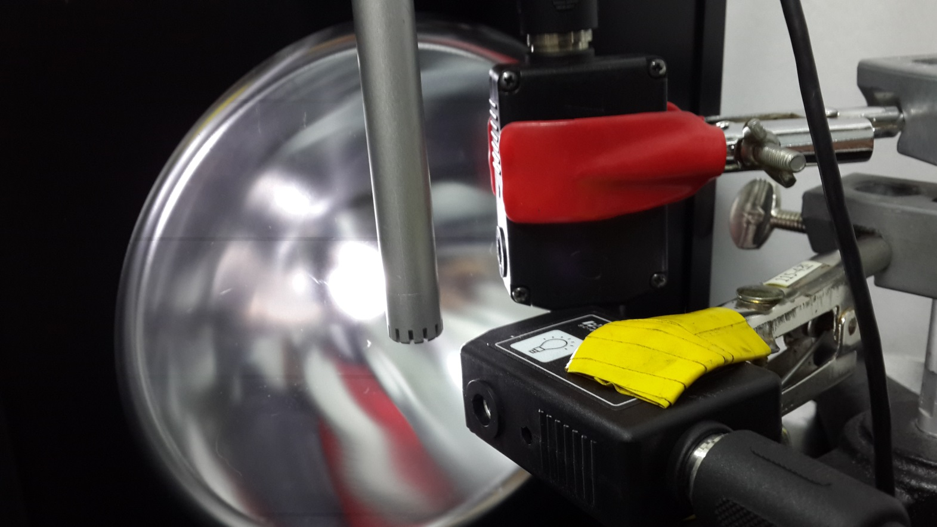
Experiment on Flash Time
Sound
sensor
Light sensor

Slide 34
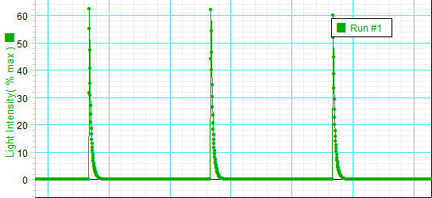
Time gap between sound and light
Sound sensor
0.00124s
Light sensor
Notes:
여기서 sound sensor의 소리가 soot.wav에서 그 stroboscope noise인지 어떻게 알아? – 파형, 특히 amplitude 비교
아까 flash 0.00005초래매 light sensor 왤케 길어? – 5V maximum 때문에 전위차 떨어지는데 시간이 좀 걸림

Slide 35
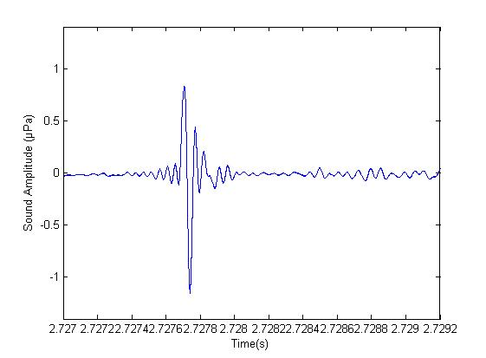
So the flash is at…..
stroboscope noise
0.00124s

Slide 36
Shockwave?
Notes:
Shock waves are characterized by an abrupt, nearly discontinuous change in the characteristics of the medium. Across a shock there is always an extremely rapid rise in pressure, temperature and density of the flow.

Slide 37
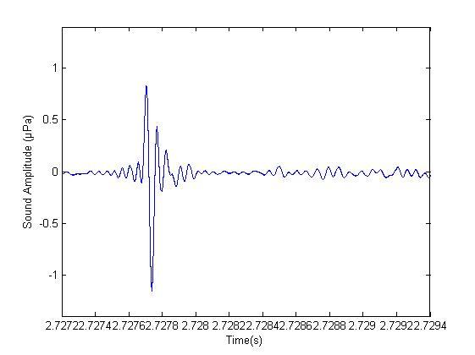
Similar waveform!
Sharp pencil broken
Flash - soot

Slide 38
?

Slide 39
Samples of various powders
Soot
Activated
Carbon
Graphite
(Grained pencil lead)
Charcoal
Iron

Slide 40
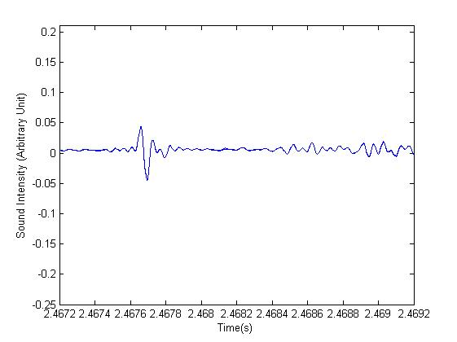
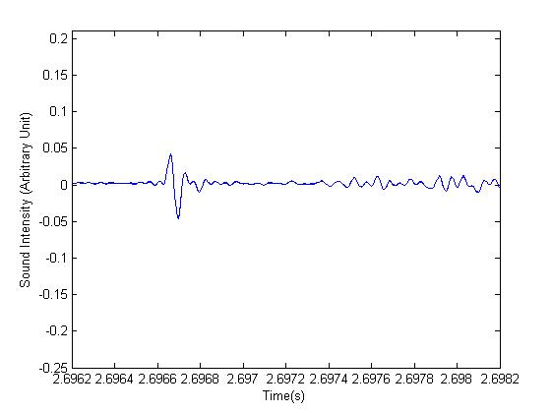
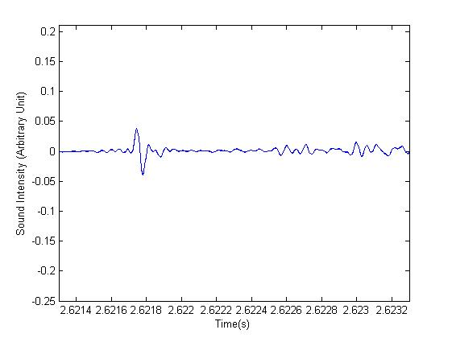
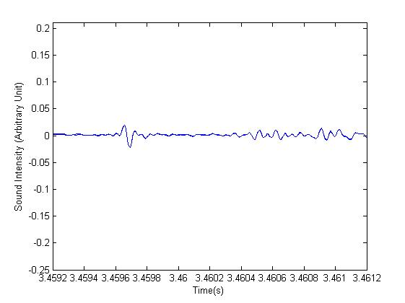
Sound from various powders
Soot
3.8
Activated
Carbon
0.90
Graphite
0.86
Charcoal
0.76
Iron
0.40

Slide 41
Sample of powder and chunk
Charcoal
powder
Charcoal
chunk

Slide 42
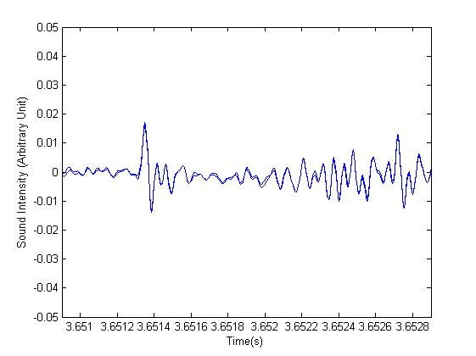
Powder VS Chunk
Powder
0.76
Chunk
0.34

Slide 43
Sample of powder and lubricant
Graphite powder
Graphite lubricant

Slide 44
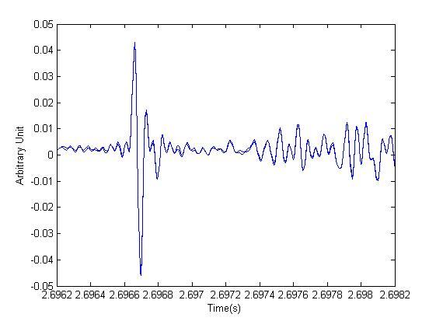
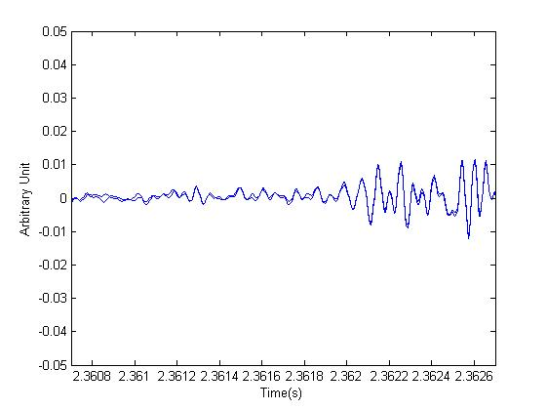
Powder VS Lubricant
Graphite
Powder
0.86
Graphite
Lubricant
?

Slide 45
Samples of various surfaces
Paper
Marker
Vinyl
Plastic

Slide 46
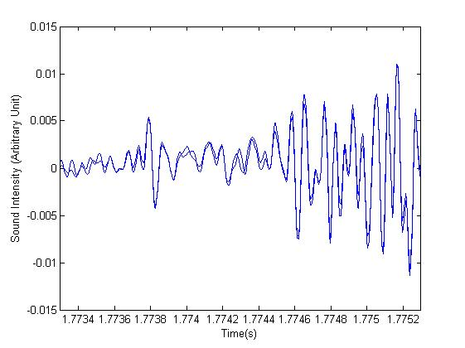
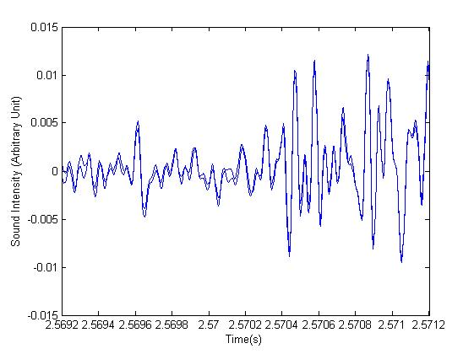
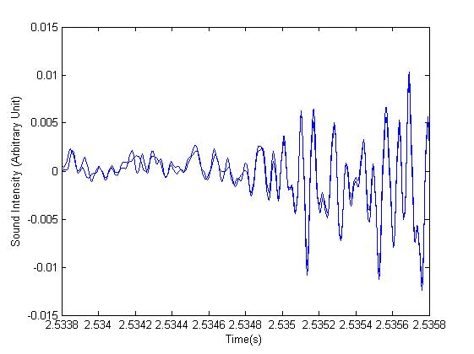
Sound from various surfaces
Paper
0.1
Marker
0.1
Vinyl
0.1
Plastic
?
Notes:
유리 넣기!

Slide 47
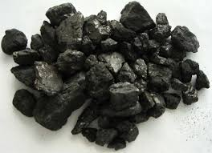
Mechanism of heat conduction
Something special about
C

Slide 48
Hypothesis for Photoacoustic Mechanism
POP!
Thermal
Vibration
(air)
Mechanical
Vibration
(sample)

Slide 49
Thermal conductivity
$$Q=\frac{kA(T_{1}−T_{2})}{L}∆t$$
Graphite: 119~165 W/m$∙$K
Air: 0.0257 W/m$∙$K
Mechanical vibration starts EARLIER!
Notes:
Specific heat 으로 수정

Slide 50
Thermal expansion coefficient
$$∆V=βV∆T$$
Graphite: $2.4×{10}^{−5} K^{−1}$
Air: $3.4×{10}^{−3} K^{−1}$
Thermal vibration has bigger AMPLITUDE!

Slide 51
Porous Structure of Soot
SEM

Slide 52
Porous Structure of Soot
LARGE
Sound!

Slide 53
Plane Structure of Graphite Lubricant

Slide 54
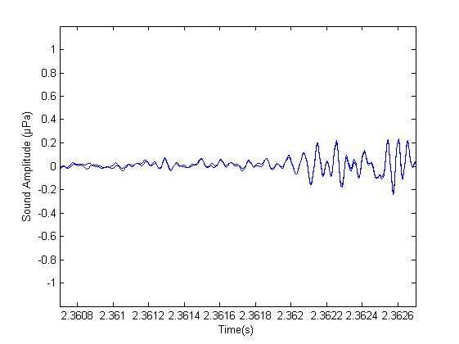
Plane Structure of Graphite Lubricant
NO
Sound!

Slide 55
Conclusion
}
Absorption
Helmholtz
Frequency
Mechanical
Vibration
120Hz
Pores!
Thermal
Vibration
RESONANCE!

Slide 56
Thank You

Slide 57
MATLAB FFT Code
[nSamples, nChannels]=size(data);
data=data*20;
waveFileLength=nSamples/fs;
N=2^(nextpow2(nSamples));
Y=fft(data(:,1),N);
NumbUniquePts=ceil((N+1)/2);
Y=Y(1:NumbUniquePts);
P=abs(Y)/waveFileLength;
f=(0:NumbUniquePts-1)*fs/N;
plot (f,P)
xlabel('Frequency (Hz)')
ylabel('Sound Intensity (Arbitrary Unit)')
axis([0, 400, 0, 10000])
FFT Number determined!

Slide 58
Heat vibration caused by lightbulb
33
32
off
on
31
Amplitude of temperature vibration does not change (0.8$℃)$
30

Slide 59
Microphone inside the jar
Notes:
데이터!

Slide 60
Microphone position and Resonance effect
RESONANCE!

Slide 61
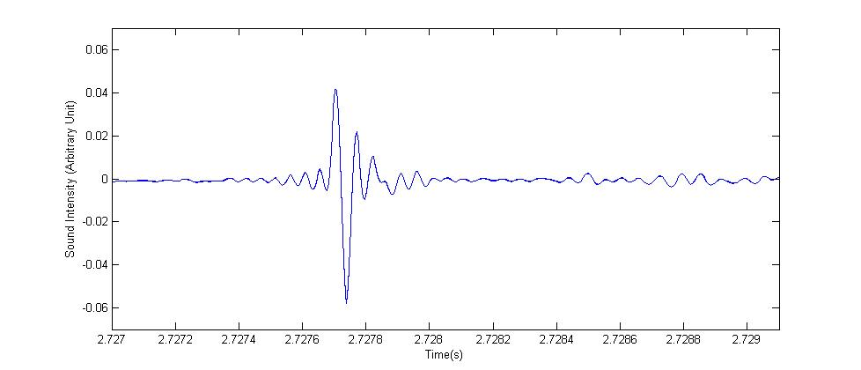
Fast reaction!
Stroboscope
sound has not arrived

Slide 63
FFT: Sound caused by only light
$f :$10000Hz ~ 20000Hz
$T/2 :$ 0.000025s ~ 0.00005s

Slide 64
Depth of soot is not important
Soot is opaque
-> All light is absorbed!

Slide 65
Effect of heat from lightbulb (justification)
Sound absorption due to thermal conduction (fundamentals of acoustics)

