Slide 1
Ball Bearing Motor
11
Kamila Součková

Slide 2
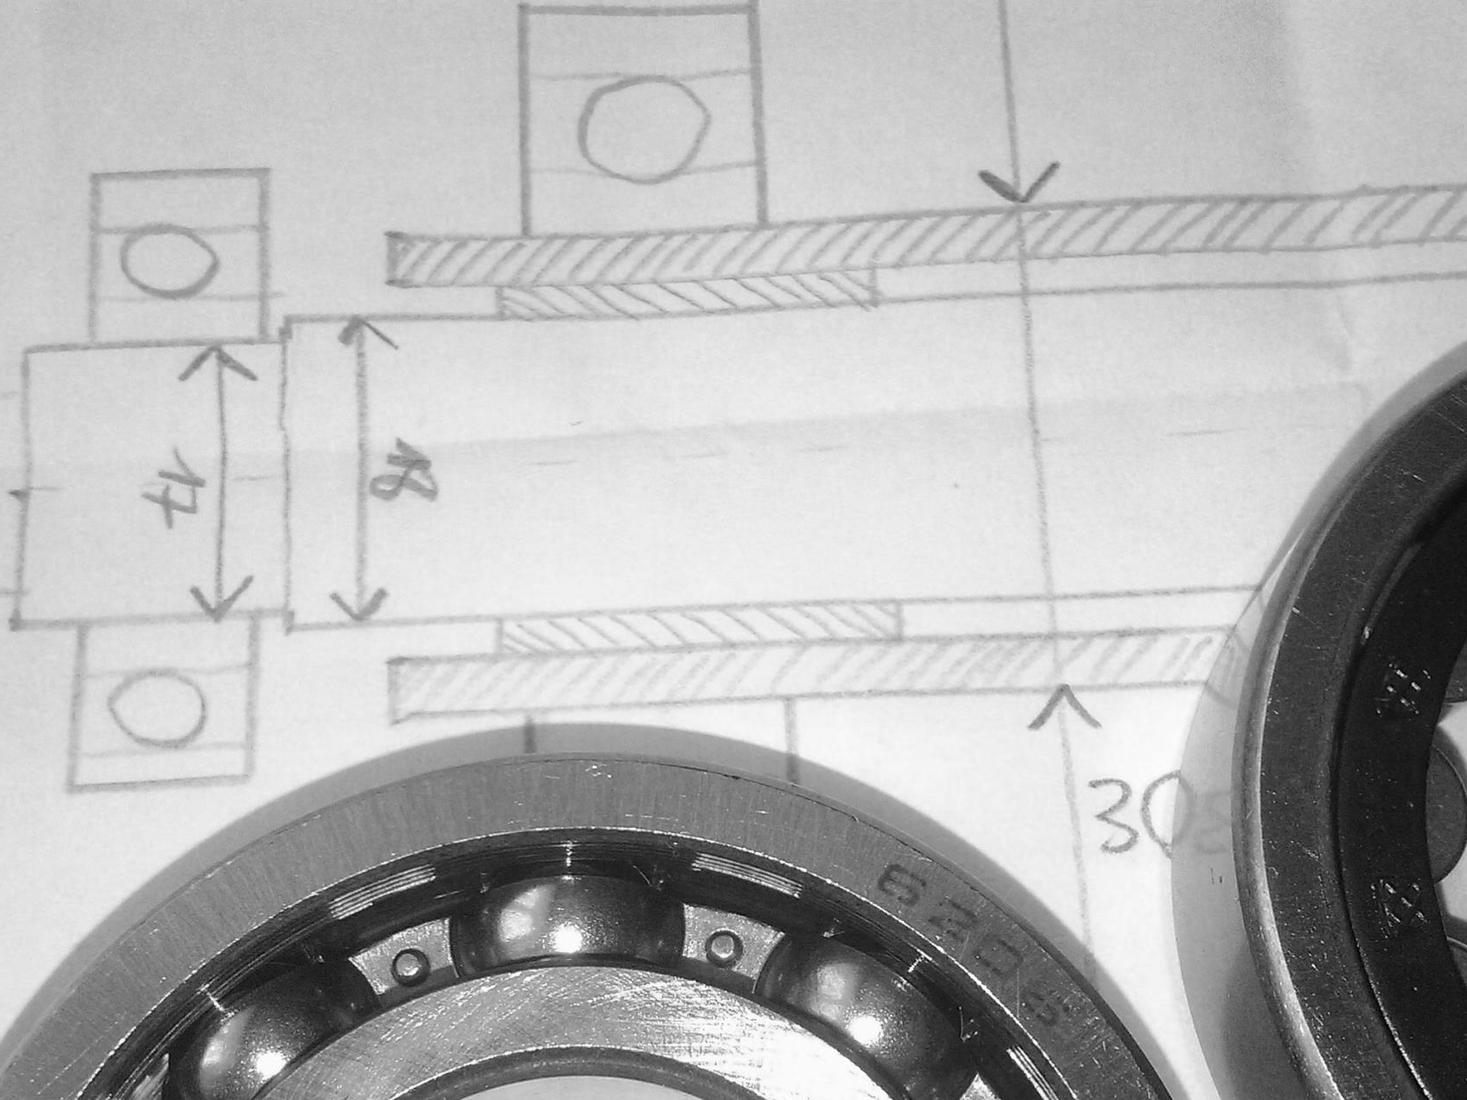
11. Ball Bearing Motor
13
11. Ball Bearing Motor
A device called a “Ball Bearing Motor” uses electrical energy to create rotational motion. On what parameters do the motor efficiency and the velocity of the rotation depend?
A device called a “Ball Bearing Motor” uses electrical energy to create rotational motion. On what parameters do the motor efficiency and the velocity of the rotation depend?

Slide 3
Introduction

Slide 4
What is a “Ball Bearing Motor”?

Slide 5
What is a “Ball Bearing Motor”?

Slide 6
What is a “Ball Bearing Motor”?

Slide 7
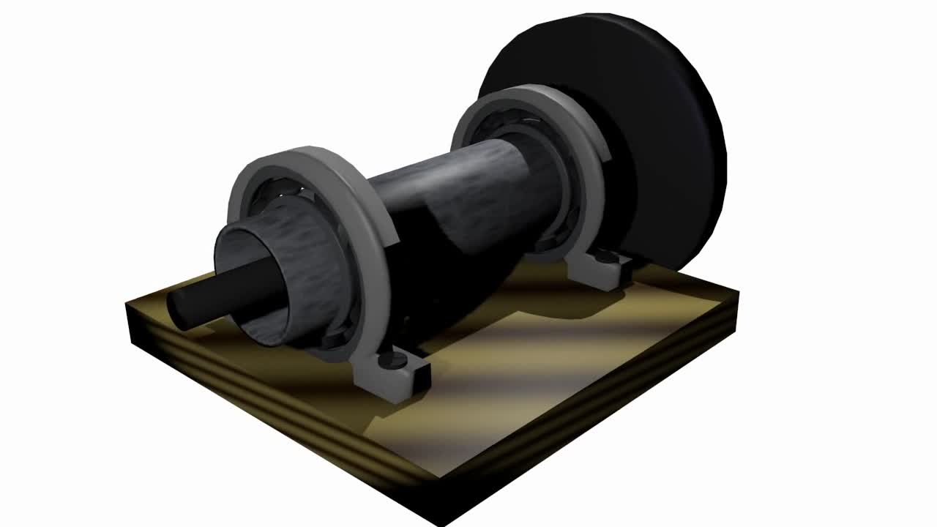
What is a “Ball Bearing Motor”?

Slide 8
What is a “Ball Bearing Motor”?

Slide 9
It Works!

Slide 10
Experiments

Slide 11
Experimental apparatus

Slide 12
Experimental apparatus

Slide 13
Experimental apparatus
V
M
V

Slide 14
Experimental Results
13
Experimental Results

Slide 15
Max Speed Measurement

Slide 16
Max Speed Measurement
disconnected
push

Slide 17
Max Speed vs. Current
current was changing in time during experiments (battery discharging etc.)

Slide 18
Efficiency Measurement
$Δ$ rotational energy
$Δ$ time
output power
efficiency
$$η=\frac{P_{o}}{P_{i}}$$
input power
$Δ$ work of
electric current
$Δ$ time

Slide 19
Efficiency Measurement
$Δ$ rotational energy
$Δ$ time
$$\frac{Δ\left(\frac{1}{2}Jω^{2}\right)}{Δt}$$
n
output power
efficiency
$$η=\frac{P_{o}}{P_{i}}$$
$J=3.2⋅{10}^{−2} kg⋅m^{2}$ (see Appendix)
$$=$$
input power
$Δ$ work of
electric current
$Δ$ time

Slide 20
Efficiency Measurement
$Δ$ rotational energy
$Δ$ time
$$\frac{Δ\left(\frac{1}{2}Jω^{2}\right)}{Δt}$$
n
output power
efficiency
$$η=\frac{P_{o}}{P_{i}}$$
$$=$$
input power
$Δ$ work of
electric current
$Δ$ time

Slide 21
Efficiency Measurement
$Δ$ rotational energy
$Δ$ time
$$\frac{Δ\left(\frac{1}{2}Jω^{2}\right)}{Δt}$$
n
output power
efficiency
$$η=\frac{P_{o}}{P_{i}}$$
$$=$$
$$U_{e}⋅I$$
input power
$Δ$ work of
electric current
$Δ$ time
$$I$$
too large to be measured directly
V
M
V
$$U_{e}$$

Slide 22
Efficiency Measurement
$Δ$ rotational energy
$Δ$ time
$$\frac{Δ\left(\frac{1}{2}Jω^{2}\right)}{Δt}$$
n
output power
efficiency
$$η=\frac{P_{o}}{P_{i}}$$
$$=$$
$$U_{e}⋅I$$
input power
$Δ$ work of
electric current
$Δ$ time
$$I$$
$$R_{w}$$
too large to be measured directly → measure voltage drop on wire!
V
M
V
$$U_{e}$$
$$U_{d}$$
$⇒ I=\frac{U_{d}}{R_{w}}$

Slide 23
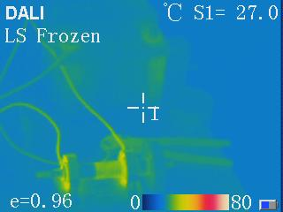
Efficiency Measurement
$Δ$ rotational energy
$Δ$ time
$$\frac{Δ\left(\frac{1}{2}Jω^{2}\right)}{Δt}$$
n
output power
efficiency
$$η=\frac{P_{o}}{P_{i}}$$
$$=$$
$$U_{e}⋅\frac{U_{d}}{R_{w}}$$
input power
$Δ$ work of
electric current
$Δ$ time
$$I$$
$$R_{w}$$
V
$R_{w}(t)$:
$$R_{w}=R_{0}\left(1+α∆T\right)$$
M
V
$$U_{e}$$
$$U_{d}$$

Slide 24
Efficiency Measurement
$Δ$ rotational energy
$Δ$ time
$$\frac{Δ\left(\frac{1}{2}Jω^{2}\right)}{Δt}$$
n
output power
efficiency
$$η=\frac{P_{o}}{P_{i}}$$
$$=$$
$$U_{e}⋅\frac{U_{d}}{R_{w}(t)}$$
input power
$Δ$ work of
electric current
$Δ$ time
$$I$$
$$R_{w}$$
V
M
V
$$U_{e}$$
$$U_{d}$$

Slide 25
Efficiency Measurement

Slide 26
Efficiency Measurement

Slide 27
Efficiency: Relevant Parameters
what we can control:
voltage
current
number of bearings
type of bearing ( → “base” friction)
moment of inertia

Slide 28
internal resistance of source
voltage
maximal current
input power
current
resistance
battery
temperature
heat capacity
running time

Slide 29
(to temperature)
number of bearings
amount of lubricant
output power
inner friction
coaxiality
moment of inertia
rolling resistance
axle
type of bearings

Slide 30
EXISTING Theories
Let us go a bit further…

Slide 31
#1: Magnetic Theory
explanation of rotation: eddy currents in rollers/axle (several variations)
Kirk T. McDonald. Ball-Bearing Motor, Joseph Henry Laboratories, Princeton University, Princeton

Slide 32
#2: Thermal Theory
explanation of rotation: local deformations of surface caused by heating due to extreme current density

Slide 33
#2: Thermal Theory

Slide 34
Which one is valid in our case?

Slide 35
Experiment #1: Cylindrical Bearings
should be qualitatively the same
could be different (different shape → different deformation)

Slide 36
Experiment #1: Cylindrical Bearings

Slide 37
Which one is valid in our case?
experiments:
#1: cylindrical bearings | ≈ the same | different

Slide 38
Experiment #2: Strong External Magnetic Field ( > $1T$)
could be different
should be the same

Slide 39
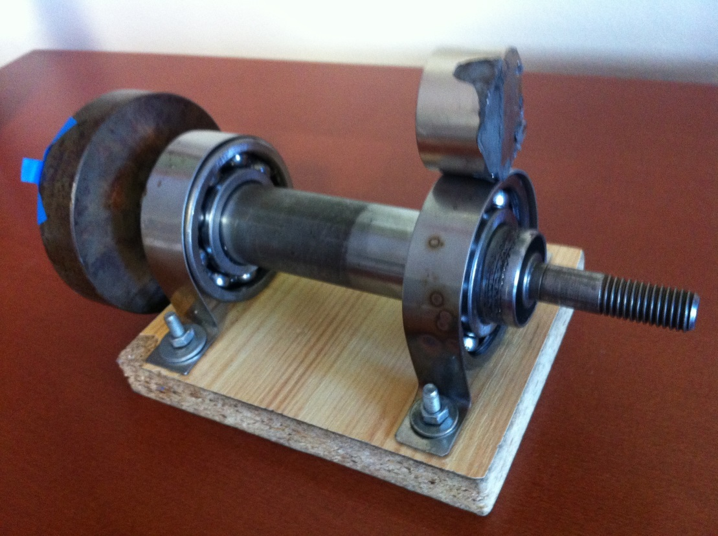
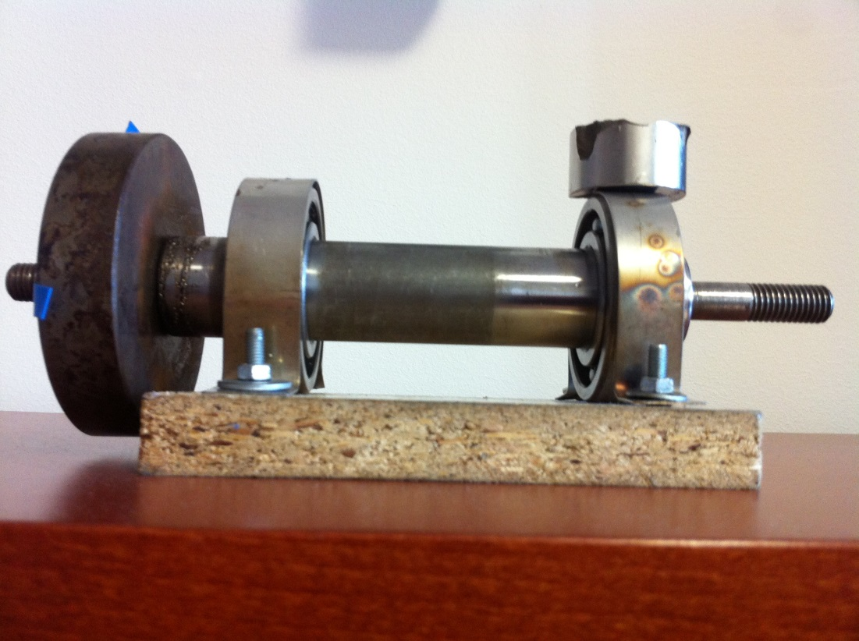
Experiment #2: Strong External Magnetic Field ( > $1T$)

Slide 40
Which one is valid in our case?
experiments:
#1: cylindrical bearings | ≈ the same | different
#2: external magnetic field | possibly different | the same

Slide 41
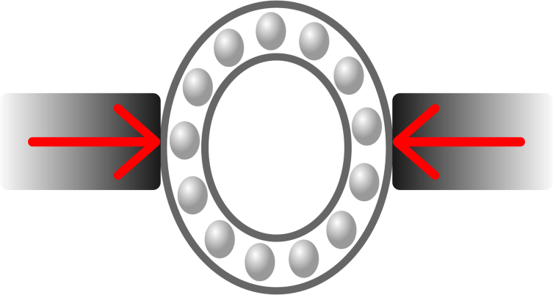
Experiment #3: Deforming the Bearing
power decrease (greater friction)
power might increase (greater normal forces)

Slide 42
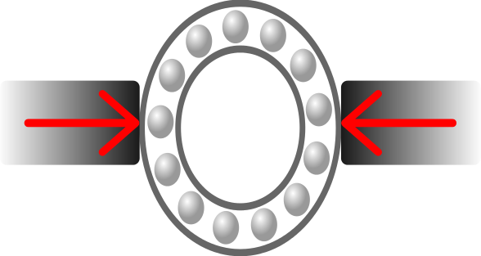
Experiment #3: Deforming the Bearing

Slide 43
Which one is valid in our case?
experiments:
#1: cylindrical bearings | ≈ the same | different
#2: external magnetic field | possibly different | the same
#3: deforming the bearing | power decrease | power increase

Slide 44
Which one is valid in our case?
✓
experiments:
#1: cylindrical bearings | ≈ the same | different
#2: external magnetic field | possibly different | the same
#3: deforming the bearing | power decrease | power increase

Slide 45
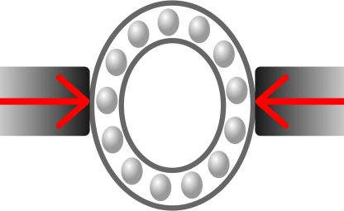
illustrated construction & built apparatus
$$I$$
$$R_{w}$$
M
V
V
$$U_{e}$$
$$U_{d}$$
measured efficiency
explored existing theories (thermal, magnetic)
✓
$$R_{s}$$
Thank you for your attention!
Conclusion
$$U$$
$$P_{i}$$
$$I_{max}$$
$$I$$
$$R$$
$$T$$
$$c$$
$$t_{r}$$
+ showed validity of thermal for our case
determined relevant parameters
$$N$$
amount of lubricant
$$P_{o}$$
$$f$$
coaxiality
$$J$$
$$R_{r}$$
axle
type of bearings
Notes:
illustrated the construction of the apparatus and built a working one (!)
then we found a way to precisely determine the efficiency, taking into account everything necessary and overcoming all experimental difficulties
and based on our experiments, we found the relevant parameters, as the task asked us to do.
We then went further by looking at the existing theories and devising several smart experiments that proved the thermal theory in our case.

Slide 46
illustrated construction & built apparatus
$$I$$
$$R_{w}$$
M
V
V
$$U_{e}$$
$$U_{d}$$
measured efficiency
explored existing theories (thermal, magnetic)
✓
$$R_{s}$$
Thank you for your attention!
Conclusion
$$U$$
$$P_{i}$$
$$I_{max}$$
$$I$$
$$R$$
$$T$$
$$c$$
$$t_{r}$$
+ showed validity of thermal for our case
determined relevant parameters
$$N$$
amount of lubricant
$$P_{o}$$
$$f$$
coaxiality
$$J$$
$$R_{r}$$
axle
type of bearings
Notes:
illustrated the construction of the apparatus and built a working one (!)
then we found a way to precisely determine the efficiency, taking into account everything necessary and overcoming all experimental difficulties
and based on our experiments, we found the relevant parameters, as the task asked us to do.
We then went further by looking at the existing theories and devising several smart experiments that proved the thermal theory in our case.

Slide 47
Appendix A: Resistance is futile
RESISTANCE IS FUTILE!

Slide 48
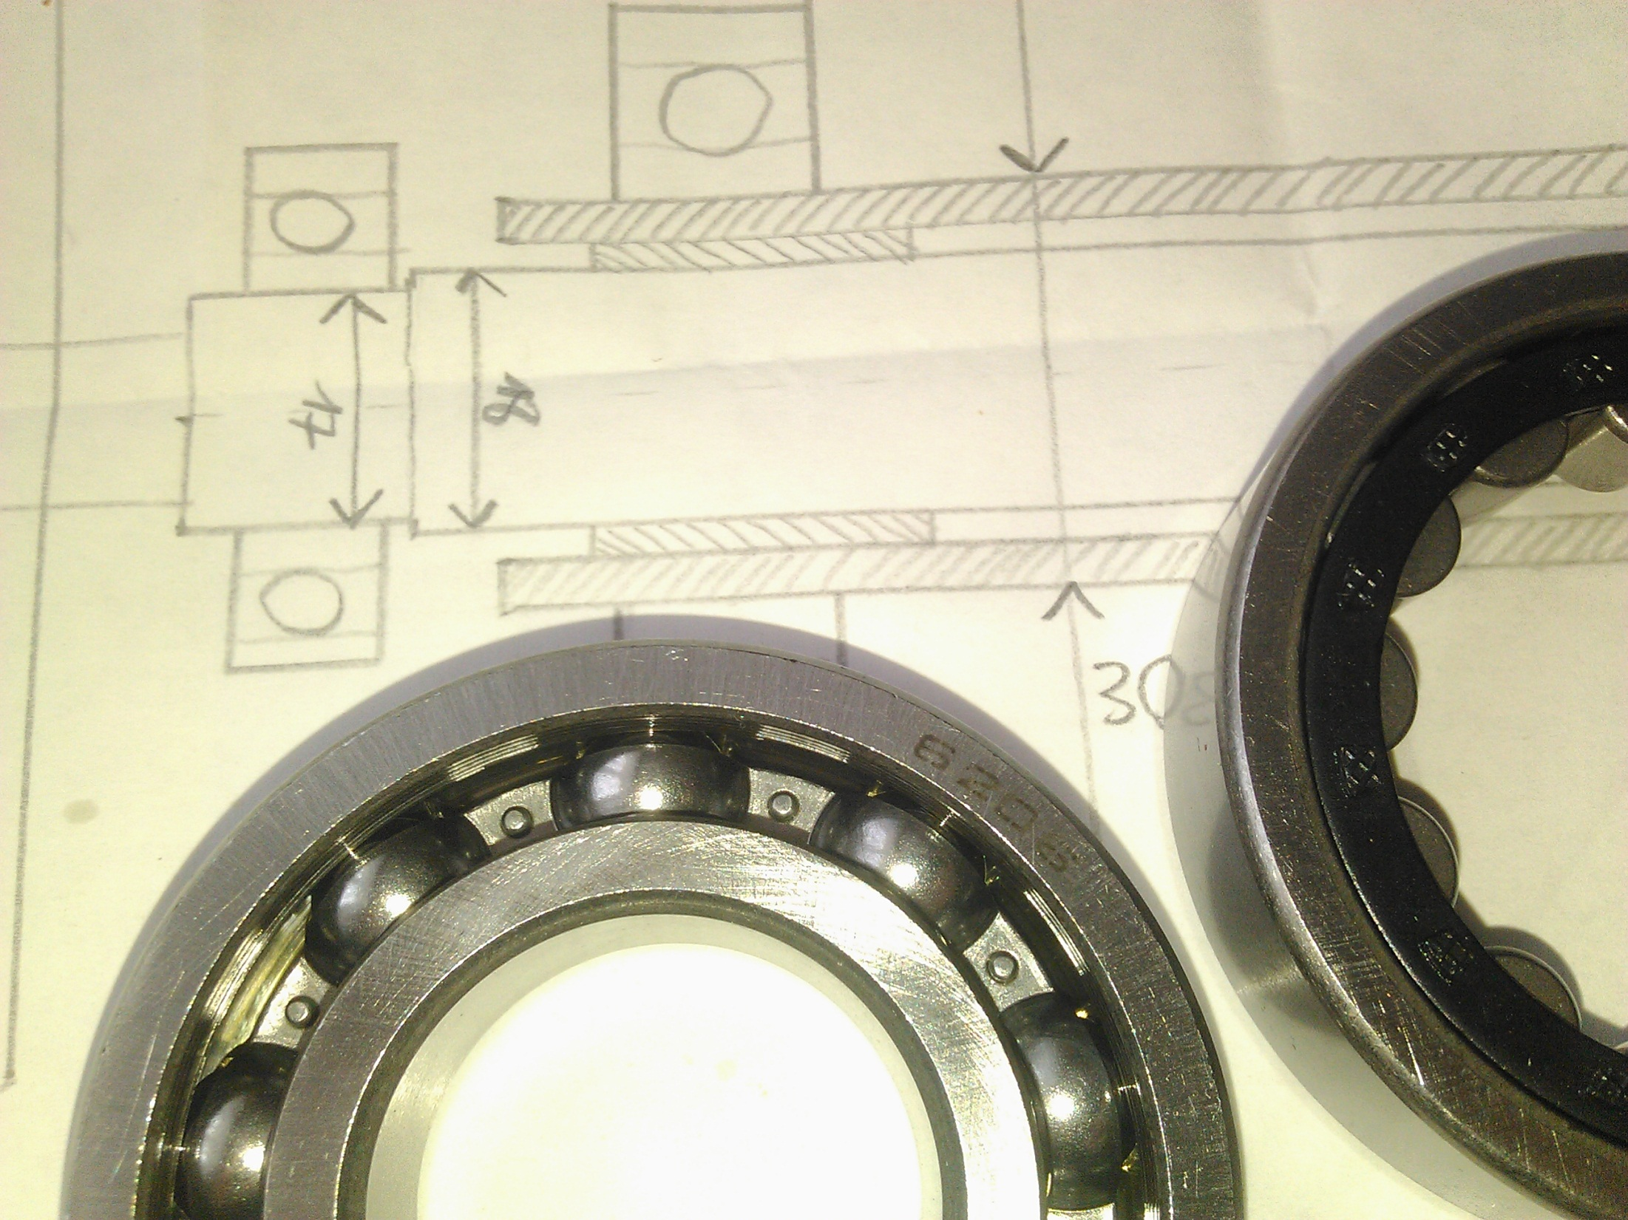
Appendices

Slide 49
Measuring Current
current very large (> 100 A) – cannot measure directly
solution: voltage drop on wire → $I=\frac{U_{d}}{R_{w}}$
1.25 V drop on thick copper wire!
$$I$$
$$R_{w}$$
M
V
V
$$U_{e}$$
$$U_{d}$$
but: wire resistance $R$ unknown
too small to be measured directly
calculation prone to errors
Notes:
TODO nejako tam vtesnat ten obvod ze co je U_d a R_w

Slide 50
Measuring Current
current very large (> 100 A) – cannot measure directly
solution: voltage drop on wire → $I=\frac{U_{d}}{R_{w}}$
1.25 V drop on thick copper wire!
$$I$$
$$R_{w}$$
M
V
V
$$U_{e}$$
$$U_{d}$$
but: wire resistance $R$ unknown
too small to be measured directly
calculation prone to errors

Slide 51
Measuring Current
solution: voltage drop on wire → $I=\frac{U_{d}}{R_{w}}$
1.25 V drop on thick copper wire!
1.25 V drop on thick copper wire!
$$I$$
$$R_{w}$$
M
V
V
$$U_{e}$$
$$U_{d}$$
→ finding wire resistance $R$:
discharge the battery so it sources measurable current (≈100A)
measure current & voltage drop simultaneously
calculate the resistance $R_{w}= \frac{U_{d}}{I}$
$$=0.0041 Ω$$

Slide 52
Importance of temperature change
$$∆T=\frac{\int{UI dt}}{mc}$$
$$∆T≈80℃$$
but it is also cooled by air
from $R_{w}=R_{0}\left(1+α∆T\right)$:
$α_{Cu}=4⋅{10}^{−3}K^{−1}⇒20\%$ resistance change

Slide 53
Determining Wire Temperature
$$R_{w}=R_{0}\left(1+α∆T\right)$$
$$Q=mcΔT=∫P_{w}\left(t\right)dt$$
$$P_{w}=\frac{U_{d}^{2}}{R}$$
$$R_{w}\left(t\right)=R_{0}\left(1+α\frac{{U_{d}}^{2}Δt}{R_{prev}mc}\right)$$

Slide 54
Our Bearings
Type: 6206
Type: 6303
Type: NJ206EC
welded
together
with our currents
braked
(will come back to later)
d | D | B
30 | 62 | 16
mm | mm | mm
d | D | B
17 | 47 | 14
mm | mm | mm
d | D | B
30 | 62 | 16
mm | mm | mm
Notes:
TODO nie roztavilo, ale zvarilo

Slide 55
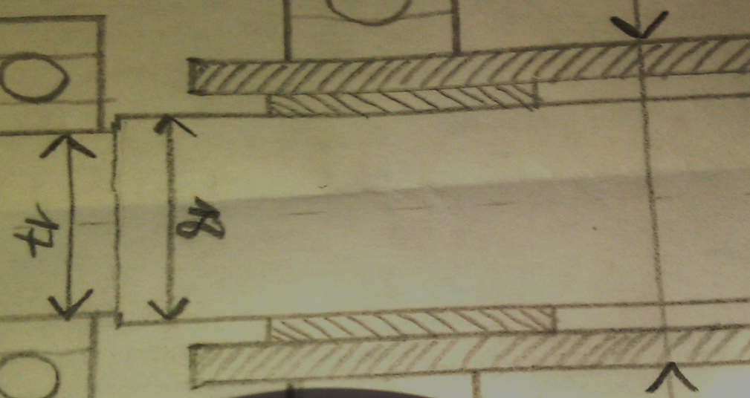
Calculation of moment of inertia
Inner race
1 - Main inner race
2 - Bearing holder
3 - Flyback wheel holder
4 - Outer race
5 - Flyback wheel
$$J=3.2⋅{10}^{−2} kg⋅m^{2}$$
$$J=\sum_{n=1}^{5}{J_{n}}$$
$$J_{1,2,3}=\frac{1}{2}mr^{2}$$
$$J_{4,5}=\frac{1}{2}m(r_{2}^{2}−r_{1}^{2})$$

Slide 56
Small ball bearings

