Slide 1
Carbon Microphone
9.
Marco Bodnár

Slide 2
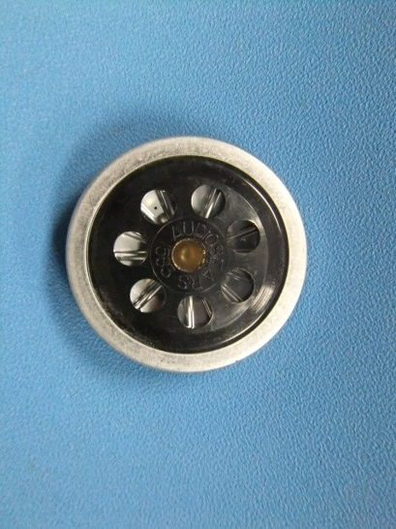
Task
For many years, a design of microphone has involved the use of carbon granules. Varying pressure on the granules produced by incident sound waves produces an electrical output signal. Investigate the components of such a device and determine its characteristics.

Slide 3
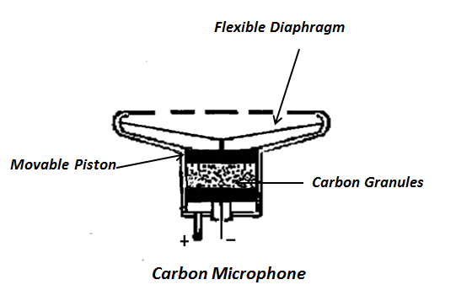
Basic scheme
Notes:
Spomenut ze chamber je non conducting

Slide 4
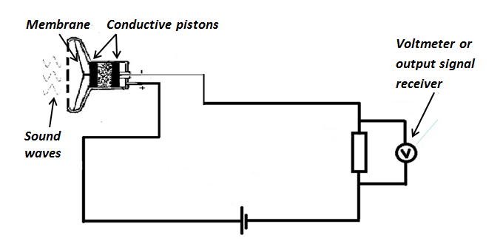
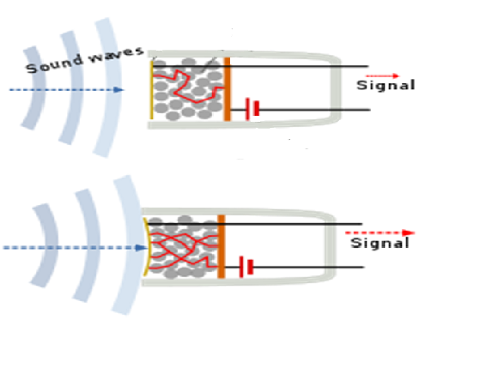
Basic scheme and principle
Resistance decreases
Current is dynamic Voltage drop across resistor is dynamic

Slide 5
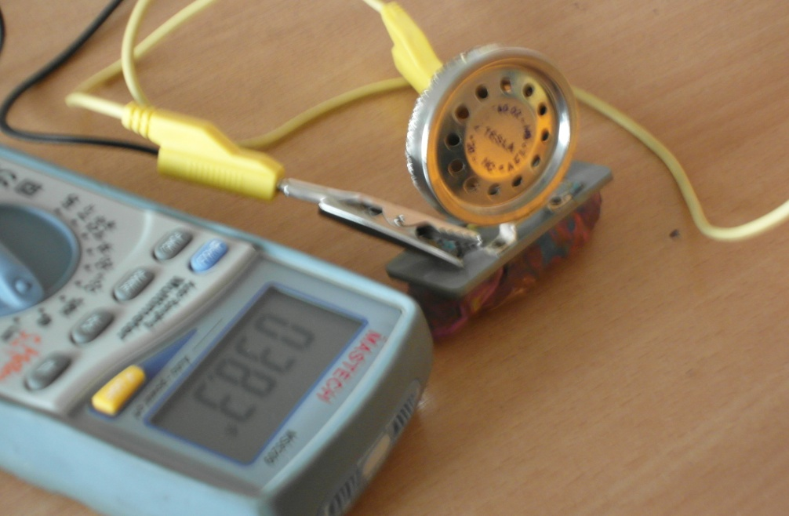
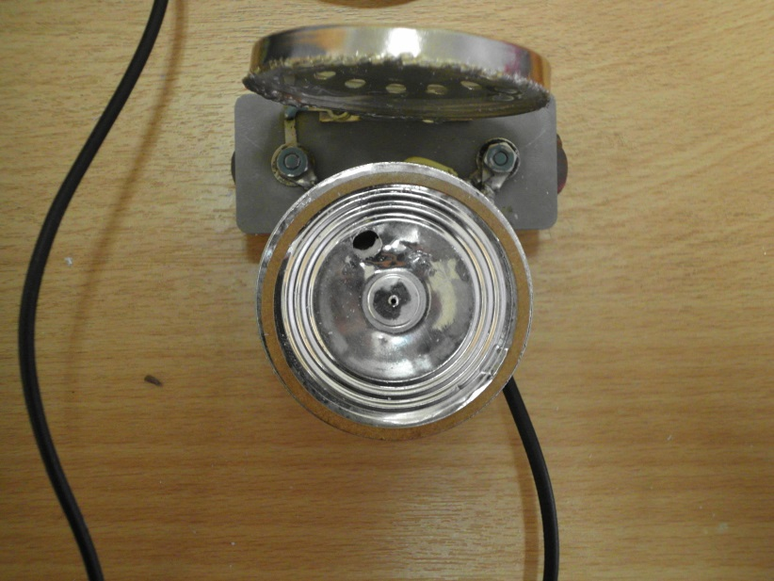
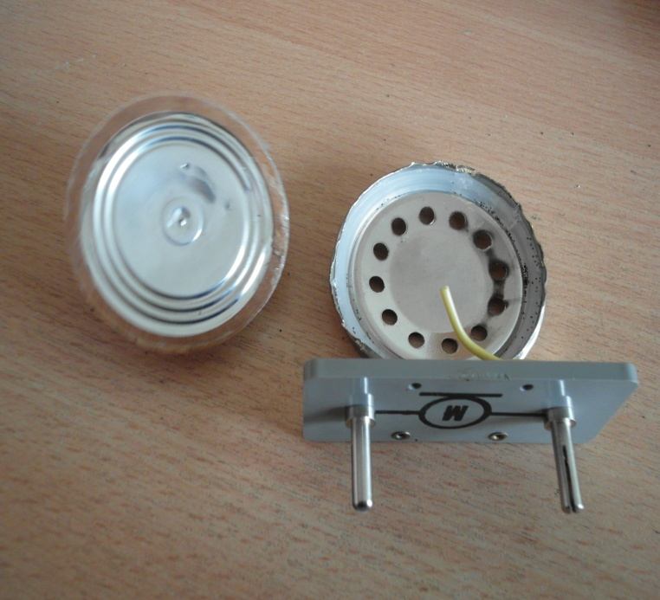
Factory assembled microphone

Slide 6
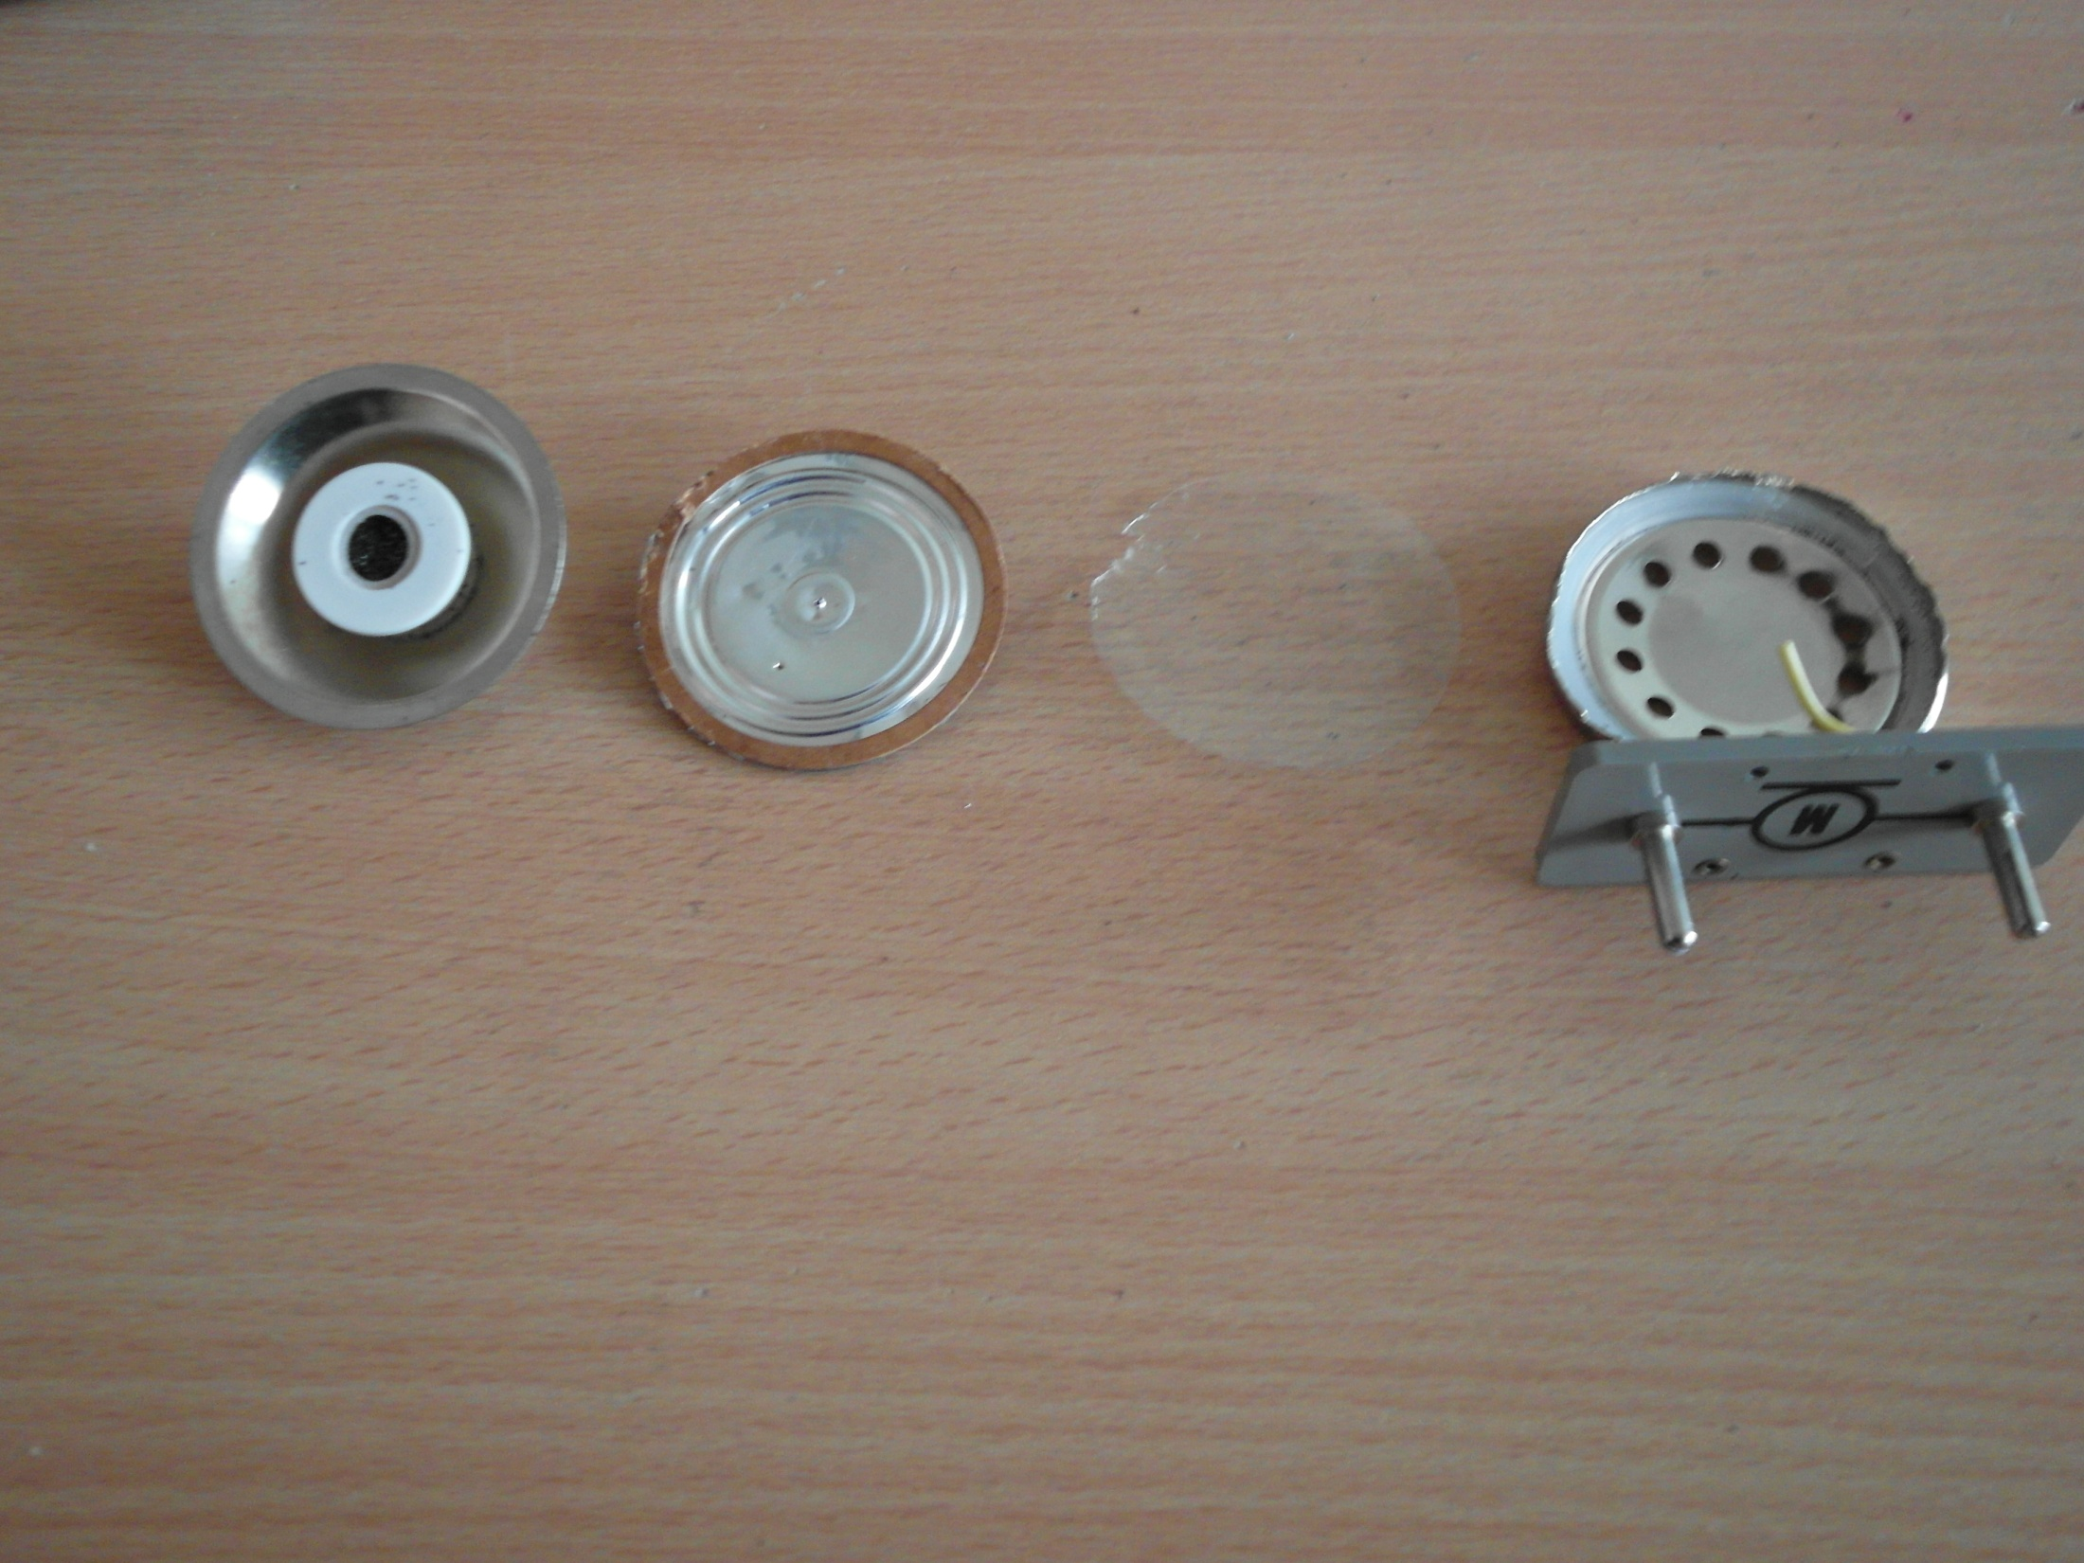
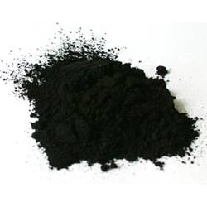
Chamber
Carbon powder
Cover
Elastic membrane
Covering membrane
Microphone base
Notes:
Elastic membrane is glued to chamber

Slide 7
Voltage is needed
MICROPHONE IS PASSIVE
- WITHOUT VOLTAGE APPLIED – NO VOLTAGE CHANGE CAN BE MEASURED
Dynamic resistance
Dynamic voltage, current
Measureable
Notes:
Some computers have voltage in jack connector about 2 V – sufficient for factory made mic, but not for out.. Bez voltage by pocitac nemal co merat

Slide 8
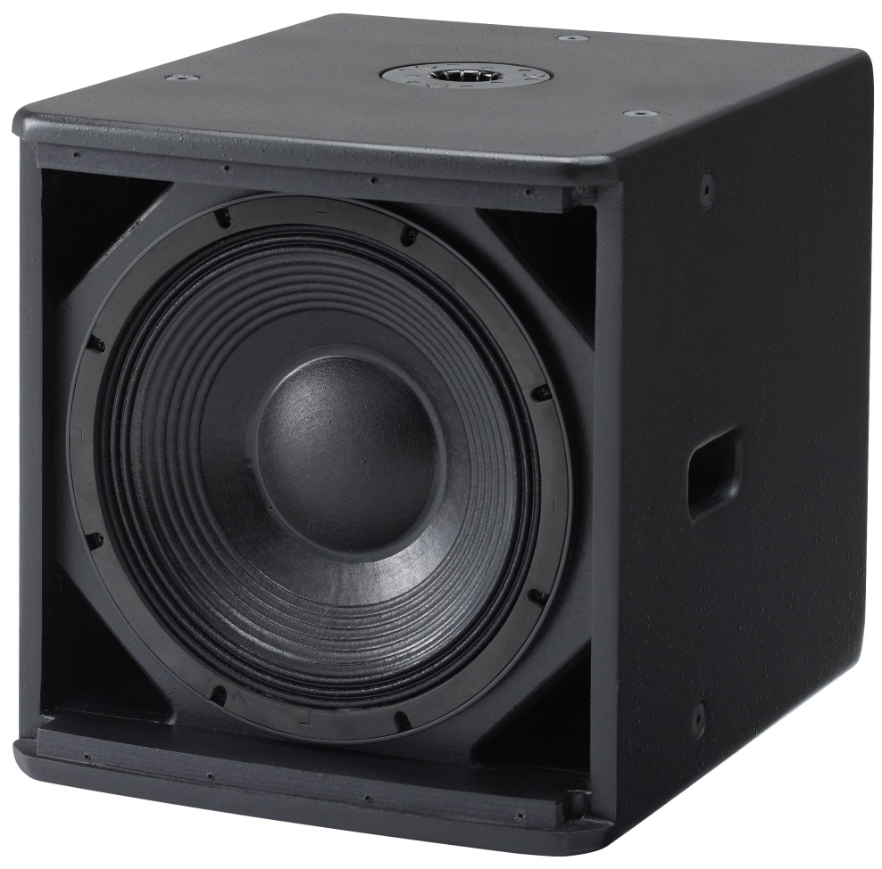
Membrane
Radius – change in frequency characteristics
Weight – as light as possible
Elasticity
Notes:
Thick enough – do not break, but not too thick – har to make oscilateSubwooofer – our prediction since we do not have ability to change membrane – thick heavy – difficult to make it oscilate..

Slide 9
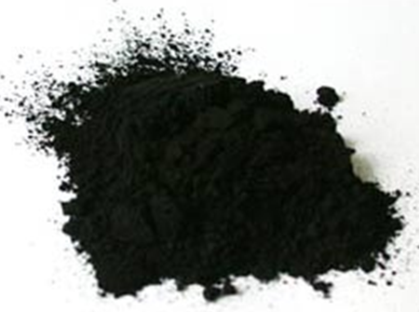
Why carbon powder?
Bad conductor
(in comparison with metals)
- sensitivity of microphone - ideally no added substances
Stable - does not change structure with temperature or other conditions*
Very high sensitivity (of its resistivity) to pressure change
*to a certain extent
Notes:
Necessary bad conductor.. If not eg gold changes would be unobservable – but the most important is its sensitivity- easily discernible changes – sum je ovplyvneny aj tvarom uhliku
So stable – even used by astronauts – it has to be clean – important otherwise noise is present – not additional substances- niekedy som videl ako dry lubricant silicum powder

Slide 10
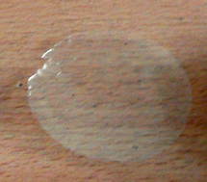
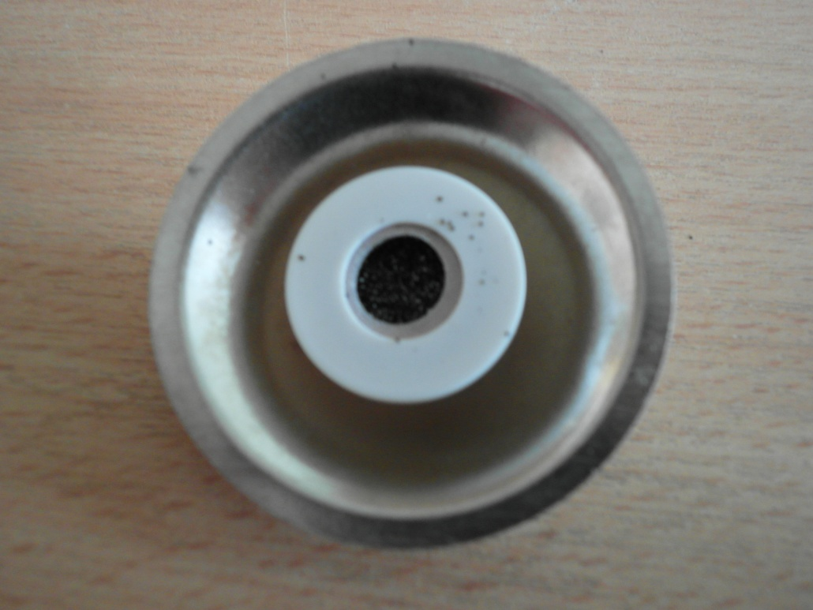
Covers
Protect inner parts of microphone (not necessary for correct functioning)
Back cover – protects from mechanical damage
Front foil – protects from dirt

Slide 11
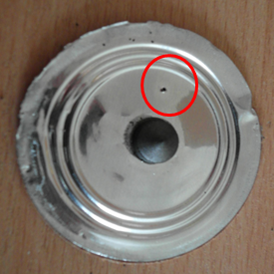
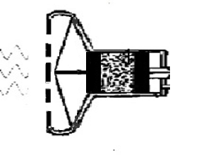
Hole in diaphragm
Hole in diaphragm used for pressure equalisation
With hole – equal pressure inside the microphone and outside– diaphragm remains same
Without hole – overpressure inside the microphone – diaphragm bulks out
Notes:
Membrane is glued – isolated – it needs hole – spomenut ze budeme skumat efekt

Slide 12
Now that we know how it works…
…we will try to make our own.

Slide 13
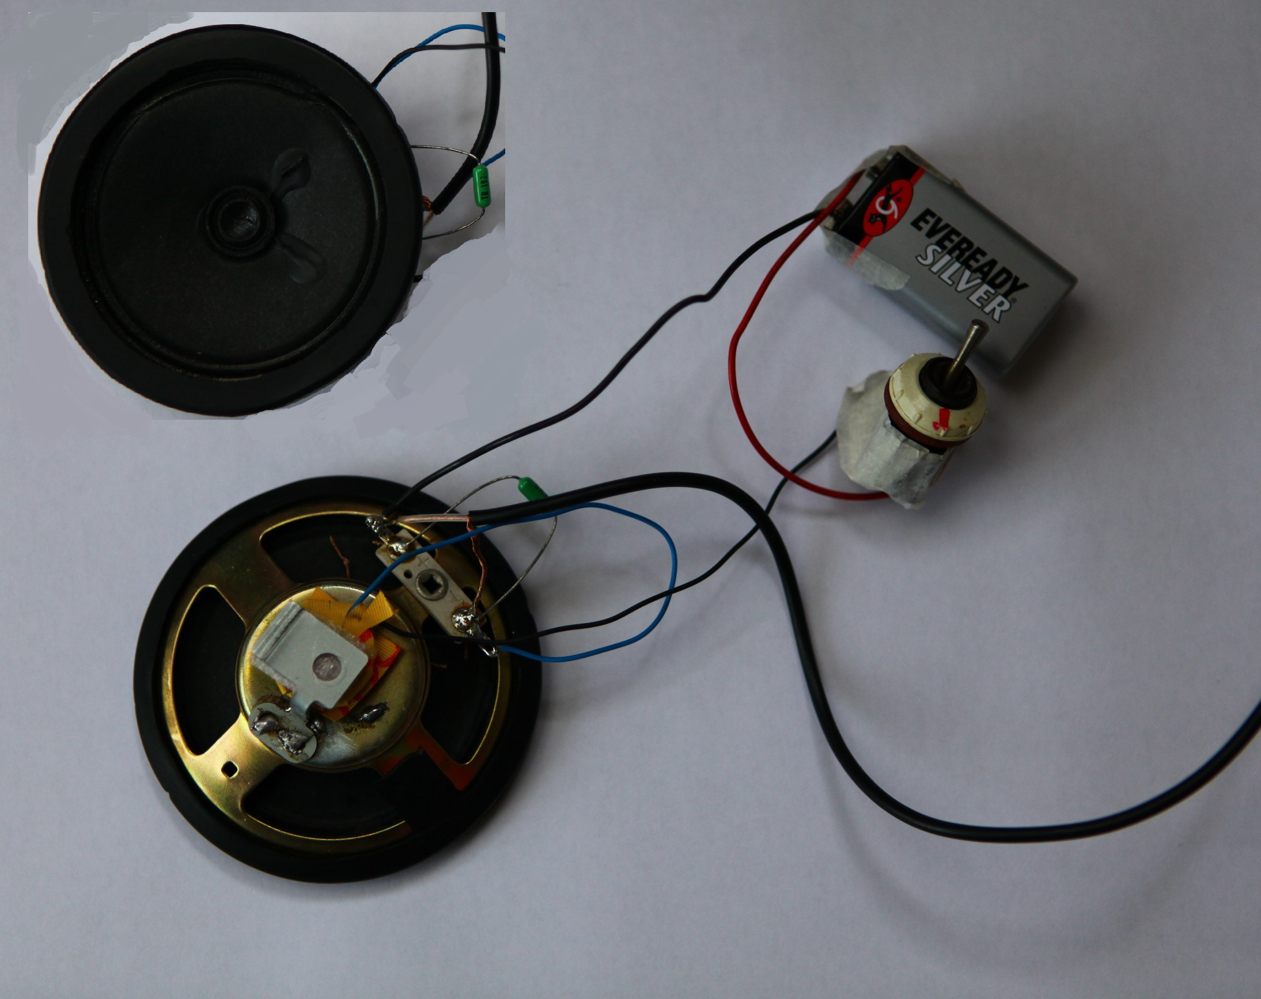
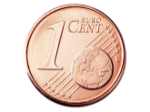
Voltage source
Flexible membrane
Chamber
Switch
Resistor
Conducting pistons
Notes:
Voltage source is needed, because the resistance is very high and 2 V is insufficient -external voltage source and resistance

Slide 14
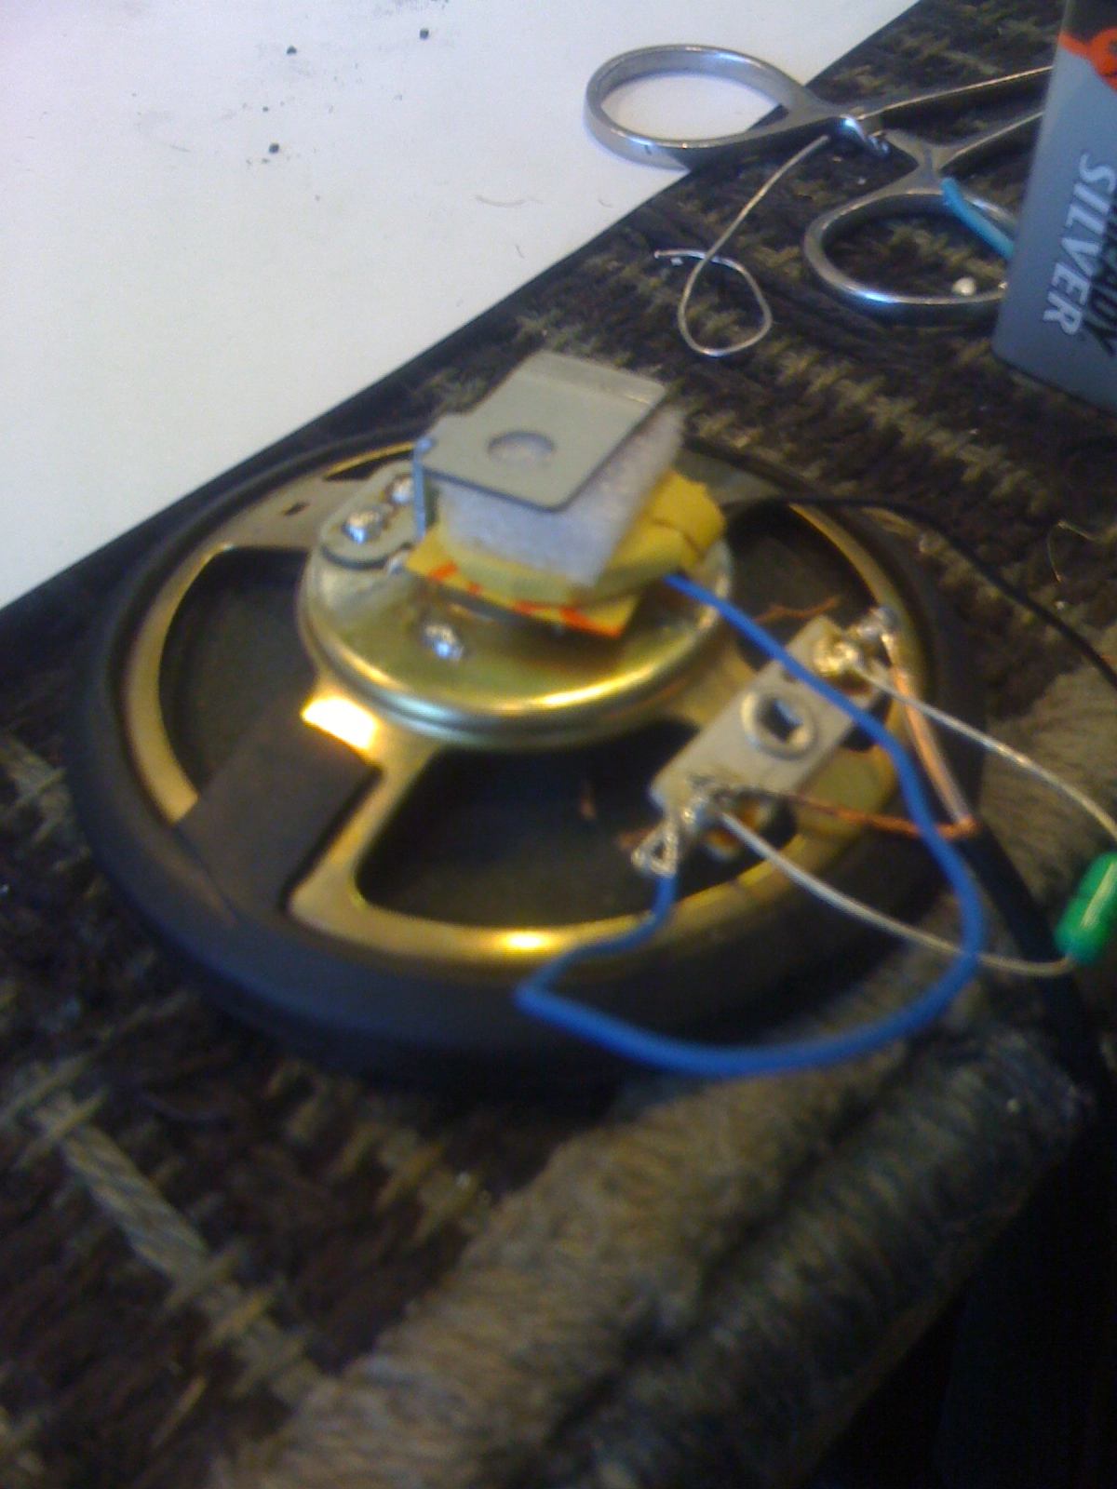
Voltage source
Resistor
Chamber
Membrane

Slide 15
Home made record
Home made
R=5000Ω
Home made
Further measurements with factory assembled microphone only.
Notes:
Vybrali sme naschval pesnicku s lower frequency – vyssie nepocujeme ni tu.. Ticho – ukazat na graph
Komentovat higher frequencies nie pocutelne … a nepouzivli sme ho lebo bol nepouzitelny prakticky bolo do neho velmi hucat z blizky – na meranie nevhodny..
Used our because non stable this was the best we could after many times –granules might be better – from some other electronic device equipment (filter – activated)- not made for this purpose

Slide 16
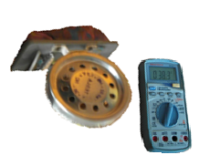
Apparatus
Sound production
Sound analysis
Loudness meter

Slide 17
Frequency response at 94 dB
Does the hole has an effect on the frequency response?
Resonant frequencies of mechanical parts
Notes:
Cavities in graph - how does the pattern changes when hole is changed?

Slide 18
Frequency response at 94 dB - hole effect
Notes:
Cavity in the graph we glued the original hole

Slide 19
Frequency response at 94 dB - hole effect

Slide 20
Frequency response at 94 dB - hole effect

Slide 21
Frequency response at 94 dB - hole effect
There is no hole effect
Notes:
Resonant freq dole lebo trasenie zhorsi nahravaciu schopnost - su tam nejake vykyvy, kde original nie je najlepsi (mal by byt lebo neposkodeni) prave kvoli poskodeniu je to roztrasene

Slide 22
Frequency response at 94 dB - hole effect
Low frequencies (speech)
- Low sensitivity
- Low quality of recording?
Notes:
Resonant freq dole lebo trasenie zhorsi nahravaciu schopnost - su tam nejake vykyvy, kde original nie je najlepsi (mal by byt lebo neposkodeni) prave kvoli poskodeniu je to roztrasene

Slide 23
Hi, how are you…? Speech record
Factory made microphone
Actually, not that bad !
Notes:
Rec je na uzkom range frequencies – podobnu citlivost – pesnicka nie je na uzkom 100 – 1000, slaba citlivost
V nahravke reci vidime ze kvalita zvuku z microphone je lepsia

Slide 24
Frequency response at 94 dB - hole effect
Let’s record these frequencies - song
Notes:
Opat ked sa na to pozrieme…

Slide 25
Song record
Factory assembled
R=100Ω
Factory made
Song has significantly worse quality
How is it possible?
Wide range of frequencies
possibly irregular input from microphone – different amplitude response
Let’s investigate amplitude dependence of microphone
Notes:
Used our because non stable this was the best we could after many times –granules might be better – from some other electronic device equipment (filter – activated)- not made for this purpose
Home made similar to factrory, due to low - zvukovka z toho robi chaos---

Slide 26
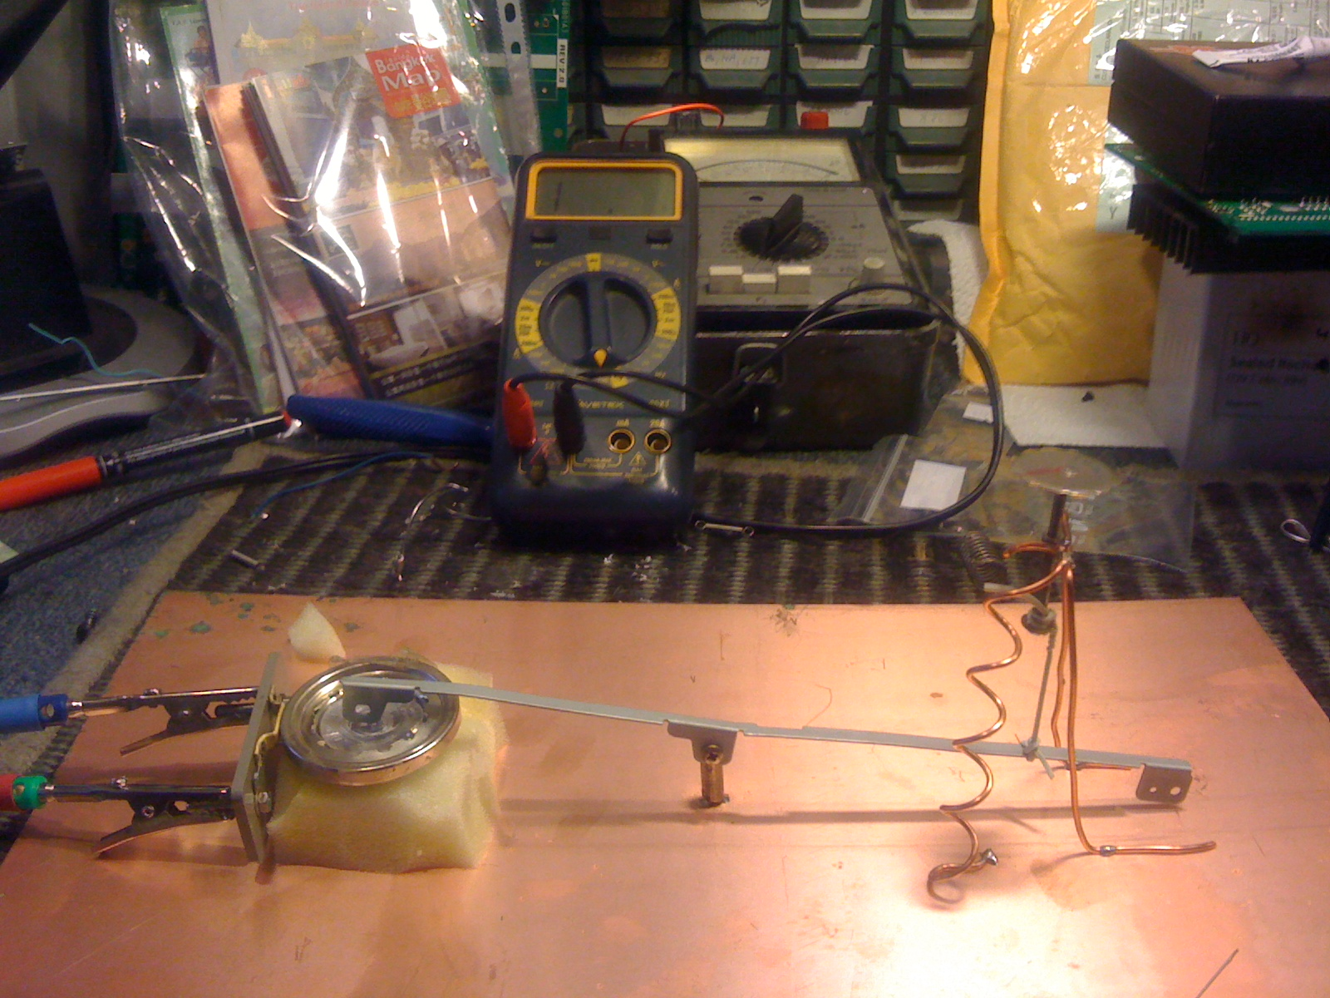
Static amplitude dependence
Turning screw increases pressure
Conductivity vs. pressure measurement

Slide 27
Static amplitude dependence
Response is non-linear
Let’s look at the amplitude characteristics
Notes:
Zastavit a povedat co to je? Co to znamena… We expect the microphone to record sound and its loudness reliably, it means that if I increase input loudness by 10 dB the recorded loudness also increases by 10 dB

Slide 28
Amplitude response characteristics
The slope is different than 1 for log-log graph
– non-linear characteristics
Slope 1
100Hz
Notes:
Cim hlasnejsie poviem tym hlas nahram ale coef mimo 1 ..

Slide 29
Amplitude response characteristics
220Hz

Slide 30
Amplitude response characteristics
y = 1,375x - 165,16
Slope 1
440Hz

Slide 31
Amplitude response characteristics
Slope 1
y = 1,7228x - 208,05
1000Hz

Slide 32
Amplitude response characteristics
Slope 1
y = 0,6554x - 83,392
3200Hz

Slide 33
Comparison for different frequencies
94 dB – frequency response measurement
Each frequency
Different sensitivity
(relative loudness)
Different slope
(change in relative loudness)
Not very optimistic
- For ideal microphone should be one curve

Slide 34
Why is sound distorted?
Speech – narrow range of frequencies
- sound card will adapt its sensitivity
Song – wide frequency span – great variation in relative loudness – sound card unable to adapt its sensitivity
Microphone can be used only to narrow range of frequencies (speech) – due to its non-linearity
Notes:
Jedna frequency potlaci ine to sa neda lebo jedna frequency prehlusi druhu – ona nastavi citlivost na nejaku slabu a ta silna bude tak prehlucnena ze to bude uz prepalene.. Squares nie sinusi

Slide 35
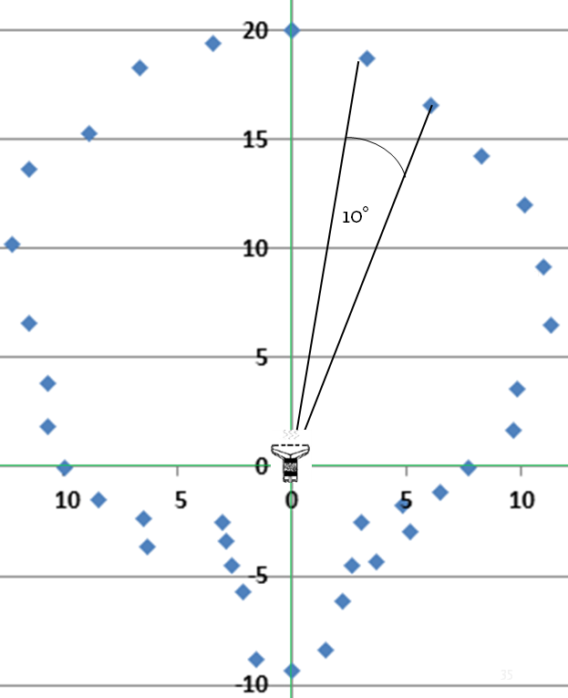
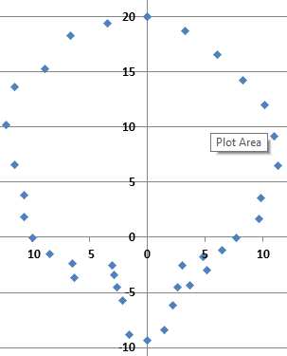
Directional pattern
L=94dB
f=3200Hz
10°
Relative axes 0 = -60 dB (relative loudness)
Notes:
We measured relative sensitivity relative to the sensitivity to the sound produced directly in front of the mic – pattern displays the relative sens. Depending on angle from the front direction and we can see that with increasing angle the magnitude decreases ( it is represented by the distance from origin to the point (radius of imaginary circle)) , there is then again increases when speaker is directly behind the mic --- During the measurement, the angle is different but the distance remains constant (and constant loudness) ------ Pattern similar to standard patterns found on the internet..
Zavisi od hlasitosti a frequency chyba merania.. Dost slbe zvuky

Slide 36
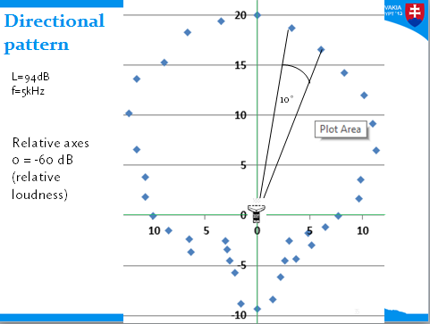
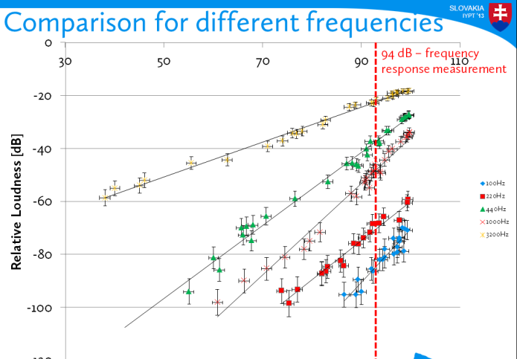
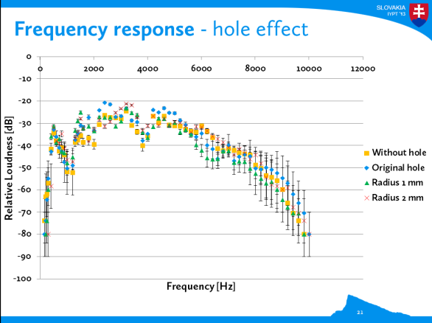
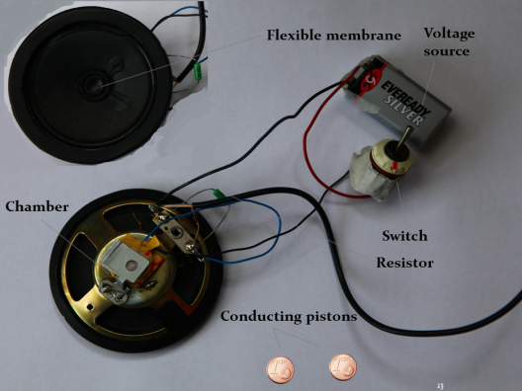
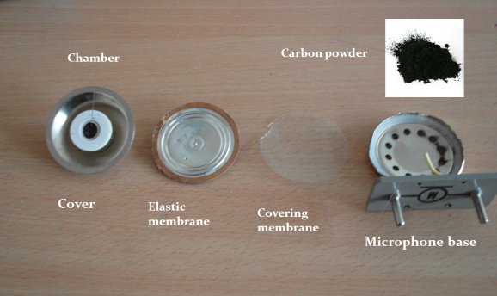
Conclusion
Thank you for your attention
Explained the principle
Investigated components of microphone
Our own microphone ☺
Characteristics of microphone
Frequency response
Investigated the ‘hole’ effect
Amplitude response
- Narrow range
Direction

Slide 37
APPENDICES
Thanks to Martin Ferianc for technical support

Slide 38
Directional – relative magnitude

Slide 39
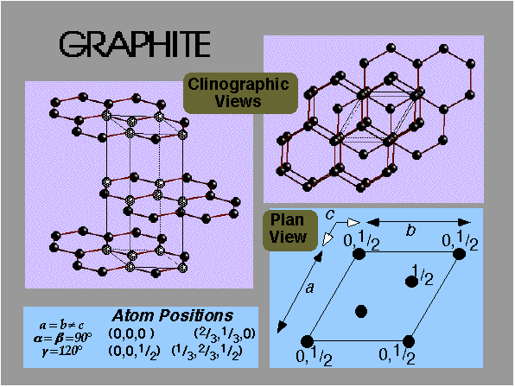
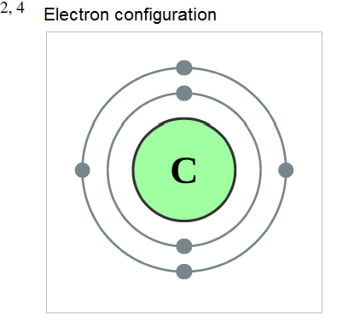
Carbon Powder
Graphite – is a very bad conductor !
big changes in resistance
Idealy no add. Substances
Van der Waals (170 pm)
Group, period, block
14, 2, p

Slide 40
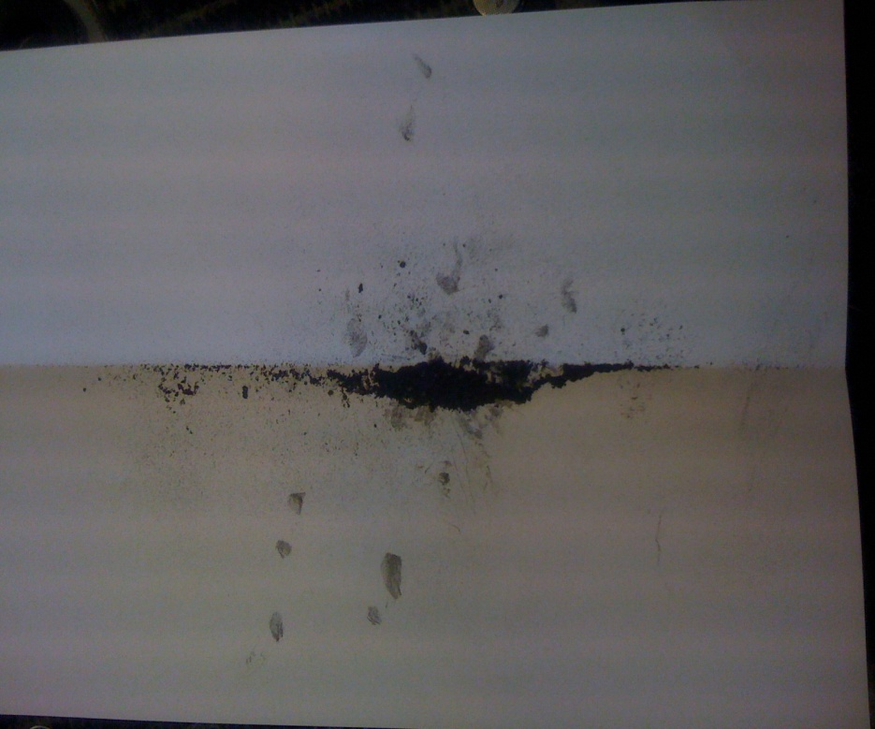
Carbon Powder
Stable
Triple point is at
10.8 ± 0.2 MPa
4,600 ± 300 K
Sublimates at 3,900 K.
Carbon powder of the carbon microphone

Slide 41
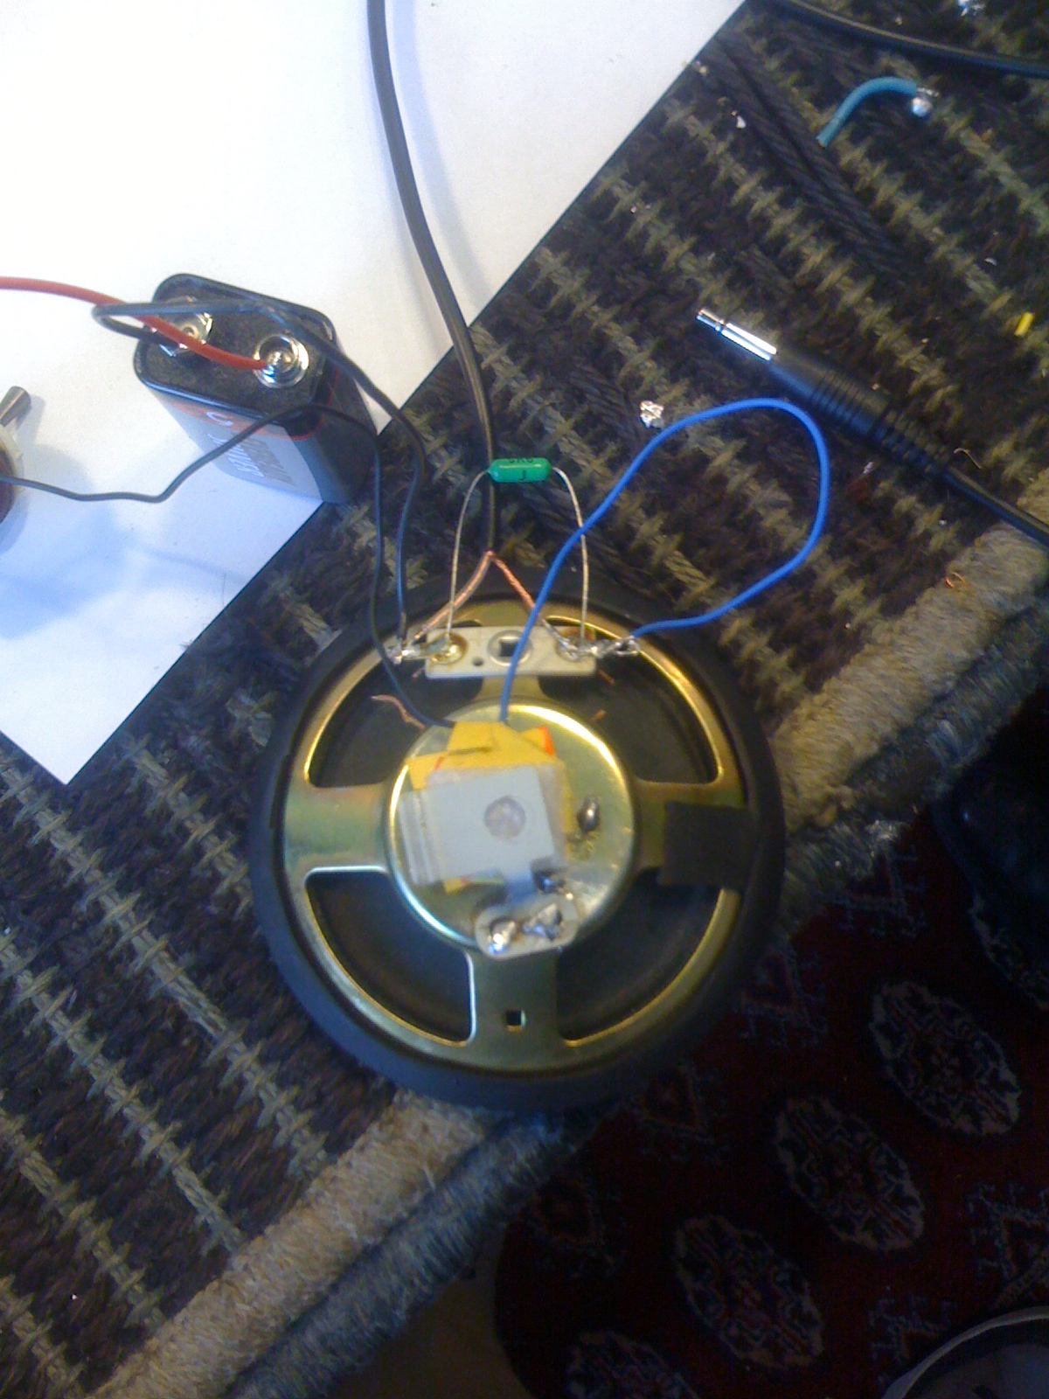
Chamber with carbon grains
Membrane
Resistor
Voltage source

Slide 42
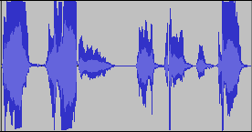
Hi, how are you…?
Home made
Factory made
Factory records speech better – small range of frequencies – what about song?
Notes:
Rec je na uzkom range frequencies – podobnu citlivost – pesnicka nie je na uzkom 100 – 1000, slaba citlivost
V nahravke reci vidime ze kvalita zvuku z microphone je lepsia

Slide 43
Comparison
Home made
R=5000Ω
Factory assembled
R=100Ω
Home made
Factory made
The record of the song with factory made has similar ‘quality’ as with home made – as predicted by its characteristics
Notes:
Used our because non stable this was the best we could after many times –granules might be better – from some other electronic device equipment (filter – activated)- not made for this purpose
Home made similar to factrory, due to low - zvukovka z toho robi chaos---

