Slide 1
Elastic Space
2
Kamila Součková

Slide 2
2 Elastic Space
The dynamics and apparent interactions of massive balls rolling on a stretched horizontal membrane are often used to illustrate gravitation. Investigate the system further. Is it possible to define and measure the apparent “gravitational constant” in such a “world”?
The dynamics and apparent interactions of massive balls rolling on a stretched horizontal membrane are often used to illustrate gravitation. Investigate the system further. Is it possible to define and measure the apparent “gravitational constant” in such a “world”?
Notes:
[NEXT] My understanding of the words “illustrate gravitation” is

Slide 3
…“illustrate gravitation”…
when viewed from the top, the objects should move as if interacting gravitationally

Slide 4
The Correct Shape
both systems:
$$E_{k}↔E_{p}$$
rubber sheet
gravity
$$\frac{1}{2}mv^{2}↔mgh(r)$$
$$\frac{1}{2}mv^{2}↔−κ\frac{mM}{r}$$
$$F_{g}=−κ\frac{Mm}{r^{2}}$$
$$h\left(r\right)=−κ_{m}M\frac{1}{r}$$
$$=φ=\frac{E_{p}}{m}$$
grav. potential
$h(r)$: membrane height at radius $r$
Notes:
in order to find what that shape should be, we compare the two systems: the rubber sheet and radial gravity
both have sth in common: E_p changes into E_k and back
E_k is the same, what is different [C] is E_p: in (radial) gravity from Newton, in rubber sheet it is given by the height in our homogeneous gravitational field.
Therefore the shape of the membrane (i.e. h(r) ) must be so that we can rewrite the right thing into the left one
[C] note: the shape represents a quantity called grav. potential
[NEXT] Therefore all we need to do to see whether the shape is correct is to take our membrane and try to fit it with a 1/R

Slide 5
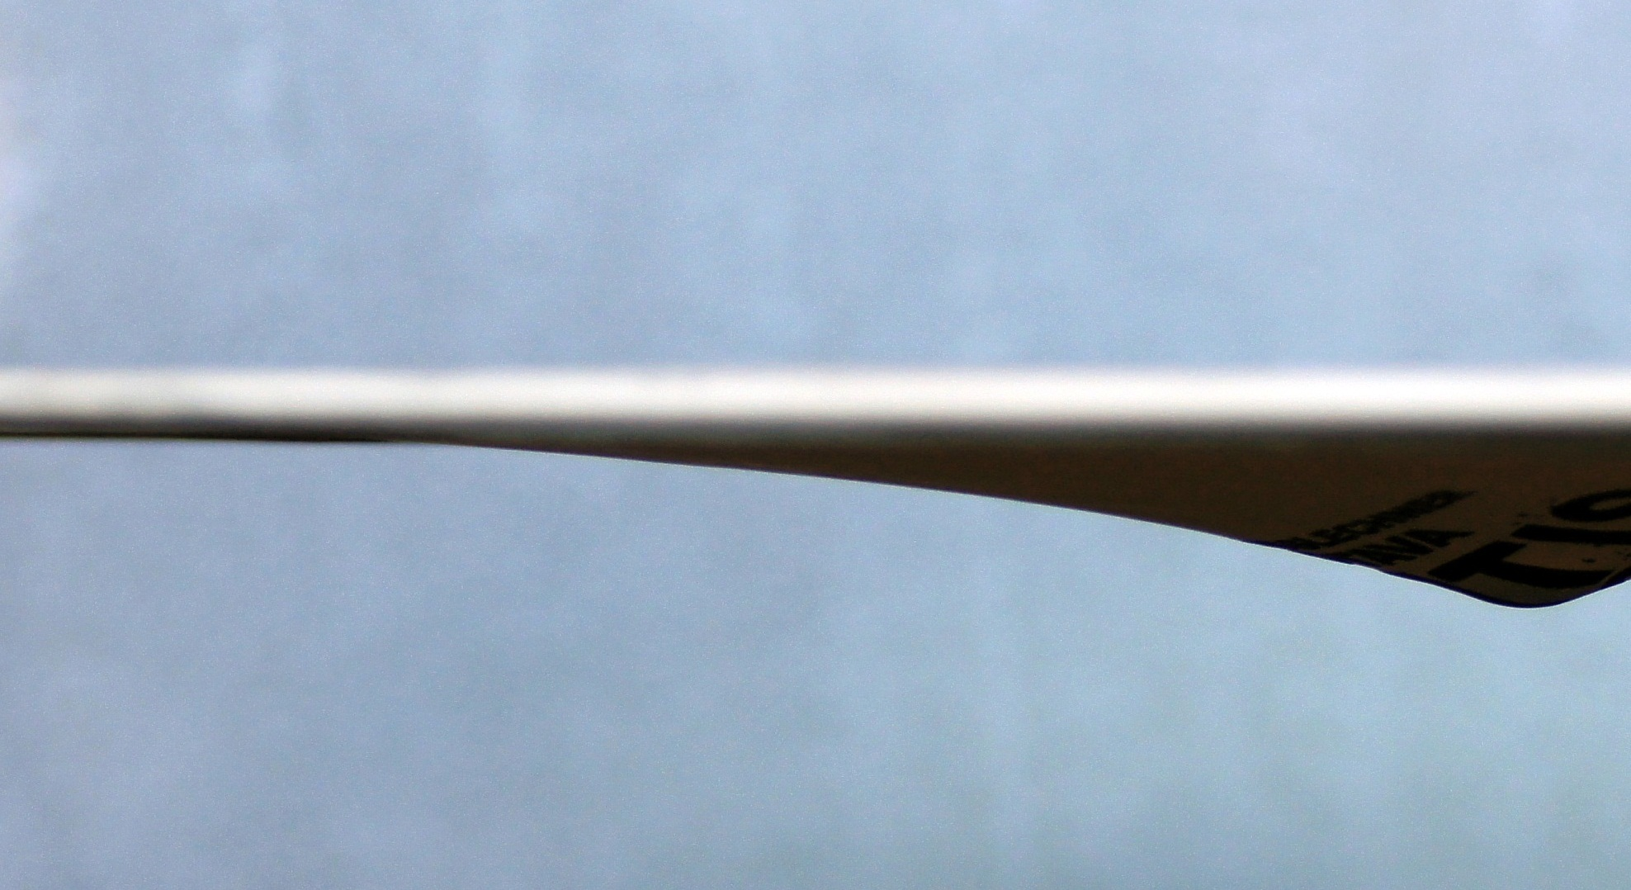
Is the Shape Correct?
?
$$−C⋅\frac{1}{r}$$
Notes:
[“?”] What is going on? [click]

Slide 6
Is the Shape Correct?
?
$$−C⋅\frac{1}{r}$$
is it only an experimental problem (i.e. imperfect membrane), or is it something fundamental?
Notes:
[NEXT] Let’s look at the physics governing the rubber sheet behavior…

Slide 7
Physics of a Rubber Sheet
What Does Rubber Do?

Slide 8
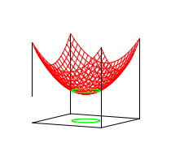
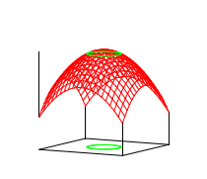
Description of Rubber Sheet Curvature
based on Feynman, R. P.: The Feynman Lectures On Physics, Vol. 2, Ch. 12:
$$∇^{2}h=\frac{g}{k}ρ$$
valid for small deformations only;
derivation in Appendix
Laplace operator
$h$: membrane height at radius $r$
$ρ$: distribution of mass
$k$: membrane stiffness
$g$: gravitational acceleration
Notes:
this is called a Poisson equation and it tells about how the curvature changes depending on mass density
laplace: differential operator (tells us about the derivatives of the function); geometric interpretation blah blah (+ : convex, - : concave)

Slide 9
Rubber Sheet vs. Gravity
rubber sheet shape
gravitational potential
$$∇^{2}h=\frac{g}{k}ρ$$

Slide 10
Rubber Sheet vs. Gravity
rubber sheet shape
gravitational potential
$$∇^{2}h=\frac{g}{k}ρ$$
$$∇^{2}φ=4πκρ$$
(derivations in Appendix)
Laplace operator
$h$: membrane height
$ρ$: distribution of mass
$k$: membrane stiffness
$g$: gravitational acceleration
$ρ$: distribution of mass
$φ$: gravitational potential
$κ$: gravitational constant
Notes:
we can write a Poisson equation for gravitational potential
as we can see, the equations have the same form, [C] the constants are different, [C] but the form is the same
and (as Mr. Feynmann emphasizes throughout his lectures) the same equations have the same solutions, therefore [C] the solutions should also be equal
[NEXT] However, as we already know, they are not

Slide 11
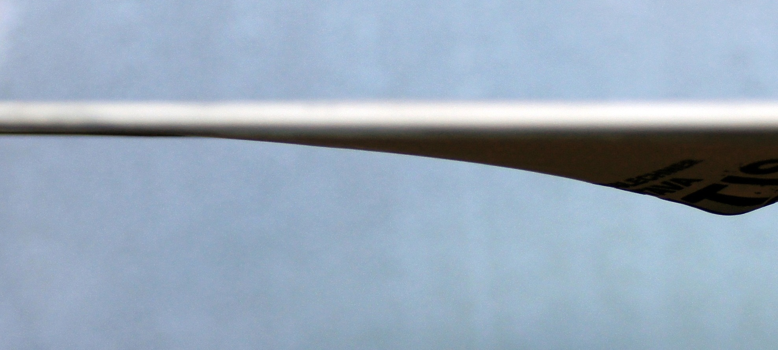
Rubber Sheet vs. Gravity
rubber sheet shape
gravitational potential
?
$$−C⋅\frac{1}{r}$$
Notes:
However, as we already know, they are not

Slide 12
rubber sheet shape
gravitational potential
✗
3
D
3
D
$$∇^{2}h=\frac{g}{k}ρ$$
$$∇^{2}φ=4πκρ$$
the rubber sheet model is a 2D problem!
Notes:
The reason is that we need to realize that the rubber sheet is 2-dimensional
[C] therefore the solutions are not the same, because the dimensionality is different
[NEXT] This means that in order to be able to compare our rubber sheet to gravity, we need to look at how gravity would work in 2 dimensions

Slide 13
Gravity in 2 Dimensions
Rubber Sheet and Gravity Equivalence

Slide 14
The Form of Newton’s Law of Gravitation
why $F_{g}∝\frac{1}{r^{2}}$ ⇒ $φ∝\frac{1}{r}$ ?
depends on the dimensionality of the world
informal reasoning: $F_{g}∝$ intensity
intensity in 3D $∝$ $\frac{1}{r^{2}}$
intensity in 2D $∝$ $\frac{1}{r}$
⇒ $F_{g}∝\frac{1}{r}$
(formal derivation based on Divergence Theorem in Appendix)
Notes:
we can find the answer by solving Poisson’s eq (which is rather complex), but we can arrive at the answer by informal reasoning, too
the force is proportional to the intensity of the gravitational field
it is a well-known fact that in 3D intensity $∝\frac{1}{r^{2}}$ and in 2D intensity $∝\frac{1}{r}$ (which can be seen easily and I will gladly elaborate on it in the discussion if desired)

Slide 15
2D
$F_{g}∝\frac{1}{r}$

Slide 16
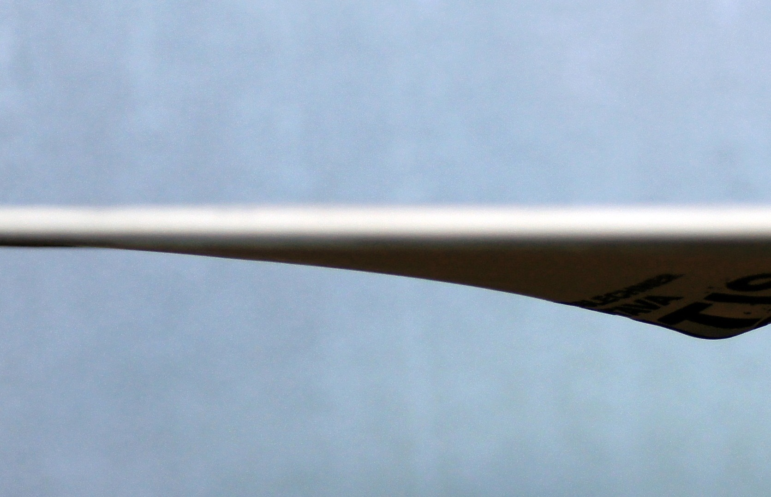
:
$F_{g}∝\frac{1}{r}$
⇒ $φ∝\log{\frac{r}{R_{0}}}$
2D
Notes:
once we know this, the potential shape can be found to be logarithmic. Therefore what we should do to confirm the equivalence is to [C] take our rubber sheet and try to fit it with a logarithmic function. [C] When we do this, we find that it is a [C] rather good fit. [NEXT]

Slide 17
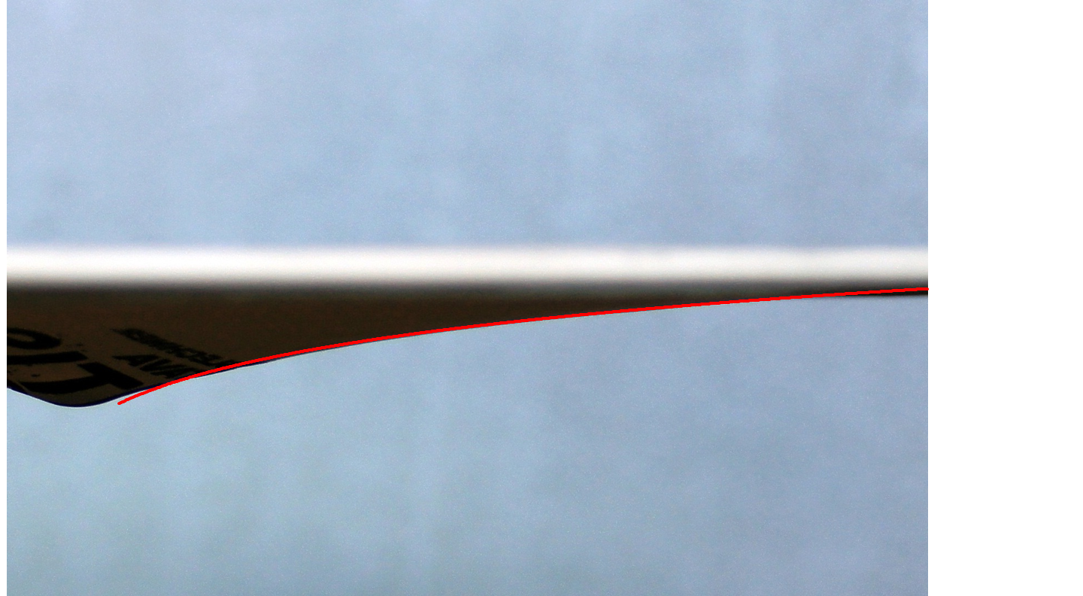
:
$F_{g}∝\frac{1}{r}$
⇒ $φ∝\log{\frac{r}{R_{0}}}$
2D
✓
$$h=C⋅\ln\left(\frac{r}{R_{0}}\right)$$
$C=16 mm$
$R_{0}=3 mm$
Notes:
once we know this, the potential shape can be found to be logarithmic. Therefore what we should do to confirm the equivalence is to [C] take our rubber sheet and try to fit it with a logarithmic function. [C] When we do this, we find that it is a [C] rather good fit. [NEXT]

Slide 18
:
$F_{g}∝\frac{1}{r}$
⇒ $φ∝\log{\frac{r}{R_{0}}}$
2D
✓
$$h=C⋅\ln\left(\frac{r}{R_{0}}\right)$$
2D rubber sheet assumes the correct shape to model 2D gravity – governed by the same equations!
$C=16 mm$
$R_{0}=3 mm$
Notes:
governed by the same equations ⇒ the shape will correctly represent gravity even if we add more objects

Slide 19
Finding the gravitational constant

Slide 20
Where to get $κ_{m}$?
from the membrane shape (potential): $φ\left(r\right)=2κ_{m}M\ln\left(\frac{r}{R_{0}}\right)$
(by solving $∇^{2}h=\frac{g}{k}ρ$ using a Green’s function)
$$h(r)=C⋅\ln\left(\frac{r}{R_{0}}\right)$$
$$κ_{m}=\frac{C}{2M}$$
Notes:
an obvious option is to directly measure the force exerted on objects, but this would be quite imprecise, therefore I have chosen a different option: find the gravitational constant from the potential (i.e. the shape of the membrane)
since the membrane shape [h(r)] is equivalent to the potential [phi(r)], by comparing the two we can find the expression for kappa_m

Slide 21
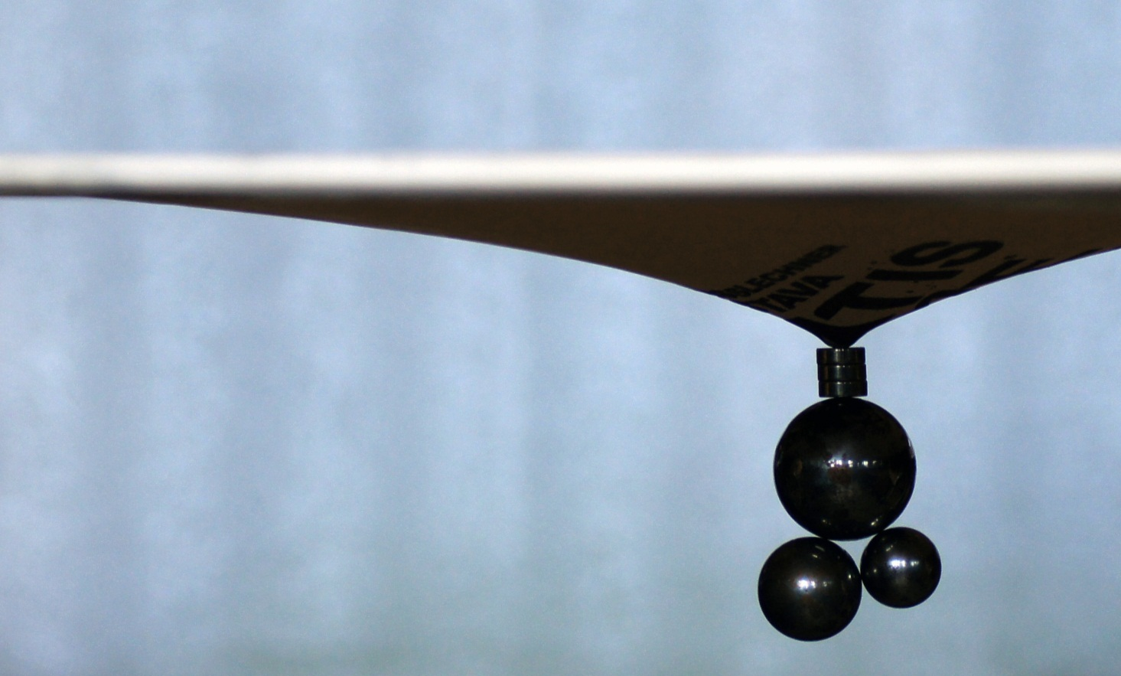
Experiment: changing mass, keeping diameter
small steel ball
strong magnet
additional weights
Notes:
vesame roznu hmotnost, lebo chceme mat nejaku tu statisticku vzorku, a nemenime polomer gulicky
(note: ocakavame, ze pre privelke hmotnosti to nebude moc fungovat, lebo prilis natiahnute / model nefunguje atd.)

Slide 22
Results
$$u(r)=C⋅\ln\left(\frac{r}{R_{0}}\right)$$
$$κ_{m}=\frac{C}{2M}$$
too
stretched
$κ_{m}=\left(5.3±0.2\right)⋅{10}^{−2}$ $\frac{m^{2}}{kg⋅s^{2}}$
Notes:
as expected, for large masses [C] we no longer get a constant (since our model is not valid at these ranges), but for smaller masses [C] our gravitational constant is indeed constant (as a good constant should be). Therefore the [C] average value from these measurements is our gravitational constant for this system, and can be used to calculate gravitational force.

Slide 23
Dynamics

Slide 24
Dynamics
the shape is correct ⇒ approx. works
but: energy losses (friction / rolling resistance)
⇒ conservation of mechanical energy
+ elasticity: finite speed of “gravitational interaction”
Notes:
for objects moving with regard to “the aether” (i.e. the membrane), mechanical energy is not conserved
energy losses v normalnej gravitacii nemame, takze to je cele zle
finite speed (sposobena tym, ze sa tam pomaly siria rozruchy – vlny), co v newtonovskej gravitacii nie je
to trenie sa prejavuje vyrazne, ako ukaze dalsi slide

Slide 25
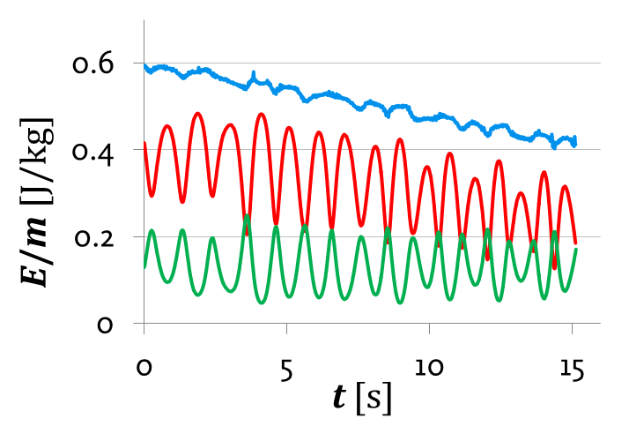
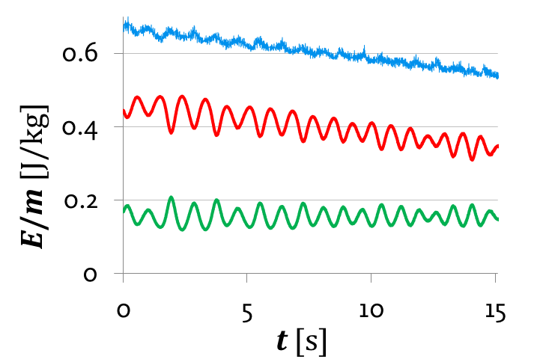
$m=1 g$, $d=12 mm$
$m=2.2 g$, $d=16 mm$
13
y [m]
t [s]
y [m]
t [s]
x [m]
x [m]
$$Σ$$
$$Σ$$
$$E_{p}$$
$$E_{p}$$
$$E_{k}$$
$$E_{k}$$
M = 1.8 kg
Notes:
zaroven si mozme vsimnut, ze nam to nechodi po slusnych, uzavretych drahach (elipsy nikde). Je to trenim, alebo by to tak bolo aj bez strat energie?

Slide 26
Ellipses?
Bertrand's theorem: stable, closed orbits can only exist if $φ∝\frac{1}{r}$ or $φ∝r^{2}$ ⇒ no closed orbits here
$M=1.8 kg$
$m=9.7 g$
$r_{init}=13.4 mm$
Johnson, Porter Wear (2010). Classical Mechanics With Applications
Notes:
po troche vyskumu sme zistili, ze to nie je len trenim
there is a peculiar statement due to Joseph Bertrand …
however, there is one exception: circular motion (possible in all spherically symmetric potentials); therefore it sort of makes sense to formulate laws analogous to Kepler’s laws

Slide 27
Kepler’s Laws
1st Law
2nd Law
3rd Law
✗
no elliptical orbits

Slide 28
Kepler’s Laws
1st Law
2nd Law
3rd Law
theoretically:✓
(conservation of momentum)
experiment: ✗
(energy losses – friction)
✗
no elliptical orbits

Slide 29
Kepler’s Laws
1st Law
2nd Law
3rd Law
(for circular orbits)
✗
$\frac{a^{3}}{T^{2}}=const.$ for $∀$ orbiting same mass
force equilibrium ($F_{g}=mω^{2}a$)
theoretically:✓
(conservation of momentum)
experiment: ✗
(energy losses – friction)
✗
no elliptical orbits
✓
$$\frac{a^{2}}{T^{2}}∝\frac{a}{T}=const.$$

Slide 30
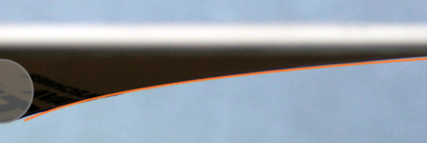
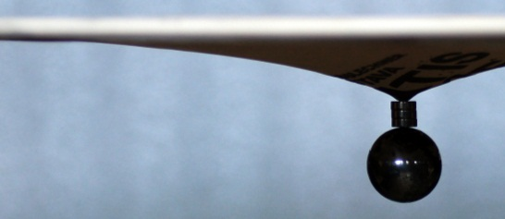
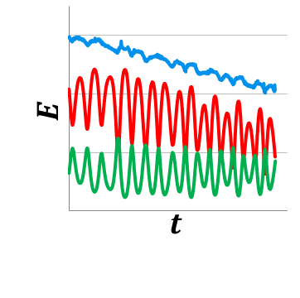
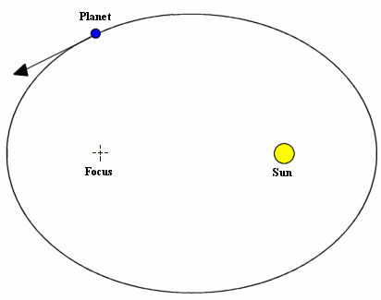
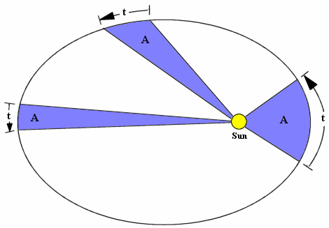
Conclusion
same motion ⇒ ⇒ shape = potential
description of sheet curvature
✓
same equations as gravity, but 2D
$$h=C⋅\ln\left(r/R_{0}\right)$$
Thank you for your attention!
$F=κ_{m}\frac{Mm}{r}$; $κ_{m}=0.053\frac{m^{2}}{kg⋅s^{2}}$
dynamics:
Kepler’s Laws:
$$\frac{a^{3}}{T^{2}}=C$$
$$Σ$$
$$\frac{a}{T}=C$$
✓
$$E_{p}$$
✗
th. , exp.✗
✓
$$E_{k}$$

Slide 31
same motion ⇒ ⇒ shape = potential
description of sheet curvature
✓
same equations as gravity, but 2D
$$h=C⋅\ln\left(r/R_{0}\right)$$
Thank you for your attention!
$F=κ_{m}\frac{Mm}{r}$; $κ_{m}=0.053\frac{m^{2}}{kg⋅s^{2}}$
dynamics:
Kepler’s Laws:
$$\frac{a^{3}}{T^{2}}=C$$
$$Σ$$
$$\frac{a}{T}=C$$
✓
$$E_{p}$$
✗
th. , exp.✗
✓
$$E_{k}$$

Slide 32
Appendix
gravity, rubber sheet: equations
gravity in N-D
derivation of Kepler’s 3rd Law
small slopes approximation
Notes:
TODO upratat

Slide 33
$φ$: Poisson’s Equation
intensity $g=\frac{F}{m}$ : gradient of potential
$$g(r)=−∇φ(r)$$
Gauss’s Theorem:
$$∇∙g(r)=−4πκρ(r)$$
together: Poisson’s equation
$$∇∙\left(−∇φ\left(r\right)\right)=−4πκρ\left(r\right)$$
$$Δφ(r)=4πκρ(r)$$

Slide 34
$φ$: Boundary Conditions, $ρ(r)$
$$Δφ(r)=4πκρ(r)$$
$φ\left(∞\right)=const$., therefore
$${∂_{n}φ|}_{S}=0$$
$ρ$: point mass in our measurements:
$$ρ\left(r\right)=m δ\left(r\right),$$
where $δ\left(r\right)$ is δ-function
($\int_{−∞}^{∞}{δ\left(x\right) dx=1}$, $∀x∈R−\left\{0\right\}:δ\left(x\right)=0$)

Slide 35
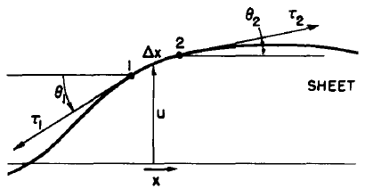
$h$: Poisson’s Equation
net force causing the rubber sheet to bend:
$∆F=k ∆y\sin{θ_{2}}−k∆y sin{θ_{1}}$
$ΔF=k∆y(\sin{θ_{2}}−\sin{θ_{1}})$
h
for $θ≪1$ : $\sin{{θ≈\tan{θ}≈\frac{∂h}{∂x}}_{ }}$, then
$$∆F= k ∆y\text{(}\frac{∂h_{2}}{∂x}−\frac{∂h_{1}}{∂x}\text{)}=k∆y\frac{∂^{2}h_{ }}{∂x^{2}} ∆x$$
$k$: “surface tension” (force per length)
Notes:
Toto je odvodenie z feynmana, druhy diel, kapitola 12.3

Slide 36
$h$: Poisson’s Equation
deformation is caused by gravity:
$$∆F=g ρ∆x∆y$$
substitute $ΔF=k∆y\frac{∂^{2}h_{ }}{∂x^{2}} ∆x$:
$$\frac{∂^{2}h_{ }}{∂x^{2}}=\frac{∆F}{k∆x ∆y}=\frac{ρg}{k}$$
generalization (vector fields):
$$∆h(r)=\frac{g}{k}σ(r)$$

Slide 37
$h$: Boundary Conditions, $ρ(r)$
$$Δφ(r)=\frac{g}{k}ρ(r)$$
$φ\left(∞\right)=const$., therefore
$${∂_{n}h|}_{∞}=0$$
$ρ$: area density negligible in comparison to mass of ball $m$, therefore approximated by δ-function:
$$ρ\left(r\right)=m δ\left(r\right)$$

Slide 38
Rubber Sheet vs. Gravity
two differential equations of the same type, in the same region
von Neumann boundary conditions: $\frac{∂_{n}f}{∂r}=0$
in a closed region such differential equations have at most one solution (Dirichlet’s problem, unique solution theorem)
character of solutions for $φ$ and $h$ will be the same – $φ∝h$

Slide 39
The Form of Newton’s Law of Gravitation
why $F_{g}∝\frac{1}{r^{2}}$ ?
Gauss’s Law: $∯_{∂V}^{ }{g⋅dA}=−4πκM$
(gravitational flux through any closed surface is proportional to the enclosed mass)
special case: spherical symmetry, point mass:
$$g⋅A_{s}=−4πκM{ ; A}_{s}=4πr^{2}$$
$$g=−\frac{4πκM}{A_{s}}=−\frac{κM}{r^{2}}$$

Slide 40
The Form of Newton’s Law of Gravitation
why $F_{g}∝\frac{1}{r^{2}}$ ?
Gauss’s Law: $∯_{∂V}^{ }{g⋅dA}=−4πκM$
(gravitational flux through any closed surface is proportional to the enclosed mass)
special case: spherical symmetry, point mass:
holds in N dimensions, too
$$g=−\frac{4πκM}{A_{s}} ; A_{s}∝r^{N−1}$$
$$g∝−\frac{κM}{r^{(N−1)}}$$

Slide 41
Gravitational Force in 2D
$g=−\frac{2κM}{r}$
potential $φ\left(r\right)=\int_{r}^{∞}{g dr}$
$$=g\log{r}+C$$

Slide 42
Derivation of the 3rd Kepler’s Law
$$F_{g}=F_{cf}$$
standard - 3D
2D rubber sheet
$$κ_{m}\frac{Mm}{r^{2}}={mω}^{2}r$$
$$\frac{r^{3}}{T^{2}}=\frac{κ_{m}M}{4π^{2}}$$
$$\frac{r^{3}}{T^{2}}=\frac{1}{4π^{2}}κM$$
$$κ_{m}\frac{Mm}{r}={mω}^{2}r$$
$$\frac{r^{2}}{T^{2}}=\frac{κ_{m}M}{4π^{2}}$$
$$\frac{r}{T}=\frac{1}{2π}\sqrt{κ_{m}M}$$
substitute $ω=\frac{2π}{T}$:

Slide 43
Large slopes do not work well
if the slope is too big, the projected force will not be monotonous
+ part of $E_{k}$ → vertical motion!
we will work only with small slopes

Slide 44
we will work only with small slopes

Slide 45
we will work only with small slopes
⇒ we can assume:
uniform tension
$\sin{θ}≈θ≈\tan{φ}=\frac{Δh}{Δx}$
$\cos{θ}≈1$
experiment:
no inelastic (permanent) deformation of membrane
Hooke’s law holds (force $∝$ deformation)
Notes:
uniform tension in the whole membrane
$\sin{φ}≈φ$: used in the derivation

