Slide 1
Invent Yourself
1
Kamila Součková

Slide 2
1 Invent Yourself
It is more difficult to bend a paper sheet, if it is folded “accordion style” or rolled into a tube.
Using a single A4 sheet and a small amount of glue, if required, construct a bridge spanning a gap of 280 mm.
Introduce parameters to describe the strength of your bridge, and optimize some or all of them.

Slide 3
Paper
standard office paper
areal density ≈ $80 g/m2$
thickness ≈ $0.1 mm$
A4: $210 mm×297 mm$
our bridge:
$280 mm$
A4

Slide 4
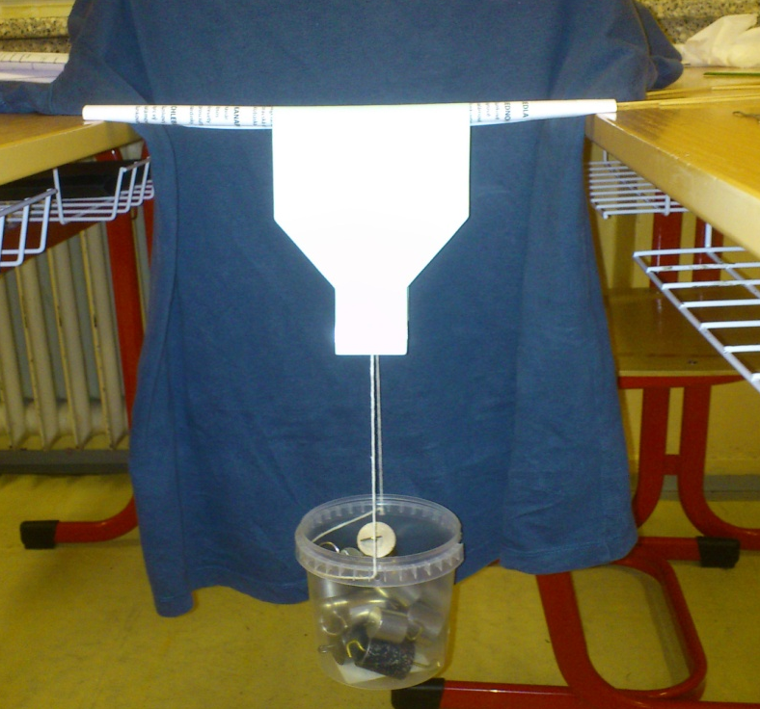
Definition of Strength
strength $≡$ maximal load the bridge can hold in its center
load placed over constant width of the bridge (12 cm)
Notes:
[NEXT] Now that we’ve defined strength, we can start building bridges and optimizing them

Slide 5
Bridge Optimization

Slide 6
How a Simple Bridge Breaks

Slide 7
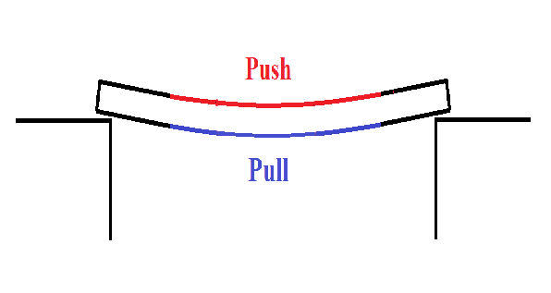
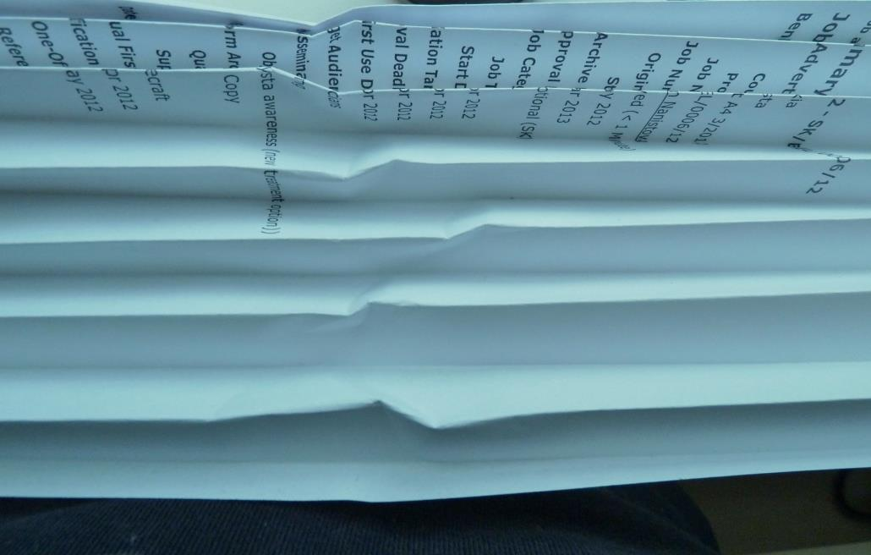
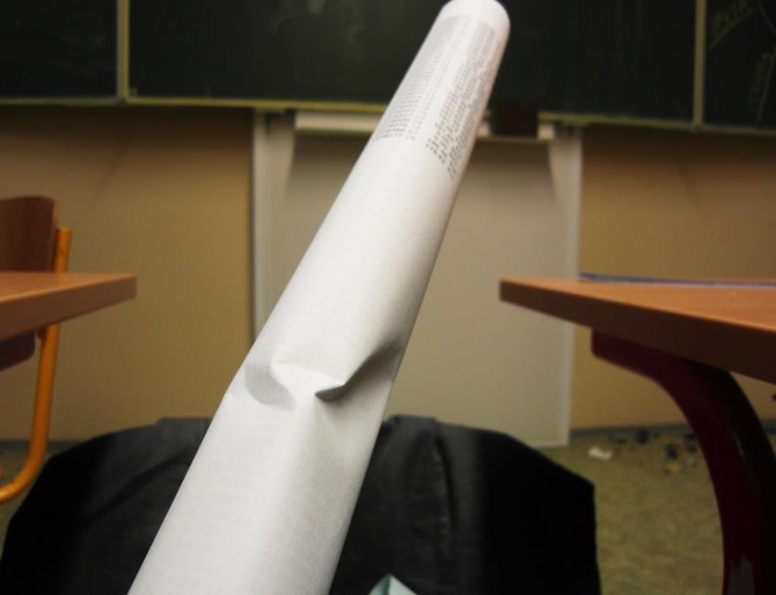
What Happened
paper:
strong in pull, weaker in push
Notes:
The bridge bent, thereby the bottom side experienced a pull and the top side a push. Since paper is quite strong in pull but weak in push, the bridge cracks (as you can see on these pictures). Therefore in our designs we will look for a bridge that can best handle this problem.

Slide 8
Bridge Designs
accordion
tube
inspired by real bridges
paper-unique
?

Slide 9
accordion
tube
inspired by real bridges
paper-unique
?

Slide 10
Accordion: Parameters
1
2
3
4
α
$$D$$
number of dents $N$
width of accordion $D$

Slide 11
Accordion: Parameters
1
2
3
4
α
$$D$$
number of dents $N$
width of accordion $D$

Slide 12
Max Load vs. # of Dents for $D=8 cm$
8 dents
tall dents bend
short dents crack

Slide 13
Max Load vs. # of Dents for $D=8 cm$
8 dents
Can we explain
the max?

Slide 14
Force analysis
strength of bridge = strength of single dent × N

Slide 15
Accordion: Explaining the Max
strength of bridge = strength of single dent × N
→ experiment: strength 0f a single dent

Slide 16
Accordion: Explaining the Max
strength of bridge = strength of single dent × N
max: highest load/length ratio ( $N∝\frac{1}{length}$ )
load
length

Slide 17
Accordion: Explaining the Max
strength of bridge = strength of single arm × N
max: highest load/length ratio ( $N∝\frac{1}{length}$ )
$$N=\left\lfloor \frac{210 mm}{2⋅13.1 mm}\right\rfloor =8$$
13.1 mm

Slide 18
Measured Max Load vs. N × Single Dent

Slide 19
Accordion: Parameters
1
2
3
4
α
$$D$$
✓
number of dents $N$
width of accordion $D$

Slide 20
Accordion: Parameters
1
2
3
4
α
$$D$$
✓
number of dents $N$
width of accordion $D$

Slide 21
Max Load vs. Accordion Width for 8 dents
max: $385 g$

Slide 22
Accordion: Parameters
1
2
3
4
α
$$D$$
✓
number of dents $N$
width of accordion $D$
✓

Slide 23
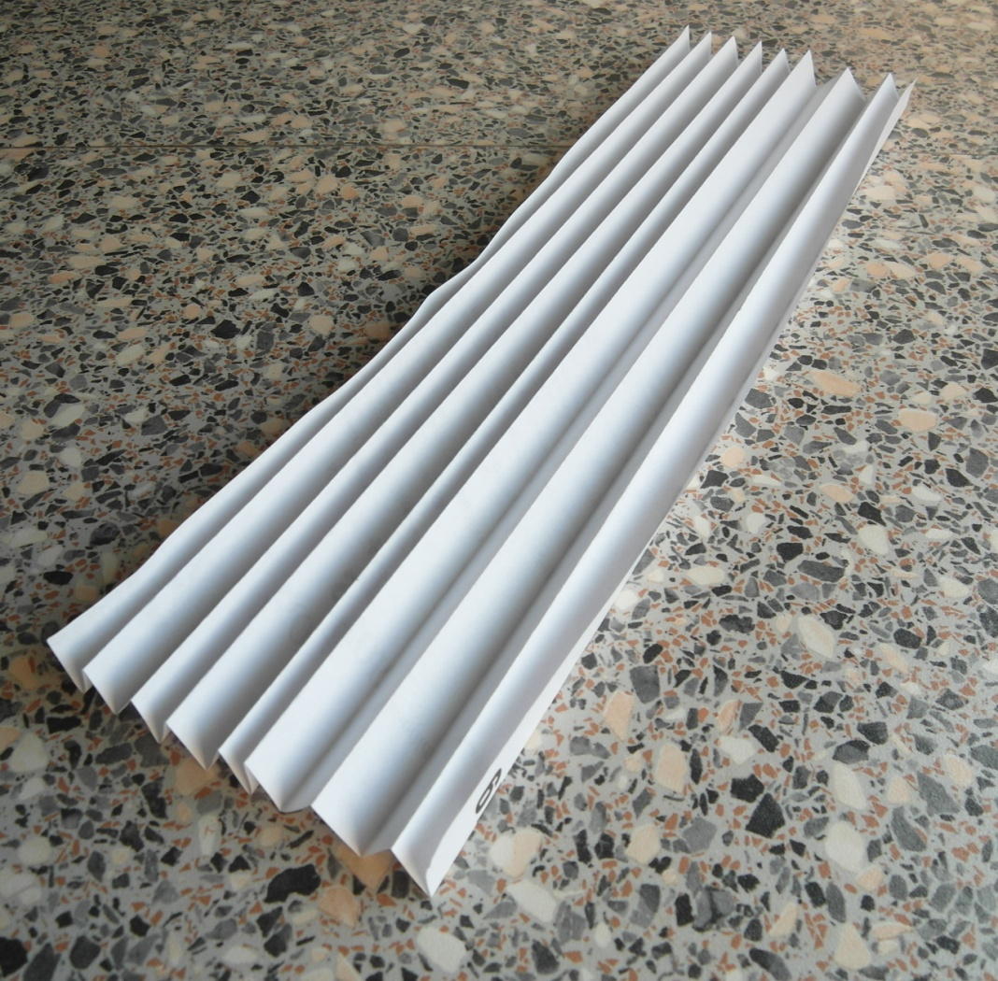
Accordion: Optimal Parameters
max:
8 dents
$D=10 cm$
$385 g$

Slide 24
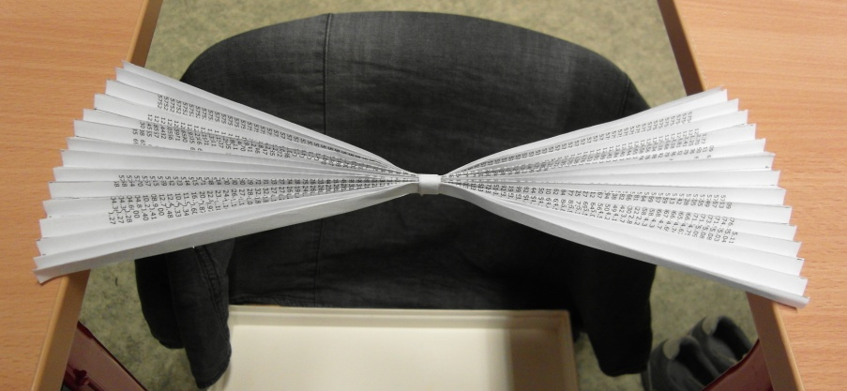
Modifying the Accordion
max load: $180 g$
low stability – crashes near the center
→ cute, but useless

Slide 25
accordion
tube
inspired by real bridges
paper-unique
$$385 g$$
?

Slide 26
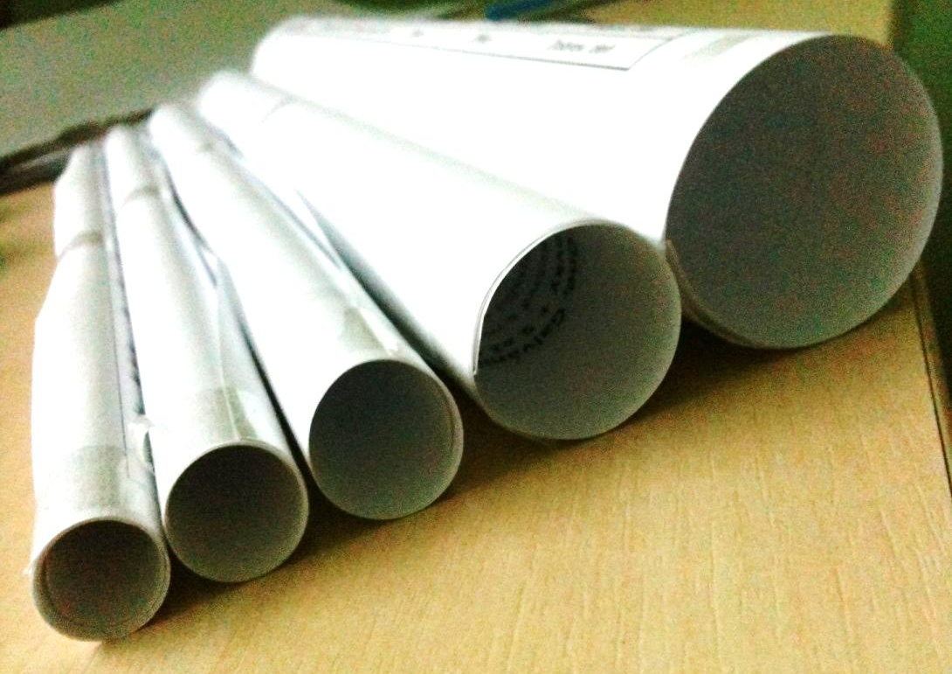
Tube: Parameters
radius $r$ ⇒ number of layers $L=\frac{210 mm}{2πr}$

Slide 27
Max Load vs. Radius
max: $2100 g$

Slide 28
Max Load vs. Radius
max: $2100 g$
let’s analyze the max!

Slide 29
Analysis of Variables
need to separate the effect of
radius
number of layers
change radius but not number of layers: experiment with double-layer tubes

Slide 30
Max Load of Double-Layer Tubes
max: highest load/diameter ratio ( $N∝\frac{1}{length}$ )
load
length

Slide 31
Max Load of Double-Layer Tubes
max: highest load/diameter ratio ( $N∝\frac{1}{length}$ )
Optimal between approx. $10−17 mm$

Slide 32
Max Load vs. Radius
Optimal between approx. $10−17 mm$

Slide 33
Tube: Optimal Parameters
Maximal strength: with $15 mm$ diameter
$$2100 g$$
Notes:
Fotka rolky s 15 mm priemer

Slide 34
accordion
tube
inspired by real bridges
paper-unique
$$385 g$$
$$2100 g$$
?

Slide 35
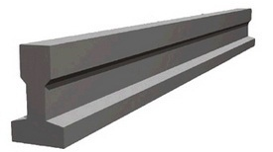
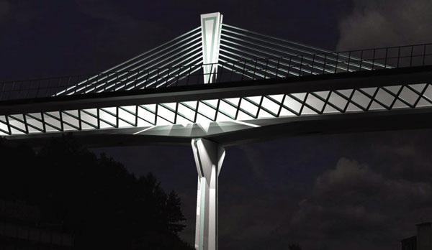
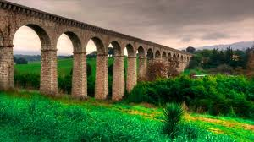
Bridges Inspired by Reality
Different girders
Suspension bridge
Pier bridge

Slide 36
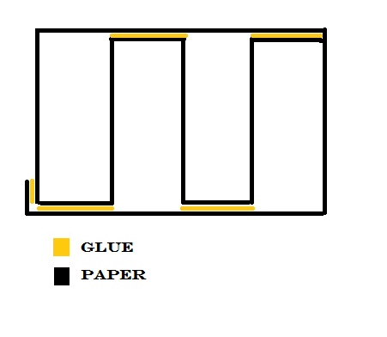
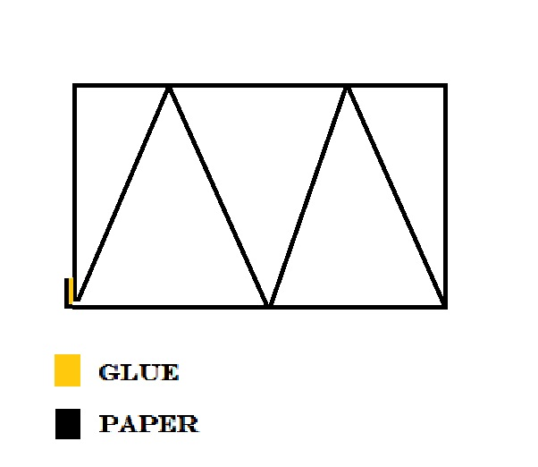
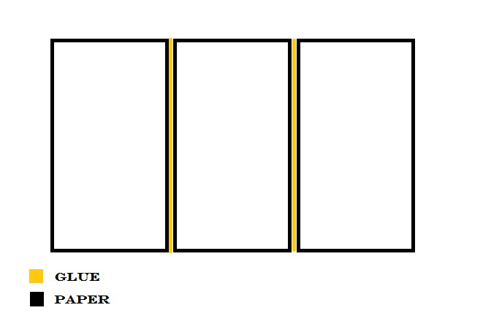
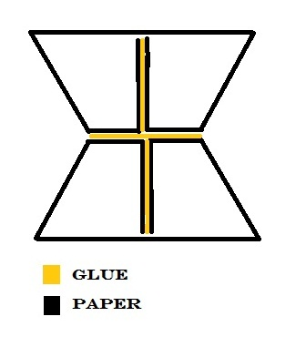
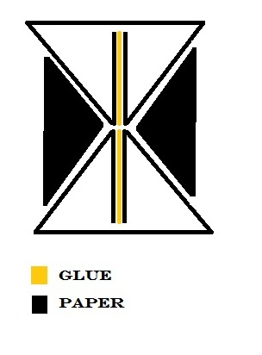
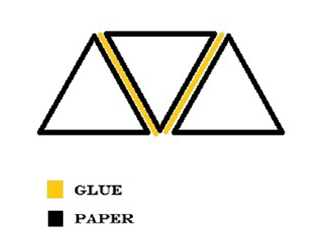
Experiments: Different Girders/Profiles
1025g
510g
640g
1040g
875g
490g

Slide 37
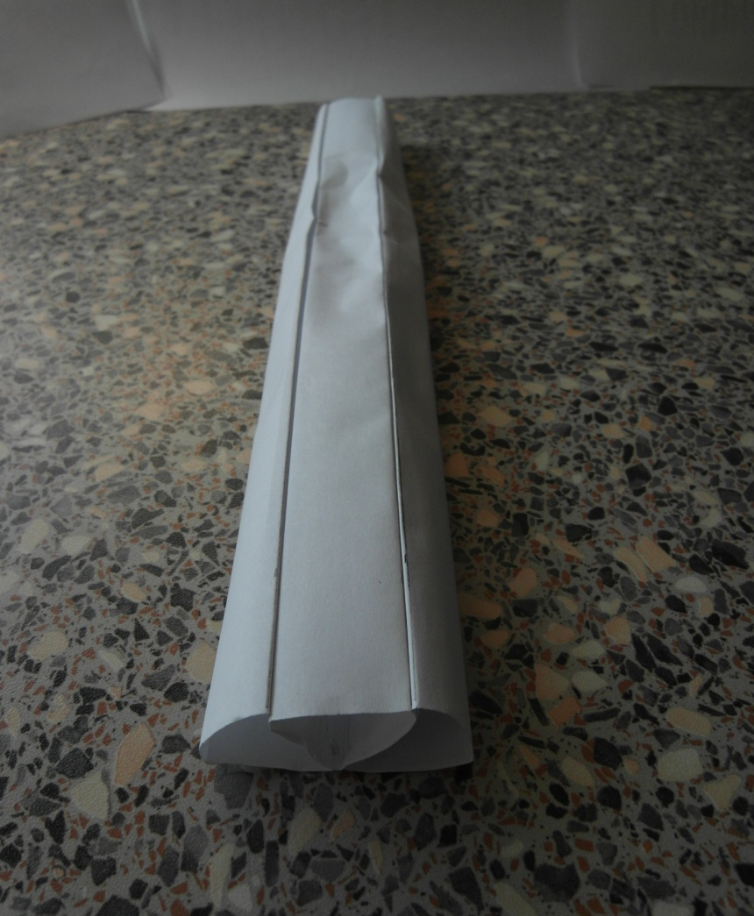
Experiments: Different Girders/Profiles
1025g
510g
640g
Max load: 1040g
max: $1040 g$
1040g
875g
490g

Slide 38
Suspension Bridge
Tubes
Straps for suspension
Strap for “walking”

Slide 39
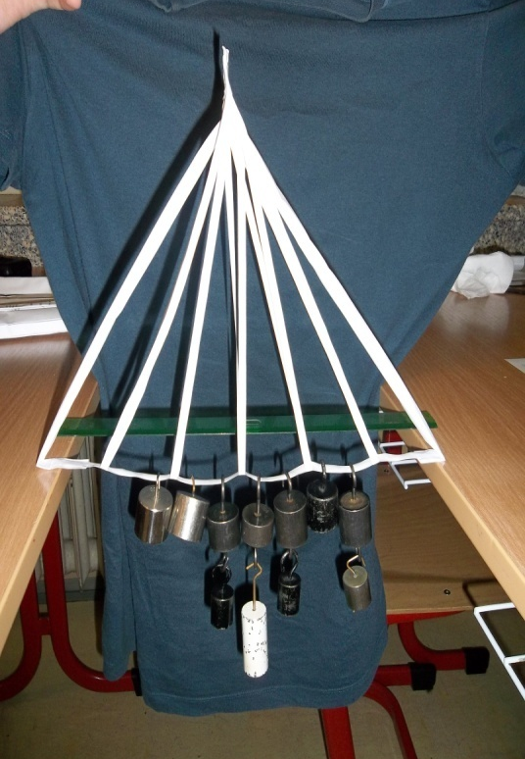
Suspension Bridge
limiting factor: strength of
supporting tubes
suspension straps
results:
 | max load
narrower straps | $$1000 g$$ | straps tore
thinner tubes | $$900 g$$ | tubes bent

Slide 40
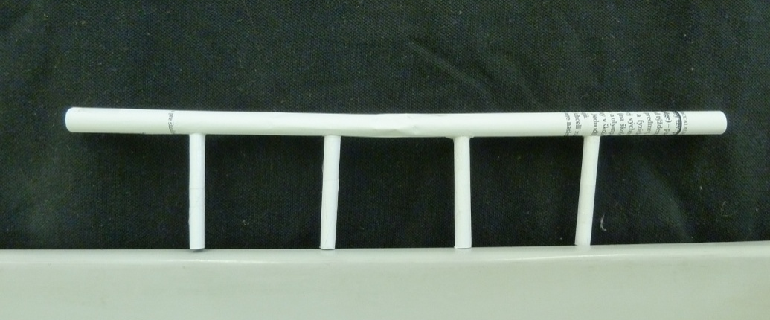
Pier bridge
relevant parameter:
strength of the tube under bending and pressure
maximal load: $1800 g$

Slide 41
accordion
tube
inspired by real bridges
paper-unique
$$385 g$$
$$2100 g$$
?
$$1800 g$$

Slide 42
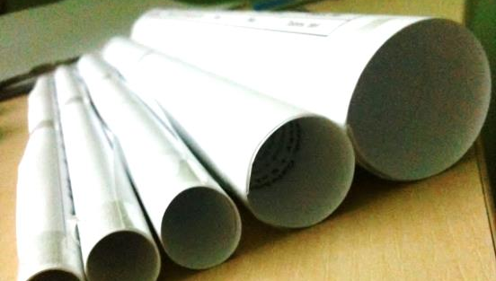
Applicability of “Components”
bending
push
pull
$$0 N$$
$$0 N$$
$$570 N$$
weak
$$21 N$$
$$100 N$$
$$570 N$$
complex
$$11 N$$
weak
$$60 N$$
$$570 N$$
Notes:
so the ideal bridge design will try to support the weight by somehow decomposing the force into push (where it will use tubes) and pull (where it will use paper strips)

Slide 43
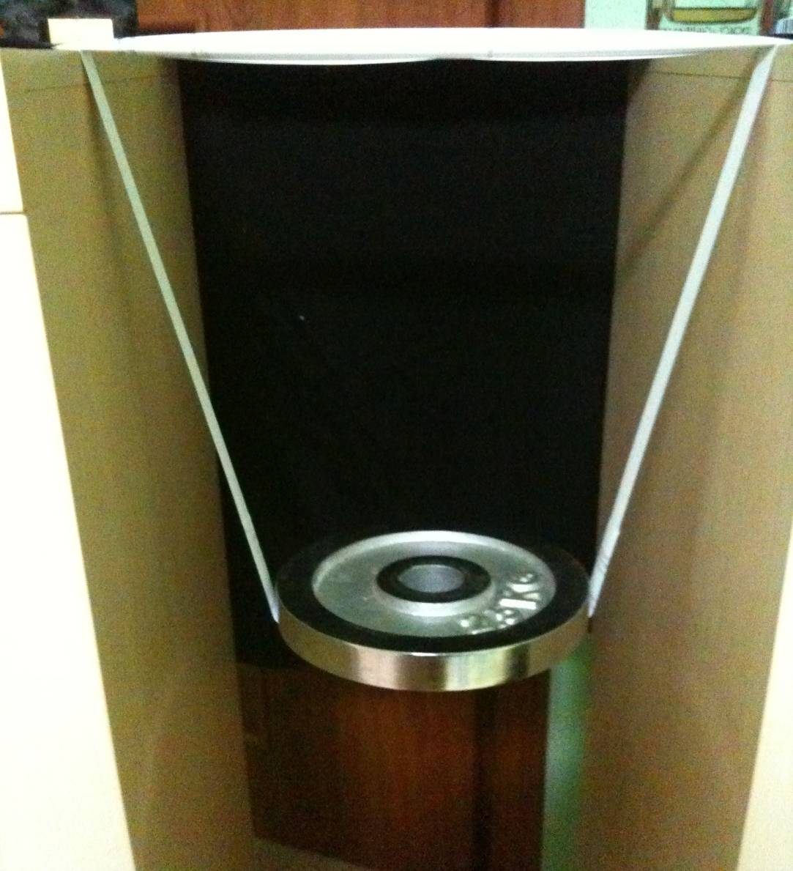
“Hercules” Bridge Design
Normal force
Force of push
tube
Force of push
Force of pull
strap
Weight

Slide 44
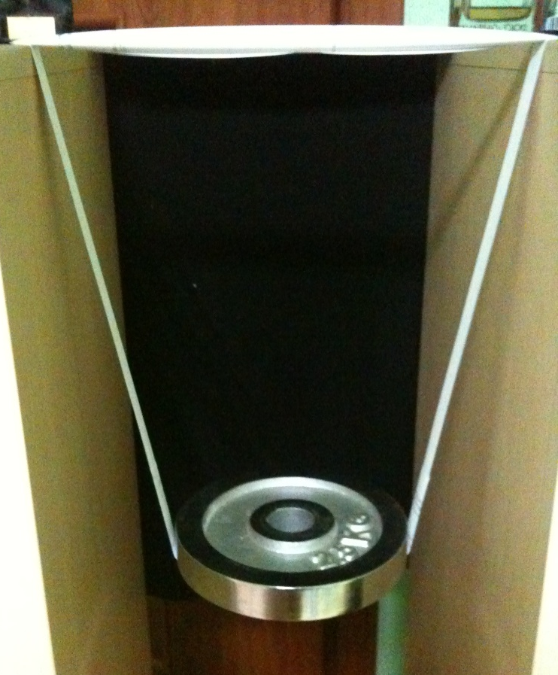
Hercules: Free Parameters
% of paper used for straps/tube
angle of straps $α$
$$a_{STRAPS}$$
$$α$$
used for straps
$$a=210 mm$$
used for tube
A4

Slide 45
Hercules: Optimizing the Design
straps:
$\frac{mg}{2\cos{α}}≤wtG$
tube:
$\frac{mg}{2\cos{α}}≤N_{LAYERS}K$
$$α$$
$t$: paper thickness
$w$: width of the strap
$G$: paper tensile strength
$K$: strength of a single tube layer

Slide 46
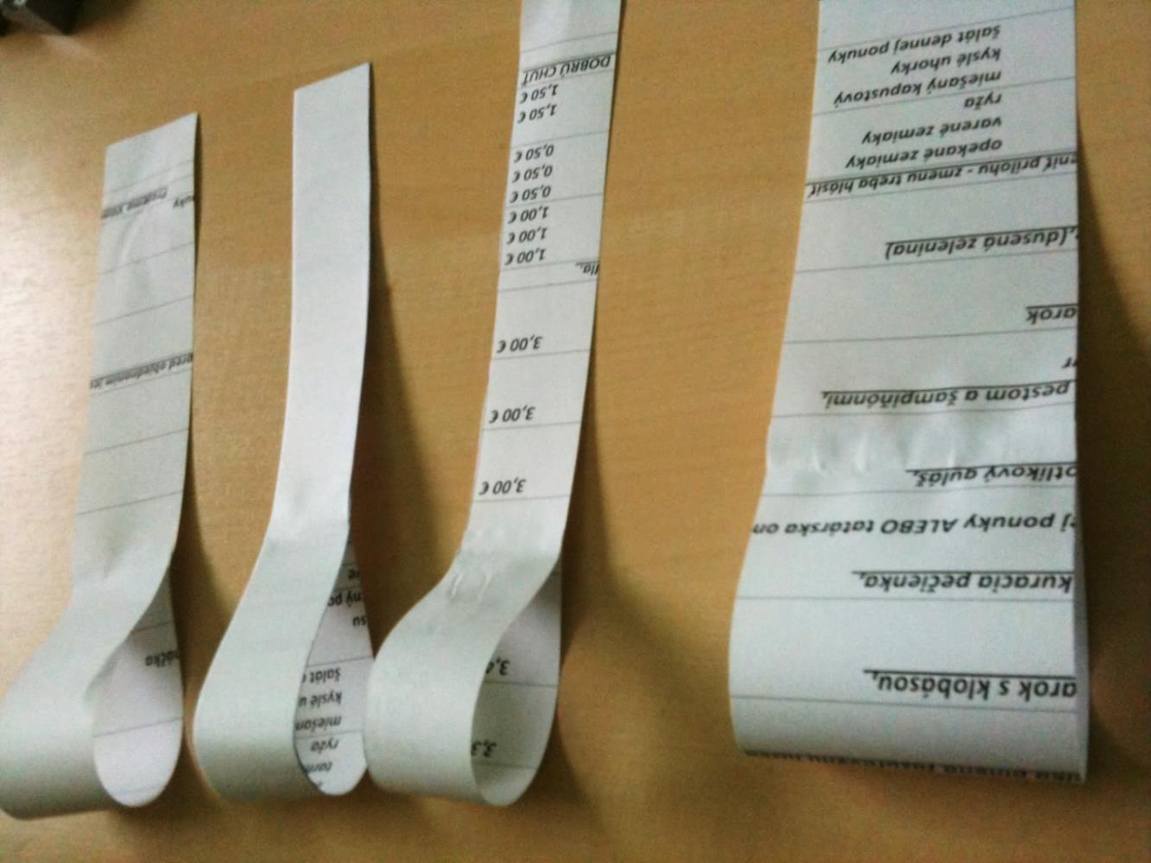
Tensile Strength of Paper Straps
no precise material constants known
experiment: changing strap width, measuring max load

Slide 47
Tensile Strength of Paper Straps
$$G=\frac{F}{wt}≈27 MPa$$

Slide 48
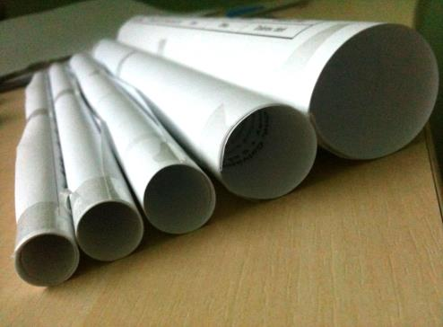
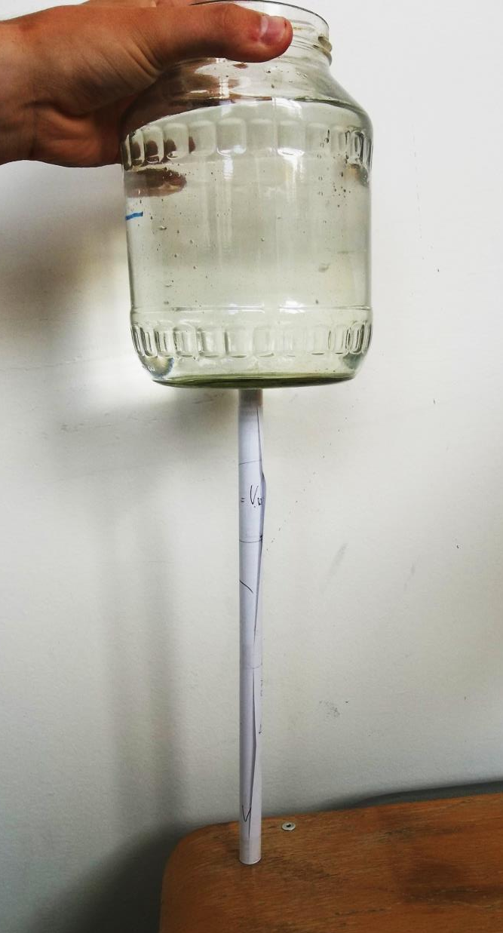
Strength of a Single-Layer Tube
weight
tube

Slide 49
Strength of a Single-Layer Tube
$$K=\frac{F}{N_{LAYERS}}≈15 N$$

Slide 50
Hercules: Strength Prediction
straps: $\frac{mg}{2\cos{α}}≤wtG$
tube: $\frac{mg}{2\cos{α}}≤N_{LAYERS}K$

Slide 51
Hercules: Strength Prediction
max: $a_{STRAPS}=4.5 cm$
($w=1.85 cm$,
$h=71.75 cm$)

Slide 52
How to make a $1.85×71.75 cm$ strap out of a $4.5×29.5 cm$ paper ?
$$a_{opt}$$
A4
→ we chose best realizable parameters instead

Slide 53
Hercules: Strength Prediction
$$a_{STRAPS}=6 cm$$
($w=2 cm$)
predicted max load: 9kg
A4
Let's test it experimentally!

Slide 54
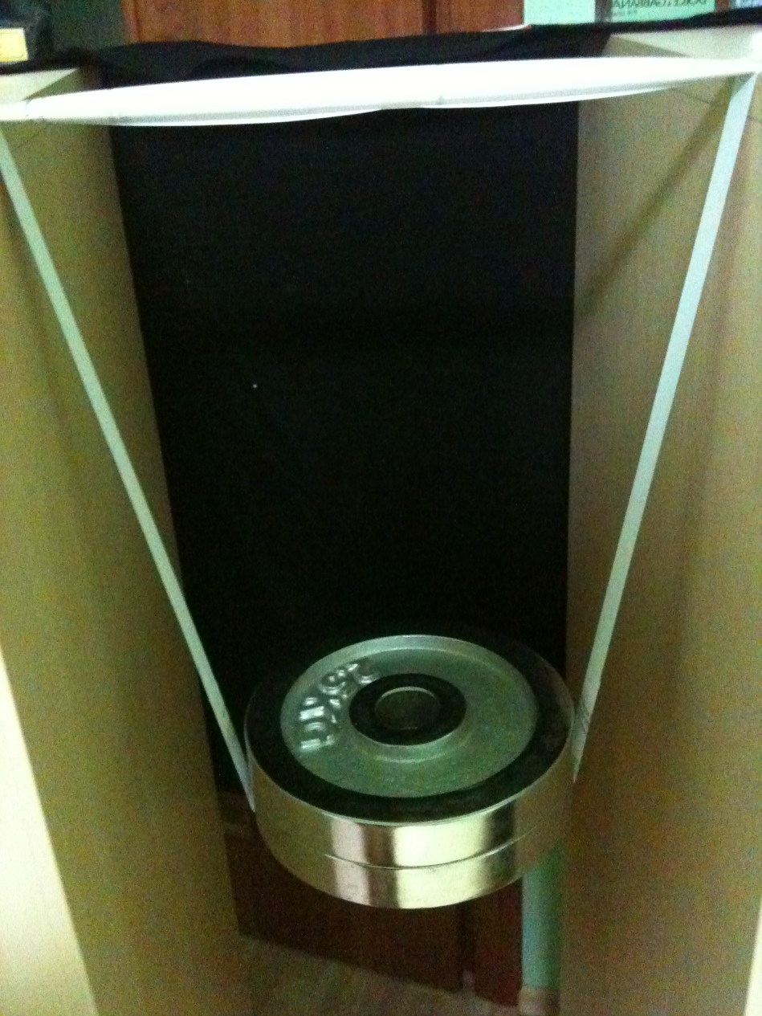
13
$$5 kg$$

Slide 55
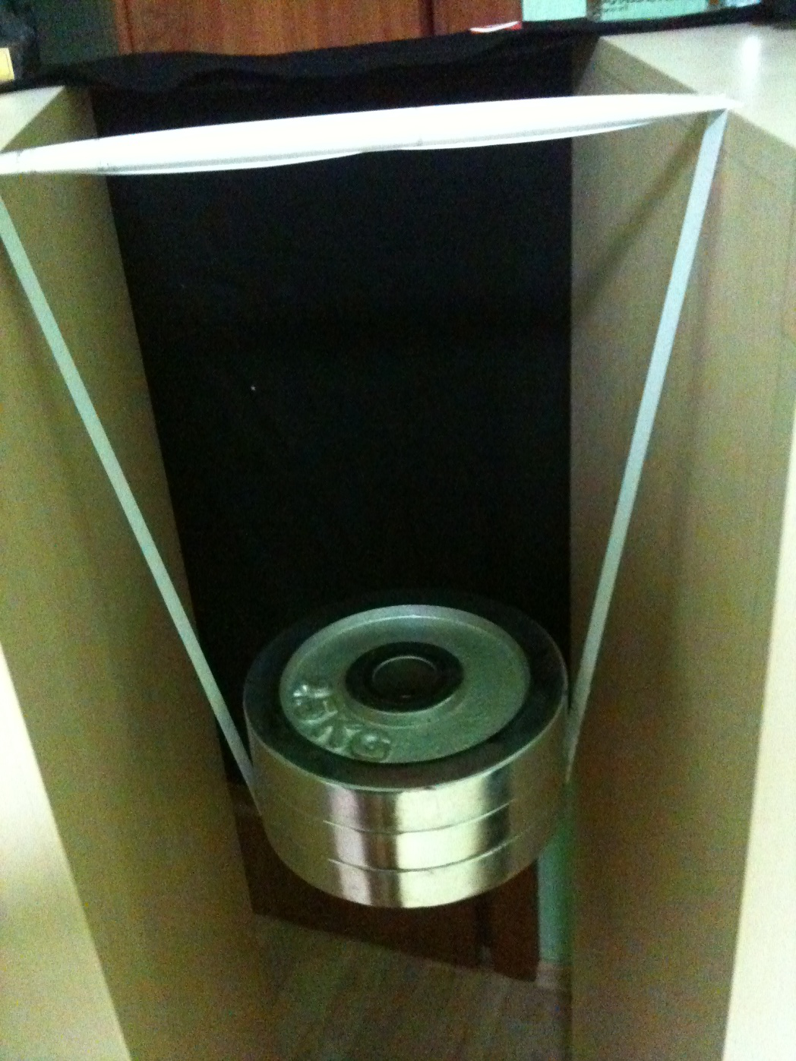
13
$$7.5 kg$$

Slide 56
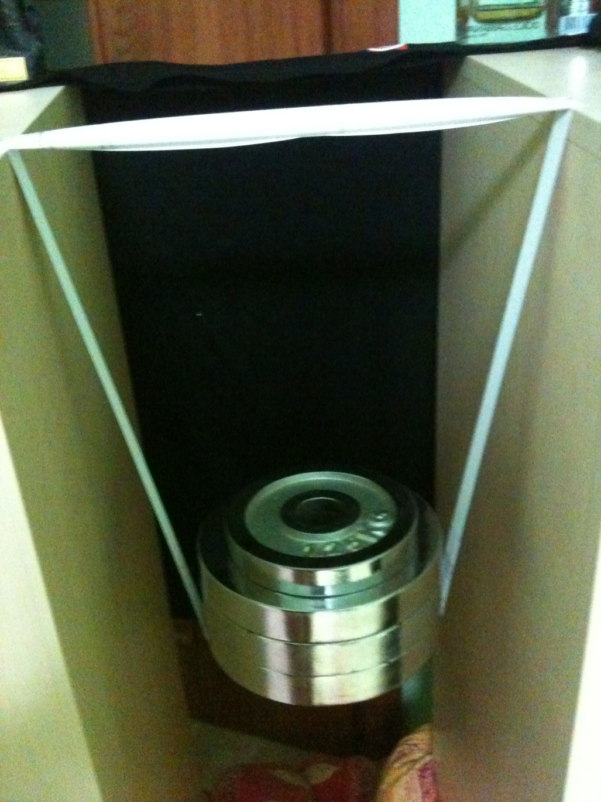
13
$$8.75 kg!$$

Slide 57
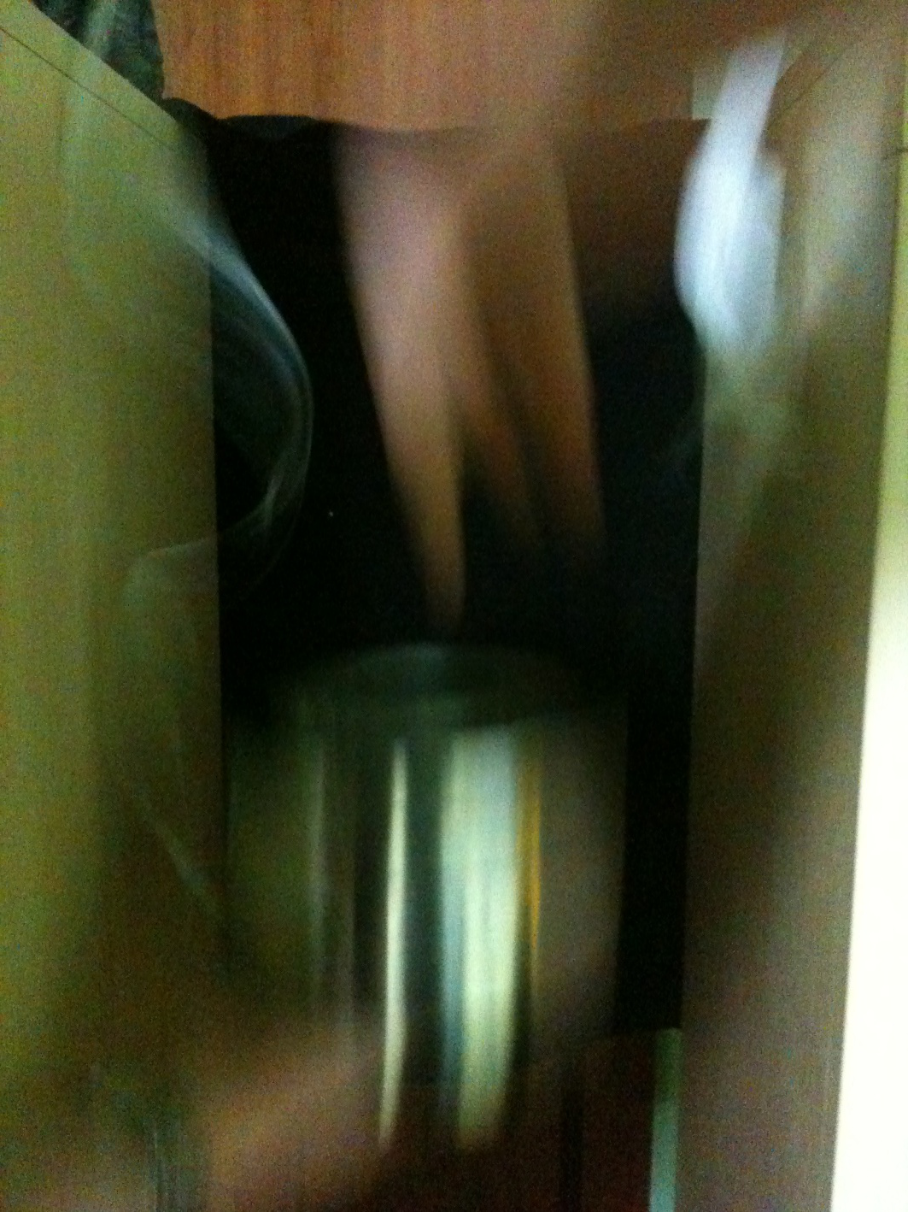
13
$$9 kg$$

Slide 58
Hercules: Summary
Applicability of “Components”
bending
push
pull
$$8.75 kg$$
✓
$$9 kg$$
Notes:
To sum up the Hercules model: by thinking about what works best with paper we were able to design a bridge which would use paper in the best way. [C] Combining our insight into how the bridge works with measurements of paper properties we were able to predict the max load it would hold and [C] test our model experimentally, which gave us the best bridge: a single A4 sheet of paper can hold up to 9kg in theory (and we achieved 8.75 kg in experiment).

Slide 59
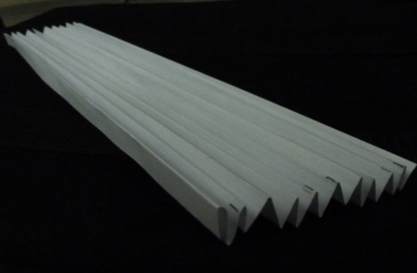
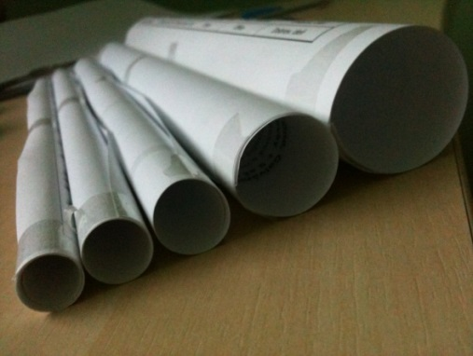
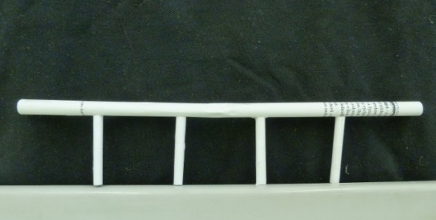
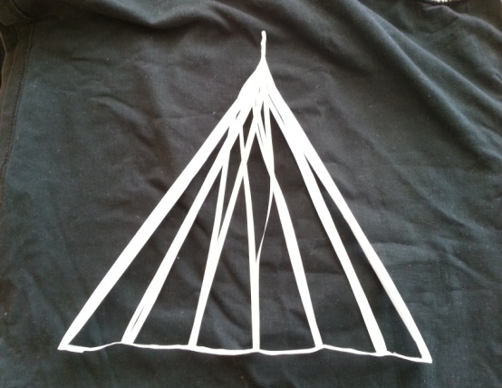
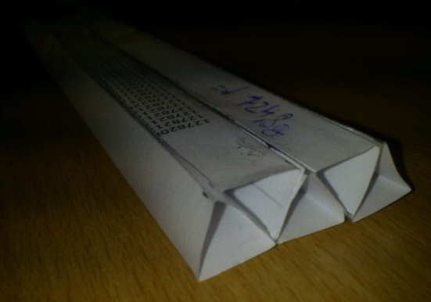
Conclusion
$$385 g$$
$$2100 g$$
$$1800 g$$
$$1000 g$$
simple: theoretically explored, max explained
inspired by reality
Hercules
✓
$$8750 g$$
$$1040 g$$

Slide 60
Thank you for your attention!
$$385 g$$
$$2100 g$$
$$1800 g$$
$$1000 g$$
simple: theoretically explored, max explained
inspired by reality
Hercules
✓
$$8750 g$$
$$1040 g$$

Slide 61
Appendices

Slide 62
Hercules: User’s Guide #1

Slide 63
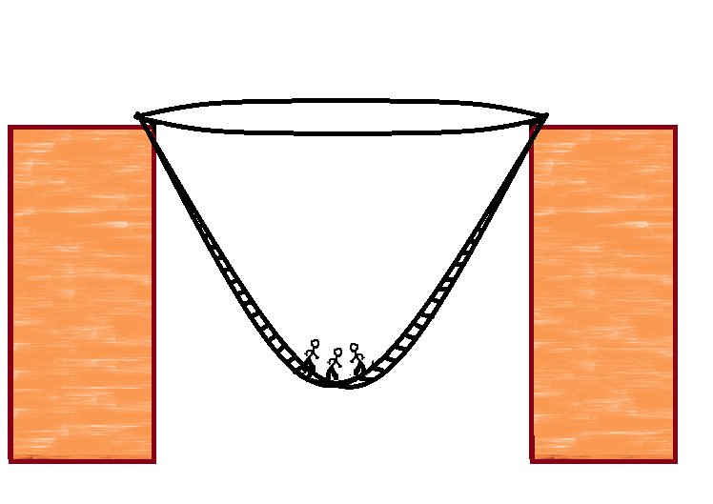
Hercules: User’s Guide #1

Slide 64
Hercules: User’s Guide #1

Slide 65
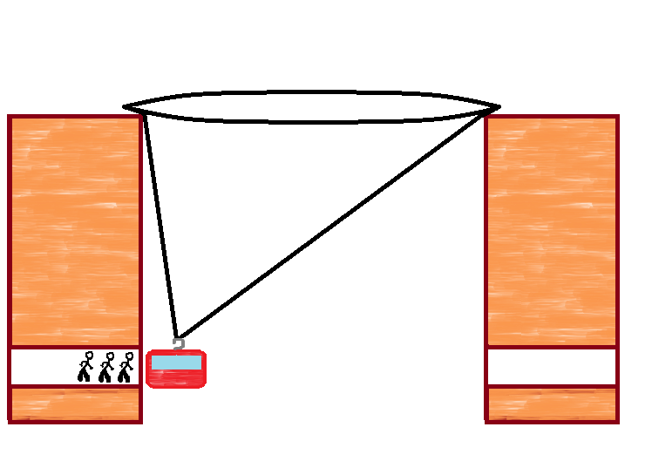
Hercules: User’s Guide #2
Passenger ropeway!
Notes:
Dodat rebrik ako prve pouzitie, lanovka ako alernativne

Slide 66
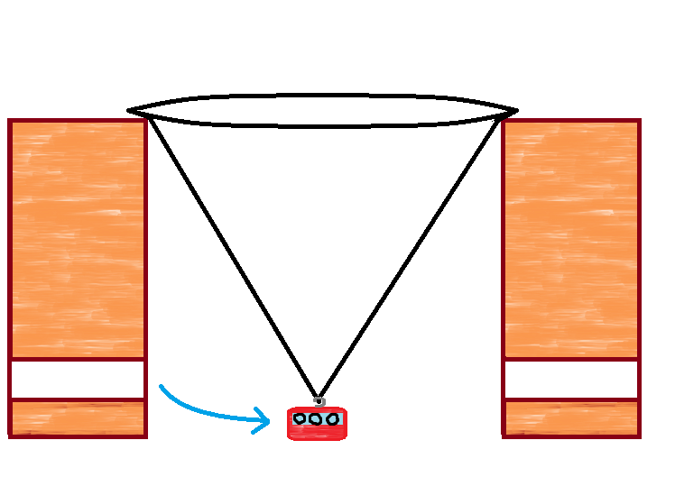
Hercules: User’s Guide #2
Passenger ropeway!

Slide 67
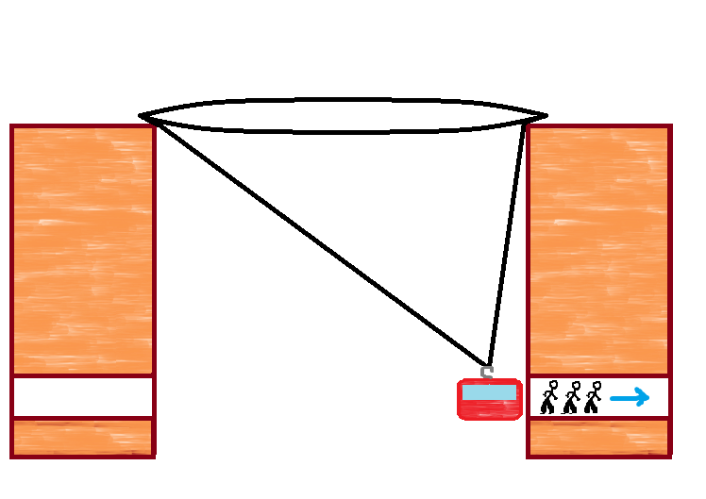
Hercules: User’s Guide #2
Passenger ropeway!

Slide 68
Strength of the 3-prism bridge

Slide 69
Construction of Hercules
tube
straps
- sticking more straps into a longer one
Width of the final strap
Tube's width

Slide 70
Forces in Hercules
Normal force
Force of push
Force of push
Force of pull
Weight

Slide 71
Forces in Hercules
Normal force
zoom
Force of push
Force of push
Force of pull
Weight

Slide 72
tube
table
strap

Slide 73
Normal force
Force of pull
(no friction)

Slide 74
Force of push
Force of pull

Slide 75
Hercules: Other Experiment

Slide 76
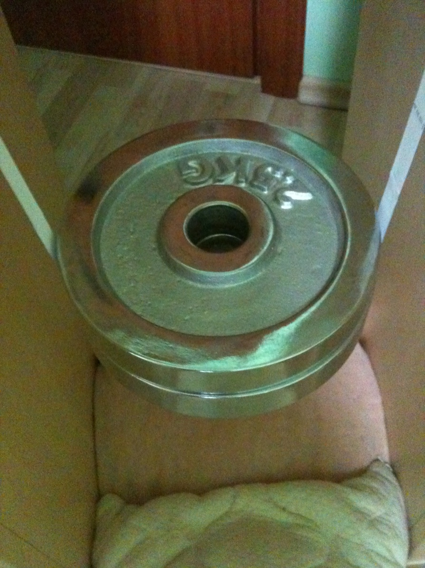
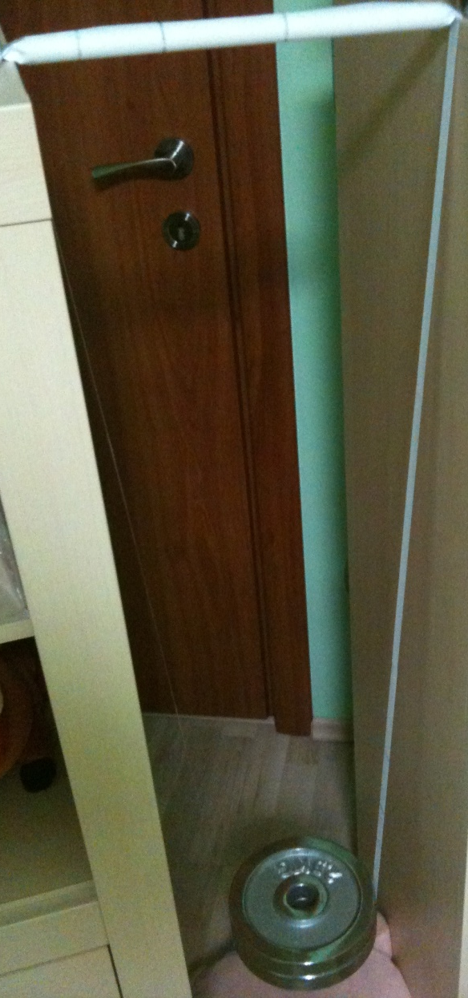
Hercules: Other Experiment

Slide 77
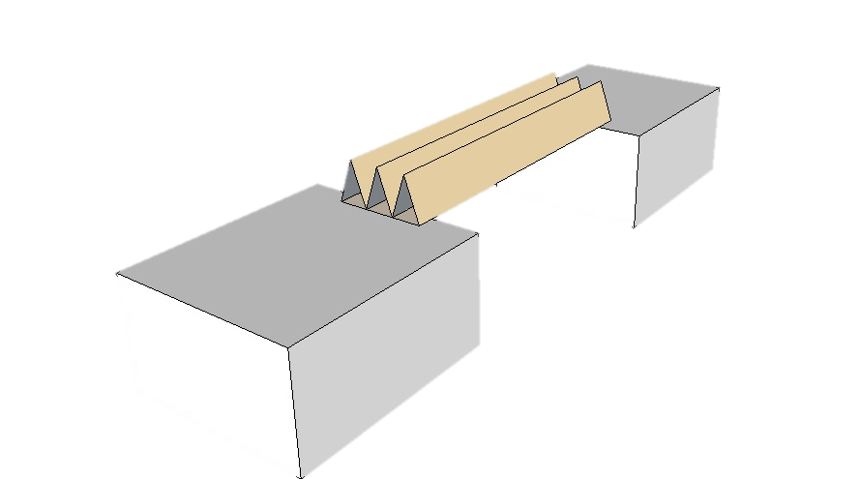
Different paper parameters
25 mm
10 mm

Slide 78
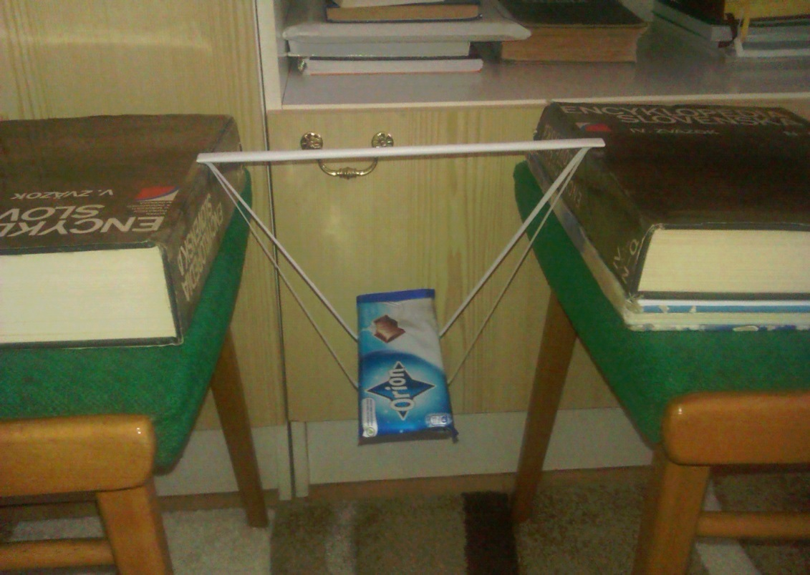
Different paper parameters
Accordion with 10 dents (10 supporting points)
“Hercules“ with two straps 0,5 cm wide
Maximal load: 750g
Maximal load: 2750g

