Slide 1
Jet and film
8
Michal Hledík

Slide 2
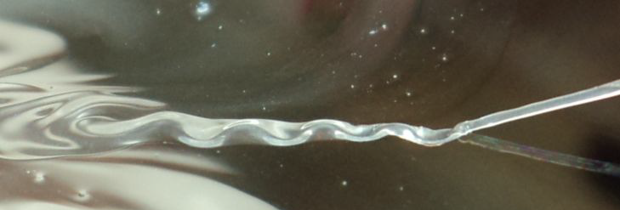
8. Jet and film
A thin liquid jet impacts on a soap film.
Depending on relevant parameters, the jet can either penetrate through the film or merge with it, producing interesting shapes.
Explain and investigate this interaction and the resulting shapes.

Slide 3
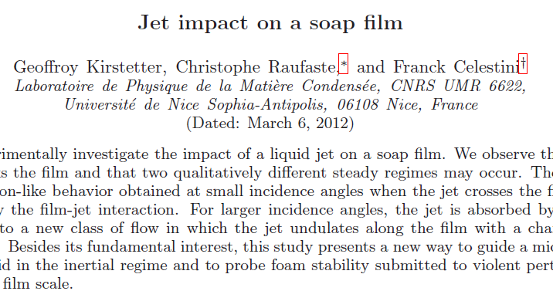
Existing work
3 modes of interaction:
The jet is reflected by the film
The jet penetrates the film
The jet undulates on the film

Slide 4
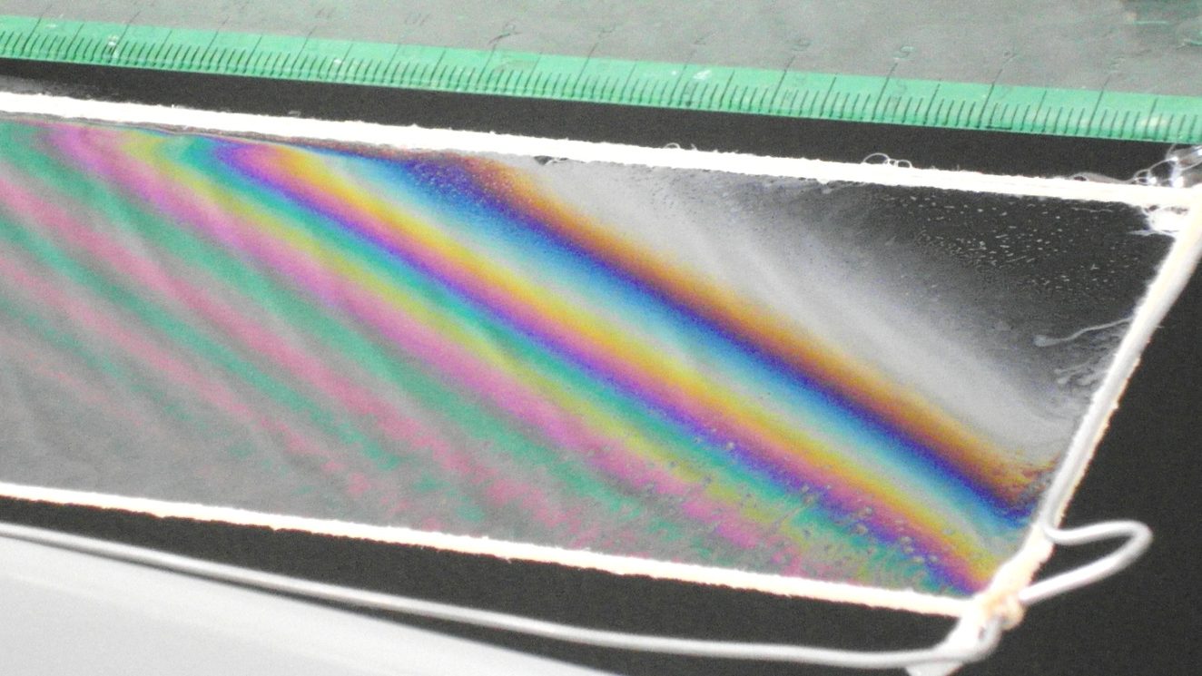
Our apparatus
Soap : water 1:10 (both jet and film)
Density
Surface tension
Inertia dominated
30 < We < 400 (Weber number)
Film thickness

Slide 5
Apparatus
Soap water supply
Changing height
different speed
Film

Slide 6
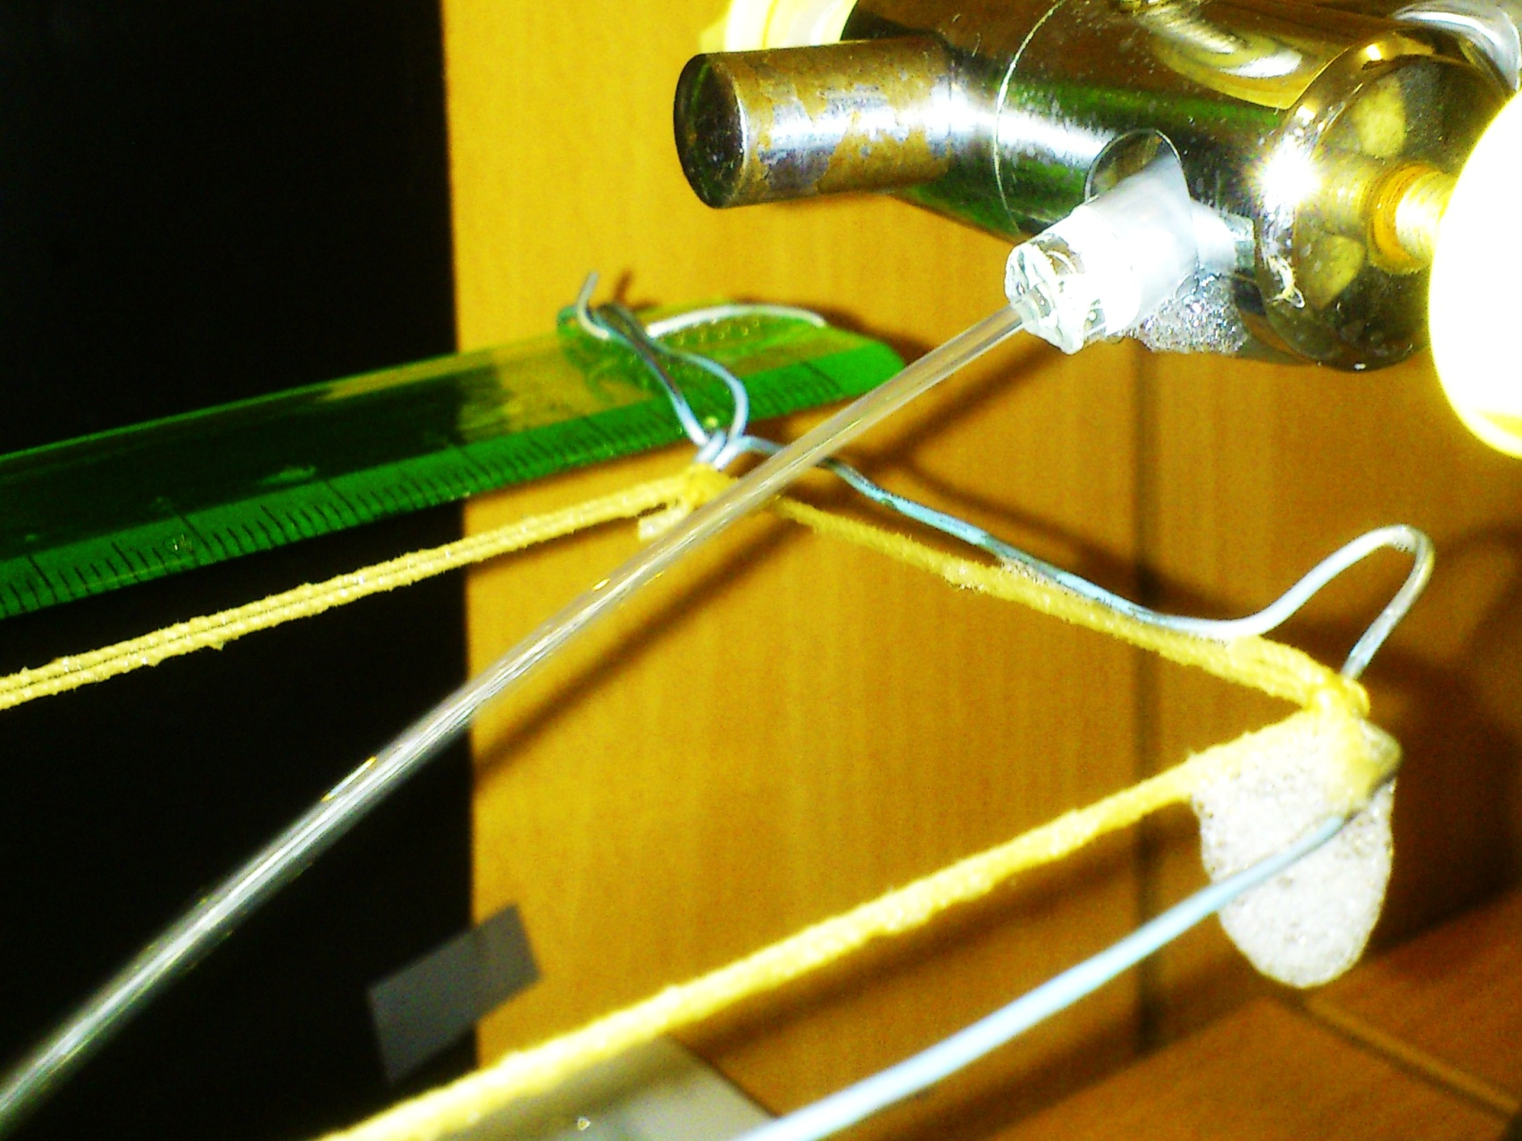
Apparatus – nozzle
Jet angle and radius changed

Slide 7
Basic forces in a jet
Surface tension
Capillary pressure

Slide 8
Basic forces in a jet
Surface tension
Capillary pressure

Slide 9
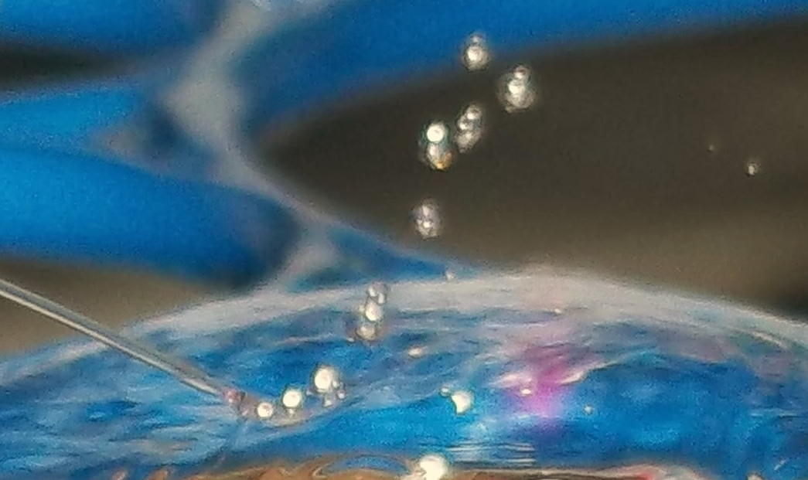
$$α$$
Thin jets
Low impact speeds
Lower incident angles
Reflection
Penetration
Undulation

Slide 10
Reflection
Thin jets → drops
(Plateau-Rayleigh instability)
Drops do not merge with the film, they bounce and roll
No full theory exists yet

Slide 11
Reflection – drops

Slide 12
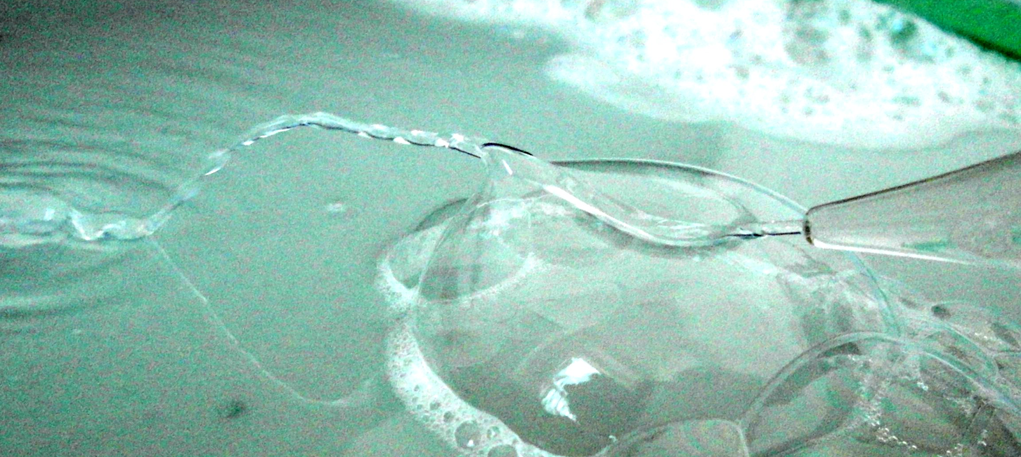
Reflection on a bubble
Spherical shape of the film – the jet keeps some of its momentum, “escapes”

Slide 13
Intermediate state
Unstable waves, oscillate, small drops are splashed away

Slide 14
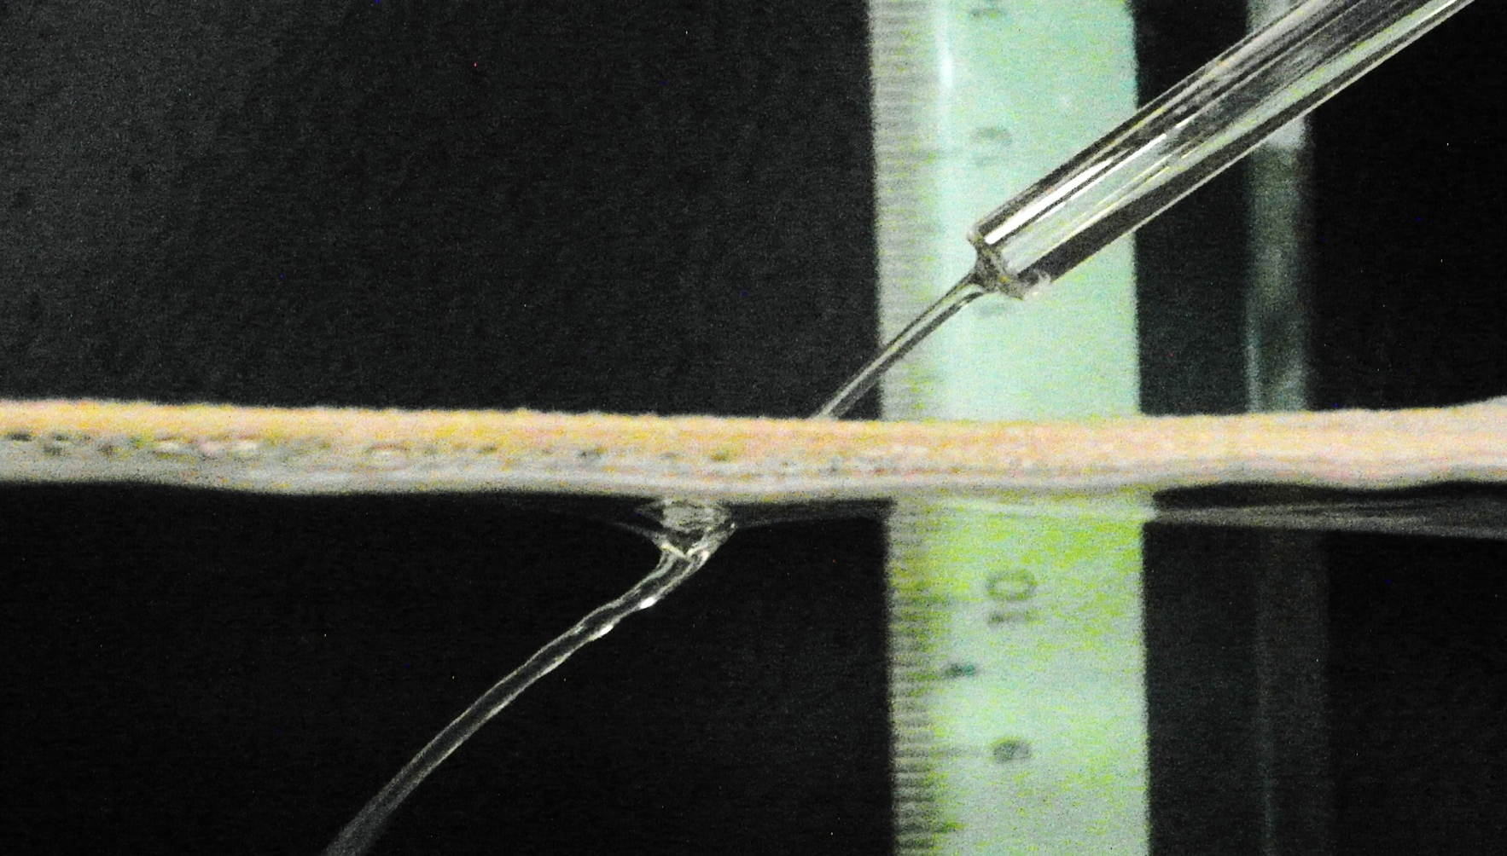
Thick Jets
High impact speed
Low incident angles
Reflection
Penetration
Undulation

Slide 15
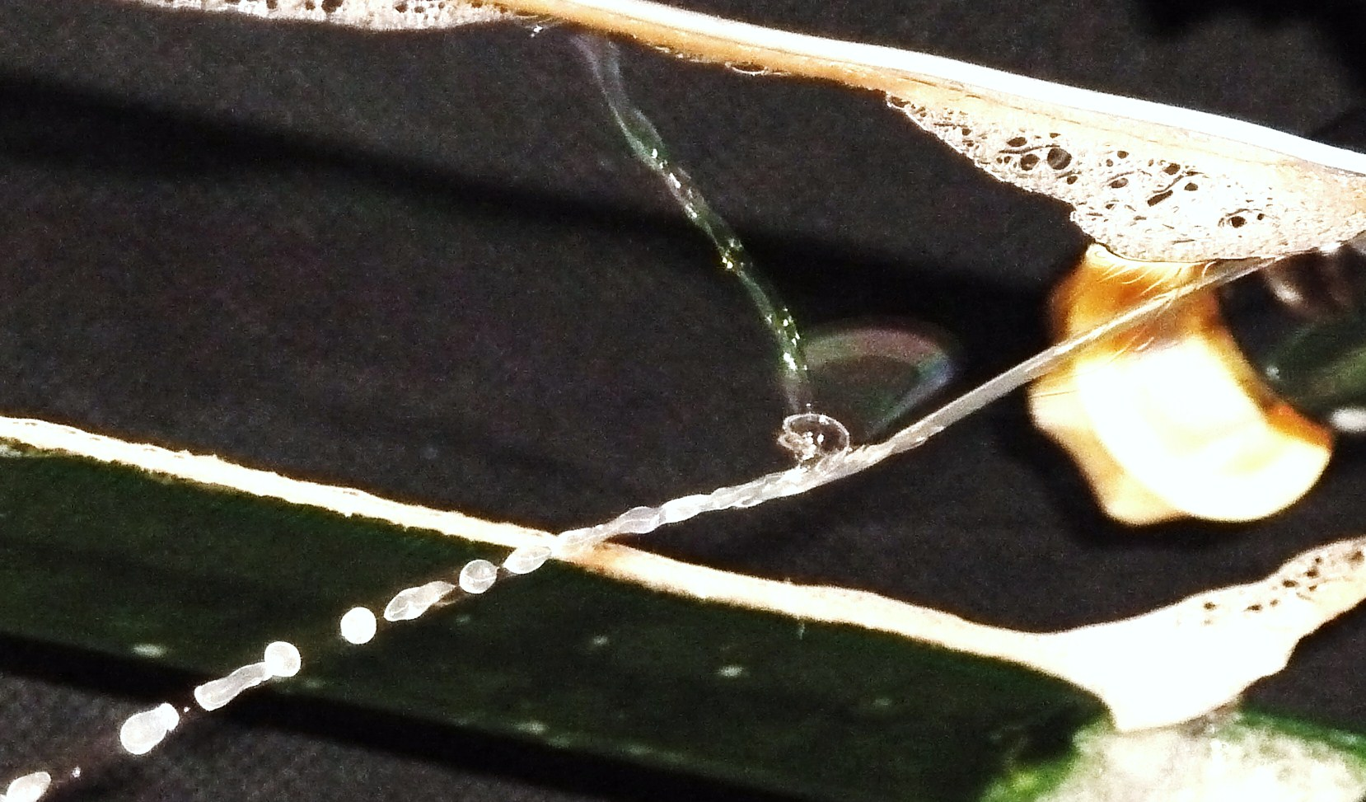
Penetrating the film
(View from below the film)

Slide 16
Penetrating the film
Theory from the cited paper

Slide 17
“Refraction” of the jet
Numerical solution
Analogy to Snell’s law of refraction

Slide 18
“Refraction” of the jet
(We = const)

Slide 19
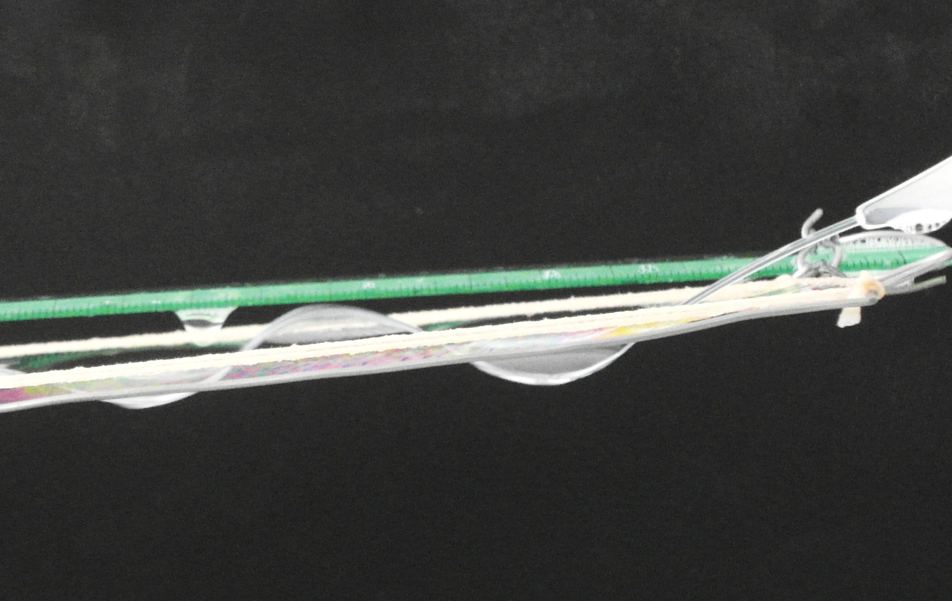
Thinner jets
Lower impact speed
High incident angle
Reflection
Penetration
Undulation

Slide 20
Undulation

Slide 21
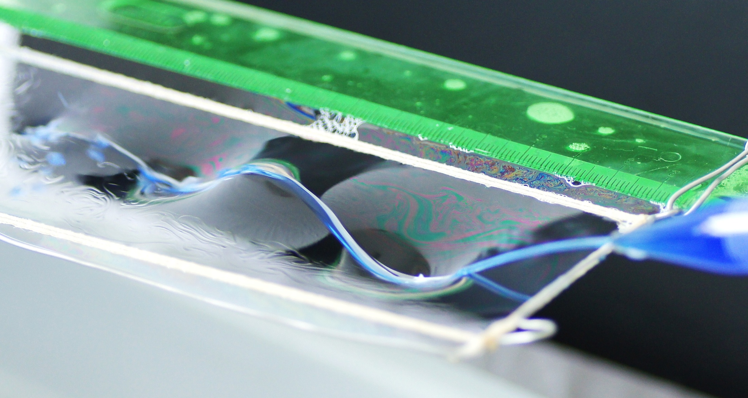
Undulation
(Jet coloured by blue ink)

Slide 22
Force analysis

Slide 23
Forces on jet element

Slide 24
Force of the film – jet cross section

Slide 25
Net force on jet element
Centripetal force:

Slide 26
Kirstetter: Approximation – circle arcs
Constant centripetal force

Slide 27
Kirstetter: Theoretical prediction
Radius of curvature (based on centripetal force):
Assuming: is constant (i.e. circle arcs):
Correlation with experiments with fitted

Slide 28
Comparison to our measurements
Experiment
Why it doesn’t work?
Incident angle changed
Thicker jets
⇒ Circle arcs approximation – inaccurate
Theory
Notes:
Doplniť čiaru x=y

Slide 29
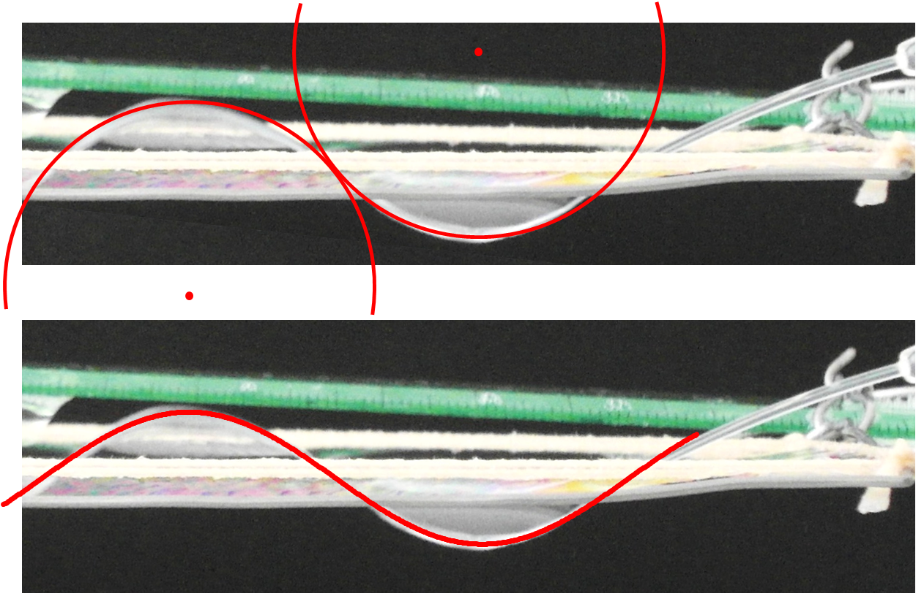
Our approximation: sine function
Arcs: cannot fit little curvatures

Slide 30
Sine shape approximation
Less than 3% of the total force
Wavelength >> amplitude
Zero force at y=0, increases with |y|

Slide 31
Shape – theoretical prediction
Constant speed in x direction, harmonic oscillations in y direction
Wavelength
Amplitude
free parameter
Notes:
Chýba nadpis

Slide 32
Experiment
Theory
Notes:
Prehodit do milimetrov

Slide 33
Experiment
Theory

Slide 34
Summary
3 modes of interaction studied
Existing theory verified, discrepancies explained, novel approach in case of undulation
Greater jet radii, incident angle changed and amplitude investigated
Thank you for your attention

Slide 35
Appendices
8. Jet and film

Slide 36
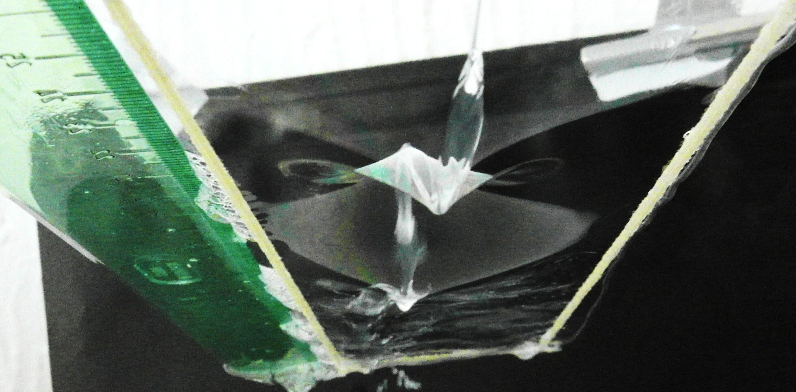
View from below the film

Slide 37
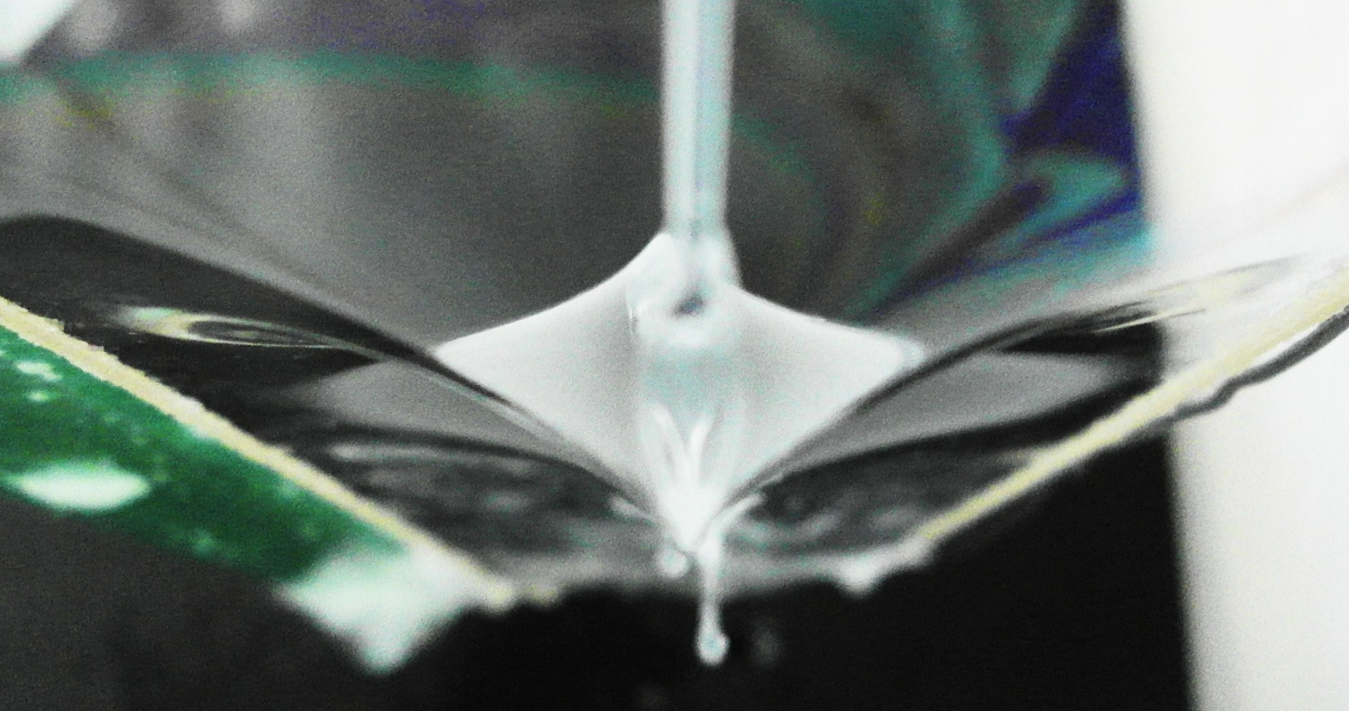
View from below the film

Slide 38
Parameters
Fixed:
Liquid
Varied:
Jet radius
Incident angle
Incident speed

Slide 39
Surface tension measurement
Counting drops from a pipet
Comparing to number of drops of deionized water (known surface tension)
Calculating the mass of a single drop;
Soap water $m_{2}≈0.02g$
Deionized water $m_{2}≈0.06g$

Slide 40
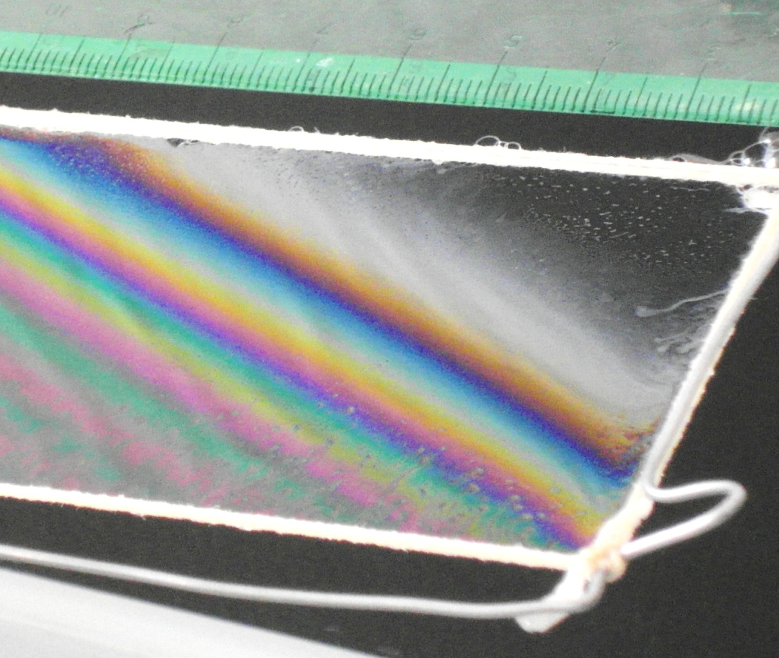
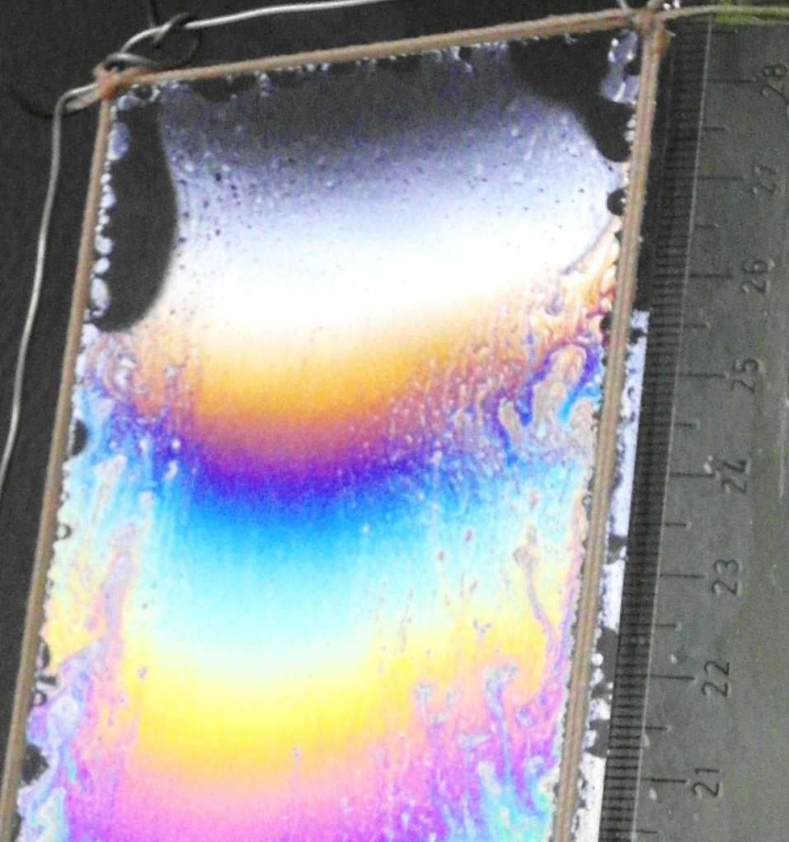
Thickness of the film

Slide 41
Interference on a thin film
Path difference
180° phase shift (beam 2)
Small :
Destructive interference of all visible light – little light reflected
1
2
Air
Film
Air

Slide 42
“Hysteresis”
Identical conditions – the mode of interaction depends on previous state

Slide 43
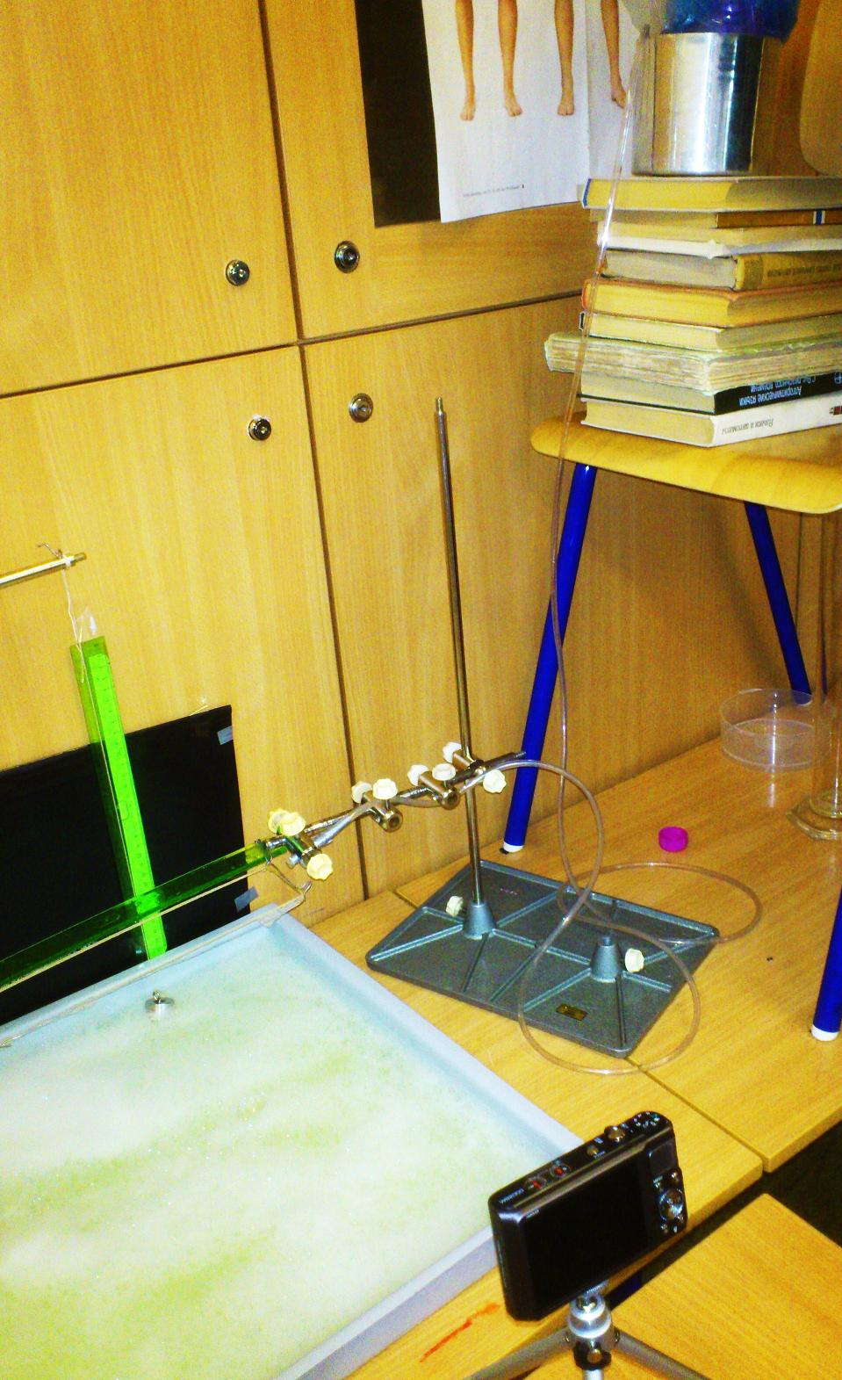
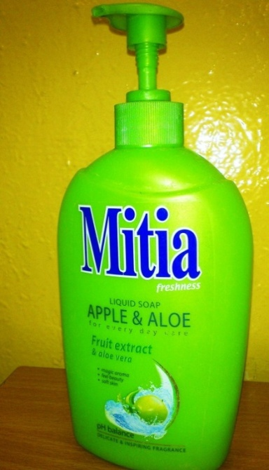
Apparatus

Slide 44
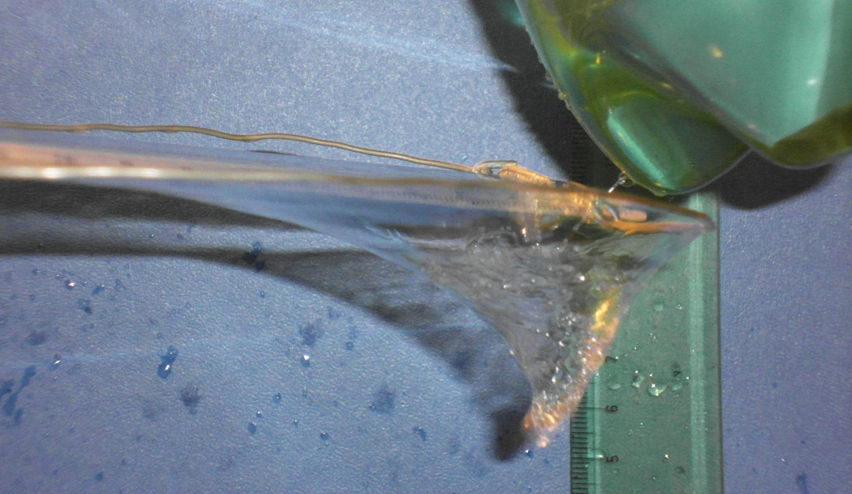

Slide 45
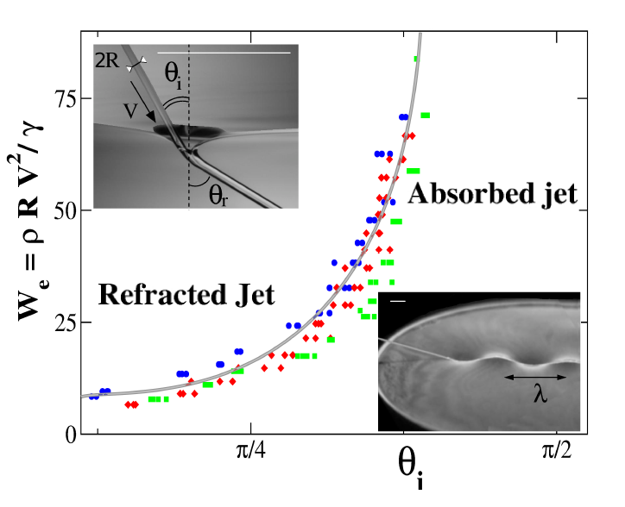
Diagram (regions)

Slide 46
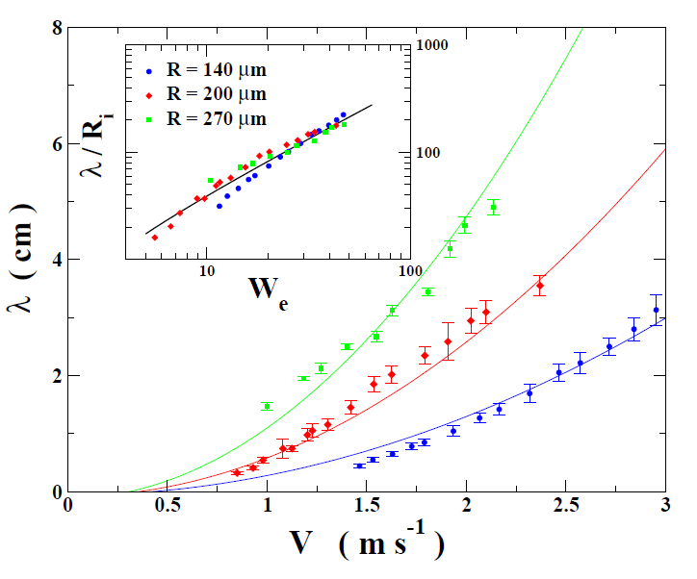
Undulation

Slide 47
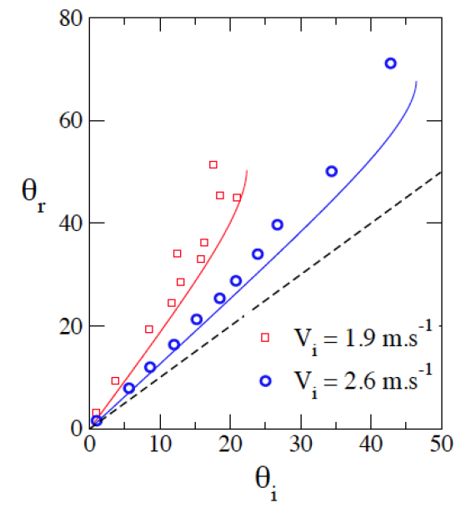
Refraction

Slide 48
Forces on jet element

Slide 50
Velocity change upon impact
1st contact with the film – the jet is decelerated
→ Smaller waves than we would expect

Slide 51
Undulation – sine shape
Expected shape
Real shape
Deceleration upon impact

Slide 52
Whole video

Slide 53
“Refraction” of the jet
(We = const)
„Refraction index“
Theory: 1.124
Experiment: 1.336
Notes:
Vysvetlenie rozdielu? Potrebujeme tam teoretickú hodnotu???

