Slide 1
Soliton
4.
Marco Bodnár

Slide 2
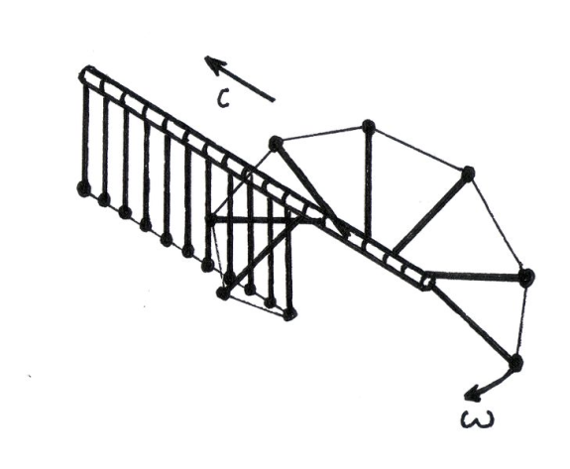
Task
A chain of similar pendula is mounted equidistantly along a horizontal axis, with adjacent pendula being connected with light strings. Each pendulum can rotate about the axis but can not move sideways (see figure).
Investigate the propagation of a deflection along such a chain.
What is the speed for a solitary wave, when each pendulum undergoes an entire 360º revolution?

Slide 3
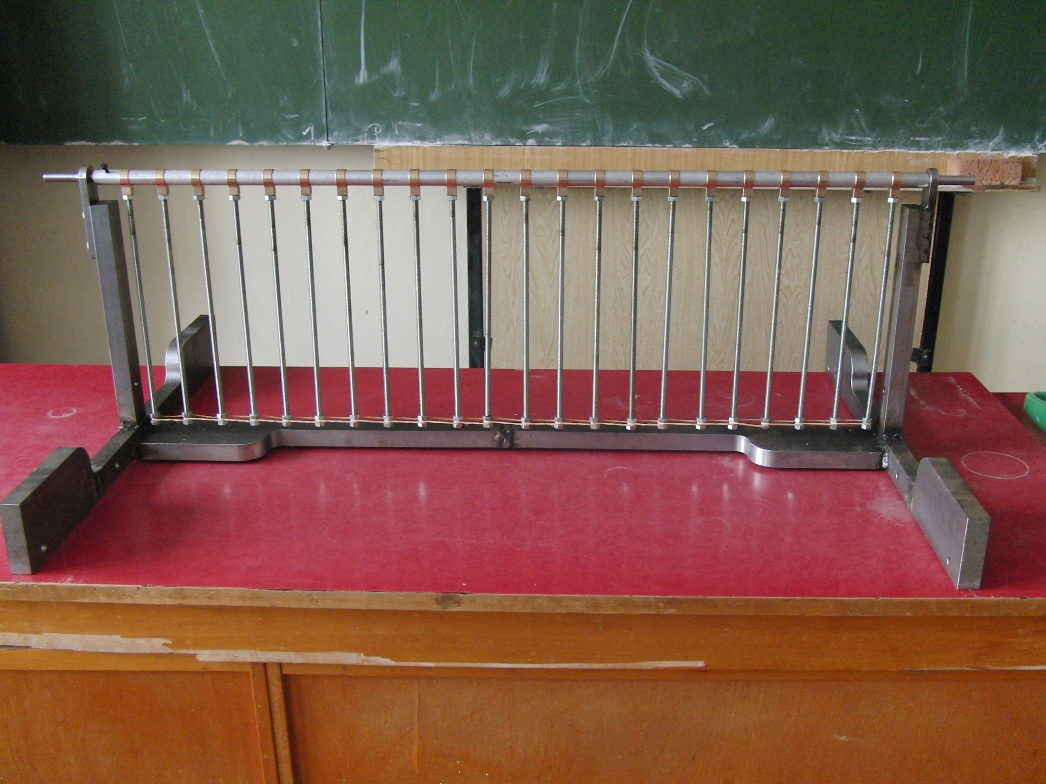
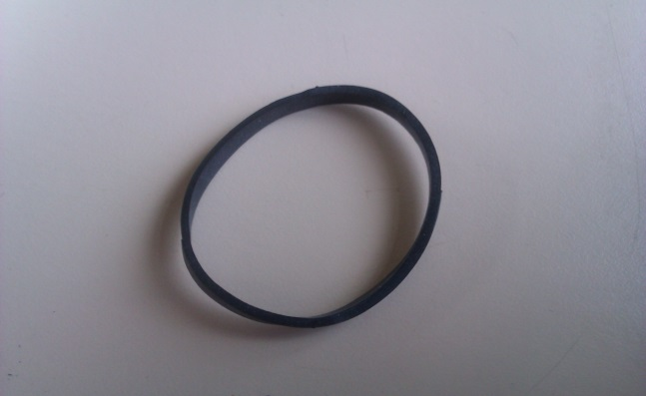
Terms & Definitions
A chain of similar pendula is mounted equidistantly along a horizontal axis, with adjacent pendula being connected with light strings. Each pendulum can rotate about the axis but can not move sideways (see figure).
Equidistantly mounted pendula
All strings are straightened equally
Using rubber as string
Small tube between pendula

Slide 4
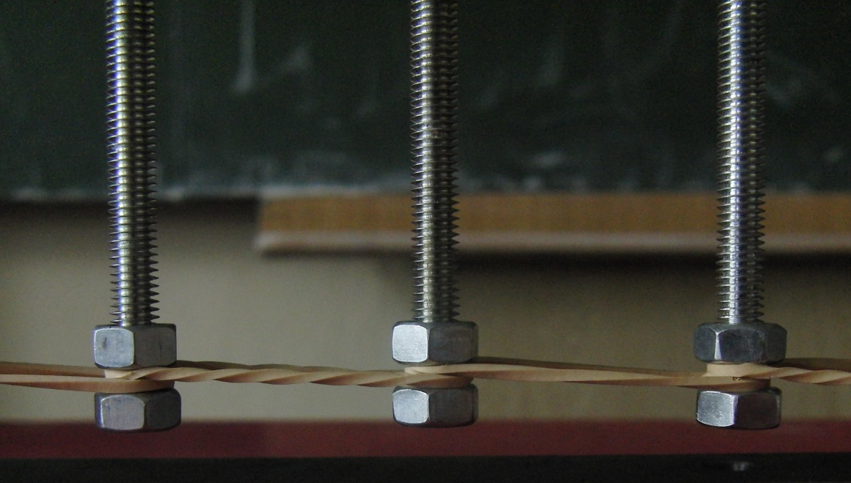
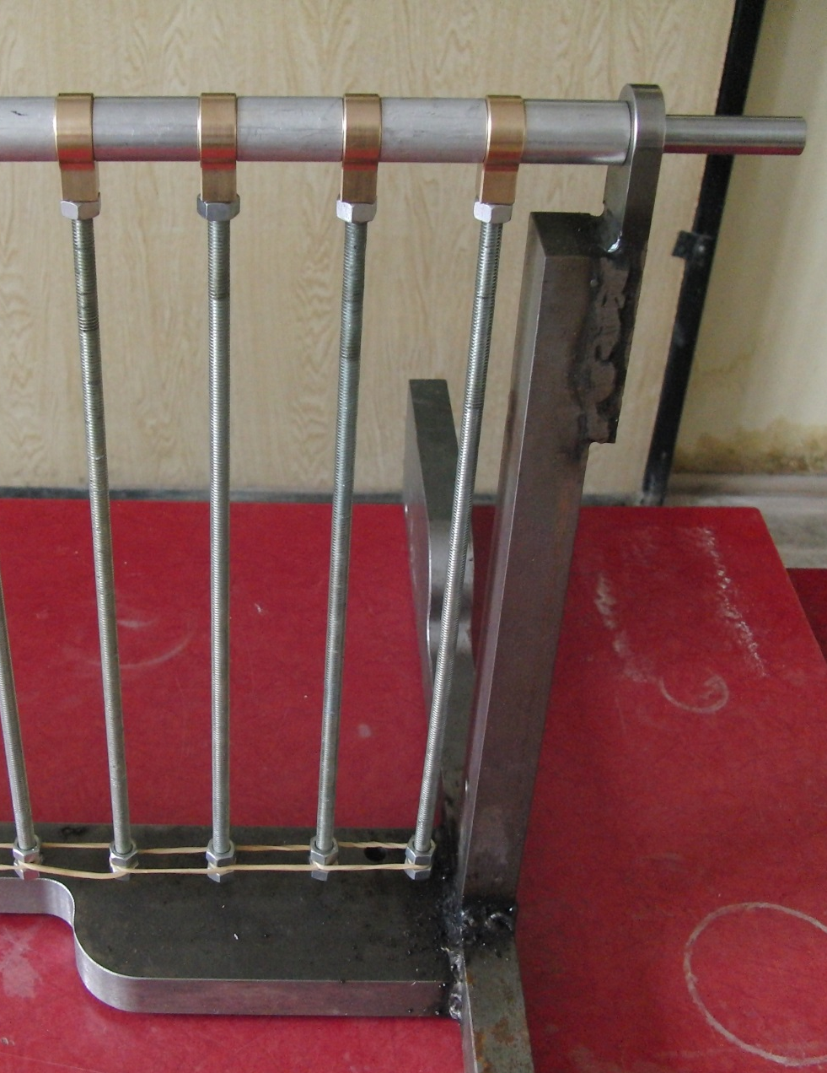
Chain of pendula

Slide 5
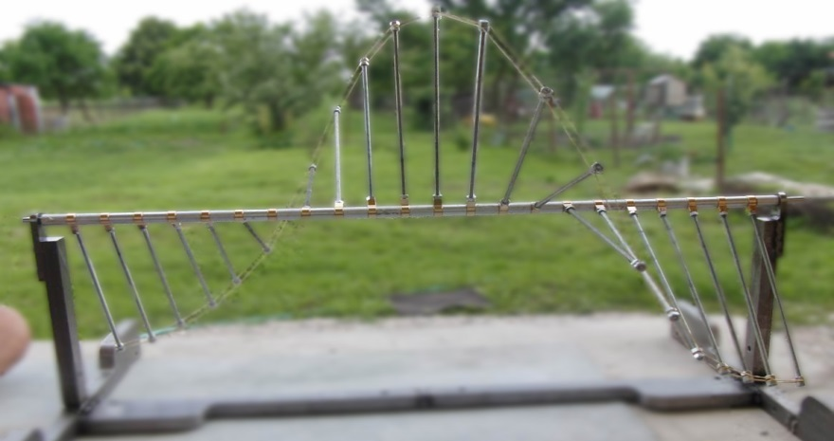
Which speed?
Group velocity
Velocity of overall shape
Velocity of the information
Angular frequency
Wave number
Phase velocity
Velocity of phase
Can be higher than
velocity of information or
even has different direction
Notes:
Zvolili sme si ju preto lebo je to phys zaujimava vec .. Rychlost vedenia informacii

Slide 6
Dispersion
Property of a given system – Group velocity is wavelength depended
Breakdown of wave
Wavefront
Notes:
+ ESTE FOTKA DUHY

Slide 7
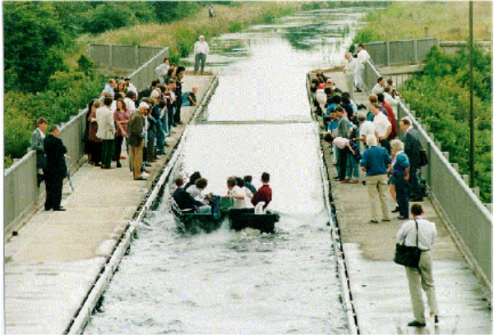
What is solitary wave?
What is the speed for a solitary wave, when each pendulum undergoes an entire 360º revolution?
Place of first observed solitary wave (soliton) (Union Canal, Scotland)
Photo from Physics of solitons. M. Peyrard, T. Dauxios, Cambridge University Press (2010), ISBN 9780521143608
Solitary wave (Soliton) on pendula chain

Slide 8
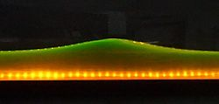
Soliton (Solitary wave)
Wave which maintains its shape and moves at constant speed
Dispersion is balanced by nonlinear effects
Nonlinear wave
(Principle of superposition doesn’t hold)
Behaves like “particle” (Localized)
https://en.wikipedia.org/wiki/File:Soliton_hydro.jpg
Different shapes, sizes and velocities

Slide 9
Physics of Chain of pendula

Slide 10
What is going on?
First pendulum is rotated
Energy is stored to the deformation of springs
Are you satisfied with this explanation?
We aren’t.
1st pendulum undergoes 360°
Kinetic energy is transferred along chain by springs
Gravity returns pendula to the static state
Reflection on Free end
Example of Chain behavior (280 fps)

Slide 11
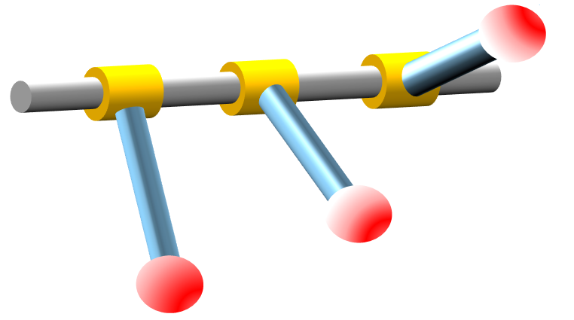
Chain of pendula: Parameters
Spacing between pendula
String force of prestression
Length of pendulum
Mass of pendulum
Position of centre of mass
Moment of inertia around bar
Notes:
Parametre standart phys kyv plus trenie

Slide 12
Equation of motion
Kinetic energy
Potential energy
(Gravity)
Potential energy
(Springs)
Using Principle of least action
(Equivalent to the Force approach)
Notes:
Sin gordona len bez trenia dostaneme a vieme iesit - staci povedat kin potential and potential sprngs sme si derivli na zaklade prestression – aplikovai principle a we get toto – je to mor econvenient.. Netreba riesit sily a vazby

Slide 13
Chain of pendula: Equation of motion
For discrete system
From Torque analysis or Using principle of least action (Derivation in appendices)
Continuous approximation to 1st order:
Using Taylor expansion:
Length between pendula
Sine-Gordon equation
Known analytical solution
Maximal possible information speed
Natural frequency of single pendulum
Notes:
Prechod z descrete do spojite.. Je to dostatocne husto... Vypnem gravitaciu . .rychlost c – no dispersion dispersia vie rychlost iba y

Slide 14
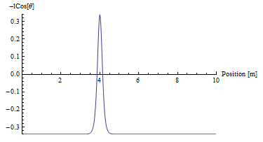
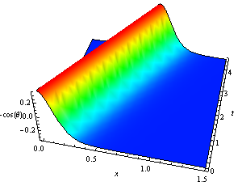
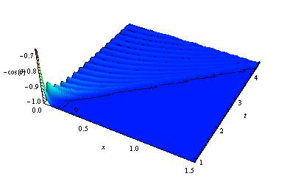
Analytic approach
Continuous system – Sine Gordon Equation
Nonlinear term
Makes interesting
phenomena
Terms of standard
wave equation
Predictions of continuous model (Sine-Gordon equation):
Initial deflections << 360°
Initial 360° deflection
Dispersion caused by gravity
Dispersion is balanced by nonlinearity
Notes:
Popis osi

Slide 15
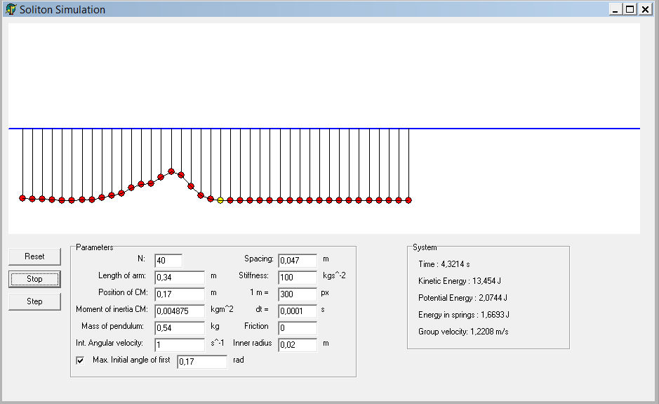
Discrete model: Numerical approach
Using Runge-Kutta 4th Order method
Without friction:
With kinetic friction:
Notes:
Slide co to robi, ked to robi – zobrali rovnicu s trenim a simulovali pohyb kyvadielok sgn v opac smeere ako hnto

Slide 16
Relations
Continuous model
(Sine-Gordon equation)
Discrete model
(Numerical simulation)
?
Experiment

Slide 17
Propagation of deflection
Small deflections
(<<360°)

Slide 18
Example of behaviour (<360°)
Initial Profile
Dispersion
Extension of profile
along chain
Dissipation
Due to Kinetic Friction
Initial 110° deflection

Slide 19
Dispersion result from analytical approach
Property of a system – Group velocity is wavelength depended
Dispersion law for our system (Derivation in appendices)
Theoretical prediction for our chain of pendula
From continuous model:
Notes:
+ ESTE FOTKA DUHY - zo sine gordona

Slide 20
Relations
Continuous model
(Sine-Gordon equation)
Without friction
Discrete model
(Numerical simulation)
?
Experiment
Friction

Slide 21
Simulation of discrete system without friction

Slide 22
Analytical approach/Discrete model
Notes:
Obidva bez friction

Slide 23
Relations
Continuous model
(Sine-Gordon equation)
Without friction
Discrete model
(Numerical simulation)
Without friction
Experiment
Friction

Slide 24
Relations
Continuous model
(Sine-Gordon equation)
Without friction
Discrete model
(Numerical simulation)
Without friction
?
Experiment
Friction

Slide 25
Comparison
Experiment
Initial 110° deflection
Numerical simulation with friction
Notes:
Bez trenia to iste

Slide 26
Group velocity / Initial angle of 1st pendulum
Notes:
Nepresne lebo jeden bod na videu

Slide 27
Relations
Continuous model
(Sine-Gordon equation)
Without friction
Discrete model
(Numerical simulation)
Without friction
?
Friction
Experiment
Friction

Slide 28
Relations
Continuous model
(Sine-Gordon equation)
Without friction
Discrete model
(Numerical simulation)
Without friction
Friction cannot be included
Friction
Experiment
Friction

Slide 29
Soliton
Entire 360° revolution
Propagation of deflection
Group velocity

Slide 30
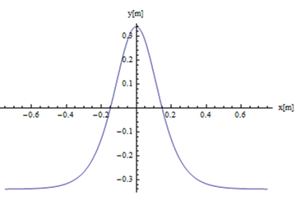
What does Sine-Gordon eq. say ?
Continuous model:
Solution with our boundary conditions^{[1]}:
What we actually see
Still one unknown variable - Group velocity !
Related to initial angular velocity at maximum (Derivation in appendices)
[1] Physics of solitons. M. Peyrard, T. Dauxios, Cambridge University Press (2010)
Notes:
+ shape comparison – soliton vide len pre boundary conditions – otocka 360-koniec volny

Slide 31
Interesting properties
$\left|v\right|$=$\sqrt{\frac{{ω_{initial}^{}}_{}^{2}}{4{ω_{0}}_{}^{2}+{ω_{initial}^{}}_{}^{2}}}c_{0}$
Notes:
+ shape comparison

Slide 32
Interesting properties
Small initial angular velocities
Group velocity rises linearly
Large initial angular velocities
The same maximum c₀ as for small deflections
Wavefront (small wavelengths) is always faster than soliton
Dispersion law for small deflections
Group velocity converges to maximal value

Slide 33
Relations
Continuous model
(Sine-Gordon equation)
Without friction
Discrete model
(Numerical simulation)
?
Experiment
Friction

Slide 34
Simulation of discrete system without friction
Maintains its shape and moves at constant speed
Soliton
Notes:
Nemeni tvar a nespomaluje

Slide 35
Group velocity / Initial angular freq.

Slide 36
Relations
Continuous model
(Sine-Gordon equation)
Without friction
Discrete model
(Numerical simulation)
Without friction
?
Experiment
Friction

Slide 37
Group velocity / Initial angular freq.
Friction
Notes:
Najprv discrete-continuus-potom exp-potom trenie – initial skok ma byt, lebo trenie
MP: A že nie ☺. Najskôr by som dal teóriu s trením, a až potom experiment. Aby tam nebol ani okamih, keď to vyzerá zle, teda že nesedí teória s experimentom. Ale netrvám na tom. Treba include trenie aby sedelo lebo real life je trenie

Slide 38
Relations
Continuous model
(Sine-Gordon equation)
Without friction
Discrete model
(Numerical simulation)
Without friction
Friction cannot be included
?
Experiment
Friction

Slide 39
Experiment
Comparison

Slide 40
Group velocity / Initial angular frequency
Notes:
Najprv discrete-continuus-potom exp-potom trenie
MP: A že nie ☺. Najskôr by som dal teóriu s trením, a až potom experiment. Aby tam nebol ani okamih, keď to vyzerá zle, teda že nesedí teória s experimentom. Ale netrvám na tom.

Slide 41
Relations
Continuous model
(Sine-Gordon equation)
Without friction
Discrete model
(Numerical simulation)
Without friction
Friction cannot be included
Friction
Experiment
Friction

Slide 42
SUMMARY

Slide 43
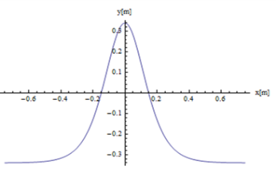
Conclusion
Analysis of the system & Equation of motion
Propagation of deflection
Experiment & Numerical simulation & Sine-Gordon
Small deflections (<< 360°)
Dispersion & Dissipation
of profile
Soliton
Stable against dispersion,
but not against friction

Slide 44
Conclusion
Continuous model
(Sine-Gordon equation)
Without friction
Small deflections (<< 360°)
Soliton
Discrete model
(Numerical simulation)
Without friction
Friction cannot be included
Friction
Experiment
Friction

Slide 45
Conclusion
Thank you for your attention!
Small deflections (<< 360°)
Dispersion law for small deflections
Wavefront (small wavelengths) is always faster than soliton
Soliton
Group velocity converges to maximal value

Slide 46
Appendices

Slide 47
Energy in springs
Looking from reference frame
connected with previous pendulum
View from above:
Assuming strong spring small

Slide 48
Why prestression?
Usual spring
Prestressed spring
Usual spring
Prestressed spring

Slide 49
Why prestression?
Usual spring
Doesn’t lead to Sine-Gordon equation
(Proved analytically & numerically)
Prestressed spring
Sine-Gordon eq.
Error in 3rd order found irrelevant by 4th order Runge-Kutta
Prestression is needed, elasticity is not important

Slide 50
Derivation of equation of motion
Using Principle of least action (Euler-Lagrange equation)
Term from Kinetic energy:
Terms from Potential energy:

Slide 51
Continuous limit: Derivation
Using Equation of motion
Small difference in angle of adjacent
pendula
Sine-Gordon equation
known analytical solution [1]
[1] Physics of solitons. M. Peyrard, T. Dauxios, Cambridge University Press (2010)

Slide 52
Chain of pendula: Equation of motion
Discrete system

Slide 53
Friction
Pendulum cannot move just rotate
Normal force acting on the axis
Causes torque of friction forces

Slide 54
Simulation (4th Order Runge-Kutta)
Using 4th order Runge-Kutta method:
More precise (With comparison to
Euler method)
Faster (Higher time step is sufficient to achieve the same accurancy)
Problem is about nonlinearity
1st order method was unstable
Simulating equation of motion for every pendulum
How it works:
Velocity k₂
Velocity k₃
Velocity k₁
State of system in t+0.5Δt
State of system in t+0.5Δt
State of system in t+Δt
State of system in t
Velocity k₄
Average velocity (k₁+2k₂+2k₃+k₄)/6
State of system in t
State of system in t+Δt

Slide 55
Dispersion: Derivation
Assuming wave in form:
Taking into the limit of Sine-Gordon equation:

Slide 56
Derivation: Group velocity of Soliton
Angular velocity at maximum point

Slide 57
Analogy
Typical length of soliton decreases with increasing group velocity
Analogy to Special Theory of Relativity – Contraction of length

Slide 58
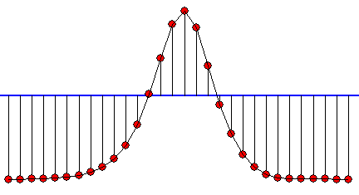
Two theoretical limits
Limit of maximal group velocity - maximal information speed
Actually never in our world (Speed of light)
Experimental limit – Disruption of spring
“Invisibility” – Consequence of contraction in discrete system
If the “length of soliton” is much smaller than
Only small oscillation observable
(Derivation in appendices)

Slide 59
“Invisibility”
If the “length of soliton” is much smaller than
What if ?
Then Continuous approach cannot be used
It requires that means
Energy in springs >> Gravitational energy

Slide 60
Ultimate answer to all: ”What if?”
Small deflection
360° deflection
Without friction
Stable profile
Large wave moving along chain
Without gravity
Dissipation of
Stable profile
Dissipation of
Large wave moving along chain
Friction
Without friction
Dispersion of initial profile
Soliton
With gravity
Dispersion & Dissipation
of initial profile
Dissipation of Soliton
Friction

