Slide 1
Rising water
10
Nikola Illášová

Slide 2
10. Rising water
Fill a saucer up with water and place a candle vertically in the middle of the saucer.
The candle is lit and then covered by a transparent beaker.
Investigate and explain the further phenomenon.

Slide 3
What does it look like?

Slide 4
Simple mechanism
Air is heated
it expands
And is pushed outside the beaker
Candle dies out ☹
Air is cooled down
and contracts
WATER RISES

Slide 5
Important questions to answer
How do p, V, T change?
How does the amount of gas change?
Combustion of oxygen
Where does heat from the candle go?
Heating of the air, losses

Slide 6
1. Ideal gas law quantities
Pressure Temperature Volume

Slide 7
Pressure inside the beaker
Changes of water level (hydrostatic pressure) compensate gas pressure changes
Pressure does not change significantly
→ Isobaric process, Gay-Lussac law

Slide 8
Pressure measured – changes negligibly
Pressure inside [kPa]
Beaker is put over the burning candle
Candle extinction, water rises
Maximal change < 0.4kPa
Time [s]

Slide 9
1. Ideal gas law quantities
Pressure Temperature Volume

Slide 10
Temperature inside the beaker
Complex temperature profile
Observations:
Hot column over the candle
Hot air accumulates at the top
The rest – slightly warmer than environment

Slide 11
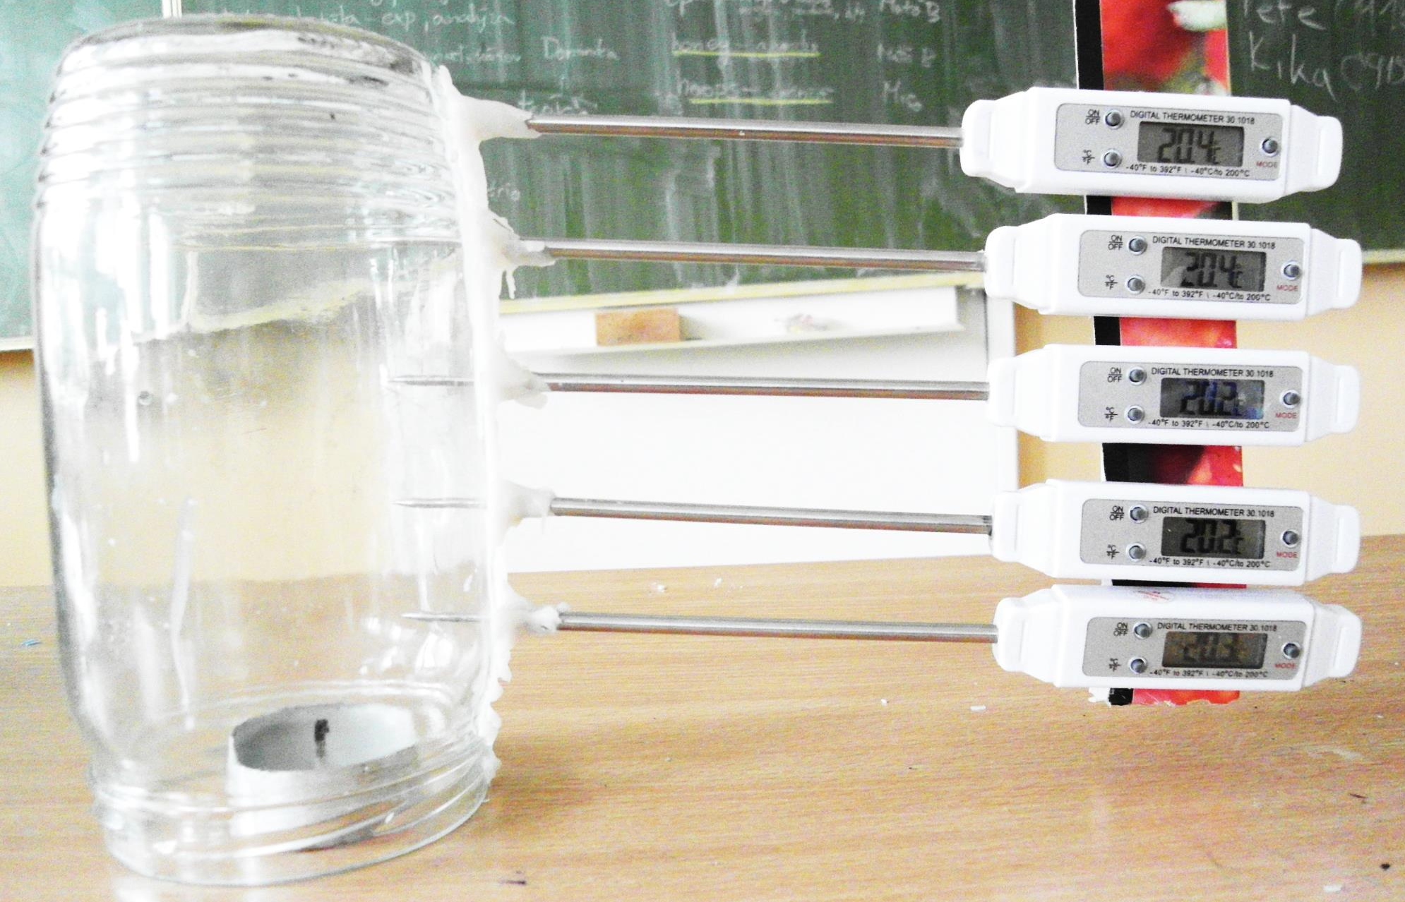
Temperature measurements
5 Different heights
2cm from the wall + over the flame

Slide 12
Temperatures – 2cm from the wall

Slide 13
Temperatures – over the flame
Metal thermometer
– non-negligible heat capacity
Cools down slower than the air
Height:

Slide 14
1. Ideal gas law quantities
Pressure Temperature Volume

Slide 15
Water volume inside the beaker
Water volume [l]
Time [s]

Slide 16
Volume of water rise
Isobaric process – Gay-Lussac law:
Before the candle extinction:
After the water rise:
Resulting volume:

Slide 17
Volume of water rise
Maximal average temperature measured: 55°C
Experiment:
Based on maximal temperature:
Difference due to unknown exact temperature profile

Slide 18
2. Number of molecules

Slide 19
How much oxygen actually burns?
Measuring cylinder, changing height of the candle
Changing volume of air above the candle

Slide 20
Time of burning vs. volume of air
Time of burning [s]
Oxygen below the candle does not burn
Volume of air above the candle [litres]

Slide 21
Burned oxygen depending on time
Heat of combustion of paraffin H = 46MJ/kg
Power of the candle P = 30W
Ratio of paraffin and O₂ burned 1/38 molecules
What fraction of the oxygen burns?

Slide 22
Time of burning vs. volume of air
Fraction of O₂ in air 21%
Fraction of O₂ burned k

Slide 23
Time of burning vs. volume of air
Time of burning [s]
About 30% of available oxygen is burned
Volume of air above the candle [litres]

Slide 24
Molar number change
Approximately 30% of oxygen burns
(oxygen comprises about 21% of air)
Increase of molar amount ≈ 2%
Change of molar amount is negligible

Slide 25
Experimental proof – no molar change
Electric wires
Match
Candle

Slide 26
Experimental proof – no molar change
No gas could leave the beaker
→ no change of final water level

Slide 27
3. Energy Analysis

Slide 28
Heat from the candle
Heats up the air in the beaker
Losses to the material of the beaker
If the candle burns long enough,
equilibrium is reached
How long does it take?

Slide 29
Time to heat up the air
Power of the candle
Volume of the air inside
Specific heat capacity
Change of temperature
Based on water rises during experiments
The candle burns much longer
→ Equilibrium is reached

Slide 30
Equilibrium state

Slide 31
Final volume of water rise
Isobaric process:
Losses to the beaker approximation:
...temperature difference between air inside and beaker
Notes:
Nie je jasne, co ten slide chce povedat.

Slide 32
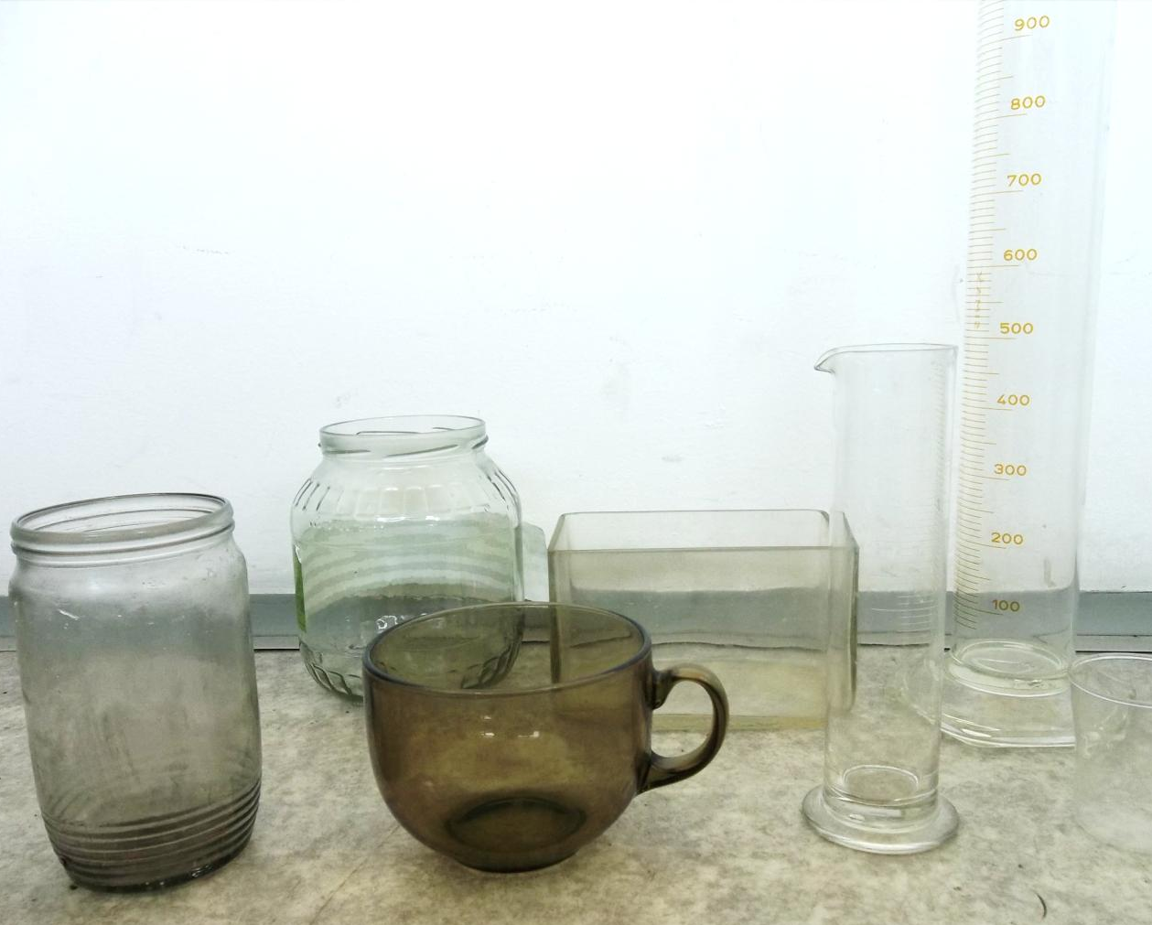
Experiment: Different beakers
Measuring volume of water rise, fitting

Slide 33
Different beakers: k vs. volume
k [W/m²/K]
Small beakers: overheated
Larger beakers – k within reasonable range
Volume of the beaker [l]

Slide 34
Experiment: changing power
Using “Pepo,” solid fuel instead of a candle to achieve high powers
Measuring volume of water rise

Slide 35
High power
Notes:
Odvodenie stavova rovnica

Slide 36
Power dependence – glass jar
Volume of water rise [l]
Power [W]

Slide 37
Power dependence – glass jar
Volume of water rise [l]
Power [W]

Slide 38
Power dependence – plastic bottle
Volume of water rise [l]
Power [W]

Slide 39
Power dependence – plastic bottle
Volume of water rise [l]
Power [W]

Slide 40
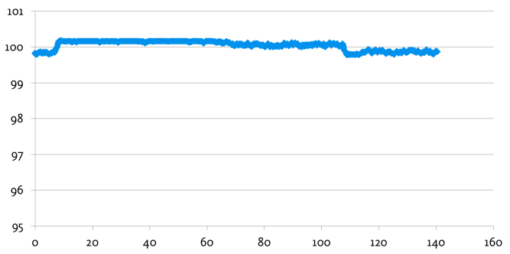
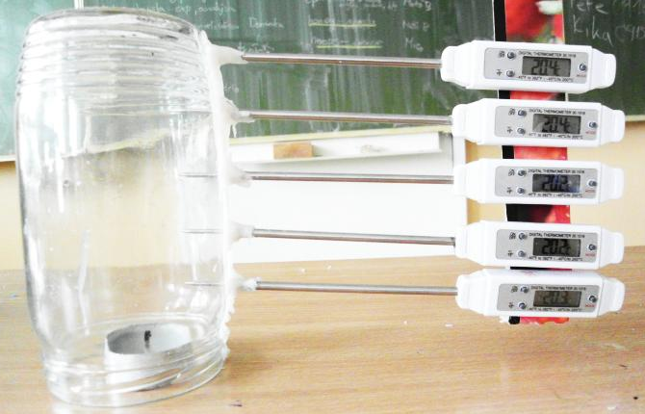
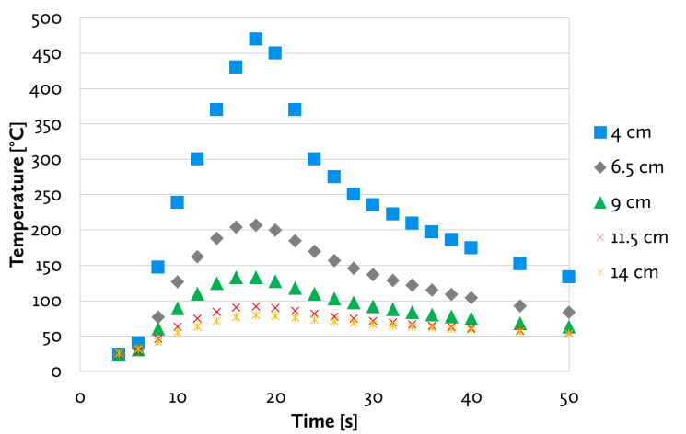
Summary – ideal gas law
Δp is negligible
Temperature measured
Volume of water rise measured + calculated

Slide 41
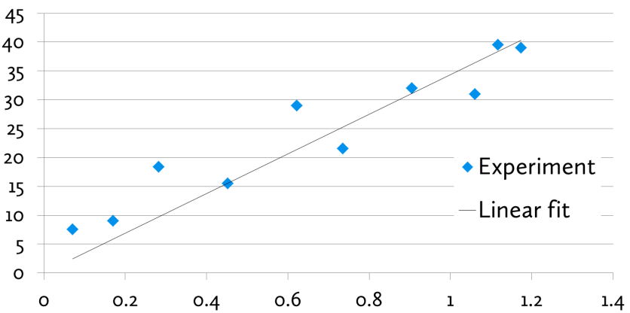
Summary – molar number
Height of candle experiment
30% of oxygen above the candle is burned
Molar number does not change significantly

Slide 42
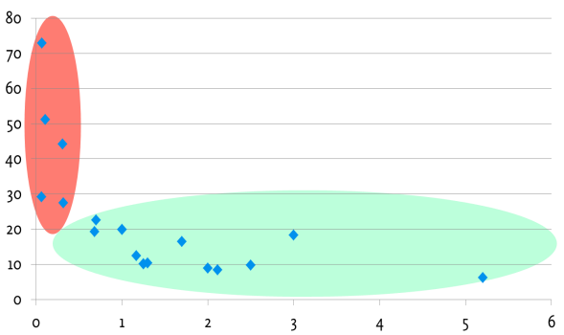
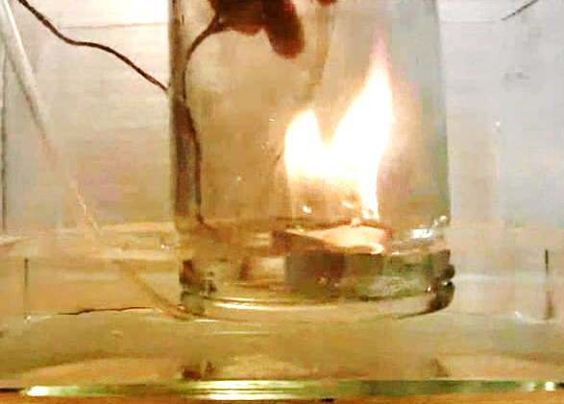
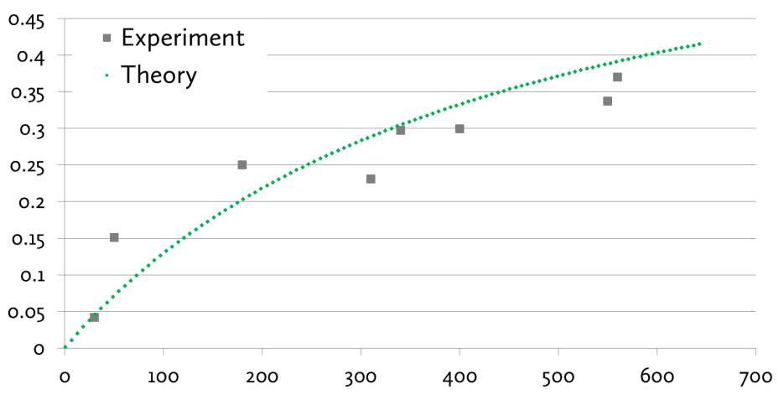
Summary – energy analysis
Equilibrium state is quickly achieved
Different beakers
Solid fuel used to enhance power

Slide 45
Water rise from y-position of candle
Equilibrium of P losses = P candle is reached

Slide 46
Thank you for your attention
Theoretically and experimentally proved:
Gas pressure & amount changes are negligible
Temperature changes are crucial
Complex temperature profile measurement
Quantitative predictions of water rise and time of burning from all relevant parameters
Power, beaker volume, position of candle
Experimentally proved

Slide 47
Temperature profile
At the top ( 50 °C)
- everywhere the same
Over the candle ( 300 °C)
- thin column of hot air
Everywhere else ( 30 °C)
- only a slight change

Slide 48
Largest “beaker” 37 x 37 x 25 cm
2,1 cm water rise

Slide 49
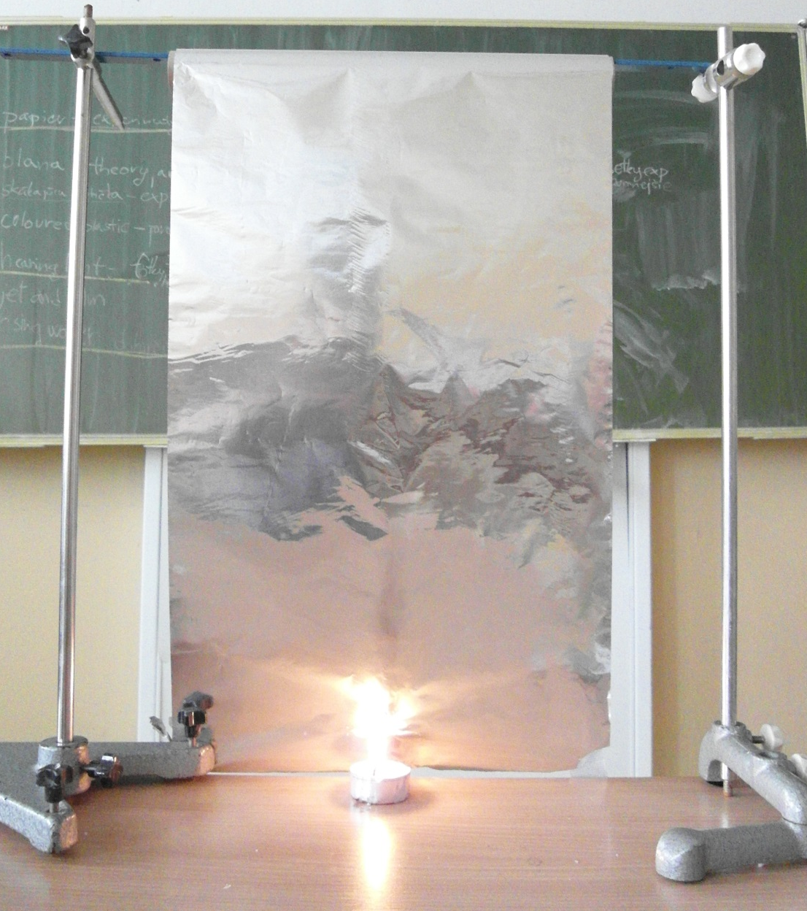
Visualization of hot column

Slide 50
Temperature goes constant
Notes:
Priemer?

Slide 51
Temperature goes constant
Candle off
Notes:
Aka teplota, kde?

Slide 52
Temperature profile measurement
20 |  |  | 60 |  | °C
17 |  | 80 | 100 | 80
13 | 70 | 85 | 140 | 85 | 70
10 | 70 | 90 | 167 | 90 | 70
7 | 60 | 140 | 250 | 140 | 60
4 | 55 | 100 | 370 | 100 | 55
1 | 40 | 90 | 500 | 90 | 40
cm | -2 | -1 | 0 | 1 | 2
Max. temperatures measured
Hot air forms very
thin column
Warm air forms a cone
Notes:
Dorobit profil vnutri

