Slide 1
5. Loaded hoop
“Fasten a small weight to the inside of a hoop and set the hoop in motion by giving it an initial push.
Investigate the hoop’s motion.”

Slide 2
Example of motion - video
Notes:
Video -> pa pokraj graf da se vidi što se događalo

Slide 4
Outline
Experimental approach
Hoop properties
Giving initial push
Parameters
Theoretical modeling
Kinematics and dynamics
Modes of motion
Comparison of experimental data and theory
Modes of motion
Dependence of angular frequency on angle for different weight mass
Hop analysis
Energy analysis

Slide 5
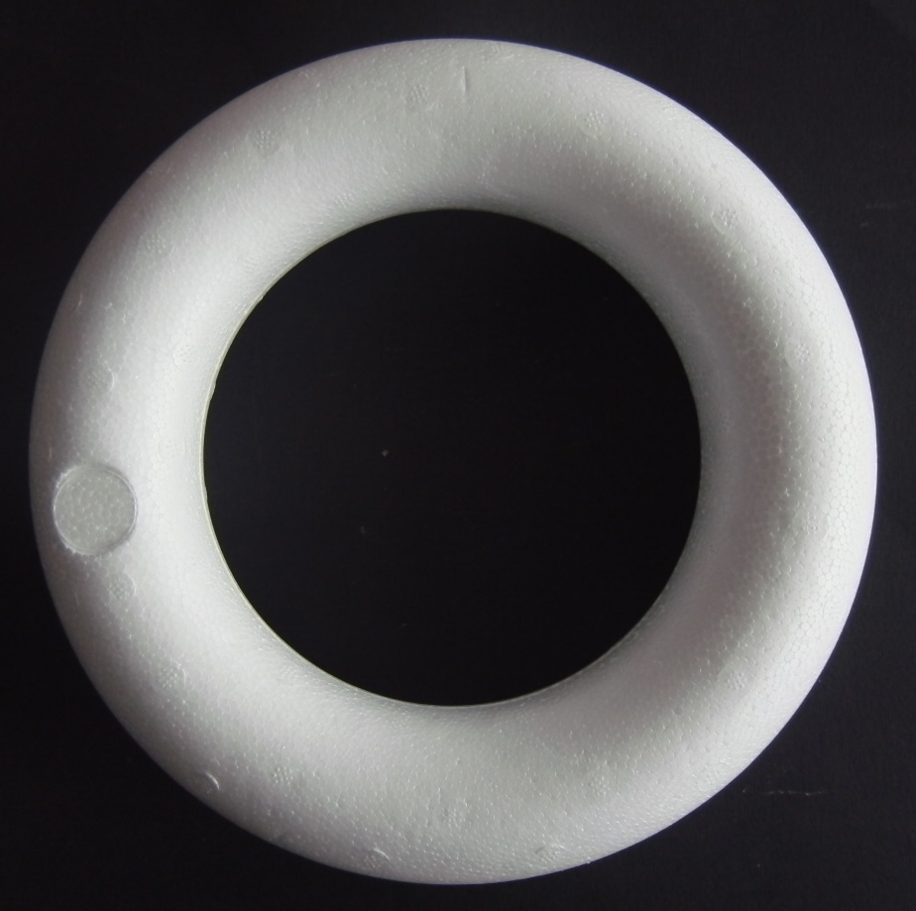
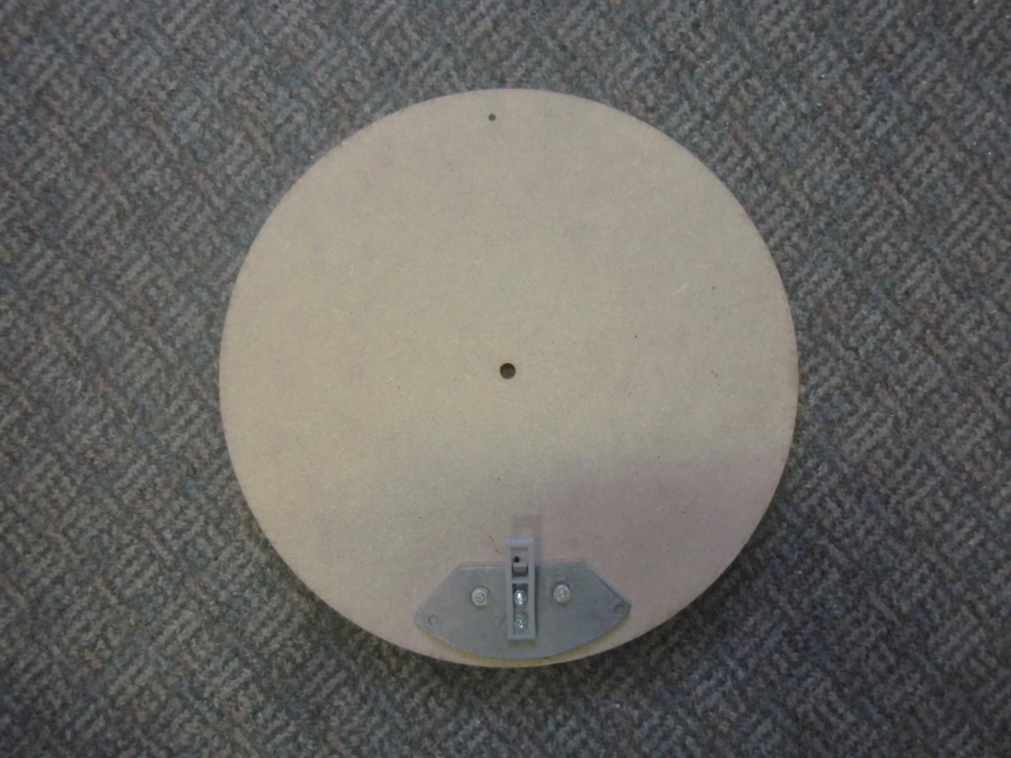
Hoop properties
124 mm
29,5 cm
99 mm
$$m_{h}=24.4g$$
$$m_{h}=186 g$$
Notes:
Dodati masu drugog obruča

Slide 6
Hoop properties
 | Hoop 1 | Hoop 2
Material | Stryofoam | Wood
Shape | Toroidal | Full ring
Determing moment of inertia | Mathematicaly $$I_{cm}=\left[{\left(R−\frac{ΔR}{2}\right)}^{2}+\frac{3}{4}{\left(\frac{ΔR}{2}\right)}^{2}\right]m_{o}+m_{u}r^{2}$$ | Eksperimentaly $$T=2π\sqrt{\frac{I_{0}}{mgd}}$$ $$I_{cm}=I_{0}−mgd$$
Determing distance from center of the mass | Mathematicaly $$r_{cm}=\frac{m_{u}}{M}r$$ | Eksperimentaly -hoop was stabilised on screwdriver

Slide 7
Experimental aproach
Frame for centering and releasing the hoop
Giving initial push
Incline
Colision
Method of motion recording
3 small areas marked with reflective stickers
Motion recorded in 120 fps
Stickers tracked in program for video analysis ImageJ

Slide 8
Theoretical modeling
$m_{h}−$ hoops mass
$m_{w}−$ mass of the weight
$I$ – moment of inertia around center
$F −$ friction force
$N−$ normal force
$$γR −center of the mass distance$$
$x,y −$ coordinates of the hoops center
$$y$$
weight
$$θ$$
$$γR$$
Mg
N
$$M=m_{h}+m_{u}$$
$$I=kMR^{2}$$
$$γ=\frac{m_{w}r}{MR}=\frac{r_{cm}}{R}$$
F
$$x$$
Kinematics of the hoop:
$$x_{c}=x+γRsin\left(θ\right) \\ y_{c}=y+γRcos(θ)$$
Dynamics of the hoop:
$$M\ddot{x_{c}}=F$$
$$M\ddot{y_{c}}=N−Mg$$
$$I\ddot{θ}=m_{w}grsin\left(θ\right)−FR$$
∆R
r
R

Slide 9
Modes of motion
Rolling
Rolling with slipping
Hop

Slide 10
Rolling
Properties of rolling
$x=Rθ, \dot{x}=Rω, \ddot{x}=Rα$
$N>0, y=0, \dot{y}=0, \ddot{y}=0$
$\left|F\right|<μN$
Solving equations for dynamics with assumption of rolling we obtain:
$ω=\sqrt{{\left(\frac{η+cosθ_{0}}{η+cosθ}\right)}^{2}\left({ω_{0}}^{2}+\frac{g}{R}\right)−\frac{g}{R}}$
$\left(\frac{N}{M}\right)=g\left(1−γ\frac{\sin^{2}{θ}}{η+cosθ}\right)−γRω^{2}\left(\frac{1+ηcosθ}{η+cosθ}\right)$
$\left(\frac{F}{M}\right)=gγsinθ−k\left({Rω}^{2}+g\right)\frac{sinθ}{η+cosθ}$
$$η=\frac{1+k}{γ}$$

Slide 11
Rolling with slipping
Properties of rolling with slipping
$\vec{F}=−μN\frac{{\vec{v}}_{r}}{{|\vec{v}}_{r}|}$ whereby ${\vec{v}}_{r}$ is relative velocity between hoop on the contact of the surface and the surface
$N=0, y=0, \dot{y}=0,$ $\ddot{y}=0$
Two cases:
$Rω>\dot{x}$
The hoop is rotating more than it’s translating
$Rω<\dot{x}$
The hoop is translating more than it’s rotating

Slide 12
Hop
The center of mass moving along a parabola with constant speed in the x direction
Conservation of angular momentum
Most probable hop when weight is on highest position
$N=0$

Slide 13
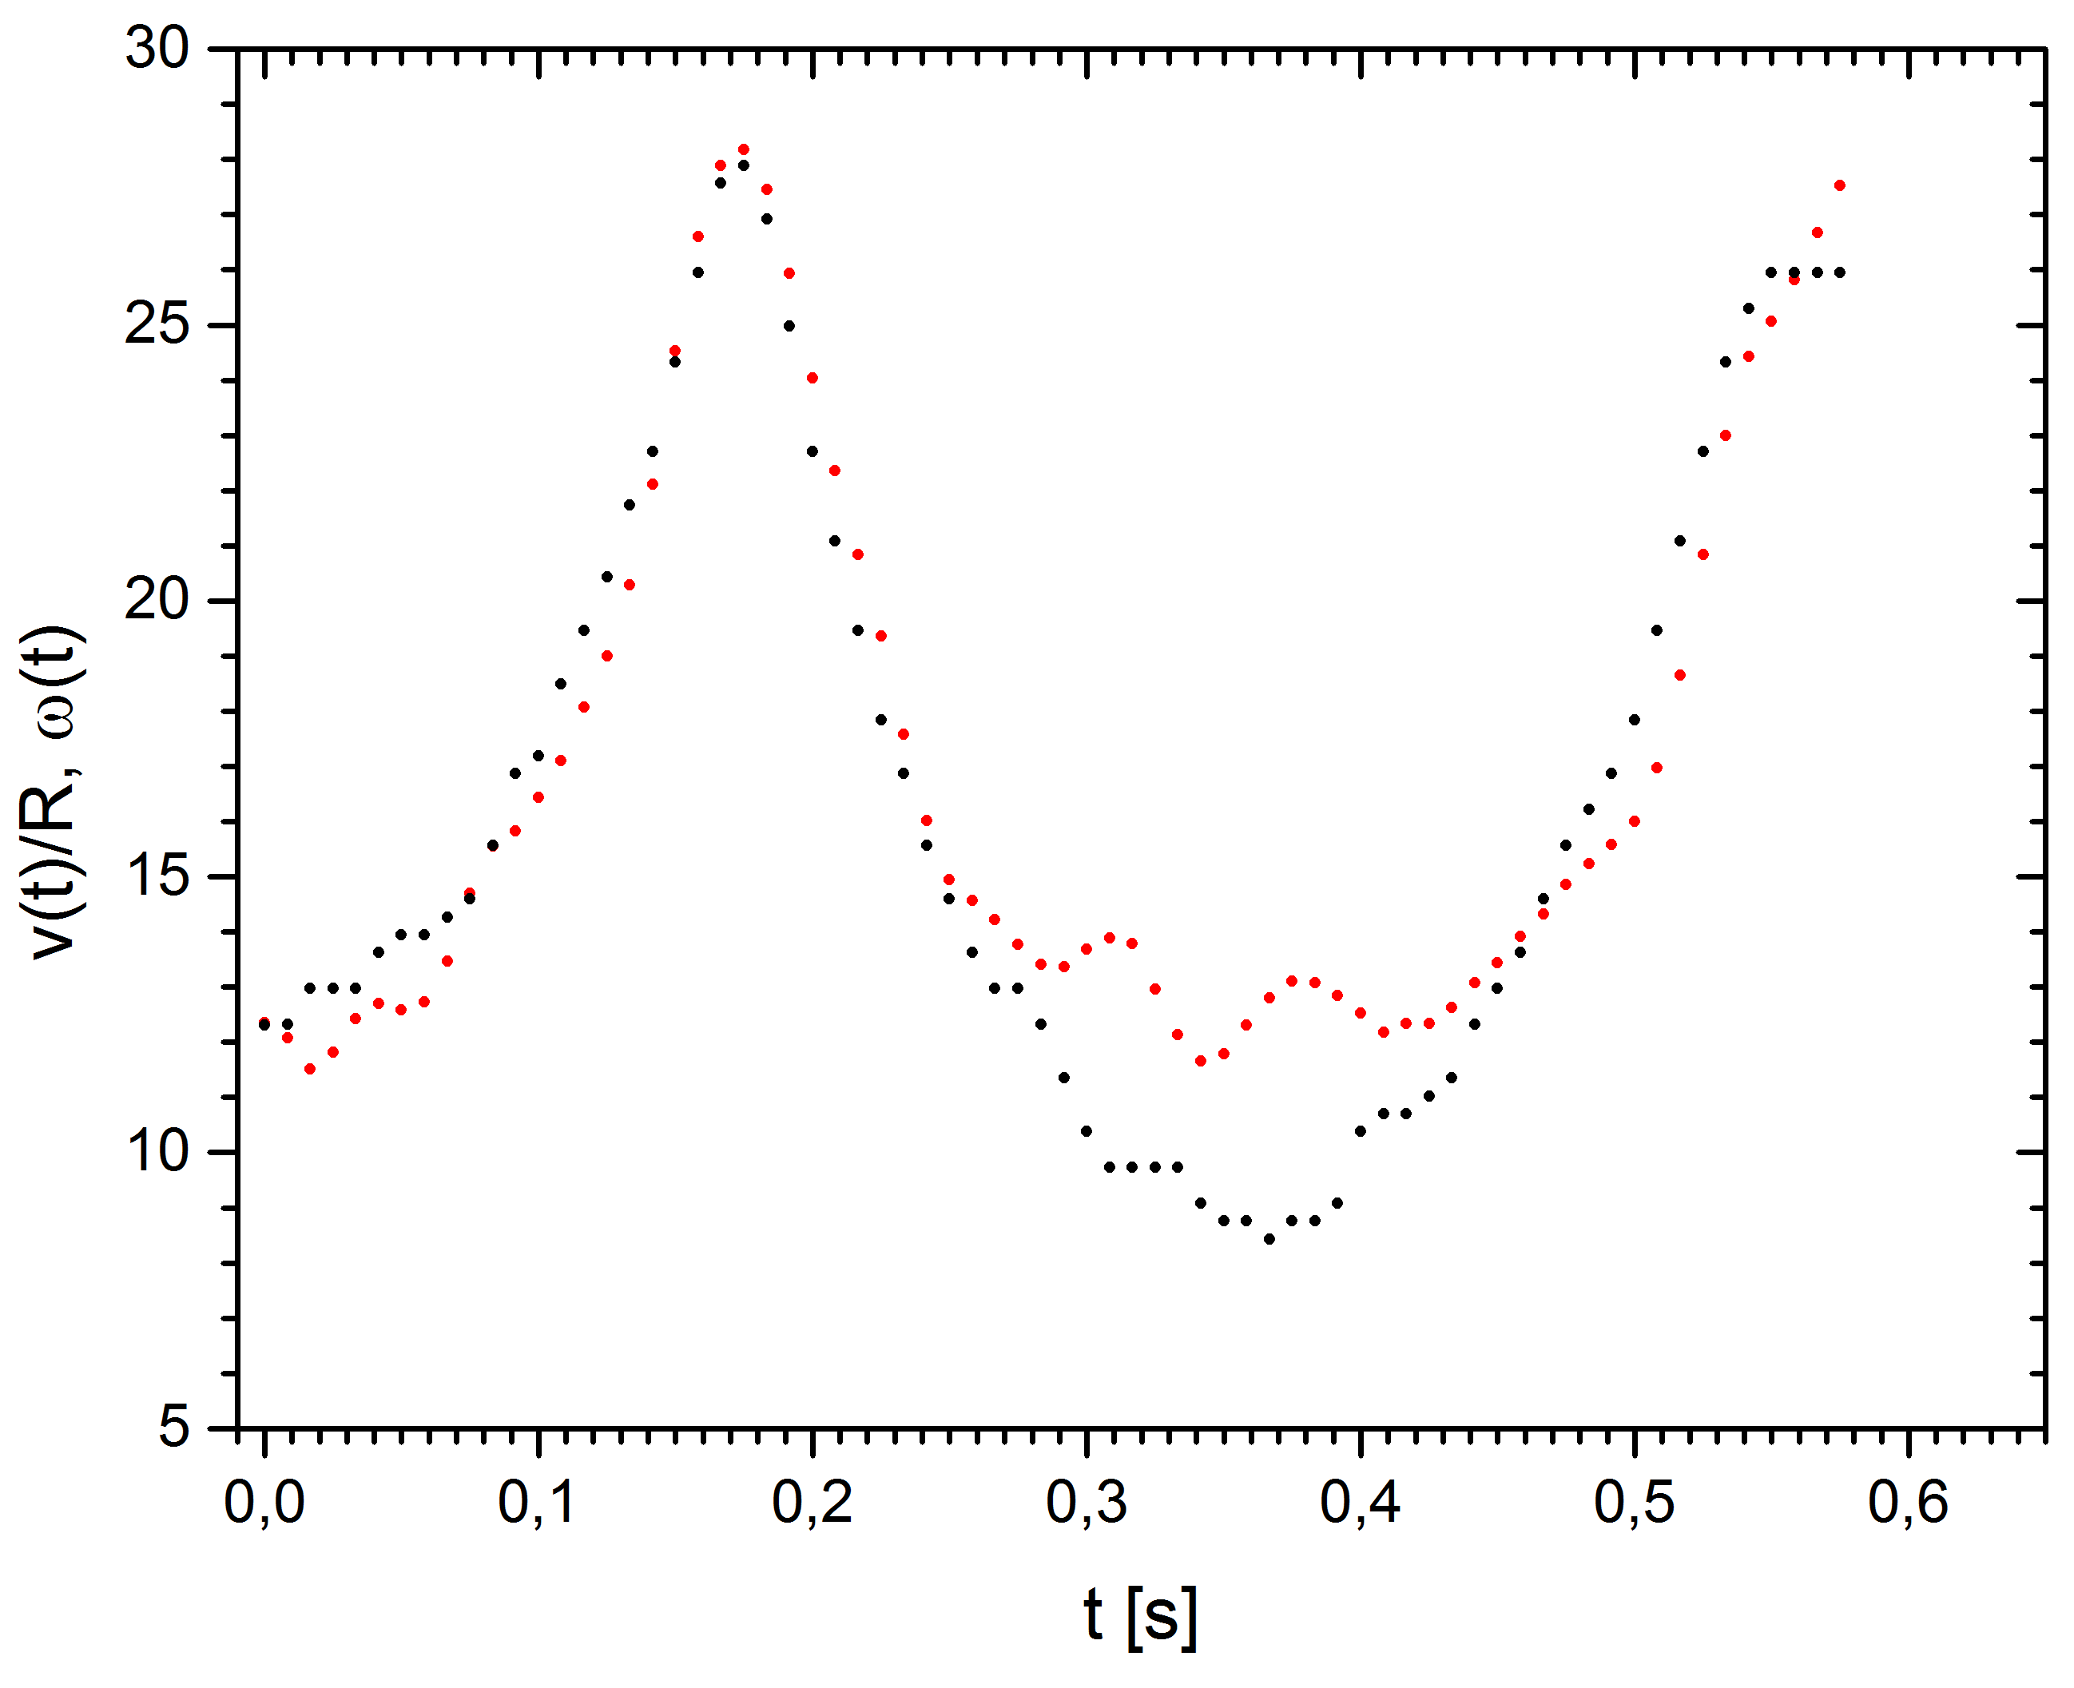
Determing hoop motion - 1
Rolling condition
$\dot{x}=Rω$
Hop
$ω −const$
$$\frac{v\left(t\right)}{R}$$
Hop
$$ω(t)$$
Notes:
Označiti skok 0,313s crvena theta(t), crna s(t)/R

Slide 14
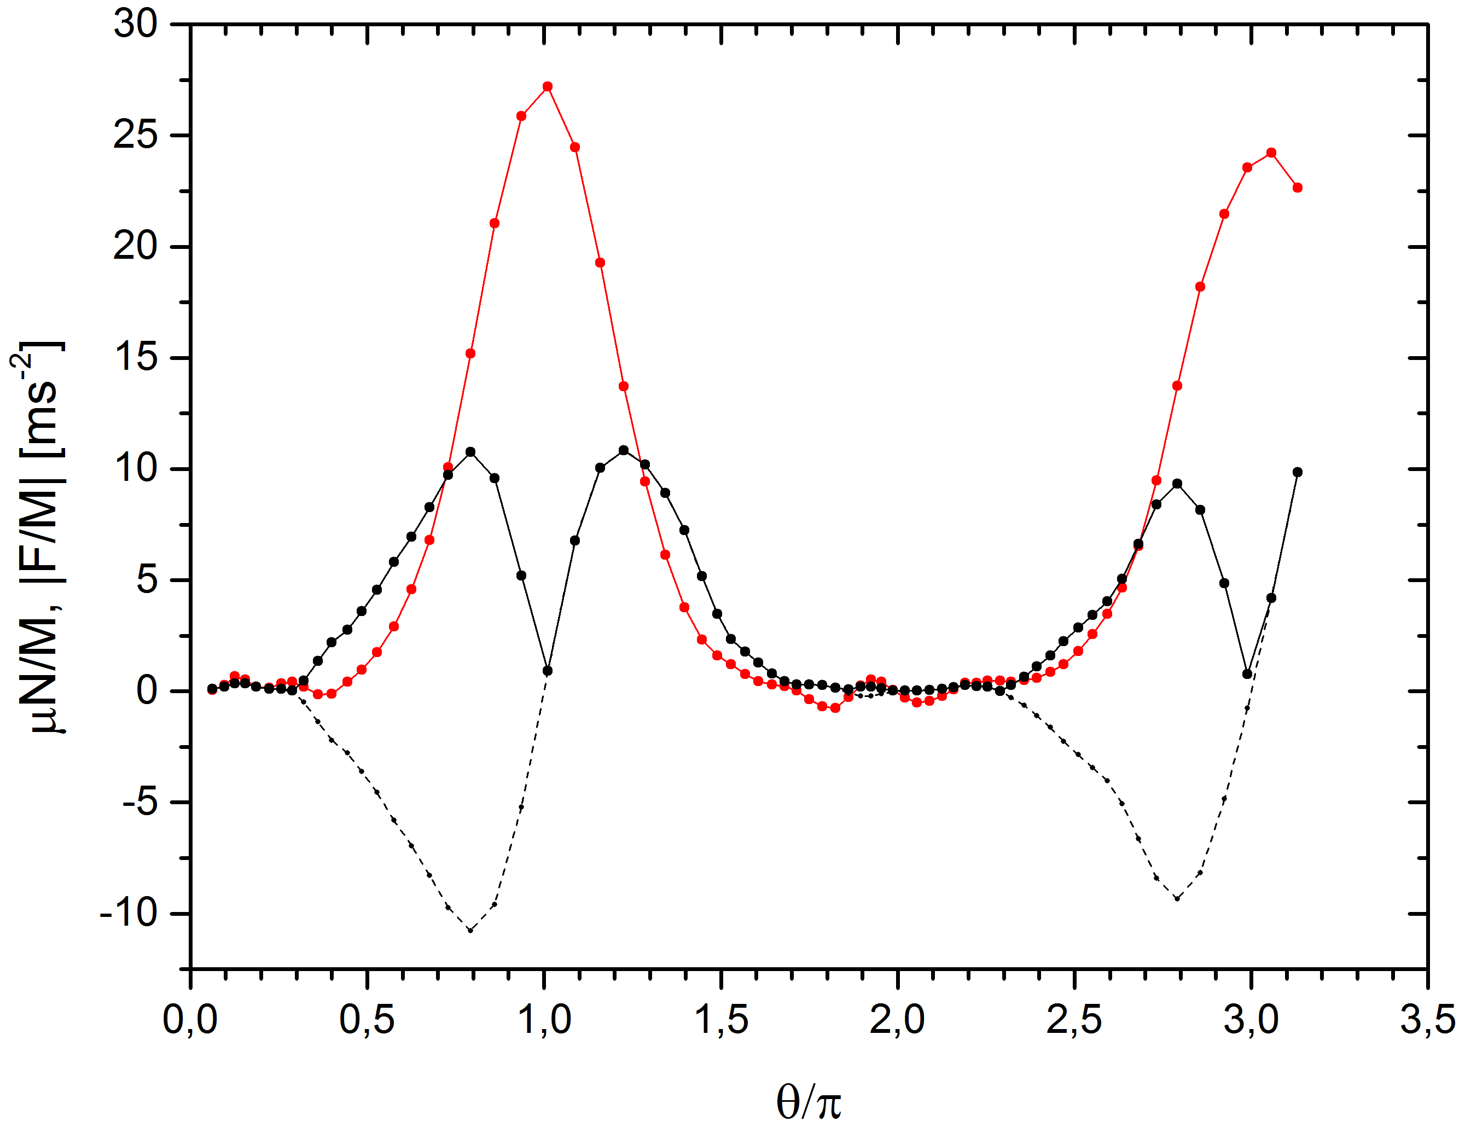
Determing hoop motion - 1
Rolling condition:
$$\left|F\right|<μN$$
Rolling with sliping condition:
$$\left|F\right|>μN$$
Hop:
$$N=0$$
$$\frac{μN}{M}$$
$|\frac{F}{M}|$
$|\frac{F}{M}|$

Slide 15
Hop analysis - 2

Slide 16
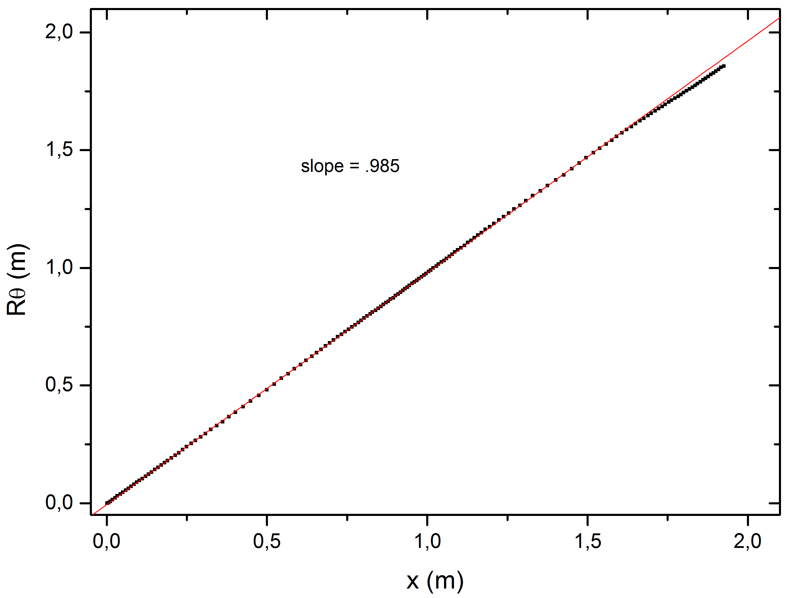
Analysis of motion without hop - 3
Rolling condition
$x=Rθ$

Slide 17
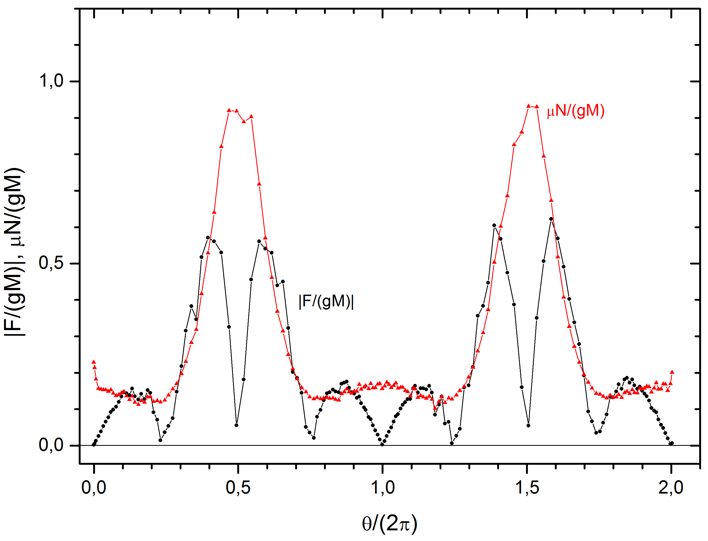
Analysis of motion without hop - 3
The motion of the hoop can be considerated as rolling $\left|F\right|<μN$
$\left(\frac{N}{M}\right)=g\left(1−γ\frac{\sin^{2}{θ}}{η+cosθ}\right)−γRω^{2}\left(\frac{1+ηcosθ}{η+cosθ}\right)$
$\left(\frac{F}{M}\right)=gγsinθ−k\left({Rω}^{2}+g\right)\frac{sinθ}{η+cosθ}$

Slide 18
Conservation of energy
Energy of a hoop:
$$\frac{E_{t}}{M}=\frac{1}{2}\left(v_{c}^{2}+k_{c}{\left(ωR\right)}^{2}\right)+gy_{c}$$

Slide 19
Dependence of angular velocity on angle for different weight mass
$$ω\left(θ\right)=\sqrt{\frac{4598.73}{{\left(3.2+cosθ\right)}^{2}}−79.11}$$
$$ω\left(θ\right)=\sqrt{\frac{4620,46}{3,49+\cos\left(θ\right)}−79,11}$$
m [g] | $$η$$
43,75 | 3.2
26,19 | 3.49
0 | $$→∞$$
$$ω\left(θ\right)=15,65$$
$ω=\sqrt{{\left(\frac{η+cosθ_{0}}{η+cosθ}\right)}^{2}\left({ω_{0}}^{2}+\frac{g}{R}\right)−\frac{g}{R}}$, $η=\frac{1+k}{γ}$

Slide 20
Conclusion
Three modes of motion were observed
Rolling
Rolling with sliping
Hop
We analyticaly solved equation of motion for rolling case
$ω=\sqrt{{\left(\frac{η+cosθ_{0}}{η+cosθ}\right)}^{2}\left({ω_{0}}^{2}+\frac{g}{R}\right)−\frac{g}{R}}$, $η=\frac{1+k}{γ}$ and the solution fits the experimental data
When the hoop hop its center of mass will move on parabolic trajectory and it will have constant angular momentum

Slide 21
Reference
M. F. Maritz, W.F.D. Theron; Experimental verification of the motion of a loaded hoop; 2012 American journal of physics
M. F. Maritz, W.F.D. Theron; The amazing variety of motions of a loaded hoop; Mathematical and Computer Modelling 47 (2008) 1077-1088
Lisandro A. Raviola, O. Zarate, E. E. Rodriguez; Modeling and experimentation with asymmetric rigid bodies: a variation on disks and inclines; March 31, 2014
W. F. D. Theron, Analysis of the Rolling Motion of Loaded Hoops, dissertation, March 2008

Slide 22
Thank you
IYPT 2014 CroatiaN team
Reporter: Domagoj Pluščec

Slide 23
Hoop1
n | $m_{u}[$g] | M[g] | I[kgm^2]$∙{10}^{−4}$ | $$γ$$ | k | $$η$$
1 | 17,8 | 42,2 | 4,33 | 0,337 | 0,657 | 4,92
2 | 26,2 | 50,6 | 5,17 | 0,414 | 0,654 | 4,01
3 | 35,5 | 59,9 | 6,1 | 0,474 | 0,652 | 3,49
4 | 44 | 68,4 | 6,95 | 0,515 | 0,65 | 3,2

Slide 24
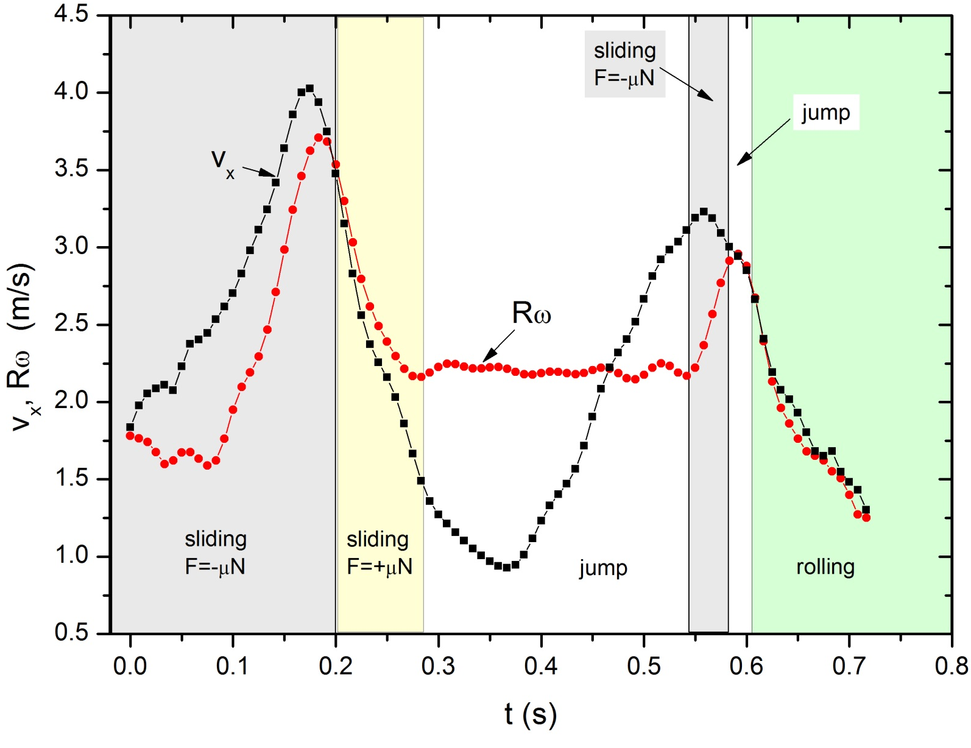
Determing hoops motion – another example

Slide 25
Rotational velocity in time – another example

Slide 26
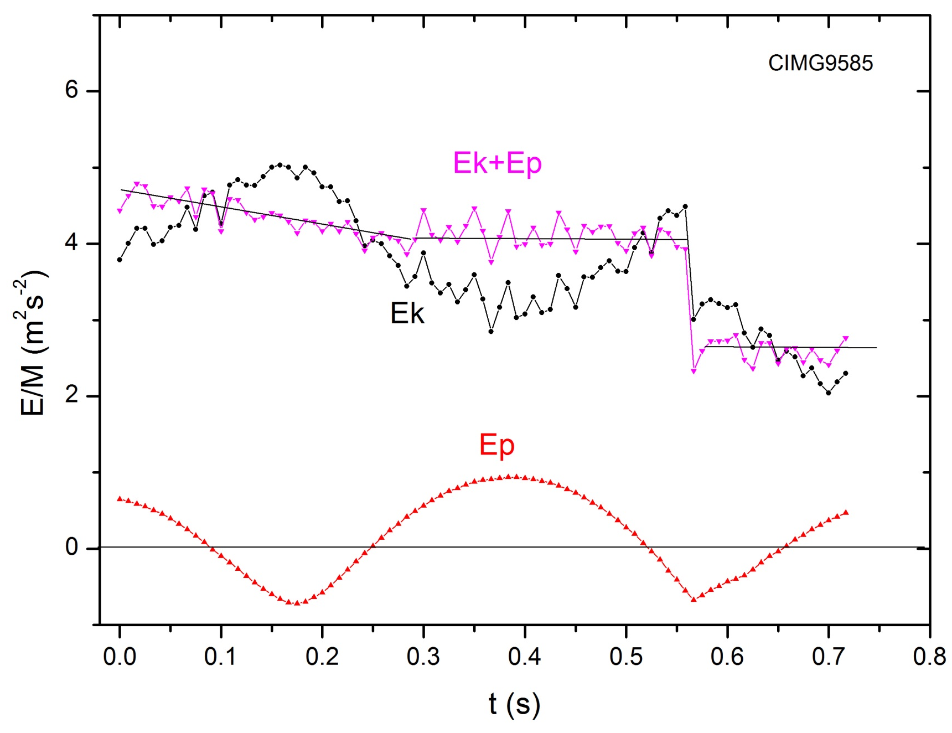
Energy – another example

