Slide 1
16. Magnetic brakes
”When a strong magnet falls down a non ferromagnetic metal tube, it will experience a retarding force.
Investigate the phenomenon.”

Slide 2
Outline
Qualitative explanation
Quantitaive explanation
Force modeling
Dipole case
Equation of motion
Apparatus and experimental methods
Measurement of magnetic flux change
Measurement of magnet velocity
Comparison of experimental data and theory
Dependence of terminal velocity on magnet size
Terminal velocity for dipole
Dependence of terminal velocity on material conductivity
Equation of motion

Slide 3
What causes the force?
Magnet falls down under the influence of gravity
Magnetic flux is changing in space
Current is induced in the tube
Currents act on magnet by force that reduces the speed of magnetic flux change (reducing the magnet speed)
z
$$F_{m}$$
$$\vec{m}$$
In the middle there is no induced current
Direction of induced currents
$$\vec{v}$$
$\vec{m}$ – magnetic moment
$\vec{v}−$velocity of a magnet

Slide 4
Force
z
According to Newton III. law:
$$\vec{F_{m}}=−\vec{F_{c}}$$
Because we know what is the force on a current loop we can write
$$d{\vec{F}}_{m}=−dI\vec{l}×\vec{B}$$
$$dz$$
F
G
$$L=N∆z$$
B
B_{z}
B
B_{z}
ρ_{m}
B_{ρ}
F_{ρ} (B_{z})
F_{ρ} (B_{z})
F_{z} (B_{ρ})
B_{ρ}
∆ρ
F_{z} (B_{ρ})
Assumption: no skin effect
$F_{m}−$ force on magnet
$F_{c}−$force on current
$Δρ−$tickness of the tube
dz – lenght of a loop
$ρ_{m}−$mean radius of the pipe
$$δ=38.3 mm>5.5 mm$$ Cu; $v=0.1ms^{−1};Δρ=1 mm$

Slide 5
Force
Magnetic field component $B_{ρ}$ is causing the force in $z$ direction so the force can be written as
$$dF_{m}=−dI∙2πρ_{m}∙B_{ρ}$$
Using Maxwell equation $\vec{∇}\vec{B}=0$ we derive expresion for $B_{ρ}$
$$dI=\frac{σΔρε}{2πρ_{m}}dz$$
$$ε=\frac{dφ}{dz}v$$
$$B_{ρ}=−\frac{1}{2πρ_{m}}\frac{dφ}{dz}$$
$$dI=\frac{Δρσv}{2πρ_{m}}\frac{dφ}{dz}dz$$
z
B_{z}
B_{z}
$\frac{dφ}{dz} −$ change of magnetic flux in z direction
ε – induced voltage
σ – material conductivity
R – restistance of the ring
B_{ρ}
B_{ρ}
F_{ρ} (B_{z})
F_{ρ} (B_{z})
F_{z} (B_{ρ})
F_{z} (B_{ρ})

Slide 6
Force
After rearranging the term we obtain total force on a magnet caused by induced current
$$F_{m}=\frac{σΔρv}{2πρ_{m}}\int_{z1}^{z2}{{\left(\frac{dφ}{dz}\right)}^{2}dz}$$
z₁, z₂ – coordinates of the tube edges

Slide 7
Equation of motion
II. Newton law for magnet states
$$m\frac{dv}{dt}=mg−F_{m}$$
After solving for $v$ we obtain ($v\left(0\right)=0$)
$$v\left(t\right)=τg\left(1−e^{−\frac{t}{τ}}\right)$$
Substitution:
$$τ=\frac{2πρ_{m}m_{mag}}{σΔρ}\frac{1}{\int_{z1}^{z2}{{\left(\frac{dφ}{dz}\right)}^{2}dz}}$$
Function is in form of exponential decay
Terminal velocity can be expressed as
$$v=τg$$

Slide 8
Determing magnetic flux change
Because $\frac{dφ}{dz}$ can be difficult to calculate we decided to experimentaly determine it
$$F=NI∙2πρ∙B_{ρ} \\ F=NI∙\frac{dφ}{dz}$$
Screw for vertical dislacement (0.01 mm)
Stand
Magnet
Coil same diameter as tube
Measured by scale
Wooden cube (in place to eliminate magnets impact on the scale)
$$\frac{dφ}{dz}=\frac{F}{NI}$$
Scale
Property of coil N = 40
Adjusted on current source I = 1A (DC)

Slide 9
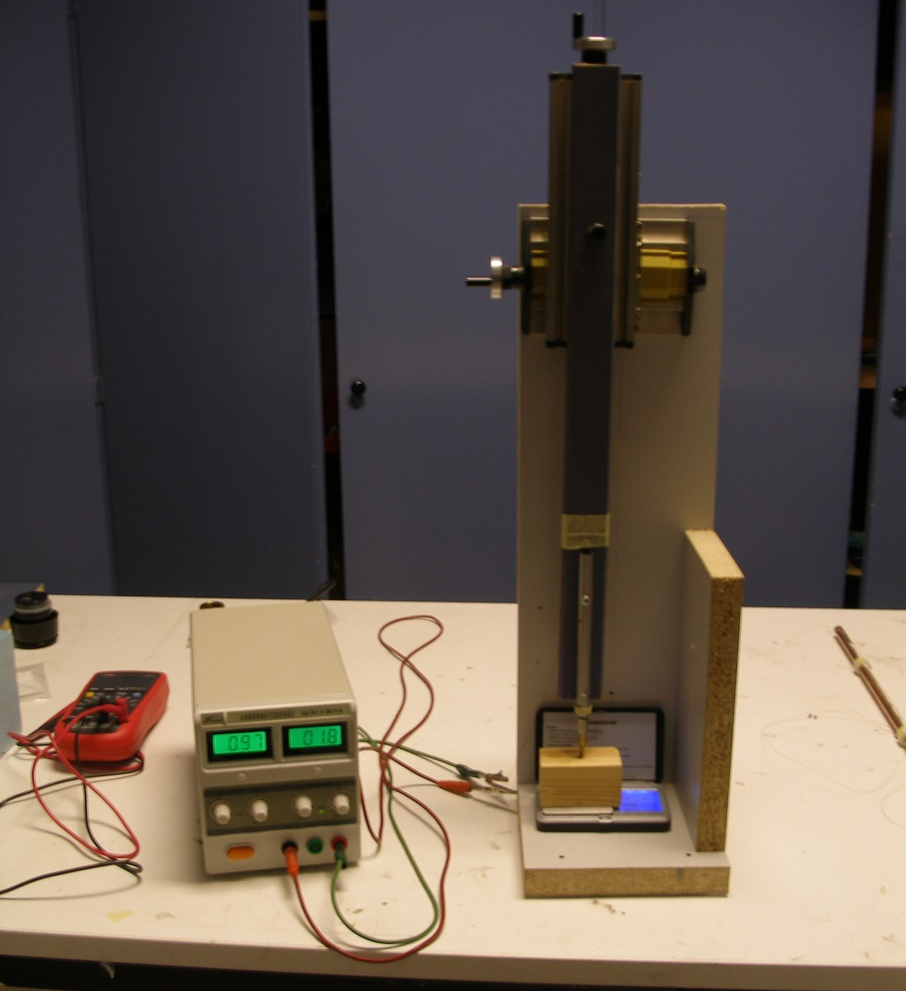
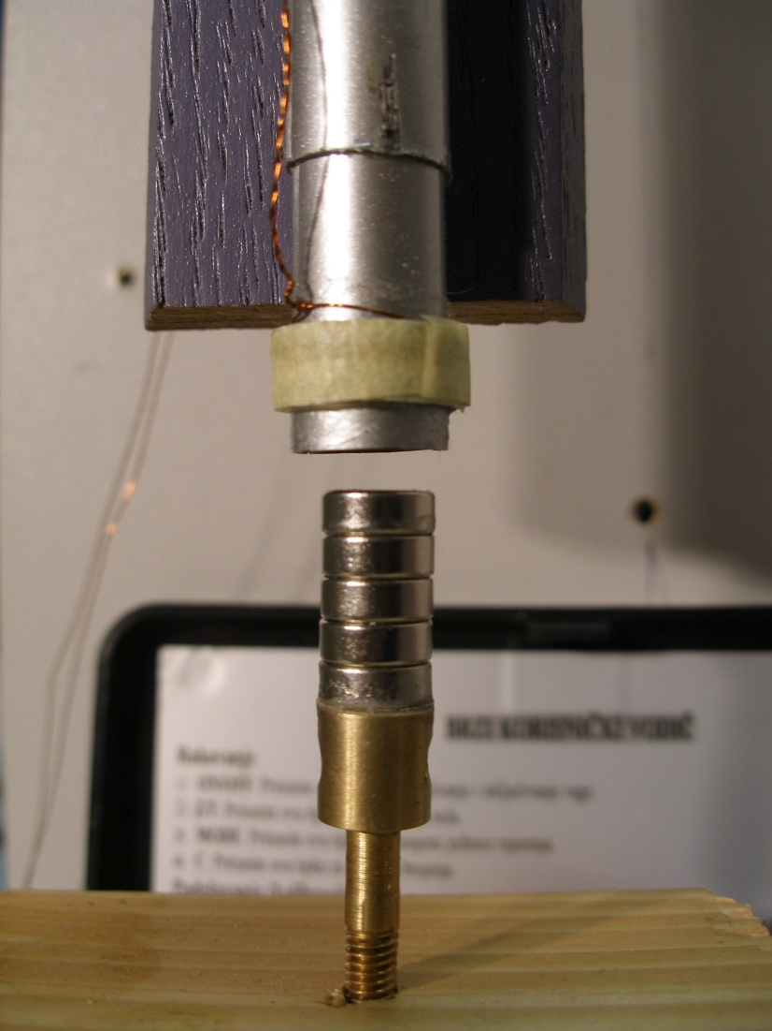
Plastic tube
Adjustable stand
Coil
Neodimium magnets
Brass screw
Current source
Scale
Wooden block

Slide 10
Example of obtained data - magnetic flux change
2r = 4 mm
h
Notes:
Grid lines ?

Slide 11
Velocity measurement
Coil used for releasing magnet
Coil used for releasing magnet
Computer controlled power supply
Detector coils
PC
Detector coils
ADC

Slide 12
Velocity measurement – coils detect passing magnet due to induction:
2r = 4 mm
h
$$ε=\frac{dφ}{dz}v$$
Copper 3 solenoids
$$ρ=5.5 mm \\ Δρ=1 mm$$

Slide 13
Dependence of terminal velocity on cylindrical magnets height – Cu and Al
Theoretical values numericaly calculated from:
$$v=\frac{2πρ_{m}m_{m}g}{Δρσ k(h)}$$
Substitution:
$$k(h)=\int_{−∞}^{∞}{{\left(\frac{dφ}{dz}\right)}^{2}dz}$$
4 mm
h
Notes:
No free parameters

Slide 14
Dipole
Dipole magnetic field in z direction (measured from the magnet):
$$B_{z}\left(z,ρ\right)=\frac{μ_{0}m}{4π}\left(\frac{2z^{2}−{ρ_{m}}^{2}}{{\left(\sqrt{z^{2}+{ρ_{m}}^{2}}\right)}^{5}}\right)$$
If the magnet is far enough from the edges of the tube we can write
$F_{m}=\frac{45{(μ}_{0}MV)2σΔρ∙v}{1024π{ρ_{m}}^{4}}$

Slide 15
Terminal velocity - dipole
Spherical magnet – radius 2.5 mm
Aluminium tube $ρ=5 mm, Δρ=1 mm$
Theoretical prediction | Experimental result
$$0.458 ms^{−1}$$ | $$\left(0.452±0.012\right)ms^{−1}$$
$$v_{t}=\frac{256dg}{15πσ{\left(μ_{0}M\right)}^{2}}∙{\left(\frac{ρ_{m}}{r}\right)}^{3}\left(\frac{ρ_{m}}{Δρ}\right)$$
d – magnet’s density
r – radius of a magnet
v_{t} – theoretical velocity

Slide 16
Velocity - conductivity
Copper tube coled down to 77K in insulating box with liquid N2
As tube warms up magnet is released and velocity measured
Magnet was constantly kept on liquid nitrogen temperature ≈ 77K (constant magnetization $M_{cold}=1.13M_{warm}$)
Conductivity measured directly - resistance of wire attached to tube
Coil used for releasing magnet
Insulating box
Detector coils
Copper wire
Notes:
Styrofoam

Slide 17
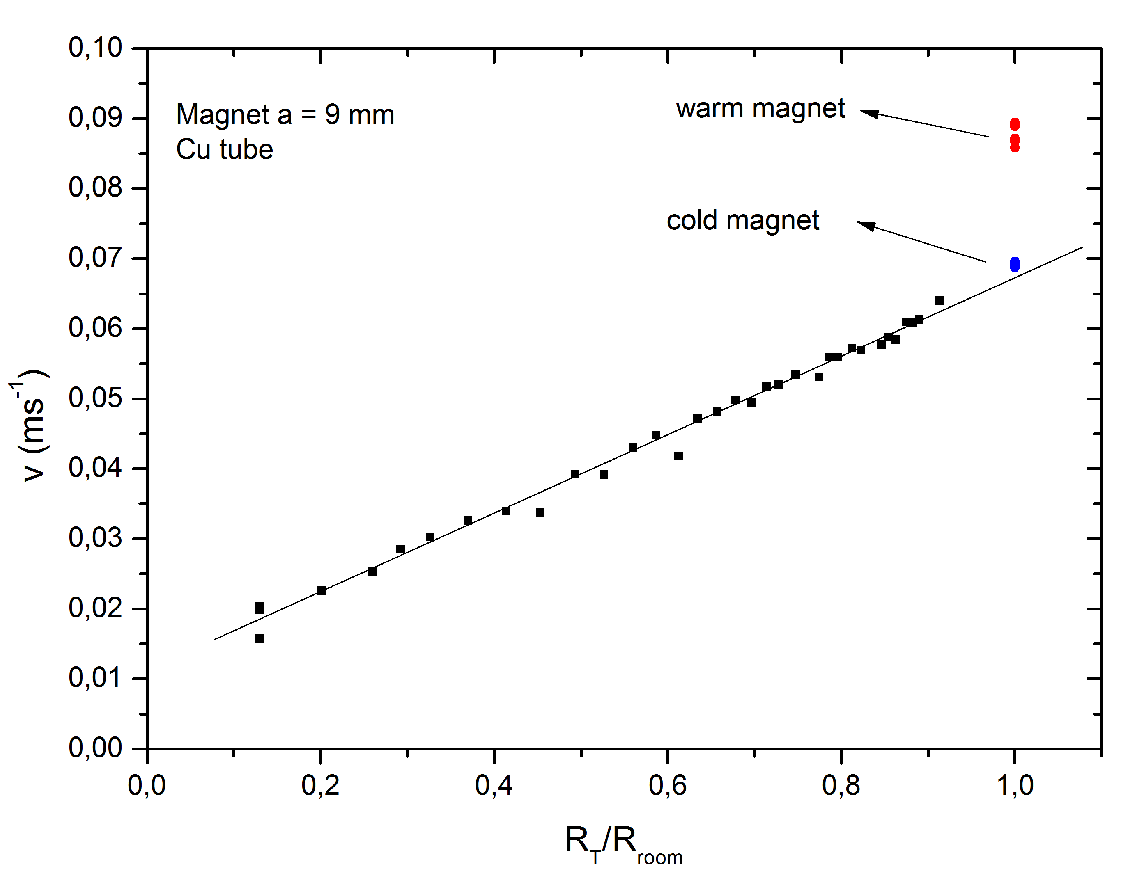
Dependence of final speed on material conductivity
$$v∝\frac{1}{σ}$$
$$R∝\frac{1}{σ}$$
$$M_{cold}=1.13M_{warm}$$

Slide 18
Dependence of velocity on distance traveled
Theoretical values
calculated numericaly from
$v\frac{dv}{dz}+\frac{v}{τm}−g=0$
Initial speed determined experimentally
System of cylindrical magnet ( $h=3 mm$ ) and weight
Velocity experimentaly determined by using $ε=\frac{dφ}{dz}v$ relation

Slide 19
Conclusion
Theoretical model developed
Quantitaive
No free parameters
Very good correlation with experiment
Assumptions
No skin effect
Constant direction and magnitude of magnetization of magnet
Rotational symmetry of the tube
Experiment
Parameters changed
Size and shape of magnet
Conductivity of material

Slide 20
Reference
Valery S Cherkassky, Boris A Knyazev, Igor A Kotelnikov, Alexander A Tyutm; Eur. J. Phys.; Breaking of magnetic dipole moving through whole and cut conducting pipes
Edward M. Purcell; Electricity and Magnetism Berkley physics course – volume 2, Second Edition; McGraw-Hill book company

Slide 21
Thank you
IYPT 2014 team of Croatia
Reporter: Domagoj Pluščec

Slide 22
Current
$$I=\frac{ε}{R}$$
$$ε=−\frac{dφ}{dt}=−\frac{dφ}{dt}\frac{dz_{0}}{dz_{0}}=\frac{dφ}{dz}v$$
$$R= \frac{1}{σ}\frac{l}{A}=\frac{1}{σ}\frac{2πρ_{m}}{Δρ∙dz}$$
$$ε=\frac{dφ}{dz}v$$
v – magnets speed $\frac{dφ}{dt} −$ time change of magnetic flux
ε – induced voltage
σ – material conductivity
l – ring perimeter
A – area of ring cross section
R – restistance of the ring
$z_{0}$ - magnets position
$$dI=\frac{Δρσv}{2πρ_{m}}\frac{dφ}{dz}dz$$
$\frac{dφ}{dt}$ - can be expresed as space change because magnetic flux around the magnet doesn’t depend on time

Slide 23
Determing B_{ρ}
Maxwell equation $\vec{∇}\vec{B}=0$ (magnetic field lines are closed curves)
$φ$₂
$$φ_{1}=φ_{2}+φ_{3}$$
$$φ_{3}=−dφ \\ φ_{3}=2πρ_{m}B_{ρ}dz$$
$φ$₃
$φ$₁
$$B_{ρ}=−\frac{1}{2πρ_{m}}\frac{dφ}{dz}$$
$φ$ – magnetic flux
Schematic representation of the magnetic flux through a closed surface (disc shape)

Slide 24
Terminal velocity
Terminal velocity is reached when gravitational force is equal to magnetic force
$$F_{g}=F_{m} \\ m_{m}g=\frac{Δρσv_{0}}{2πρ_{m}}\int_{−∞}^{∞}{{\left(\frac{dφ}{dz}\right)}^{2}dz}$$
Supstitution $$k=\int_{−∞}^{∞}{{\left(\frac{dφ}{dz}\right)}^{2}dz}$$
$$v_{0}=\frac{2πρ_{m}m_{m}g}{Δρσk}$$

Slide 25
Assumptions used in derivation of model
Tube is rotational symetrical in z direction
Thin tube and the magnet is falling with low velocities (model does not take into consideration skin effect)
$δ=\sqrt{\frac{2}{μσω}}≫ρ_{m}; ω\sim \frac{v}{ρ_{m}}$
We didn’t take into account case in which magnet rotates in such a way that direction of its magnetic moment changes
$$δ=38.3 mm>5.5 mm$$ Cu; $v=0.1ms^{−1};Δρ=1 mm$
$δ$ – skin depth
$ω$ – characteristic frequency

Slide 26
Detailed dipole model derivation 1/2
In theoretical modeling part we obtained
$$F_{mag}=\frac{σΔρv_{o}}{2πρ_{m}}\int_{z1}^{z2}{{\left(\frac{dφ}{dz}\right)}^{2}dz}$$ in this equation we need to find $\frac{dφ}{dz}$ for dipole
Magnetic flux trought cross section of tube can be expressed as
$$φ\left(z\right)=2π\int_{0}^{ρ_{m}}{B_{z}ρ dρ}$$
And by using expresion for a field of dipole in z direction $B_{z}\left(z,ρ\right)=\frac{μ_{0}m}{4π}\left(\frac{2z^{2}−{ρ_{m}}^{2}}{{\left(\sqrt{z^{2}+{ρ_{m}}^{2}}\right)}^{5}}\right)$ we obtain magnetic flux in z direction

Slide 27
Detailed dipole model derivation 2/2
Magnetic flux in z direction
$$φ\left(z\right)=\frac{μ_{0}m}{2}\frac{ρ_{m}^{2}}{{\left(z^{2}+ρ_{m}^{2}\right)}^{\frac{3}{2} }}$$
From that we derive magnetic flux change
$$\frac{dφ(z)}{dz}=−\frac{3ρ_{m}z}{{\left(z^{2}+ρ_{m}^{2}\right)}^{\frac{5}{2}}}$$
By knowing magnetic flux change we can obtain force
$$F_{mag}=\frac{9{(μ}_{0}m)2σΔρ∙{{ρm}_{}^{3}∙v}_{0}}{8π}\int_{z1}^{z2}{\frac{ z^{2}}{{\left(z^{2}+{ρ_{m}}^{2}\right)}^{5}}dz}$$
If the magnet is far enough from the edges of the tube we can write
$F_{mag}=\frac{45{(μ}_{0}MV)2σΔρ{∙v}_{0}}{1024π{ρ_{m}}^{4}}$

Slide 28
Equation of motion with initial velocity
$$m\frac{dv}{dt}=mg−F_{mag}, v\left(0\right)=v_{0}$$
After solving for $v$ we obtain:
$$v\left(t\right)=v_{0}∙e^{−\frac{t}{τm}}+mgτ(1−e^{−\frac{t}{τm}})$$
Supstitution:
$$τ=\frac{2πρ_{m}m_{mag}}{σΔρ}\frac{1}{\int_{z1}^{z2}{{\left(\frac{dφ}{dz}\right)}^{2}dz}}$$

Slide 29
Terminal velocity derived from energy conservation
$$P_{current}=P_{gravity}$$
$$P_{c}=I^{2}R$$
After substituing terms for current and resistance we obtain $$P_{c }=\frac{Δρσv_{0}^{2}}{2πρ_{m}}k$$
$$P_{g}=mgv_{0}$$
$$v=\frac{2πρ_{m}m_{m}g}{Δρσk}$$
Supstitution $$k=\int_{−∞}^{∞}{{\left(\frac{dφ}{dz}\right)}^{2}dz}$$

Slide 30
Apparatus properties - tubes
 | Copper | Aluminium
$$ρ_{m}$$ | 5.5 mm | 5 mm
$$Δρ$$ | 1 mm | 1 mm
$$σ$$ | $$5.96∙{10}^{7}Sm^{−1}$$ | $$3.5∙{10}^{7}Sm^{−1}$$
$$μ_{r}$$ | 0.999994 | 1.000022

Slide 31
Apparatus properties - magnets
Neodimium magnets
Magnetic permeability $μ_{r}=1.05$
Density $d=7.5 gcm^{−3}$
$μ_{0}M≈1.1T$
Cylindrical magnets
$m=1.13 g$
$2r=4mm;h=3mm$
Spherical magnets
$m=0.50 g$
$r=2.5 mm$

Slide 32
Example of obtained data - force

Slide 33
Determing magnetic flux change 2
$$k=\int_{−∞}^{∞}{{\left(\frac{dφ}{dz}\right)}^{2}dz}$$

Slide 34
Determing magnetic flux change 3
$$k=\int_{−∞}^{∞}{{\left(\frac{dφ}{dz}\right)}^{2}dz}$$
Function k(a) aproximated by
$$k\left(h\right)=\frac{x^{2}}{15.08858+0.28338}$$
on interval [2.81, 27.8] mm
Notes:
Copper tube

Slide 35
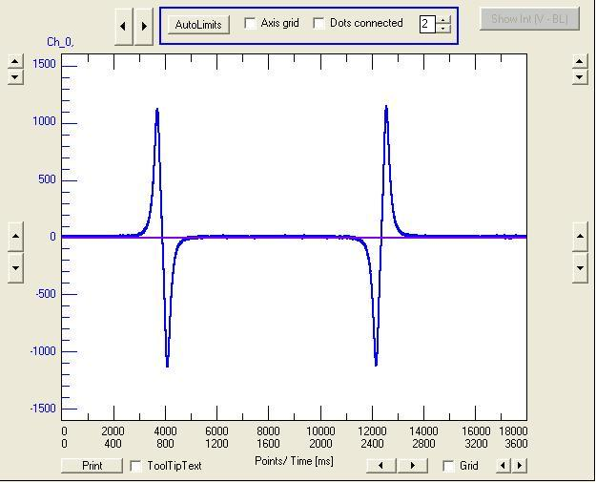
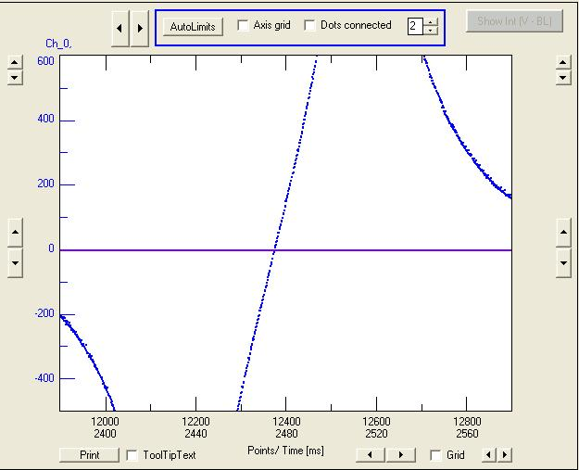
Velocity measurement
Coils detect passing magnet due to induction:
Aluminium, 2 solenoids
$$ε=\frac{dφ}{dz}v$$

Slide 36
Theoretical change of velocity
$$v\left(t\right)=τg\left(1−e^{−\frac{t}{τ}}\right)$$
Supstitution:
$$τ=\frac{2πρ_{m}m_{mag}}{σΔρk}$$

Slide 37
Cooling - change of the magnetization of the magnet
$$v∝\frac{1}{M^{2}} \\ \frac{v_{warm}}{v_{cold}}=\frac{M_{c}^{2}}{M_{w}^{2}} \\ M_{c}=M_{w}\sqrt{\frac{v_{warm}}{v_{cold}}}$$
For our case:
$$M_{c}=1.13M_{w}$$

Slide 38
Heating of cooled tube

Slide 39
Cooling - change of tube dimesion
Change of radius of the pipe
$$A=A_{0}\left(1+2αΔT\right) \\ \frac{ρ_{1}}{ρ_{0}}=\sqrt{1+2αΔT}$$
$\frac{ρ1}{ρ0}=\sqrt{1+2∙16.6∙{10}^{−6}K^{−1}∙216K}=1.00357919468$
$$α_{cu}=16.6∙{10}^{−6}K^{−1}$$

Slide 40
Tube with slit vs tube without slit
 | Tube | Tube with slit | Without tube
Time | $$\left(2.61±0.05\right)s$$ | $$\left(1.68±0.19\right)s$$ | $$0.45 s$$
1 m long aluminium tube
$$ρ=1.25 cm ;Δρ=2 mm$$
Magnet properties
Cylindrical magnet
$2r=1 cm;h=1cm$

Slide 41
Superconductor

Slide 42
Skin effect
$J=J_{s}e^{− \frac{d}{δ}}$

