Slide 1
Problem 13. Rotating saddle
Reporter: Domagoj Pluščec

Slide 2
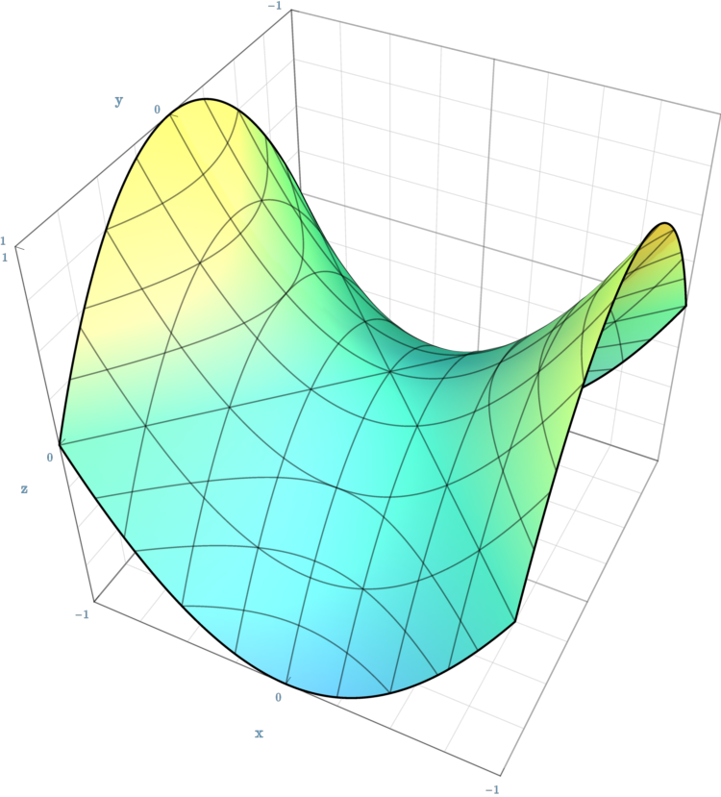
Problem 13
„A ball is placed in the middle of a rotating saddle. Investigate its dynamics and explain the conditions under which the ball does not fall off the saddle.”
Saddle - hyperbolic paraboloid
$$z=\frac{x^{2}}{a}−\frac{y^{2}}{b}, a,b∈ℛ^{+}$$

Slide 3
Motion example

Slide 4
Outline
Theoretical modeling
Analogy to Paul trap model
Stability conditions
Parameters
Experimental aproach
Saddle construction
Ball releasing method
Ball properties
Determing rotational frequency
Recording balls motion
Results
Ball trajectory
Dependence of stabilization time on frequency
Friction influence on stabilization

Slide 5
Theoretical modeling
Paul trap analogy (R.I. Thompson, 2002)
Forces from rotational frame reference on the ball
$m\vec{a}=−m\vec{Ω}×\left(\vec{Ω}×\vec{r}\right)−2m\vec{Ω}×\vec{v}−\vec{∇}U$(*)
Electric field potential
Gravitational potential
Alternating of electric potential
Rotation of the saddle
Centrifugal force
Coriolis force
Force caused by gravitational potential
m – ball mass
$Ω$ – saddle angular velocity
r – ball distance from center of the saddle
(*) as analogy we are neglecting friction, because it is difficult to solve analyticaly and we are going to disscus friction indepentendtly

Slide 6
Gravitational potential of the saddle
$$U=mgz=mg\left(\frac{x^{2}}{a}−\frac{y^{2}}{b}\right)$$
$$U=\frac{m}{2}\left({ω_{1}}^{2}x^{2}−{ω_{2}}^{2}y^{2}\right)$$
Supstitution:
$$ω_{1}^{2}=\frac{2g}{a}$$
$$ω_{2}^{2}=\frac{2g}{b}$$

Slide 7
Assumptions:
If ball is stabilized it will be near the center of the saddle
Close to the center of the saddle we neglact the change in z direction ($\dot{y},\dot{x}>\dot{z})$
Using assumptions and projecting on (x,y) plane we obtain:
$$\ddot{x}−2Ω\dot{y}+\left({ω_{1}}^{2}−Ω^{2}\right)x=0 \\ \ddot{y}+2Ω\dot{x}−\left({ω_{2}}^{2}+Ω^{2}\right)y=0$$
For equations ansatz is in the form of $x=c_{1}e^{−iλt}$, $y=c_{2}e^{−iλt}$
All solutions for $λ$ must be real for keeping ball stabilized because then solution of the equations is periodic function (Euler formula $e^{ix}=cosx+isinx)$
For lambda we obtain:
$$λ_{1,2}^{2}=\frac{ω_{2}^{2}−ω_{1}^{2}−2Ω^{2}}{2}±\frac{1}{2}\sqrt{{\left(ω_{1}^{2}+ω_{2}^{2}\right)}^{2}+8Ω^{2}(ω_{1}^{2}−ω_{2}^{2})}$$
>0
>0

Slide 8
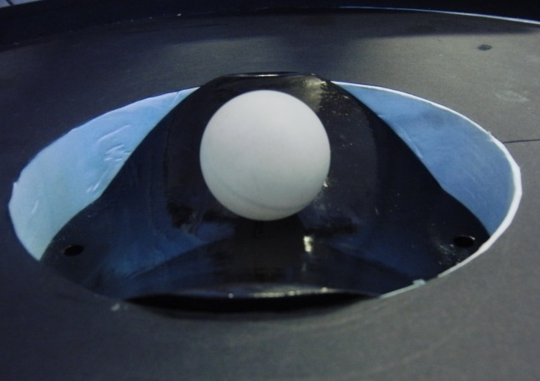
Stability conditions
$Ω=0 −point (0,0)$
Unstable equilibrium $\frac{∂U}{∂x}=\frac{∂U}{∂y}=0$
In x direction stable equilibrium $\frac{∂^{2}U}{∂x^{2}}>0$
In y direction unstable equilibrium $\frac{∂^{2}U}{∂y^{2}}<0$
$Ω>0$
${ω_{2}}^{2}{≤ω_{1}}^{2}≤Ω^{2}$
or
${ω_{1}}^{2}{≤ω_{2}}^{2}≤{3ω_{1}}^{2}$(*) and ${ω_{1}}^{2}≤Ω^{2}≤ \frac{{\left({ω_{1}}^{2}+{ω_{2}}^{2}\right)}^{2}}{{{8(ω}_{1}}^{2}−{ω_{2}}^{2})}$
Supstitution:
$$ω_{1}^{2}=\frac{2g}{a}$$
$$ω_{2}^{2}=\frac{2g}{b}$$
(*)obtained by investigating saddle curvature properties - Oleg N. Kirillov, 2010

Slide 9
Parameters
Saddle shape
Rotating frequency
Friction impact
Moment of inertia of the ball (influence of the rotation of the ball)

Slide 10
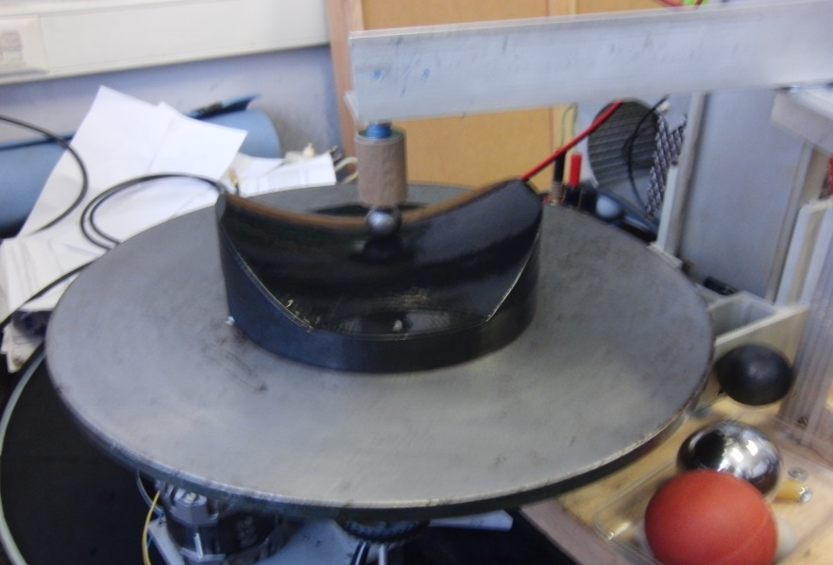
Experiment
Saddle construction
Saddle made by CNC miling machine
Saddle $z=\frac{x^{2}}{21}−\frac{y^{2}}{21} \left[cm\right]$, saddle radius 7.5 cm
Ball releasing
Metal balls
Released by a coil (interuption of current caused ball drop)
Balls with radius 8.5 mm and 12.5 mm
Plastic and rubber balls
Released by hand
Balls with radius: 13 mm, 20 mm, 37.5 mm

Slide 11
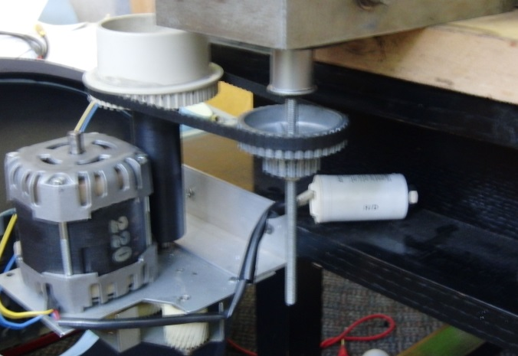
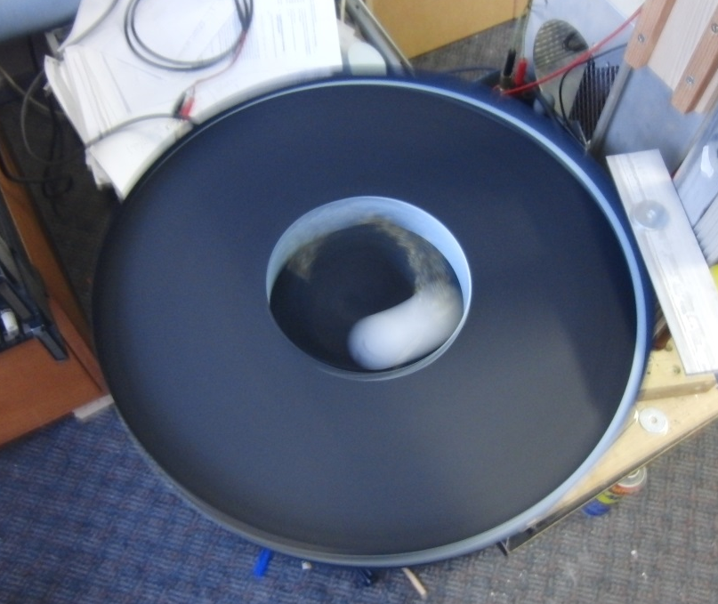
Experiment
Determing frequency of saddle rotation
Determined with stroboscope
Frequency of rotation of constructed turntable in range from 1 Hz to 5.5 Hz
Determing ball motion
Motion recorded with high speed camera (120 fps)
Tracked in program for video analysis ImageJ
Center and axis of symetry of the saddle were determined by marks on the saddle

Slide 12
$$f=1.71 Hz$$ Metal ball
$r=$8.5 mm

Slide 13
Ball trajectory - labaratory frame reference

Slide 14
Ball trajectory - rotational frame reference

Slide 15
Dependence of stabilization time on saddle frequency
1.54 Hz

Slide 16
Friction impact – theoretical analysis
We assume that when the ball is moving on the saddle that it is rolling
For ball near the center we neglect it’s movement in z direction ($\dot{y},\dot{x}>\dot{z})$
We aproximated friction force in forme of $\vec{F}=μmg\frac{\vec{v}}{|v|}$ where $μ$ is coefficient of rolling friction
$μ\sim 0.001$*
We solved numericaly equations from our model and numericaly added friction force and observed how it influences our model
*Physics and Chemistry of Interfaces; Hans-Jürgen Butt, Karlheinz Graf, 2003

Slide 17
$$μ=0;f=1.6 Hz$$
$$picture dimensions 0.9x0.9 cm$$
$$μ=0.005;f=1.6 Hz \\ picture dimensions 15x15 cm$$

Slide 18
Conclusion
We constructed a saddle and experimental setup for rotation of a saddle and system for releasing metal balls
Simple theoretical model for point mass
Stabilization conditions:
${ω_{2}}^{2}{≤ω_{1}}^{2}≤Ω^{2}$ or
${ω_{1}}^{2}{≤ω_{2}}^{2}≤{3ω_{1}}^{2}$ and ${ω_{1}}^{2}≤Ω^{2}≤ \frac{{\left({ω_{1}}^{2}+{ω_{2}}^{2}\right)}^{2}}{{{8(ω}_{1}}^{2}−{ω_{2}}^{2})}$
Assumption:
$\dot{y},\dot{x}>\dot{z}$ for the ball near the center of the saddle
We discussed friction impact on ball stability
Friction will always destabilises ball on the rotating saddle

Slide 19
Literatura
Johan Nilsson; Trapping massless Dirac particles in a rotating saddle; Phys. Rev. Lett. 111, 100403 (2013)
R.I.Thompson, T.J. Harmon, M.G. Ball; The rotating saddle trap: a mechanical analogy to RF-electric-quadrupole ion trapping?; Can. J. Phys. 80, 1433-1448 (2002)
Oleg N. Kirillov, Brouwer’s problem on a heavy particle in a rotating vessel: wave propagation, ion traps, and rotor dynamics; Physics Letters A 375, 1653-1660 (2011)
Physics and Chemistry of Interfaces. Hans-Jürgen Butt, Karlheinz Graf, Michael Kappl, 2003

Slide 20
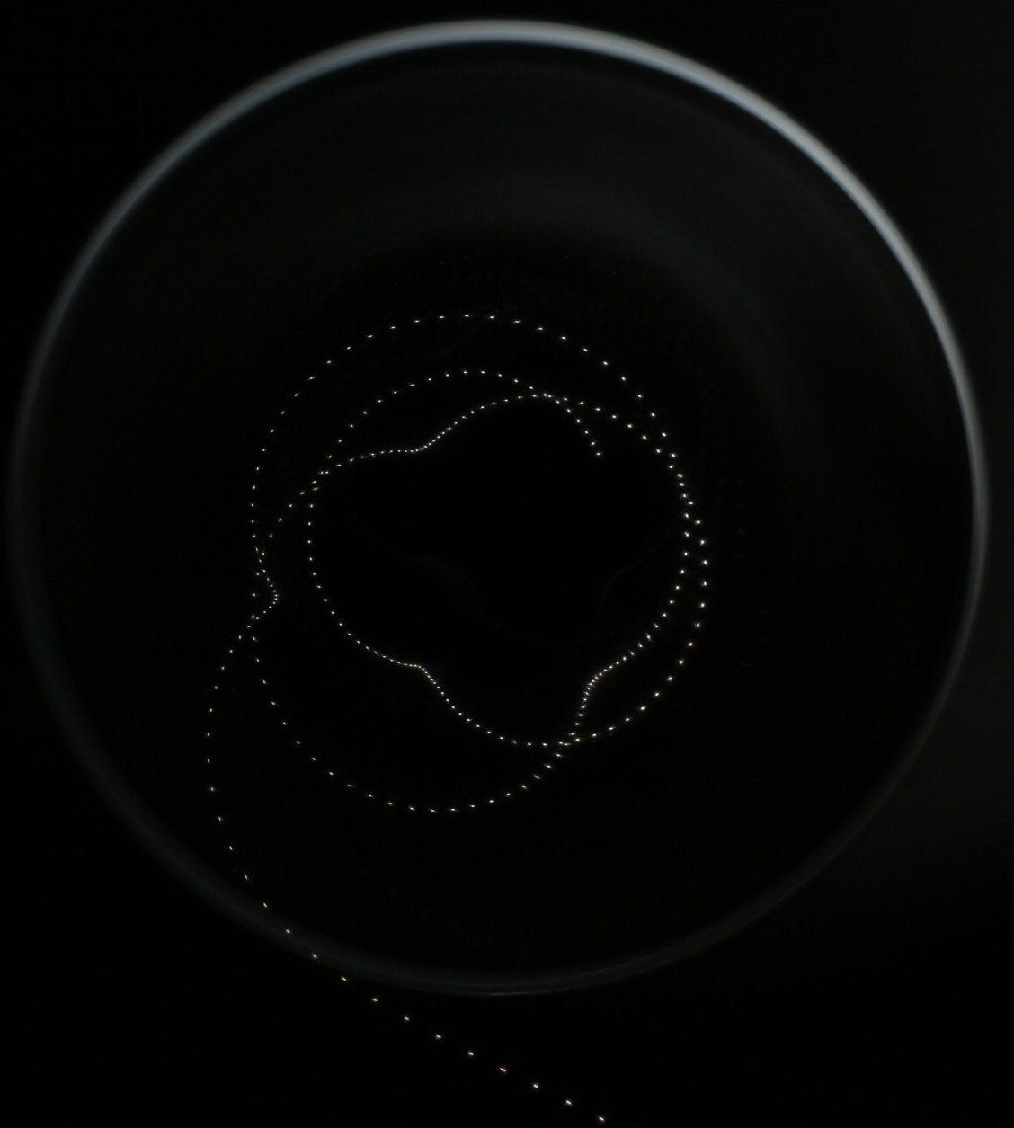
Stroboscopic picture of the balls motion

Slide 21
Thank you
IYPT 2014 CroatiaN team
Reporter: Domagoj Pluščec

Slide 22
Ball trajectory – rotational frame reference
$$μ=0.005;f=1.71 Hz$$

Slide 23
Ball trajectory - labaratory frame reference
$$μ=0.005;f=1.71 Hz$$

Slide 24
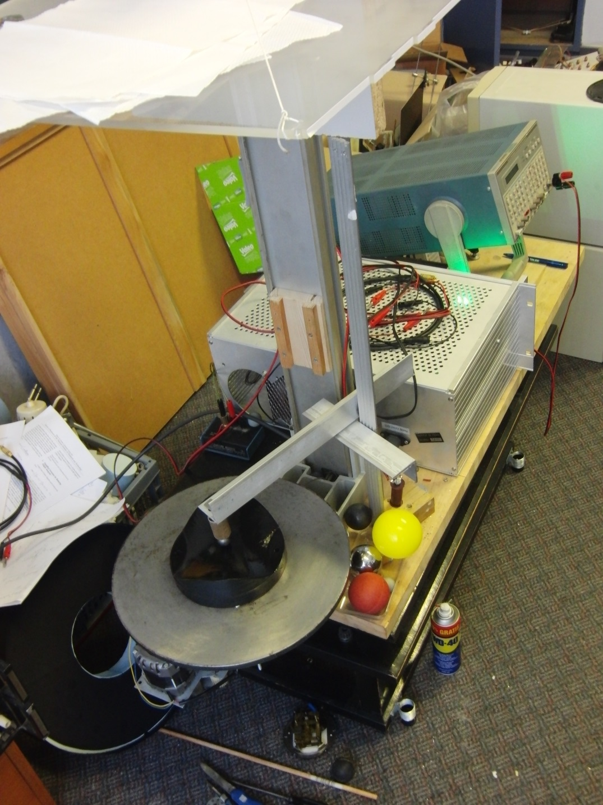

Slide 25
$$\ddot{x}−2Ω\dot{y}+\left({ω_{1}}^{2}−Ω^{2}\right)x=0 \\ \ddot{y}+2Ω\dot{x}−\left({ω_{2}}^{2}+Ω^{2}\right)y=0$$
$$−λ^{2}c_{1}+2c_{2}λΩi+\left({ω_{1}}^{2}−Ω^{2}\right)c_{2}=0 \\ λ^{2}c_{2}+2c_{1}λΩi+\left({ω_{2}}^{2}+Ω^{2}\right)c_{2}=0$$
Det=0
$$λ^{4}+\left(ω_{2}^{2} −ω_{1}^{2}−2Ω^{2}\right)λ^{2}−\left(ω_{1}^{2}−Ω^{2}\right)\left(ω_{2}^{2}+Ω^{2}\right)=0$$
$$λ_{1,2}^{2}=\frac{ω_{2}^{2}−ω_{1}^{2}−2Ω^{2}}{2}±\frac{1}{2}\sqrt{{\left(ω_{1}^{2}+ω_{2}^{2}\right)}^{2}+8Ω^{2}(ω_{1}^{2}−ω_{2}^{2})}$$

