Slide 1
14 . Rubber Motor
‘A twisted rubber band stores energy and can be used to power a model aircraft for example. Investigate the properties of such an energy source and how its power output changes with time.’
IYPT 2014
Team Croatia
Reporter: Ilona Benko

Slide 2
Properties of rubber materials
elastomer → viscoelasticity
Mullins’ effect
  hysteresis while stretching, entire energy isn’t restored, waste in a form of thermal energy
structure→ coiled molecular chains, polymers (covalent bonds) whose entropy decreases when rubber band is being stretched*
  unstretched rubber band is in the state of maximum entropy
  * I.M. Ward, J. Sweeney: An Introduction to the Machanical Properties of Solid Polymers

Slide 3
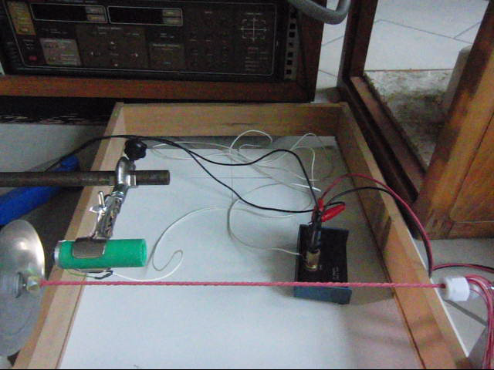
Observation of how does motor work

Slide 4
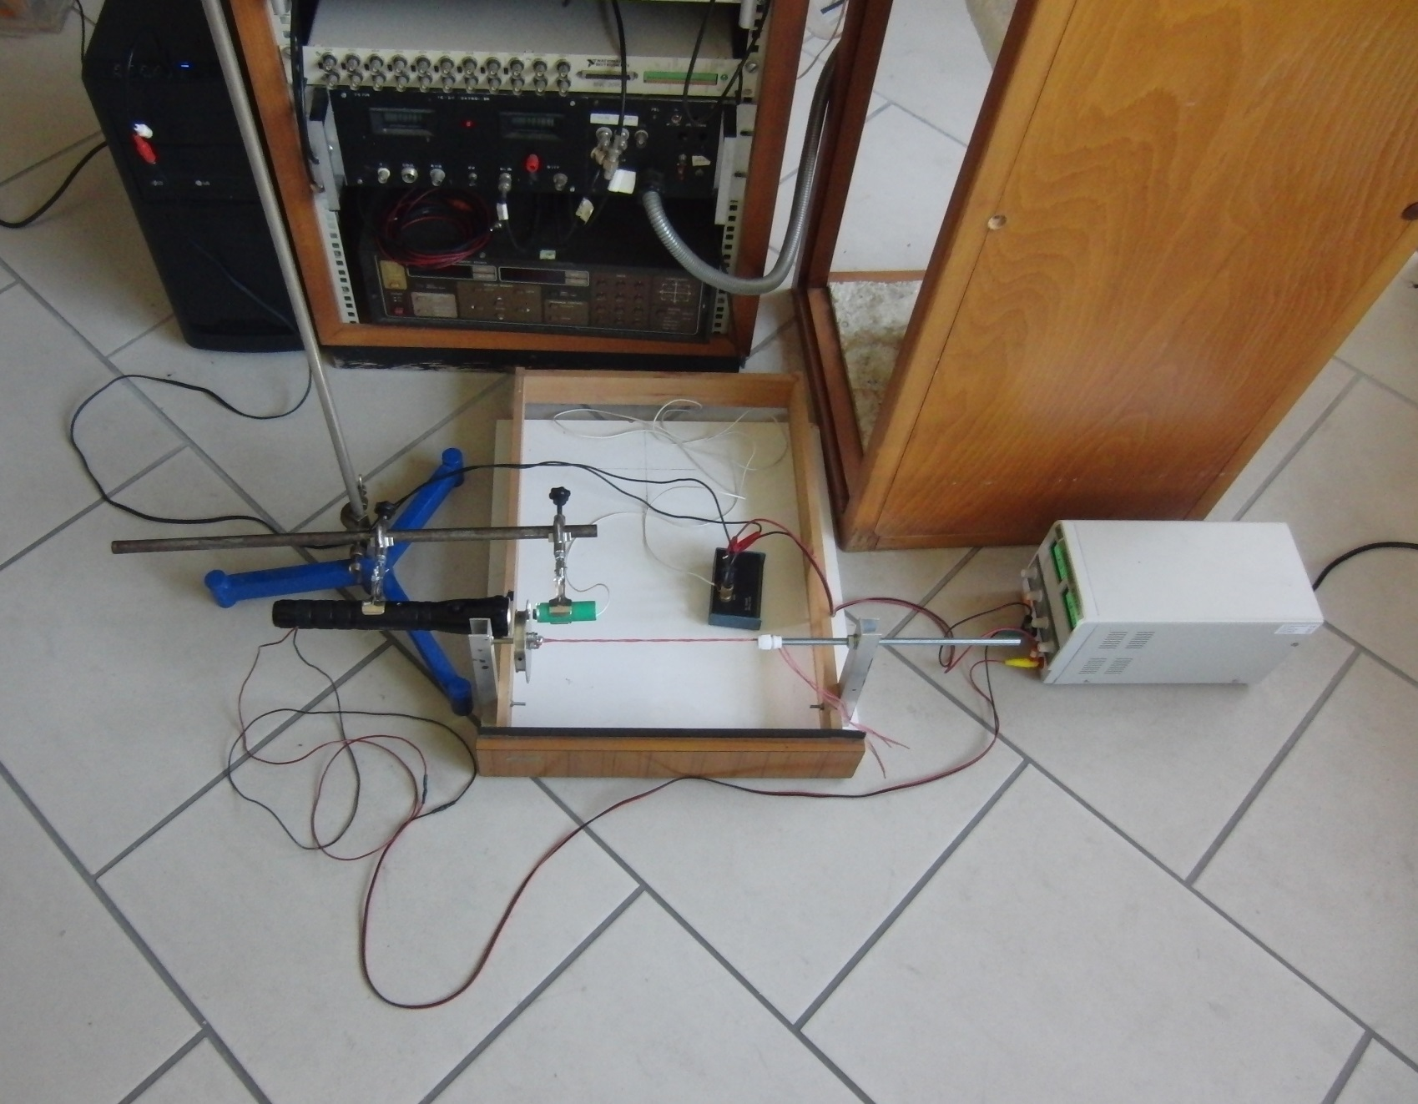
Experimental setup
sound card
photoresistor
resistor
lamp
ball bearing with gaps
generator
stand
coiled rubber threads

Slide 5
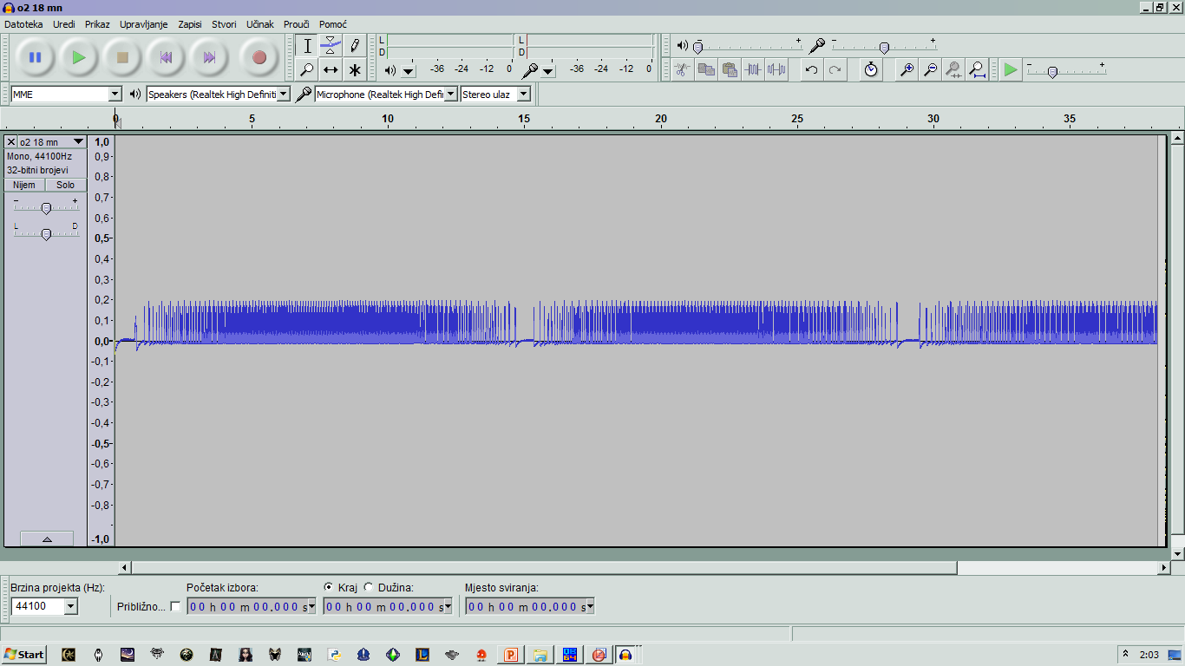
Processing measurements
coiling and uncoiling of rubber band recorded in Audacity (.wav)
than reformatted into
.txt files to continue
further processing in
our programs we made for analysis
after processing in those programs, change of angle in time is known and angular velocity, kinetic energy, force and power output can be calculated

Slide 6
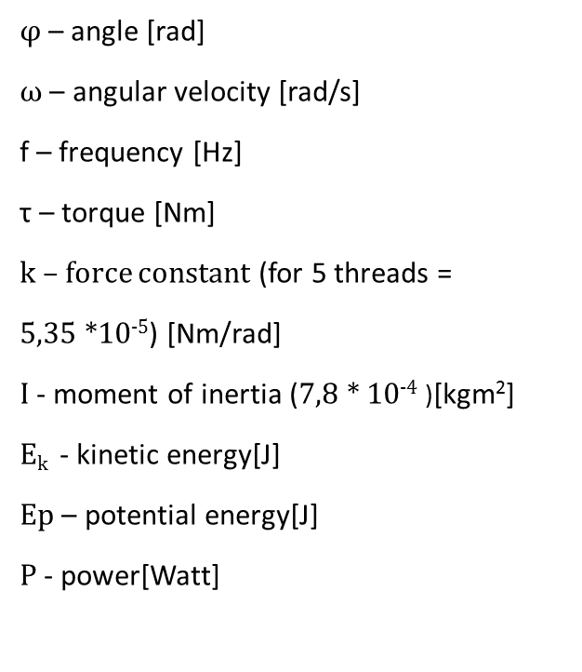

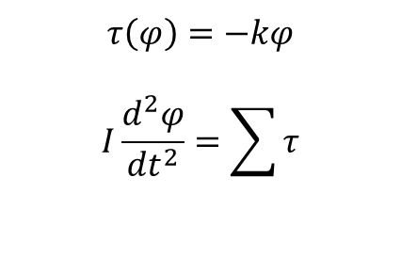
Mathematical model of osilaroty motion
$$τ\left(φ\right)=−kφ$$
$$I\frac{d^{2}φ}{dt^{2}}=\sum{τ}$$
φ – angle [rad]
ω – angular velocity [rad/s]
f – frequency [Hz]
τ – torque [Nm]
k – force constant (for 5 threads =
5,35 *10⁻⁵) [Nm/rad]
I - moment of inertia (7,8 * 10⁻⁴ )[kgm²]
E_{k} - kinetic energy[J]
$Ep$ – potential energy[J]
P - power[Watt]
Without friction:
$$I\frac{d^{2}φ}{dt^{2}}+kφ=0$$
General solution of this equasion for mechanical oscillator is:
$φ\left(t\right)=φ_{0}\cos\left(ω_{0}t−θ\right)$
$θ$ is starting phase, and $ω_{0}=\sqrt{\frac{k}{I}}=2πf$

Slide 7
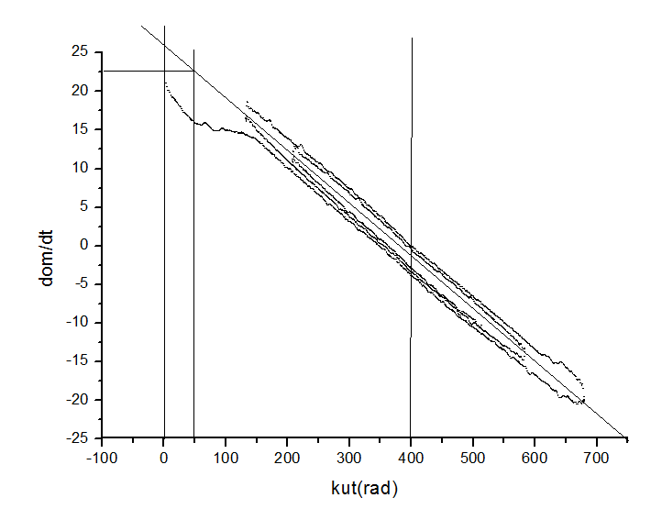
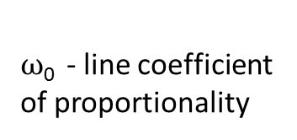

Graph: first derivation of angular velocity/time vs angle in radians
Measuring $ω$₀
$ω$₀ - line coefficient of proportionality

Slide 8
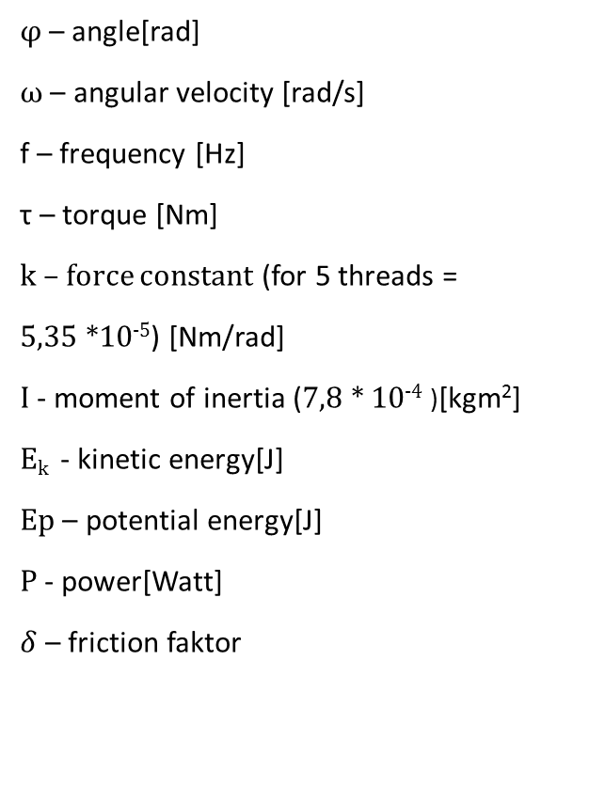
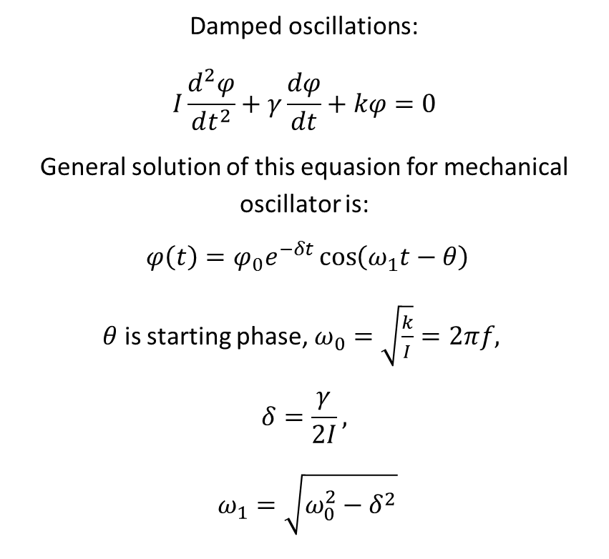
Mathematical model of oscilaroty motion
Damped oscillations:
$$I\frac{d^{2}φ}{dt^{2}}+γ\frac{dφ}{dt}+kφ=0$$
General solution of this equasion for mechanical oscillator is:
$φ\left(t\right)=φ_{0}e^{−δt}\cos\left(ω_{1}t−θ\right)$
$θ$ is starting phase, $ω_{0}=\sqrt{\frac{k}{I}}=2πf,$
$$δ=\frac{γ}{2I},$$
$$ω_{1}=\sqrt{ω_{0}^{2}−δ^{2}}$$
φ – angle[rad]
ω – angular velocity [rad/s]
f – frequency [Hz]
τ – torque [Nm]
k – force constant (for 5 threads =
5,35 *10⁻⁵) [Nm/rad]
I - moment of inertia (7,8 * 10⁻⁴ )[kgm²]
E_{k} - kinetic energy[J]
$Ep$ – potential energy[J]
P - power[Watt]
$δ$ – friction faktor

Slide 9
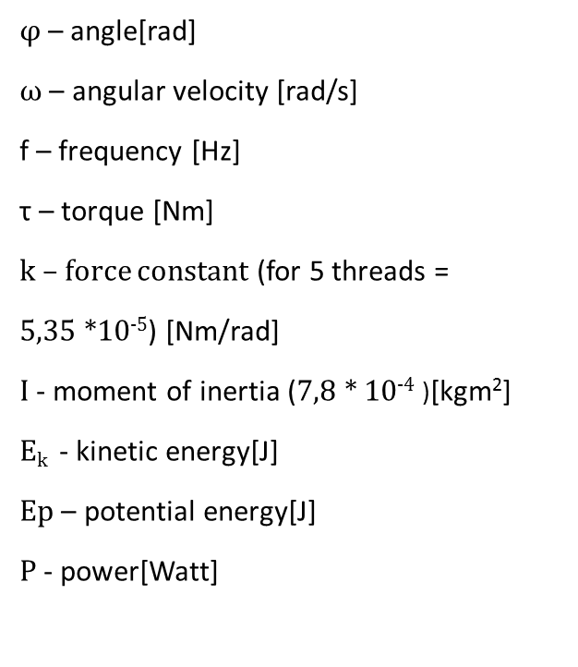
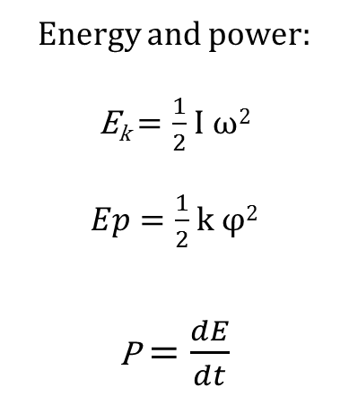
Mathematical model of osilaroty motion
φ – angle[rad]
ω – angular velocity [rad/s]
f – frequency [Hz]
τ – torque [Nm]
k – force constant (for 5 threads =
5,35 *10⁻⁵) [Nm/rad]
I - moment of inertia (7,8 * 10⁻⁴ )[kgm²]
E_{k} - kinetic energy[J]
$Ep$ – potential energy[J]
P - power[Watt]
Energy and power:
E_{k}$=\frac{1}{2}$ I ω²
$Ep=\frac{1}{2}$ k φ²
P$=\frac{dE}{dt}$

Slide 10
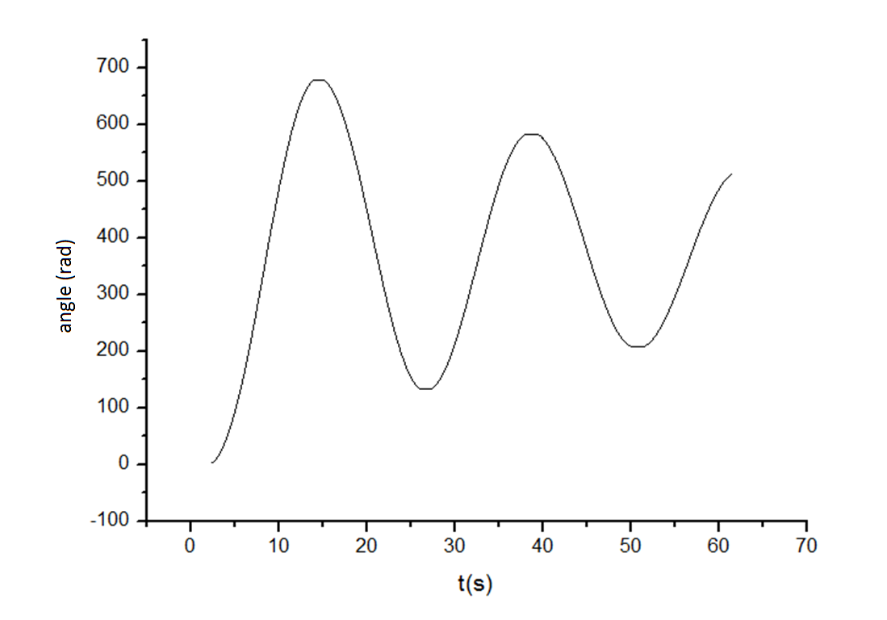
Result analysis
bundle of 5 rubber threads
bundle length: 16 cm
nubmer of coils: 61,5
Graph 1: angle vs time

Slide 11
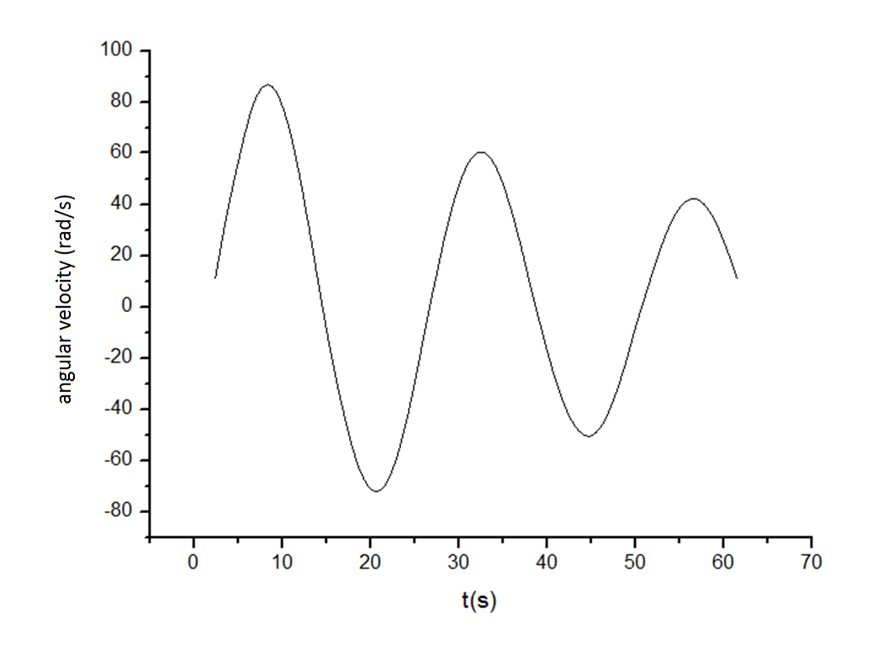
Result analysis
bundle of 5 rubber threads
bundle length: 16 cm
nubmer of coils: 61,5
Graph 2: anglular velocity vs time

Slide 12
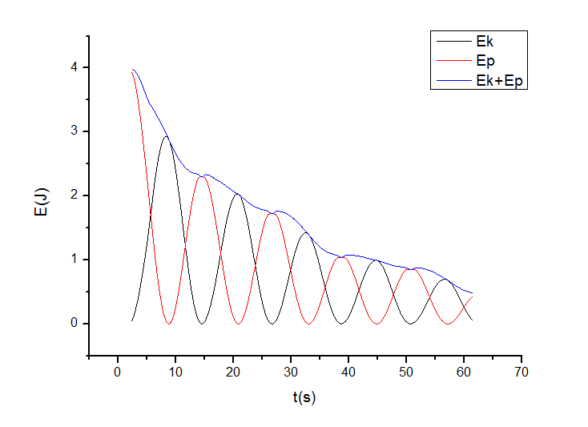
Result analysis
bundle of 5 rubber threads
bundle length: 16 cm
nubmer of coils: 61,5
Graph 3: energy vs time

Slide 13
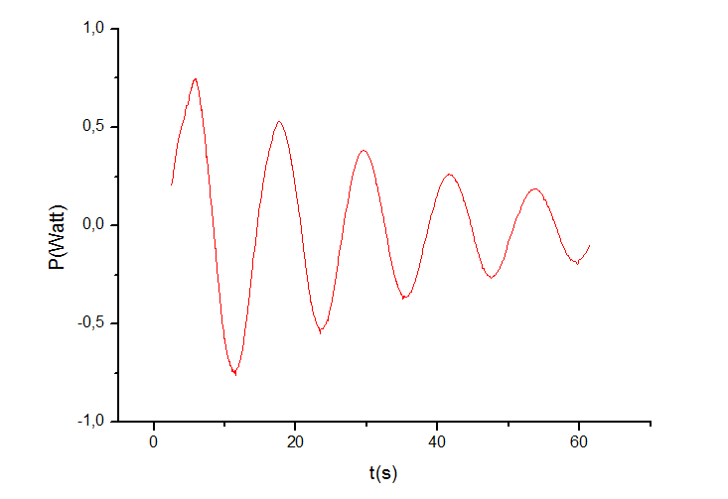
Result analysis
bundle of 5 rubber threads
bundle length: 16 cm
nubmer of coils: 61,5
Graph 4: power vs time

Slide 14
Analysis of different number of coils
l=18 cm

Slide 15
Analysis of different number of coils
l=18 cm

Slide 16
Analysis of different bundle lengths

Slide 17
Analysis of different bundle lengths

Slide 18
Analysis of different number of threads

Slide 19
Analysis of different number of threads

Slide 20
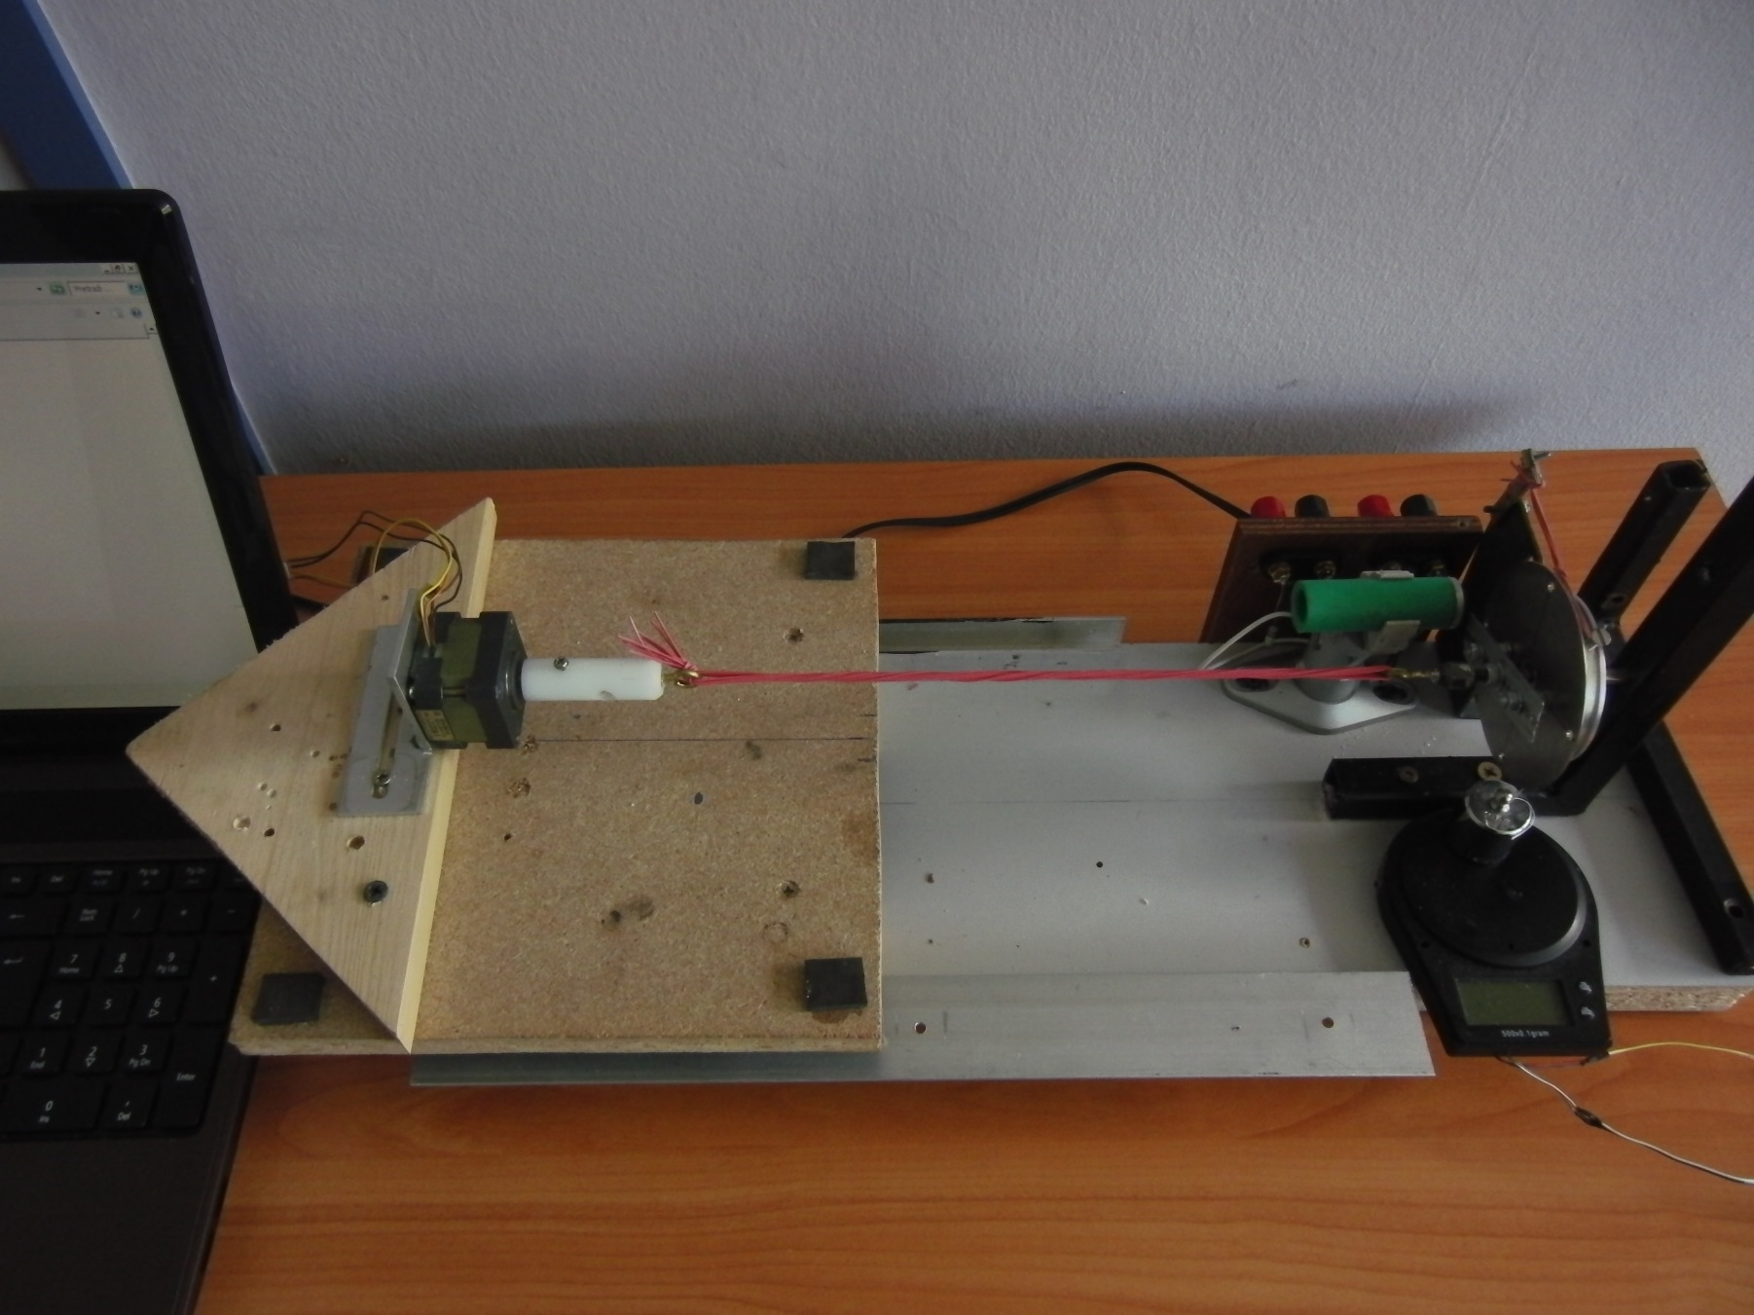
New setup and measuring torque

Slide 21
Analysis of different number of threads

Slide 22
Conclusion
energy which moves the motor comes from kinetic and potential energy stored in molecules of which rubber material is consisted
while in motion, damping slows and finally stops motor
hysteresis → energy loss happens because of heating and friction in oscillatory motion
more power can be gained by:
  using bundle made of maximum number of rubber threads
  using longer bundle
  increasing rubber tension or number of coils
when tension is increased, more energy is gained in exact time interval
hysteresis also rapidly increases as we gain more energy from motor

Slide 23
Literature list
Hysteresis and Rubber Bands (madphysics.com)
Elastomers and entropic springs (Aparna Baskaran, Syracuse University)
Stretching a Rubber Band (schoolphysics.co.uk)
I. M. Ward and J. Sweeney. An introduction to the mechanical properties of solid polymers (Wiley, 2005)
A. N. Gent. Rubber Elasticity: Basic Concepts and Behavior; Science and Technology of Rubber (Elsevier, 2005)
L. G. McAneny. Rubber band powered motor for model airplane
G. Savarino and M. R. Fisch. A general physics laboratory investigation of the thermodynamics of a rubber band
J. Pellicer, J. A. Manzanares, J. Zúniga, and P. Utrillas. Thermodynamics of rubber elasticity. J. Chem
C. M. Roland. The Mullins effect in crosslinked rubber

