Slide 1
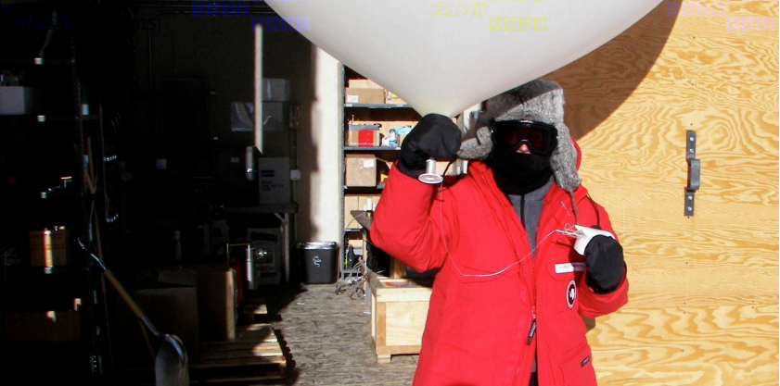
Problem No. 12
1
Cold balloon
Ábel Beregi, Team Hungary

Slide 2
The problem
2
As air escapes from an inflated rubber balloon, its surface becomes cooler to the touch.
Investigate the parameters that affect this cooling. What is the temperature of various
parts of the balloon as a function of relevant parameters?

Slide 3
Outline
3
Setup
Theoretical investigation
Part one: Adiabatic cooling of air
Part two: Cooling of the rubber, because change of entropy
Experiment results
Thermal images
Heat distribution
Isotherms on the surface of the baloon
Summary
Sources

Slide 4
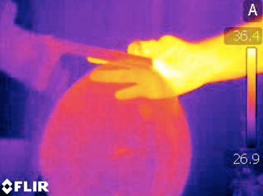
Setup
4
Surface temperature ➔ IR Camera
Inside temperature ➔ Thermistor
Pressure ➔ Pressure sensor

Slide 5
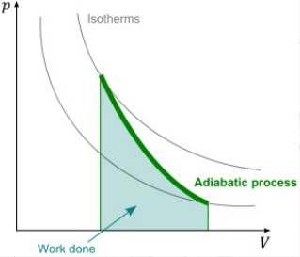
Adiabatic cooling of air
5
Pressure is decreasing
Volume is increasing
There is no time for heat transfer

Slide 6
6

Slide 7
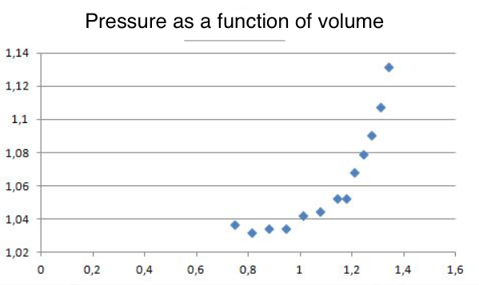
Theorem part one: adiabatic cooling of air
7
Pressure (Bar)
Volume (Liter)

Slide 8
Reasons for the difference
8
The process is approximately adiabatic
The rubber heats up the air

Slide 9
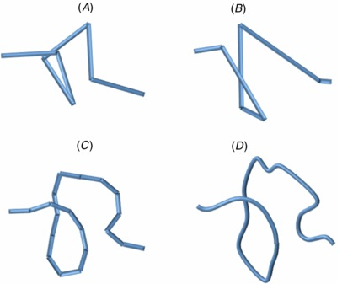
Theorem part 2: change of entropy
9
Using the freely-jointed chain model

Slide 10
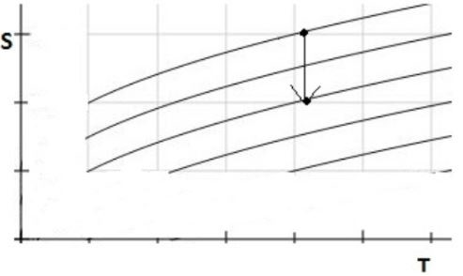
Slow (isothermal) stretching
10
(1)
(2)
(3)
(4)
(5)
(6)

Slide 11
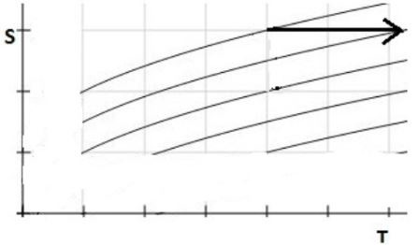
11
Fast (adiabatic) stretching
(1)
(2)
(3)
(4)
(5)
(6)
[3]
*

Slide 12
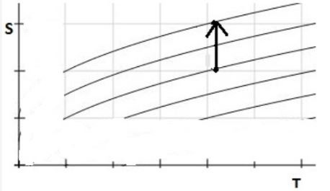
12
Slow (isothermal) deflation

Slide 13
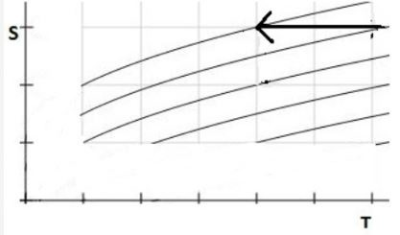
13
Main point: fast (adiabatic) deflation

Slide 14
14
Experiments
Let`s see the results of the theoretical investigation in our experiments

Slide 15
Thermal image
15

Slide 16
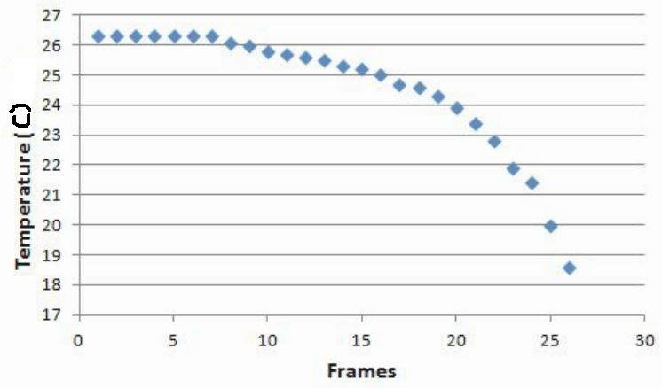
16
Temperature as a function of time

Slide 17
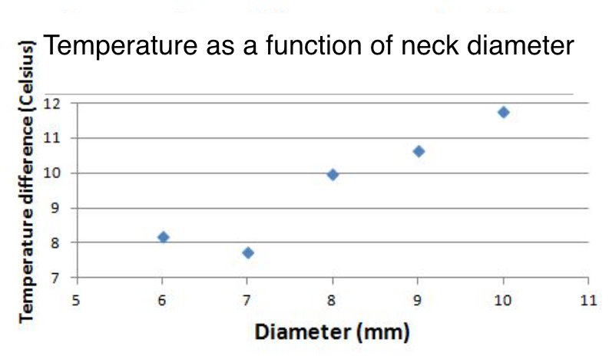
17
The theoretical maximum of cooling is 15 degrees of Celsius *
*Juhasz A., Tasnadi P: Erdekes anyagok anyagi erdekessegek, Akademiai kiado, Budapest 1992

Slide 18
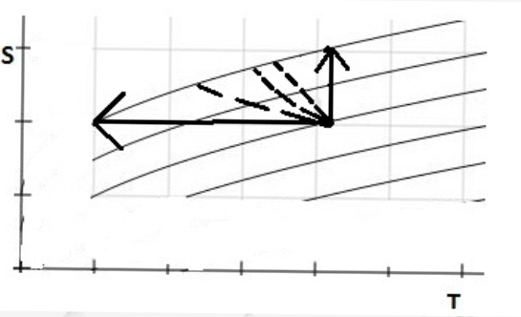
18
our results
isotherm process
adiabatic process

Slide 19
Heat distribution
19

Slide 20
Heat distribution
20

Slide 21
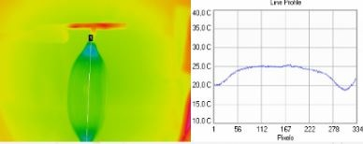
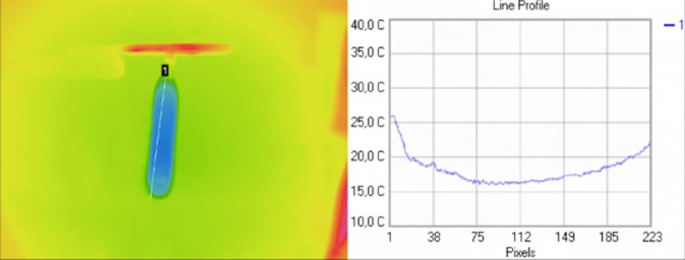
21

Slide 22
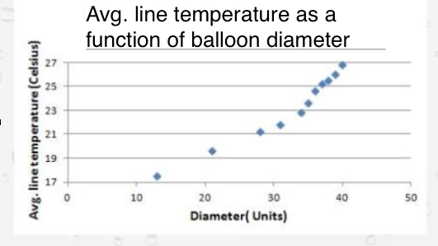
Average line temperature as a function of balloon diameter
22
d

Slide 23
Isotherms
23

Slide 24
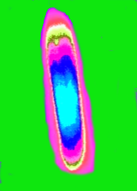
Isotherms
24

Slide 25
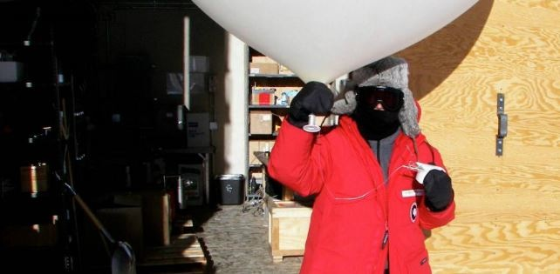
Conclusions
25
Rubber has a really interesting material behavior
The cooling has to be investigated not just in space but in time too
Unnecessary to use a big balloon
The cooling was mostly because of change of entropy

Slide 26
Sources
26
Kathryn R. Williams: The Thermodynamic Properties of Elastomers: Equation of State and Molecular Structure Nash, L. K. J. Chem. Educ., 1979, 56 , 363.
Juhasz Andras, Tasnadi Peter: Erdekes anyagok anyagi erdekessegek, Akademiai Kiado, Budapest 1992
http://inside.mines.edu/~dwu/classes/CH351/labs/elastomer/Wet%20Lab%204/Wetlab4.pdf

Slide 27
27
Thank you for your attention!

