Slide 1
Ball Sound
4
Jakub Chudík

Slide 2
Task
When two hard steel balls, or similar, are brought gently into contact with each other, an unusual ‘chirping’ sound may be produced.
Investigate and explain the nature of the sound.

Slide 3
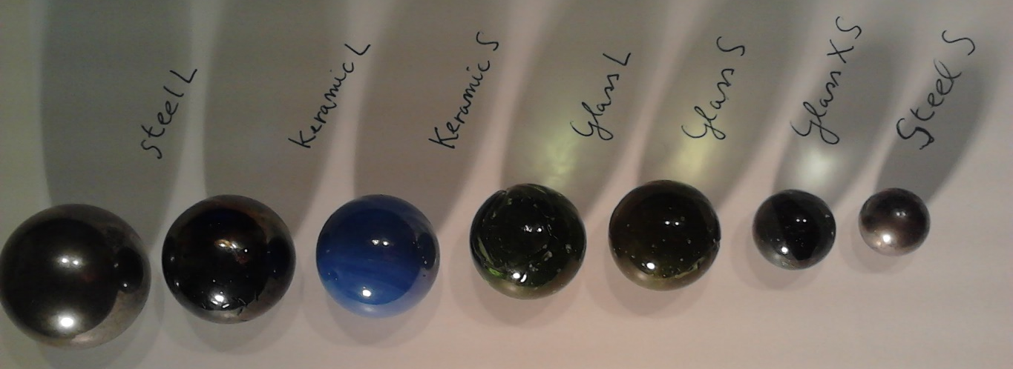

Different Balls
Collisions between different
balls and one large steel ball
Chosen for the longest duration and
the lowest prevalent frequency

Slide 4
In our presentation
Nature of the sound
Examine the sound
Recreate the sound

Slide 5
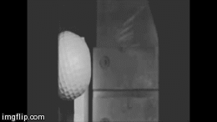
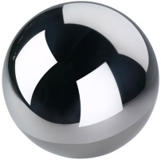
Possible sources
Vibration of the balls
Impulsive translational acceleration

Slide 6
Vibrations for steel balls of 5cm diam.
Mode number | Natural frequency (kHz)
1 | 51.8
2 | 68.3
3 | 77
4 | 93.1
5 | 97
6 | 98.5
7 | 118.7
8 | 128.2
9 | 136.7
10 | 138.3
Lowest frequency
is 51,8 kHz
Vibrations of the balls certainly
do not contribute to audible sound!
Lowest frequency
for our
balls is 64,75 kHz
Limit of human ear
is 18-20 kHz
K. Mehraby et al. „Impact noise radiated by collision of two spheres“,
Journal of Mechanical Science and Technology 25 (7) (2011)

Slide 7
Impulsive translational acceleration
One oscillating sphere
Two colliding spheres
K. Mehraby et al. „Impact noise radiated by collision of two spheres“,
Journal of Mechanical Science and Technology 25 (7) (2011)

Slide 8
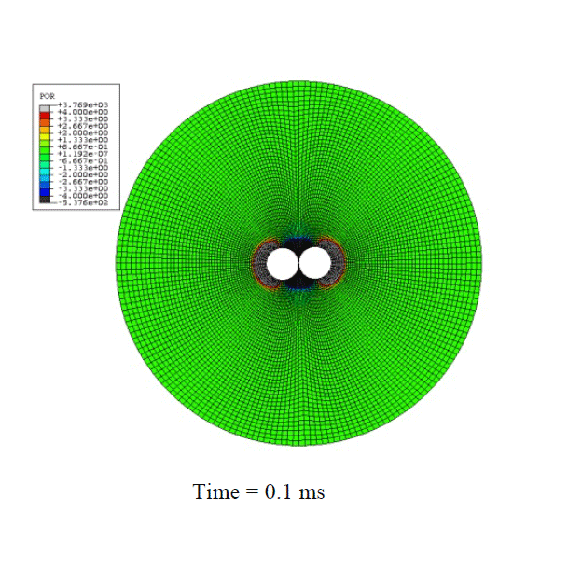
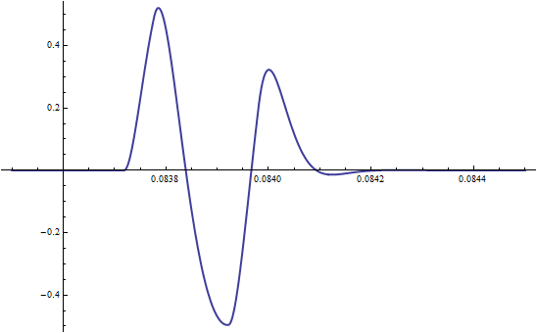
Impulsive translational acceleration
One collision
Two colliding spheres
K. Mehraby et al. „Impact noise radiated by collision of two spheres“,
Journal of Mechanical Science and Technology 25 (7) (2011)

Slide 9

Nature of the sound
Examine the sound
Recreate the sound

Slide 10
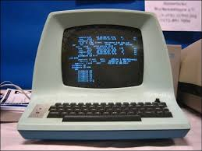
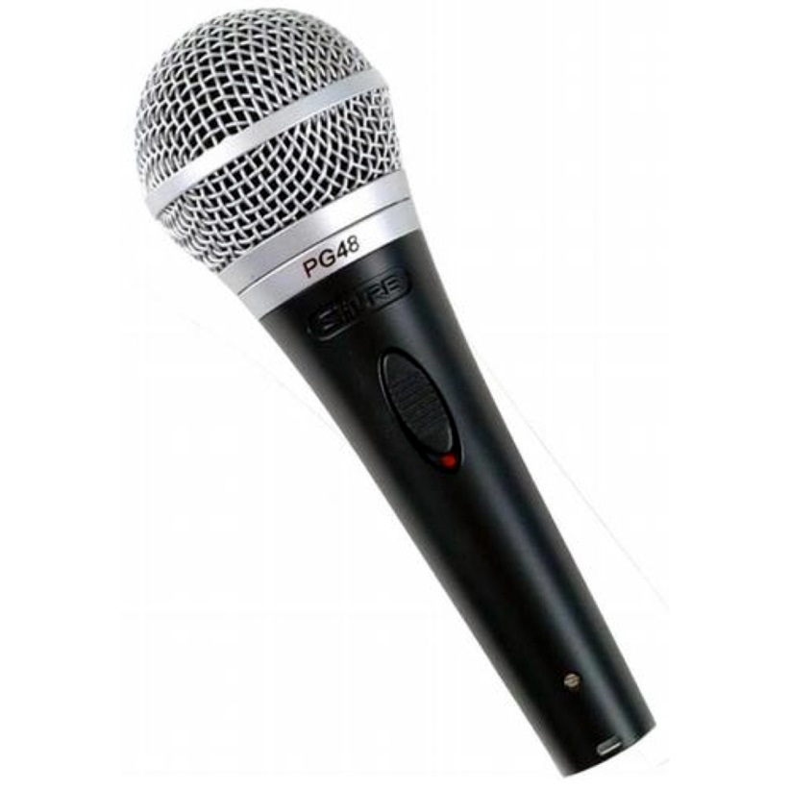
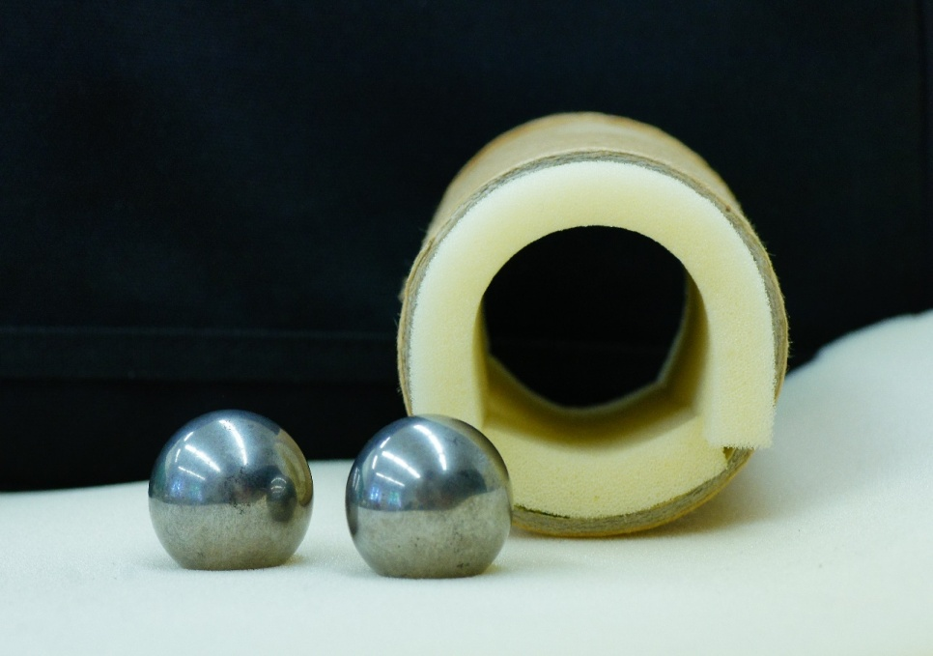
Our apparatus

Slide 11
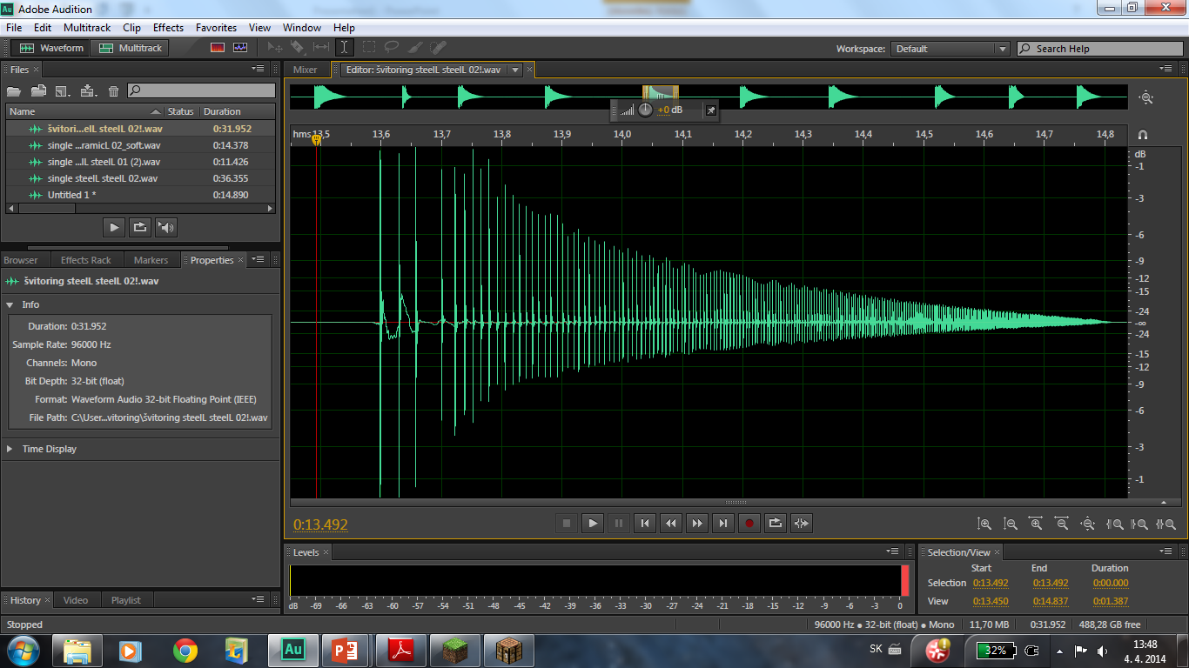
Sound analysis
Whole sound made
of individual collisions

Slide 12
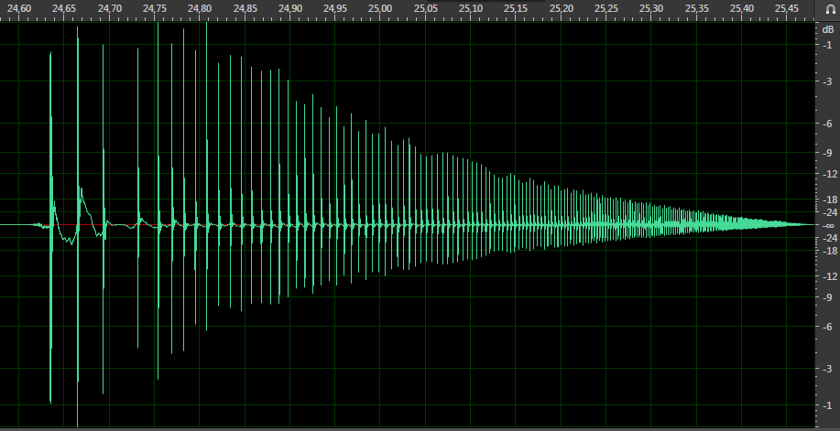
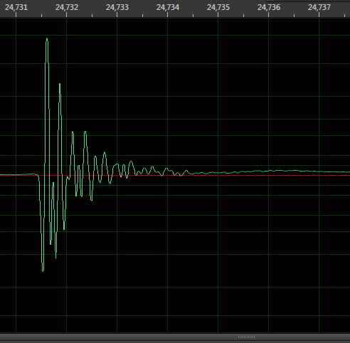
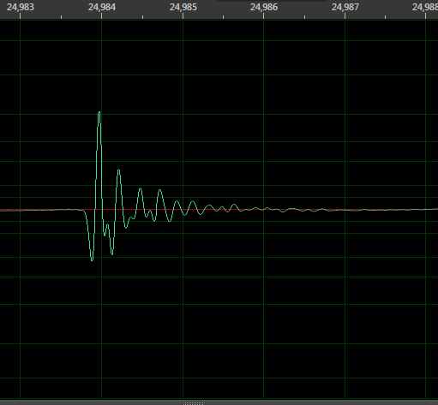
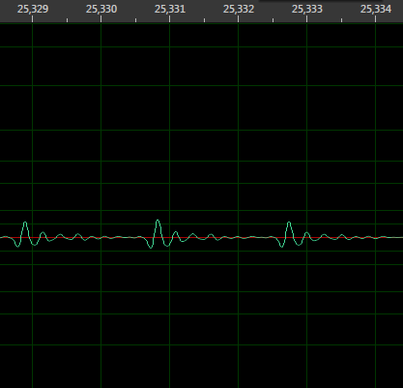
Sound of individual collisions

Slide 13
Sound of individual collisions
Decreasing amplitude
Individual collisions are similar
But the chirping has a rising tone
Time between collisions
is decreasing

Slide 14
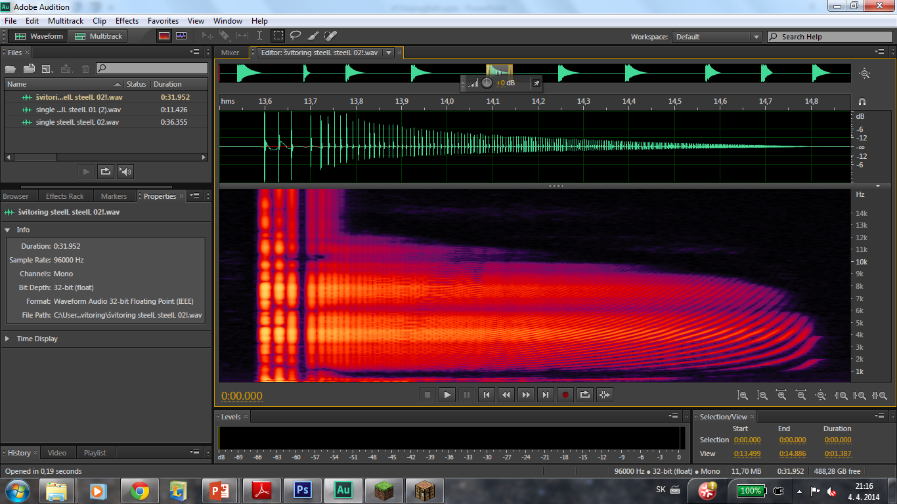
Spectral analysis of our measured chirping
Time
Frequency

Slide 15
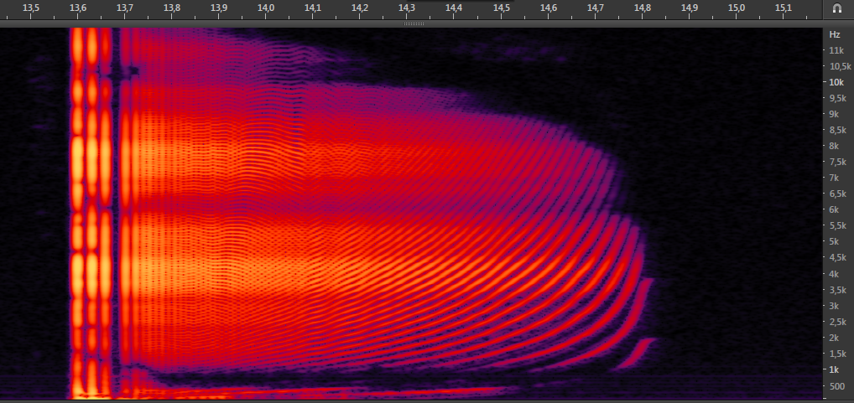
Spectrum of chirping sound (FFT)
First few collisions:
distinguishable
“Fluent” sound

Slide 16
Spectrum of chirping sound (FFT)
Peaks rising in time

Slide 17
Time between collisions

Slide 18
Frequency of collisions in time

Slide 19
Spectrum of chirping sound (FFT)
… if you remember…
Peaks rise in time
Pattern is caused by
increase of
frequency of collisions

Slide 20
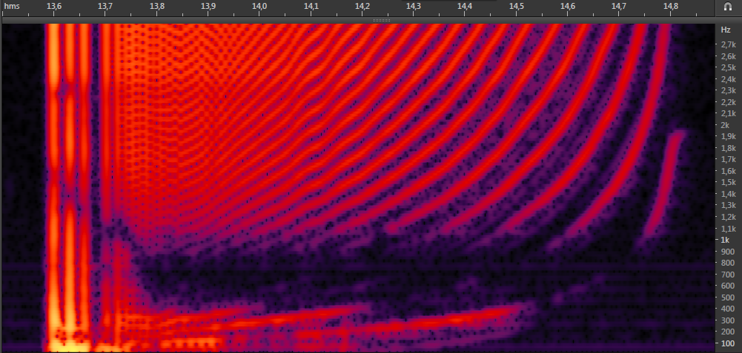
Frequency of collisions
=n*

Slide 21
Multiple of frequency
of collisions
=n*

Slide 22
=n*

Slide 23
=n*

Slide 24
=n*

Slide 25
Nature of the sound
Examine the sound
Recreate the sound

Slide 26
Ingredients for an artificial sound
Time of individual collisions
Impact speed for each collision
  Determines loudness
Sound of a single collision

Slide 27
Simplified model of collisions
Constant attractive force
Time between 2 collisions:
mass
speed after the last collision
Coefficient of restitution:
Impact speed change:

Slide 28
Simplified model of collisions
Impact speed decrease in time:
  Suitable for fast chirping
Speed before collisions:
Time between collisions:

Slide 29

Reality check
Distortions caused
by hitting the foam

Slide 30
Reality check

Slide 31
Reality check
Similar to real behavior!

Slide 32
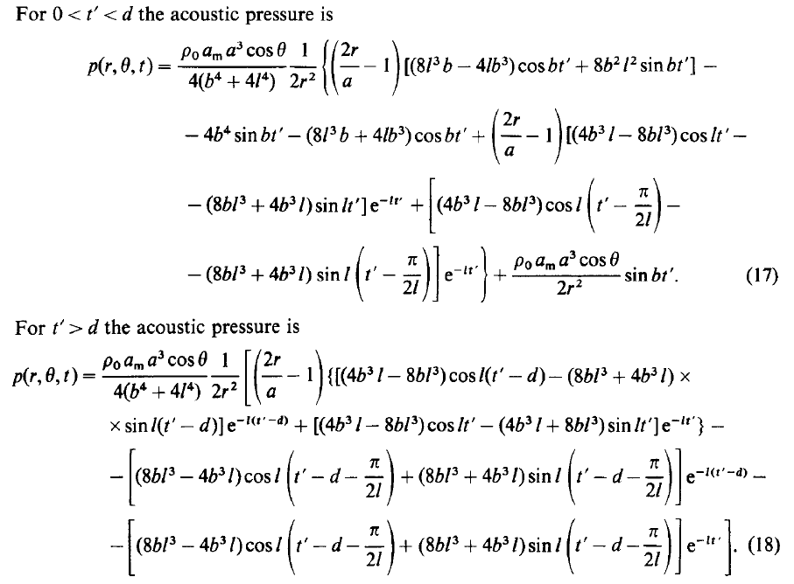
Notable conclusions
Loudness of the sound
LOUD
But not
negligible
quiet
quiet
But not
negligible
LOUD

Slide 33
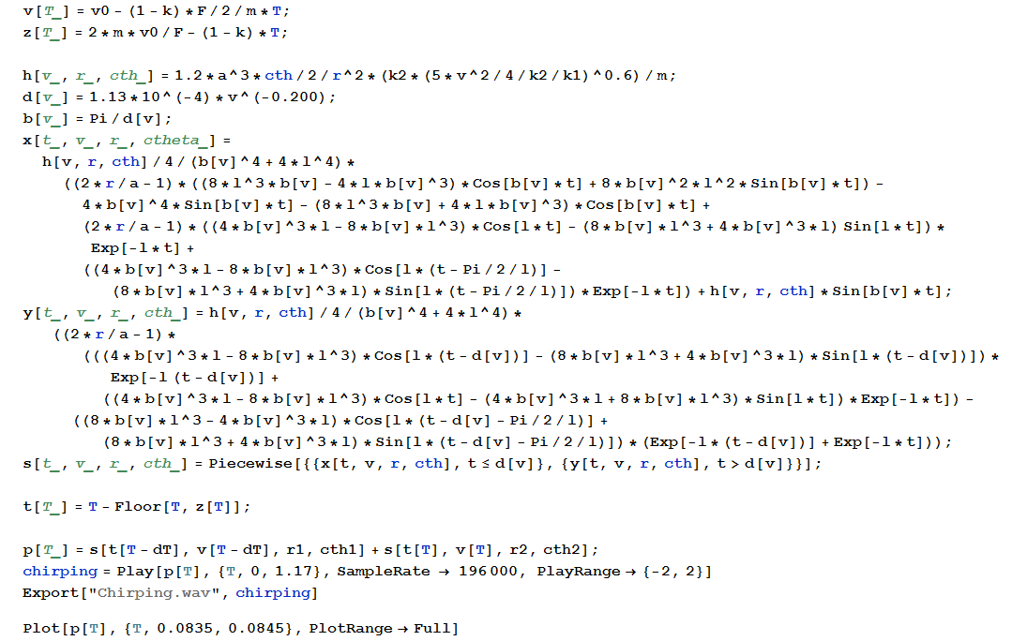
Sound creation in Mathematica

Slide 34
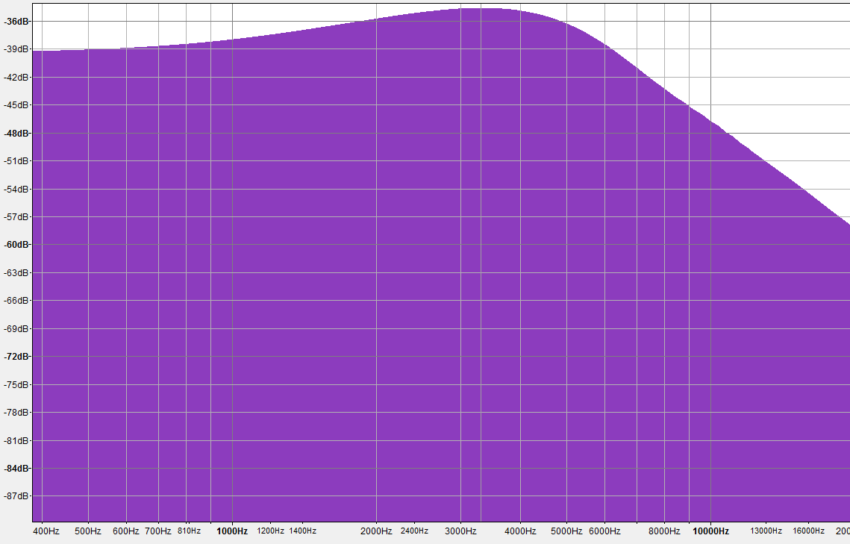
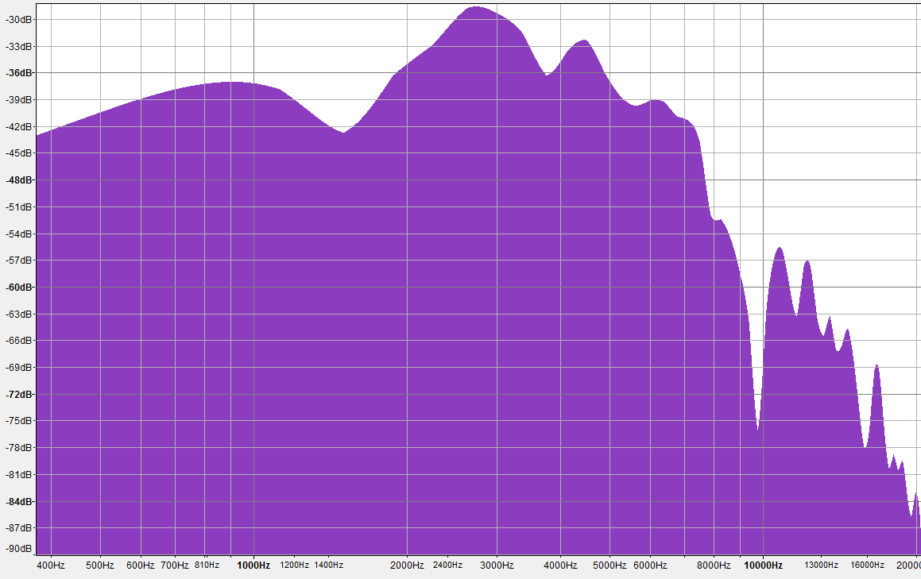
Artificial vs. Real

Slide 35
Conclusion – Nature of sound
Mode number | Natural frequency (kHz)
1 | 51.8
2 | 68.3
3 | 77
4 | 93.1
5 | 97
6 | 98.5
7 | 118.7
8 | 128.2
9 | 136.7
10 | 138.3
Two options
  Vibration of balls
  Impulsive translational acceleration
Lowest frequency
of our balls
113,5 kHz

Slide 36
Conclusion – Analysis and Recreation
Simplified model of collision
Advanced theory
  L. L. Koss, R. J. Alfredson:
Generated authentic sound

Slide 37
Thank you for
your attention
=n*

Slide 38
Sound of single collision
K. Mehraby et al:
L. L. Koss, R. J. Alfredson:
“Impact noise radiated by collision of two spheres“
Journal of Mechanical Science and Technology, 2011
“Transient sound radiated by spheres undergoing an elastic collision”
Journal of Sound and Vibration, 1972
  Finite elements method simulation
  “Perfect” agreement with experiment
  Fully theoretical & analytical
  solution
  Underestimates the loudness
  for theta=90°
  Otherwise good correlation

Slide 39
Koss & Alfredson: Theory basis
Interaction of balls:
  Acceleration approximation:
Velocity potential
for an oscillating sphere*:
Fourier transform
of ball’s motion
Velocity potential
for colliding balls
(duration of contact)
*I. Malecki: Physical Foundations of Technical Acoustics

Slide 40
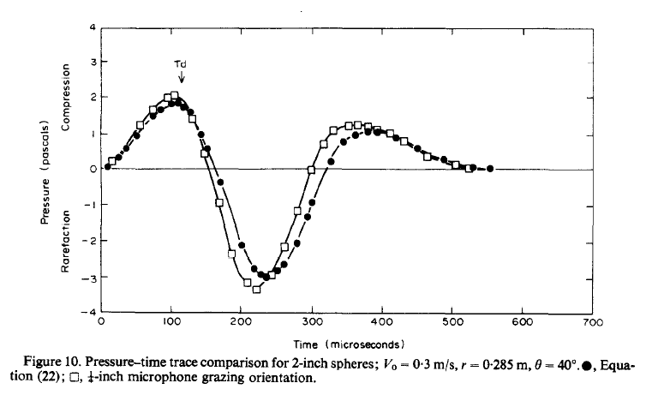
Koss & Alfredson: results

Slide 42
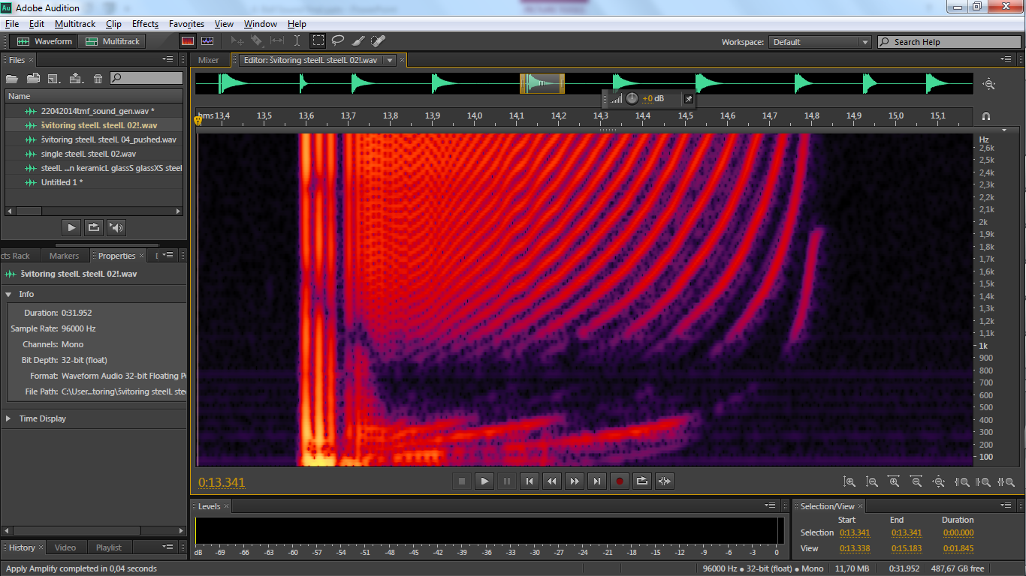

Slide 44
Different Balls
No principial difference in sound
7700 Hz
6200 Hz
7000 Hz
8000 Hz
5000 Hz
Sound differs in frequency and duration

Slide 45
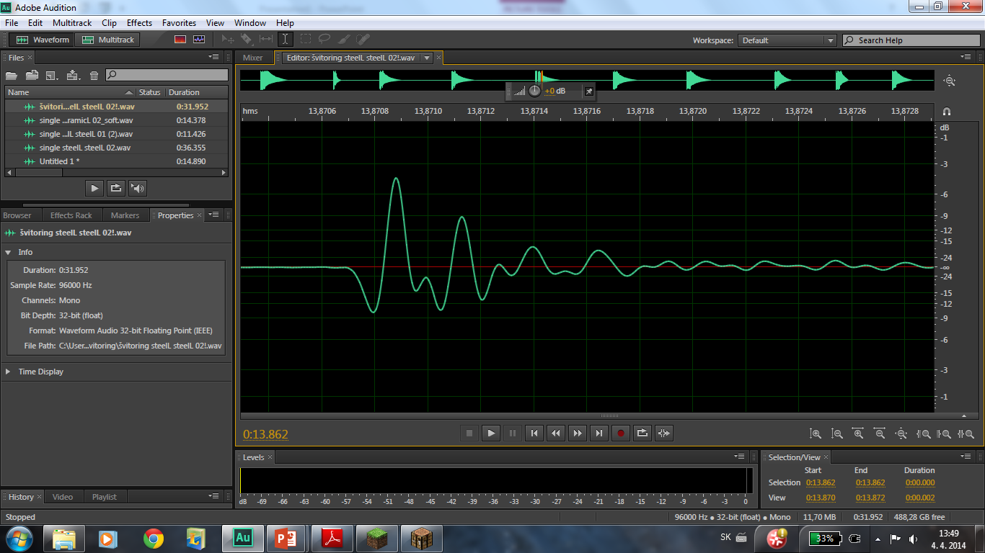
Sound analysis

Slide 46
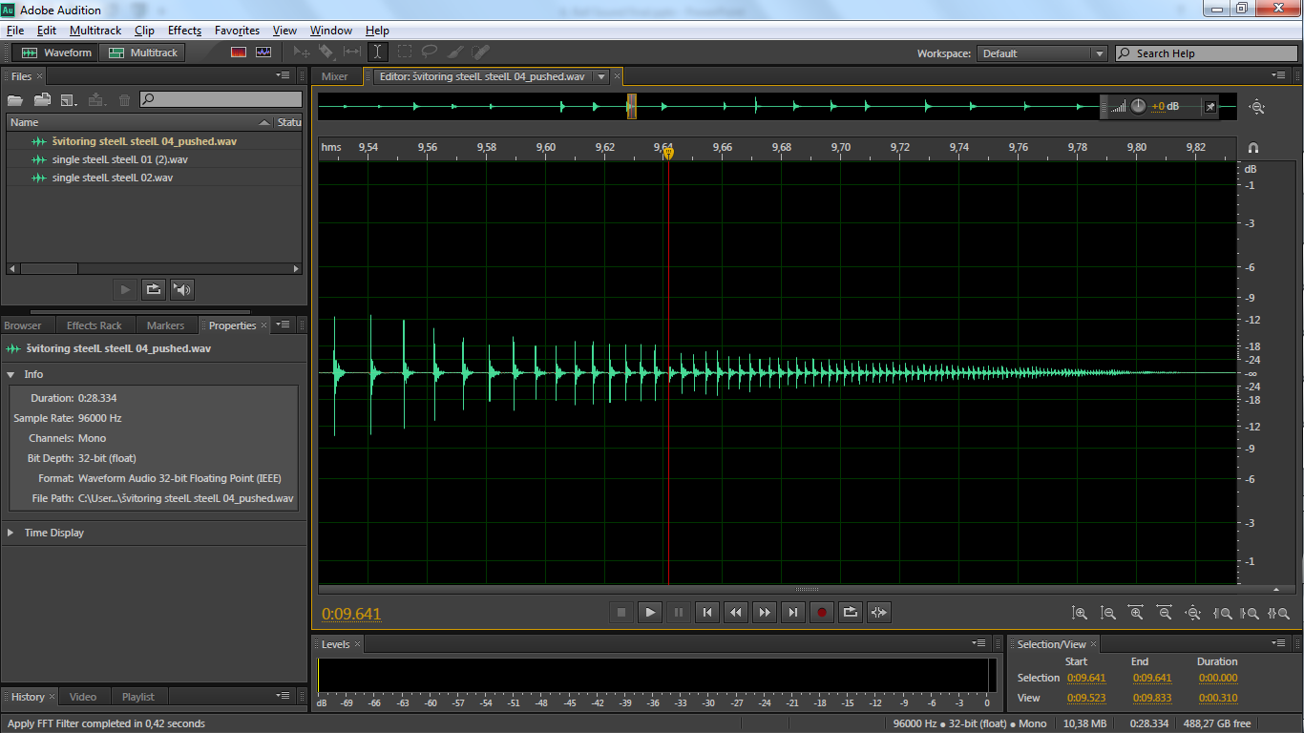
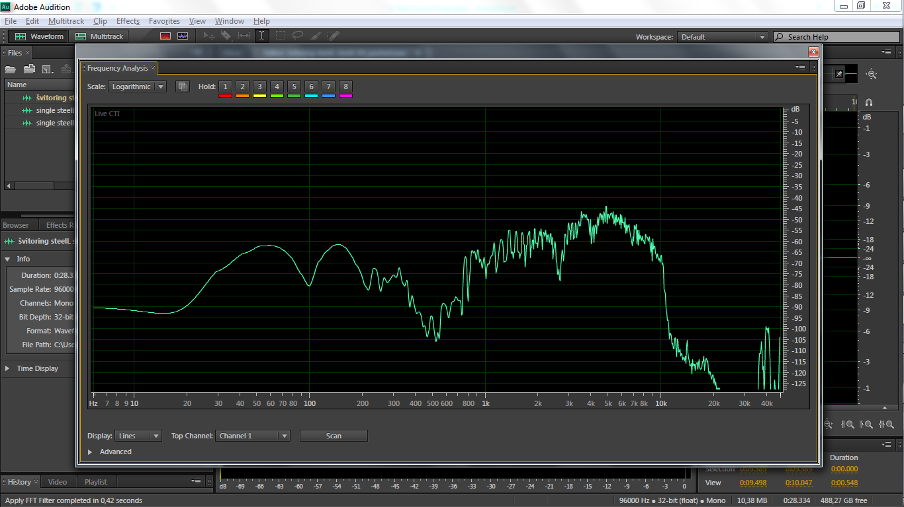
Procedure of Fourier transform
Scanned area
FFT size

Slide 48
Period of collisions
Similar to real behavior!!

Slide 49
If all collisions are the same
only frequency of the
collisions increases
we can generate sound

Slide 50
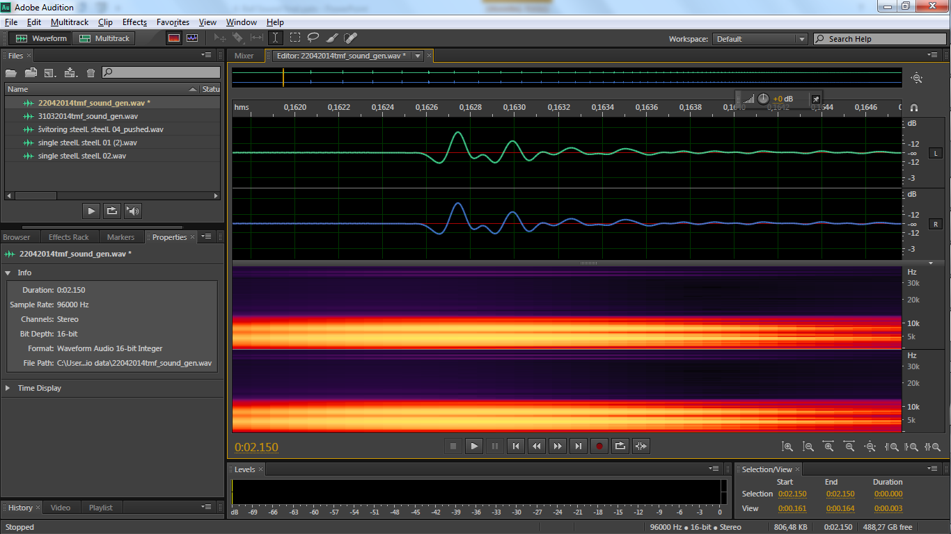
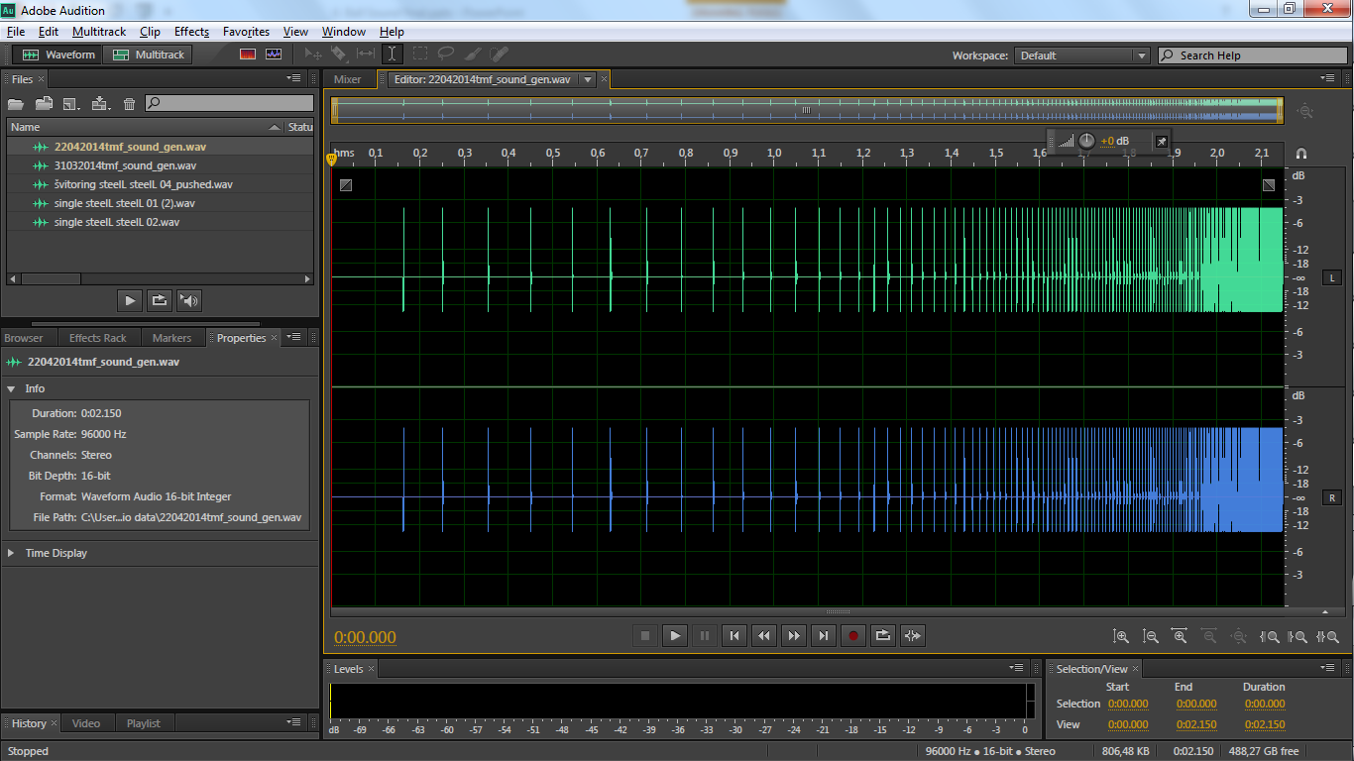
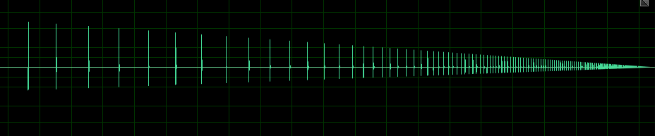
Generating fake chirping sound
Take 1 collision
Paste 185 times with increasing frequency
And decreasing amplitude

Slide 51
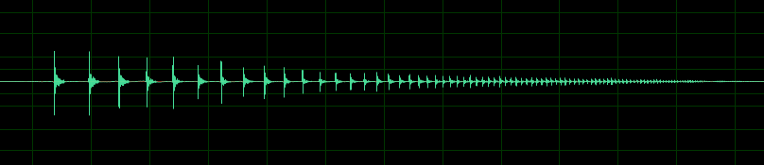
Reality check
Measured
Generated

Slide 52
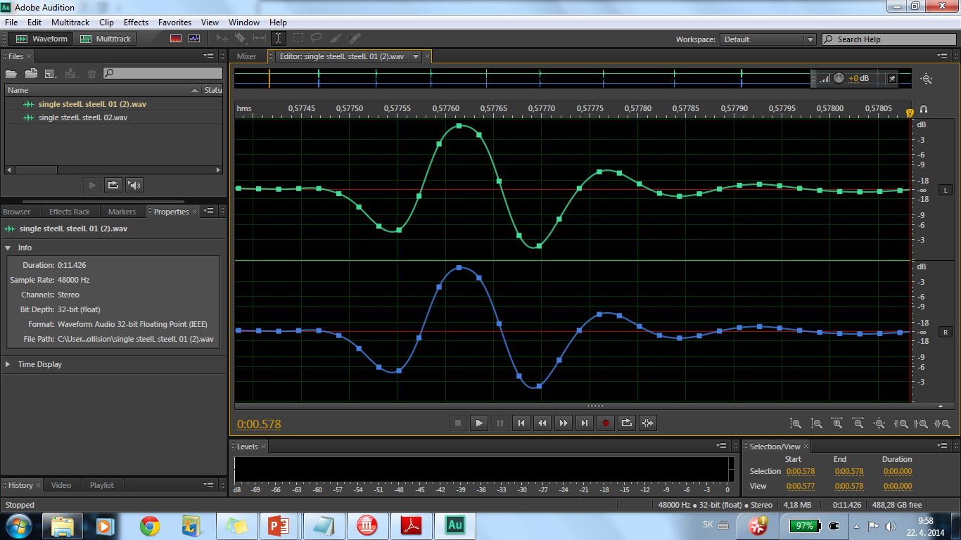
Single collision – our measurement vs theory

Slide 53
Spectral analysis
Distinguish individual collisions
Pattern caused by increasing frequency of the collisions

Slide 54
Our apparatus
Steel Balls:
Radius: 1.43 cm
Mass: 0.095 kg
Colliding on soft foam
Little energy losses due to damping

Slide 55
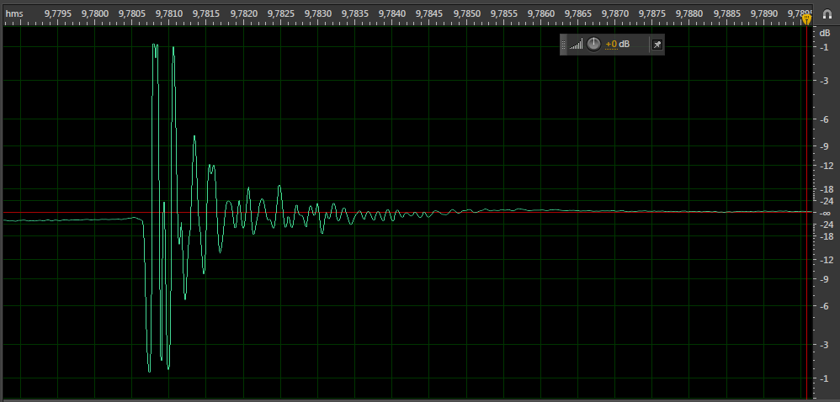
Single collision noise approximation
Real waveform

Slide 56
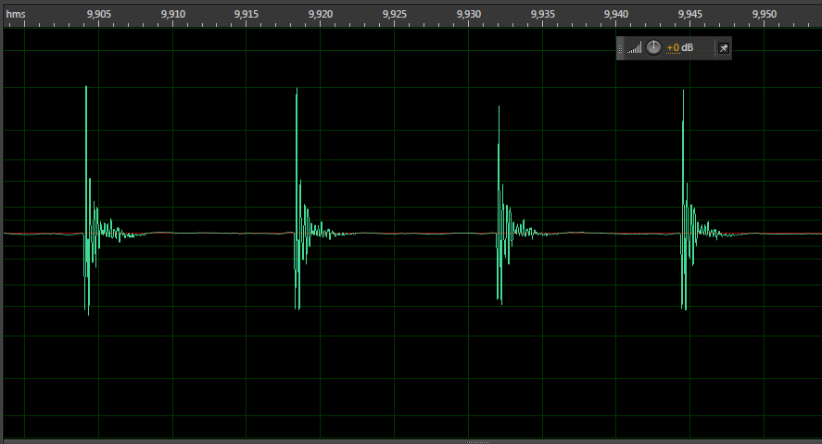
Chirping sound
Subsequent Identical sounds
REAL chirping sound

Slide 57
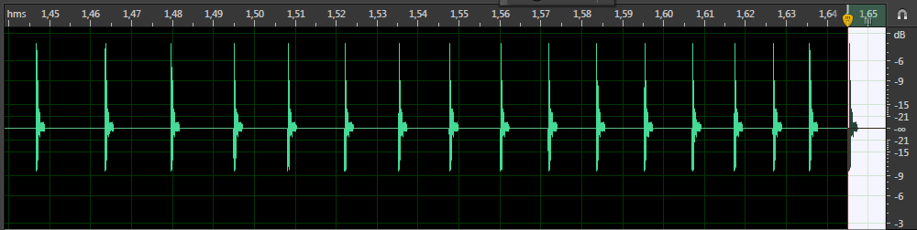
Second verification method
We can generate chirping sound by pasting the same single-collision-waveform one after another

Slide 58
Now we know the motion of the balls

Slide 59
Motion
Origin
Why do we hear the chirping?

Slide 60
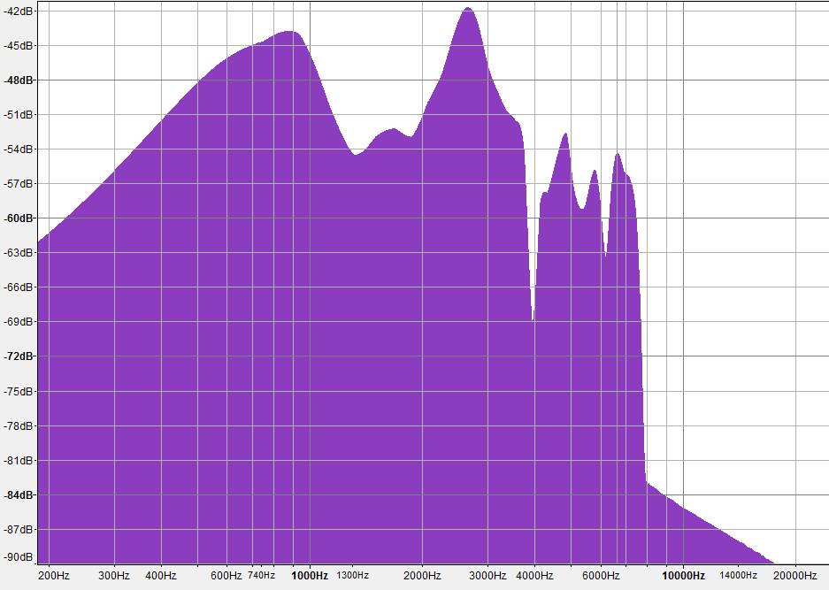
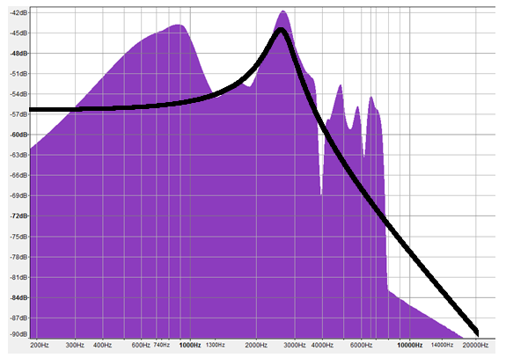
Spectrum of one collision
Our model
Let’s put the collisions together!
Fourier transform

Slide 61
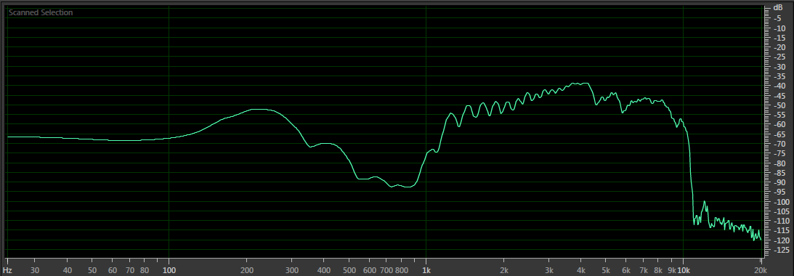
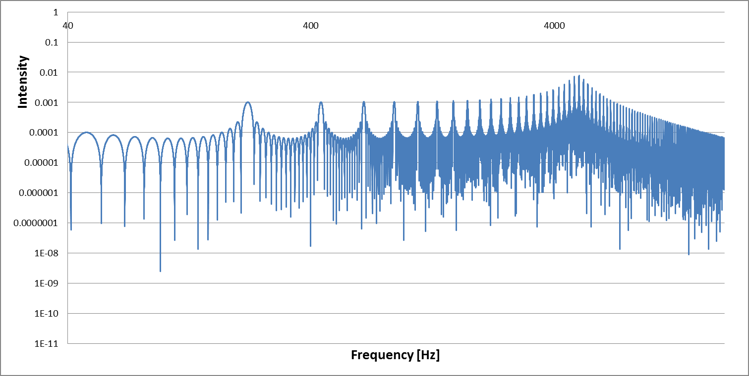
Spectrum of one moment of chirping
200Hz – frequency of collisions

Slide 62
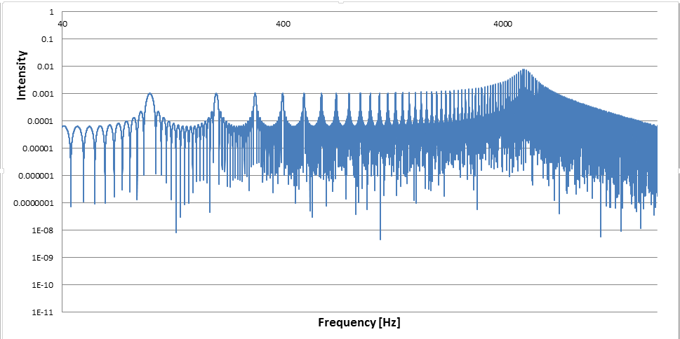
Time is increasing => frequency of collisions increasing
Peak in time rising

