Slide 1
Coefficient of diffusion
10
Marek Bašista

Slide 2
Assignment
Using a microscope, observe the Brownian motion of a particle of the order of micrometer in size. Investigate how the coefficient of diffusion depends on the size and shape of the particle.

Slide 3
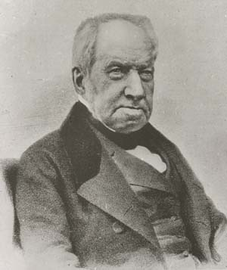
Observation
Carbon particles in water

Slide 4
What is the Brownian motion
Y
$$\vec{r}$$
X
Particle moves = diffunds

Slide 5
What is the Brownian motion? Simulation 2D
Source: http://www.rpgroup.caltech.edu/courses/aph162/2006/Protocols/diffusion.pdf

Slide 6
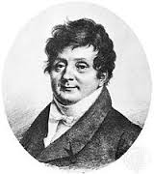
Diffusion equation in 2D
$$D∇^{2}P=\frac{∂P}{∂t} ⟺ D\left(\frac{∂^{2}P}{∂x^{2}}+ \frac{∂^{2}P}{∂y^{2}}\right)=\frac{∂P}{∂t}$$
Solution (1. time used Fourier transformation):
P
$$P\left(x, y, t\right)=\frac{e^{−\frac{x^{2}+y^{2}}{4Dt}}}{4πDt}$$
$$\iint_{−∞}^{∞}{P\left(x, y, t\right)dxdy=1}$$
x
y
Source: http://www.rpgroup.caltech.edu/courses/aph162/2006/Protocols/diffusion.pdf

Slide 7
Diffusion equation in 2D
Position [x(t), y(t)] cannot be predicted but $\left\langle x\right\rangle$ and $\left\langle y\right\rangle$ can.
Logically:
$$\left\langle x\right\rangle = \iint_{−∞}^{∞}{xP\left(x, y, t\right)dxdy=0}$$
$$\left\langle y\right\rangle = \iint_{−∞}^{∞}{yP\left(x, y, t\right)dxdy=0}$$
Using polar coordinates:
$$\left\langle r^{2}\right\rangle =\int_{0}^{2π}{\int_{0}^{∞}{r^{2}P\left(x, y, t\right)rdrdθ}}=\int_{0}^{2π}{\int_{0}^{∞}{\frac{r^{3}}{4πDt}e^{−\frac{r^{2}}{4Dt}}drdθ}}$$
The most probable position is [0, 0] - initial state
Generally for n dimensions:
$\left\langle r^{2}\right\rangle =4$Dt
$$\left\langle r^{2}\right\rangle =2nDt$$
Source: http://www.rpgroup.caltech.edu/courses/aph162/2006/Protocols/diffusion.pdf

Slide 8
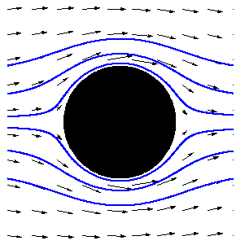
Coefficient of diffusion
Calculation by Einstein (1905):
$$D= \frac{kT}{f}$$
k - Boltzmann constant
T - thermodynamic temperature
$η$ – dynamic viscosity of the fluid
$f=3πηd$ – for spheres (Stokes)
d – diameter of the particle
d
$$D(d)=\frac{kT}{3πηd }$$
$$η$$

Slide 9
How to measure D(d)?
Choose small time interval t (time between frames).
Determine square of particle displacement during t.
Repeat steps 1. and 2. as many times as possible.
Calculate average value of r² - $\left\langle r^{2}\right\rangle$.
Calculate D.
r
D=$\frac{\left\langle r^{2}\right\rangle }{4t}$
Time t
Time 0s

Slide 10
Experiments
10

Slide 11
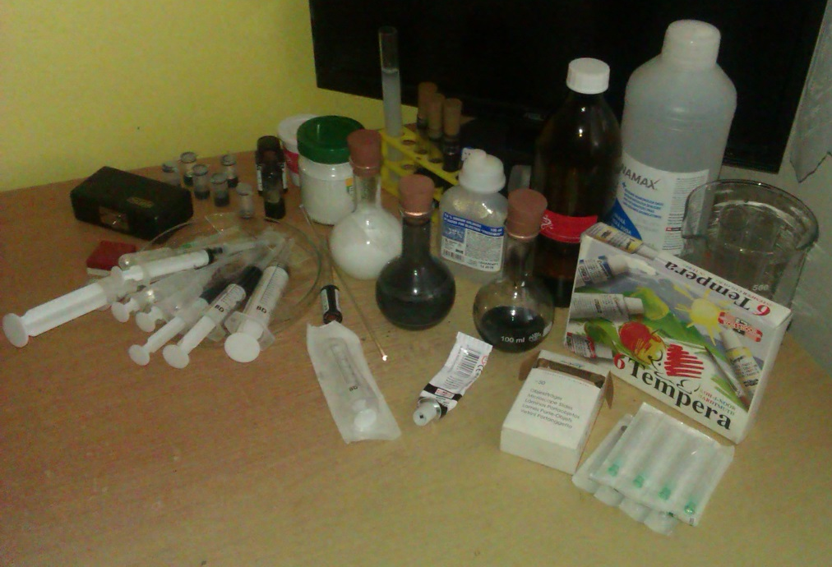
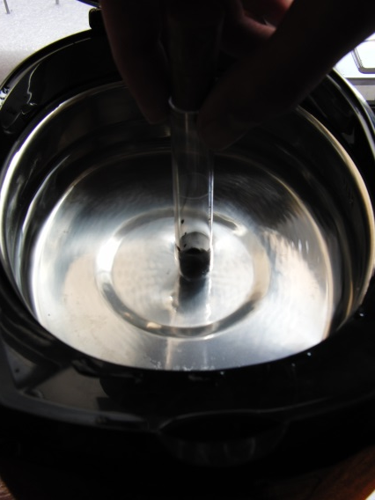
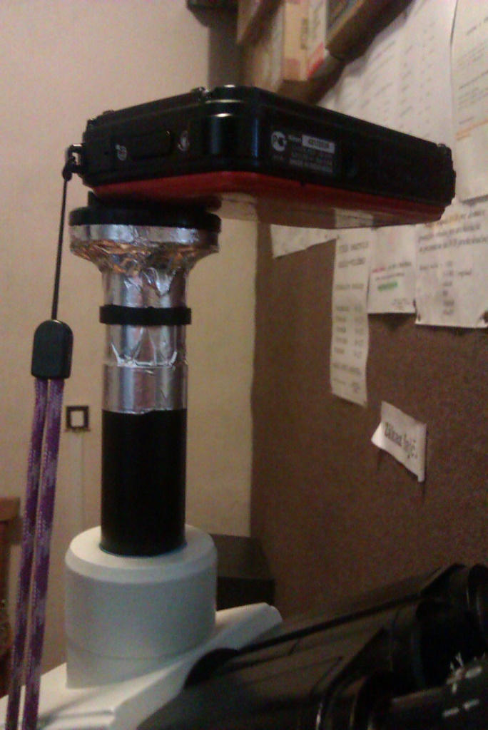
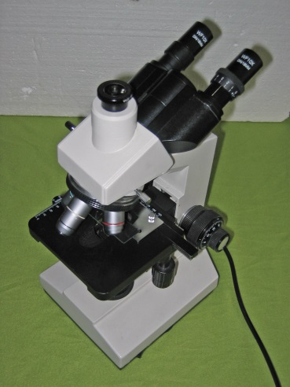
Experimental equipment

Slide 12
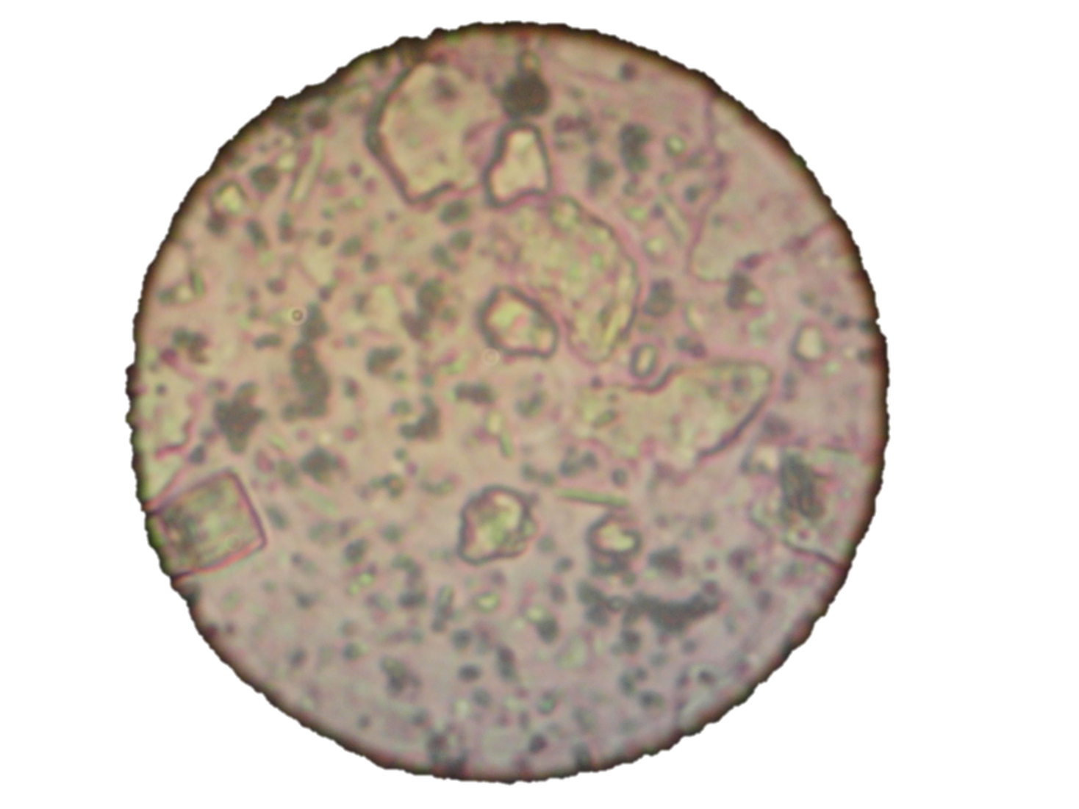
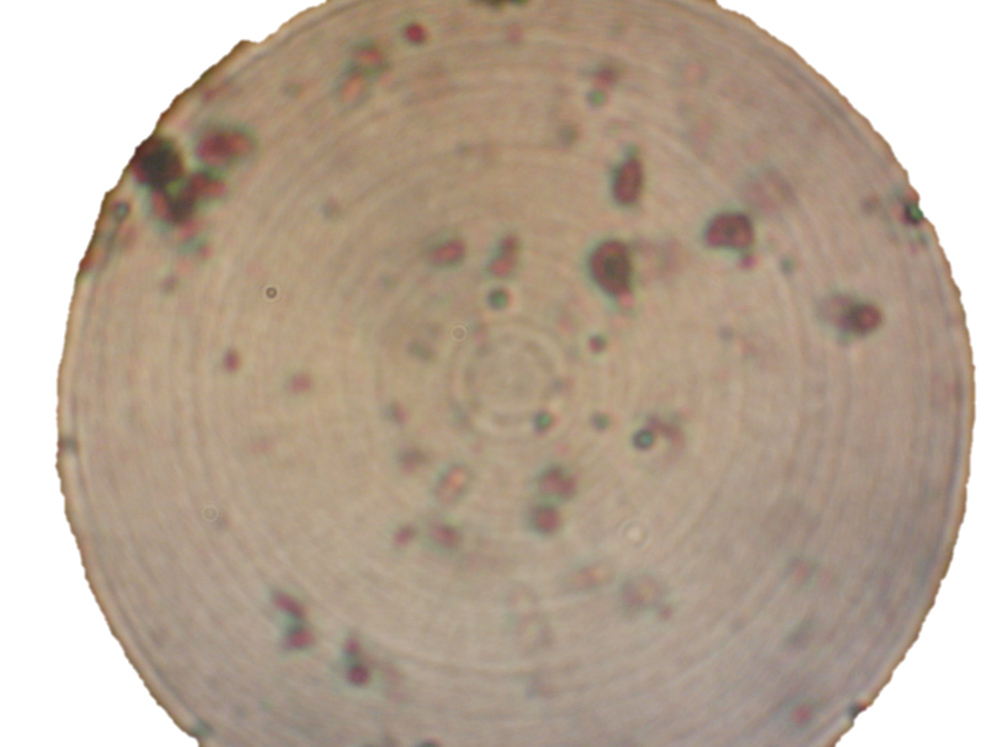
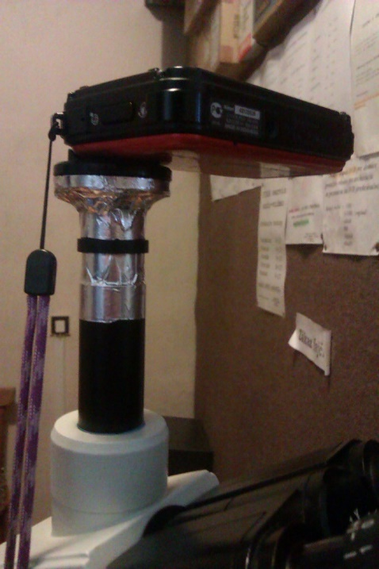
Our tried particles
$$100 μm$$
POLYMERS AND TiO2
LATEX PAINT
CARBON PARTICLES
CARBON - INDIAN INK

Slide 13
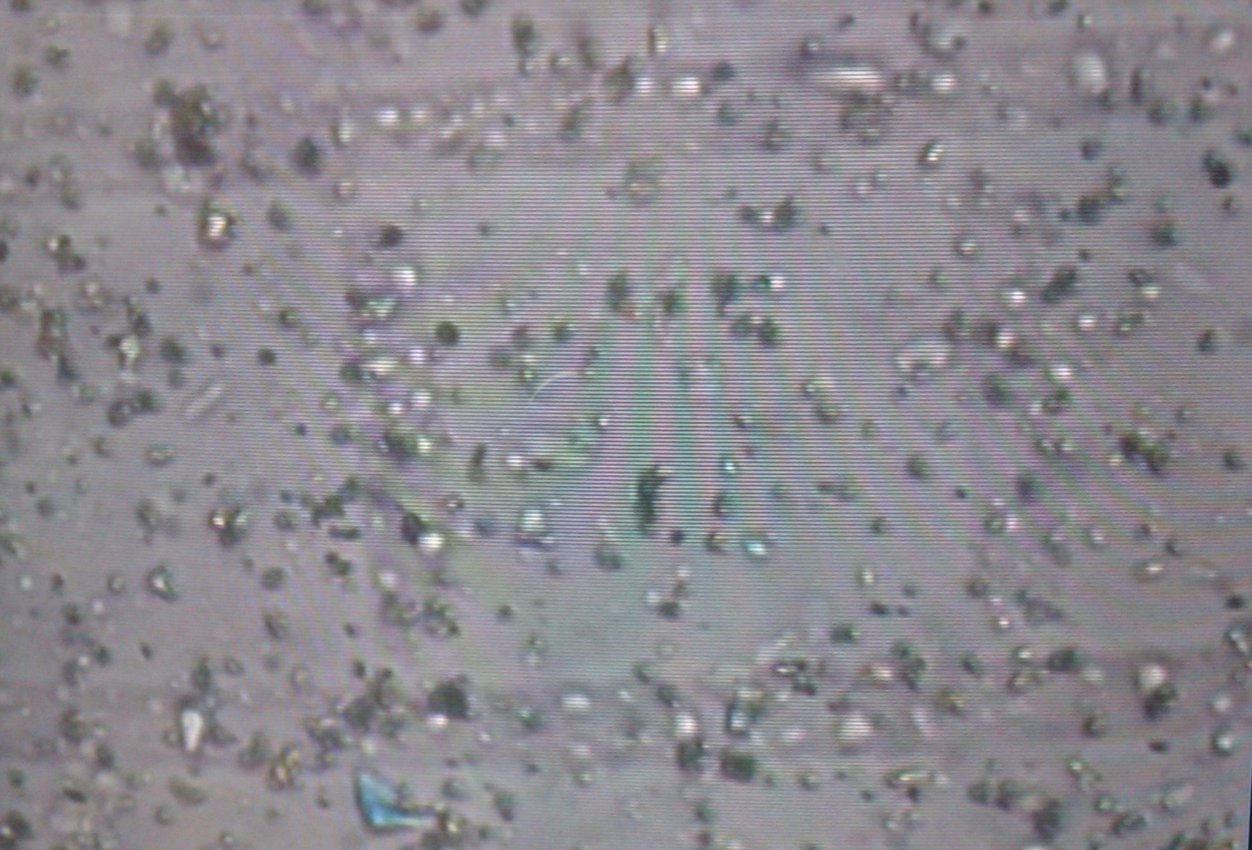
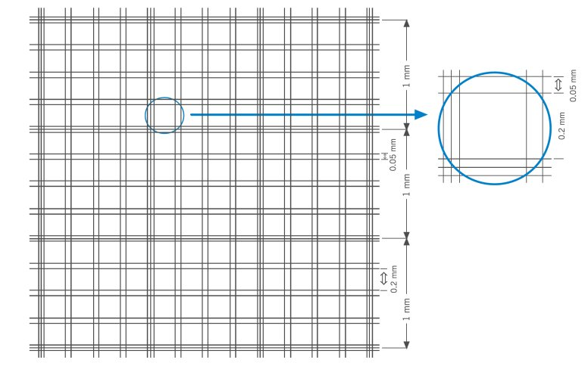
Callibration of the size
$$50 μm$$
Burker's chamber – used for red blood cells calculation, 50µm*50µm raster

Slide 14
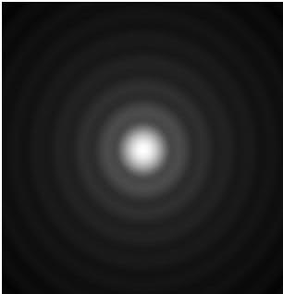
Particle size measurement problem? Diffraction of light
$$λ$$
~3,3 µm
~2,2 µm
Airy disc – small point source image
$$λ$$
-Apparent size of particle is about 2λ larger than real one
-Substraction of 2λ is unusable for small particles (less than 1µm)

Slide 15
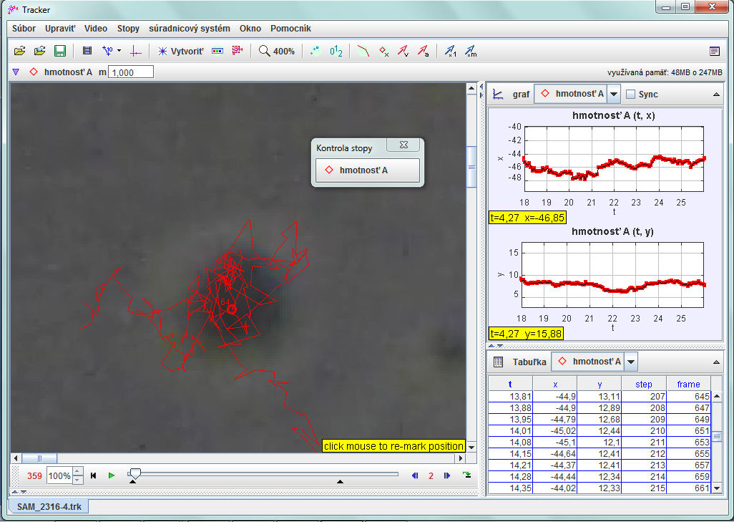
Position vector square (time)
Milk fat particle – analysis
OBR cely screen 1.SG

Slide 16
Experiment 1: Radii determination
10

Slide 17
Probability distribution function – effective radii determination
X/Y displacement during constant time ~ 66ms
MILK FAT PARTICLES
$$D_{x}=0,49 μm^{2}/s$$
$$D_{y}=0,61 μm^{2}/s$$
$$R_{x}≈0,98μm$$
$$R_{y}≈0,80μm$$
Nearly spherical particle »
$$R_{x}≈ R_{y}$$

Slide 18
Experiment 2: Particle Size
10

Slide 19
Observation - explanation
Particles in latex paint, diluted in distilled water for lowering concentration.
$$D(d)=\frac{kT}{3πηd }$$
100 µm

Slide 20
Particle size
Big particle - collisions with glass » reduced diffusion coefficient
$$D ∝\frac{1}{d}$$
$\frac{1}{d}$ fit

Slide 21
Experiment 3: Particle Shape
10

Slide 22
Influence on the diffusion
Diffusion is similar as for spherical particles - prolonged particle rotates randomly
Average behavior is like as for spherical particle with some effective radius

Slide 23
X-Y position analysis
$$D_{y}=0,40 μm^{2}/s$$
$$D_{x}=0,34 μm^{2}/s$$
Probability
$$R_{x}=R_{y}=1,02 μm$$
Particle rotates – average behavior as a spherical particle (for long observation time)
Displacement [µm]
Graf 1, 2
Rx approx Ry approx 1,02 um
? Like a spherical particle?
Particles rotates during the diffusion
Average behavior as spherical particle (for long observation time)

Slide 24
But – change of coordinate system makes difference!
T
We will analyse the motion of the particle ALONG and PERPENDICULARY to its main axis
y
$$α$$
L
x
We set NEW coordinate system for each individual time step in the center of the particle.

Slide 25
Longitudinal and Transversal movement
$$D_{L}=0,24 μm^{2}/s$$
$$D_{T}=0,40 μm^{2}/s$$
Transversal Direction fit
$$R_{L}≈1,28 μm$$
Probability
$$R_{T}≈0,82 μm$$
Displacement[µm]
Particle moves more in transversal direction than longitudinal

Slide 26
Explanation
$$a$$
$$a$$
l
a$<l$
$$S∝lr$$
$$F_{collisions} ∝ a^{2}$$
$$F_{collisions}∝al$$
$$F_{viscous} ∝a$$
$$F_{viscous} ∝\sqrt[3]{la^{2}}$$
$$(Perrin formula)$$
$\frac{F_{collisions}}{F_{viscous}} ∝a < \frac{F_{collisions}}{F_{viscous}} ∝\sqrt[3]{al^{2}}$

Slide 27
Conclusion
Observation of the Brownian motion (latex paint, milk, carbon particles)
Theory – Diffusion equation
P
$$D∇^{2}P=\frac{∂P}{∂t}$$
x
y
Analysis of diffusion movement of spherical particle – determination of effective radii $R_{x}$ and $R_{y}$ ${ R}_{x}≈R_{y}$

Slide 28
Conclusion
Measurement of diffusion coefficient in dependence on particle radius – theory $D∝\frac{1}{d}$ – confirmed
Analysis of diffusion movement of strongly aspherical particle
Behaves like spherical particle in a laboratory frame – $R_{x}≈R_{y}$
Asphericity detected from analysis of the longitudinal and transversal movement $R_{T}>R_{L}$
Big particle - collisions with glass » reduced diffusion coefficient
$$D ∝\frac{1}{d}$$
$\frac{1}{d}$ fit
Thank you for your attention!

Slide 29
ENJOY!
Carbon particles in water

Slide 30
Appendix
10

Slide 31
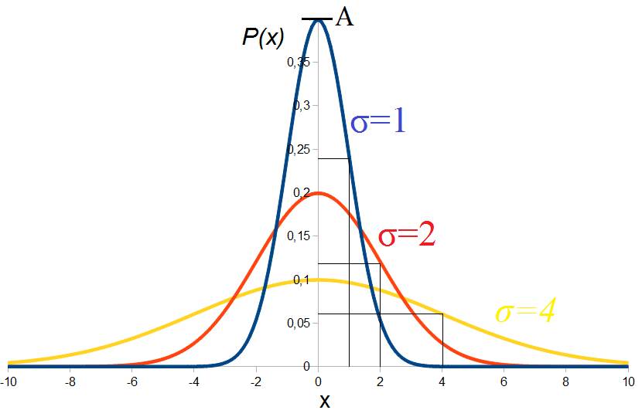
Probability distribution function in 1D
$$P\left(x, t\right)=\frac{e^{−\frac{x^{2}}{2Dt}}}{\sqrt{2πDt}}$$
$D= \frac{∆\left\langle x^{2}\right\rangle }{t}= \frac{σ^{2}}{t}$

Slide 32
Perrin formulas – drag coefficients
PROLATE ELLIPSOID
$$P= \frac{a}{b}$$
$$f_{0}=6πηR$$
$$R={\left(ab^{2}\right)}^{\frac{1}{3}}$$
$$\frac{f}{f_{0}}= \frac{P^{−\frac{1}{3}}{\left(P^{2} −1\right)}^{\frac{1}{2}}}{ln\left[P+{\left(P^{2}−1\right)}^{\frac{1}{2}}\right]}$$
c
b
a
LONG ROD
b
a
$$c=b<a$$
$$\frac{f}{f_{0}}= \frac{{\frac{2}{3}}^{\frac{1}{3}}P^{\frac{2}{3}}}{ln\left[2P\right] − \frac{3}{10}}$$
$$R={\left(\frac{3}{2}b^{2}a\right)}^{\frac{1}{3}}$$

Slide 33
OBLATE ELLIPSOID
$$\frac{f}{f_{0}}= \frac{{\left(P^{2} −1\right)}^{\frac{1}{2}}}{{P^{\frac{2}{3}}tan}^{−1}\left[{\left(P^{2} −1\right)}^{\frac{1}{2}}\right]}$$
$$P= \frac{a}{b}$$
c
b
a
$$c=b>a$$
$$R={\left(a^{2}b\right)}^{\frac{1}{3}}$$
$$f_{PROLATE}=\left\{\frac{P^{−\frac{1}{3}}{\left(P^{2} −1\right)}^{\frac{1}{2}}}{ln\left[P+{\left(P^{2}−1\right)}^{\frac{1}{2}}\right]}\right\} 6πη{\left[Pb^{3}\right]}^{\frac{1}{3}}$$
$$f_{OBLATE}=\left\{\frac{{\left(P^{2} −1\right)}^{\frac{1}{2}}}{{P^{\frac{2}{3}}tan}^{−1}\left[{\left(P^{2} −1\right)}^{\frac{1}{2}}\right]}\right\}6πη{\left[P^{2}b^{3}\right]}^{\frac{1}{3}}$$
$$f_{LONG ROD}=\left\{\frac{{\left(P^{2} −1\right)}^{\frac{1}{2}}}{{P^{\frac{2}{3}}tan}^{−1}\left[{\left(P^{2} −1\right)}^{\frac{1}{2}}\right]}\right\}6πη{\left[Pb^{3}\right]}^{\frac{1}{3}}$$

Slide 34
Changing coordinate system! - equations
T
y
$$α$$
L
x
$$l=xcosα+ysinα$$
$$t=ycosα−xsinα$$

Slide 35
Mass of the particle
$$\frac{1}{2}kT= \frac{1}{2}mv^{2}$$
$$ma=−fv+X$$
$$\frac{d^{2}x}{dt^{2}}=−3πηd\frac{dx}{dt}+X$$
$$\overline{\frac{{dx}^{2}}{dt}}=kT\frac{1}{3}πηr+{Ce}^{\frac{−6πηr}{m}t}$$
t-time between collisions - ~10(-8)s

