Slide 1
Cold balloon
12
Jakub Chudík

Slide 2
Cold balloon

Slide 3
Task
As air escapes from an inflated rubber balloon, its surface becomes cooler to the touch. Investigate the parameters that affect this cooling.
What is the temperature of various parts of the balloon as a function of relevant parameters?

Slide 4
How does it look?
Notes:
Odstranit zvuk z videi

Slide 5
What causes cooling?
AIR
Cool down of air
due to expansion
RUBBER
Cool down of rubber
due to contraction
Notes:
Vzduch vs. Guma – ideme testovat

Slide 6
Can the air cause the cool down?
h
width of air layer
Escaping air expands due to pressure drop
Assuming adiabatic expansion:
S
surface of air layer
Small balloon:
Large balloon:

Slide 7
Total heat transferred
Heat from the boundary
layer
Heat transferred through
air
Create temperature gradient
Isobaric heat
capacity
Width of air layer
Balloon surface
Heat conductivity of air
Time of deflation

Slide 8
Total transferred heat
Upper estimate of total heat transferred:
Drop of balloon temperature:

Slide 9
Estimated temperature drop due to cooling effect of air expansion
Large balloon:
Small balloon:
But balloons cool down much more!
Large balloon:
Small balloon:

Slide 10
Experimental verification
Smaller balloon inflated inside a larger one
Air escaping from smaller balloon into larger one
IF cool-down of air causes the balloon to cool down, both balloons stay at the same temperature
Outer balloon
Escaping air
Larger balloon
Inner balloon
Smaller balloon

Slide 11
Cool down of smaller balloon inside larger one
Notes:
Slide s popisom videa pred toto
Odstranit zvuk z videi

Slide 12
Cooling effect at the hole of balloon

Slide 13
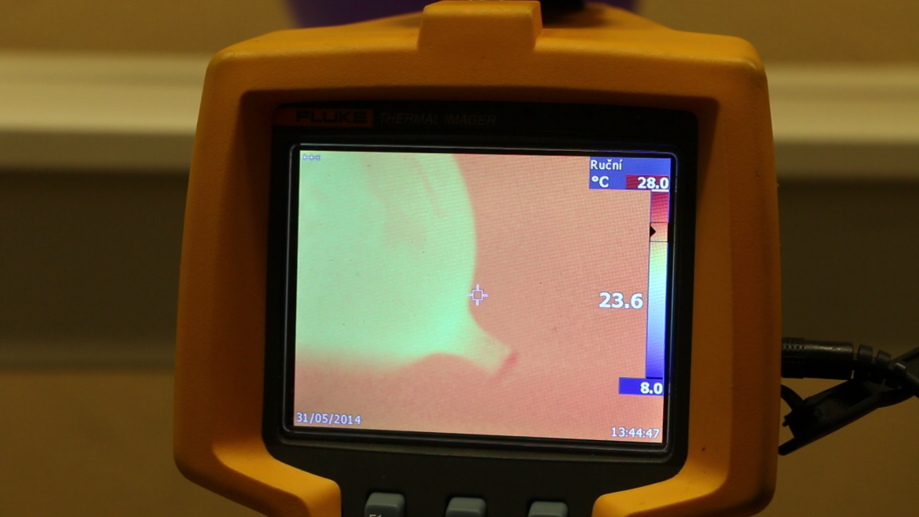
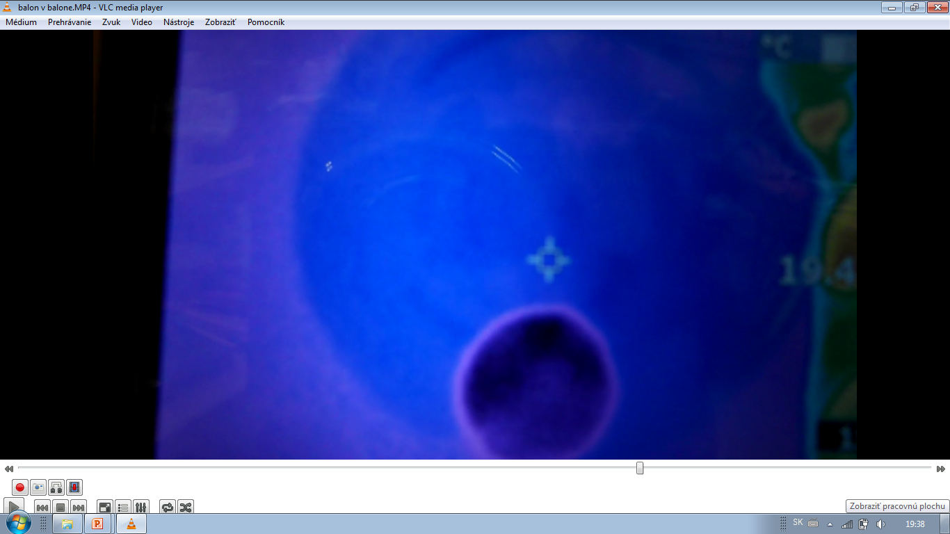
Summary of the effect of air
Mathematical model
Calculated the cooling effect of air
Large balloon –
Small balloon –
Two experimental verifications

Slide 14
What causes cooling?
Air does not cause the cooling!!!
AIR
Cool down of air
due to expansion
RUBBER
Cool down of rubber
due to contraction
Notes:
Vzduch vs. Guma – ideme testovat

Slide 15
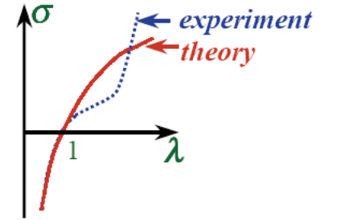
Existing theory
Equation of state:
Statistical physics of polymers
Applicable only for small extensions
40% - 120% stretch
Alexei R. Khokhlov: Lecture 3 on elastomer physics

Slide 16
Due to:
ThIS theory is no
longer applicable
Too high extensions
Up to 800%
Hysteresis of rubber

Slide 17
Our task now is to:
Explain the mechanism of heat-up and cool-down
Internal structure and 1st law of thermodynamics
Show the dependence of cool down on stretch
Determine the parameters affecting the stretch

Slide 18
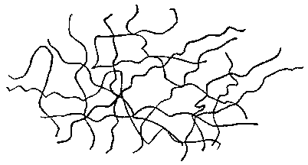
Rubber elasticity
Rubber is composed of cross-linked polymer chains in constant movement
Tension in stretched rubber is caused by thermal motion of molecules
Notes:
Elasticita a thermal properties su trochu nejasne, co sa tym mysli
Radsej nieco ako “tension in stretched rubber caused by thermal motion of molecules”

Slide 19
Rubber elasticity
Increased temperature increased tension
Known experiment: stretched rubber with weight contracts when heated by flame
Heat is transformed into work
rubber bands
gas flame
weight
pulled distance
Feynman, Leighton, Sands: Feynman Lectures on Physics

Slide 20
Pull and release
1st law of thermodynamics:
When pulled:
Adiabatic expansion
When released:
Adiabatic compression
$$∆U=Q+W$$
$$W>0$$
$$Q=0$$
$$W<0$$
$$Q=0$$
Notes:
Formulacia suvisu vnutornej energie a teploty

Slide 21
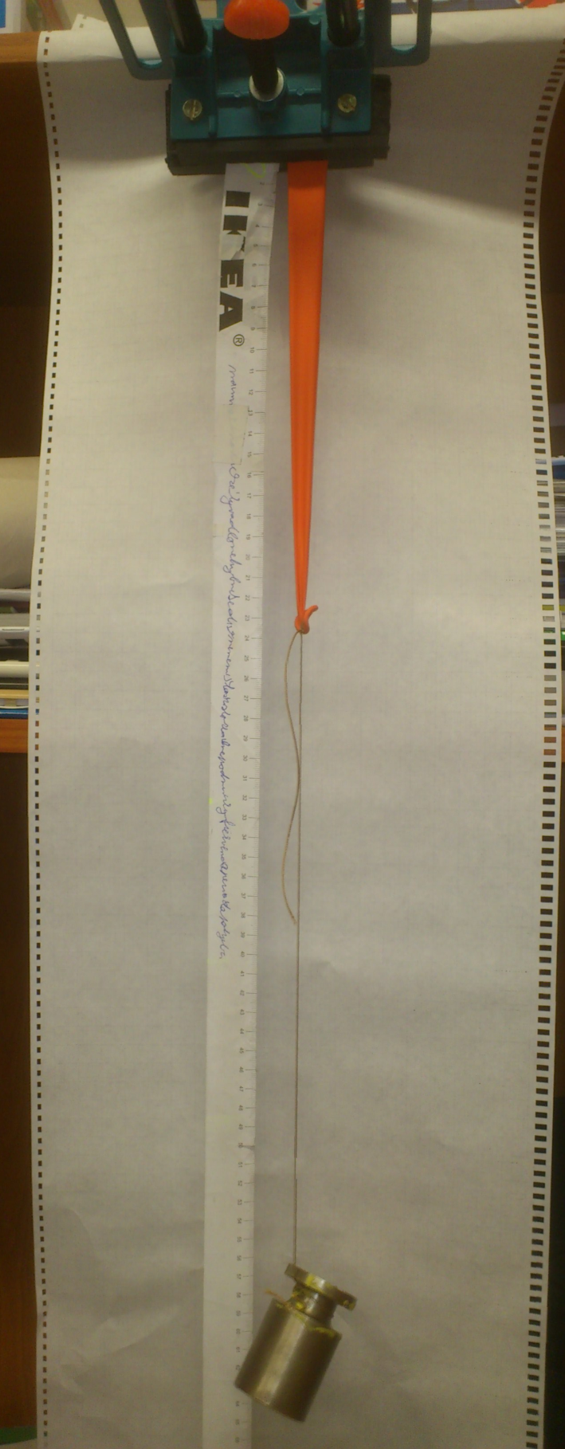
Apparatus
Different weights
Measuring temperature
before and after stretch
before and after release
balloon
meter
weight
Notes:
Vysvetliť experimentálny dizajn: dám závažie, nechám ochladiť na izbovú teplotu, zložím závažie, odmerám teplotu

Slide 22
Pull
During stretching, chains kink each other up by thermal movement
Adiabatic expansion
Internal energy increases → rubber heats
$$W>0$$
H + $∆$h
$$∆U=W$$
tension
Notes:
Náraz na pevný materiál – odrazí sa rovnako rýchlo
Pridat suvis prace a vnut. energie (vid minuly slide)
Stretched -> stretching (znie to dobre?) (zohriatie sa deje len pocas natahovania, nie ked je uz natiahnuta)
Tension increases, rubber pulls sa mi sem nehodi, ide skor o zohriatie
Obrazok asi v pohode..

Slide 23
Temperature change when stretched - heating up
Standard deviation – 1,7°C

Slide 24
Release
Polymer chains become relaxed and soft
Thermal energy is transformed into work
Adiabatic contraction:
Internal energy decreases → rubber cools
H
$$W<0$$
$$∆U=Q+W$$
Notes:
Nárazy do mäkkých predmetov – odoberá energiu
Tiez termodyn. Veta
Lose energy by som dal prec kvoli radikalnym porotcom ☺ Skor nieco ako kinetic (thermal) energy absorbed and used to do work

Slide 25
Temperature change when contracted – cooling down

Slide 26
Change of temperature:

Slide 27
Summary
Change of internal energy observable as heat
Cool down depends on the amount of stretch of rubber
Notes:
Nechceme pridat conclusion z predchadzajucej casti? Napr.:
Important parameter: strain of rubber (stale vidime posledny graf)
→ Varies based on: thickness, curvature

Slide 28
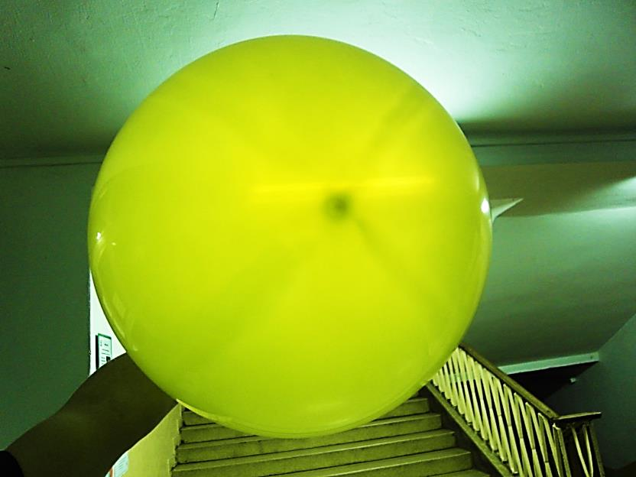
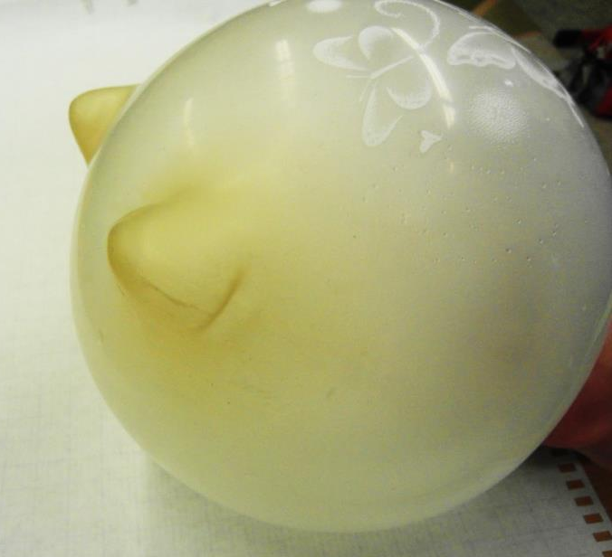
Different parameters affecting the stretch
Grip
Thickness
Curvature

Slide 29
Grip

Slide 31
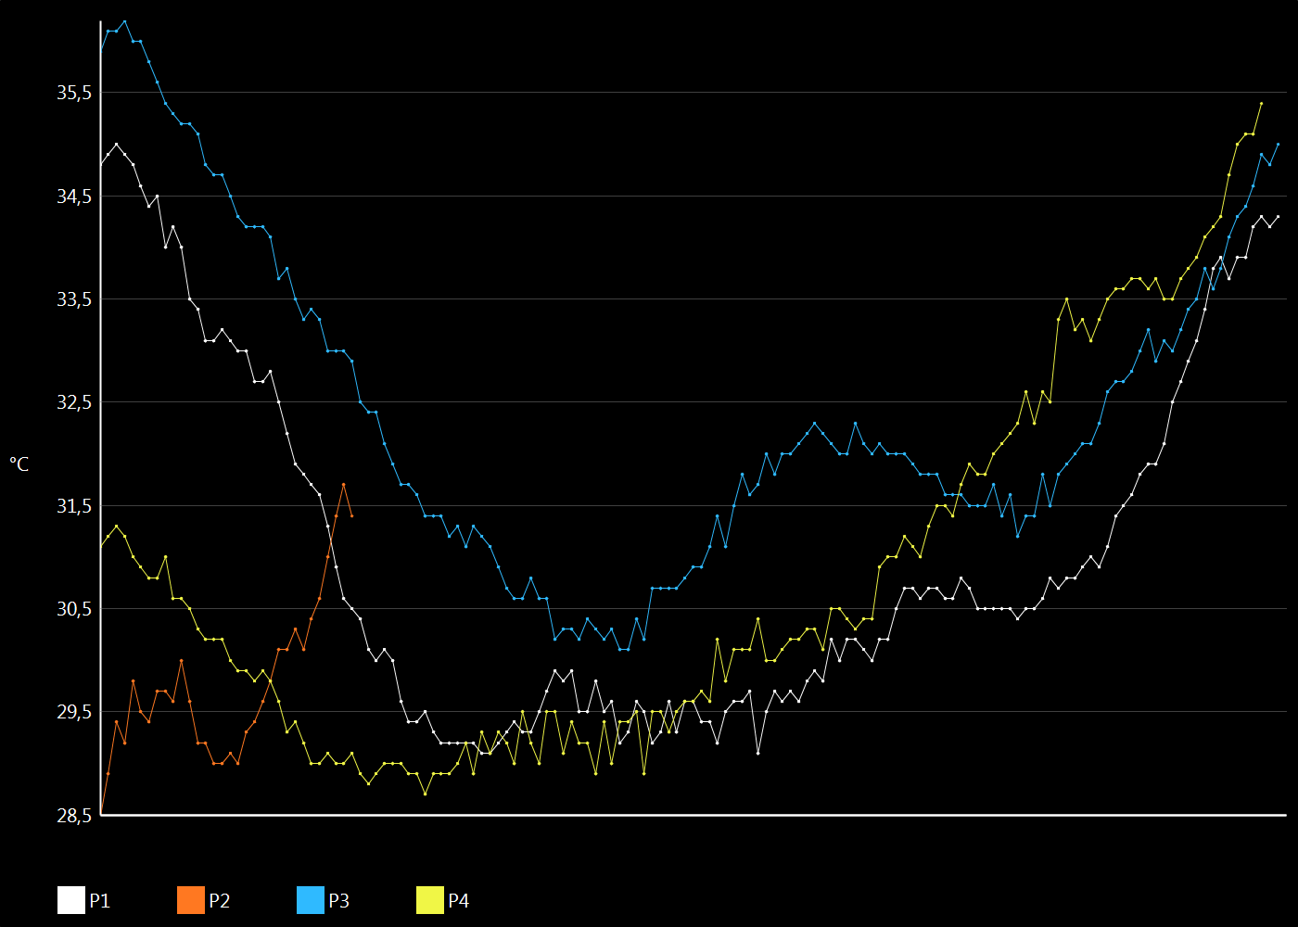
P3
P1
P4
P2

Slide 32
Thinner / thicker
Thicker layer of rubber – stiffer, less strain

Slide 33
Thinner / thicker
Harder to see through
thicker rubber
Notes:
prvy

Slide 34
Thinner / thicker
More stretched part heated up more
Notes:
prvy

Slide 35
Shape of the balloon
After air escaped:
Less stretched parts are warmer
Stretched parts are cooler

Slide 36
Shape of the balloon

Slide 37
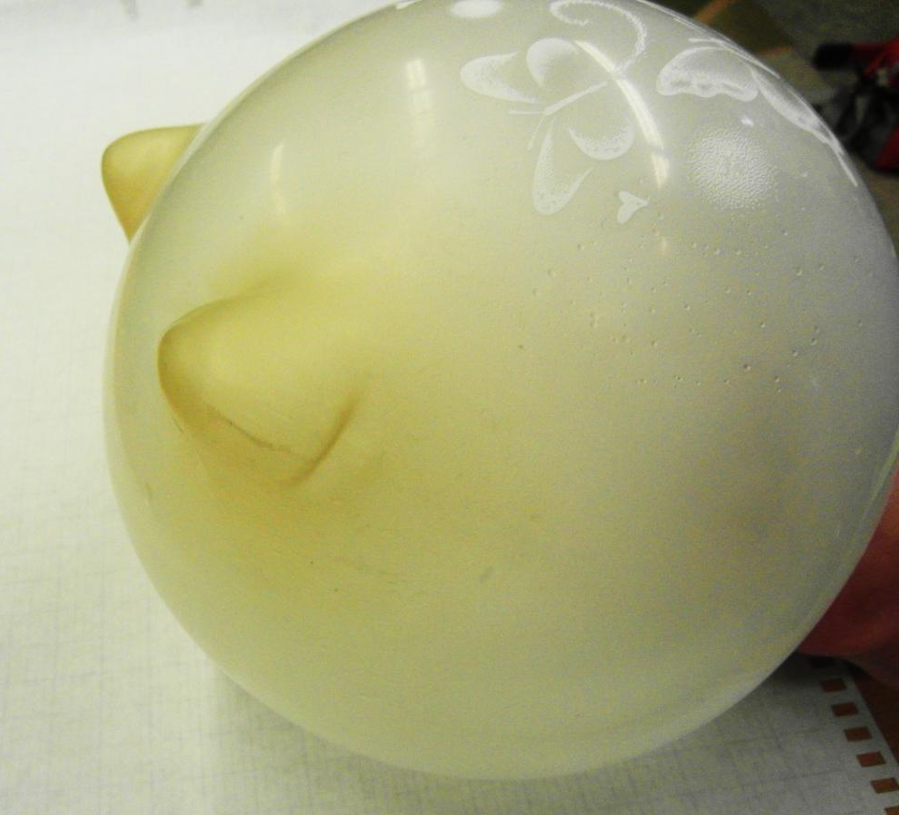
Curved
More curved are
less stretched
Less stretched
cool down less

Slide 38
Curved
More curved parts – smaller tension is sufficient to compensate air pressure
Less strain
Tension of rubber
Normal component of the tension
Air pressure

Slide 39
Curved – less cooled

Slide 40
Conclusion - air
Mathematical model
Calculated maximal effect
Large balloon –
Small balloon –
Two experimental verifications

Slide 41
Conclusion - theory
Existing theory is not sufficient
We need another approach
Thermal motion and tension
Cool down dependence on stretch

Slide 42
Thank you for your attention

Slide 43
Force dependence on speed of stretch

Slide 44
Maximal stretch/force dependance

Slide 45
Stretch dependence on weight

Slide 46
Hysteresis of rubber

Slide 47
Dependence of temperature change on stretch

Slide 49
Attrition of rubber

Slide 50
Heat transferred through air
Width of air layer
Balloon surface
Heat conductivity of air
Time of deflation
To create the gradient , some heat had to be transferred first.. (with higher gradient)

Slide 51
Heat from the boundary layer
Based on (isobaric) heat capacity c_{p} this heat has to be transferred
to create the gradient:

Slide 52
Temperature drop in the rubber
More realistic estimate
½ surface
½ time
Adjust heat capacity
Then
Small balloon
Large balloon

Slide 53
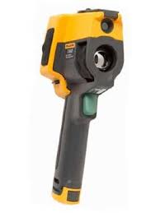
Our equipment – Fluke TiR
Measurement range: -20°C to 120°C
Accuracy:
Thermal sensitivity: ≤ 0.09 °C at 30 °C
Image frequency: 9Hz refresh rate

