Slide 1
Freezing droplets
8
Jakub Chudík

Slide 2
Task
Place a water droplet on a plate cooled down to around -20 °C.
As it freezes, the shape of the droplet may become cone-like with a sharp top. Investigate this effect.

Slide 3
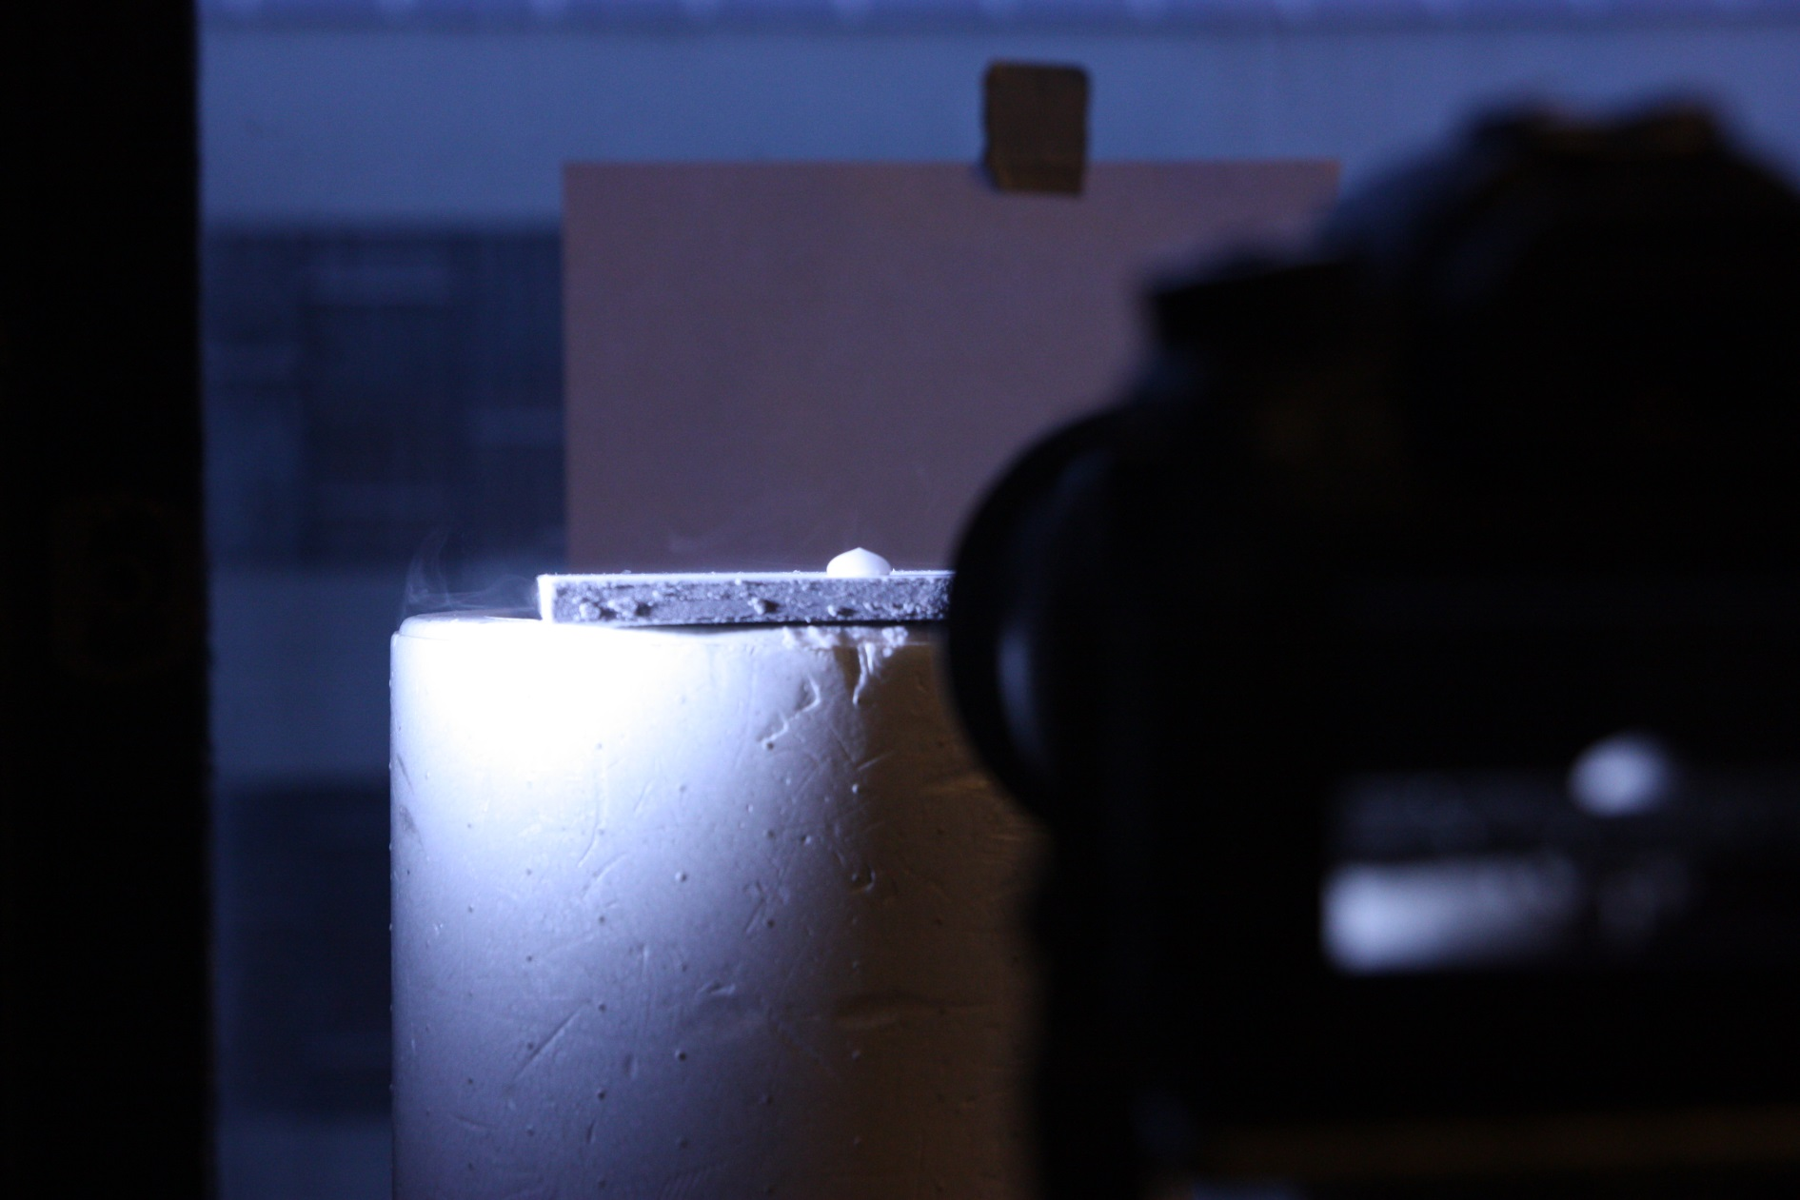
Equipment

Slide 4
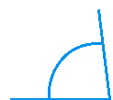
Droplet
Surface
Volume
Inclination
Curvature
Material
Contact angle
Temperature
$$θ$$

Slide 5
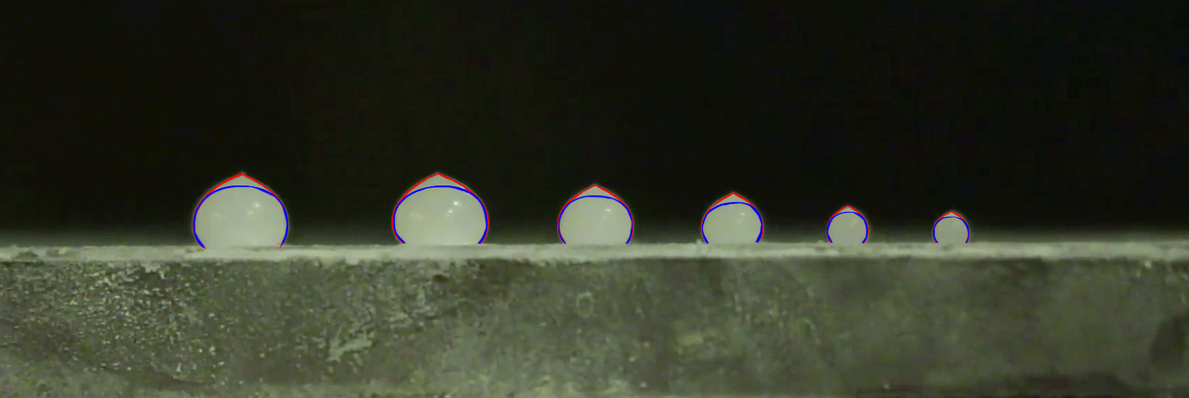
Dependence on the volume of the droplet
Essentially the same

Slide 6
Inclination of the surface
α=62°

Slide 7
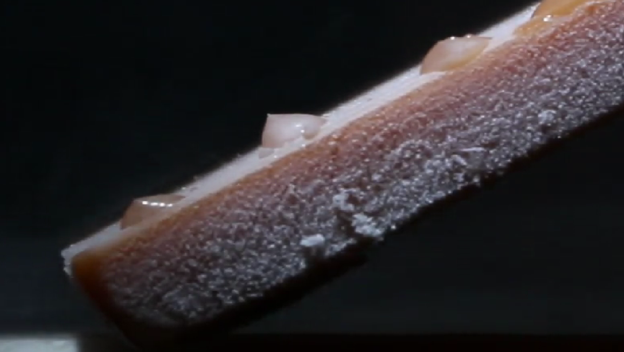
Inclination of the surface
α=27°

Slide 8
Curvature of the surface

Slide 9
Curvature of the surface

Slide 10
Curvature of the surface

Slide 11
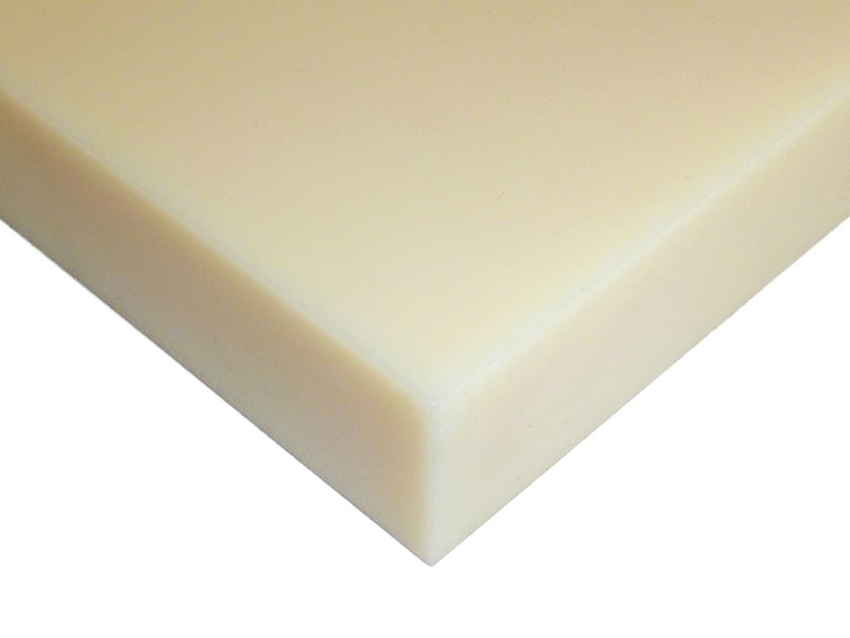
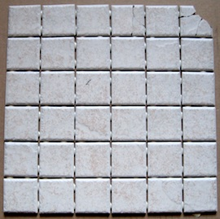
Material of the surface
Plastic
Metal
Ceramics

Slide 12
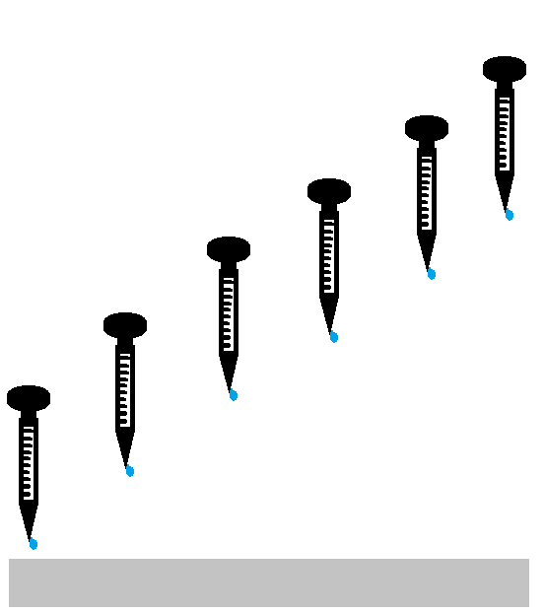
Contact angle of the droplet
$$θ$$
+
Different heights
Droplets of the same volume

Slide 13
Different contact angles

Slide 14
Temperature
-12,5°C
-35,1°C
-21,8°C
-57,8°C

Slide 15
Extreme volume of the droplet
4 cm

Slide 16
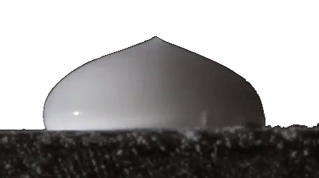
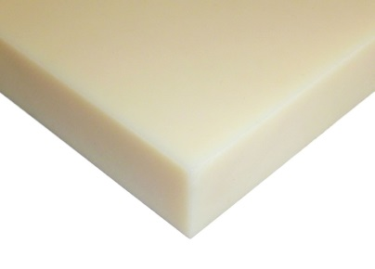
Summary of preliminary experiments
Changeable parameters
Droplet
Volume
Surface
Inclination
Curvature
Material
Contact angle
Temperature
No qualitative
changes
Plastic
Metal
-12,5°C
-35,1°C
Ceramics
-21,8°C
-57,8°C

Slide 17
What is the shape of the peak?
Described by

Slide 18
Existing literature
“Pointy ice-drops: How water freezes into a singular shape“ J.H. Snoeijer and P. Brunet, Am. J. Phys. 80, 764 (2012)
Heat conduction equations solved
Assumption: Planar freezing
Notes:
Simple mathematical modelling
Spherical droplet

Slide 19
Existence of reservoir
Water blown away
during freezing

Slide 20
Existence of reservoir
Cut in half

Slide 21
Existence of reservoir
Depression in ice

Slide 22
The peak: An alternative approach
Shape as we approach the top: always a cone
1st term of Taylor’s expansion of :
“Stabilized freezing”

Slide 23
Stabilized freezing: water → ice
Freezes to
Equation for
But we need to know the shape of reservoir

Slide 24
Heat flow on the water-ice interface
Heat flow:
perpendicular to the water-ice interface
near the surface: parallel to the surface
Interface is perpendicular to the surface

Slide 25
Shape of the reservoir
Heat flowing unevenly:
Hotter/colder areas are created
Heat flows to the colder
Heat flow becomes evenly distributed
Stabilized freezing:
Heat flow evenly distributed; perpendicular to interface
Reservoir: spherical cap

Slide 26
Stabilized freezing: water → ice
Freezes to
Substitute for

Slide 27
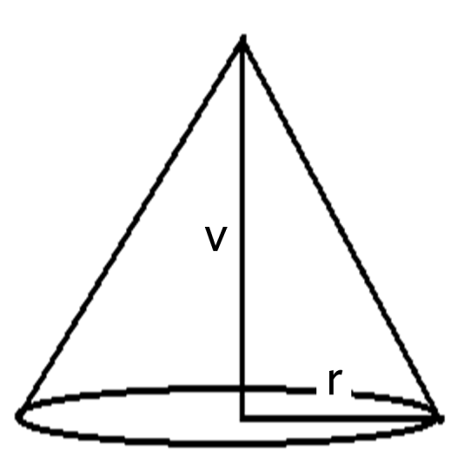
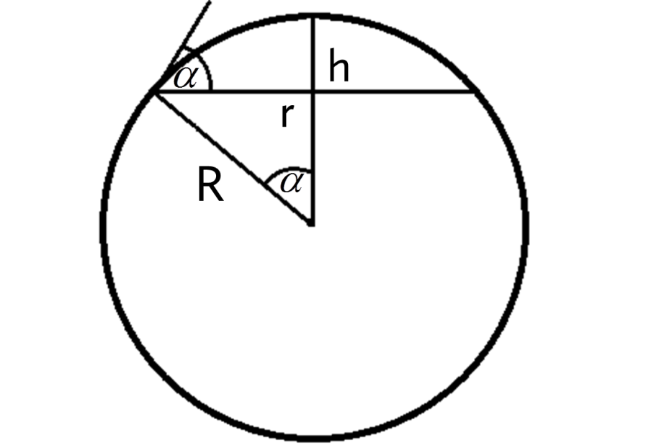
Volume of liquid and solid
27

Slide 28
Equation for alpha
Solution:

Slide 29
Measured angle of approximately 25° on our droplet
25°

Slide 30
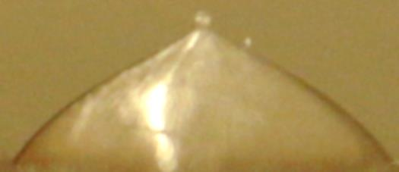
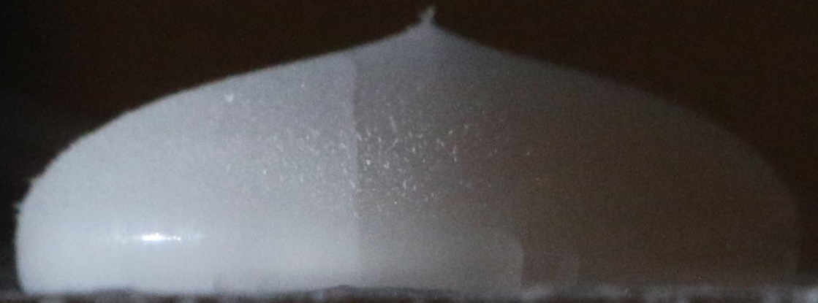
Seemingly different droplets
25°
25°
25°

Slide 31
25°
25°
25°
25°
25°
25°
Different droplets but we still
measured approximately 25°
on each one

Slide 32
Simulation
Heat conduction
Rotational symmetry
No heat transfer to the air
Plate: constant temperature

Slide 33
Simulation time increment
Droplet is divided into segments with thickness h, contact area S
Heat conduction between segments, thermal conductivity k
Layer of new ice added; latent heat of freezing L

Slide 34
Simulation

Slide 35
Real droplet vs simulated one

Slide 36
Freezing: Simulation vs. Experiment

Slide 37
Freezing: Simulation vs. Experiment

Slide 38
Summary of preliminary experiments
Changeable parameters
Droplet
Volume
Surface
Inclination
Curvature
Material
Contact angle
Temperature
No qualitative
changes
Plastic
Metal
-12,5°C
-35,1°C
Ceramics
-21,8°C
-57,8°C

Slide 39
Conclusion

Slide 40
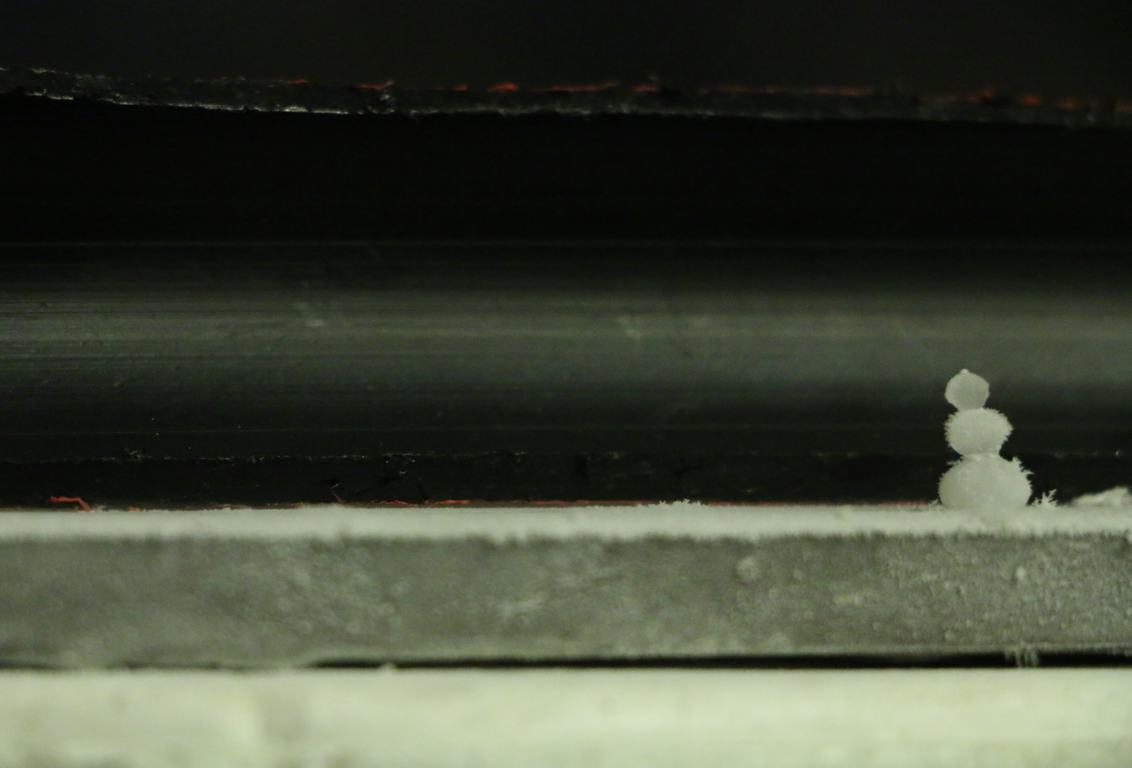
Thank you for your attention
Yes the snowman is made from frozen droplets r=cca 3mm

Slide 41
Apendix

Slide 42
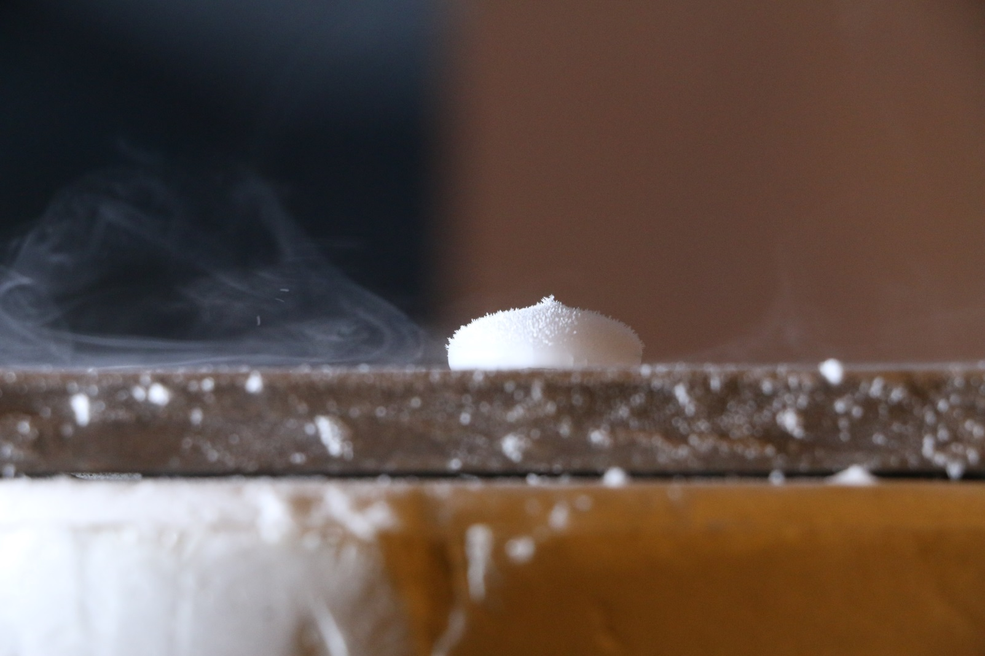
Hairiness
42

Slide 43
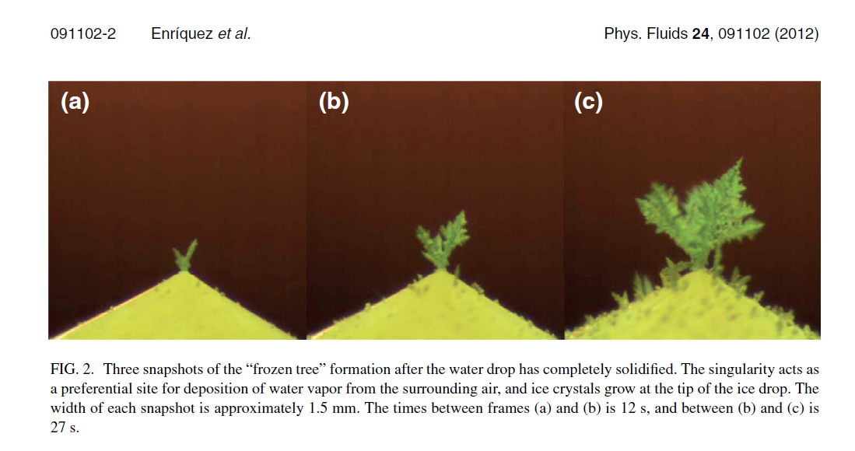
Hairy droplets – known problem
43

Slide 44
Volume of solid
v
r
44

Slide 45
Volume of liquid
h
r
R
45

Slide 46
Spherical shape of the droplet
$$\text{Bo} \text{= }\frac{ρgR^{2}}{γ}$$
$ρ$ : liquid density
g : gravity acceleration
R : diameter of perfect sphere with the same volume
$$γ :surface tension$$
46
Notes:
Pomer hydrostatickej sily ku povrchovému napätie. Charakterizuje tvar kvapky.
The dimensionless parameter that quantifies the
importance of gravity compared to surface tension is the
Bond number
46

Slide 48
Solidifying sessile water droplets W. W. Schultz, M. G. Worster, D. M. Anderson

Slide 49
The shape of solidifying droplet when ρ = 0.9

Slide 50
Close up

Slide 51
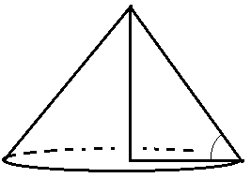
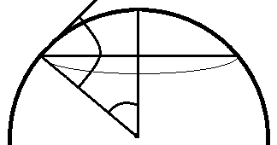
51

Slide 52
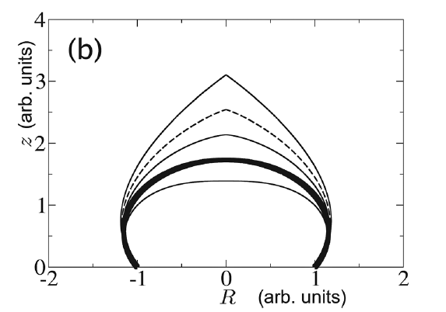
But our physical
model of linear freezing
is insufficient
Our math model
is sufficient

Slide 53
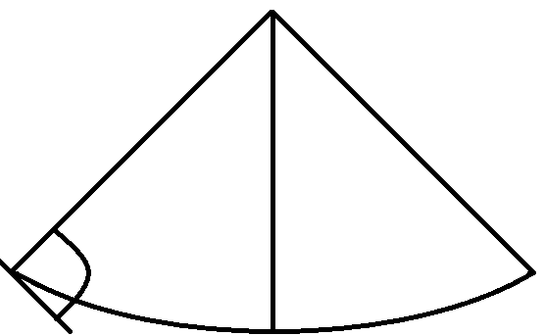
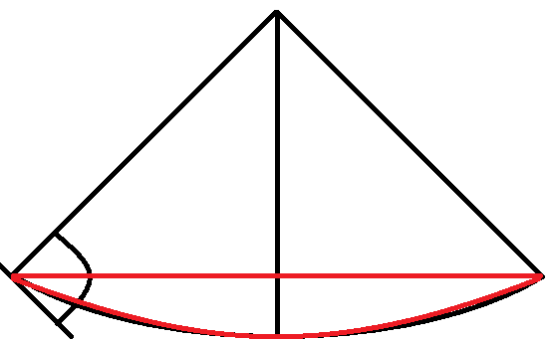
Shape of reservoir
α=90°
Its a spherical cap!

Slide 54
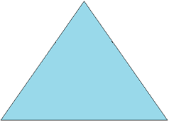
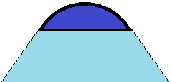
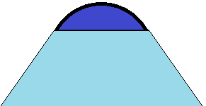
Planar freezing
Vl
Vs
Using known formulas for volumes
Spherical cap
Cone

Slide 55
Planar freezing
Vl
Vs
We can calculate density/pike angle relation

Slide 56
Angle of cone vs ratio of densities
Existence of cone only for P < 0,75

Slide 57
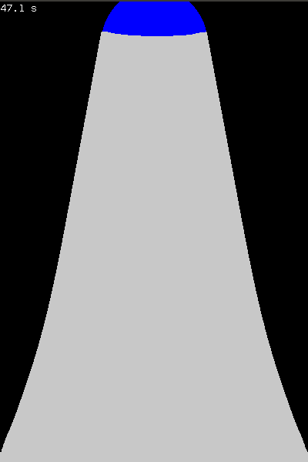
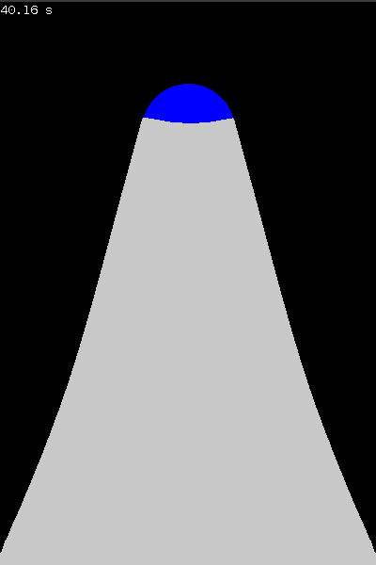
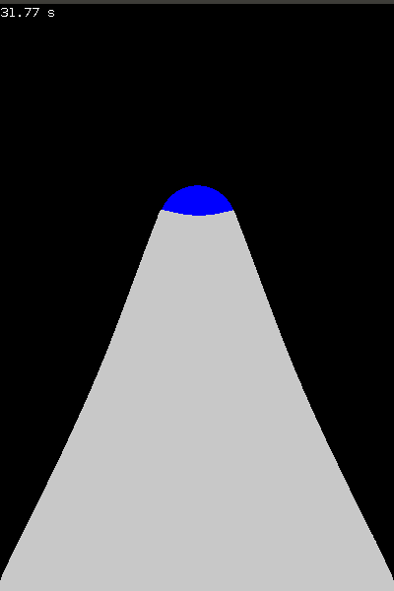
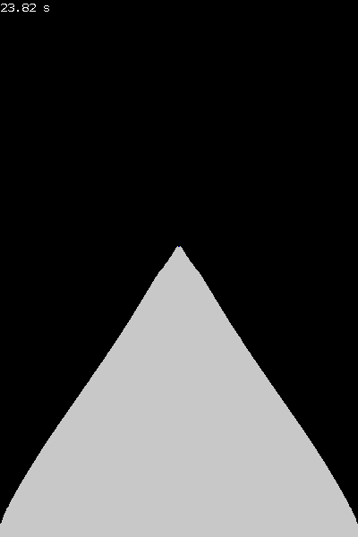
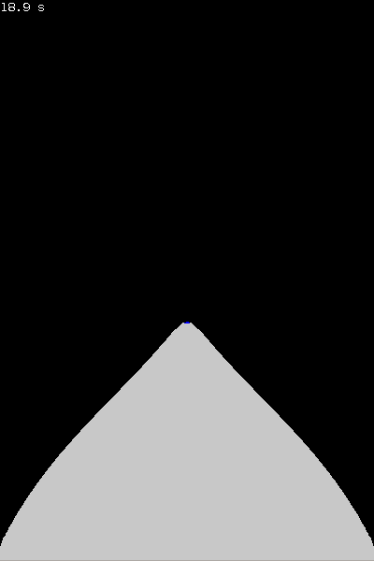
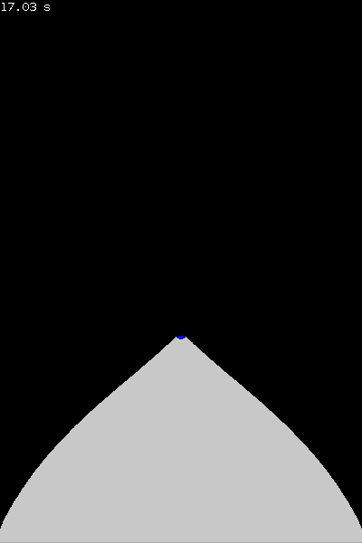
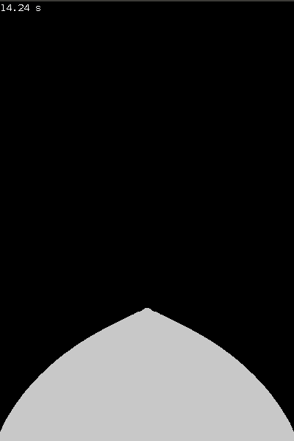
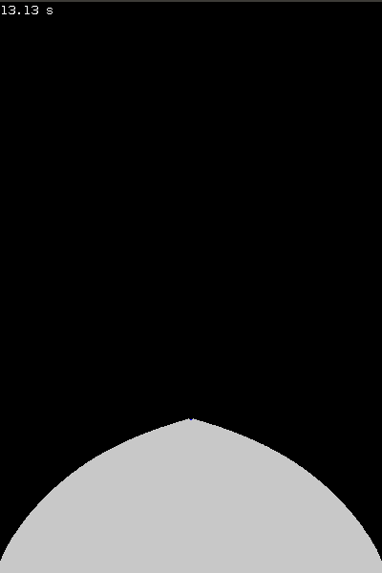
Simulated droplets with different P
0,05
0,3
0,4
0,5
0,65
0,75
0,80
0,85
0,9
0,95
1

Slide 58
Simulation vs theory

Slide 59
Simulated extremes - size
3 times smaller
10 times larger
Change of peek angle is negligible

Slide 60
Simulated extremes - temperature
-12°C
-60°C
Change of peek angle is negligible

Slide 61
Simulated extremes – heat capacity 34kJ
Change of peek angle is negligible

Slide 62
Simulated extremes – radius of contact area
r=2,5 mm
r=4 mm
Change of peek angle is negligible

Slide 63
Simulated extremes – radius of contact area r=5 mm
Change of peek angle is negligible

Slide 64
Simulated extremes – conductivity 4 times larger
Change of peek angle is negligible

Slide 65
Simulated extremes – all together
Change of peek angle is negligible

Slide 66
Density ratio
it works
Bismuth (Bi)
Antimony (Sb)
Silicon (Si)
Germanium (Ge)
Gallium (Ga)
Water
Toxic
High temperature
of melting

Slide 67
Stare slidy

Slide 68
Existing literature
“Pointy ice-drops: How water freezes into a singular shape“ J.H. Snoeijer and P. Brunet Am. J. Phys. 80, 764 (2012)
Planar freezing
Ratio of densities
Critical ratio of densities to create convex pike is ¾
Water is not predicted to create convex pike
Notes:
Simple mathematical modelling
Spherical droplet

Slide 69
Formation of pike for different density ratios – linear freezing
Water
P=0.9
P = 0.65
Obviously wrong
P = 0.75
P = 0.85
P = 1
P = 1.2
Result => P≥0.75 => pike

Slide 70
Middle section of a freezing droplet
Assumed shape
Real shape
Exact shape of reservoir?

Slide 71
Middle section of freezing droplet
Assumed volume
Real volume

Slide 72
Angle/density ratio
For p<1 => pike is created
Water

Slide 73
Simulation of the process of freezing
Heat convection
Changeable parameters
Density ratio
Volume of droplet
Contact area
Temperature of plate
Heat capacity
Heat conductivity

