Slide 1
Hologram
2
Mário Lipovský
Notes:
Niekto, kto bude ukazovať hologramy – IYPT pri začiatku, 3D kocka

Slide 2
Task
It is argued that a hologram can be hand made by scratching a piece of plastic.
Produce such a ‘hologram’ with the letters ‘IYPT’ and investigate how it works.

Slide 3
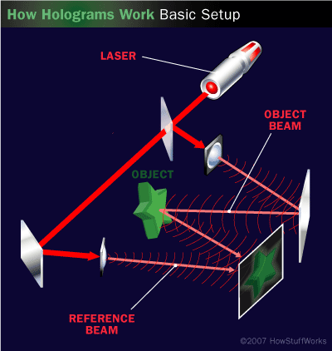
Real hologram - 3D image stored in 2D
This is not our case
What is scratched “hologram”
in this task?

Slide 4
Simple scratch on the plastic
IYPT
Boring 2D image
Light is scattered to all directions
Both eyes see the image at the same position
Whole image visible on the surface

Slide 5
“Hologram” = advanced image
If 2 eyes see 2 different images
Final image is visible over/under the surface
IYPT
IYPT
IYPT

Slide 6
“Hologram” = advanced image
2 eyes see 2 different images
How can this be achieved?
Light can’t be scattered to all directions
IYPT

Slide 7
Smooth scratch – planar scatter
Light is scattered
in only 1 plane
Only 1 eye
can see the image
at this position

Slide 8
Smooth scratch – conical scatter
Incident rays
Light is reflected into
a conical shape
Only 1 eye can see point at this position
Reflected rays

Slide 9
Circular scratch behaviour
Eye can see 2 points – symmetrical scratch
2 different points
each visible by 1 eye
form a point in space

Slide 10
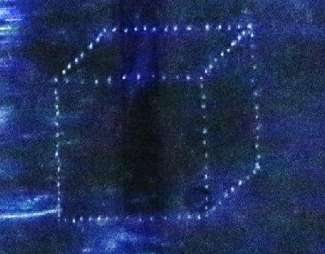
Hologram of 2D view of cube
Visible image
Circular scratches
Circle centres
More points of reflection
= reflected line

Slide 11
2D hologram is easy to create
Let’s create 3d hologram

Slide 12
Depth of point vs. radius of circle
Concentric circles
= line perpendicular to surface

Slide 13
Creating 3D hologram
Sketch
Concentric circles = perpendicular
Constant radius = parallel

Slide 14
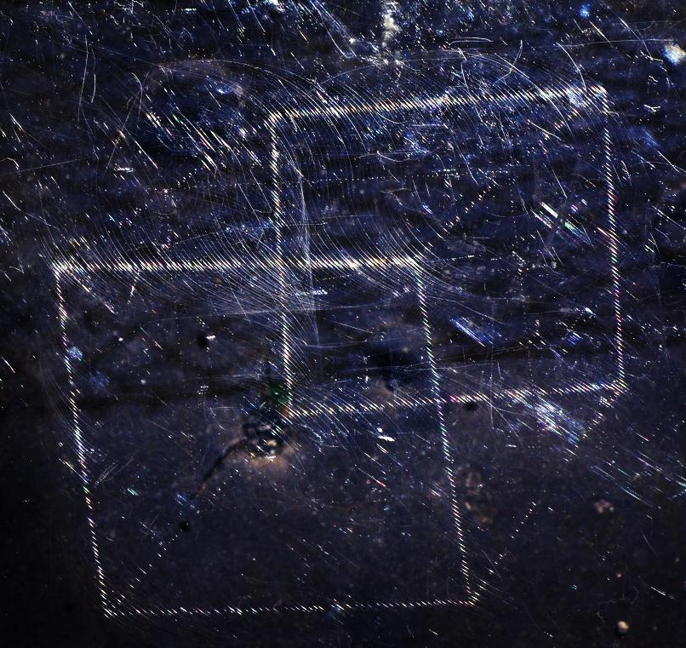
3D hologram

Slide 15
Exact calculation of REFLECTION points

Slide 16
Geometry of the beam
Normal
Beam reflected to the eye
Incident beam
$$α$$
$$β$$
$$α$$
(tangential to scratch)
$$β$$
Point, we are interested in
Scratch
(Unit vectors)
Condition of shining:

Slide 17
Condition of reflection
Which points on a circle fulfill this condition?
Too difficult to solve analytically
Simulation
C++, OpenGL 3D graphics
Numerically checks the condition
for 600+ points on each circle

Slide 18
Simulation

Slide 19
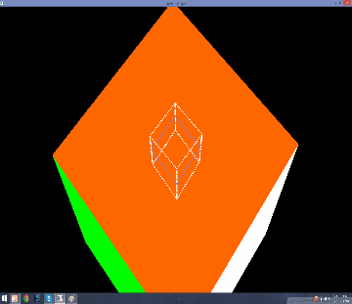
Simulation output

Slide 20
Experimental verification of theory

Slide 21
Experimental conditions
Light and hologram - stay at the same place
Camera moves horizontally
Camera moves vertically
IYPT
IYPT

Slide 22
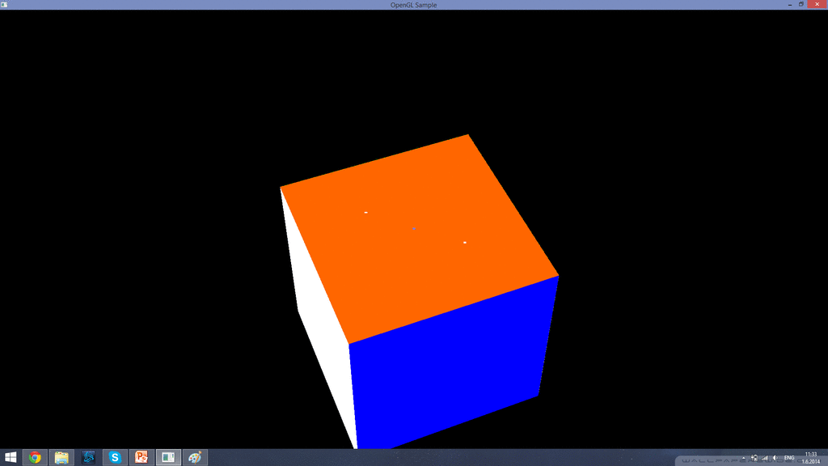
Horizontal camera movement
Angular position
of 1 point
Horizontal displacement
of camera
vs.
α
shift

Slide 23
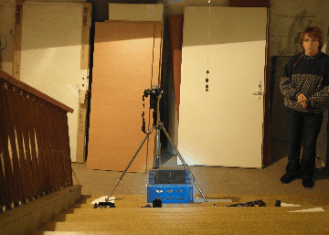
Experimental setup
Camera shift
Hologram shift

Slide 24
Horizontal movement - simulation
α
shift

Slide 25
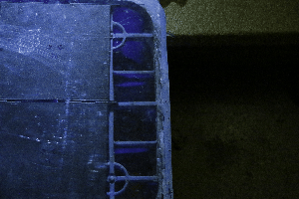
Simulation vs. experiment
Horizontal movement

Slide 26
Vertical camera movement
Distance
of 2 points
Vertical displacement
of camera
vs.
distance

Slide 27
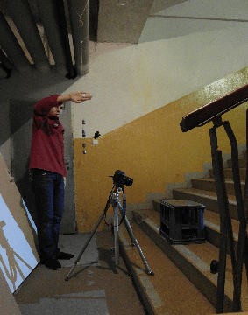
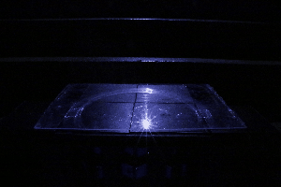
Experimental setup
Notes:
Powerpoint nevie orezavat gify, tak sa necudujte

Slide 28
Vertical movement - simulation

Slide 29
Simulation vs. experiment
Vertical movement

Slide 30
Simulation vs. experiment
Vertical movement
Above straight reflection
α
α

Slide 31
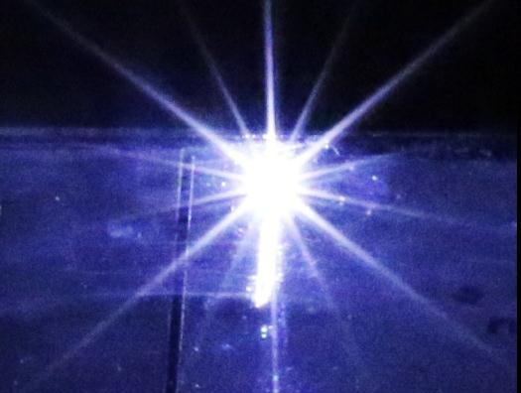
Simulation vs. experiment
Vertical movement
In the straight reflection
α
α

Slide 32
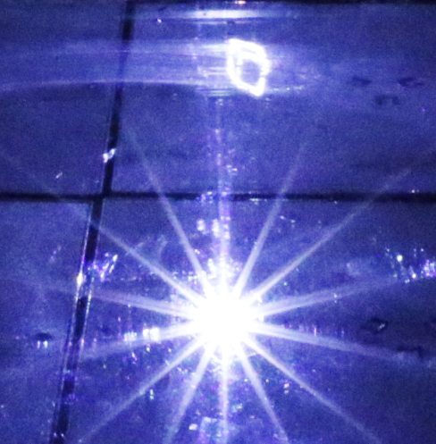
Simulation vs. experiment
Vertical movement
Below straight reflection
α
α

Slide 33
CONCLUSION

Slide 34
Conclusion – simple mechanism
Simple scratch = boring image
“Hologram” = image visible under/over the surface

Slide 35
Conclusion – simple mechanism
Scratches = only part of space is lit
Eyes see 2 different images = points in space

Slide 36
Conclusion – simple mechanism
Working 2D & 3D holograms

Slide 37
Theory = geometrical optics
Law of reflection →

Slide 38
Simulation = practical use of theory

Slide 39
Conclusion - Experiments

Slide 40
Experimental verification of theory

Slide 41
Thank you for your attention

Slide 42
Appendices

Slide 43
More than 1 image visible?
Perpendicular reflection = Whole plane is lit
α
β
α
β
Conical area is lit
more points on circle may reflect light
Notes:
Prec

Slide 44
Circular scratch
Line
- Line segments visible
Circle
- Small segments always visible
Notes:
prec

Slide 45
Human 3D vision mechanism
Distance
Object

Slide 46
Position of shining point on circle

Slide 48
Scratch on the plastic

Slide 49
Radius of the circle sratch
We see section of a circle → radius $∝$ length of the shining part
Small radius 13cm
Large radius 30cm

Slide 50
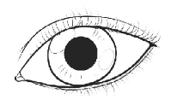
Distance vs. radius
Distance is propotional to radius
We can create straight
line through space

