Slide 1
Loaded hoop
5
Mário Lipovský

Slide 2
Task
Fasten a small weight to the inside of a hoop and set the hoop in motion by giving it an initial push.
Investigate the hoop’s motion.

Slide 3
Types of hoop motion
Rolling
Spinning
Skidding
Jump
ω
v
N

Slide 4
1) Rolling
m_{weight} = 22g
m_{hoop} = 28g
r_{hoop} = 41 mm

Slide 5
1) Rolling
Conservation of mechanical energy
Rolling condition
can be calculated from
Rotational kinetic energy of the system
Potential energy of the system
Translational kinetic energy of the system
Friction force is strong enough
to prevent slipping
ω
θ
G[x, y]
N
F

Slide 6
2) Spinning/Skidding
m_{weight} = 322g
m_{hoop} = 28g
r_{hoop} = 41 mm

Slide 7
2) Spinning/Skidding
Newton’s laws of motion
ω can be calculated by
numerical integration of ε
Torque equation
Friction force reaches
it’s maximum
:
my
:
mx
θ
G[x, y]
mg
N
F

Slide 8
3) Jump
m_{weight} = 220g
m_{hoop} = 28g
r_{hoop} = 41 mm

Slide 9
3) Conditions needed to jump
Forces
gravity
centrifugal
Condition of leaving the ground
:
ω
my
:
mx
mg
N

Slide 10
3) When does hoop jump?
Jump occurs
ω
θ
G[x, y]
Jump occurs
Notes:
Overit

Slide 11
3) When does hoop jump?
Jump occurs
ω
θ
G[x, y]
Jump occurs
Notes:
Overit

Slide 12
3) Jump
Hoop – Constant ω around centre of gravity
Centre of gravity – projectile motion

Slide 13
Types of hoop motion
Rolling
Spinning
Skidding
Jump
How to determine changes
of motion types?
ω
v
N
F

Slide 14
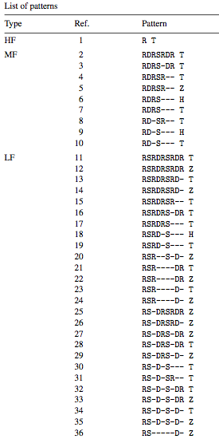
What has been done
Analysis of Rolling Motion of Loaded Hoops
[ W.F.D. Theron ]
4 types of motion
Combined into 36 patterns
Numerical simulation
Observed only 1 x 360° rotation
Stopped right after the hoop leaves ground
Our own simulation
Compare with our experiments
Simulate jump

Slide 15
Simulation
Init. conditions (x, θ, ω)
1) Rolling
2) Skidding / Spinning
3) Jump
Numerical solution, using method of small increments (t)

Slide 16
Simulation

Slide 17
Experiments
Constant parameters
r – hoop radius
hoop material (rigid)
f – coefficient of friction (ground)
Changing parameters
ω – initial velocity
m – mass of weight

Slide 18
1) Rolling
m_{weight} = 22g
m_{hoop} = 28g
r_{hoop} = 41 mm
Notes:
OVERIT PRVE VIDEO

Slide 19
Angular displacement in time θ(t)

Slide 20
Position of centre of mass y(t)

Slide 21
2) Spinning/skidding
m_{weight} = 322g
m_{hoop} = 28g
r_{hoop} = 41 mm

Slide 22
Position of centre of mass y(t)

Slide 23
3) Jump
m_{weight} = 220g
m_{hoop} = 28g
r_{hoop} = 41 mm

Slide 24
4) Oscillation
m_{weight} = 3,6g
m_{hoop} = 3,9g
r_{hoop} = 20,4 mm

Slide 25
m_{weight} = 22g
= small eccentricity
mostly boring rolling
Phase diagram of movement
What happens in time?
ω₀ = 10 rad/s - rolling
ω₀ = 15 rad/s - still rolling …
ω₀ = 20 rad/s - spinning/skidding occur
ω₀ = 25 rad/s – finally some jump
rolling
skidding
spinning
jump

Slide 26
m_{weight} = 214g
= higher eccentricity
Phase diagram of movement
Irregularities – spinning/skidding occur at lower velocities
Immediate jump
rolling
skidding
spinning
jump

Slide 27
m_{weight} = 322g
Phase diagram of movement
Increasing eccentricity – shift of patterns to lower velocities
rolling
skidding
spinning
jump

Slide 28
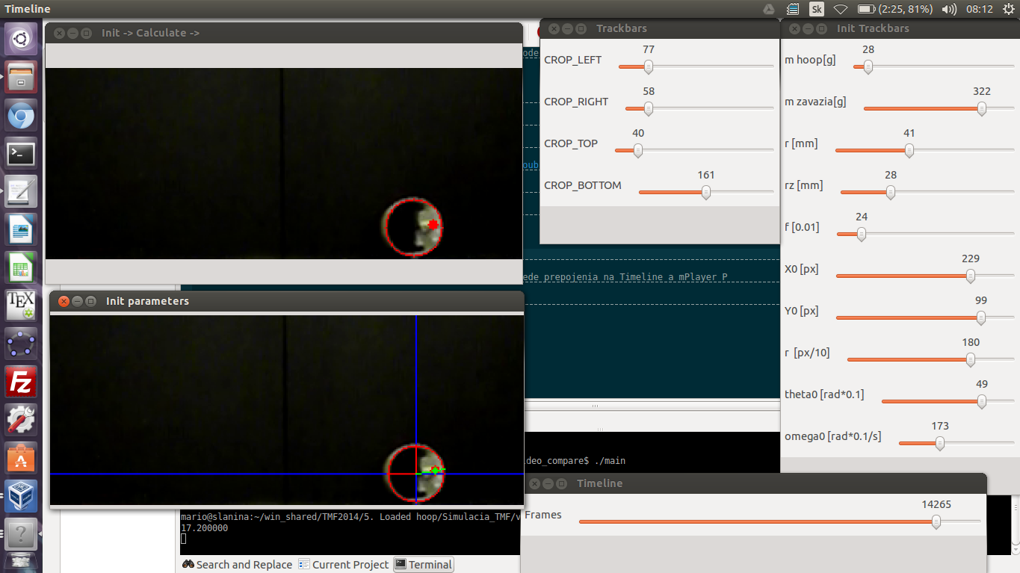
Conclusion
Description of types of motion
1) Rolling
2) Spinning/Skidding
3) Jump
Theoretical prediction of motions
1) Rolling
2) Spinning/Skidding
3) Jump
Numerical simulation
Theory & simulation proved by experiments
Thank you for your attention

Slide 29
Thank you for your attention

Slide 30
Appendices

Slide 31
Comparison to original paper [W.F.D. Theron]
γ = 3/4
f = 0,4

Slide 32
Comparison to original paper [W.F.D. Theron]
γ = 3/4
f = 0,09

Slide 33
Description of the system
Centre of hoop S [X, Y]
Angular displacement θ
Centre of gravity G [x, y]
Normal force
Friction force
ω
:
my
:
θ
mx
S[X,Y]
G[x, y]
mg
N
F

Slide 34
Description of the system
ω
:
my
:
θ
mx
S[X,Y]
G[x, y]
N
F

Slide 35
Elastic hoop – obvious difference in motion

