Slide 1
Pot-in-Pot refridgerator
7
Natália Ružičková

Slide 2
Task
The ‘pot-in-pot refrigerator’ is a device that keeps food cool using the principle of evaporative cooling.
It consists of a pot placed inside a bigger pot with the space between them filled with a wet porous material, e.g. sand.
How might one achieve the best cooling effect?
Low temperature
Fast cooling

Slide 3
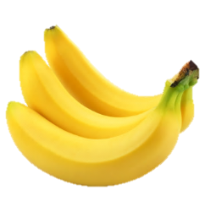
Mechanism
Wet porous material: Evaporation → latent heat → cooling
Heat transfer from the environment
Equillibrium:

Slide 4
Preliminary Experiment
Porous material: sand
Works, but could be better

Slide 5
Evaporation requirements
Must be wet (capillarity)
Exposed to air flow

Slide 6
Sand: a granular material
Big granules:
→ Better airflow
→ Water drains down
Small granules:
→ Can soak with water
→ Little space for airflow

Slide 7
Other kind of porous material: Cloth
Gets soaked with water
Can be exposed to air flow on sufficient area

Slide 8
Cloth vs. sand: the difference
We have a working refrigerator

Slide 9
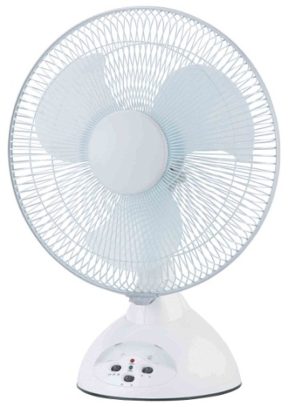
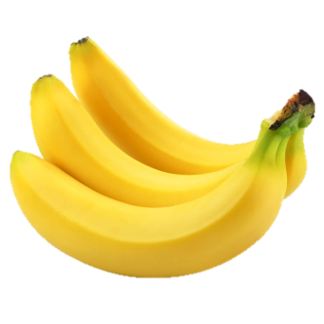
A working refrigerator
Airflow
Porous material: cloth
Inner pot
Outer pot
Liquid (water) for evaporation
Content

Slide 10
Task
“How might one achieve the best cooling effect?”
Simple model of the cooling
Experimentally verify & optimize
Estimate the best possible cooling
Low temperature
Fast cooling

Slide 11
Model of the cooling

Slide 12
Model of the cooling effect
Evaporation rate: $dm=ASvdt$ $A:$ related to volatility of the liquid (in air)
Heat transferred from the surroundings: $dQ=BSvΔTdt$ $B:$ related to thermal conductivity, capacity of air
$S$ Surface area
$v$ Air flow speed
$ΔT$ Temperature difference

Slide 13
Model of the cooling
Calorimetry:
Final temperature drop:
Speed of cooling:

Slide 14
Experimental verification & investigation

Slide 15
1. High vs. low outer pot
Terminal temperature:
depends on materials only → Equal
Cooling rate:
more water → bigger $C$ → slower cooling

Slide 16
High vs. low pot: final temperature
Both models:
the same terminal temperature

Slide 17
High vs. low pot: rate of cooling
Low outer pot:
Less water → smaller thermal capacity → faster cooling

Slide 18
2. Size and shape of the fridge
Terminal temperature:
Independent of size/shape
Speed of cooling:
Independent of size/shape
Empty refrigerator: Proportional to surface area

Slide 19
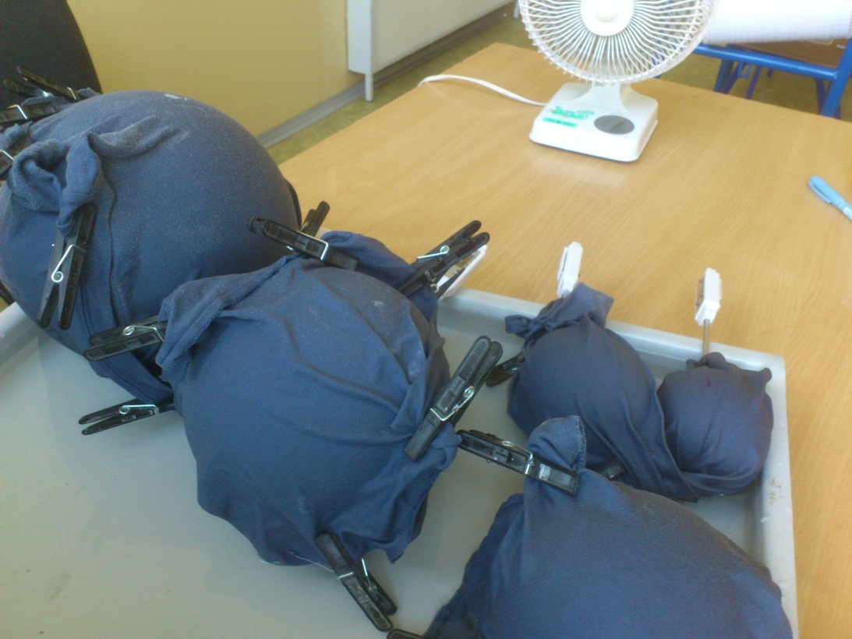
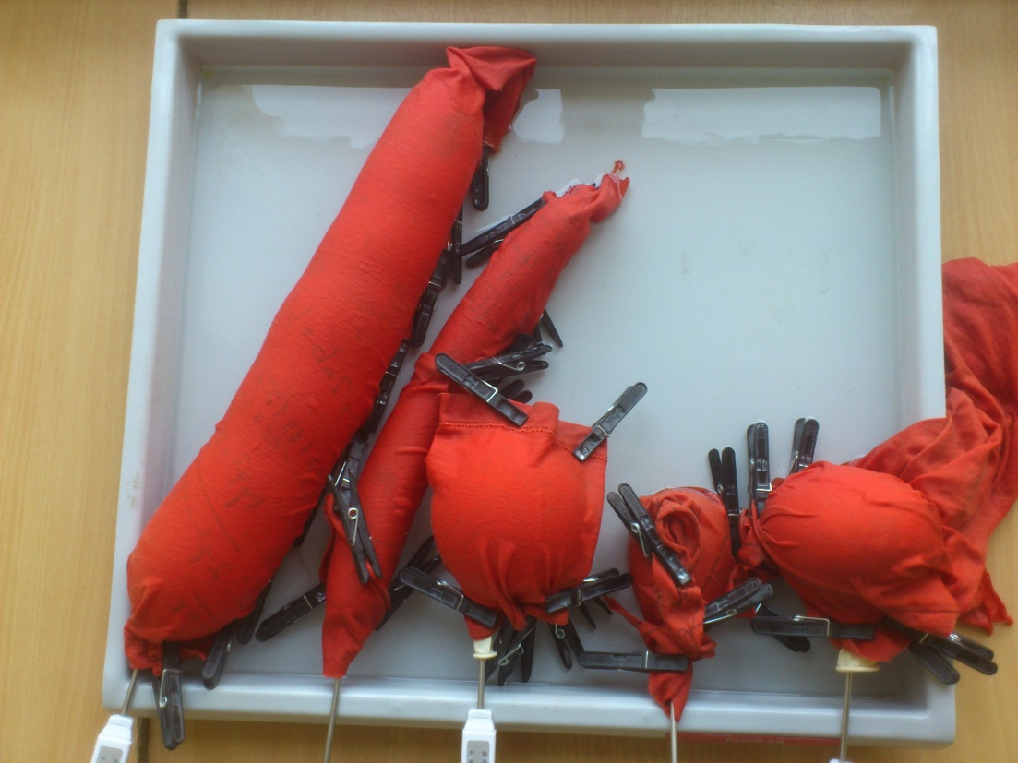
Effect of different sizes

Slide 20
Effect of different size

Slide 21
Effect of different shapes
Size and shape of an empty fridge:
No effect on cooling

Slide 22
3. What’s inside
Terminal temperature:
Independent of content
Speed of cooling:
High capacity → slower cooling

Slide 23
Changing heat capacity of the fridge
Sand, slower cooling
Bigger capacity → slower cooling
No effect on final temperature
Air, quicker cooling
Water, slowest cooling

Slide 24
4. Different liquid
Terminal temperature:
Grows with volatility & latent heat
Speed of cooling:
Independent of liquid (only a small capacity difference)

Slide 25
Water VS. Etanol:
More volatile liquid → lower terminal temperature

Slide 26
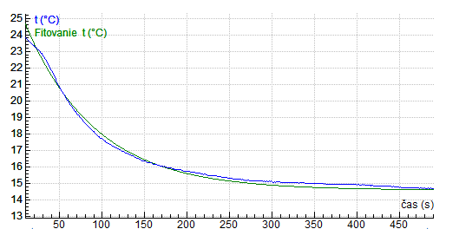
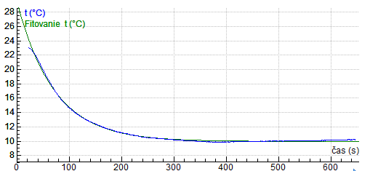
Water vs. ethanol: exponential fit
Water
Ethanol
Different liquids → similar speed of cooling
Slight difference: different thermal capacity

Slide 27
What is the best possible effect?

Slide 28
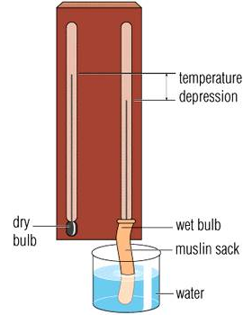
Minimal temperature estimation
Analogical phenomenon: Assman psychrometer
Wet and dry thermometer
Wet is cooler due to evaporation
Equilibrium state:
Solution:
Sufficient airflow

Slide 29
Wet bulb vs. refrigerator
We can get close to the theoretical minimum

Slide 30
Minimal achievable temperature

Slide 31
Best cooling effect
Sufficient air flow
Maximize the area of evaporation
Minimal temperature
volatile liquid with low concentration in air (eg. Ethanol)
speed
Minimise thermal capacity of the fridge (eg. Low outer pot)

Slide 32
Thank you for your attention

Slide 33
APPENDICES

Slide 34
Assman psychrometer theory
Assumptions:
Air cools to T_{fridge}; vapor pressure saturates
(thanks to fast airflow)
Equilibrium of heat flow:
Numerically solve for
(complicated function )
Wet bulb

Slide 35
Extra measurements

Slide 36
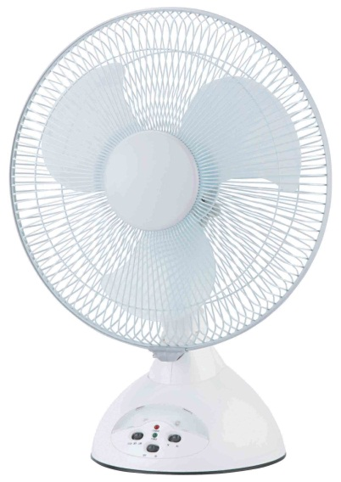
Airflow importance

Slide 37
Water vs. ethanol: Rate of evaporation
→ Ethanol: more volatile

Slide 38
Do we need cloth or not?

Slide 39
What is the best material for cloth?

Slide 40
Why the type of cloth does NOT matter?
1) Water fills gaps
2) Water soaks
Water fills gaps.
The surface of water = the area of evaporation
→ The same as normal cloth
Area of evaporation
=
area through which heat gets in
Equilibrium temperature doesn’t change

Slide 41
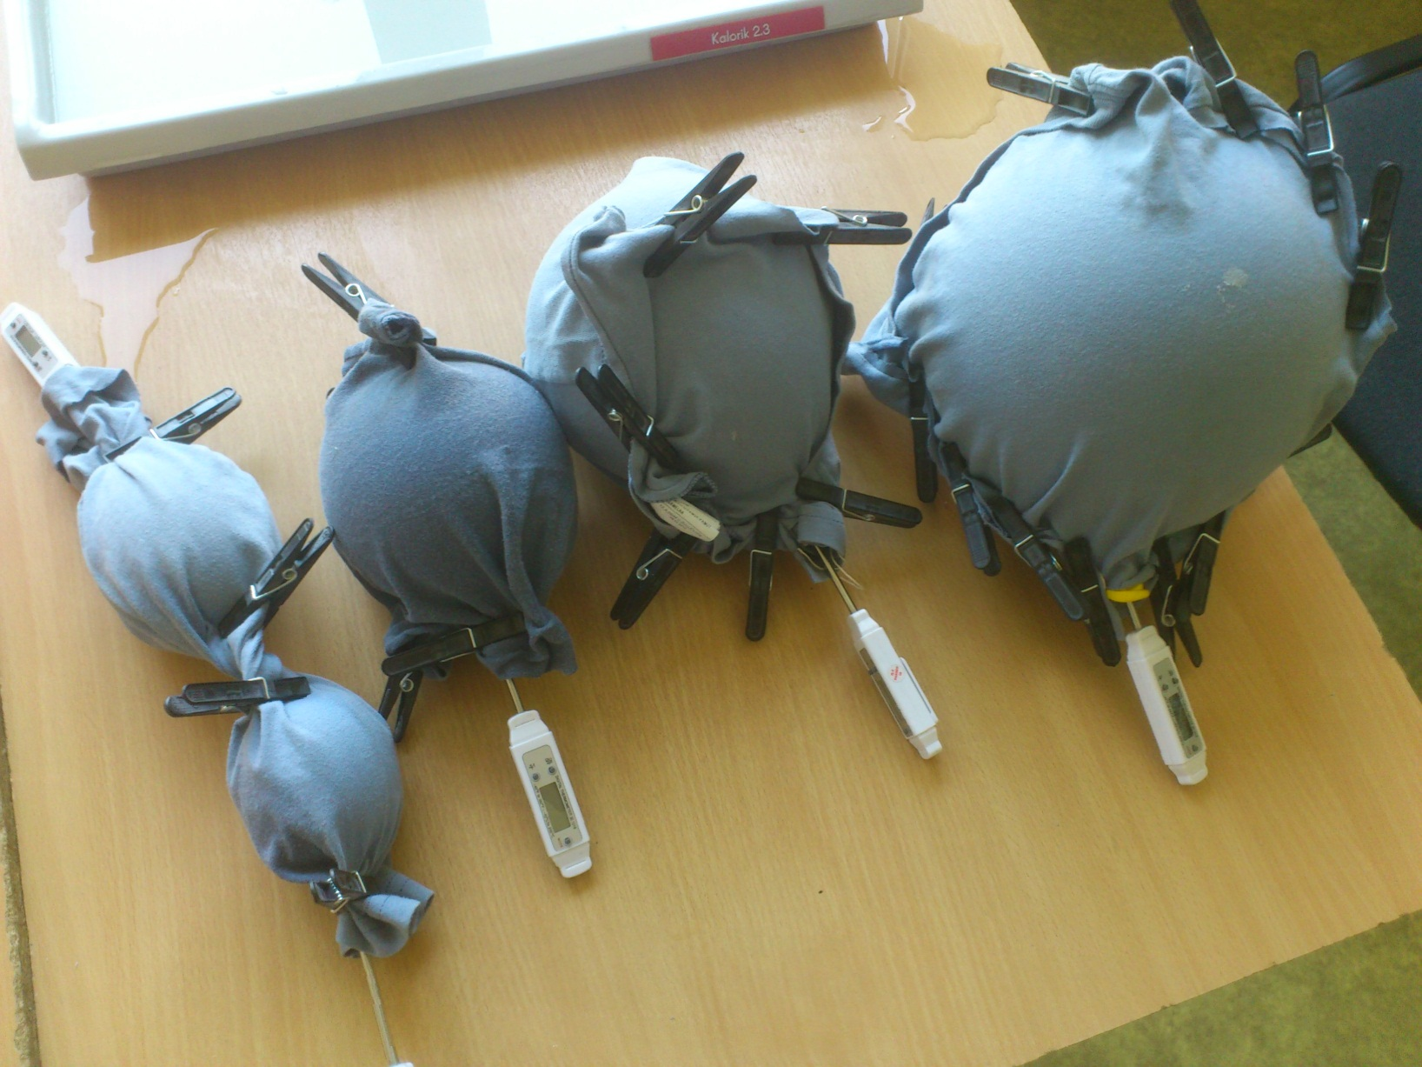
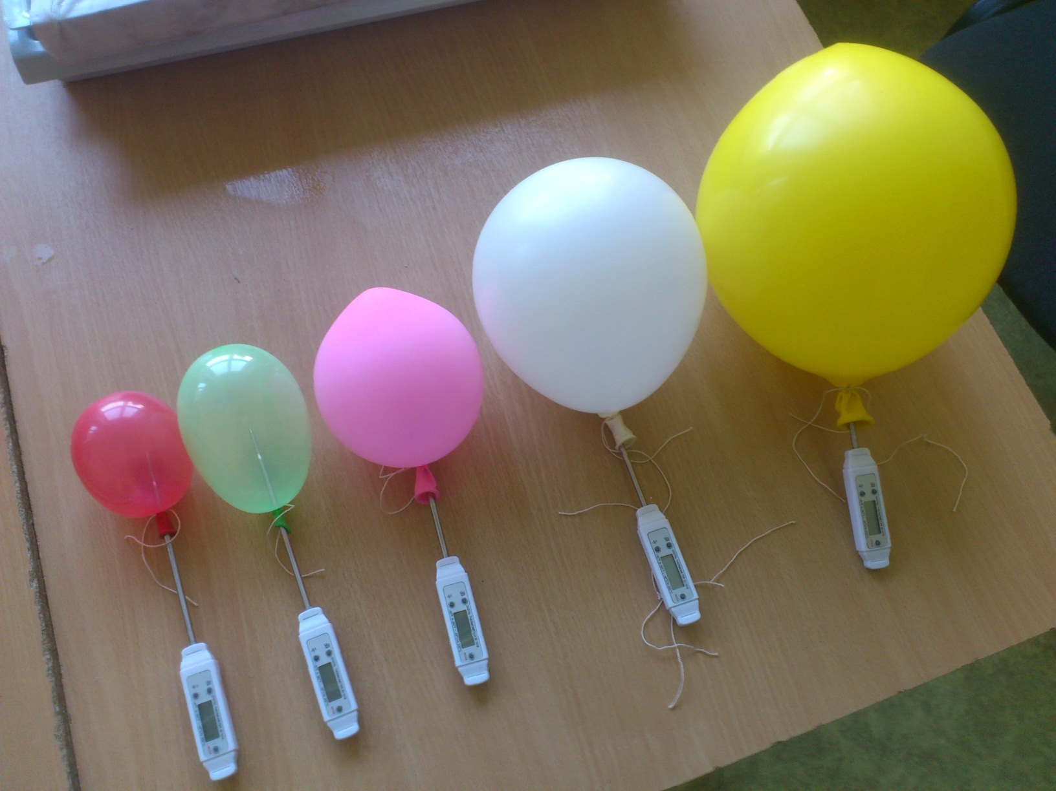
Effect of different sizes

Slide 42
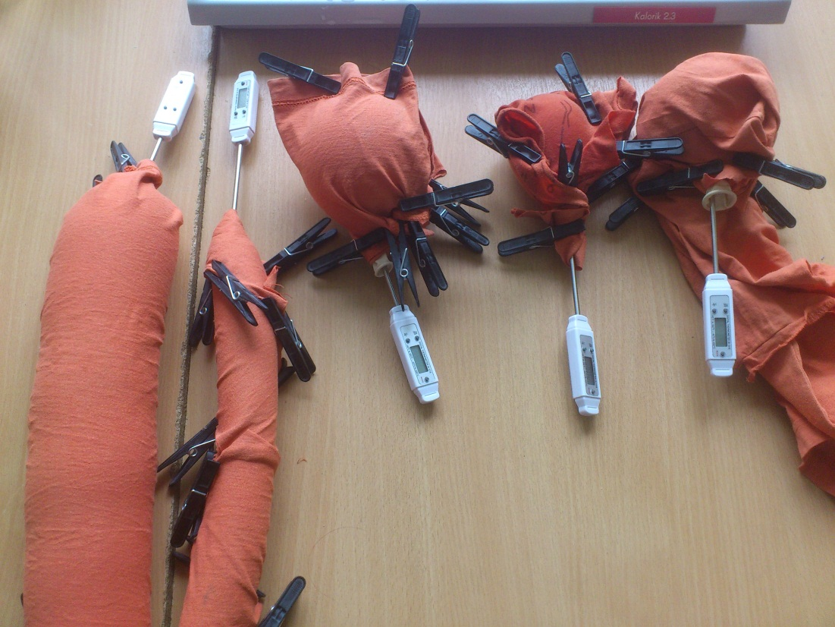
Effect of different shapes

Slide 43
Our refrigerator

Slide 44
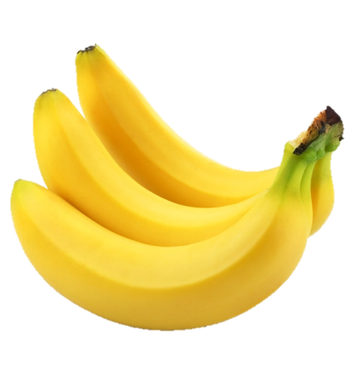
Covered VS uncovered areas
Uncovered areas → heat gets in
Covered areas
→ Evaporation + heat gets in
Height of cloth

Slide 45
Does area of cloth matter?
Whole fridge must be covered

Slide 46
Why istn’s the second pot needed?
only requirement for fridge’s surface
…ISOLATED AREAS MUST BE UNCOVERED WITH CLOTH
So that area of evaporation
=
area trough heat gets in
Area of evaporation
=
area through which heat expands
We do not need the second pot

Slide 47
Speed of cooling
k1= ability of liquid to evaporate [kg/m3]
k2= part of air which cools down [J/Km3]
1/tau
Properties of liquid
Temperature difference

Slide 48
Assman psychrometer: theory
Equillibrium of heat flow:
Air cools to Tfridge; vapor pressure saturates:

Slide 49
Assman psychrometer: theory
Surrounding air:
Transfers heat to the cloth:
Absorbs water vapor (heat used for evaporation)
Equilibrium (terminal temperature):

Slide 50
Minimal T: theoretical estimation
Terminal temperature:
Numerically solved for
(complicated function )

Slide 51
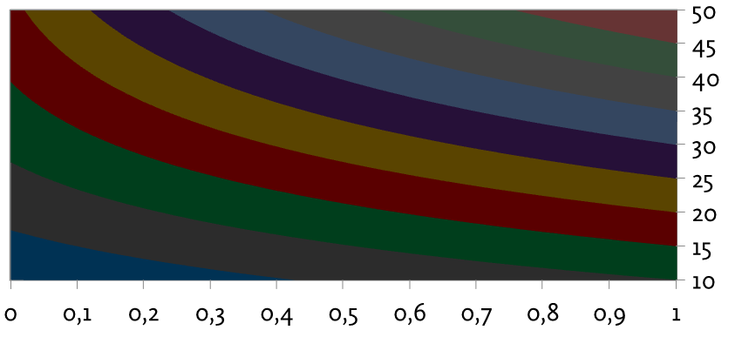
Conclusion – What should the most effective refrigerator look like?
Minimal temperature:
sufficient air flow, maximize evaporation area
volatile liquid with low concentration in air (eg. Ethanol)
Fastest cooling:
Fast air flow
Minimise thermal capacity of the fridge (eg. Low outer pot)
Prediction of minimal temperature

