Slide 1
13. ROTATING SADDLE
Reporter: Natália Ružičková
Notes:
Test poznamok
1

Slide 2
Task
A ball is placed in the middle of a rotating saddle.
Investigate it's dynamics and explain the conditions under which the ball does not fall off the saddle.

Slide 3
How can the rotation help the stability?
Static saddle: just rolls off
Rotating saddle: rolls around the saddle
→ effect of slopes
cancels

Slide 4
Ball’s motion (laboratory ref. frame)
Goes around with the saddle
Centripetal force needed → unstable
Remains stationary
(Rolls back quickly enough)
→stable

Slide 5
Ball’s stability requirements
Sufficient saddle rotation
Cancels the effect of slopes
Rolling backwards
Avoids centrifugal force
How can these be achieved?

Slide 6
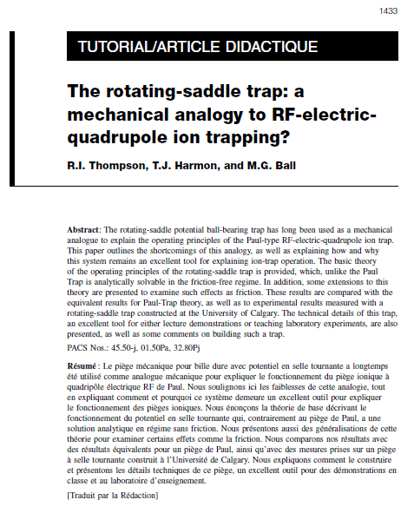
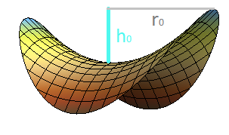
Existing theory
Thompson: The rotating-saddle trap: a mechanical analogy to RF-electricquadrupoleion trapping?
Canadian journal of Physics, Vol. 80, 2002
Koch: Konzeption und Aufbau einer mobilen Experimentiereinheit fur Schuleräprsentationen zum Thema Teilchenfallen
Universität Stuttgard, 2004
Point mass in gravitational potential
Constrained to saddle’s surface
Mathematical trick:
coordinates in complex plane

Slide 7
Solution
ball’s POSITION
Ω: angular velocity (saddle rotation)
A,B,C,D: determined by initial conditions
Condition of stability (z does not diverge):
The only requirement for stability:
f > fc

Slide 8
Experimental verification

Slide 9
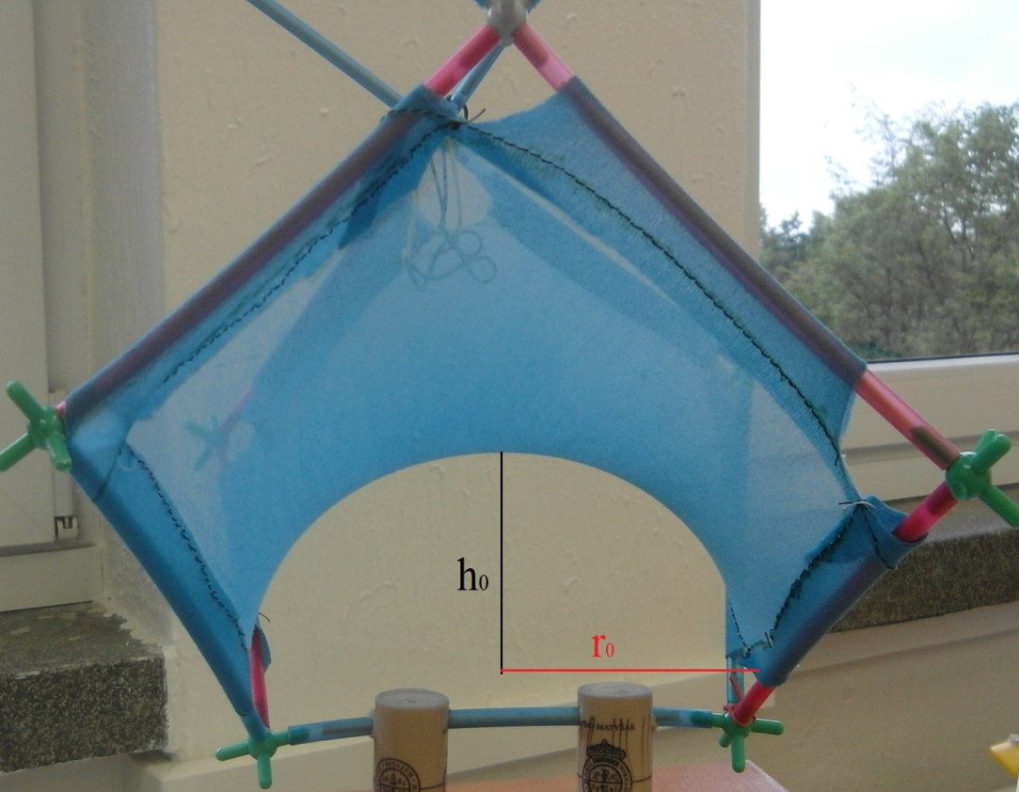
Apparatus: Saddles
h₀ = 6,5cm
r₀ = 8cm
f_{c} = 2,25 Hz
material = nylons
h₀ = 1,5cm
r₀ = 8cm
f_{c} = 1,08 Hz
material = plastic

Slide 10
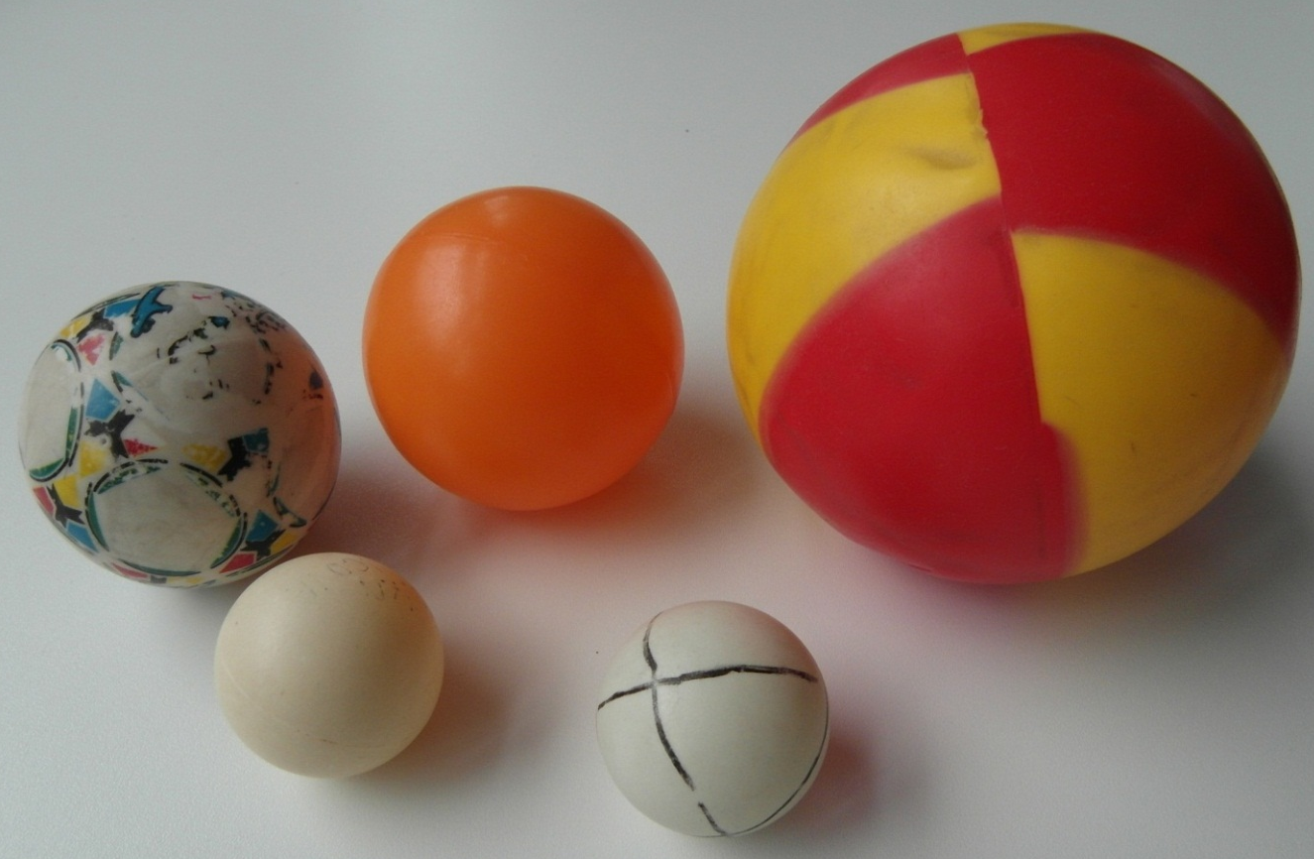
Apparatus: Balls
Radius range:
0,63 cm – 3,26 cm
Mass range:
8,39 g – 35,79 g
solid
Radius range:
1,88 cm – 5,0 cm
Mass range:
2,46 g – 26,56 g
hollow

Slide 13
Stability vs. Frequency
WHY?
… drag forces
Significant increase in lifetime
but clearly not infinite

Slide 14
Second condition: Must roll back fast enough
Friction/rolling resistance:
Drags the ball to rotate with the saddle
Ball becomes unstable

Slide 15
Literature: Effect of friction
Thompson:
Analytical solution; always diverges
Koch:
Numerical solution; no record of stability
Maximal lifetime
Stability

Slide 16
Parametres affecting the lifetime
Drag forces & Friction
Frequency
Ball ≠ point mass
Initial position
?

Slide 17
1. DRAG forces & FRICTION

Slide 18
Effect of friction
Thompson:
Higher friction → lower lifetime
TL = trapping lifetime
σ ~ friction coefficient
R = initial distance from the center
r₀= trap's radius

Slide 19
1. Lifetime vs. Friction: Experiment
DRY
NYLON SADDLE
μ=0,25
MAXIMUM LIFETIME:
2,25s
NYLON SADDLE
SOAKED WITH WATER
μ=0,09
MAXIMUM LIFETIME:
6,33s
>
PREDICTION CONFIRMED
<

Slide 20
Not so simple
Koch’s article:
 | Teflonspray (lower friction) | Clean saddle (higher friction)
Lifetime | 10,1s | 54,7s
HIGHER FRICTION
HIGHER LIFETIME
?

Slide 21
What if the ball does NOT slip?
EXPECTATION:
High friction → Slipping → Short lifetime
SUFFICIENT FRICTION
Avoids slipping
Causes ball’s rotation

Slide 22
Sufficient friction: no slipping
Similar to zero friction (no slip)
Dragging effect:
only rolling resistance (much lower than dynamic friction)
Relatively stable:
Zero friction
Sufficient friction

Slide 23
Measurement: Slipping vs. Rolling
Slipping (dynamic friction)
Rolling (static friction)
SUFFICIENT FRICTION
=
HIGHER LIFETIME
AVERAGE LIFETIME:
(30 measurements)
2,7 s ± 0,4 s
AVERAGE LIFETIME:
(30 measurements)
8,8 s ± 2,6 s

Slide 24
Parameters affecting lifetime
Friction
dynamic: the lower, the longer lifetime
static: fulfills ‘no slipping’ condition
Frequency
Moment of inertia
Initial position
?

Slide 25
2. Frequency

Slide 26
JUMPING

Slide 27
1. Ball free to move upwards
Very fast rotation: insufficient g to follow the saddle’s curvature
Height changes harmonically
UP
UP
DOWN
height
DOWN
Harmonic frequency = 2Ω
time

Slide 28
Condition of jumping
Saddle shape in polar coordinates
Vertical acceleration:
Constrained to surface
Jumps
Critical frequency for jumping:
r
h

Slide 29
Estimation vs. reality
TOO HIGH FREQUENCY
NO MORE CONSTRAINED TO SADDLE’S SURFACE
LOWER LIFETIME
We measured the distance in which jump occurred and estimated the frequency
Measured frequency:

Slide 30
Parameters affecting lifetime
Friction
Frequency
Lower limit: rise of lifetime
Upper limit: jumping
Moment of inertia
Initial position
?

Slide 31
3. Moment of inertia

Slide 32
Hollow VS. Solid Ball
Greater moment of inertia
More energy needed for rolling
Lower speed
Longer lifetime
Should have longer lifetime than

Slide 33
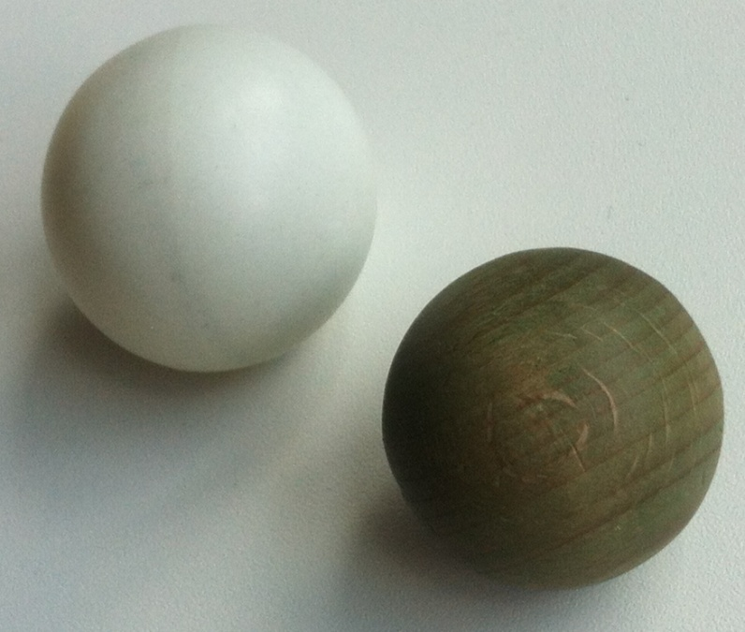
EXPERIMENT
Greater moment of inertia
=
longer lifetime
AVERAGE LIFETIME:
(30 measurements)
8,96 s ± 1,74 s
AVERAGE LIFETIME:
(30 measurements)
2,11 s ± 0,34 s

Slide 34
Parameters affecting lifetime
Friction
Frequency
Moment of inertia
Higher moment of inertia = longer lifetime
Initial position
?

Slide 35
4. INITIAL POSITION

Slide 36
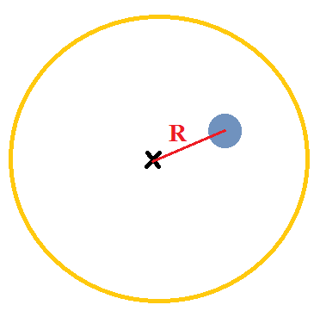
INITIAL POSITION
saddle
The further from the center we place the ball,
the sooner it falls off

Slide 37
Conclusions
Conditions under which the ball should be stable
Sufficient saddle rotation
Theory: Critical frequency fc
Experiment – never stable (rise od lifetime)
Avoiding centripetal force
Theory: No or low drag force
Our contribution: by backward rotation

Slide 38
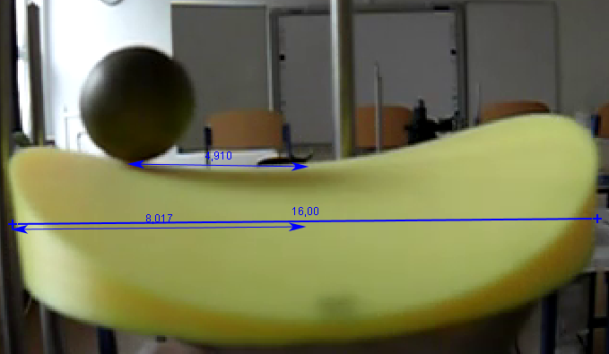
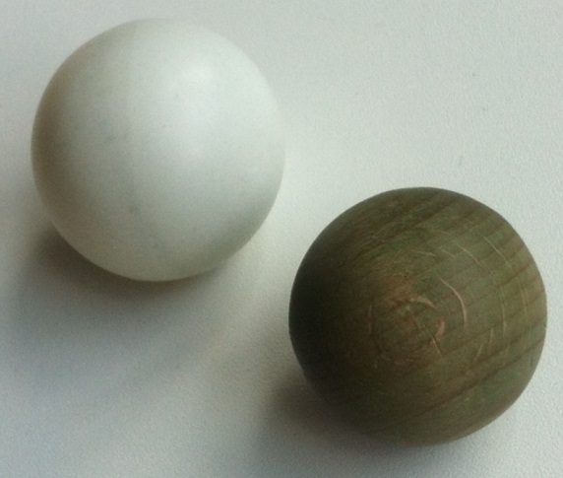
Conclusions
Examined ‘minuses’ of the theory
Friction:
Theory: solution only for specific case
Our contribution: sufficient friction = more stable
Jumping (not mentioned in theory)
upper limit for frequency exists + estimation
Rotation of the ball (not mentioned)
Dependence on the moment of inertia

Slide 39
Thank you for your attention

Slide 40
Appendices

Slide 41
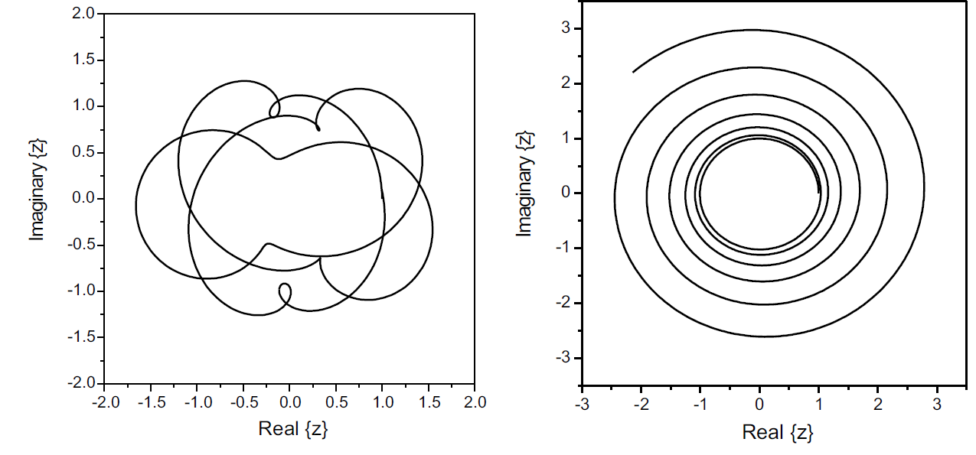
Prediction: Stability vs. Frequency

Slide 42
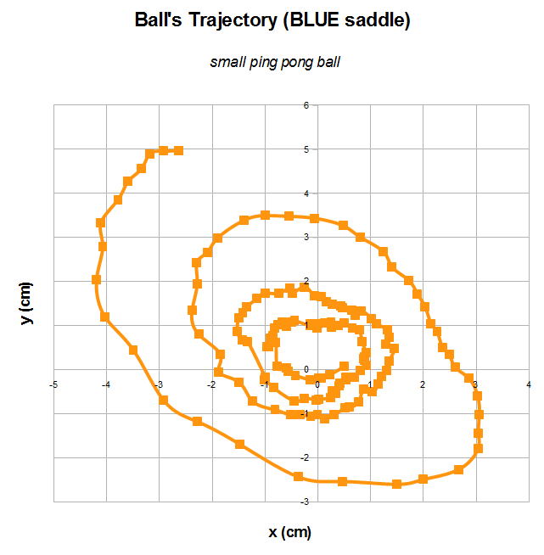
Similar to predicted behaviour
But always limited lifetime

Slide 43
Apparatus: Rotation
Rotation: driller
Frequency range: 0.6Hz – 3.7Hz

Slide 44
Small ping pong ball

Slide 45
INITIAL POSITION
saddle

Slide 46
Hollow balls' parameters
ping-pong ball:
d= 3,94 cm
m= 2,46 g
α (friction coef.) = 0,19
small ping pong ball:
d= 3,76 cm
m= 3,16 g
big orange ball:
r= 3,26 cm
m= 6,93g
α (friction coef.) = 0,25
white ball:
r=2,9cm
m=46,79g
big red-yellow ball:
r=5,0cm
m=26,56g

Slide 47
Hollow balls' parameters
Big green ball:
r= 3,26 cm
m= 13,30g
α (friction coef.) = sufficient
small green ball:
r= 1,77 cm
m= 17,72g
Big metal ball:
r= 1,01 cm
m= 35,79g
Small metal ball:
r=0,63cm
m=8,39g

Slide 48
Sufficient friction (no slipping)
No friction
Sufficient friction
2.

Slide 49
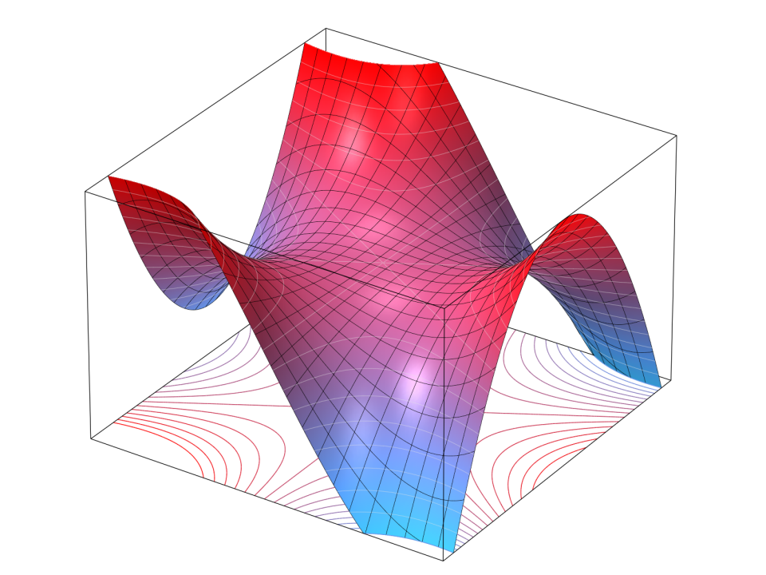
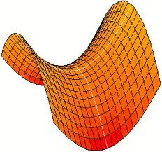
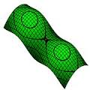
Saddle
Convex in one direction; concave in the other
Various saddle types:
Convenient for mathematical description

Slide 50
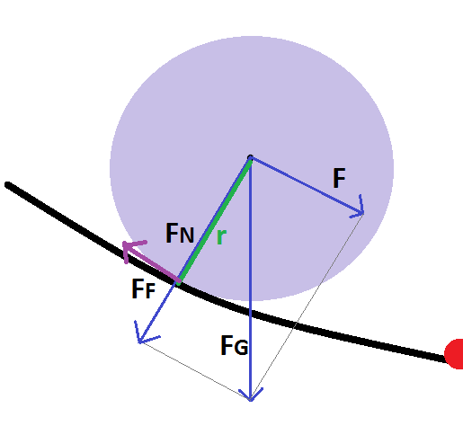
POINT MASS vs BALL
DEEPER SADDLE
THE BIGGER
COMPONENT OF F_{G}
CAUSES THE TORQUE
THE LESS IT RESEMBLES
POINT MASS
TRAP'S CENTER

Slide 51
'DEEP' vs 'SHALLOW' saddle
MAXIMUM LIFETIME:
4,07 s
MAXIMUM LIFETIME:
23,91 s
THE SMALLER THE SADDLE'S HEIGHT IS, THE MORE STABLE THE BALL IS

Slide 52
FRICTION

Slide 53
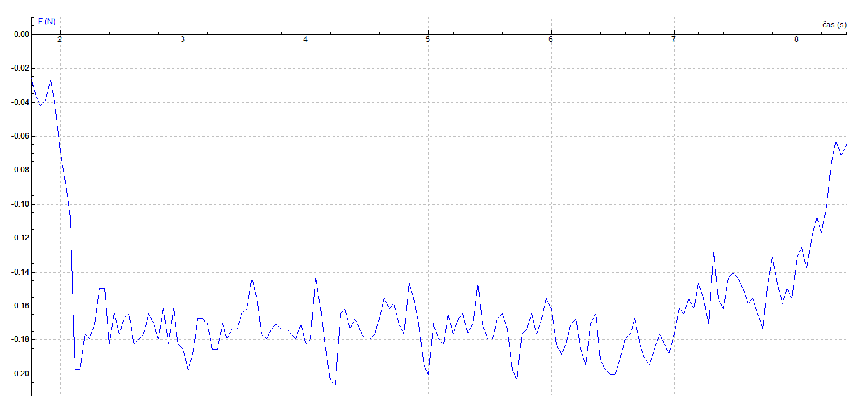
Friction
–blue saddle

Slide 54
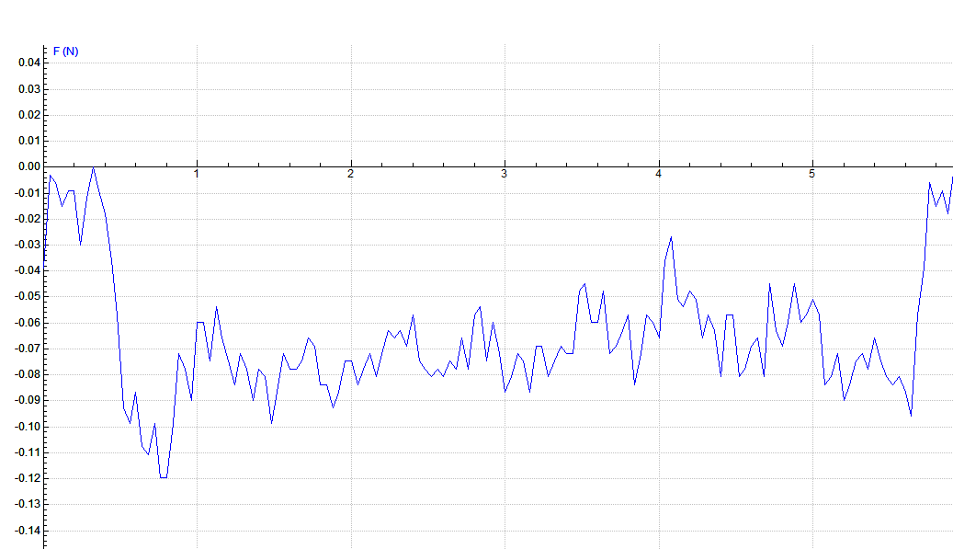
Friction
–blue saddle+ WATER

Slide 55
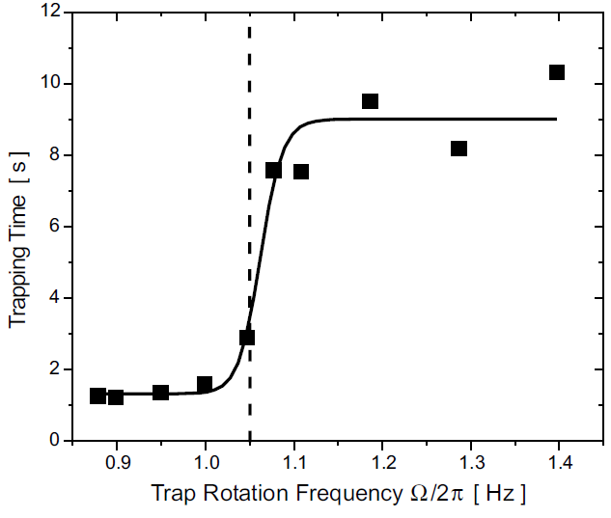
TRAPPING LIFETIME
THOMPSON'S ARTICLE

Slide 56
THEORY

Slide 57
Theory
Gravitational potential:
- assigned to the rotating frame (fixed to U)
- converted to the laboratory frame:

Slide 58
using the following formula yields
using dimensionless parameters and
converting to the complex plane ,
the 2 equations are reduced into:

Slide 59
Applying another substitution yields the solution:
where A,B,C,D are real parameters depending on initial conditions and
β± ∈ R - {0} => result will diverge in any case => particle is trapped only if β± ∈ I, thus

Slide 60
The condition for stability is:
regardless of initial position of the ball
q>0,5
q≤0,5

Slide 61
Limited trapping lifetime
1) unstable trapping parameters (q>0,5)
2) friction (q≤0,5)
β ~ friction coefficient

Slide 62
BALL’S PATH

Slide 63
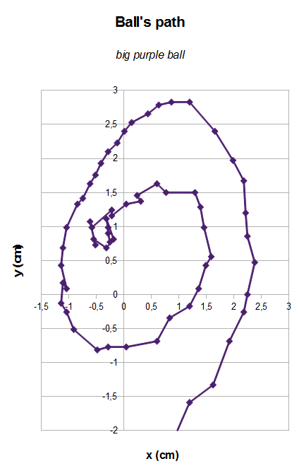
BALL'S PATH
– short trapping lifetimes
video

Slide 64
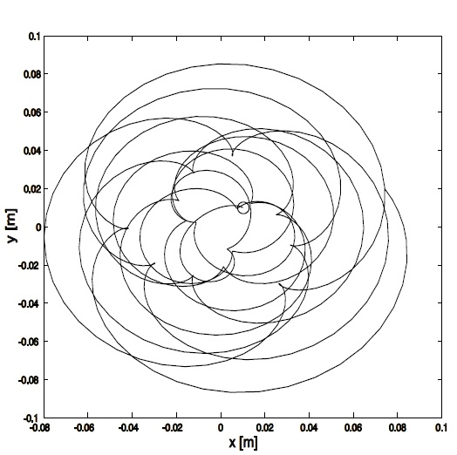
BALL'S MOTION
– longer trapping lifetimes
OUR DIAGRAM
THEORETICAL DIAGRAM
video
KOCH'S ARTICLE
11:35

Slide 65
STABLE TRAPPING PARAMETERS
stable
unstable

Slide 66
BALL'S MOTION
– longer trapping lifetimes

Slide 67
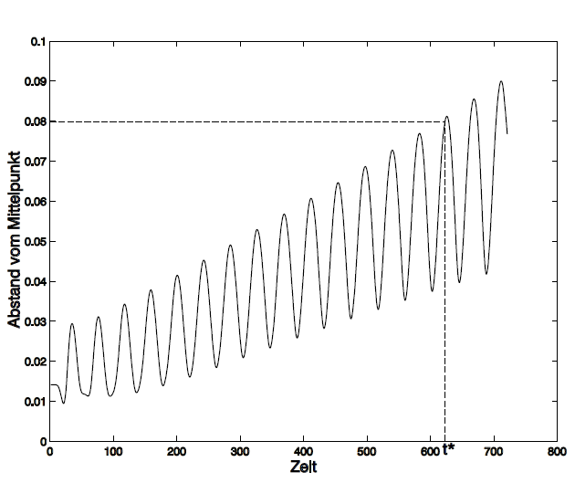
BALL'S PATH
– longer trapping lifetimes
THEORETICAL DIAGRAM
OUR DIAGRAM
KOCH'S ARTICLE

Slide 68
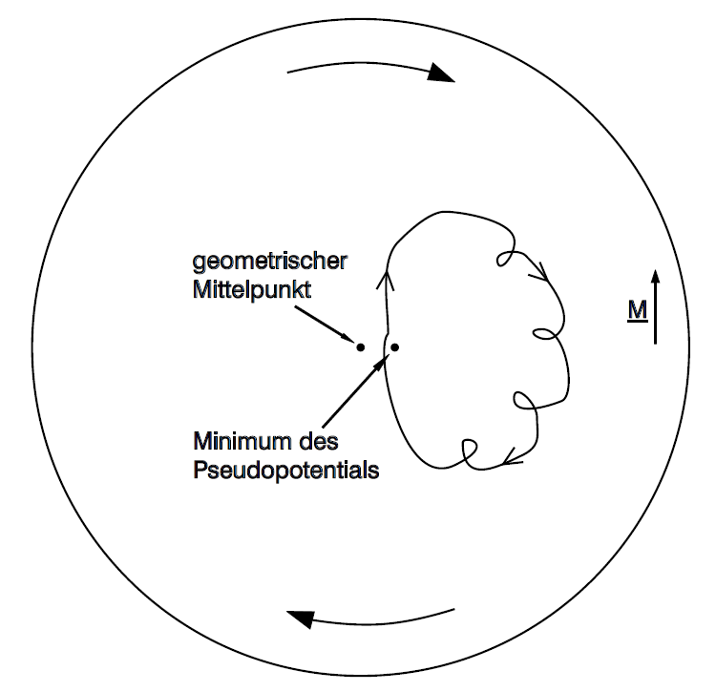
ANGLE

Slide 69
=> result will diverge in any case =>
particle is trapped only if , thus
The condition for stability is:

Slide 70
Theory (Thompson's article)
Gravitational potential:
- assigned to the rotating frame (fixed to U)
- converted to the laboratory frame:

Slide 71
=> result will diverge in any case =>
particle is trapped only if , thus
The condition for stability is:

Slide 72
SOURCES
R.I. Thompson, T.J. Harmon, and M.G. Ball:
The rotating-saddle trap: a mechanical analogy to RF-electricquadrupoleion trapping?
(Can. J. Phys. Vol. 80, 2002)
Wolfgang Rueckner, Justin Georgi, Douglass Goodale, Daniel Rosenberg, David Tavilla:
Rotating saddle Paul trap
(American Journal of Physics 63, 186 (1995); doi: 10.1119/1.17983)
A. K. Johnson and J. A. Rabchuk:
A bead on a hoop rotating about a horizontal axis: A one-dimensional ponderomotive trap
(Citation: American Journal of Physics 77, 1039 (2009); doi: 10.1119/1.3167216)
Tobias Koch:
Konzeption und Aufbau einer mobilen Experimentiereinheit fur Schuleräprsentationen zum Thema Teilchenfallen

Slide 73
Stara prezentacia

Slide 74
Friction & Initial conditions
friction in equations exponential growth
limited trapping lifetimetime T_{L}
2 reasons for lifetime limitation:
1) unstable trapping parameters
2) friction

Slide 75
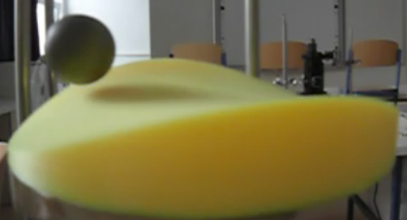
Conclusion
Conditions under which the ball should be stable
Critical frequency
We found its limitations and examined the effects
Jumping
Friction, initial position
Rotation of the ball
We constructed 2 saddle traps with different parameters, used different types of balls
Analysis of ball’s path and motion while being trapped +comparison with theory
+VERIFICATION

Slide 76
Conclusions
Theory’s assumptions
Our contribution
Stability
Calculation of critical frequency
Infinite trapping lifetime for
Experimental verification
Experimentally confuted
Lifetime rise for

Slide 77
Conclusions
Theory’s approach
Our contribution
Friction
Dynamic
Static
Jumping
Rotation
Solved for special case only
not mentioned
2) not mentioned
3) not mentioned
Experimental verification
Correlates best with point-mass theory- optimal case
upper limit for frequency + estimation
Dependence on moment of inertia + verification

