Slide 1
Twisted Rope
3
Matej Badin

Slide 2
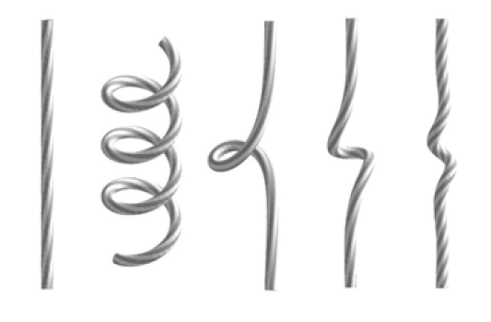
Problem
Hold a rope and twist one end of it.
At some point the rope will form a helix or a loop.
Investigate and explain the phenomenon.
Notes:
Fotka aparatury

Slide 3
Apparatus
Rope suspension –holder
Handle
(“Twist one end of it”)
Weight (Changeable tension)

Slide 4
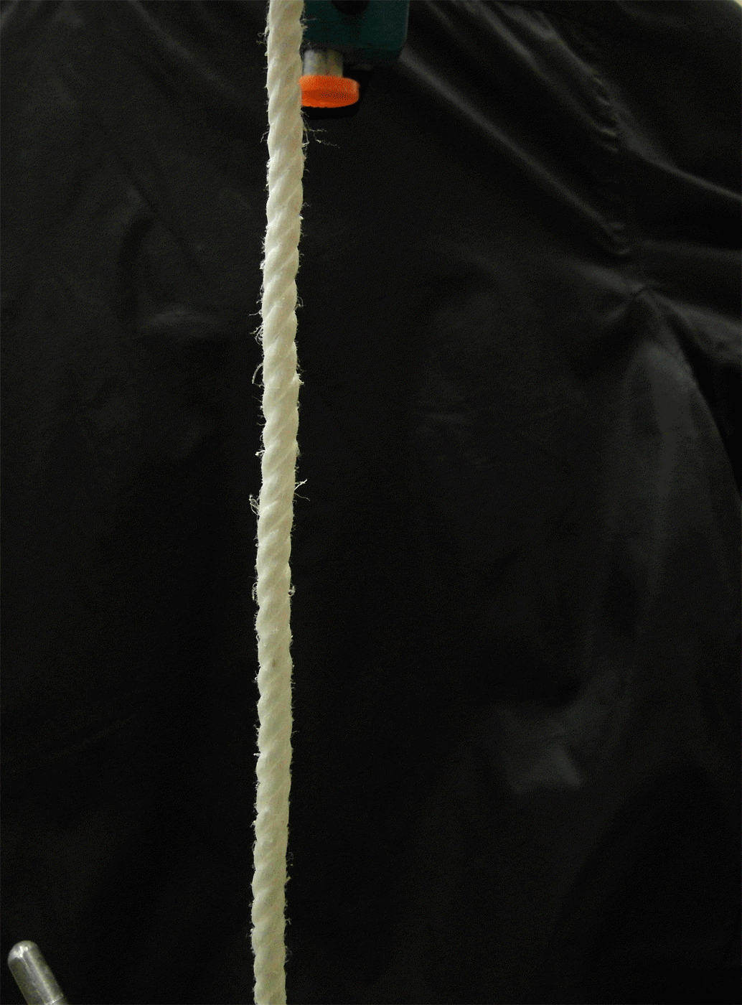
We twist one end. What happens?
Loops/helices are formed
Why does it occur?

Slide 5
Why do the do the formations appear?
How to achieve the minimal energy?
Energetically favorable state.
Potential energy rises upon deformation:
Torsional deformation
Bending (loops)
Potential of tension force (Modeled by gravity force of weight)
Notes:
Fotky – stocene bez coilov, coily, potencialna energia – zdvihnute zavazie

Slide 6
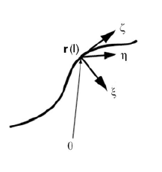
Existing theoretical model
Our approach: simple qualitative model
Euler-Kirchhoff’s equations (Force and torque equilibrium)
Limitations & Drawbacks:
Works only for ideal rods
Several solutions with different energy
No general analytical solutions is known
→ Solutions only for simple cases
→ Numerical modeling

Slide 7
Energy of the rope
Twist angle
Number of loops
Energy
$E_{T}\left(φ\right)$: Rises faster than linearly
$$φ$$
Loops are similar:
Constant energy increment ${ΔE}_{L}$ per loop
$$N_{L}$$
$$E_{Bending}$$
$$F_{s}Δs=mgΔh$$

Slide 8
Twist or loop?
Energy in twisting
Twisting instability condition
$$2π\frac{dE_{T}}{dφ}≥F∆s+∆E_{B}$$
Critical torque
$$2πτ≥F∆s+∆E_{B}$$
Energy
Critical point:
Twisting will stop here
1 turn
→ loop
1 turn
2nd option - Loop
1st option - Twist
$${ΔE}_{L}$$
$$∆E≈2π\frac{dE_{T}}{dφ}$$
1 turn
→ twist
Number of twists
$$\frac{φ}{2π}$$

Slide 9
Reaching the torsional instability
$$φ/2π$$

Slide 10
Reaching the torsional instability
Coils are preferable state
Twisting instability
$$2πτ≥F∆s+∆E_{B}$$
1 Coil per twist
$$φ/2π$$
Notes:
0 err

Slide 11
Formations:
Spirals
Coils

Slide 12
Spirals vs. coils
Smaller curvature ($∆E_{B})$
Greater impact on length ($∆s$)
Prevail under low tension
Greater curvature
Smaller impact on length
Prevail under high tension
$$2πτ≥F∆s+∆E_{B}$$

Slide 13
Spirals

Slide 14
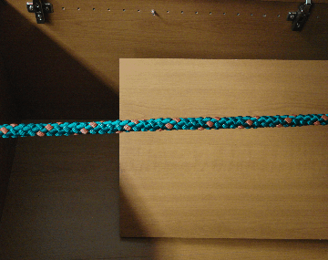
Coils

Slide 15
Points of investigation
Torque & Length during creation
Thickness and tension of rope
1
2
2

Slide 16
1. Torque and length during the twisting
Depending on number of twists
2 materials:
Sisal Polypropylene

Slide 17
Torque characteristics – Sisal rope
$$2πτ≥F∆s+∆E_{B}$$
3. weakest spot
2. weakest spot
Twisting
The weakest spot
Coil
Coil
Coil

Slide 18
Torque characteristics - Polypropylene
$$2πτ≥F∆s+∆E_{B}$$
First coil:
The weakest spot
Continuous creation of coils
– Existing helix is enlarged continuously

Slide 19
Length of rope during coil creation
1 twist → 1 coil
Each coil takes the same length of rope
=> Approx. linear decrease in length with number of twists
Sudden jumps for sisal rope, continuous line for polypropylene

Slide 20
Coils effect on length

Slide 21
Coils effect on length
Sudden mode
continuous mode

Slide 22
Conclusion part 1:
Coils form 1 per twist
…after the critical torque is reached
And result in linear decrease in length
Discrete or continuous coil creation

Slide 23
2. Influence of tension and diameter

Slide 24
Changed: tension (different weights)
Measured: number of twists for the 1st coil
$$2πτ≥F∆s+∆E_{B}$$
Greater tension → coils need greater torque → will form later

Slide 25
Number of twists for the 1st coil

Slide 26
Changed: diameter (different ropes)
Measured: number of twists for the 1st coil
Prediction: Scaling…

Slide 27
Scaling
Piece of rope:
N twists needed
Half as thick:
Similar to twice as long
2N twists needed
Twice as long:
2N twists needed
Dependence on diameter:

Slide 28
Twists vs. Diameter

Slide 29
Twists vs. Diameter

Slide 30
Changed: Diameter (different ropes)
Measured: Critical torque
$$2πτ≥F∆s+∆E_{B}$$
Grows with diameter Grows with diameter
→ Greater torque needed

Slide 31
Max torque dep. on diameter

Slide 32
Conclusion
Reason to form:
Energetically favorable for large twists
Spirals vs. coil occurrence:
small vs. large tension

Slide 33
Appendix

Slide 34
Our Qualitative Hypothesis
Twist angle
Energy
Energy in twisting
Rapid increase of potential energy caused by loop formation
Twisting instability condition
$$∆E<mg∆h$$
Rope is twisted
$$∆E=mg∆h$$
$$∆E>mg∆h$$
Coil occurs
$$∆E$$
1st option - Twist
$$F_{s}ds=mg∆h$$
2nd option - Loop
1
$$\frac{φ}{2π}$$
Number of twist

Slide 36
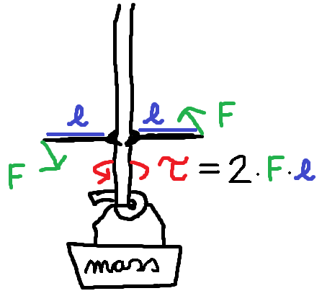

Slide 38
Formations

Slide 40
Sisal number of coils

Slide 41
Sisal torque

Slide 42
Sudden vs. continuous
Hypothesis:
Sisal – higher internal friction, delays coil creation
Also visible on length!

Slide 43
Work and potential energy

Slide 45
Length
Effect of coil creation on length.

