Slide 1
Water bombs
9
Mário Lipovský

Slide 2
Task
Some students are ineffective in water balloon fights as the balloons they throw rebound without bursting.
Investigate the motion, deformation, and rebound of a balloon filled with fluid.
Under what circumstances does the balloon burst?

Slide 3
Content
Motion and deformation
Two types
Rebound
Angle of rebound
Burst
Energies in balloon
Elastic
Kinetic
Potential
Summary

Slide 4
How it looks

Slide 5
How it looks

Slide 6
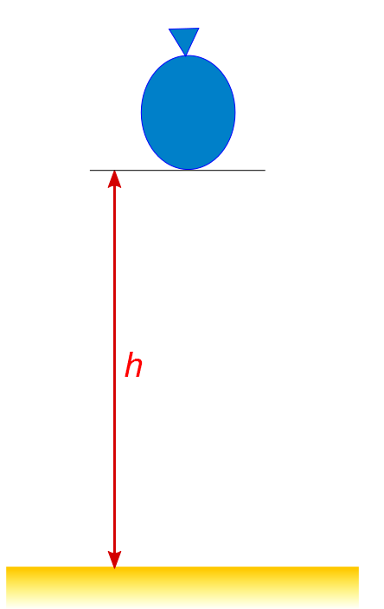
Motion and deformation
Kinetic energy
Potential energy
Elastic energy

Slide 7
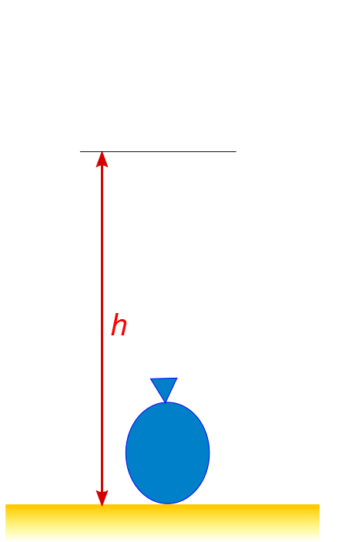
Motion and deformation

Slide 8
Motion and deformation
Water flows to the sides

Slide 9
Motion and deformation
Maximal radius of balloon
Water stopped by rubber
Some energy lost
- water flows

Slide 10
Motion and deformation
Rubber is contracting

Slide 11
Motion and deformation

Slide 12
Motion and deformation

Slide 13
Motion and deformation
Energy losses
Water convection
Heat

Slide 14
Different type of deformation
The view is from the bottom of the aquarium

Slide 15
Different type of deformation
Elongated balloon
Easier to stretch

Slide 16
Different type of deformation
Hard to stretch
Hard to stretch
Easier to stretch
Hard to stretch
Hard to stretch
Hard to stretch
Hard to stretch

Slide 17
Different type of deformation

Slide 18
Different type of deformation

Slide 19
Different type of deformation
Maximal length
Starts to contract

Slide 20
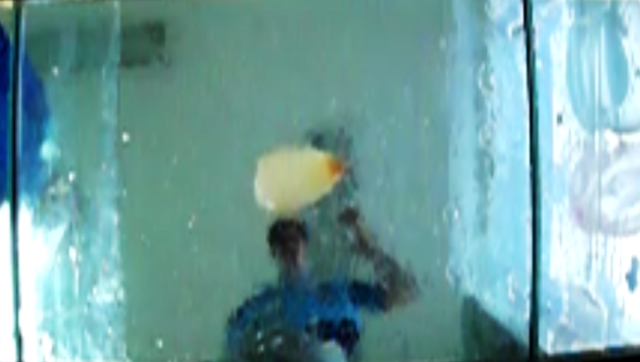
Different type of deformation
Balloon jumps

Slide 21
“Investigate the motion, deformation and rebound…”

Slide 22
Rebound
Balloon is accelerating
in horizontal way
Balloon wants to rotate
Jumps to the side

Slide 23
Jumping balloon

Slide 24
Jumping balloon

Slide 25
Jumping balloon

Slide 26
“Investigate the motion, deformation, and rebound of a balloon filled with fluid. Under what circumstances does the balloon burst?”

Slide 27
Apparatus
m
Balloon with mass m
Changing height h from h=0cm
Find the smallest h, when it bursts
Do it with many balloons
h

Slide 28
Height, which causes burst
We can calculate the potential energy…
m
h

Slide 29
Potential energy needed to burst
Kinetic energy
Potential energy
Elastic energy

Slide 30
Elastic energy of balloon
Can be calculated from
pressure change during inflation

Slide 31
Pressure measurement

Slide 32
Elastic energy of balloon

Slide 33
More measurements of elastic energy

Slide 34
Elastic energy of balloon with water

Slide 35
Total energy given to balloon
Potential energy of fall
Elastic energy

Slide 36
Total energy needed to burst (Potential + Elastic)
Let’s measure the energy without losses

Slide 37
Compressing
Parallel plates
Height
Scale
Force

Slide 38
Apparatus
Height-meter
Compressed
balloon
Scale (Force)

Slide 39
Compressed balloon
Plate
Balloon
Plate

Slide 40
Force vs. depth of compression
Depth

Slide 41
Force vs. depth of compression

Slide 42
Work done by apparatus
for many balloon volumes
Let’s add the initial elastic energy
More than 1000 measure-points

Slide 43
Total energy needed for burst (Work + Elastic)
Rising tendency

Slide 44
Big balloon
Almost maximal tension
Almost maximal tension
Almost maximal tension
Almost maximal tension
Almost maximal tension
Almost maximal tension
Almost maximal tension
Almost maximal tension
Almost maximal tension
Almost maximal tension
Almost maximal tension
Almost maximal tension
Elastic energy is almost maximal

Slide 45
Small balloon
Low tension
Low tension
Max tension
Low tension
Low tension
Low tension
Low tension
Elastic energy is
less than maximal
Friction
Tension at the bottom remains the same

Slide 46
Total energy needed for burst (Work + Elastic)
max
max
min
min
Let’s compare it with the first experiment!
max
max
max
max E
max
max
max
max

Slide 47
Energy needed to burst trough fall & through compression

Slide 48
Falling balloon
In graph
In real life
There are losses
Water convection
Heat
Let’s assume that
constant ratio of energy
is preserved

Slide 49
Energy needed to burst trough fall & through compression

Slide 50
Energy needed to burst trough fall & through compression
k=0,38
Very simple assumption
Ratio of losses is constant (k)
Remarkable result!

Slide 51
What we have
We can derive approximately the velocity of throw
needed to burst a balloon

Slide 52
Approximate velocity needed for burst

Slide 53
Summary
Motion and deformation
Rebound
friction

Slide 54
Summary - Burst
m

Slide 55
Summary - Burst
m
k=0,38

Slide 56
Thank you for your attention!

Slide 57
Appendices

Slide 58
Energy needed to burst trough fall & through compression
k=0,38

Slide 59
Rubber stretch at rebound

Slide 60
Rubber stretch at rebound

Slide 61
Adding air

Slide 62
Other liquid

Slide 63
Elastic energy of the balloon
Stretching a piece of rubber, surface tension
In terms of pressure inside:

Slide 64
Spherical shape:
Elastic energy

