Slide 1
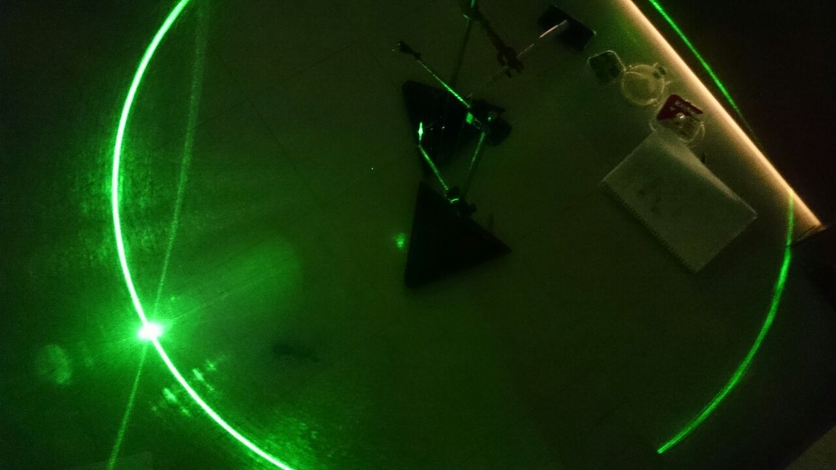
Problem 14 Circle of Light
Reporter: Felipe de Melo

Slide 2
Problem 14 Circle of Light
When a laser beam is aimed at a wire, a circle of light can be observed on a screen perpendicular to the wire. Explain this phenomenon and investigate how it depends on the relevant parameters.

Slide 3
Theoretical Introduction
Experiments
Conclusion
Procedures
Relevant parameters
Refraction
Reflection
Interference
Snell’s Law
Data Analysis
Materials
Notes:
Here are the contents of my presentation. I will start with a theoretical introduction, after that I will speak about our experiments and finally I will give the conclusion.

Slide 4
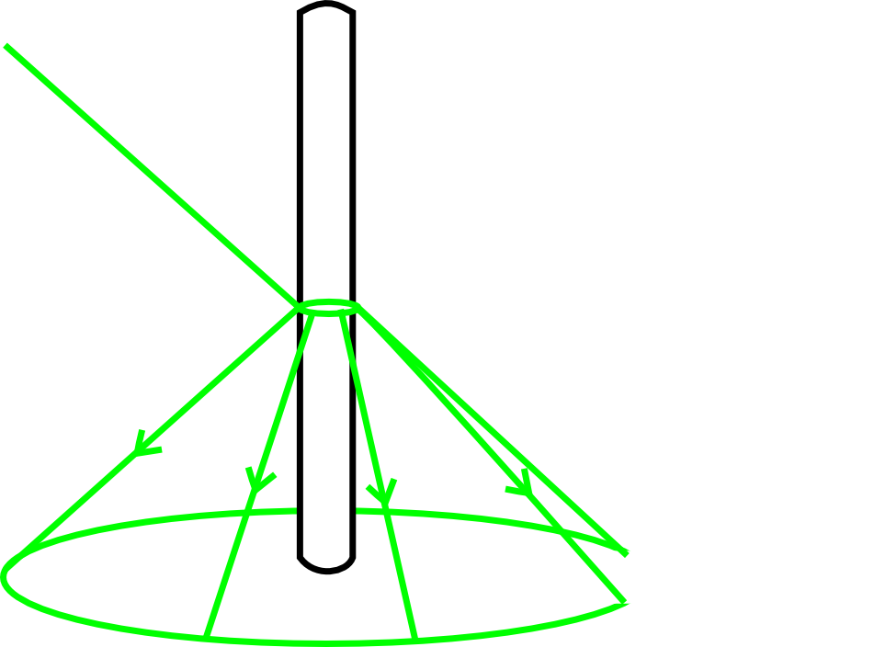
Reflection
Reflection occurs on the surface of the wire
Conic formation
Incidence angle$=$Reflection angle

Slide 5
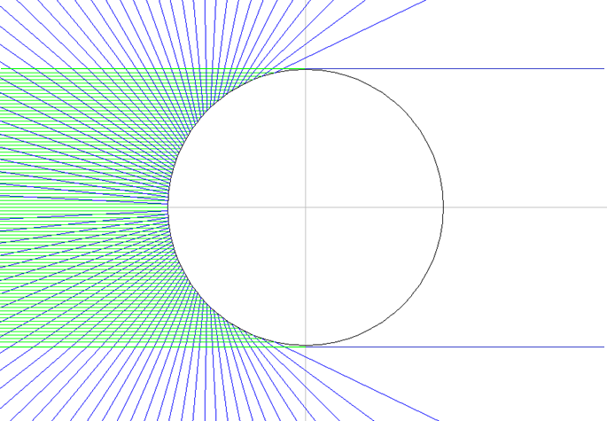
Reflection
Half of the wire surface
All the circle, without the wire shadow
Only because the wire is rounded the reflection forms a circle

Slide 6
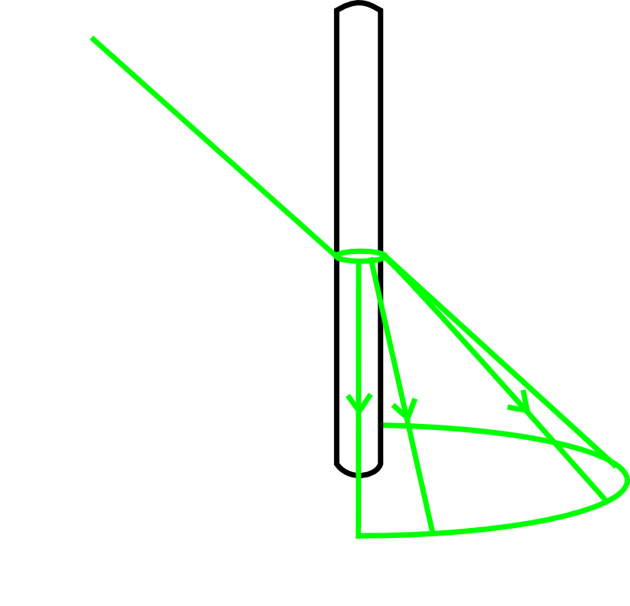
Refraction
Refraction occurs through the wire
Will form the front part of the circle
Higher refraction indeces will distribute the refraction along a bigger part of the circle

Slide 7
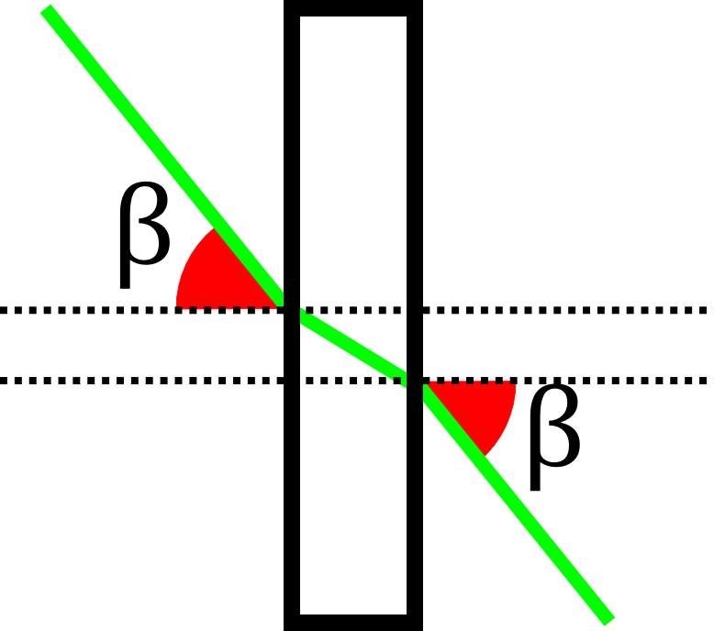
Refraction
Vertical projection plan
Both angles are equal
We will call this angle as beta

Slide 8
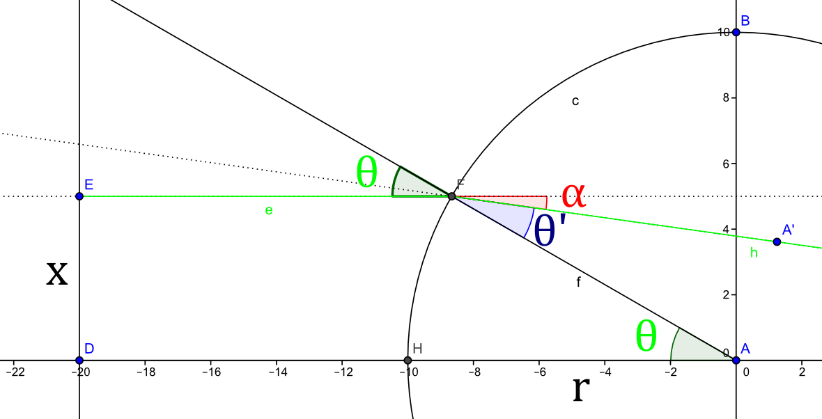
Refraction
Horizontal projection plan
The wire
A laser light ray
Incidence angle
First angular deviation
Distance to wire center
Refraction angle
Wire radius

Slide 9
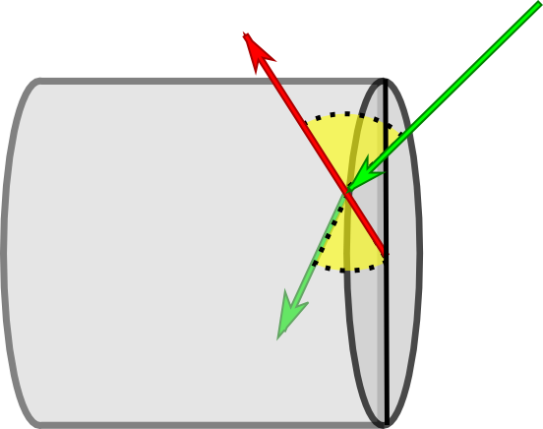
Refraction
Snell’s law
$$n_{1}∗sen\left(θ_{1}\right)=n_{2}∗sen(θ_{2})$$
$$\vec{s_{1}}$$
Does not exist a plan that contains both at the same time $θ_{1} and θ_{2}$
$$\vec{N}$$
$$θ_{1}$$
Incident light ray
Normal straight line in relation with the surface
$$\vec{s_{2}}$$
$$θ_{2}$$
Best way to quantify both angles is using vectors
Refracted light ray

Slide 10
Refraction
Vectorial form of Snell’s law
Air refraction index
Normal unit vector
$$\hat{s_{2}}=\frac{n_{1}}{n_{2}}\left[\hat{N}×(−\hat{N}×\hat{s_{1}})\right]−\hat{N}\sqrt{1−{\left(\frac{n_{1}}{n_{2}}\right)}^{2}\left(\hat{N}×\hat{s_{1}}\right) ⋅\left(\hat{N}×\hat{s_{1}}\right)}$$
Refracted light ray unit vector
Incident light ray unit vector
Wire refraction index

Slide 11
Refraction
$$α=\tan^{−1}{\frac{\left(\sqrt{1−η^{2}\left(1−\cos^{2}\left(β\right)\cos^{2}\left(θ\right)\right)}−η\cos\left(θ\right)\cos\left(β\right)\right)\sin\left(θ\right)}{η\sin^{2}\left(θ\right)\cos\left(β\right)+cos⁡(θ)\sqrt{1−η^{2}\left[1−\cos^{2}\left(β\right)\cos^{2}{(θ)}\right]}}}$$
Inclination in relation to horizontal axis
$$η=\frac{n_{1}}{n_{2}}$$
The last refracted ray, with biggest angular deviation
$$\lim_{θ→\frac{π}{2}}{α}=\tan^{−1}\frac{\sqrt{1−η^{2}}}{\cos{β} η }$$

Slide 12
Refraction
$$α_{max}=\tan^{−1}\frac{\sqrt{1−η^{2}}}{\cos{β} η }$$
$$α_{max}=\tan^{−1}\frac{\sqrt{n_{2}−1}}{\cos{β}}$$
Assuming $n_{1}=1$: wire immersed in air

Slide 13
Refraction
$$α_{max}=\tan^{−1}\frac{\sqrt{n_{2}−1}}{\cos{β}}$$
$$0<β<\frac{π}{2}$$
$$0<\cos{β}<1$$
On this interval,
$\cos{β}$ is a decresent function

Slide 14
Refraction
Refraction index
Light intensity
Inclination angle
Light intensity
Increase the area iluminated by refracted light

Slide 15
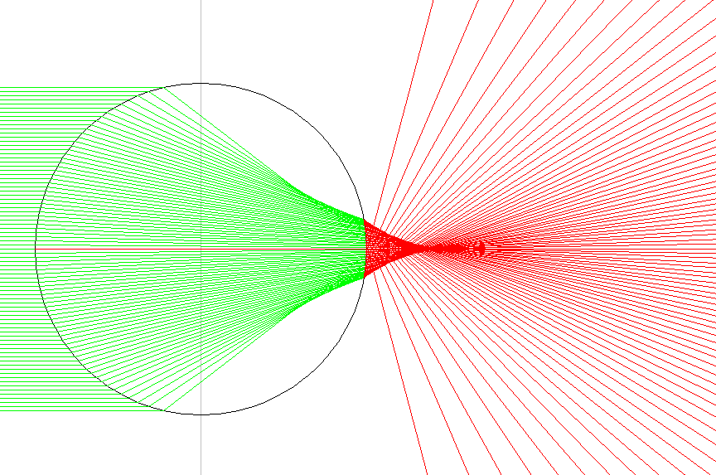
Refraction
Form primaly the front part of the circle

Slide 16
Refraction and Reflection
Energy conservation
$$T+R+A=1$$
Translucid wire
Assume absorption equals to zero
$$T+R=1$$

Slide 17
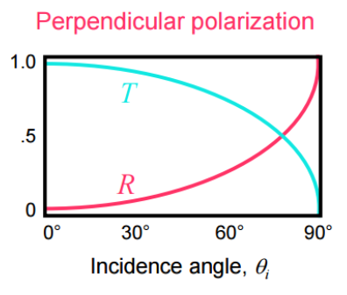
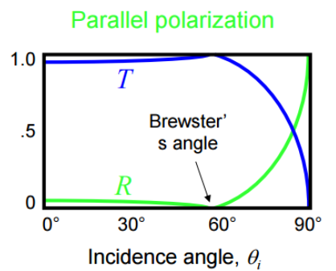
Refraction and Reflection
Fresnel’s Relation
http://www.ece.rice.edu/~daniel/262/pdf/lecture13.pdf

Slide 18
Refraction and Reflection
From spherical geometry:
$$\cos{θ_{i}}=\cos{θ}\cos{β}$$
$$β≤θ_{i}<\frac{π}{2}$$
Higher values for beta will increase the reflected light intensity

Slide 19
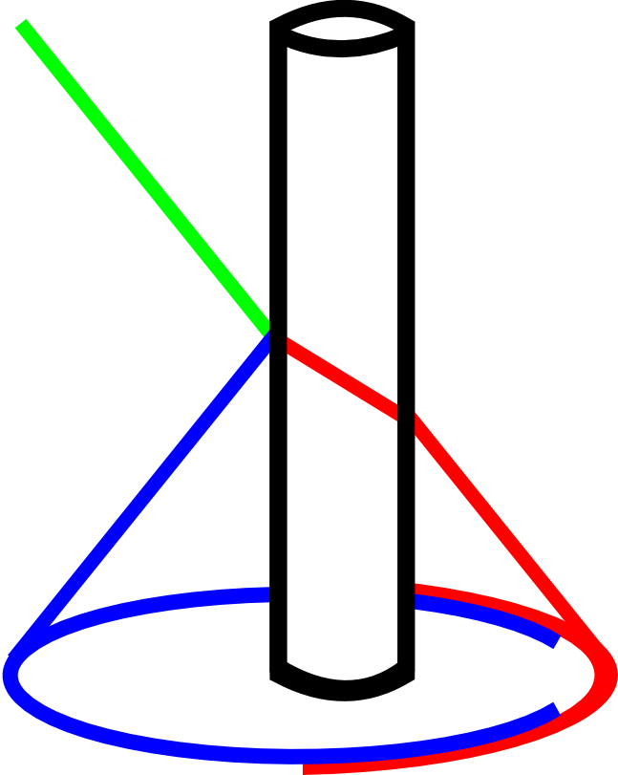
Refraction and Reflection
Refraction
Reflection

Slide 20
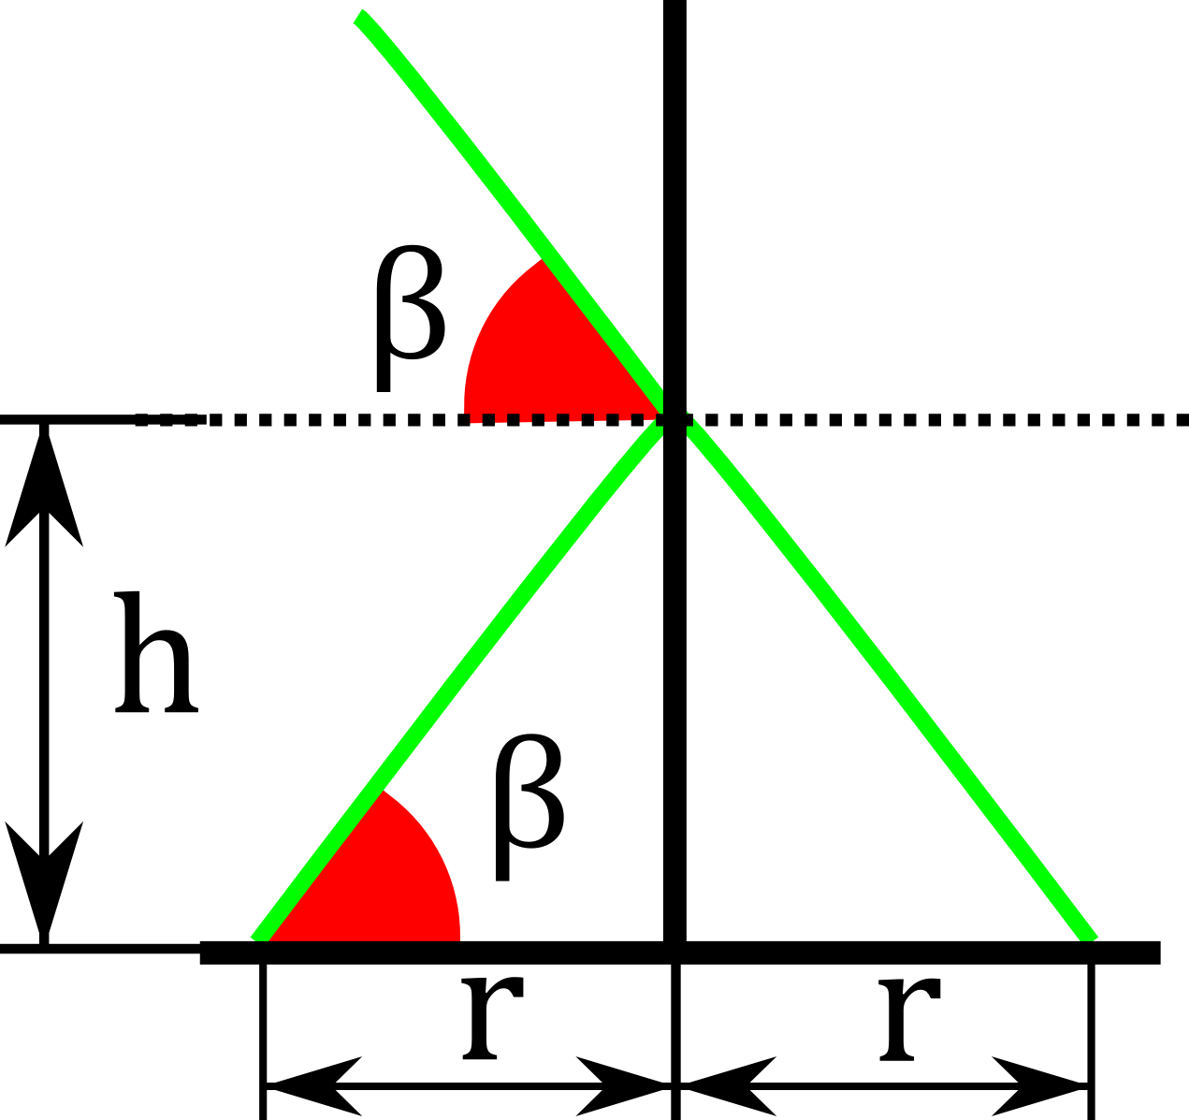
Circle formation
Laser
Wire
$$r≅\frac{h}{\tan{β}}$$
Disconsidering the wire dimensions

Slide 21
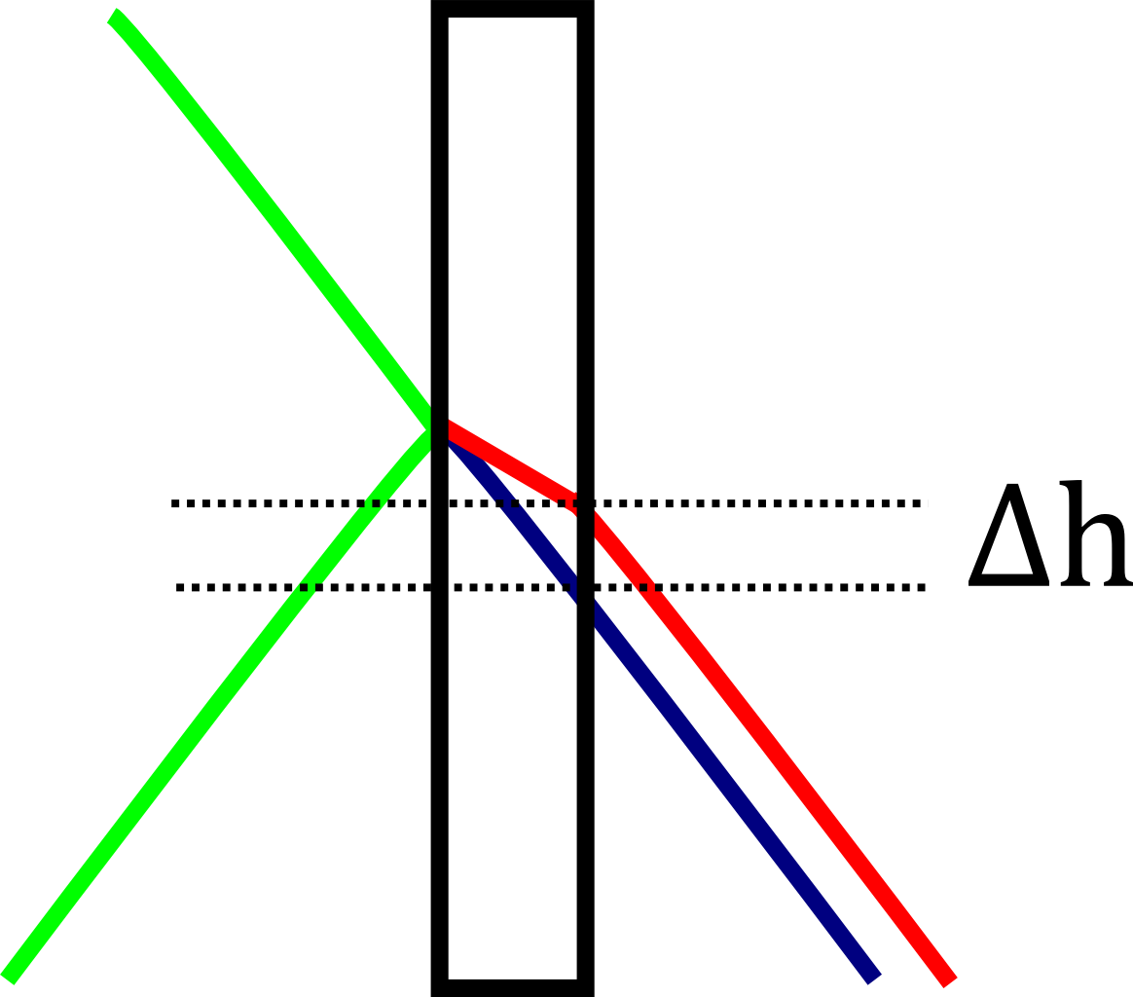
Circle formation
$$Δh=d(\sin{β}−\sin{β′})$$
Horizontal inclination
Horizontal inclination after refraction
Wire diameter
Much smaller than other experiment dimensions
$Δh$ can be disconsidered

Slide 22
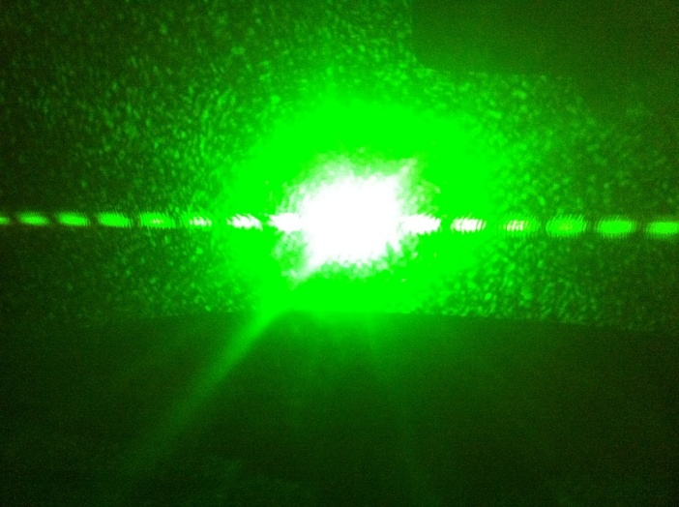
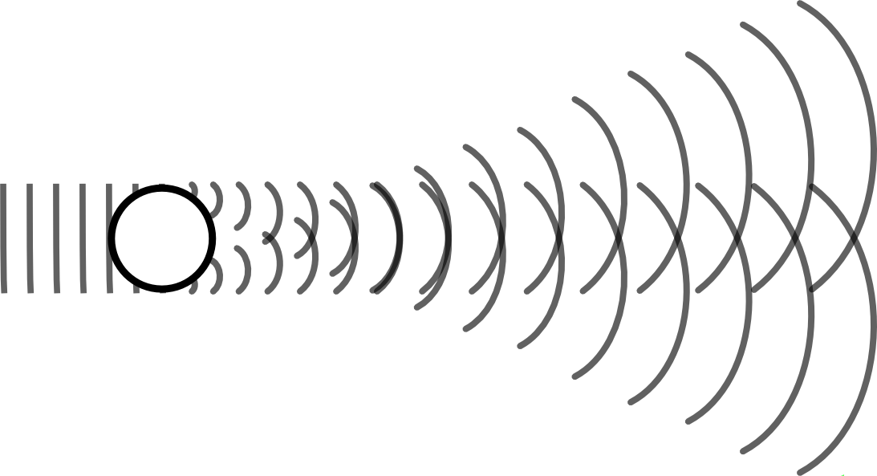
Interference
Double slit pattern of interference
Distance to screen
Light wave-length
Distance between two dark shadows
$$w= \frac{z λ}{d}$$
Wire diameter

Slide 23
Prediction of the relevant parameters
The measure of the radius
Incident angle
Light intensity distribution
Wire dimensions
Thinner wires will turn easier to see the interference
Refraction Index
Light intensity distribution

Slide 24
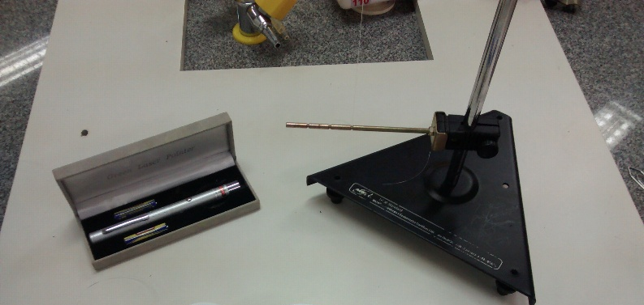
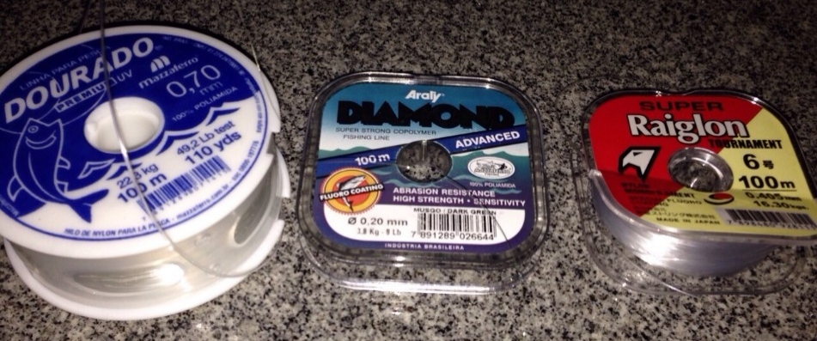
Experiments
materials
Nylon wires (n=1.56) with different diameters (0.405mm, 0.7mm, 0.8mm)
Copper wire of 150 $μm$
Micrometer
Laser of wave-length 532nm
Chalk powder

Slide 25
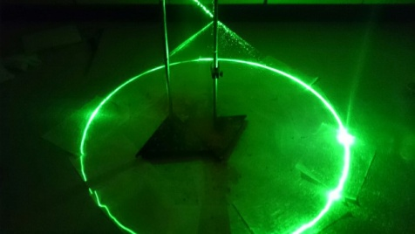
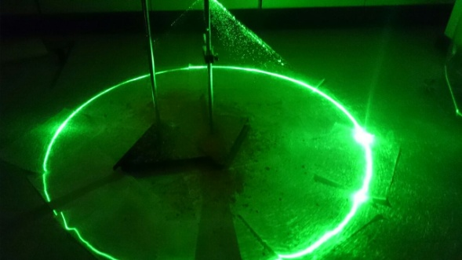
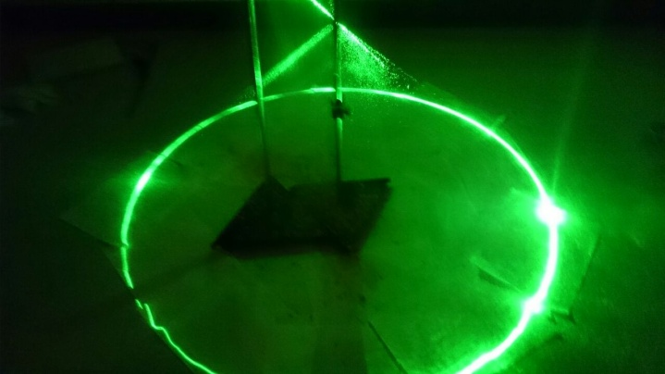
Experiments
Conic formation
Conic formation
Height and radius
Light intensty
Intensity

Slide 26
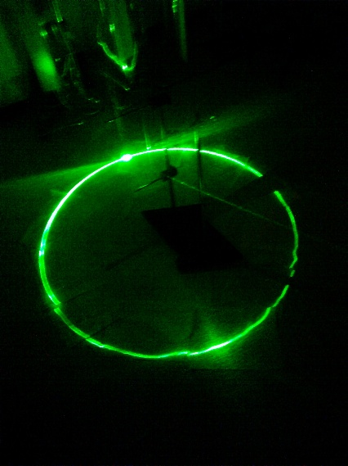
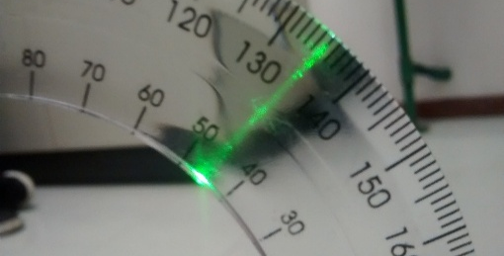
Experiments
Relation between height and radius
Conic formation
Height and radius
Light intensty
Intensity

Slide 27
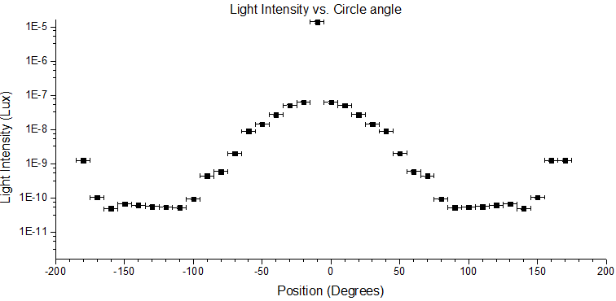
Experiments
Light Intensity Distribution
$$β=35.0°±0.5$$
Conic formation
Point of maximun refraction +
Height and radius
Light intensty
Intensity
Point of maximun reflection

Slide 28
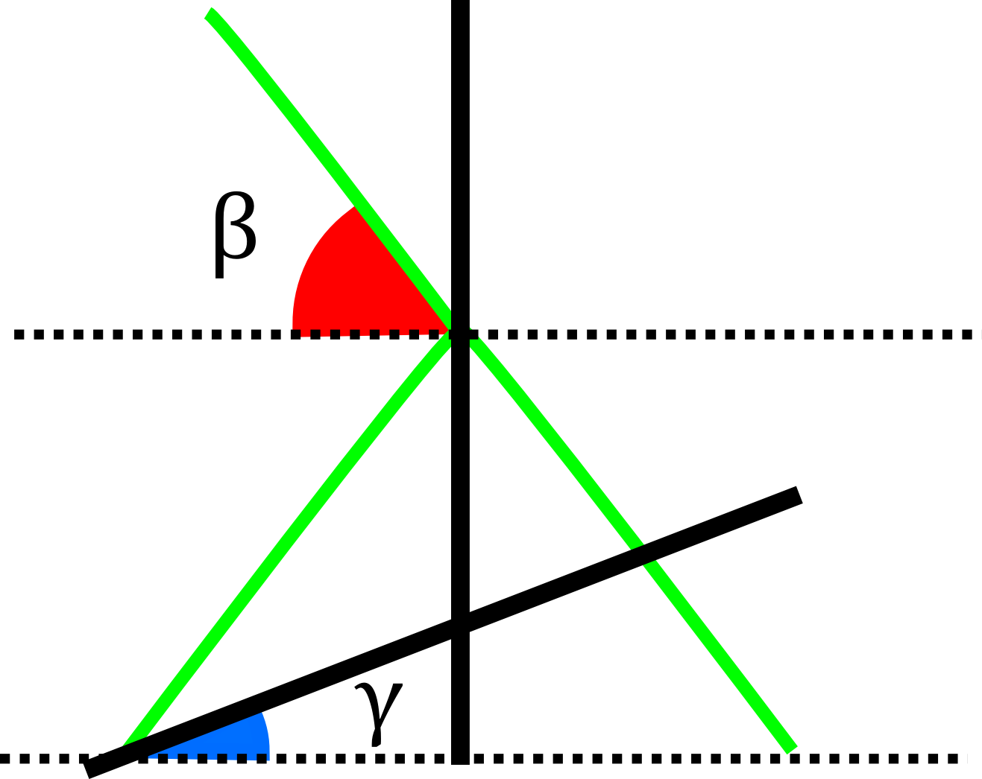
Experiments
Different shapes
Laser
$γ=0⇒$ It will form a circle
Wire
$0<γ<β⇒$It will form an ellipse
Screen
$γ=β⇒$It will form a parabola
$γ>β⇒$It will form a hyperbole

Slide 29
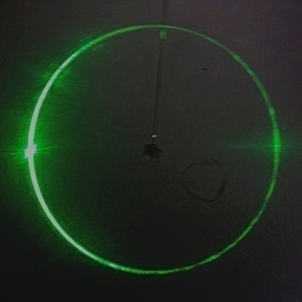
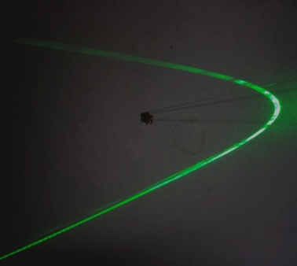
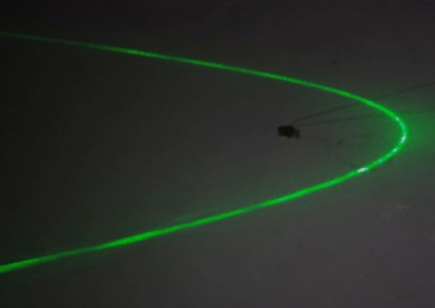
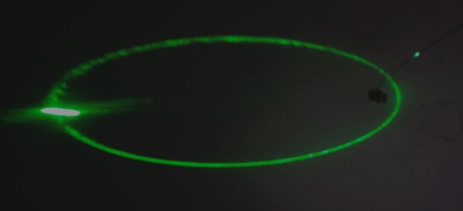
Experiments
Different shapes
$γ=0⇒$ Circle
$0<γ<β⇒$Ellipse
$γ=β⇒$Parabole
$γ>β⇒$Hyperbole

Slide 30
Experiments
Interference
$$d=150 μm ± 5μm$$
$$\frac{d}{z}w= λ$$
$$z=2,79 m ±0,05m$$
$$λ_{experimental}=\frac{150∗{10}^{−6}}{2,79}{10}^{−2}$$
$$w=1,00 cm ±0,05cm$$
$$λ_{experimental}=537nm ±33nm$$
$$λ_{real}=532 nm$$
Copper wire, only reflects the light

Slide 31
Experiments
Interference
Interference
+
Reflection
+
Refraction
0.2 mm nylon wire

Slide 32
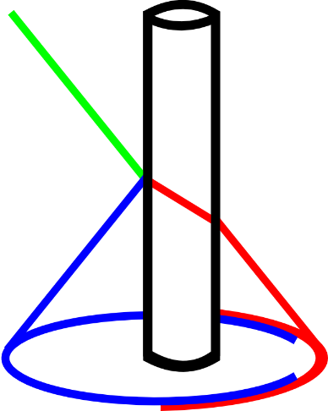
Summary:
Theoretical introduction

Slide 33
Summary:
experiments

Slide 34
Conclusions
Relevant parameters
Laser inclination
Increase reflectance
Refraction Index
Shape of the wire
Define the shape of figure
Position of the surface
Visibility of interference
Thinner wire diameter

Slide 35
Bibliography
Vector form of Snell’s Law, Available on http://www.starkeffects.com/snells-law-vector.shtml, Access on 20 April
REFLECTIVITY; Wikipedia. Available on <http://en.wikipedia.org/wiki/Reflectivity> Access on 10 november
FRESNEL EQUATIONS; Wikipedia. Available on <http://en.wikipedia.org/wiki/Fresnel_equations> Access on 10 november
KONG, H. J. ; CHOI, Jin; SHIN, J. S.; YI, S. W.; JEON, B. G.; Hollow conic beam generator using a cylindrical rod and its performances.
MV Klein & TE Furtak, Optics, 1986, John Wiley & Sons, New York; Huygens Principle

Slide 37
Refraction
$$θ=\arcsin\left(\frac{x}{r}\right)$$
$$α=θ−θ′$$

Slide 38
Height variation
$$Δh=d(\sin{β}−\sin{β′})$$
$$Δh=2d∗\sin{\frac{β−β^{′}}{2}}∗\cos{\frac{β+β^{′}}{2}}$$
$$≤1$$
$$Δh≤2d$$

Slide 39
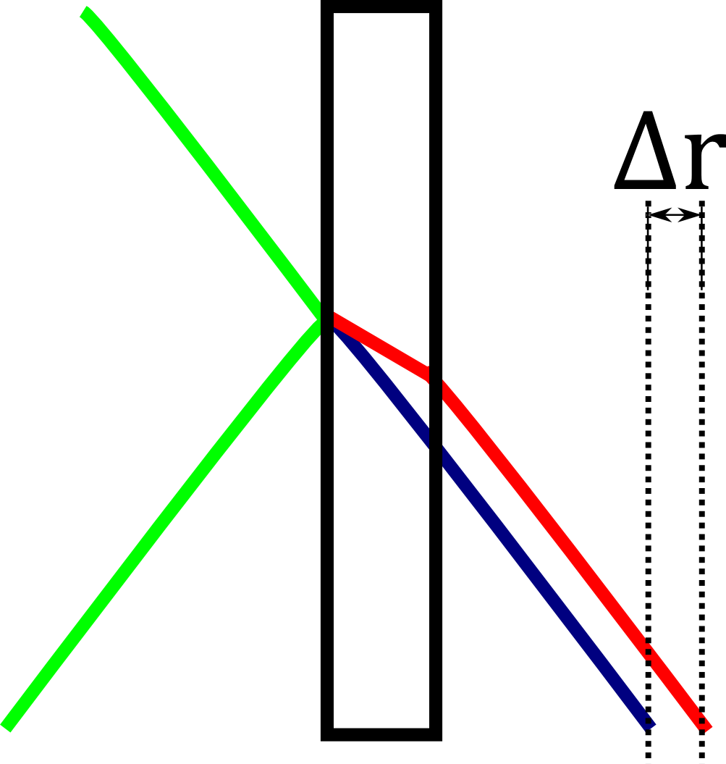
Radius variation (i)
$$Δr=\frac{Δh}{\tan{β}}$$
$$Δh=d \left(\sin{β}−\sin{β′}\right)$$

Slide 40
Radius variation (iI)
Before refraction light velocity on this projection: $V′=V∗\cos{α}$
$$\frac{\sin{β}}{\cos{α}}n_{1}=\sin{β′}n_{2}$$
$$Δh=d\sin{β} \left(1 −\frac{η}{\cos{α}}\right)$$
$$Δr=d\cos{β \left(1−\frac{η}{\cos{α}}\right)}$$

Slide 41
Radius variation (iII)
$$Δr=d\cos{β \left(1−\frac{η}{\cos{α}}\right)}$$
$$\left|α\right|<\frac{π}{2}$$
$$≤1$$
$$<1$$
$$Δr<d$$

Slide 42
LIGHT INTENSITY
Fresnel’s equations
$$R_{1s}\left(x\right)={\left(\frac{n_{air}\cos{θ\cos{β}} – n_{wire}\sqrt{1−{\left(\frac{n_{air}}{n_{wire}}\right)}^{2}∗{\left(1−\cos^{2}{θ}\cos^{2}{β}\right)}^{2}} }{n_{air}\cos{θ}\cos{β} +{ n}_{wire}\sqrt{1−{\left(\frac{n_{air}}{n_{wire}}\right)}^{2}∗{\left(1−\cos^{2}{θ}\cos^{2}{β}\right)}^{2}}}\right)}^{2}$$
Perpendicular polarized light
$$R_{1p}(x)={\left(\frac{n_{air}\sqrt{1−{\left({\left(\frac{n_{air}}{n_{wire}}\right)}^{2}∗{\left(1−\cos^{2}{θ}\cos^{2}{β}\right)}^{2}\right)}^{2}}−{ n}_{wire}\cos{θ\cos{β}}}{n_{air}\sqrt{1−{\left({\left(\frac{n_{air}}{n_{wire}}\right)}^{2}∗{\left(1−\cos^{2}{θ}\cos^{2}{β}\right)}^{2}\right)}^{2}}+ n_{wire}\cos{θ\cos{β}}}\right)}^{2}$$
Paralel polarized light

Slide 43
LIGHT INTENSITY
Fresnel’s equations

