Slide 1
Contactless calliper
15
Martin Marek

Slide 2
Problem definition
Invent and construct an optical device that uses a laser pointer and allows contactless determination of thickness, refractive index, and other properties of a glass sheet.

Slide 3
Measuring refractive index using Brewster’s angle

Slide 4
Measuring the index of refraction: Brewster‘s angle
$$n=\tan{θ}$$
$$α$$
$$1$$
$$α=arctan⁡(n)$$
$$n$$
Brewster‘s angle
Fresnel equations → Brewster‘s angle
(reflected beam is completely s-polarized)

Slide 5
Brewster‘s angle in logarithmic scale

Slide 6
Apparatus for measuring Brewster‘s angle
CMOS sensor
Diffraction-limited laser beam
Polarizing filter
Glass sheet

Slide 7
Apparatus for measuring Brewster‘s angle
Mirror-calibrated laser
(to point along a yellow line)

Slide 8
Apparatus for measuring Brewster‘s angle
Mirror-calibrated camera
(to be situated directly above glass sheet)
Level-calibrated tripod
(to eliminate perspective aberrations)

Slide 9
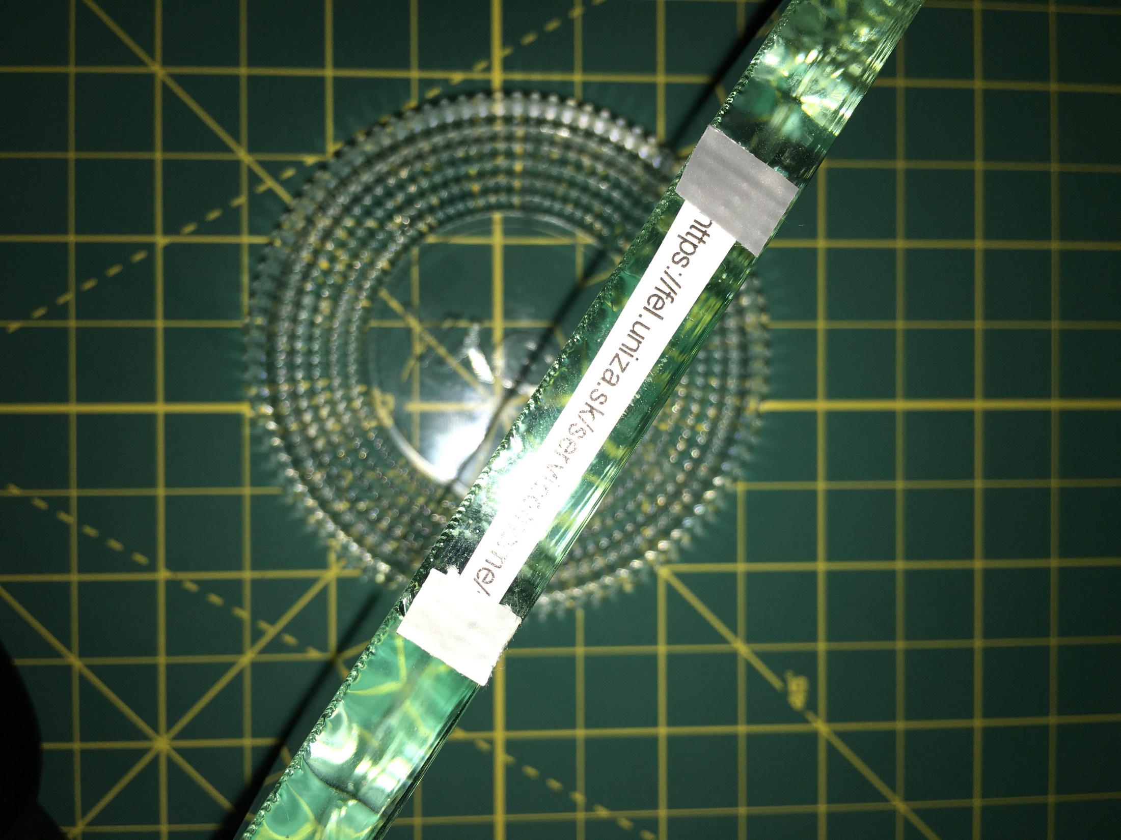
Brewster‘s angle measurements

Slide 10
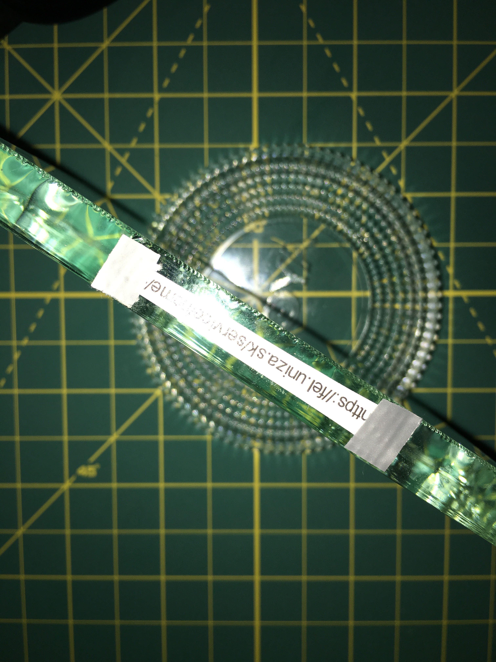
Brewster‘s angle measurements
Error = 0.15˚

Slide 11
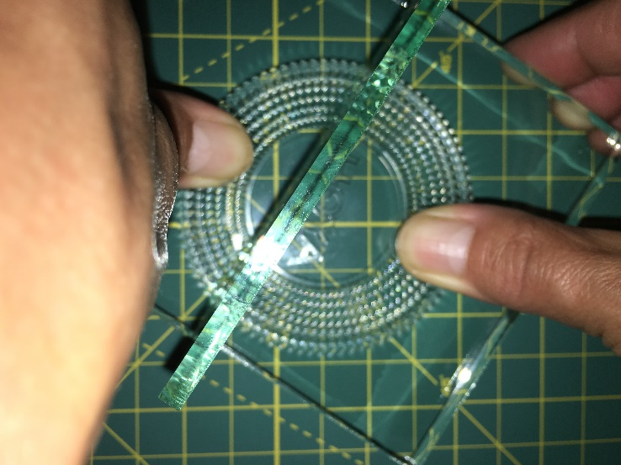
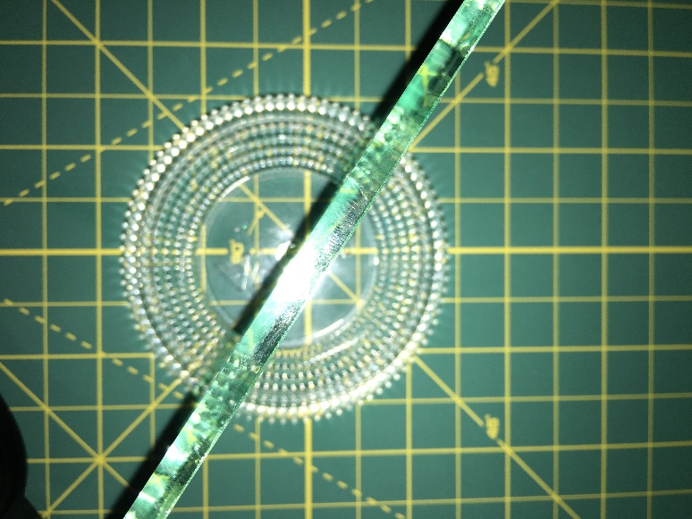
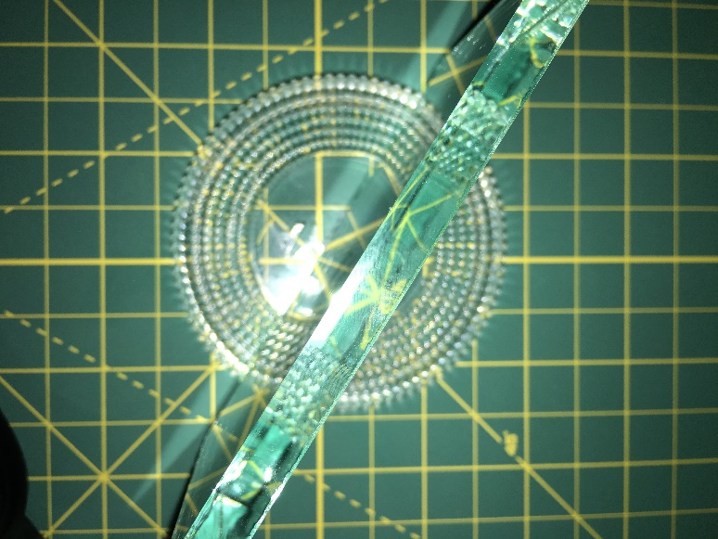
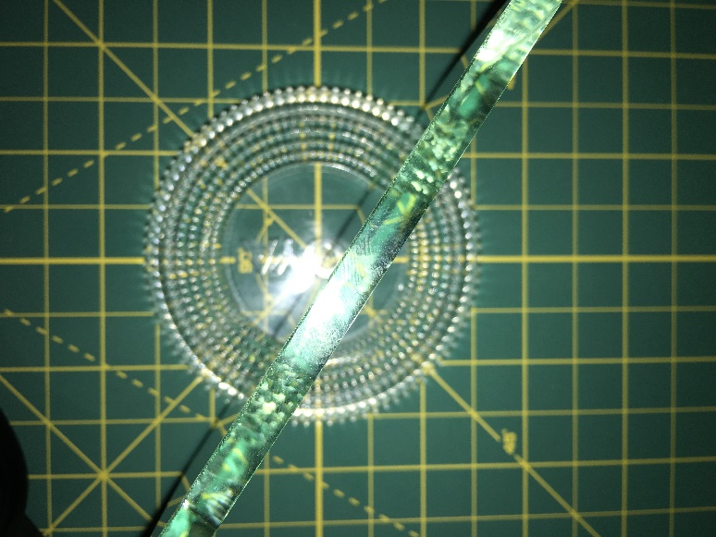
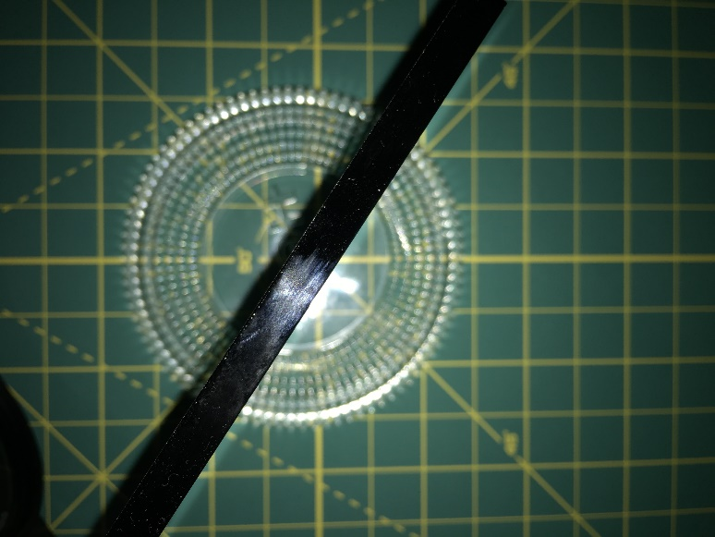
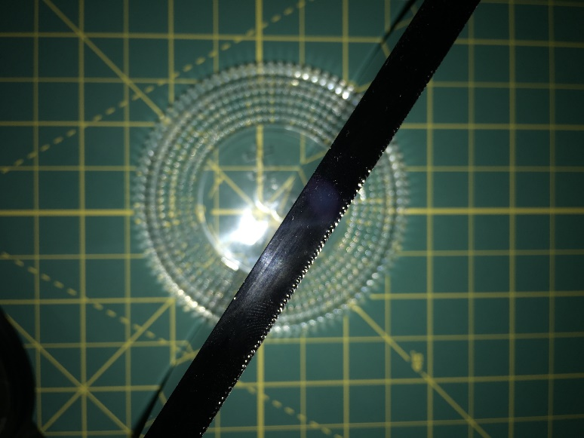
Brewster‘s angle measurements
Measurements of 7 different sheets

Slide 12
Brewster‘s angle measurements
zoom
Sheet 2
Sheet 3
Sheet 4
Sheet 6
Sheet 7
Sheet 1
Sheet 8

Slide 13
Brewster‘s angle measurements
Sheet 2
What’s going on?
Sheet 6
Sheet 7
Sheet 8
All of the sheets are from the same manufacturer
Sheet 3
Sheet 4
Sheet 1

Slide 14
Brewster‘s angle: 2nd (verification) measurements
Sheet 2
Sheet 7
Sheet 6
Sheet 8
Sheet 3
Sheet 4
Sheet 1
Sheet 5
✓
$n$ error $≈$ 0.008

Slide 15
Limitations of reflections method: phase diagram
Suitable for measurement
Unsuitable for measurement

Slide 16
Brewster’s angle: conclusion
Usage: | Refractive index
Error: | ± 0.08
Limitation (n = 1.5): | ~0.16mm
$$α$$
$$1$$
$$n$$

Slide 17
Measuring refractive index using Fresnel equations

Slide 18
2nd method of measuring the index of refraction: Intensity of p-polarized reflected light
$$R_{p}={\left|\frac{n_{1}cosθ_{t} −n_{2} cosθ_{i}}{n_{1}cosθ_{t}+n_{2} cosθ_{i}}\right|}^{2}$$
$$α$$
$$1$$
$$n$$
zoom

Slide 19
2nd method of measuring the index of refraction: Intensity of p-polarized reflected light
$$R_{p}={\left|\frac{n_{1}cosθ_{t} −n_{2} cosθ_{i}}{n_{1}cosθ_{t}+n_{2} cosθ_{i}}\right|}^{2}$$
Error caused by non-uniform cross section of intensity of laser beam (we only consider the highest intensity pixel)
Fit values:
Refractive index: $1.52 ± 0.015$

Slide 20
Limitations of reflections method: phase diagram
Suitable for measurement
Unsuitable for measurement

Slide 21
Fresnel equations: conclusion
Usage: | Refractive index
Error: | ± 0.015
Limitation (n = 1.5): | 0.16mm
$$α$$
$$1$$
$$n$$

Slide 22
Measuring thickness using internal reflections

Slide 23
Thickness and index of refraction: internal reflection
measured
$$x$$
$$α$$
$$1$$
$$\frac{x}{2d}=\frac{\sin{α}}{\sqrt{n^{2}−\sin^{2}{α}}}$$
$$n$$
$$d$$
Derived from geometrical optics
Obtained by regression

Slide 24
Thickness and index of refraction: internal reflection
measured
$$x$$
$$α$$
$$1$$
$$\frac{x}{2d}=\frac{\sin{α}}{\sqrt{n^{2}−\sin^{2}{α}}}$$
$$n$$
$$d$$
Derived from geometrical optics
Brewster’s angle
Obtained by regression

Slide 25
Thickness and index of refraction: internal reflection
1.
CMOS sensor
$$x$$
$$α$$

Slide 26
Thickness and index of refraction: internal reflection
2.
Extremely thin beam
1.
CMOS sensor
3.
Camera
$$x$$
$$α$$

Slide 27
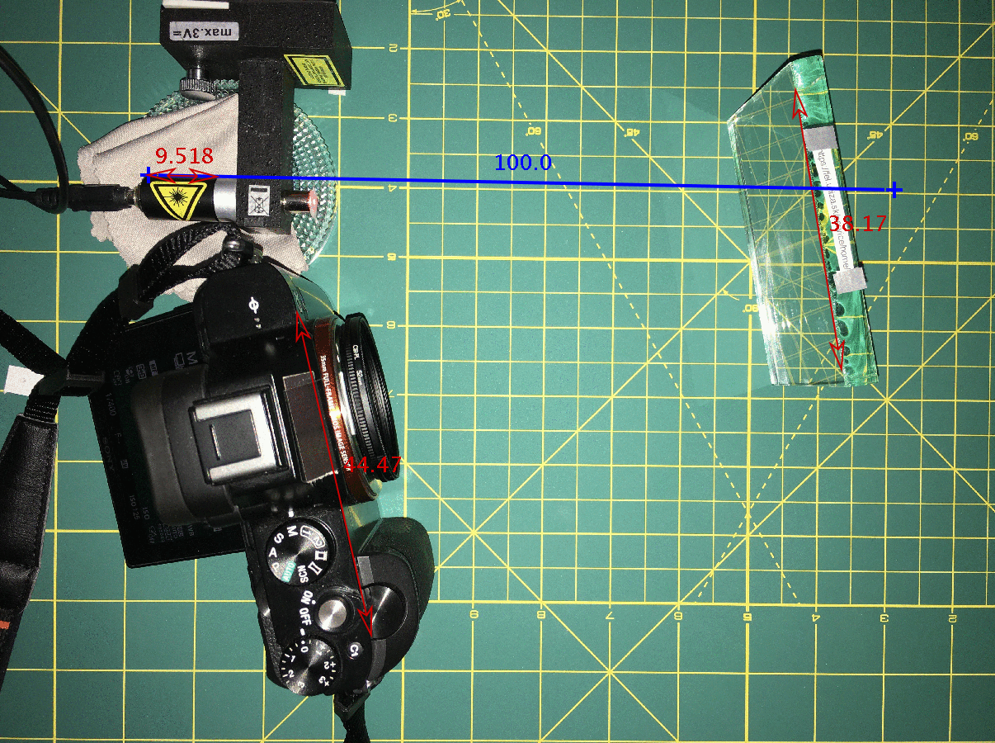
Digitally measuring the distance and angle
Took a picture from the top to measure the angles

Slide 28
Digitally measuring the distance and angle
Took a picture on the camera to measure the distance
Took a picture from the top to measure the angles

Slide 29
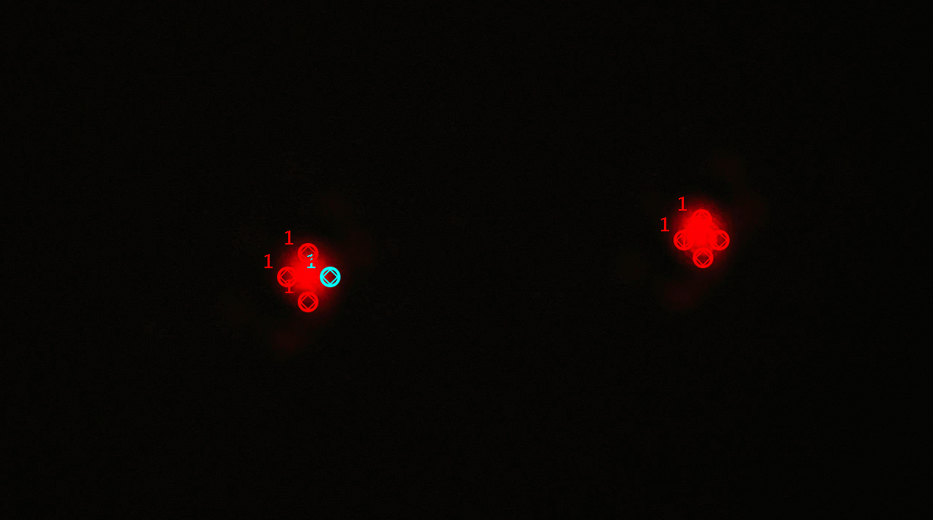
Digitally measuring the distance and angle
Measured 4 points for each beam
Extremely high precision
Derivation of error
$\sim 0.1$mm (varied for each measurement)

Slide 30
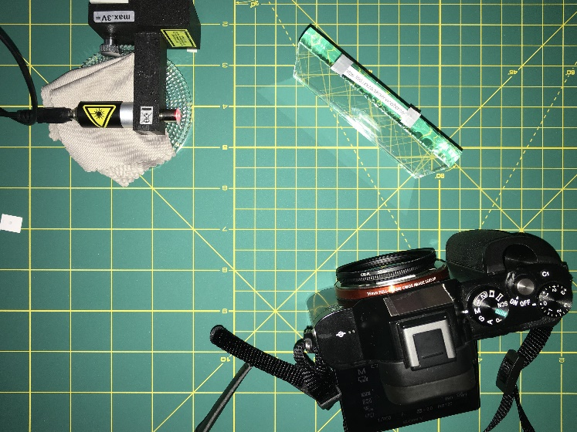
Inclining the sensor to prevent a ”stretched” image
$$θ$$
$$α$$
$$α$$
$$x$$
$$θ$$
$$90˚−α$$
$$θ$$
$$90˚+α−θ$$
$$d$$
$$x=\frac{d\cos{(α−θ)}}{\cos{(α)}}$$

Slide 31
Fitting depth, using refractive index from Brewster’s angle
Some points are slightly off
Input values:
Index o$f refraction:\left(1.44 ±0.073\right)$
Fit values:
D$epth (10.02 ± 0.721) mm$

Slide 32
Comparing predicted vs. measured data
Input values:
D$epth 9.77mm$
Index of refraction $1. 502$
Micrometer value
All points are off

Slide 33
In search for an explanation

Slide 34
What if the sides are inclined?
Side 1
Side 2

Slide 35
What if the sides are inclined?
Side 1
$$δ$$
Introduce an inclination angle
Side 2

Slide 36
Inclination of the sides of sheet of glass
$$∆x=\frac{c\sin{(∆θ)}}{\cos{(α)}}$$
$$∆x$$
$$∆d=d\tan{β}\left[\frac{\cos{(δ+β)}}{\cos{(2δ−β)}}\cos{(β)}−1\right]$$
$$∆θ$$
$$c$$
$$θ − ∆θ$$
$$α$$
$$α$$
$$90˚ − α$$
$$α$$
$$d\tan{β}$$
$$∆d$$
$$d\tan{(}β+2δ)$$
$$90˚ −β0−2δ$$
$$β$$
$$d$$
$$d$$
$$β$$
$$δ$$
$$δ$$
$$β+δ$$
$$90˚ −δ− β$$
$$90˚ −2δ−β$$

Slide 37
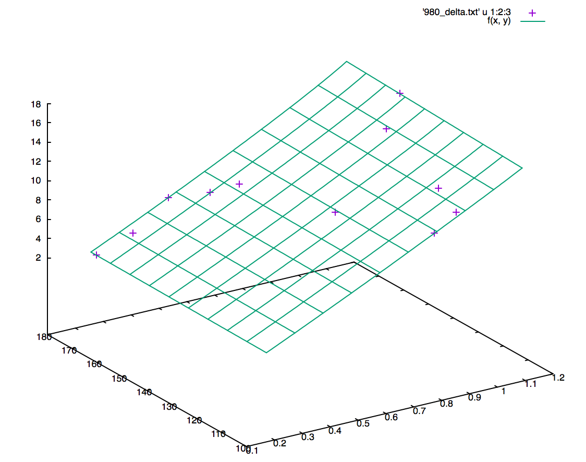
Reflections: 3D plot
Input values:
Index of refraction $1. 502$
Fit Values:
$δ=0.055±0.002˚$
$d=9.78±0.005$mm
Measured beam distance (mm)
Micrometer:
$d=9.77±0.005$mm
Camera distance (mm)
Angle

Slide 38
Measurement vs. theory correlation

Slide 39
Limitations of reflections method: phase diagram
Suitable for measurement
Unsuitable for measurement

Slide 40
Internal reflections: conclusion
Usage: | Thickness Inclination angle
Error: | ± 0.005mm ± 0.002˚
Limitation (n = 1.5): | 0.16mm
$$x$$
$$α$$
$$1$$
$$n$$
$$d$$

Slide 41
Measuring thickness using Michaelson interferometer

Slide 42
Michelson interferometer
Laser
Half-translucent mirror
Glass sheet
Inclination of glass sheet causes difference in OPL
Negative lens
Shift of interference pattern (by N stripes)
Interference pattern
Notes:
OPL = optical path length

Slide 43
Michelson interferometer: measurement output
n or d can be obtained by regression
Observed pattern
Shift of interference pattern by N stripes
Sheet width
$$N=\frac{2d(1−\cos\left(α\right))(n−1)}{nλ−λ(1−\cos\left(α\right))}$$
[Deepak N. Iyer , Lehigh University, A Michelson interferometric technique for measuring refractive index of sodium zinc tellurite glasses]
Refractive index

Slide 44
Michelson interferometer: measuring thickness by regression
Input values:
Index of refraction $1. 48$
Fit Values:
$d=1.03±0.043$mm
Micrometer:
$d=1.05±0.005$mm

Slide 45
Michelson interferometer: conclusion
Usage: | Thickness
Error: | ± 0.043mm
Limitation (n = 1.5): | (0.3 – 2)mm
Laser
Half-translucent mirror
Glass sheet
Inclination of glass sheet causes difference in OPL
Shift of interference pattern (by N stripes)
Interference pattern

Slide 46
Back to the definition of the problem…
Invent and construct an optical device that uses a laser pointer and allows contactless determination of thickness, refractive index, and other properties of a glass sheet.
✓

Slide 47
Observing internal tension

Slide 48
Observing internal tension
Crossed
polarizers
Glass sheet
Paper

Slide 49
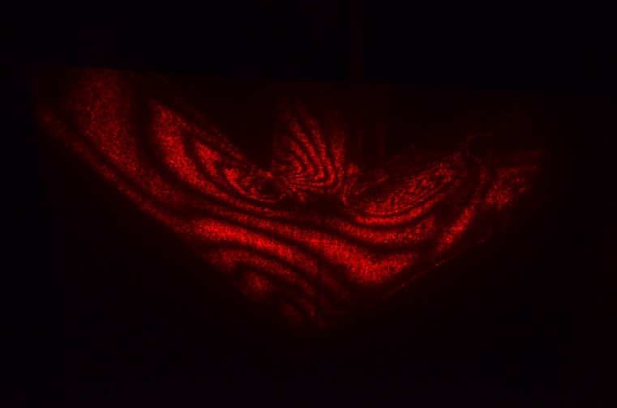
Observing internal tension: plastic protractor
No object inserted
Object with an internal tension
No change of polarization
Change of polarization

Slide 50
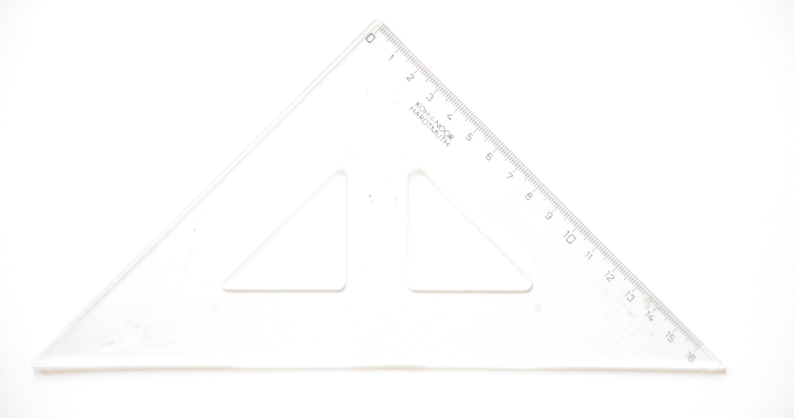
Observing internal tension: plastic protractor

Slide 51
Observing internal tension: sheet of glass
No object
Glass sheet
Extremely low internal tension

Slide 52
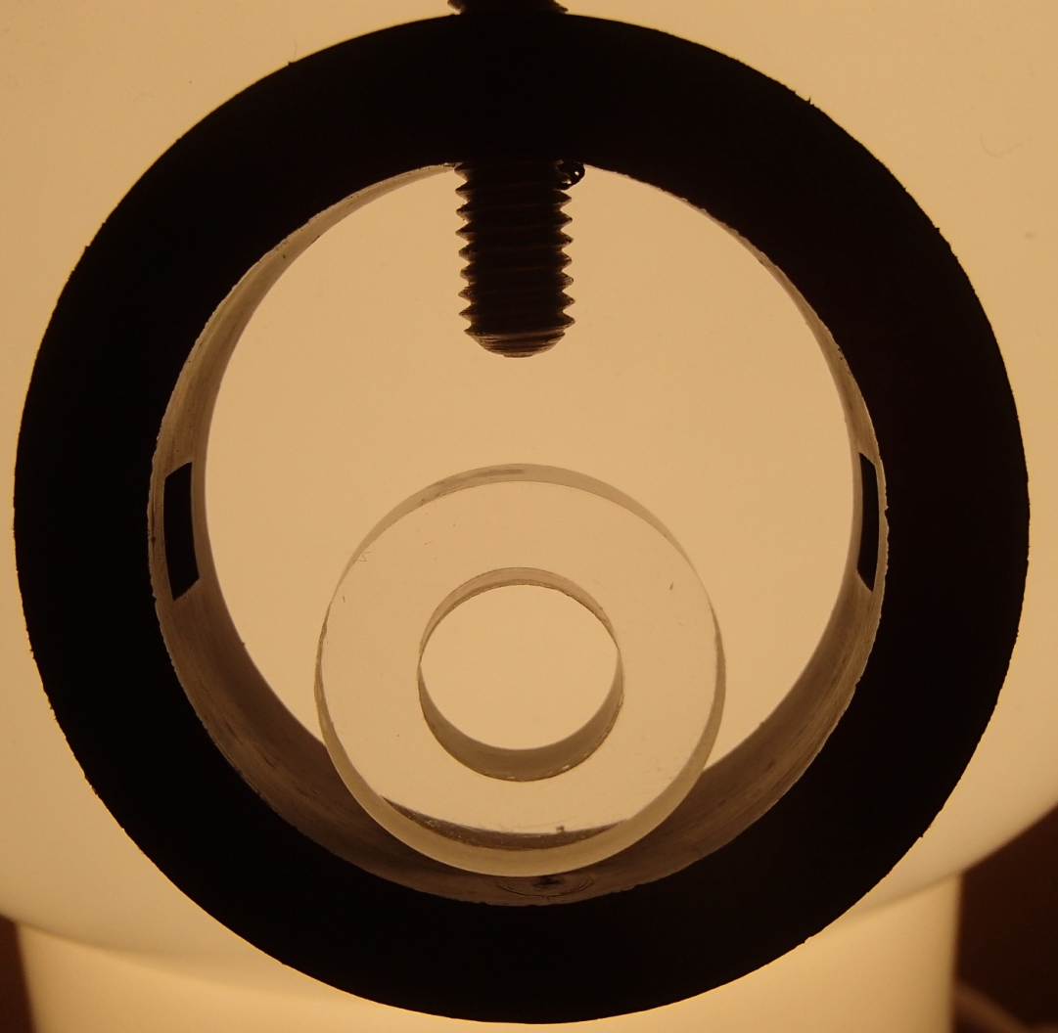
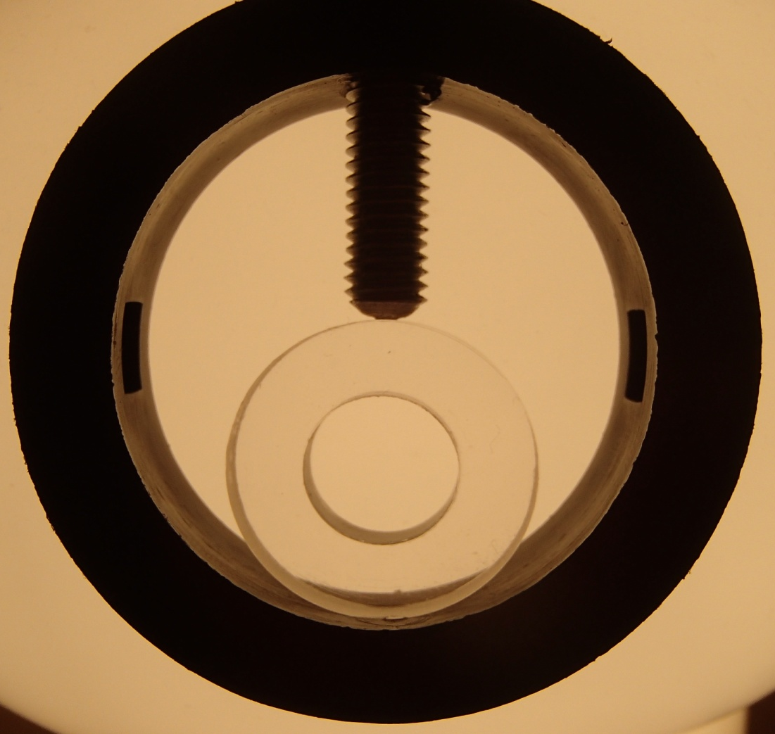
Applying external force to create internal tension
Relaxed
Stressed

Slide 53
Applying external force to create internal tension
Relaxed
Stressed

Slide 54
Measuring absorption coefficient

Slide 55
Measuring the absorption coefficient
1.
2.
CMOS
CMOS
3.
4.
CMOS
CMOS

Slide 56
Measuring the absorption coefficient
Glass sheets
CMOS
$$R= \frac{{\left|\frac{n_{1}cosθ_{i} −n_{2} cosθ_{t}}{n_{1}cosθ_{i}+n_{2} cosθ_{t}}\right|}^{2}+ {\left|\frac{n_{1}cosθ_{t} −n_{2} cosθ_{i}}{n_{1}cosθ_{t}+n_{2} cosθ_{i}}\right|}^{2}}{2}$$
reflections
Fresnel’s equations

Slide 57
Measuring the absorption coefficient
$$I_{0}=55. 99$$
$$I=I_{0} e^{−xα}$$
$α=159.03±2.06 m^{−1}$

Slide 58
Absorption: conclusion
Usage: | Absorption
Error: | ± 2m⁻¹
Limitation: | $$αd≫−ln\left(1−\frac{ΔI}{I_{0}}\right)$$
Approximated limitation: | $αd≫0.02$

Slide 59
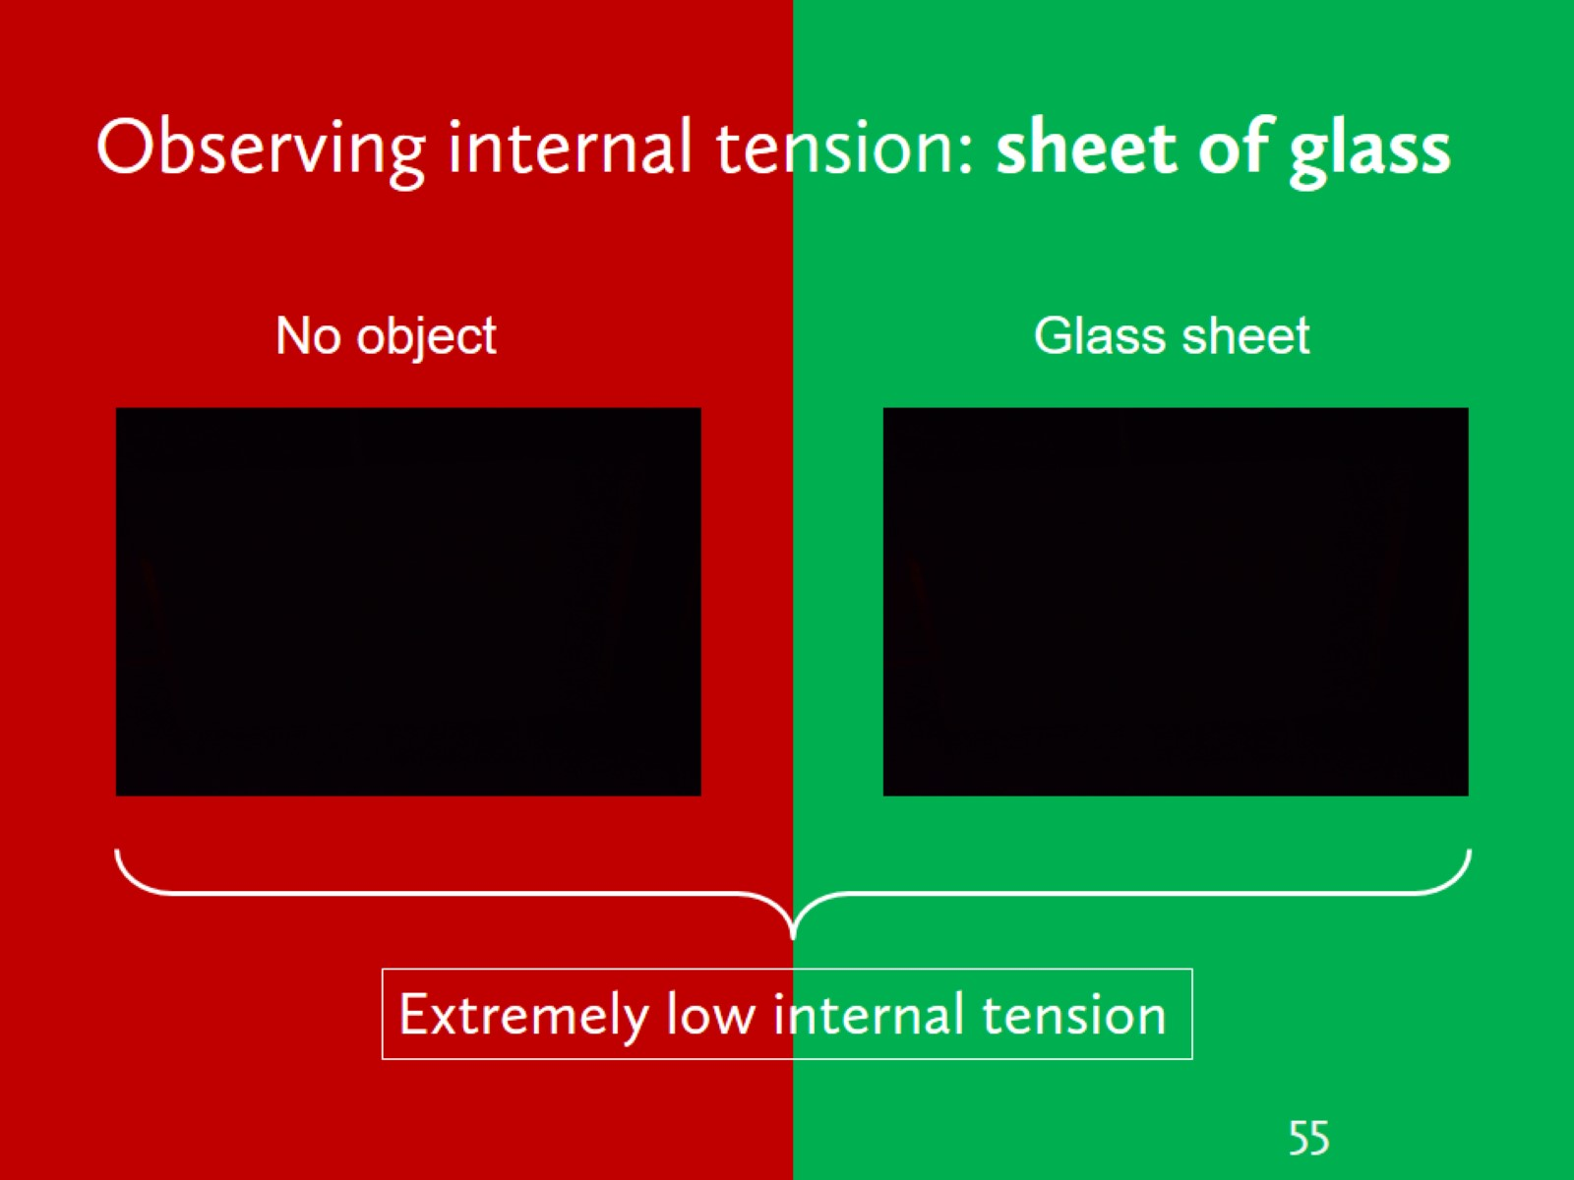
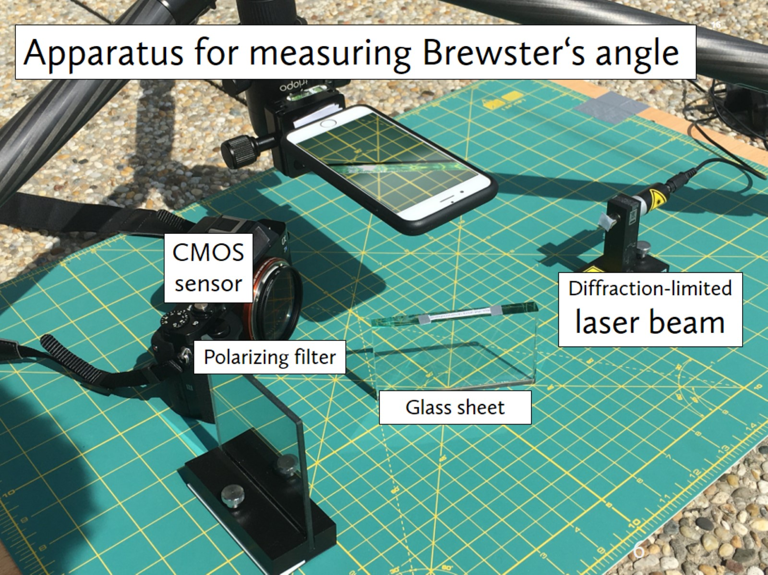
Contactless calliper
Thickness
Absorbtion
Internal tension
Refractive index

Slide 60
Contactless calliper
Thickness
Absorbtion
Internal tension
Refractive index

Slide 61
Contactless calliper
Thickness
Absorbtion
Internal tension
Refractive index

Slide 62
Contactless calliper
Thickness
Absorbtion
Internal tension
Refractive index

Slide 63
Contactless calliper
Thickness
Absorbtion
Internal tension
Refractive index

Slide 64
Output
Quantity | Uncertainty | Range | Method
Index of refraction | ± 0.008 | $d≳$ 0.16mm | Brewster angle
Thickness | ± 0.005mm | $d≳$ 0.16mm | Internal reflections
Inclination angle | ± 0.002˚ | $d≳$ 0.16mm | Internal reflections
Absorption | ± 2m⁻¹ | $αd≫0.02$ | Absorption

Slide 65
Refractive index

Slide 66
Thickness

Slide 67
Internal tension

Slide 68
Absorbtion

Slide 69
Appendix

Slide 70
Deriving minimal $αd$
$${I_{0}−I_{0}e}^{−αd}≫ΔI$$
$${1−e}^{−αd}≫\frac{ΔI}{I_{0}}$$
$$e^{−αd}≫1−\frac{ΔI}{I_{0}}$$
$$αd≫−ln\left(1−\frac{ΔI}{I_{0}}\right)$$

Slide 71
Complex index of refraction
Absorption coefficient
$$\hat{n}=n+i\frac{α}{k}$$
Wavenumber
Refraction
Absorption
$$n=1.5025±0.0013+i\left(1,573±20\right)×{10}^{6}$$
Notes:
Wavelength = 635nm

Slide 72
Speed of light
Speed of light in vacuum
$$v=\frac{c}{n}$$
Speed of light in the glass
Index of refraction

Slide 73
2nd method of measuring the index of refraction: Intensity of p-polarized reflected light
$$R_{p}={\left|\frac{n_{1}cosθ_{t} −n_{2} cosθ_{i}}{n_{1}cosθ_{t}+n_{2} cosθ_{i}}\right|}^{2}$$
Fresnel: 56.18˚
Brewster: 56.47˚

Slide 74
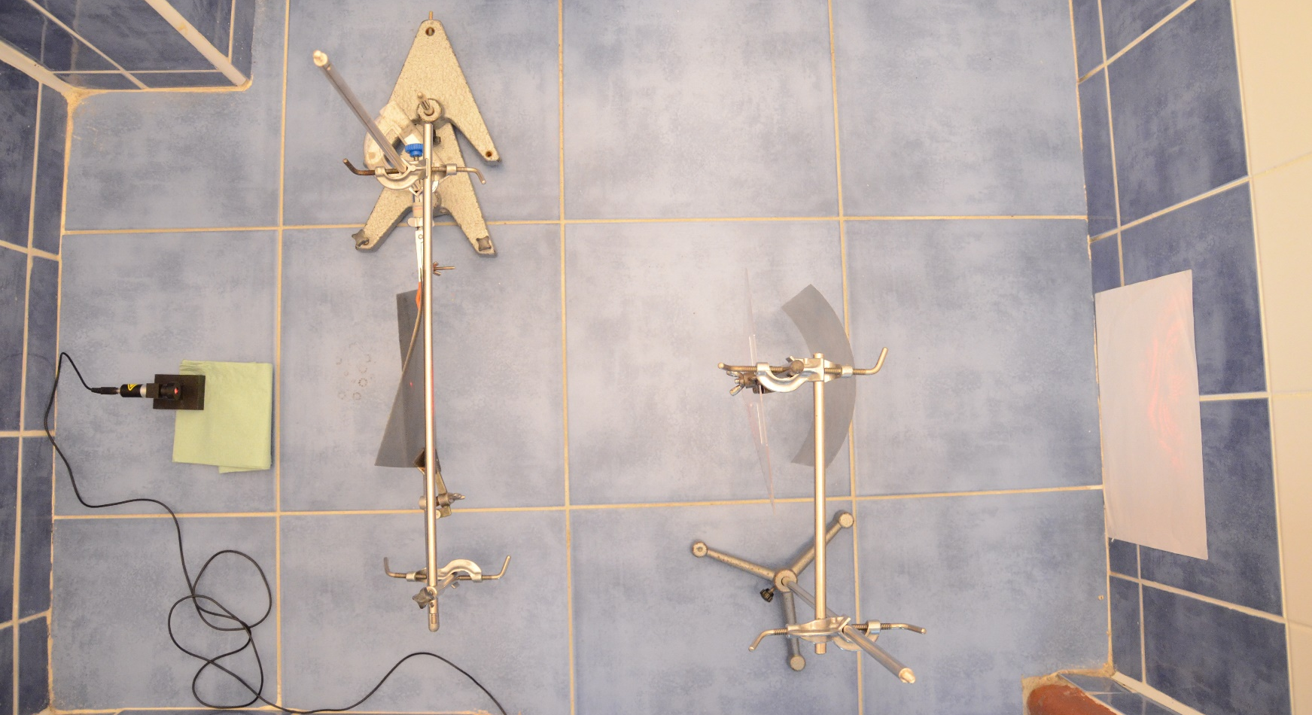
Observing internal tension
$90°$ pol.
$0°$ pol.
Sheet
paper

Slide 75
All data
Fit values:
D$epth (10.02 ± 0.721) mm$
Index o$f refraction (1.44 ±0.073)$
Actual Values:
$n=1.502$
$d=9.77$mm

Slide 76
Fiting thickness and inclination angle
Camera distance values unique for each point
Perfect fit!

Slide 77
Michelson interferometer: measuring refractive index by regression
Input values:
$d=4.88$mm
Fit Values:
$n=1.46$
Brewster’s angle:
$$n=1.48$$

