Slide 1
Lagging Pendulum
02
Martin Gažo

Slide 2
Task
A pendulum consists of a strong thread and a bob.
When the pivot of the pendulum starts moving along a horizontal circumference, the bob starts tracing a circle which can have a smaller radius, under certain conditions.
Investigate the motion and stable trajectories of the bob.

Slide 3
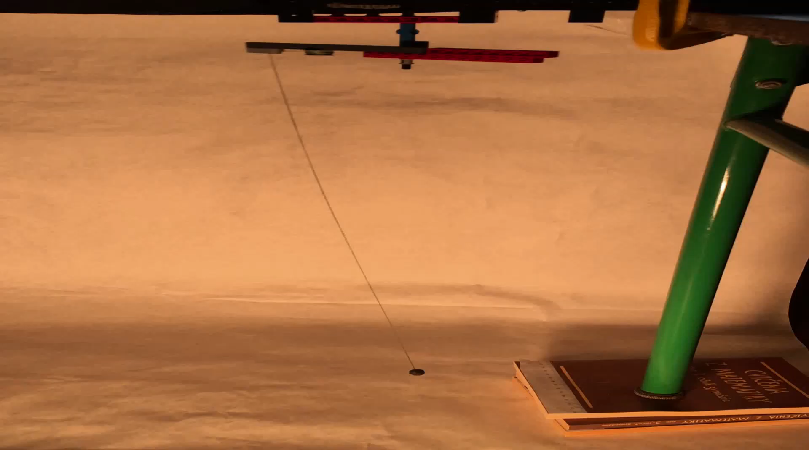
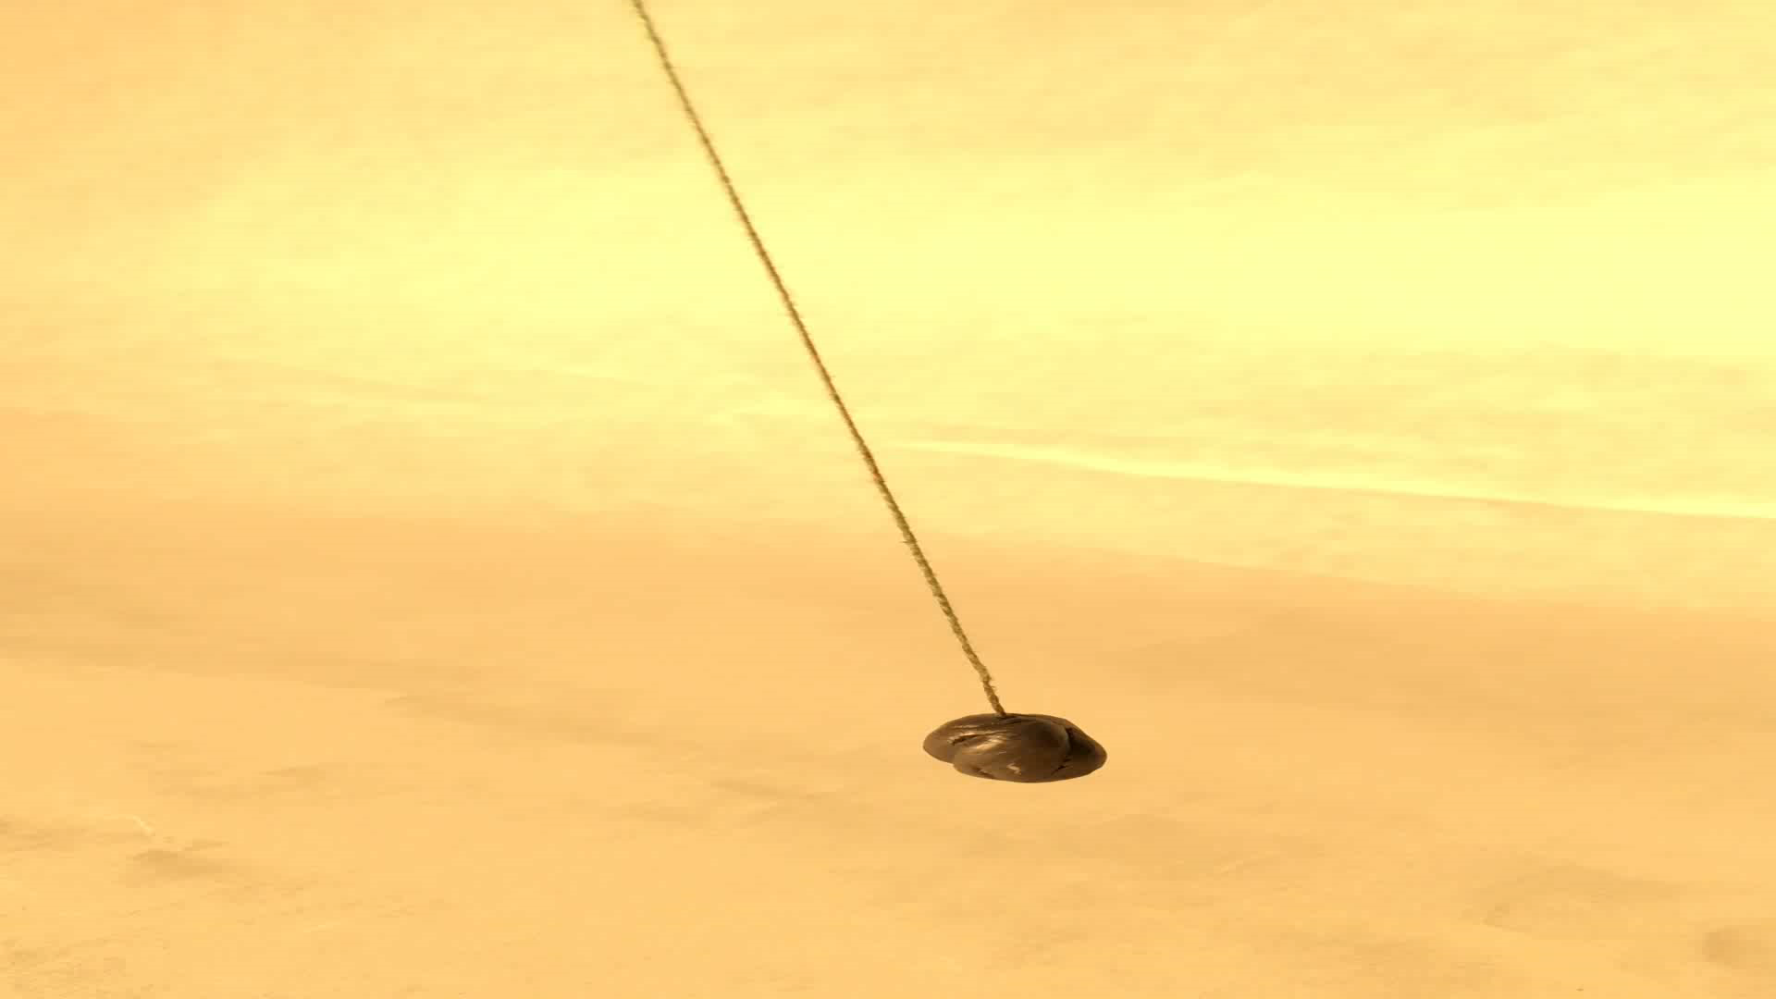
What does it look like?
Stationary point
“Smaller circle”

Slide 4

Lagging pendulum
Lagging pendulum
lag = phase lag regarding attachment point by almost $π$
Stationary point
“Smaller circle”

Slide 5
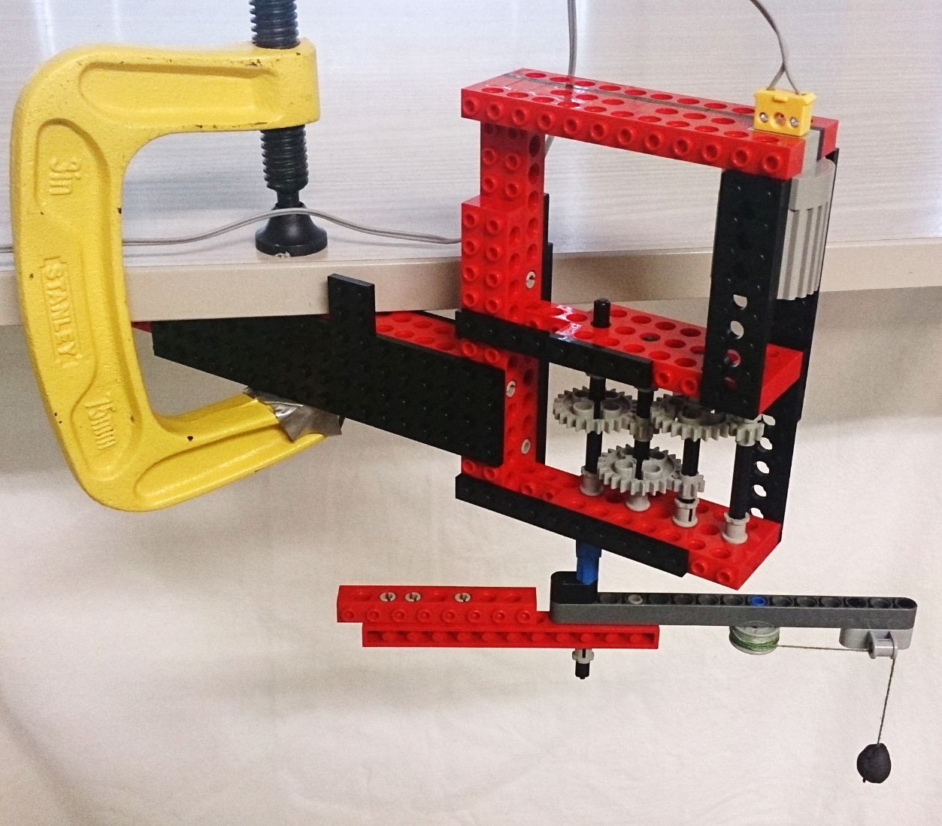


Apparatus
Power source (adjustable $ω$)
$$ω$$
Motor
Pendulum

Slide 6
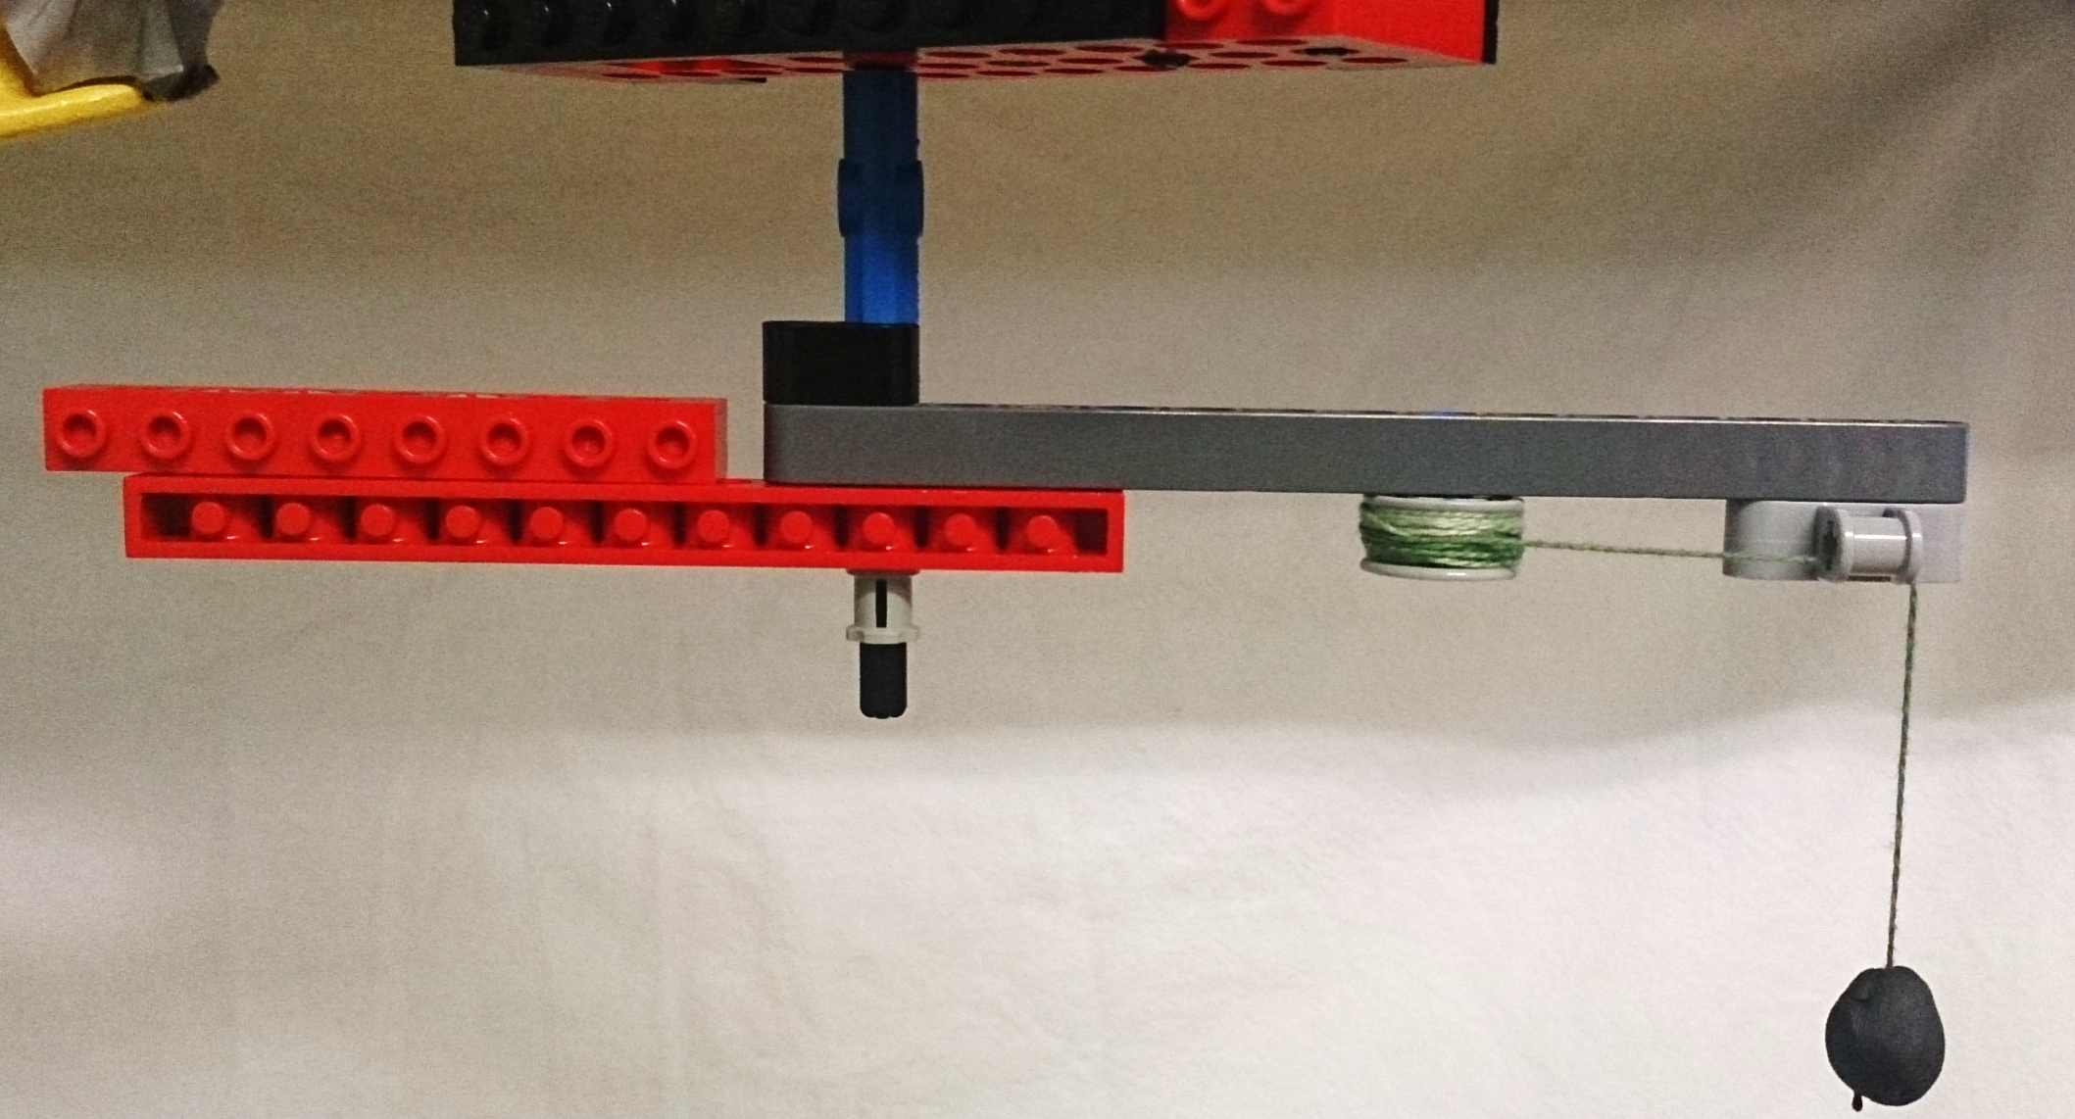




Apparatus
Regulation of $R$
$$R$$
Regulation of $L$
Thread
$$L$$
Bob

Slide 7





Analytical theory: circular trajectories
ω
Assumption: bob moves only in vertical plane
Frame of reference: rotating with the arm
$$R$$
$$α$$
$$L$$
Force of the thread
$$ω_{0}=\sqrt{g/L}$$
Angular acceleration:
Centrifugal force
$$\ddot{α}\left(α\right)=−ω_{0}^{2}\sin{α}+ω^{2}\left(\frac{R}{L}+\sin{α}\right)\cos{α}$$
Gravity
Centrifugal
Gravitational force
Notes:
Therefore, we have only 3 forces acting on the bob

Slide 8




Analytical theory: circular trajectories
$\ddot{α}$ [arb. u.]
What’s the typical dependence of $\ddot{α}$ on $α$?
Equilibrium
points
$α$ [rad]
$$ω_{0}=\sqrt{g/L}$$
$$\ddot{α}\left(α\right)=−ω_{0}^{2}\sin{α}+ω^{2}\left(\frac{R}{L}+\sin{α}\right)\cos{α}$$
$$=0$$
Equilibrium condition

Slide 9

Analytical theory: circular trajectories
$$ω_{0}=\sqrt{g/L}$$
$$\ddot{α}\left(α\right)=−ω_{0}^{2}\sin{α}+ω^{2}\left(\frac{R}{L}+\sin{α}\right)\cos{α}$$
$$=0$$
Equilibrium condition

Slide 10



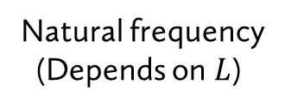



Analytical theory: circular trajectories
Equlibrium condition:
$$−\sin{α}+\frac{ω^{2}}{ω_{0}^{2}}\left(\frac{R}{L}+\sin{α}\right)\cos{α}=0$$
Centrifugal force
$$ω_{0}=\sqrt{g/L}$$
Two free parameters: $ω/ω_{0}$ and $R/L$
$$R$$
$$L$$
Natural frequency
(Depends on $L$)
Let’s plot solution in the dependence of $ω/ω_{0}$

Slide 11



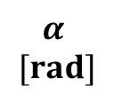
Equilibrium angles
$$α$$
$$[rad]$$
1st trajectory: “traditional”
$$\frac{ω}{ω_{0}}$$
“Circles with a smaller radius”
2nd trajectory: “lagging”
3rd trajectory
$$\frac{R}{L}=0,2$$
$$ω_{0}=\sqrt{g/L}$$
Notes:
TODO: vyznacit este kde je mensia kruznica a kde uz nie (pre zaporne uhly)

Slide 12
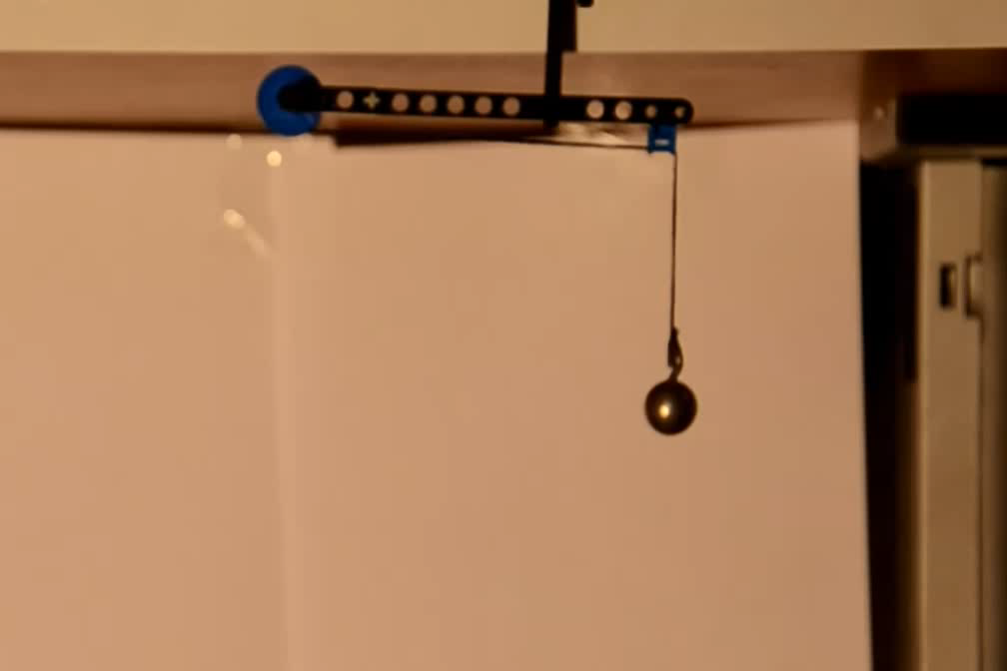
Spotted circular trajectories
✓ Observed
✓ Observed
✗ Not observed
Notes:
TODO videa

Slide 13
Spotted circular trajectories
✓ Observed
✓ Observed
✗ Not observed
Possible flaw: equilibrium doesn’t necessary imply stability
Are the trajectories stable?
Notes:
TODO videa

Slide 14



Are the trajectories stable?
Hold on…
We should also add 2nd dimension
Pendulum lower potential energy
We will plot total effective potential energy
2nd: Lagging
$\ddot{α}$ [arb. u.]
$α$ [rad]
3rd
$α$ [rad]
2nd trajectory: unstable
Traditional
3rd
Traditional
2nd: Lagging
energy [arb. u.]
Integration
Angular acceleration
Potential energy
Notes:
2D graph - energy

Slide 15
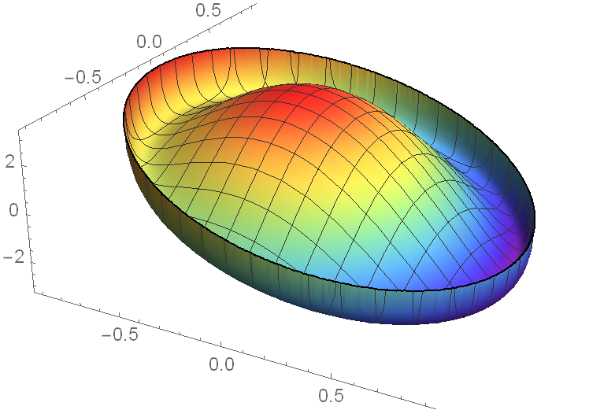
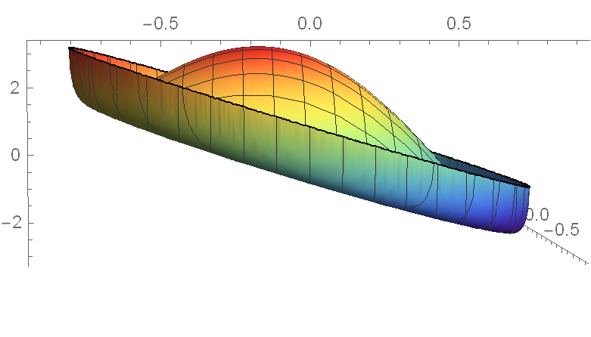


3D Energy plot in corotating frame
3rd position
Lagging position
$y$
Energy
Traditional position
Unstable
(2nd dimension)
Unstable
(all dimensions)
Stable
falls down
View from side
$x$
Notes:
3d tu bude

Slide 16
Results
Stability analysis does not correspond
with the experiment, where the lagging motion (2nd position) is observed
Something is missing…
We haven’t included Coriolis force!

Slide 17
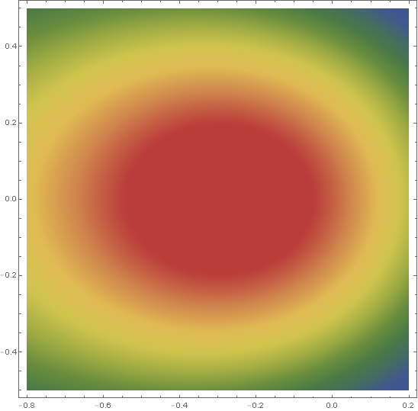
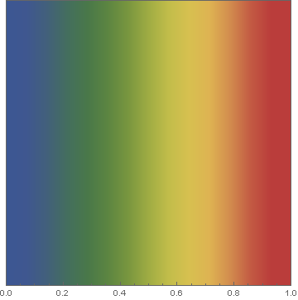
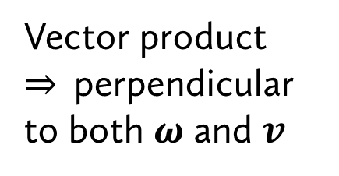
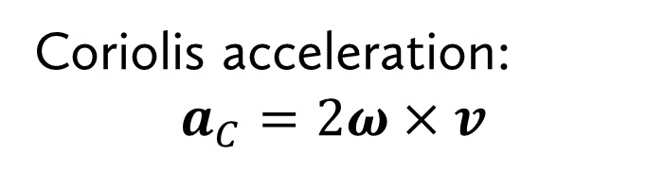

Stabilizing effect of Coriolis force
Coriolis acceleration:
$$a_{C}=2ω×v$$
Velocity of the bob
in rotating frame
Potential energy map
Angular velocity of the rotating frame
Vector product
$⇒$ perpendicular to both $ω$ and $v$
Large
$$a_{cor}$$
Coriolis force could act as a centripetal force
(that has the same direction)
Bob
Small

Slide 18
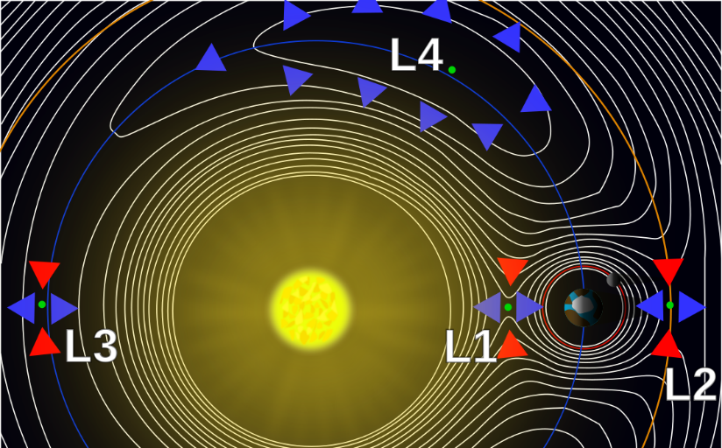
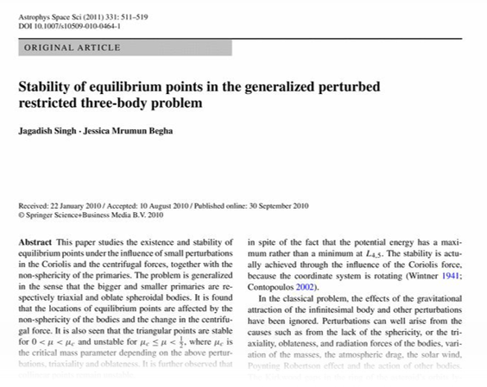
Stabilizing effect of Coriolis force
Coriolis acceleration:
$$a_{C}=2ω×v$$
Photo credits:
By Lagrange_points.jpg: created by NASAderivative work:
Xander89 - Lagrange_points.jpg, CC BY 3.0,
https://commons.wikimedia.org/w/index.php?curid=7547312
Velocity of the bob
in rotating frame
Potential energy map
Angular velocity of the rotating frame
Vector product
$⇒$ perpendicular to both $ω$ and $v$
Large
Well-known problem:
stability of L4, L5 Lagrange points
also stabilized by the Coriolis force
$$a_{cor}$$
Coriolis force could act as a centripetal force
(that has the same direction)
Singh, Jagadish, and Jessica Mrumun Begha. "Stability of equilibrium points in the generalized perturbed restricted three-body problem." Astrophysics and Space Science 331.2 (2011): 511-519.
Bob
Small

Slide 19
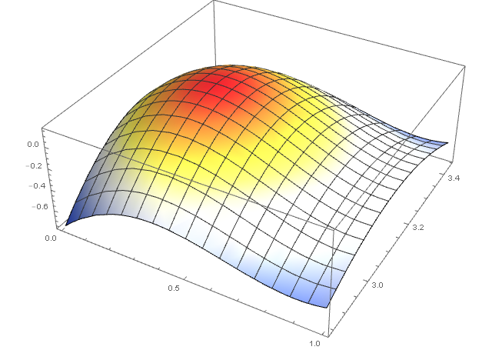


How does Coriolis stabilize?
Energy
[arb. u.]
$φ$
Lagging position
$θ$

Slide 20
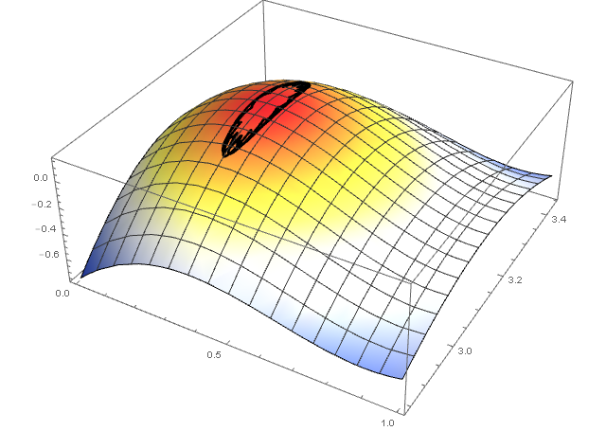
How does Coriolis stabilize?
Energy
[arb. u.]
$φ$
Lagging position
✓
$θ$
Stable
Fits experiment

Slide 21
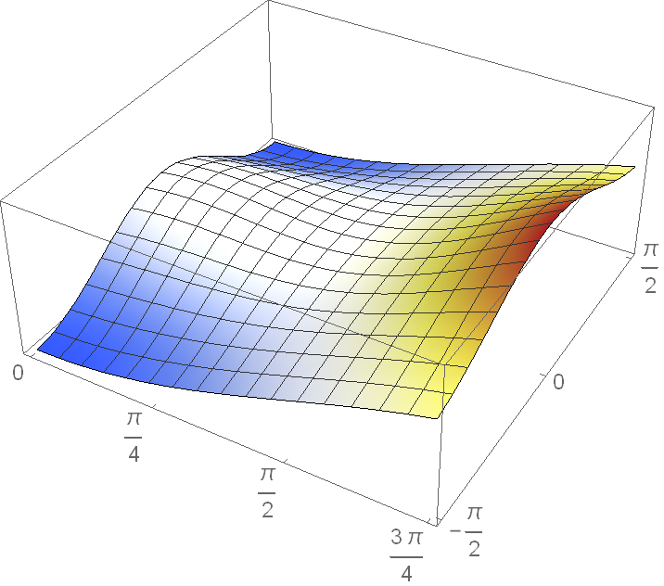


Could Coriolis force stabilize 3rd position?
Energy
[arb. u.]
3rd position
$φ$
✓
Unstable
$θ$
Fits experiment
Notes:
theta ab y nebula zaporna

Slide 22
Overview: predictions and experiment
1st trajectory: “traditional”
2nd trajectory: “lagging”
3rd trajectory
Position:
Theoretical predictions:
Stable
Stable
Unstable
Experiment:
✓ Observed
✓ Observed
✓ Not observed
Qualitative predictions
Quantitative predictions
✓ Done
Notes:
TODO videa

Slide 23
Lagging angle: theory – experiment
Theory
Experiment

Slide 24
Task
A pendulum consists of a strong thread and a bob.
When the pivot of the pendulum starts moving along a horizontal circumference, the bob starts tracing a circle which can have a smaller radius, under certain conditions.
Investigate the motion and stable trajectories of the bob.
✓ tracing a circle
✓smaller radius
Under certain conditions…

Slide 25
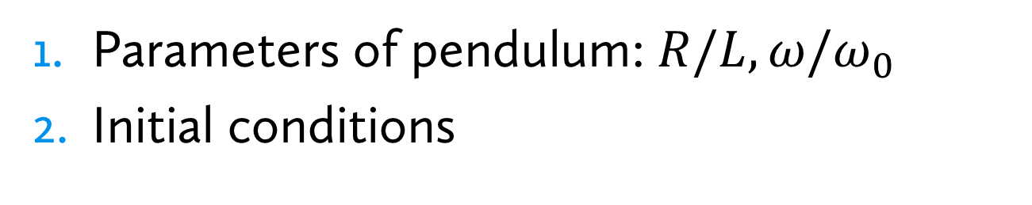
Conditions of lagging motion
Parameters of pendulum: $R/L,ω/ω_{0}$
Initial conditions
Notes:
Pomer omega/omega_0(L) od pomer R/L

Slide 26
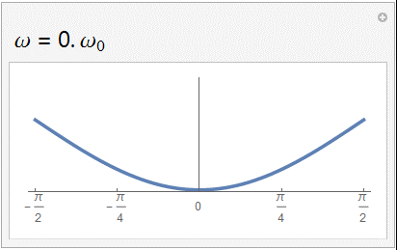
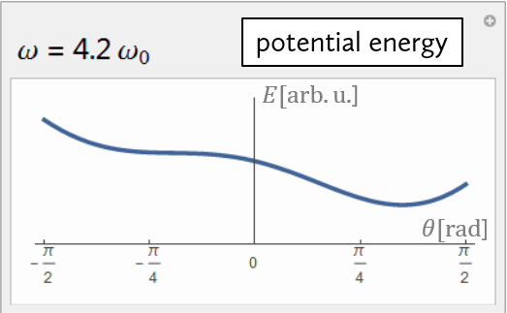





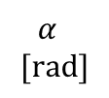
Parameters: $ω/ω_{0}$ by $R/L$
Equilibrium angles
We can calculate critical angular velocity from theory
$$α$$
$$[rad]$$
potential energy
$$\frac{ω}{ω_{0}}$$
$E[arb.u.$]
inflex point
equilibrium
$θ[rad$]
Only 1 position
Lagging position exists
Critical angular velocity ($ω_{c}$)

Slide 27
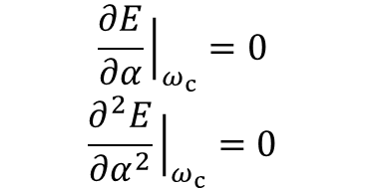
Parameters: $ω/ω_{0}$ by $R/L$
Equilibrium angles
We can calculate critical angular velocity from theory
$$α$$
$$[rad]$$
potential energy
$$\frac{ω}{ω_{0}}$$
$E[arb.u.$]
$θ[rad$]
conditions:
$$\frac{∂E}{∂α}{\left.​\right|}_{ω_{c}}=0$$
$$\frac{∂^{2}E}{∂α^{2}}{\left.​\right|}_{ω_{c}}=0$$
Only 1 position
Lagging position exists
equilibrium
inflex point
Critical angular velocity ($ω_{c}$)
Can be solved only numerically

Slide 28



Critical omega – theoretical prediction
$$ω_{c}/ω_{0}$$
Critical omega tends to
diverge when $\frac{R}{L}→1$
No solution
$$R/L$$

Slide 29



Critical omega – theoretical prediction
$$ω_{c}/ω_{0}$$
Critical omega tends to
diverge when $\frac{R}{L}→1$
No solution
Always-unstable region
$$\frac{R}{L}<1$$
$$R$$
$$L$$
coriolis
sum
$$R/L$$
$$R/L$$
gravity
unstable region

Slide 30
Critical omega
$$ω_{c}/ω_{0}$$
Critical omega tends to
diverge when $\frac{R}{L}→1$
Always-unstable region
$$\frac{R}{L}<1$$
$$R/L$$
Unstable zone

Slide 31
Critical angular velocity: theory-experiment

Slide 32


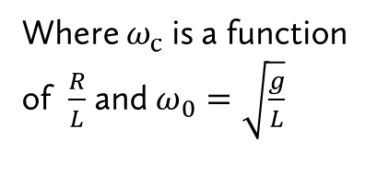
Conditions for parameters
$$\frac{R}{L}<1$$
𝑅/𝐿<1
$$ω>ω_{c}$$
𝜔>𝜔_c
$$R$$
1. Ratio of lengths:
$$L$$
2. Angular velocity:
Where $ω_{c}$ is a function of $\frac{R}{L}$ and $ω_{0}=\sqrt{\frac{g}{L}}$
Conditions: parameters necessary for lagging motion
✓

Slide 33
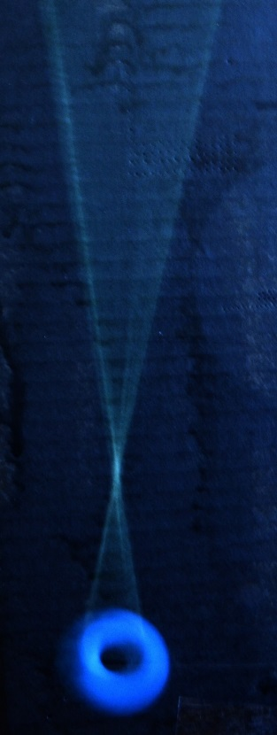
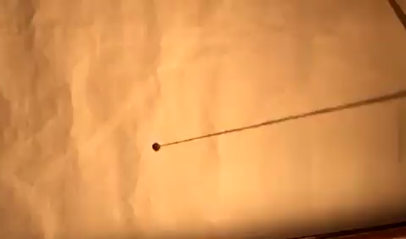
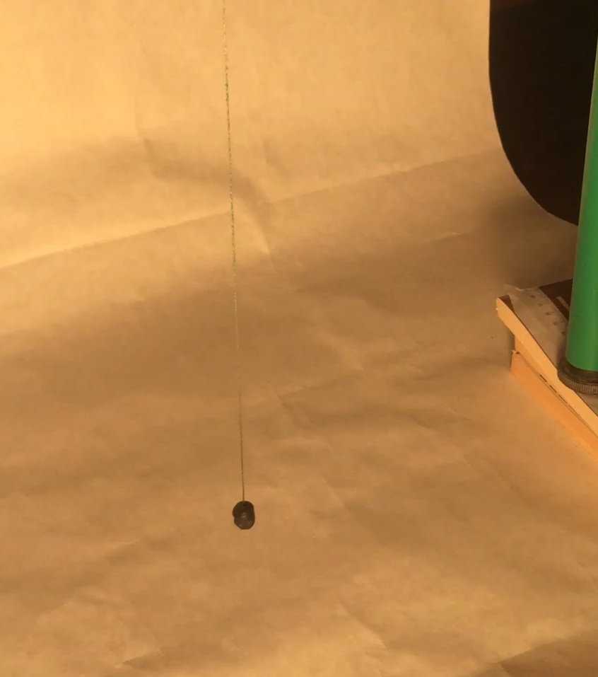
Initial conditions: time evolution
In the beginning the motion is jerky
(trembling)
Later, bob stabilizes to lagging motion
Stationary point
Time-lapse video:
trembling → lagging
Lagging motion:
Long-exposure photograph
Motion is being stabilized by air drag
Notes:
(to ensure that lagging was reached)

Slide 34


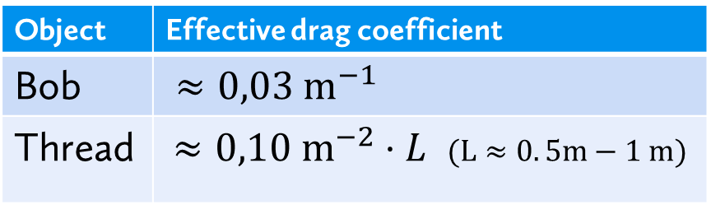
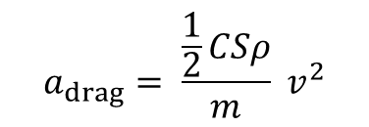
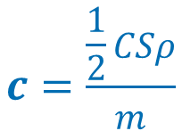
Effect of air drag
$$a_{drag}= \frac{\frac{1}{2}CSρ}{m}{ v}^{2}$$
$$c=\frac{\frac{1}{2}CSρ}{m}$$
Bob parameters:
$$mass=\left(1.29±0.02\right)g$$
$$diameter=(1.3±0.1)cm$$
“Effective drag coefficient”
Object | Effective drag coefficient
Bob | $≈0,03 m^{−1}$
Thread | $≈0,10 m^{−2}⋅L$ $(L≈0. 5m−1 m)$
Thread has also
a great affect on damping

Slide 35
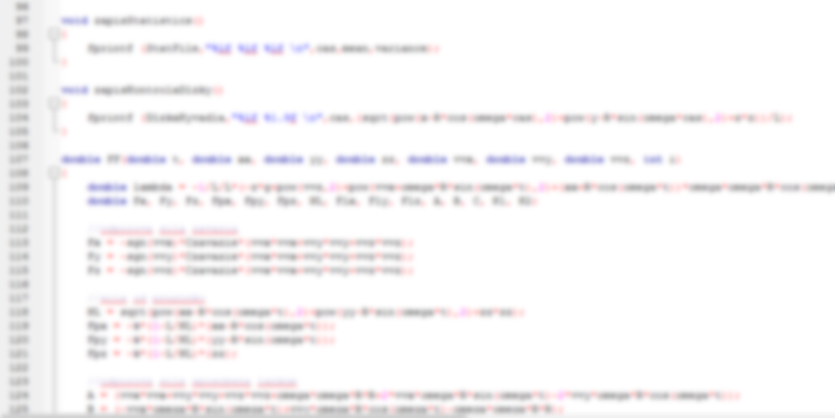
Numerical simulation
We are unable to solve system analytically
Numerical simulation from first principles
Inertial frame of reference used
Air drag of the thread computed
(may have different direction than that of the bob)
Constraint modelled using Lagrange multipliers
(Spherical coordinates omitted due instabilities near poles)

Slide 36
Numerical simulation
Runge-Kutta-Fehlberg algorithm (4th order method)
Computes both 4th order and 5th order
Error estimate
(difference between 4th and 5th order)
Adapts stepsize if the error is too big
Despite these upgrades:
  Numerical instability (violation of constraint)
Thread exchanged with very hard spring
The lenght of thread stays constant in simulation & spring does not influence character of motion

Slide 37
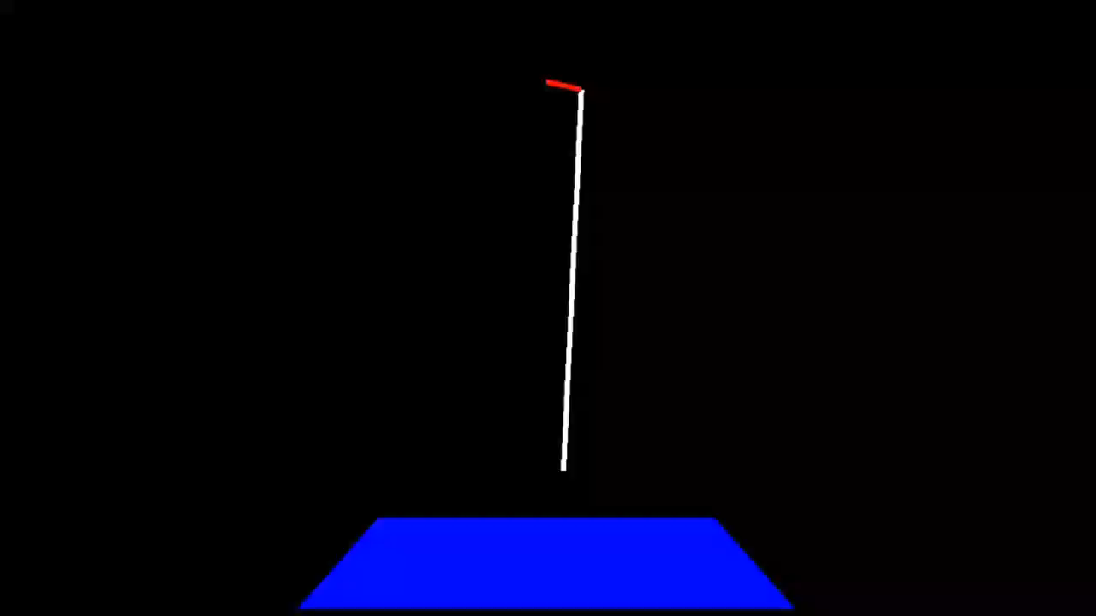
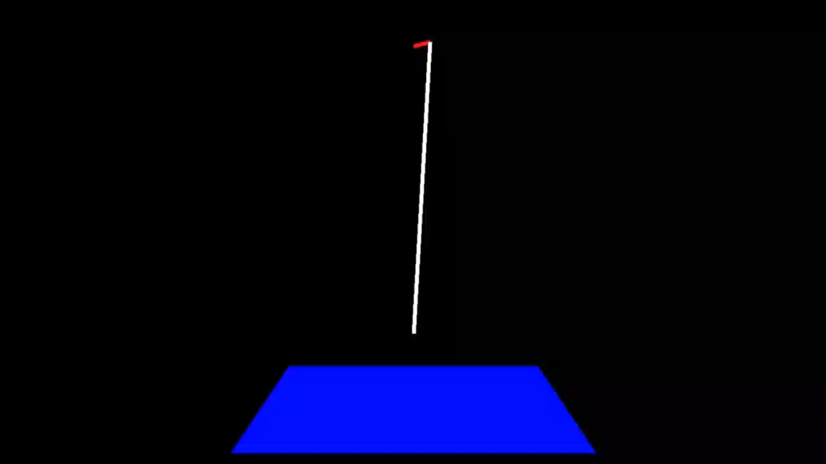
Example output from simulation
Trembling
(initial motion)
Lagging motion
(relaxed motion)

Slide 38













Air drag: stabilization
Parameters:
$$R/L≐0.114$$
$$ω=4ω_{0}$$
$$θ_{initial} =0.15$$
$θ$[rad]
$$0.2$$
$$0.175$$
$$Δθ≈0.005$$
Dissipation
$$0.15$$
~$15s$
Time
$φ$[rad]
Trembling
Lagging
$$π+0.1$$
Stabilization
$$π$$
$$Δφ≈0.03$$
$$π−0.1$$
~$15s$
Time
(Boundary is only qualitative and approximate)

Slide 39

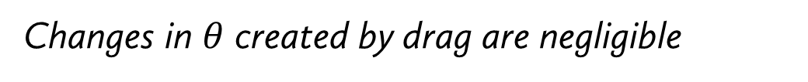
Simulation: equilibrated angles $θ$
Phase transition
(critical ang. velocity)
Initial angle (in simulation)
Changes in $θ$ created by drag are negligible
Notes:
Change of $\backslash theta$

Slide 40



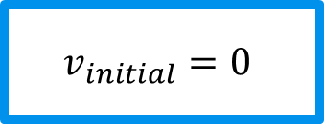




Initial conditions: angles
$$v_{initial}=0$$
$$φ [rad]$$
$$−π$$
$$0$$
$$π$$
$$0,3$$
$$θ [rad]$$
Traditional motion
Lagging motion
Initial conditions
$$0$$
Notes:
YES/NO, co je to no? dost unstable motion.. Da sa nejako klasifikovat?

Slide 41

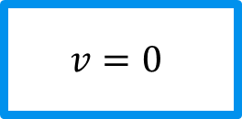






Initial conditions: angles
$$v=0$$
$$θ [rad]$$
$$0,35$$
Traditional motion
$$0,30$$
Lagging motion
$$−0,5$$
$$0$$
$$0,5$$
$$φ [rad]$$

Slide 42
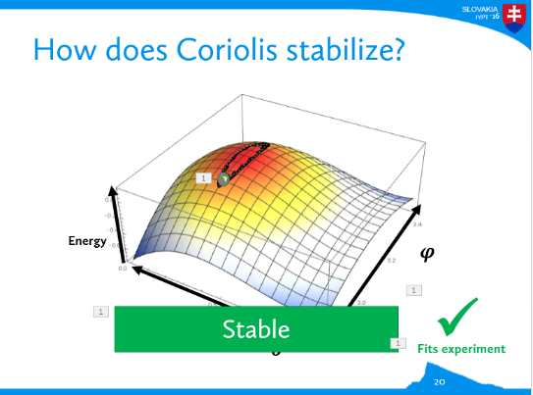
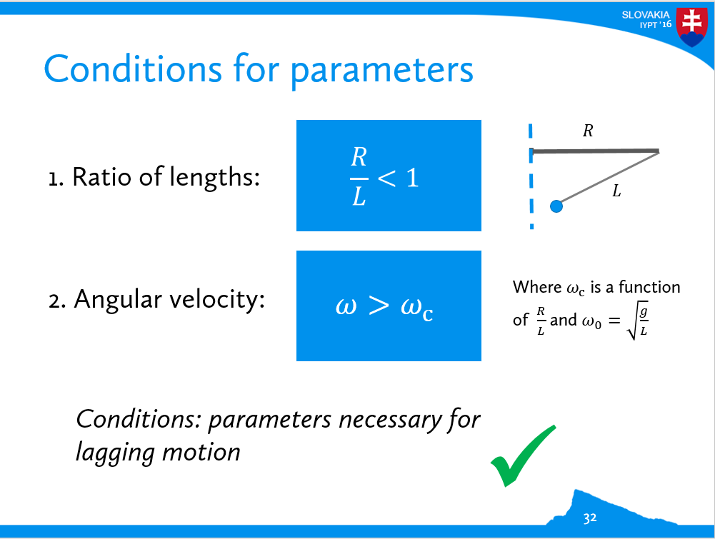
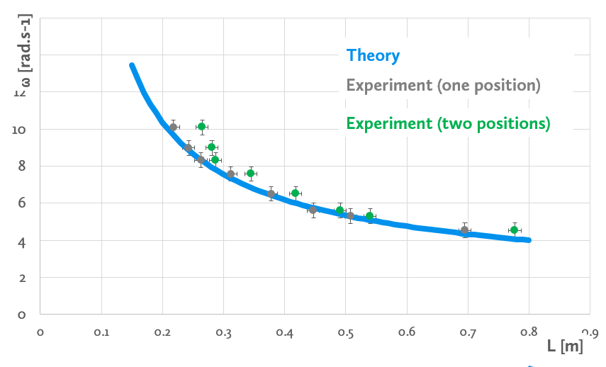
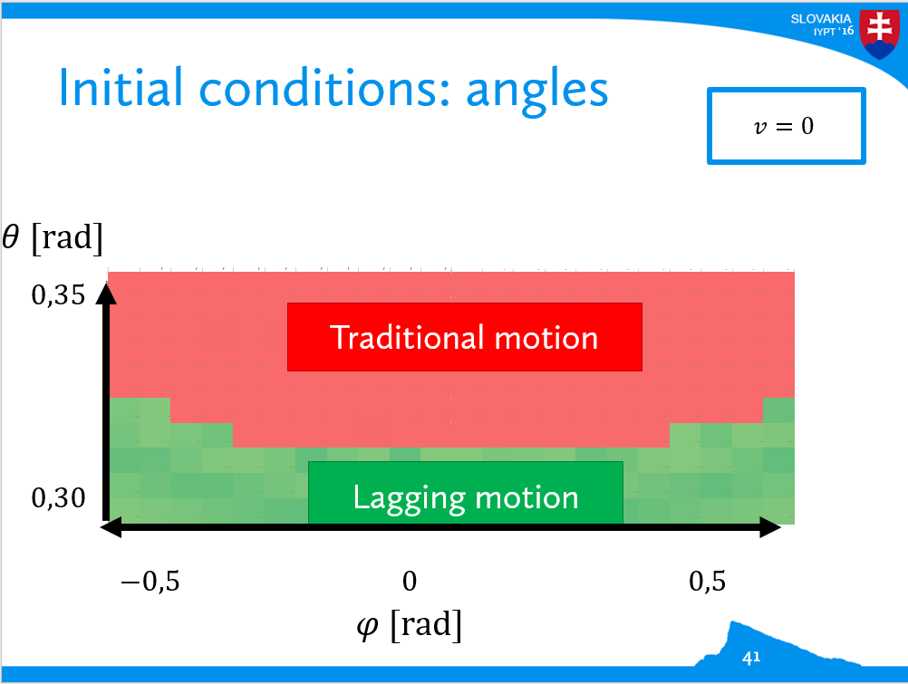
Conclusion
Lagging motion at a potential maximum
  Stabilized by Coriolis force
Conditions for lagging motion
3D equations of motion
  Phase diagrams predicted

Slide 43
Thank you for your attention!
Lagging motion at a potential maximum
  Stabilized by Coriolis force
Conditions for lagging motion
3D equations of motion
  Phase diagrams predicted

Slide 44
Lagging Pendulum
02
Martin Gazo

Slide 45
APPENDICES

Slide 46


What is Coriolis force?
Bob moves away from the center
$$Δr$$
Coriolis acceleration:
$$a_{C}=2ω×v$$

Slide 47

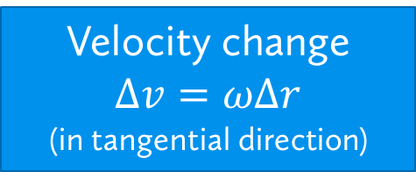
What is Coriolis force?
Bob moves away from the center
Velocity change $Δv=ωΔr$
(in tangential direction)
$$F_{c}$$
Fictitious force acting sideways
$$Δr$$
Coriolis acceleration:
$$a_{C}=2ω×v$$

Slide 48


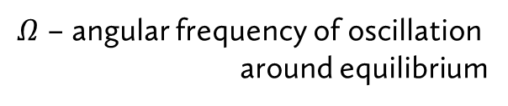


Coriolis on parabolic potential
Circular trajectories around equilibrium
$$Ω^{2}r=−C^{2} r+2 ω (Ωr)$$
Centripetal
Centrifugal + Gravity
(2nd order Taylor expansion of potential)
Coriolis
$Ω$ – angular frequency of oscillation
around equilibrium
$$\frac{Ω}{ω}$$
Solution:
$$Ω=ω± \sqrt{ω^{2}−C^{2}}$$
No solution for steep potential
Slope: $C^{2}/ω^{2}$

Slide 49
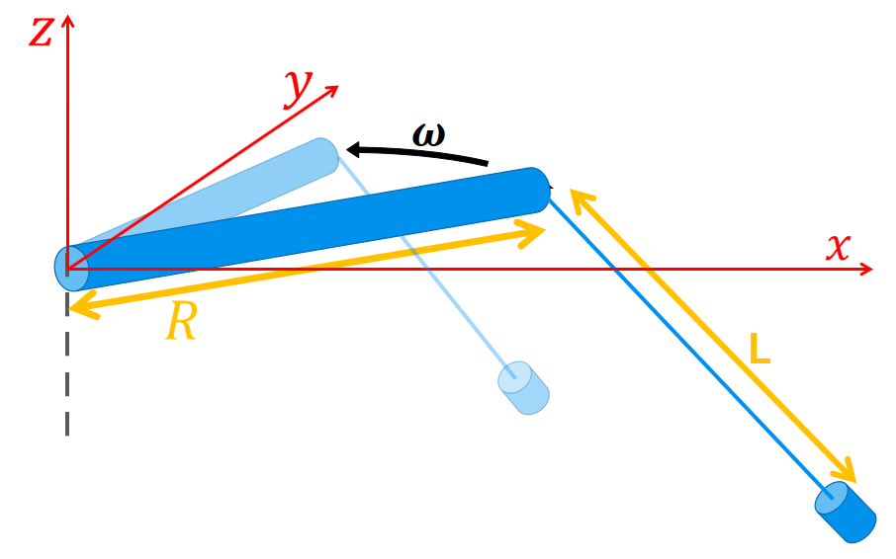



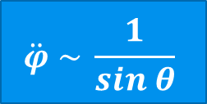

Simulation: Equations of motion
Lagrange approach
Spherical coordinates $θ, φ$
$$\ddot{φ} \sim \frac{1}{sin θ}$$
Numerically unstable near south pole
Cartesian coordinates $x,y,z$
Non-conservative forces (not included in potential energy; e.g. air drag)
$$λ=−\frac{m}{2L^{2}}(gz−{\left(\dot{x}+ωRsinωt\right)}^{2}−{\left(\dot{y}−ωRcosωt\right)}^{2}−{\dot{z}}^{2}$$
$$−ω^{2}R\left(cosωt\left(x−Rcosωt\right)+sinωt(y−Rsinωt)\right)$$
Lagrange multiplicator
$$+F_{Vx}\left(x−R\cos{ωt}\right)+F_{Vy}\left(y−R\sin{ωt}\right)+F_{Vz}z$$

Slide 50




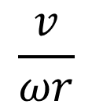
Initial conditions: velocity
$$ω/ω_{0}$$
$$1$$
8
$$2$$
$$\frac{v}{ωr}$$
Lagging motion
Highly unstable
(deviations exceed the range)
$$0$$
Cricital angular velocity

Slide 51
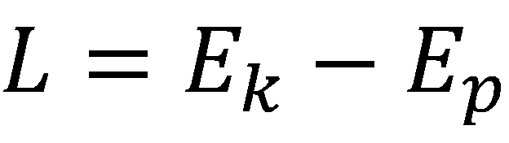



Fundamental equations
Definition of Lagrangian
Kinetic and (total) potential energy
For Lagrangian applies:
If there are other forces (not yet included) then:
Arbitrary coordinate
Sum of all (generalized) forces which have not been included yet in potential energies

Slide 52

Fundamental equations
Definition of Lagrangian
Kinetic and (total) potential energy
Lagrange multiplier
Constraint equation:
Determines area where there the thread could be located (because of configuration in which it is)

Slide 53





Fundamental equations
Kinetic energy
Constraint equation
(total) potential energy
Lagrange multiplier
Counting derivation
continuing
Other two coordinates will be derived analogically

Slide 54




Fundamental equations
Values of forces in particular coordinates
External forces
- for example drag
Lagrange multiplier
- needed to be evaluated
making derivatives

Slide 55



Let us derive λ first
modifying
making a derivative once more
modifying, marking part of the expression by ,,A“

Slide 56



..now ,,A“
Defining ,,A“
Accelerations in particular coordinates

Slide 57



..continuing with λ
addition
modifying

Slide 58




Unstable motion
$$θ_{avg}$$
Highly-unstable “zig-zag” motion
Unstable in $φ$ angle
$$ω/ω_{0}$$
Zig-zag motion
View from outside

Slide 59







Variation on textbook problem
Special case: $R=0$ $⇒$
Unstable
$$R/L=0,001$$
$$R/L=0,01$$
$$R/L=0$$

Slide 60






3D Energy plot
3rd position
Lagging position
$φ$
$$θ=0$$
Traditional position
Energy
Unstable
(2nd dimension)
Unstable
(all dimensions)
Stable
$$0$$
$θ$
Notes:
3d tu bude

Slide 61


Stability analysis of found positions
Total potential energy in the reference frame of arm
[Arbitrary units]
$$L=0,3m$$
$$R=0,1m$$
$$ω=10rad.s^{−1}$$
Energy
Displacement perpendicular to the arm
(y)
Color scale
Displacement in the direction of the arm
(x)

Slide 62

Drag of thread

Slide 63



