Slide 1
№6.Disappearing ink
Maryia Valoshyna,
Spectrum, Belarus

Slide 2
Problem situation
chemical
Suggest a chemical formulation for the ink that would disappear after used to write a text. What parameters determine the time when the text becomes invisible? Is it possible to process the paper in such a manner that the text appears again?
appears again

Slide 3
History

Slide 4
What the effect of the ink is based on
Photosensivity
UV light sensivity
Thermo sensitivity
Chemical reaction
Carbonization
Metathesis
Irreversible
Reversible
±

Slide 5
Thermally sensitive

Slide 6
UV light sensitive

Slide 7
Chemical reactions. Variants review
 | Reagents | Actions | Reaction equation | Colour | Reversibility
1 | Milk | Warm up | Carbonization | Brown | -
2 | Lemon acid |  |  |  | -
3 | Cobalt(II) chloride |  | CoCl₂•6H₂O=6H₂O↑+CoCl₂ | Blue | +
5 | Copper(II) sulphate + | Aqueous ammonia | CuSO₄+NH₄OH=Cu(OH)₂↓+(NH₄)₂SO₄ |  | +
6 | K₄[Fe(CN)₆] + | Iron(III) sulphate | 4FeCl₃+3K₄[Fe(CN)₆]=Fe₄[Fe(CN)₆]₃↓+12KCl |  | -
7 | Starch + | Alcoholic solution of iodine | (C₆H₁₀O₅)n + I₂ => (C₆H₁₀O₅)n*I₂ | Dark blue | -

Slide 8
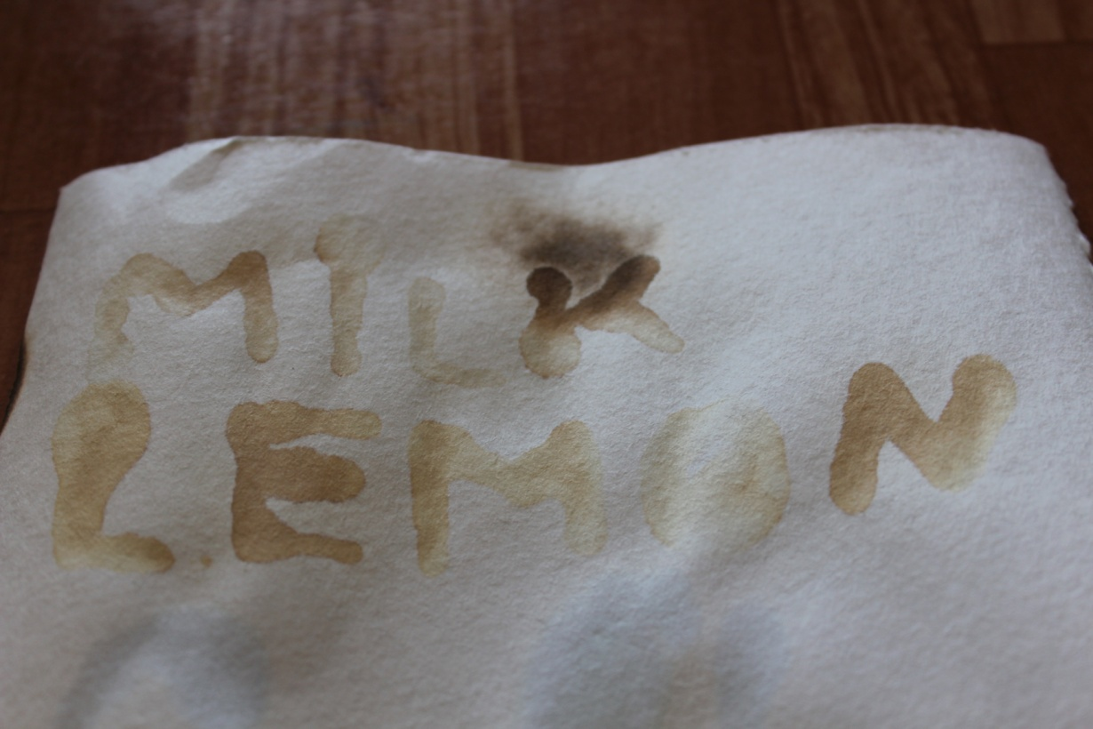
Carbonization reactions

Slide 9
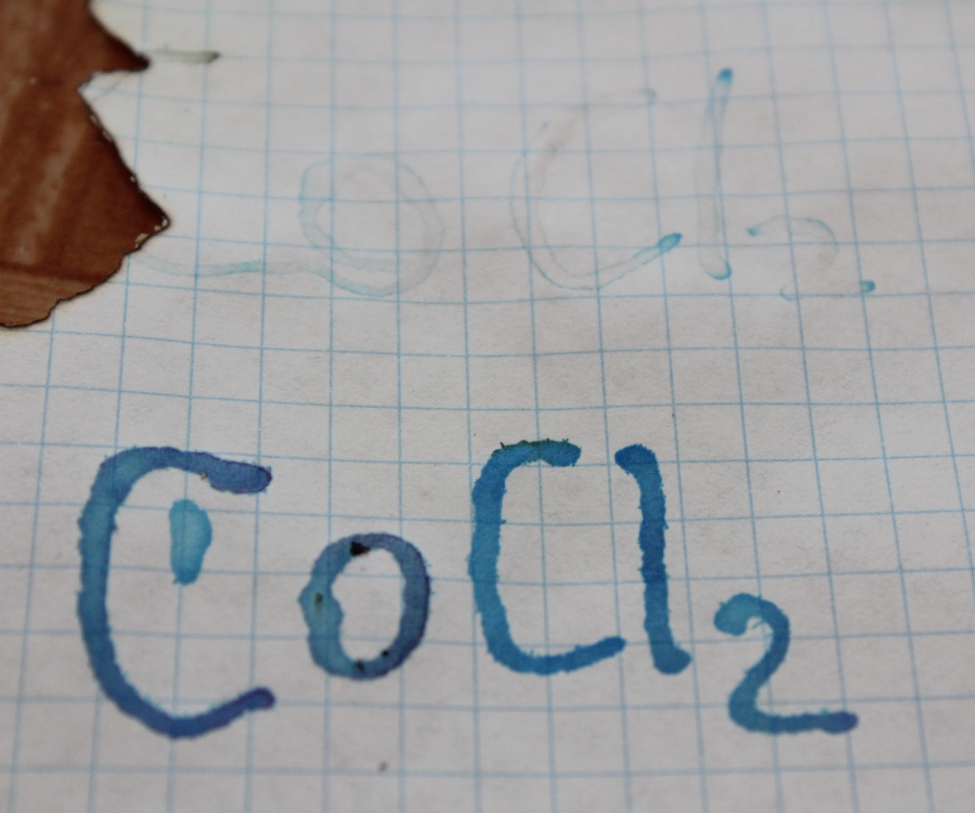
Metathesises
CoCl₂•6H₂O=6H₂O↑+CoCl₂

Slide 10
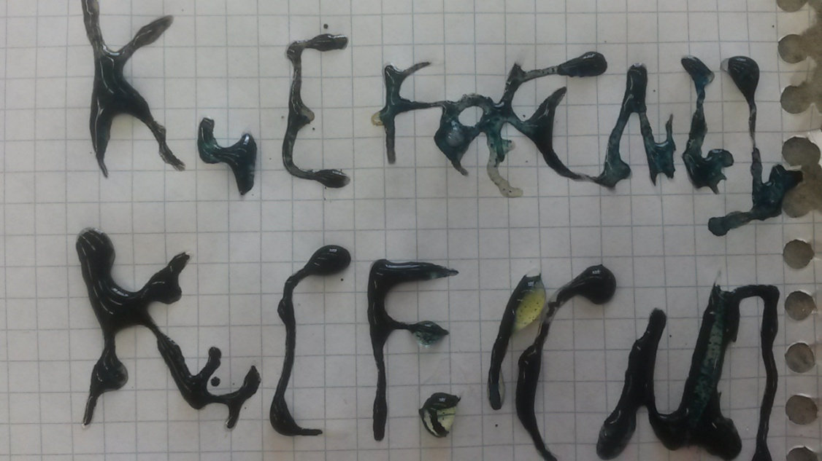
4FeCl₃+3K₄[Fe(CN)₆]=Fe₄[Fe(CN)₆]₃↓+12KCl

Slide 11
Cu(H₂O)₄SO₄ + 4NH₄OH Cu(NH₃)₄SO₄ + 8H₂O
Cu(NH₃)₄SO₄ + xH₂O→ Cu(NH₃)_{4-x}(H₂O)_{x}SO₄ + xNH₃ ↑

Slide 12
(C₆H₁₀O₅)n + I₂ => (C₆H₁₀O₅)n*I₂

Slide 13
Results
We have suggested plenty of chemical formulations for the ink that can disappear or stay visible after the text is written.
We have found out the parameters that determine the time the text disappears:
For UV light-sensitive ink and the chemical methatesises the main parameter is the concentration of the reagents
For thermally sensitive reactions the parameter is the temperature of the liquid you add to the cup

Slide 14
Thank you for your kind attention!

Slide 15
Supplement

Slide 16
Thermally sensitive
Zinc oxide (Zinc white), 500—600 °C - reversible
Tetraiodmerkurate(II) of copper(I) Cu₂[HgI₄] 60°-65 °C (red / brown)
Tetraiodmerkurate(II) of silver(I) Ag₂[HgI₄], 40°-45 °C (lemon-yellow / brown)

Slide 17
Literature

Slide 18
Experiments
Cobalt chloride Lemon acid Milk Starch
Copper(II) sulphate Iron(III) sulphate K4[Fe(CN)6]

Slide 19
Photos
*здесь будут фотографии экспериментов

Slide 20
Some more photos
*и здесь тоже

Slide 21
Still photos
*и, наверное, здесь тоже

