Slide 1
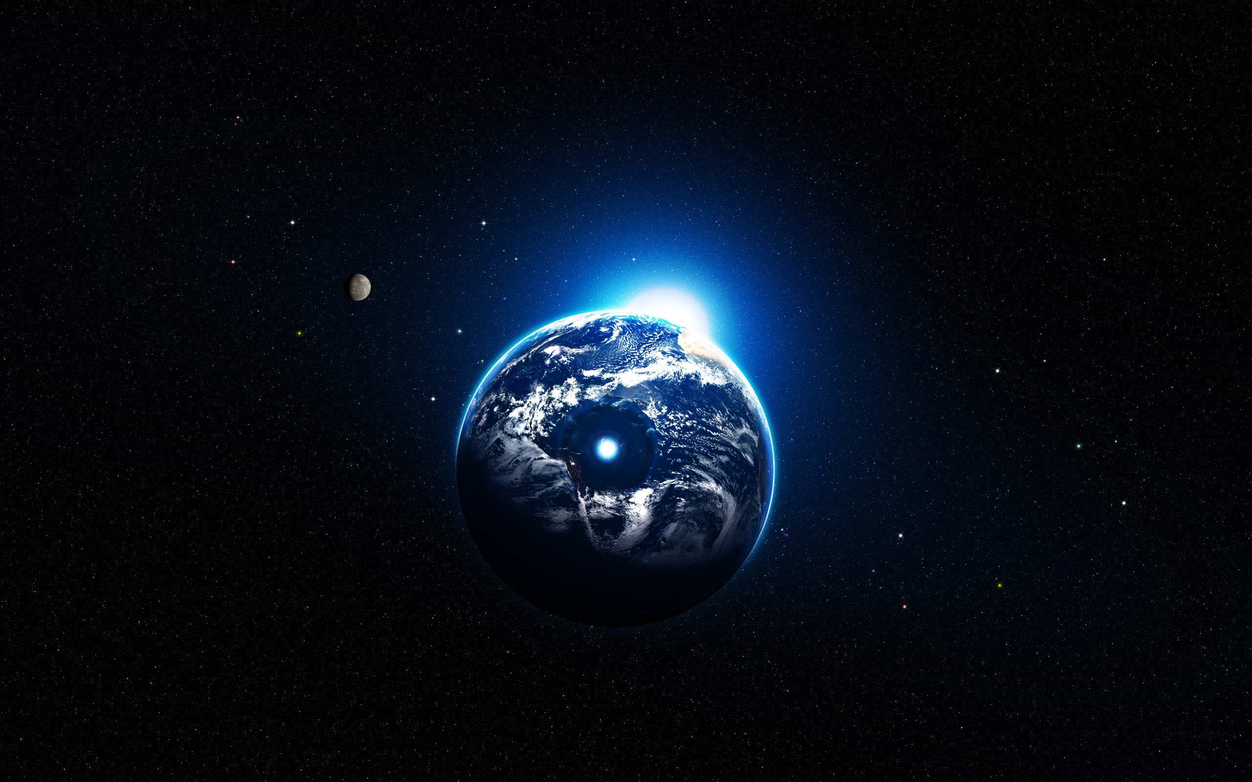
Problem №9
Distances in open space

Slide 2
Problem
How do astronomers measure distances between the planets of the Solar System, between the stars in our Galaxy, or between the galaxies? Determine the distance between the two space objects of your choice.

Slide 3
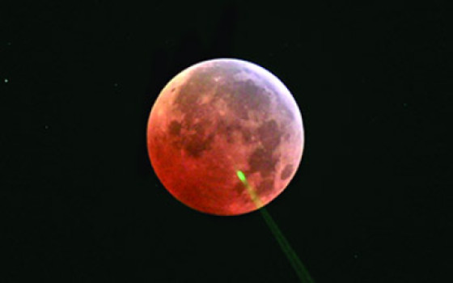
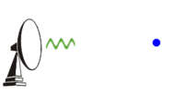
Distances in Solar system
Circulation period
Radiolocation
Laser ranging
(Moon only)
$$𝓇=\sqrt[3]{Τ^{2}+(1+\frac{m}{m_{s}})}$$
$r$ – average distance between Sun and planet (a.u.) $Τ$– circulation period
$m$ – mass of the planet
$m_{s}$- mass of Sun
A:95%
A:98%
A: almost 100%
1 astronomical unit (а.u.) is 149 597 870 ± 2 km

Slide 4
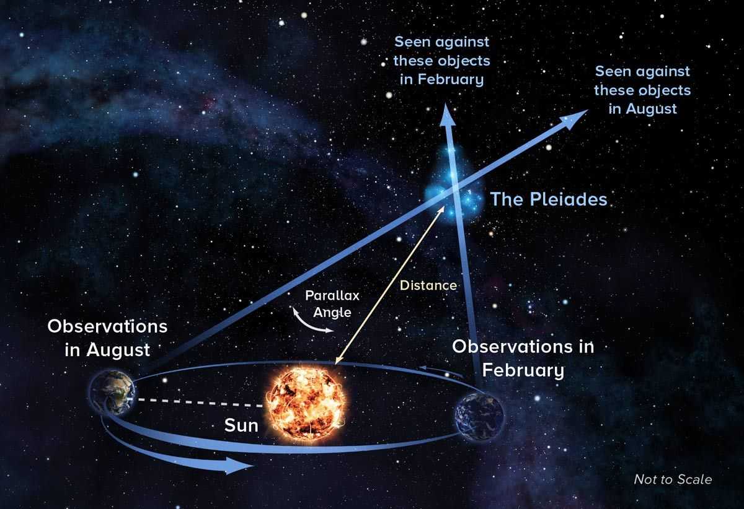
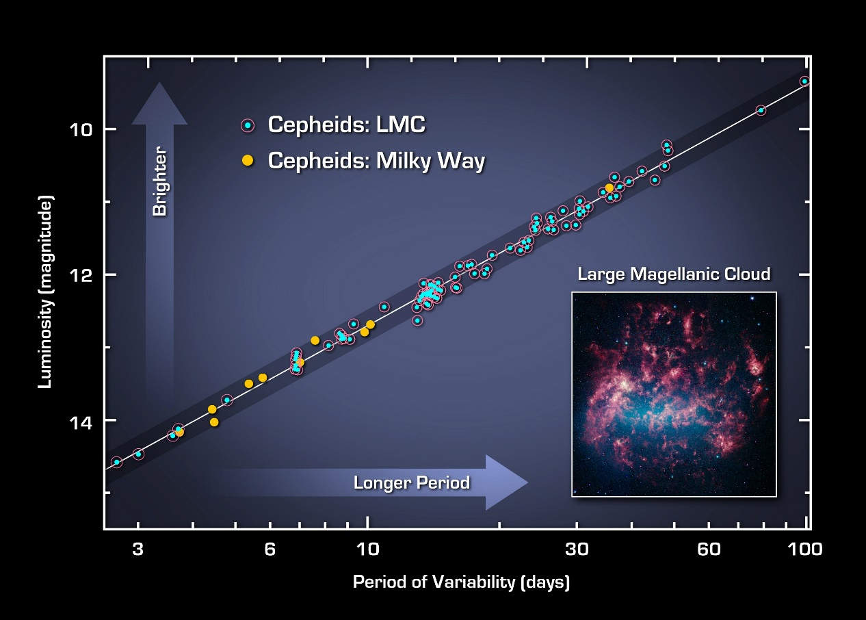
Stars in our galaxy
Parallax
Cepheid variable
$d=$ $\frac{1}{π^{′′}}$
A: 80-99%
d – distances in pс
π – angle in seconds
A: 60%
Parsec(pc) = 206265 а.е.

Slide 5
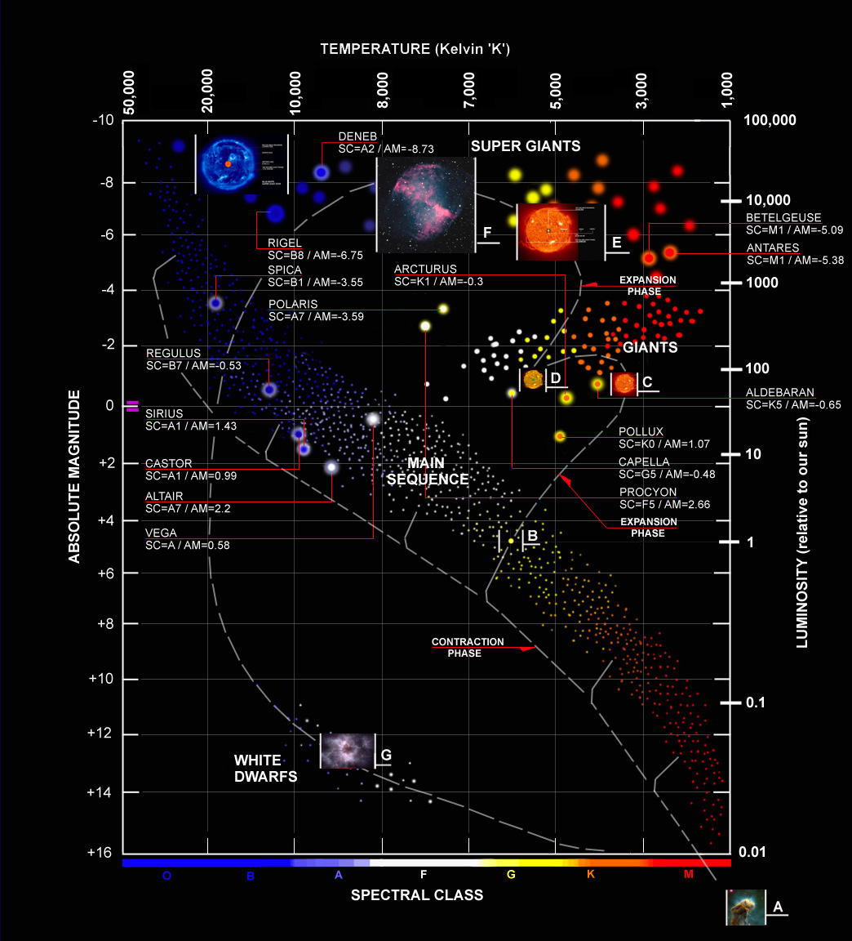
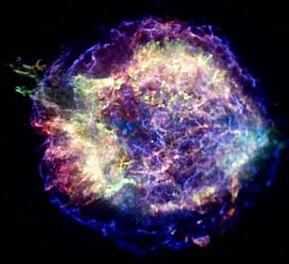
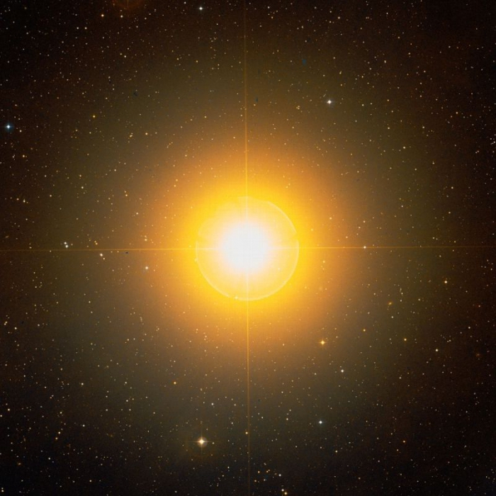
Spectral method
The method of standard candles
A: 60%
A: 20%

Slide 6
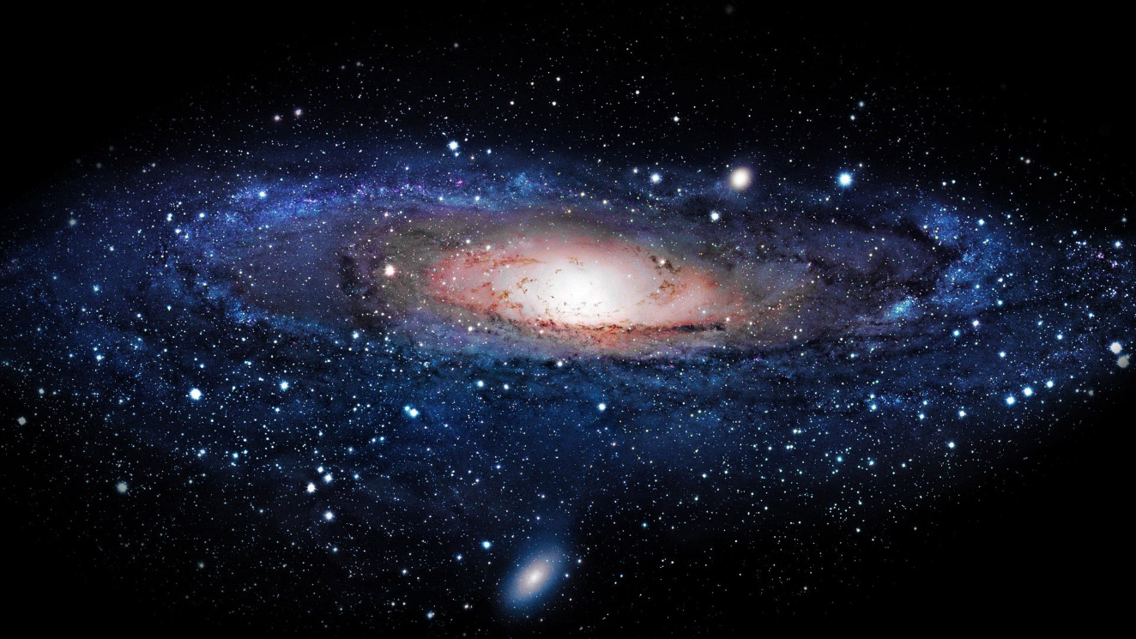
Distances between the galaxies
Parallax
Cepheid variable
The method of standard candles
Hubble's law
Spectral method
$$v=H_{0}D$$
$v$ – speed of galaxy
$H_{0}$- Hubble's constant
D – proper distance
A: 10%

Slide 7
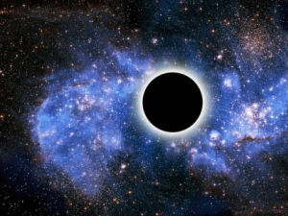
Own definition
Parallax
Cepheid variable
Too far
It’s not a Cepheid
The method of standard candles
Spectral method
No light
No light
Other method

Slide 8
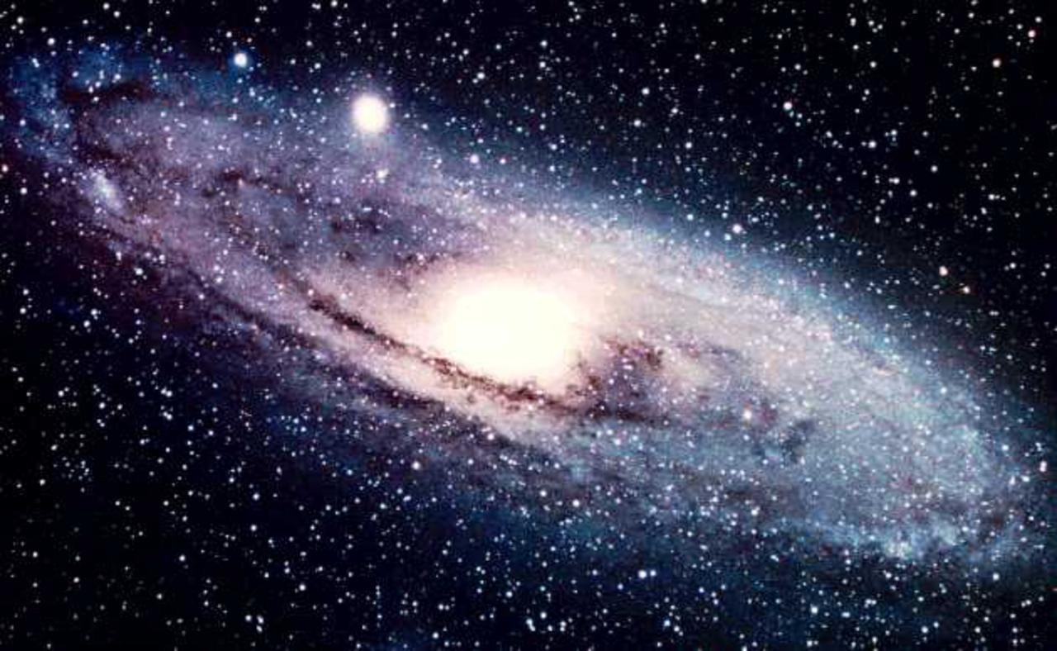
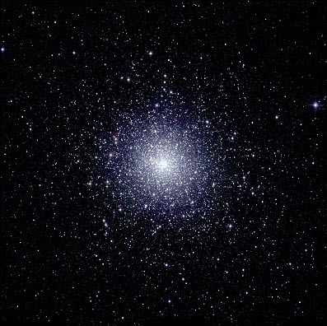
Our simple method
globular clusters
157±10

Slide 9
Globular clusters
$$x=L∗cosa ∗\cos{B}$$
$$y=L∗cosB ∗\cos{L}$$
L
a
Y$=\sum{y≈0}$
B
X
$X=\sum{x}$ ≈27978±5000
light years
Y
Scientific results:
25 900 ± 1 400 light years

Slide 10
Results
We can accurately find distances in our Solar System
While the distance is growing, the accuracy dramatically falls; to measure the distances to other galaxies we will have really huge error.
Our galaxy has a big black hole in the center. In our work we found the distance between our planet and a hole, which is about (28 ± 5)*1000 light years.

Slide 11
Thanks for attention!

