Slide 1
Falling Ball
Belarus
Reporter
Gleb Penyazkov

Slide 2
The problem
An electronic balance is connected to a PC in order to record the time dependence of the measured weight. A light frame is mounted on a tall beaker filled with water. The frame has a holder allowing controlled release of a small ball such that it falls into the water. The beaker is placed on the balance as depicted in the Figure. Investigate how the readings of the balance reflect the different phases of the motion of the ball.

Slide 3
Experiment Experimental setup
Tall beaker
Force sensor
Electronic laboratory “Archimed”

Slide 4
What is observed
PMS-300
12 times slow-down

Slide 5
Phases of the ball movement
Free fall of the ball
Impact with liquid surface
Ball moves in the liquid
Impact with the bottom
Ball bounces

Slide 6
Comparing two media
Water
PMS-300
Water PMS – 300
η=0.001 Pl η=0.3 Pl

Slide 7
Comparing two media
Water
PMS-300

Slide 8
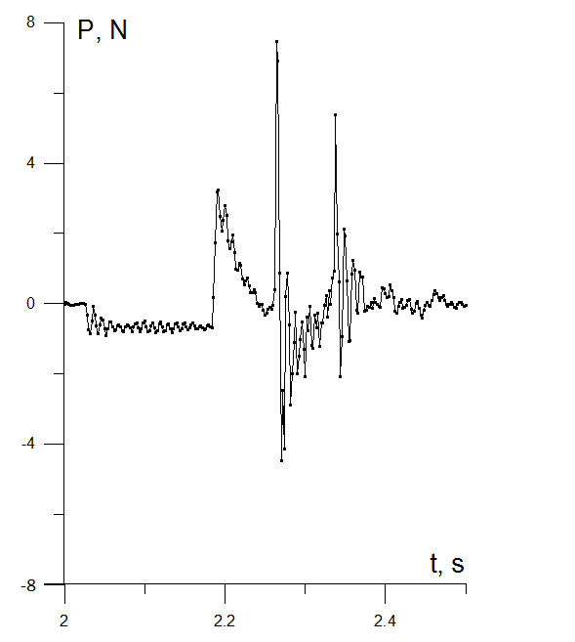
Results
water
3
PMS-300
2
1
1. Ball in the air
2. Ball blows to water
3. Ball blows to the bottom

Slide 9
What can be deduced from the weight records
Mass of the ball (if we know the radius of the ball we can calculate the density)
Distance between the ball and liquid surface
Viscosity of PMS-300 is much higher than water viscosity (time of falling in liquid and number of bouncing)
P
t

Slide 10
IT IS NOT SIMPLE!
Does classical hydrodynamics applicable to this phenomenon?
Everything Should Be Made as Simple as Possible, But Not Simpler
A. Einstein
C_{D} – drag coefficient
A. HAIDER and 0. LEVENSPIEL, 1989

Slide 11
ESTIMATIONS OF FORCES AFFECTING BALL MOTION IN INFINITE LIQUID
For the impact velocity v=1.4 m/s
Re=28000 Re=93.3
(turbulent flow) (laminar flow)
CD=0.457 CD=1.13

Slide 12
Conclusions
The phenomenon of a falling ball with entering another medium was studied. The readings of the balance were interpreted. It was found that the plot of the balance reading is complex and different stages of the experiment brought out were classified:
Free fall of the ball
Impact with liquid surface
Ball moves in the liquid
Impact with the bottom
Ball bounces
Certain characteristics were found to correlate with ball and liquid parameters.

Slide 13
Thank you for your attention!

Slide 14
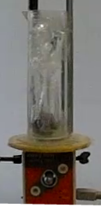
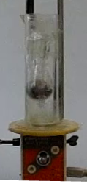
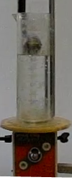
Vertical coordinate and velocity of falling ball in water
3
1
2

Slide 15
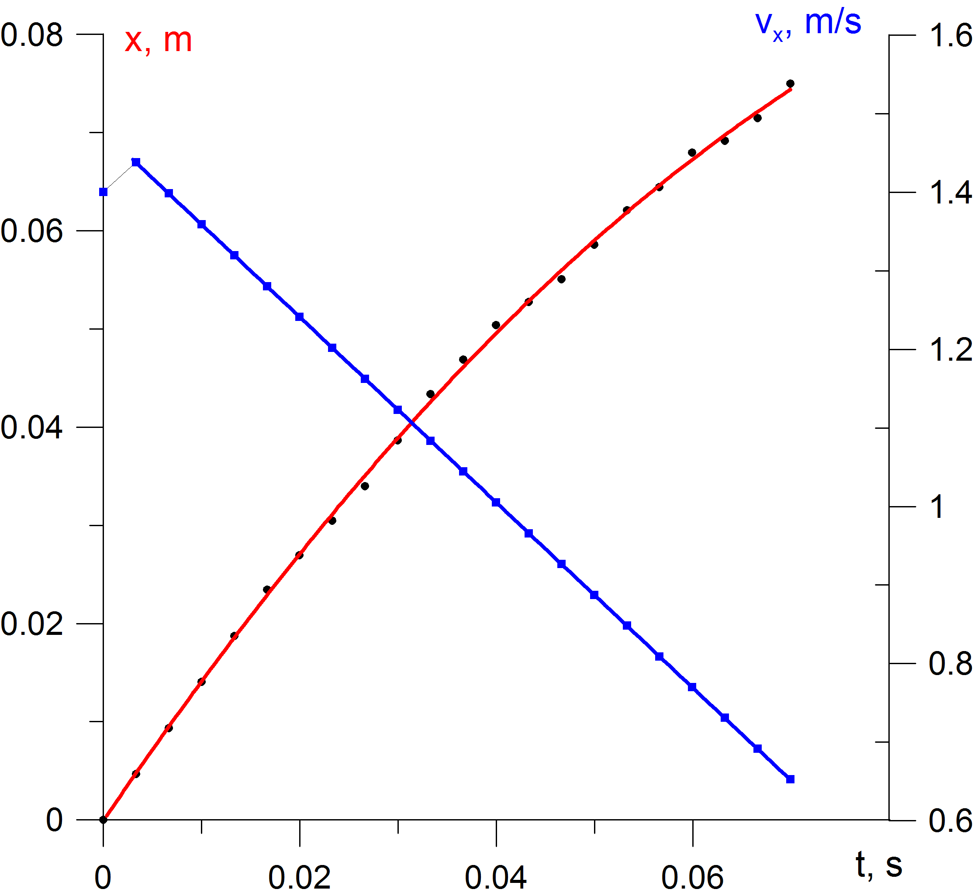
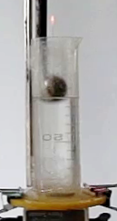
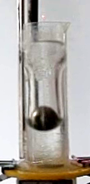
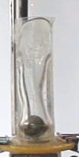
Vertical coordinate and velocity of falling ball in PMS
1
2
3
Указать а

Slide 16
Re
Reynolds number is the ratio of hydrodynamic thrust to the viscous shear stress

Slide 17
Main features and discussion
Difference between weight records for water and PMS-300. Negative and positive acceleration.
Deep weight reduction at after ball impact with the bottom.

