Slide 1
Problem #15. Fly
A fly can easily walk on a ceiling. How is this possible? Can one find such a ceiling that the fly would be unable to walk on?

Slide 2
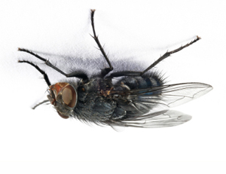
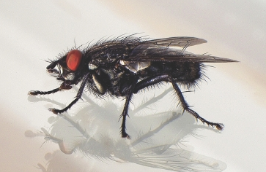
The Solution of the problem
To explain the possibility of fly to walk on the ceiling
To find such ceiling, where fly would be unable to walk on
Do experimental part of the problem
1

Slide 3
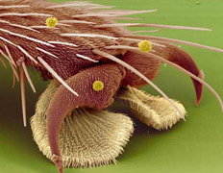
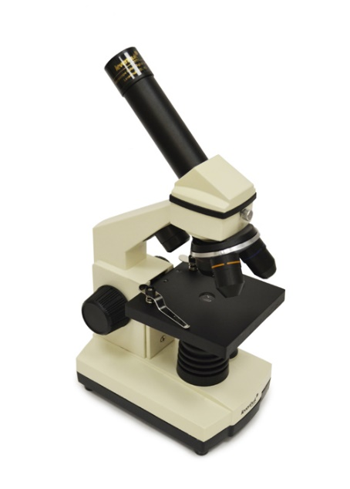
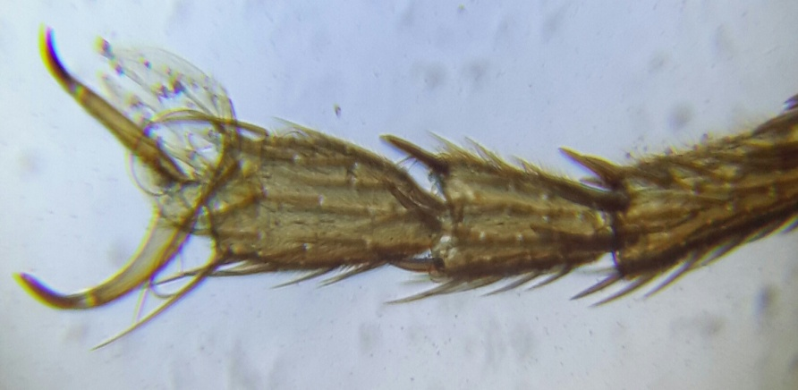
The texture of legs
claw
foot pad
So clever fly uses both physics and chemistry for it’s needs
setae (tiny hairs)
2

Slide 4
Moving the foot farther from a body
How do flies move?
3
Rotation of a foot round an axis

Slide 5
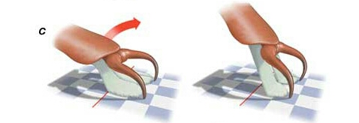
Claws are used for the separation of rakes
Wings are used to help the fly to tear off the ceiling
4

Slide 6
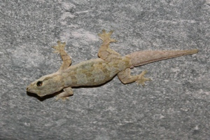
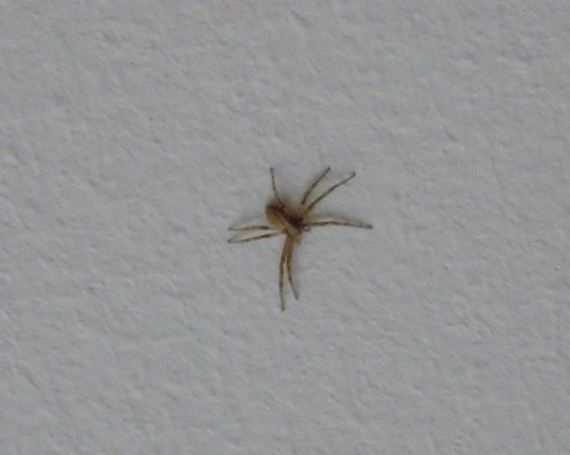
The fly is not so unique
A gecko on the ceiling
A spider
5

Slide 7
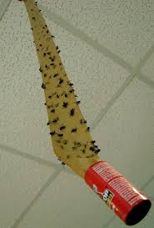
How we can stop the fly from walking on the ceiling
Stick the fly to the ceiling
Soak the ceiling with insecticides and fumigators
Easy, 100% acts, but give us inappropriate and unpleasant vision
Unhealthy as for flies so for human, rather expensive
6

Slide 8
The anti-fly ceiling structure
It is possible to use such substances that will react with the oil and sugar that flies produce
Hexane
Benzene
Octane
Etc
Oil and soap (surfactant) to increase the sliding and to make the streak
To cool the ceiling in order to make the difference of temperature (room temperature and the ceiling one), so the water condensate will be formed and prevent from the fly
7

Slide 9
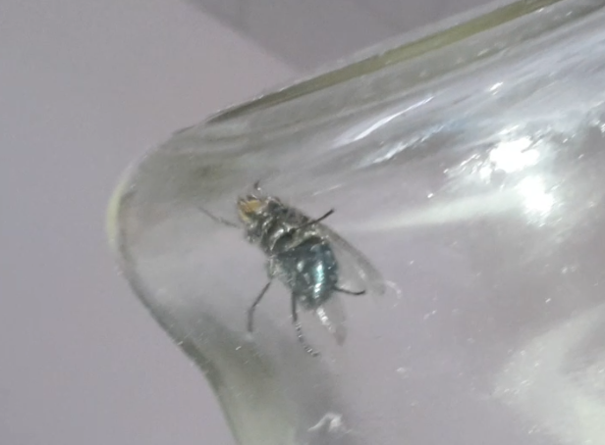
Experimental part
8

Slide 10
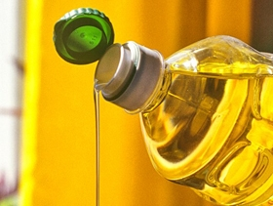
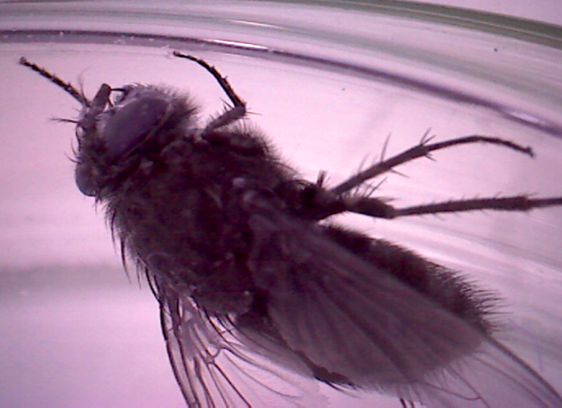
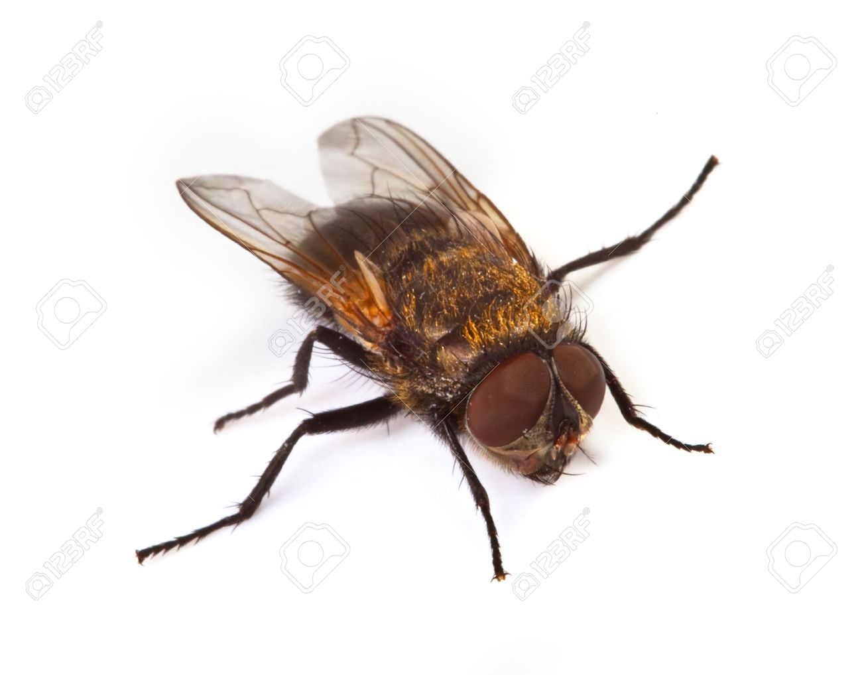
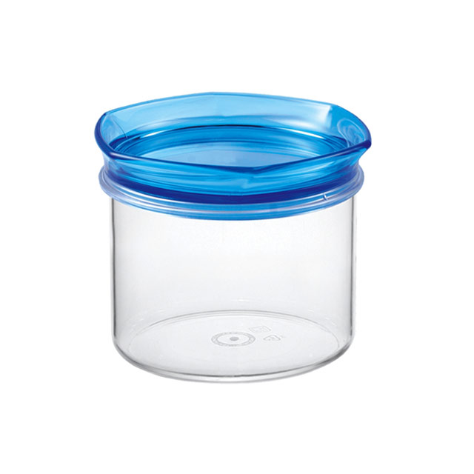
Experiment #1
9

Slide 11
A short video for 7 seconds
10

Slide 12
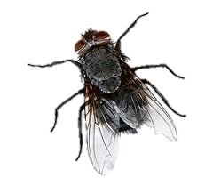
Experiment #2
16.4°С
condensate
Humidity: 80%
20°С
11

Slide 13
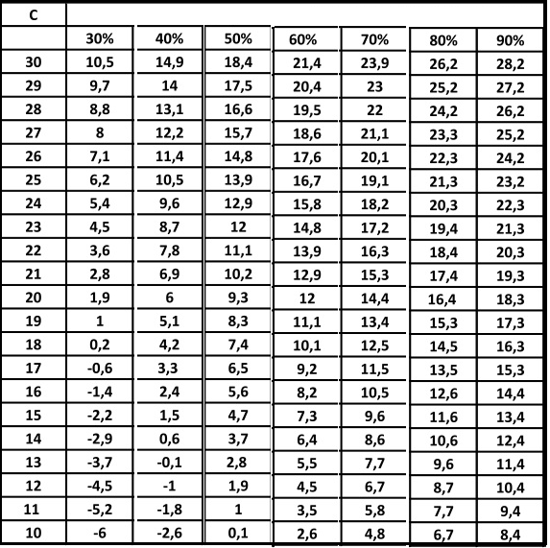
Psychrometric table
Due point at relatively humidity
12

Slide 14
Conclusions
Flies have 2 different methods for walking on the ceilings: chemical and physical;
There are several different possibilities to prevent the fly from walking on the ceiling: chemical harmful substances, oil and soap, ceiling condensation
The experimental part was provided and we successfully confirmed the practical opportunity of origin of the ceilings without walking flies
However that is your choice if is worth doing that!
13

Slide 15
Thank you for your attention!
14

