Slide 1


Problem №14 Galton box

Slide 2
Problem
In the Galton box, a regular 2D lattice of obstacles disperses a thin flow of falling particles. When falling on the bottom of the box, the particles show a normal distribution. Use various types of particles and different arrangements of the obstacles to find the conditions when the distribution is no longer normal.

Slide 3
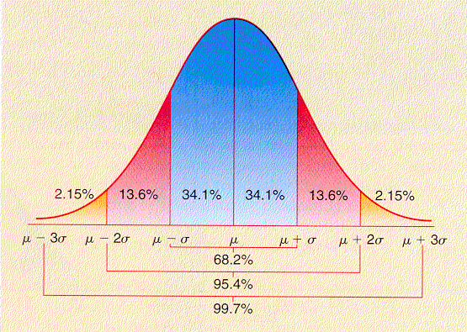
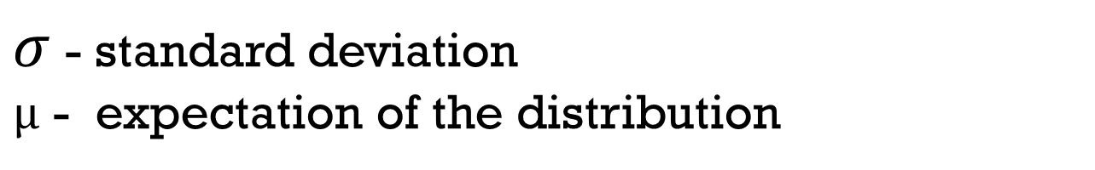
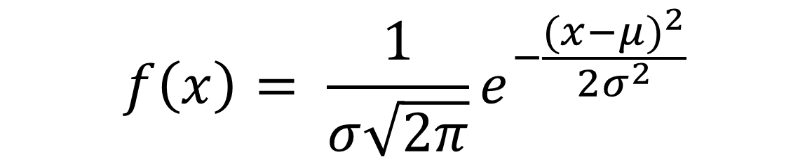
Normal distribution
$$f\left(x\right)= \frac{1}{σ\sqrt{2π}}e^{−\frac{{(x−μ)}^{2}}{2σ^{2}}}$$
$σ$ - standard deviation
$μ$ - expectation of the distribution

Slide 4
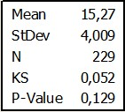
Normal distribution tests
Kolmogorov–Smirnov test
Shapiro-Wilk test
Skewness and kurtosis test
Durbin test
D'Agostino test
Vasicek test
David-Hartley-Pearson test
Chi-square test
Anderson-Darling test
Fillibena test
Kolmogorov-Smirnov test
Criterion Martins-Iglevicha test
Linas-Mudholkara test
Shpigelhaltera test
Sarkadi test
Smirnov-Cramer-von Mises test
Abnormal distribution:<0,05
Normal distribution:> 0,05
Kolmogorov–Smirnov test

Slide 5
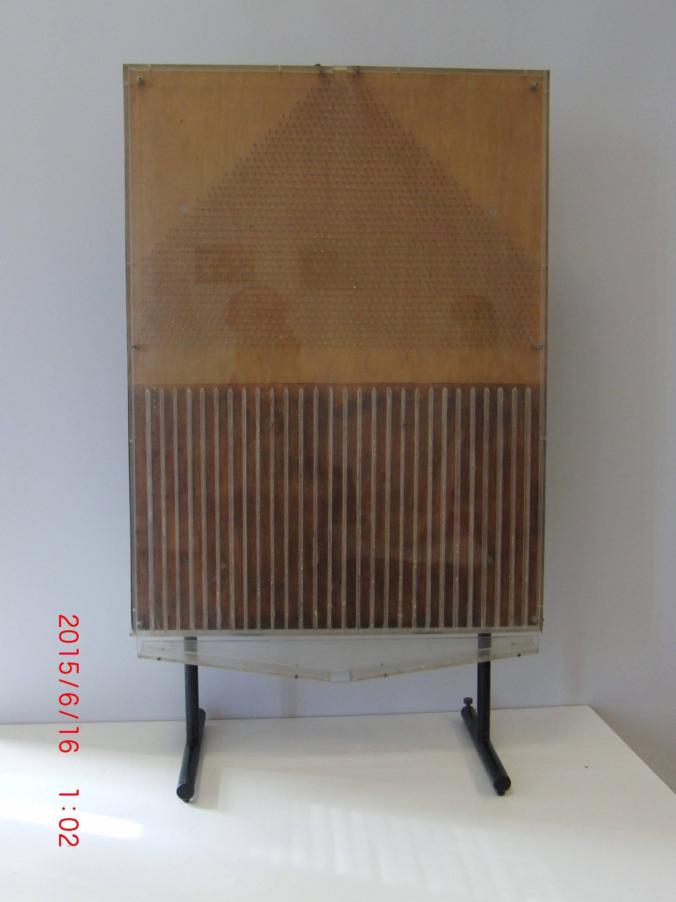

Galton box
1cm
38 rows
1cm
35 cm
30 partitions
5

Slide 6
Parameters
Angle(between floor and lateral edge)
Angle(between floor and back panel)
Size of particles
Form of particles
Adding plug
Modification of nails

Slide 7
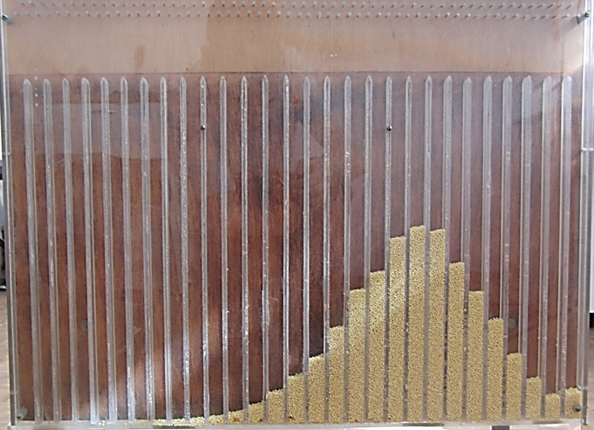
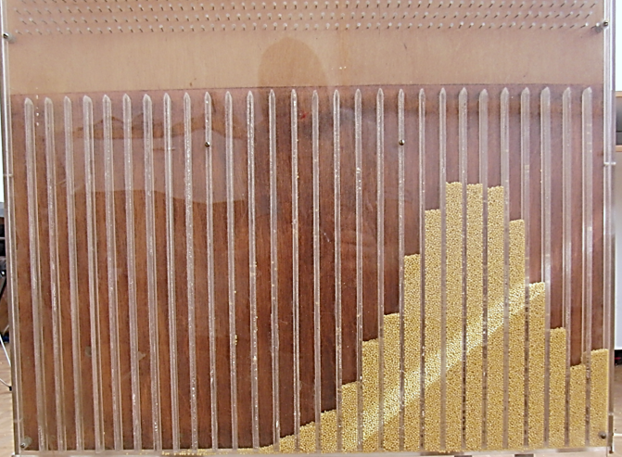
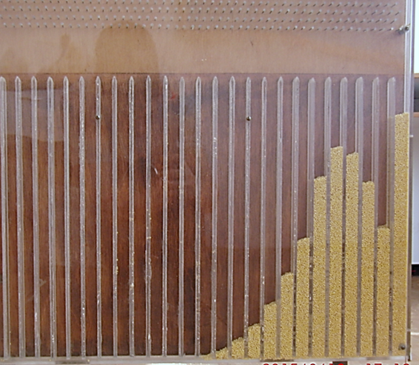
Angle(between floor and lateral edge)
Millet

Slide 8
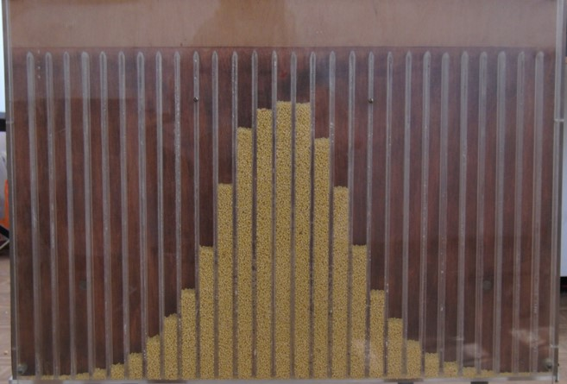
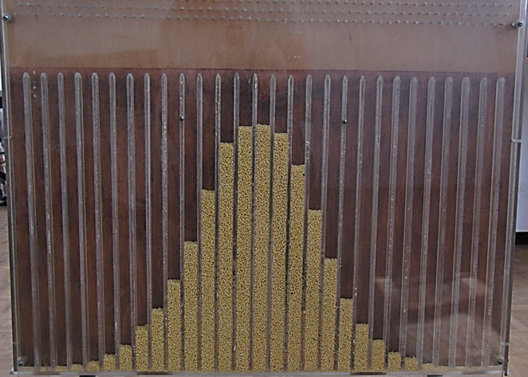
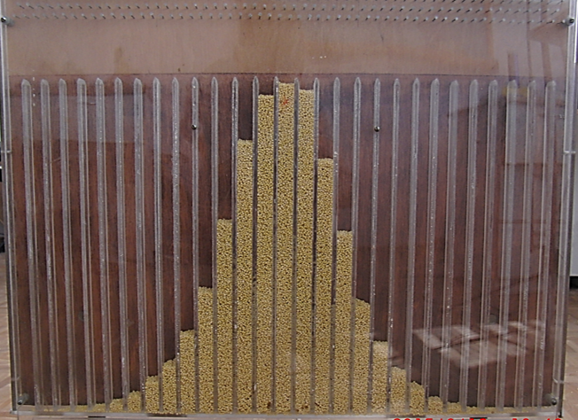
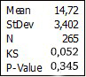
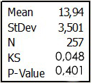
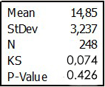
Angle(between floor and back panel)
Millet

Slide 9
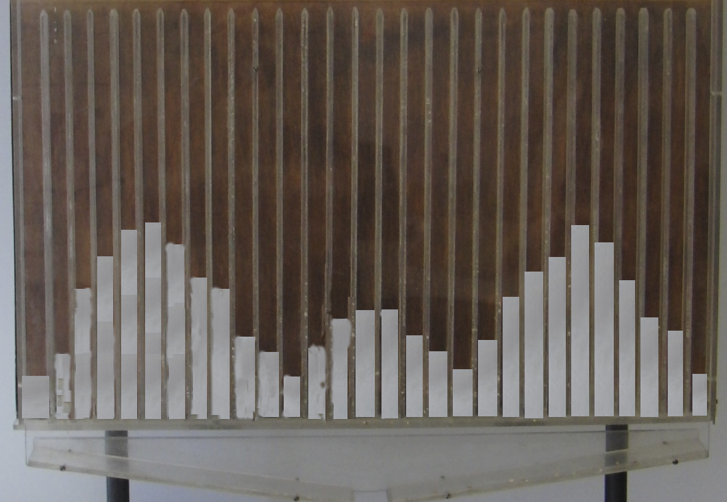
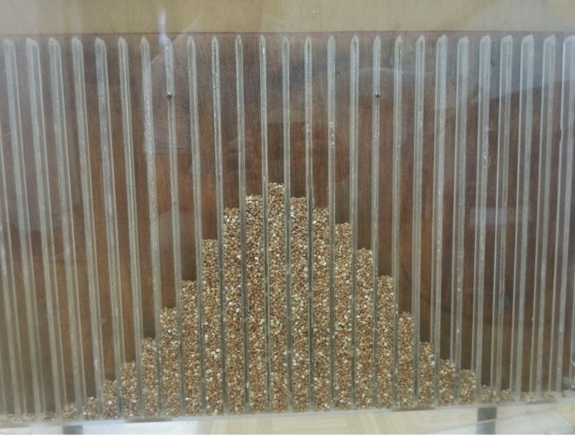
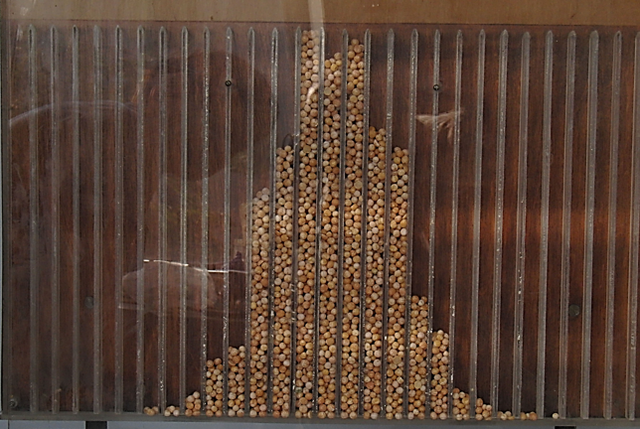
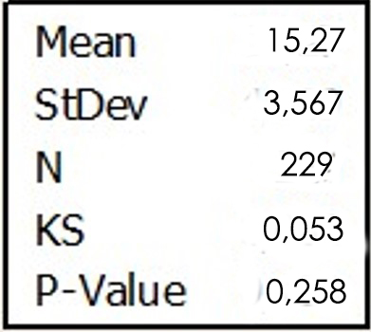

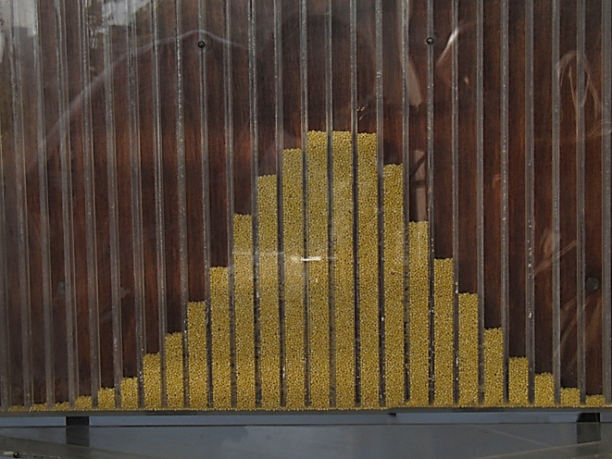
Size of particles
Solt
Buckwheat
Pees
< 1 mm
8-10 mm
4-7 mm
1-3 mm
Millet

Slide 10
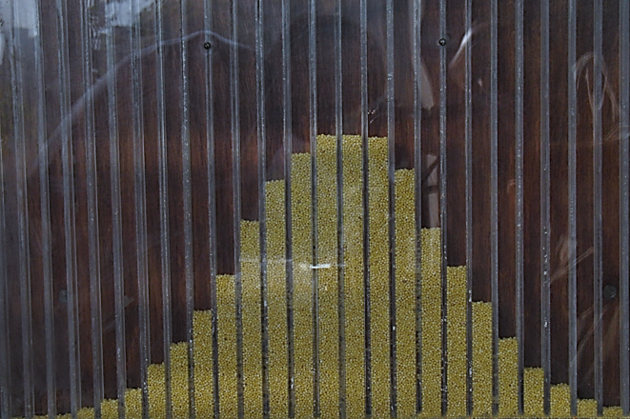
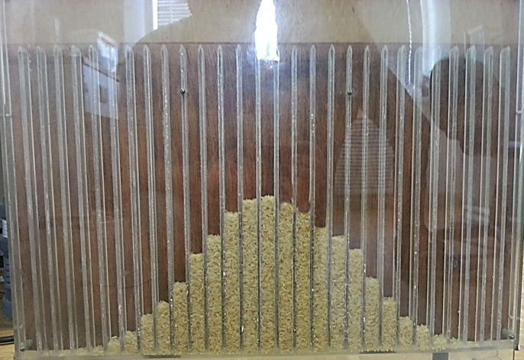

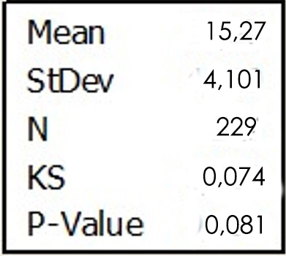
Form of particles
Rice
Millet
Round
Oval

Slide 11
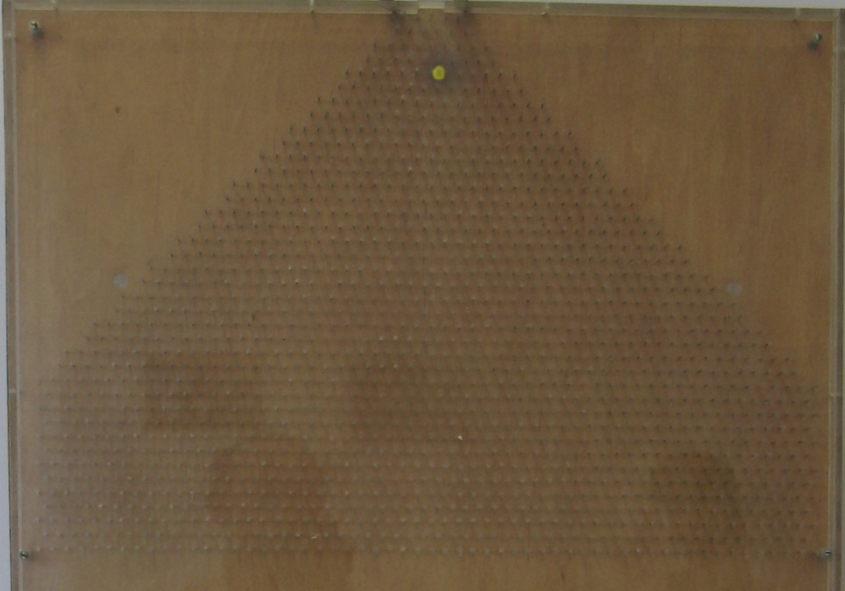
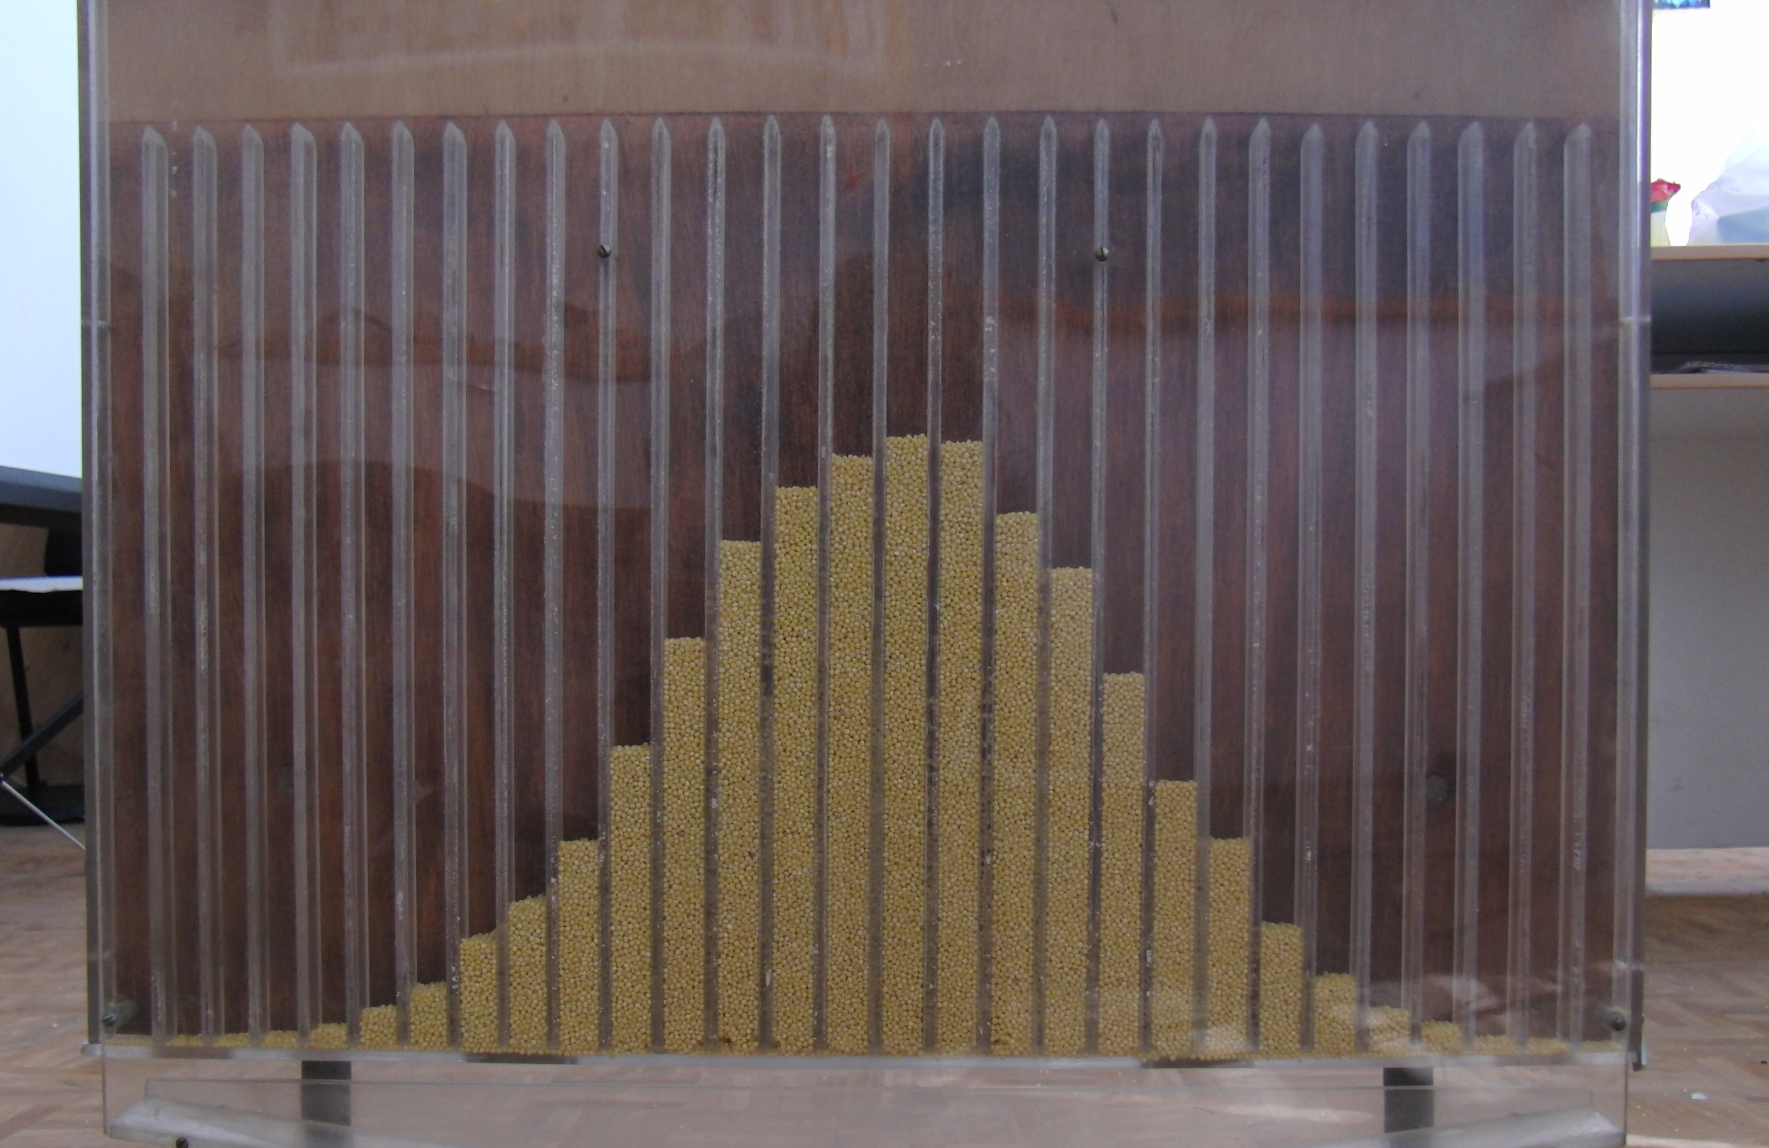

Plug

Slide 12
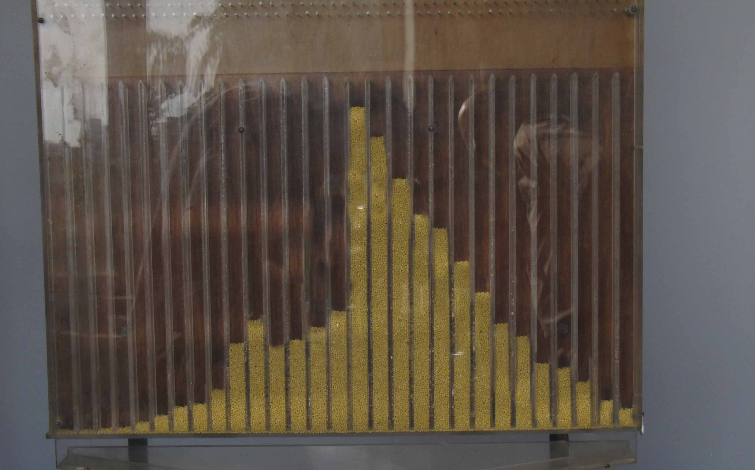
Modification of Nails

Slide 13
Results
Changing angle floor and lateral edge can lead to appearing abnormal distribution.
Abnormal distribution is formed because of a too large or too small diameter of balls which lead to their seizing.
Nails can be changed, which can reduce the amount of particles turning in one direction, which also leads to abnormal distribution.

Slide 14
Thanks for attention!

