Slide 1
Library
Kolb Anton
Spectrum, Belarus

Slide 2
Problem
One person has decided to download all of the fiction existing in the English language and store it on a single USB stick. He expects to find or generate the respective text files, compress them, and then index them conveniently. Is this ambition realistic? Suggest a plan to approach this goal and solve a partial problem of this plan.

Slide 3
Main questions
Size of all English fiction literature
Time to obtain it
Max. USB stick size
The max. factor of compression

Slide 4
WorldCat (http://www.worldcat.org/)
Covers 72,000 libraries in 170 countries.
Searching for English language printed books containing “fiction” among subjects yields 940 thousand entries.

Slide 5
WorldCat (http://www.worldcat.org/)
Of them 890 thousand were printed after 1960 and are still likely to be subject to copyright regulations.
Let 1 book cost $7 => we need around 6 million dollars to buy them all.
Our sponsors didn’t like that number ☺.

Slide 6
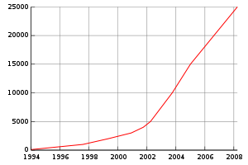
Project “Gutenberg”
A free digital library started in 1971.
Contains about 40 thousand books to date.
In 2002..2008 have scanned 20 thousand books with approximately linear speed (3.3kbooks/year).
Scanned books
Amount of scanned books by year

Slide 7
Project “Gutenberg”
In 2002..2008 have scanned 20 thousand books with approximately linear speed (3.3kbooks/year).
If we had as many volunteers working with the same speed, it would take 270 years to scan the 870k books we bought.
(The publishers wouldn’t stop for that period and wait…)
Our mothers didn’t like that numbers ☺.

Slide 8
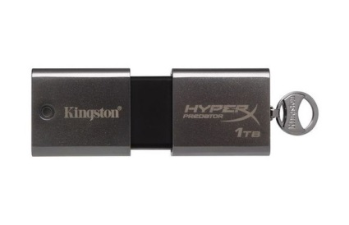
The biggest USB stick
Kingston has announced a USB stick with the capacity of 1 terabyte.

Slide 9
Shannon’s information considerations
A letter of the English language carries approximately 1 bit of information
(in average 2 guesses to continue a text).
Established in a human-based study.
“Prediction and Entropy of Printed English” (Shannon, Bell System Technical journal, 1951)

Slide 10
Shannon’s entropy considerations
A letter of the English language carries approximately 1 bit of information…
…therefore the best compression ratio we can hope for is about 8 times, as a character is usually represented as an 8-bit byte.

Slide 11
Experimental check
16 GB of text of 40 thousand books (Gutenberg)
(400kb/book – text only)
Archiver | Compressed size, GB | Compressed size, % | Compression ratio (approx.)
(Uncompressed) | 16.0 | (100%) | (1:1)
GZip (level 9) | 5.4 | 34% | 1:3
BZip2 (level 9) | 4.0 | 25% | 1:4
7Zip (“ultra”) | 3.8 | 24% | 1:4
XZ (level 9) | 3.7 | 23% | 1:4
1 TB would fit the text of 10 million books’ texts compressed 1:4.
94 GB should be enough to store the 940k books in the WorldCat.

Slide 12
Our partial solution
Zip-compressed text of 40k books (Gutenberg) accessible from a single-file cross-platform Java application (5.5GB).

Slide 13
Problems
We can’t estimate the volume of all the literature exactly (the problem is vaguely formulated).
Compression ratios may vary.
Storing graphics in books would require much more space.

Slide 14
Conclusions
The number of books under consideration is approximately 1 million.
We need much money and time to buy and scan the 900k that are paid.
400kb/book gives 400GB (text only).
If we don’t have that big USB stick, we could fit into 100GB using popular compression algorithms.
The program we’ve developed agrees with that.

Slide 15
Thank you for attention!

