Slide 1
Problem № 22

Slide 2
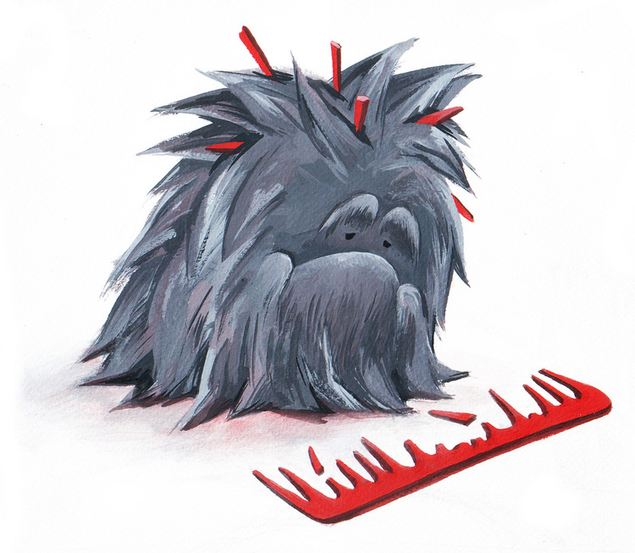
Problem
Compare several methods to empty a bottle of water and indicate the fastest method

Slide 3
Standard bottle
V=0,5 l
1,9 cm
6 cm
Time: 8±0,2 sec.

Slide 4
What is happened?
Lower pressure
Bloom!
$$F_{a}$$
$$V\left(speed\right)$$
$$become$$
$$bigger$$
$$F_{a}$$
Time
Mg(less water)
Mg(water)

Slide 5
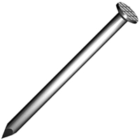
Parameters
Create other way to air bubble
Change the diameter of neck of a bottle
Create the hole in the bottom

Slide 6
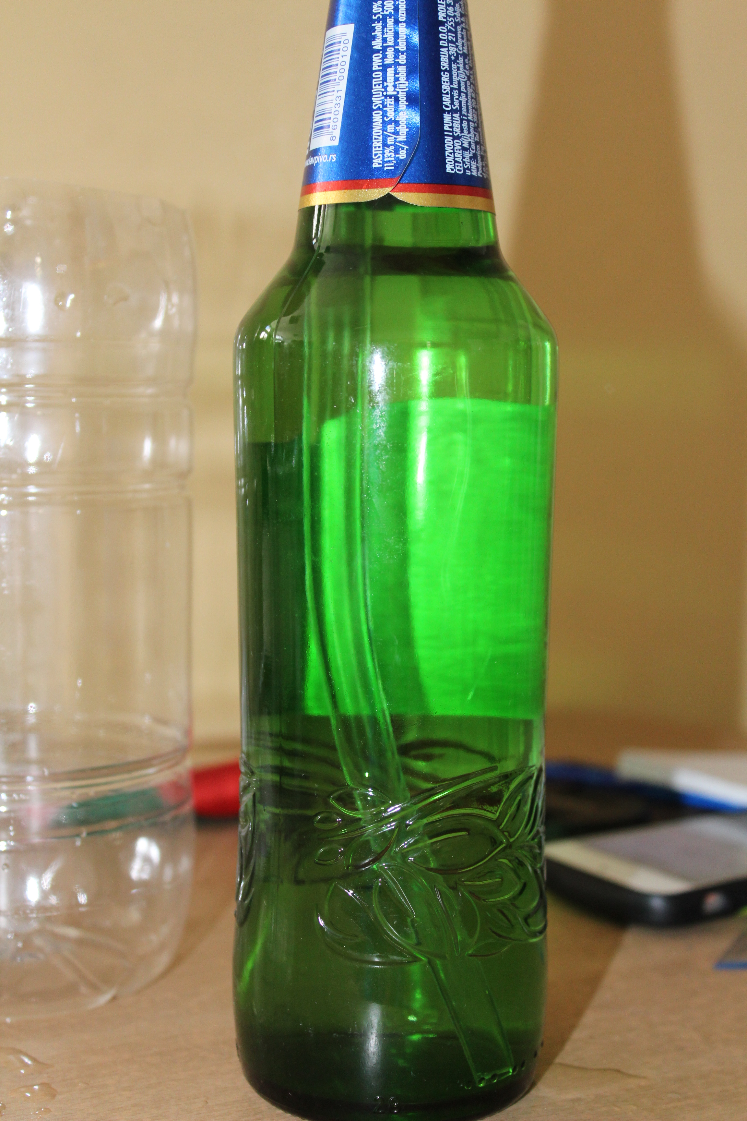
Other way

Slide 7
Experiment
$d_{1}$= 0,4 cm
$d_{2}$= 1 cm
$d_{3}$=1,8 cm (neck of a bottle)

Slide 8
Tubes
$D_{1}$= 0,4 cm
Time:4±0.06 sec
$D_{1}$= 1 cm
Time:4,5 ±0.1 sec
Bigger way out for water

Slide 9
Neck
Standard one
$D_{1}$= 1,8 cm
T = 8±0,02cm
Bigger one
$D_{2}$= 6 cm
T = 2±0,04cm

Slide 10
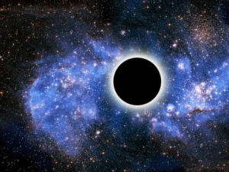
Hole
We can’t create a hole

Slide 11
Other methods
Create a vortex in the bottle
Temperature

Slide 12
Conclusion
To make faster empty we should make bigger exit square.
Or should create other method

Slide 13
Thanks for you attention! Be happy!

